Slide 1
UMLx Automated software sizing and effort estimaiton
Kan Qi

Slide 2
Purposes
Work as data mining platform to extract useful information that can facilitate decision making in software engineering.
Software size metrics for scope management, resource allocation, etc.
Effort estimation for planning, risk mitigation, task assignment, etc.
Software understanding for testing, maintenance, and architecture, etc.

Slide 3
The approaches
Design Artifacts Analysis
User stories, Use cases, Design artifacts
Source Code Analysis
Architecture recovery – components, transactions, data elements.
Automated Software Sizing
Automated transaction identification and classification
50+ design and code metrics
Incremental Effort Estimation
Continuous effort estimation over the process
Data-driven Software Management
Prioritization of development tasks
Resource allocation
Feasibility analysis
Productivity Measuing.

Slide 4
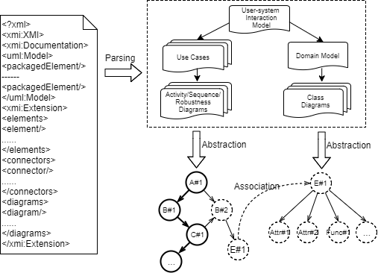
User-system interaction model
1. XMI files are parsed into a hierarchy of UML elements that define the user-system interaction model.

Slide 5
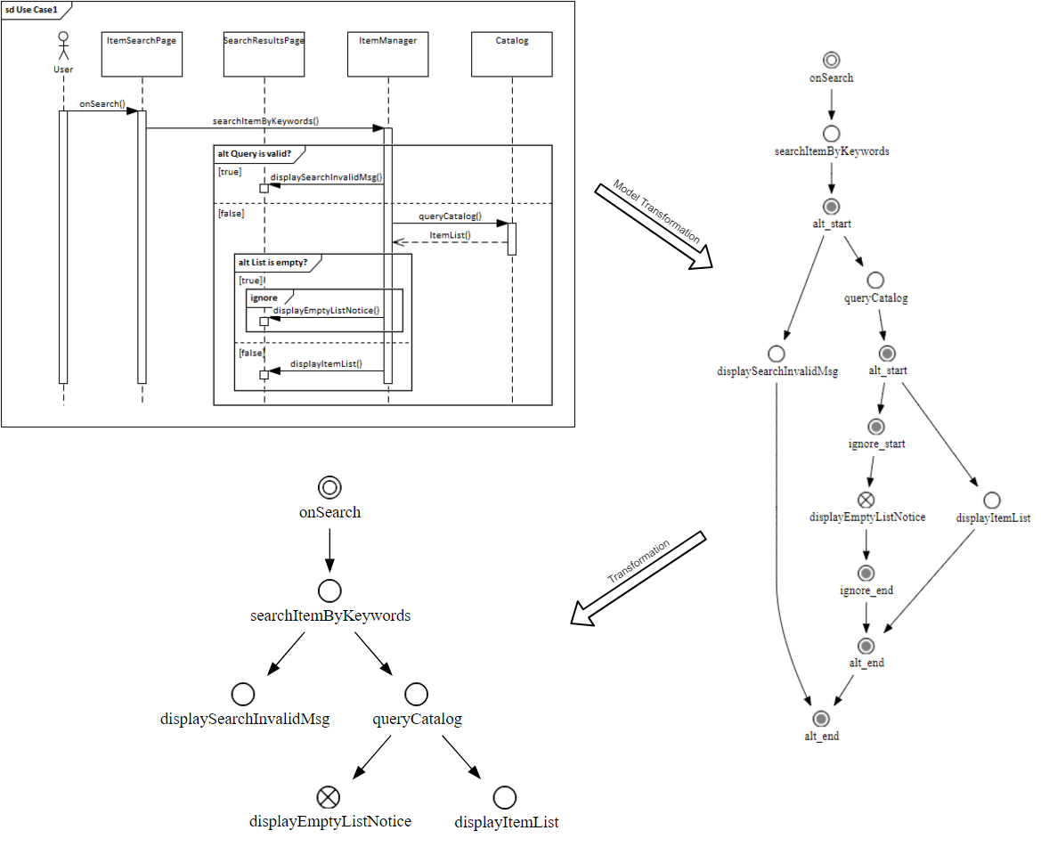
User-system interaction model
1. UML diagrams are abstracted into control flow diagrams for graph traversing algorithms.

Slide 6
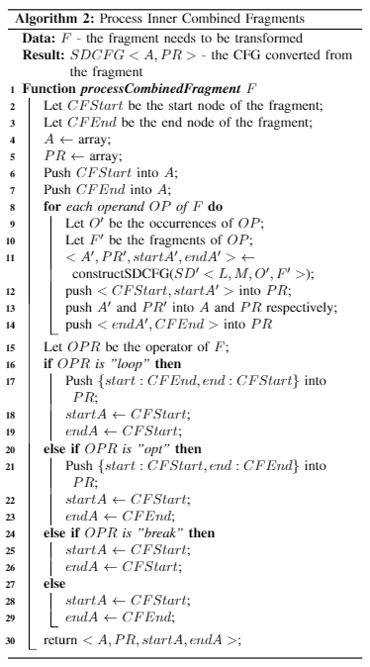
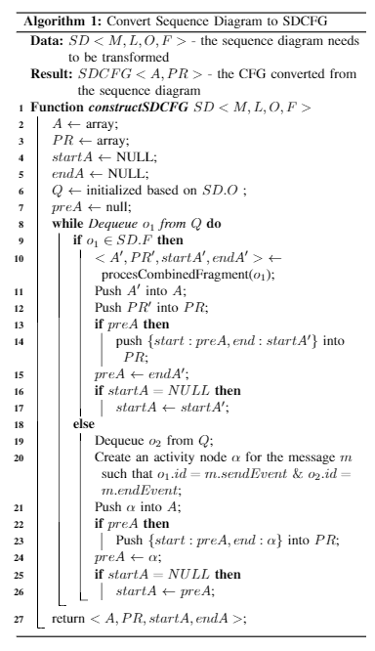
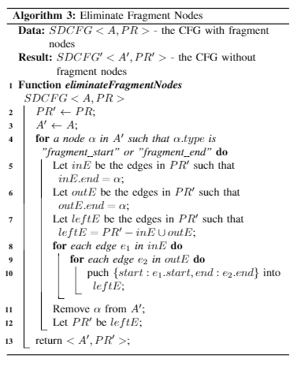
Model Transformation Algorithms

Slide 7
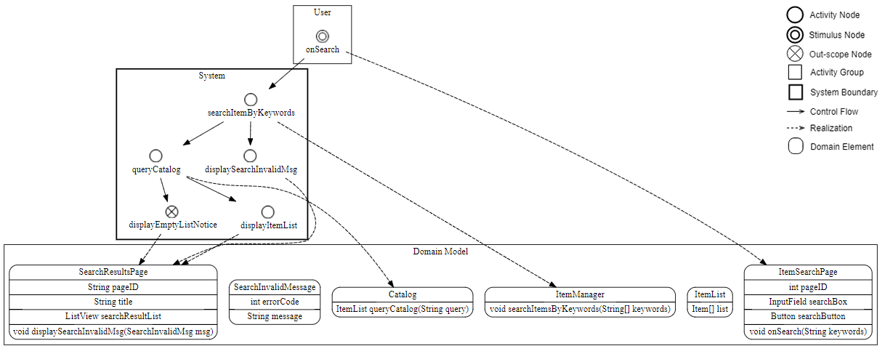
User-system interaction model
The rules to determine system boundaries, stimuli, components, etc.
Elements are visualized by notations.

Slide 8
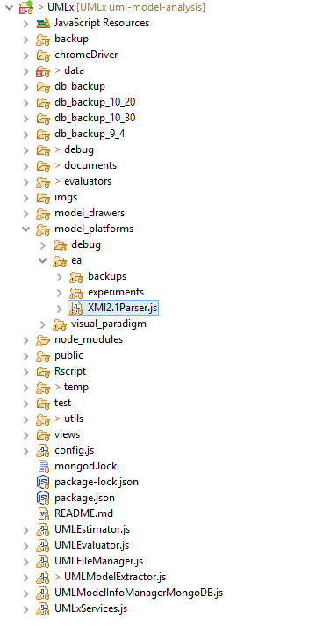
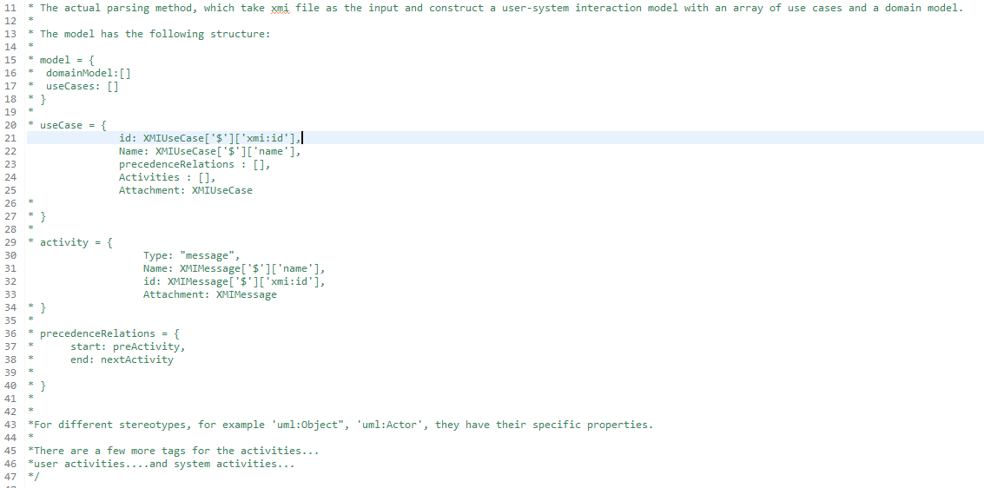
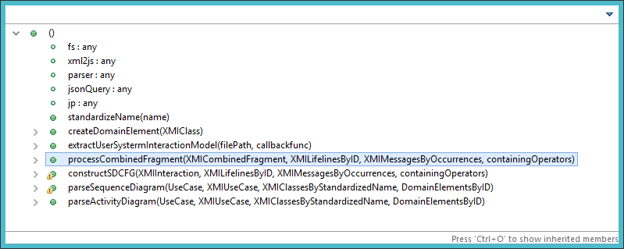
USIM Implementation Details

Slide 9
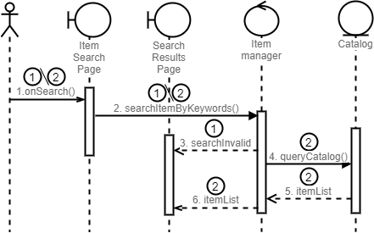
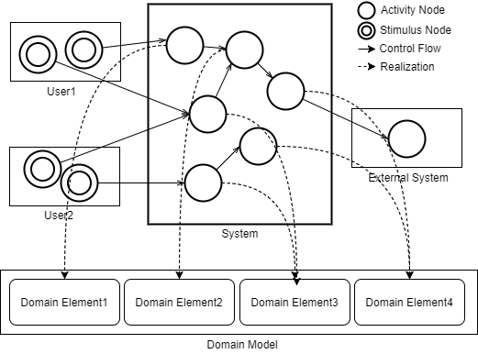
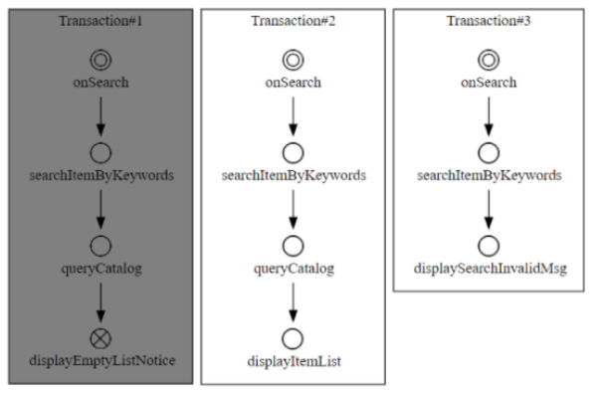
Transaction Identification
The rules to determine system boundaries, stimuli, components, etc.
Elements are visualized by notations.

Slide 10
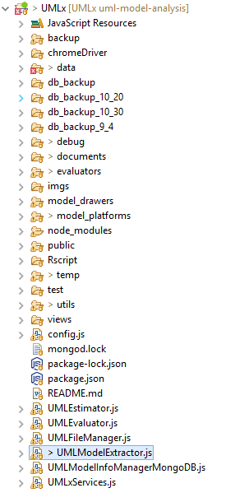
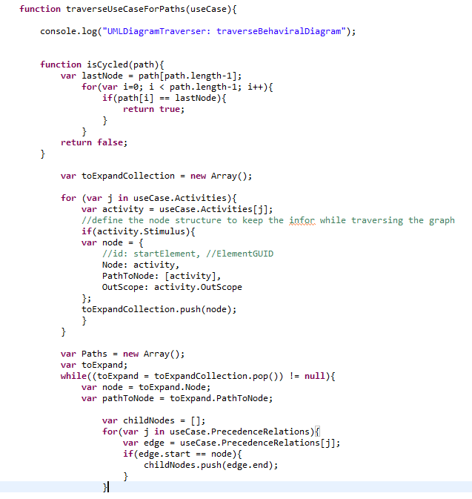
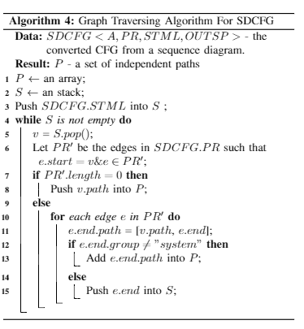
TI Implementation Details

Slide 11
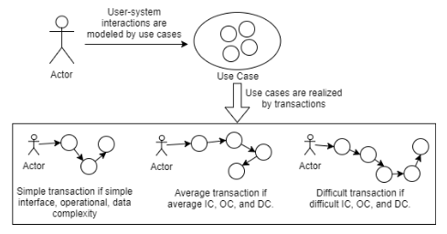
TC Transaction Classification
1. Transactions are classified by interface, operational, data complexity, which are evaluated by the metrics defined based on the properties extracted from UML diagrams.

Slide 12
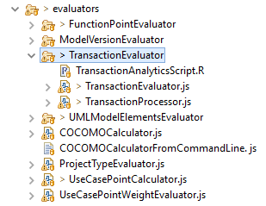
TC Implementation Detail
Encapsulated in the transaction evaluator.

Slide 13
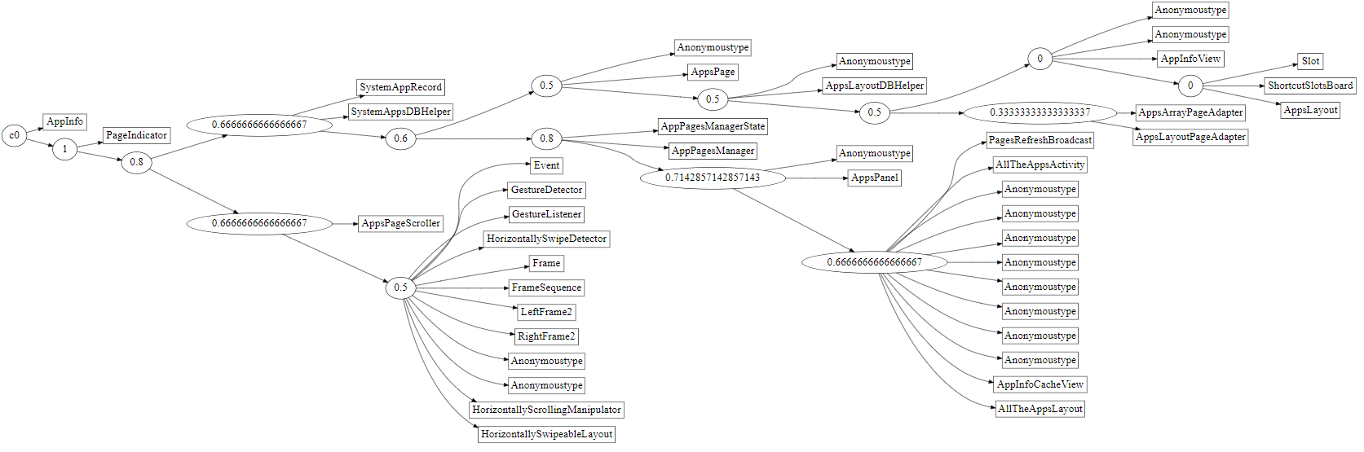
Code Analysis

Slide 14
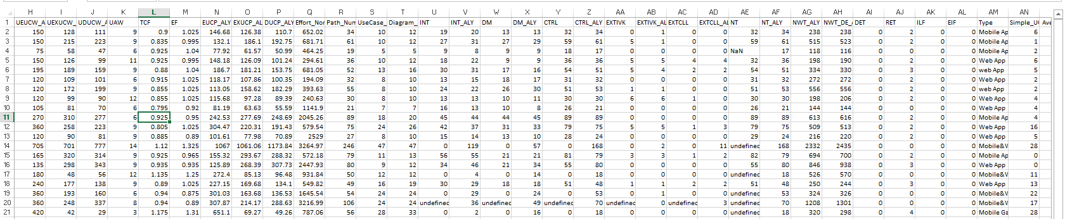
Model Profiling
The modeling information are evaluated and output for various decisions.
The plugin framework. Evaluators (plugins) are pluggable into the evaluation paradigm.
Multi-level/aspect evaluation: UML elements, transaction, use case, model (project), repo levels, use case points and its variants.

Slide 15
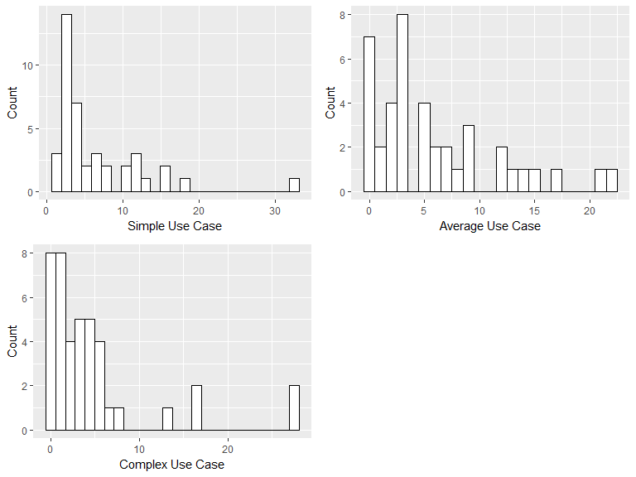
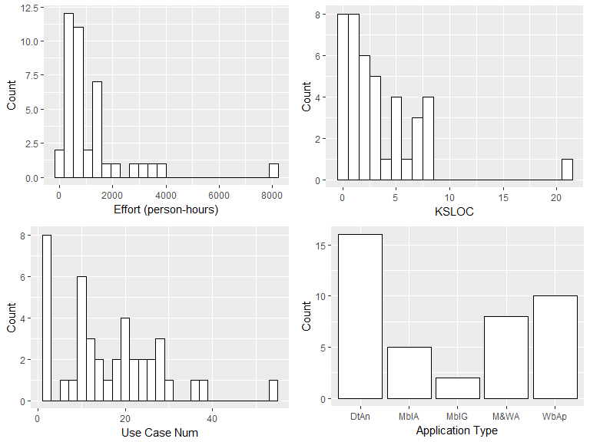
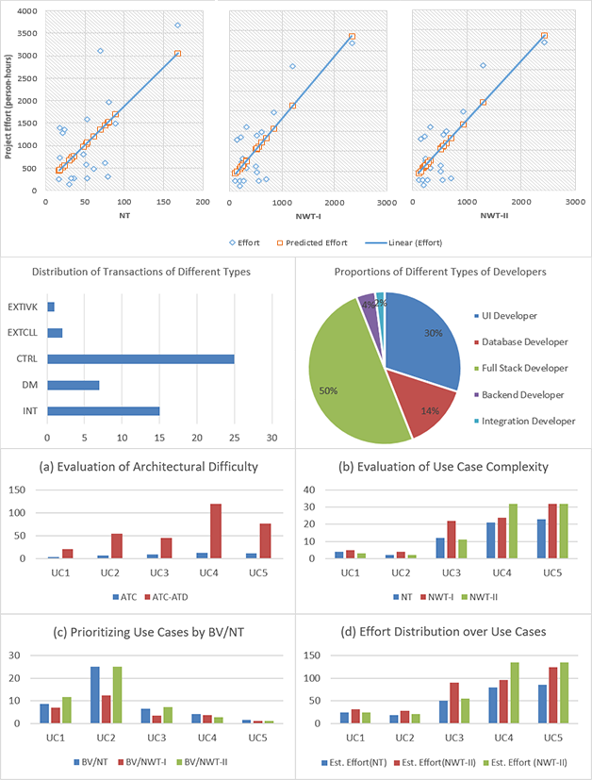
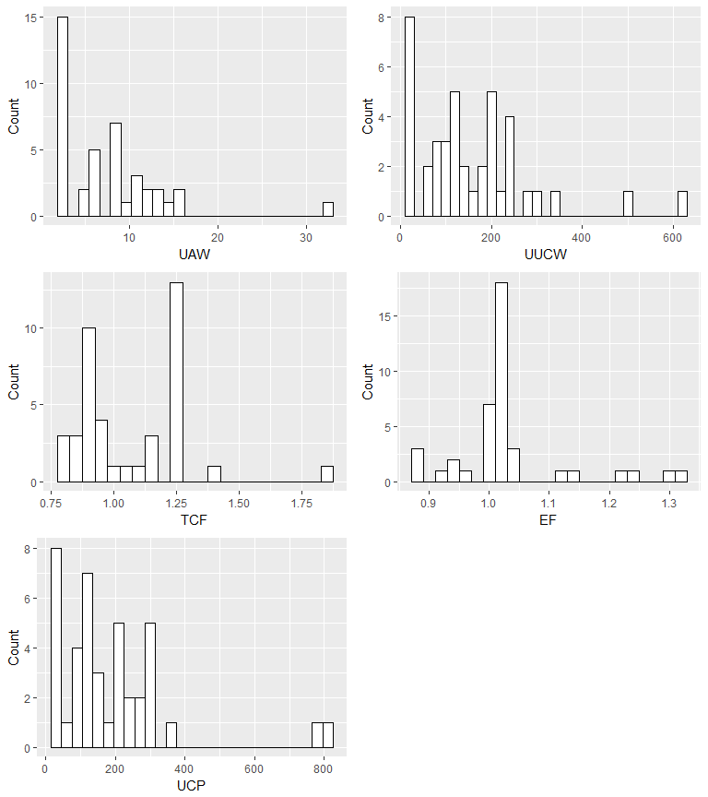
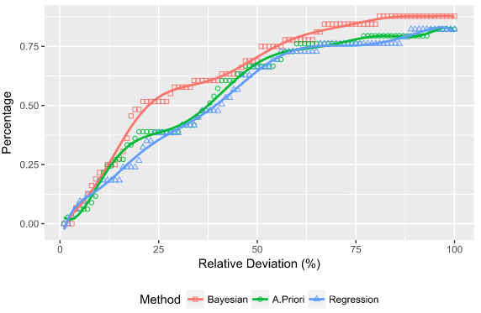
Use Cases of the Derived Model Information

Slide 16
Tasks
The code pieces, analytical scripts, data are not fully integrated.
Better structure of the framework to streamline the data processing procedure.
Better ways to visualize the data and models. Some visualizations are not fully integrated to the web page.
Explore model calibration and evaluation models.

Slide 17
Questions?

Slide 18
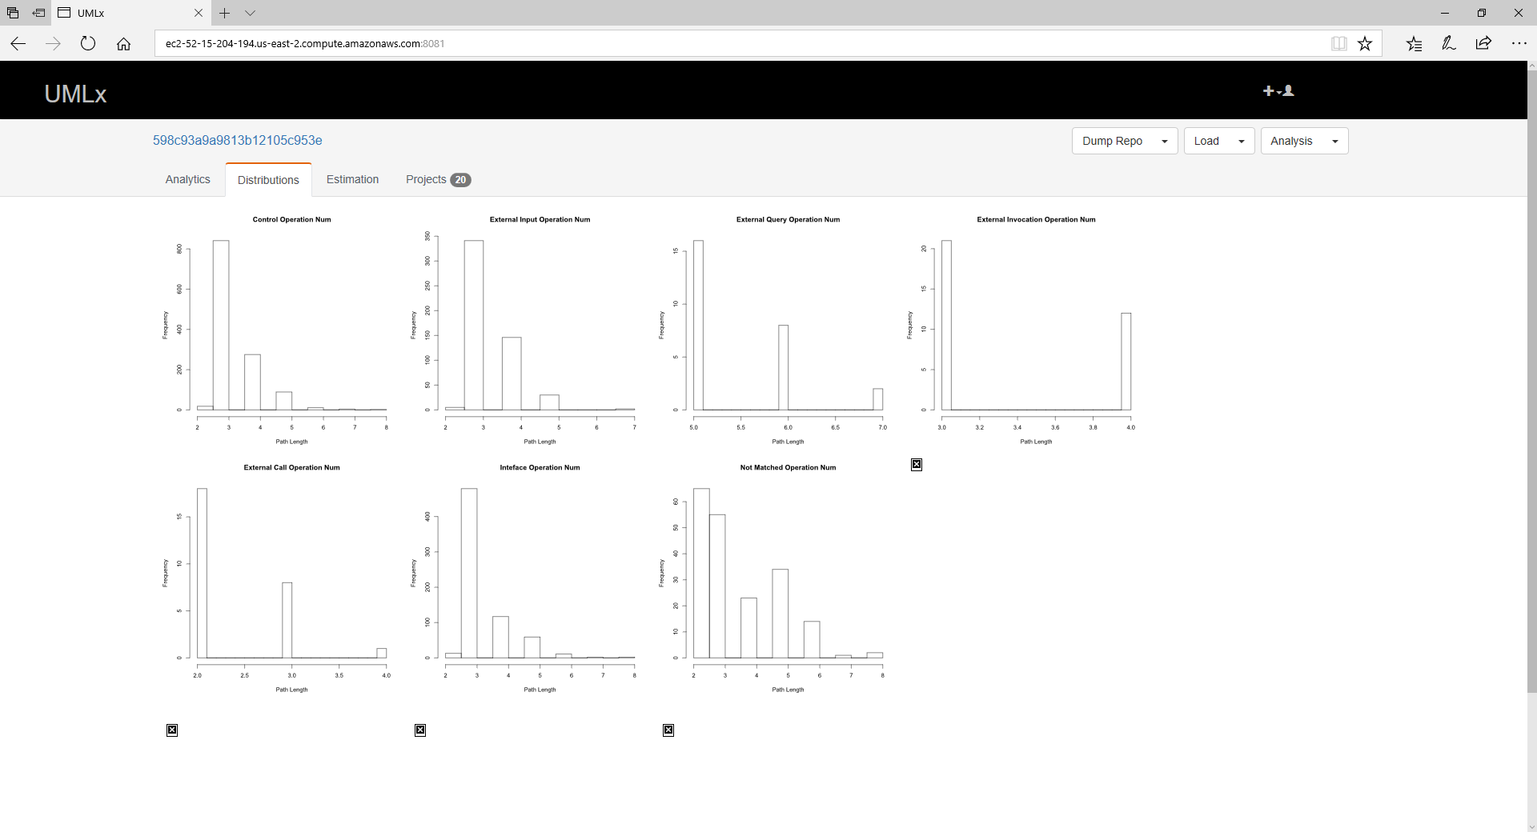
Screenshots

Slide 19
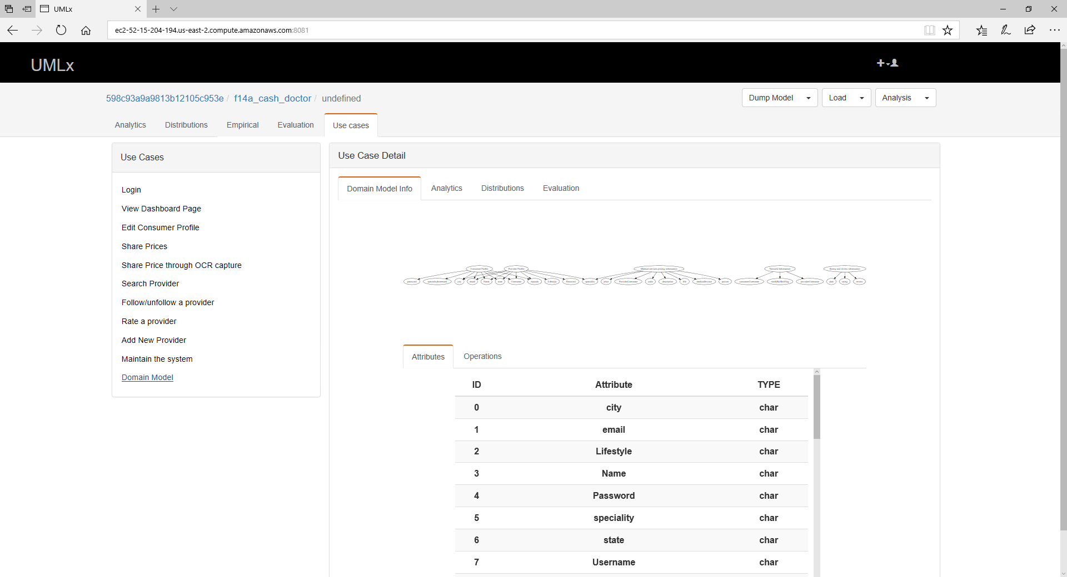
Screenshots

Slide 20
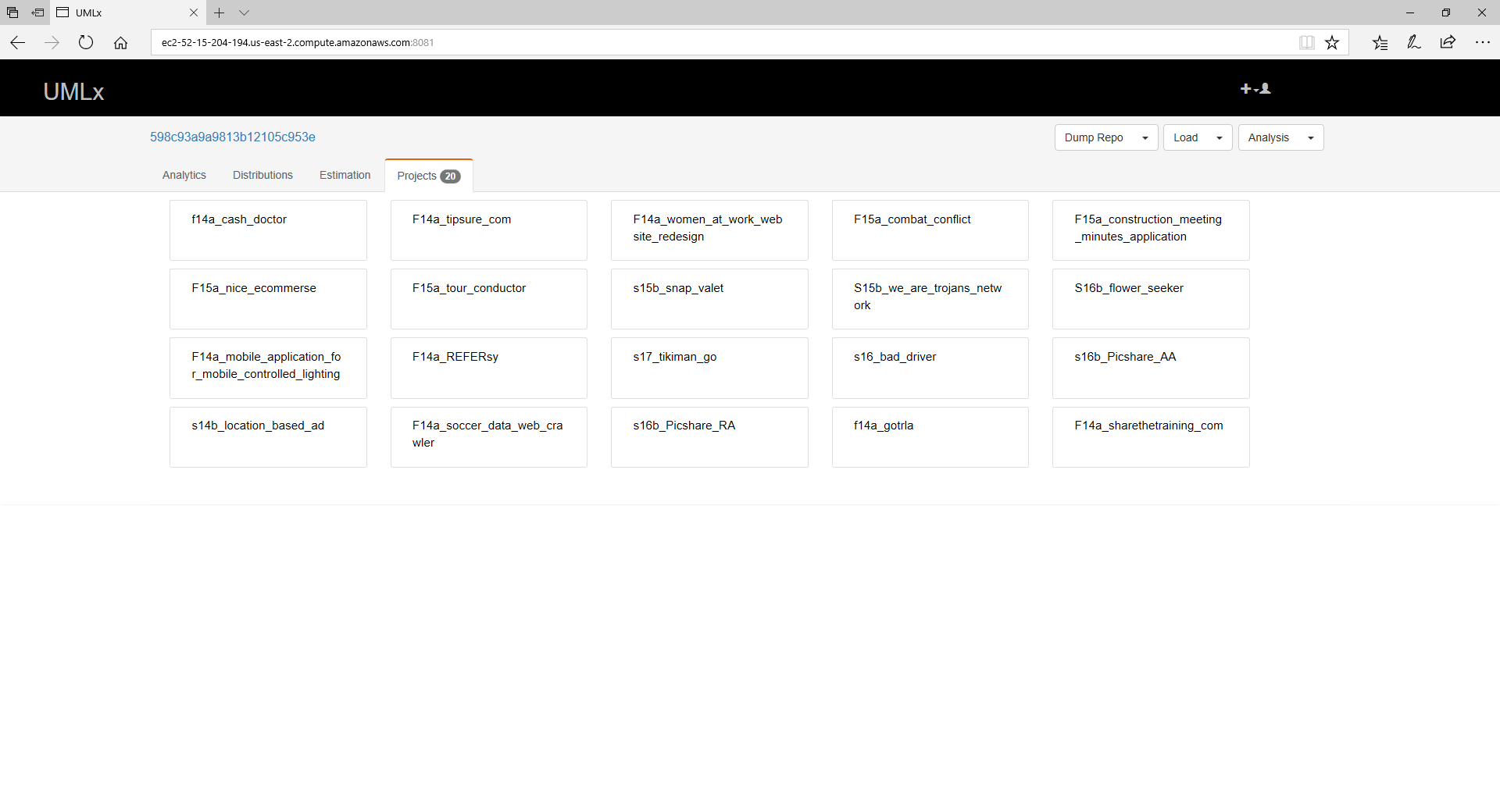
Screenshots

Slide 21
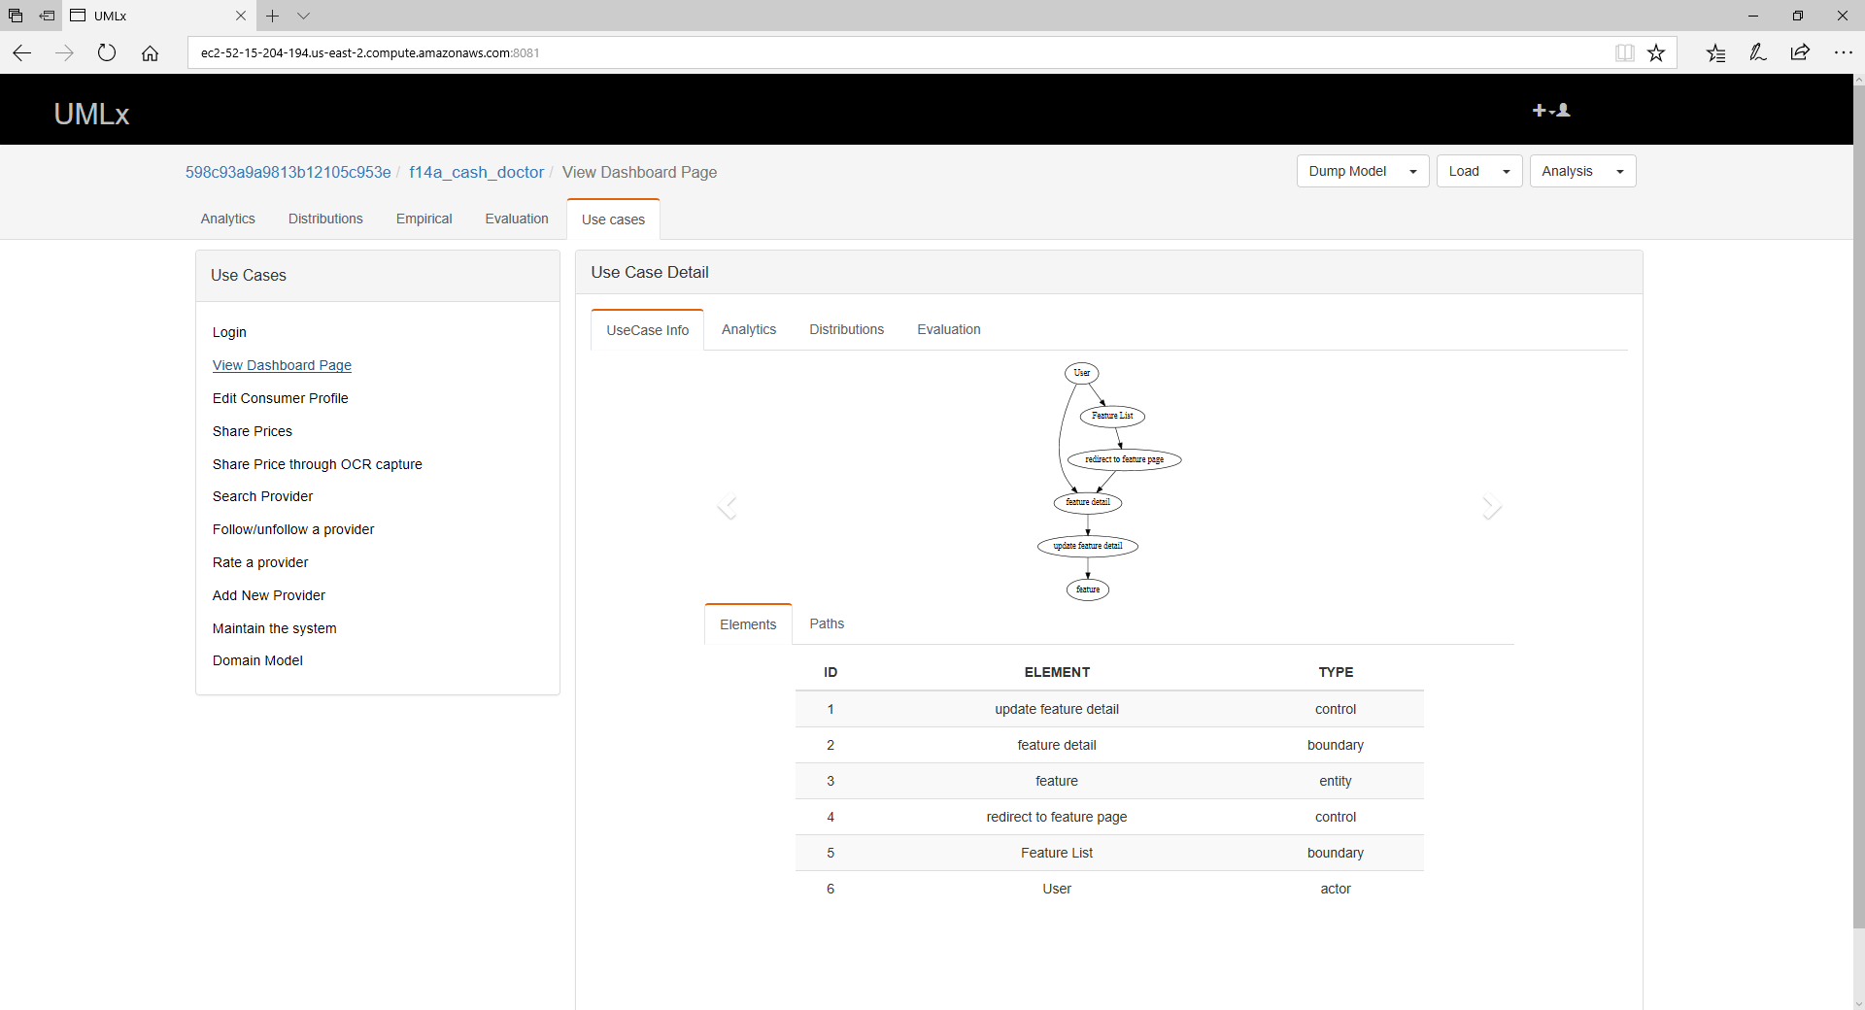
Screenshots

Slide 22
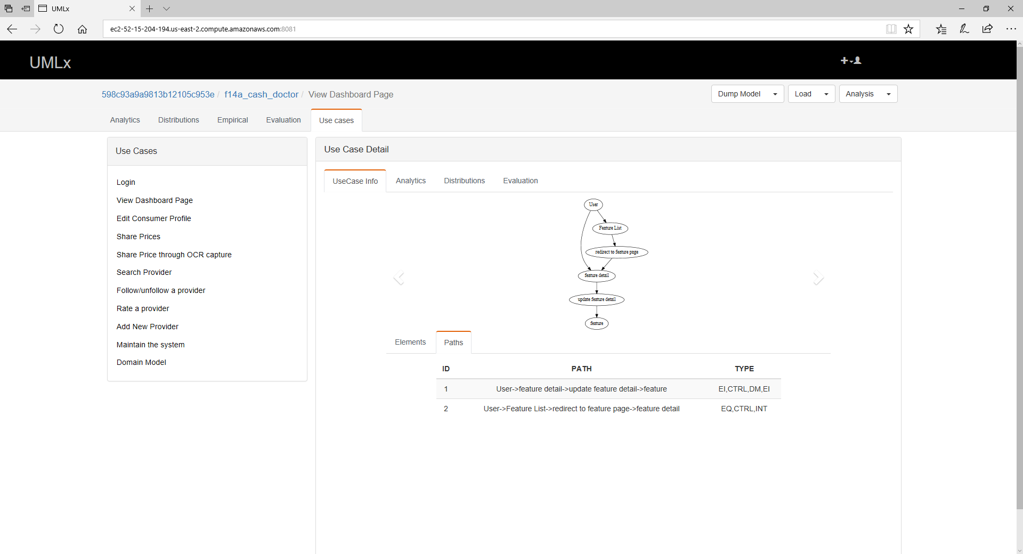
Screenshots

