Slide 1
UMLx Automated software sizing and effort estimaiton
Kan Qi

Slide 2
Purposes
Work as data mining platform to extract useful information that can facilitate decision making in software engineering.
Software size metrics for scope management, resource allocation, etc.
Effort estimation for planning, risk mitigation, task assignment, etc.
Software understanding for testing, maintenance, and architecture, etc.

Slide 3
The approaches
Automated Software Sizing
Design Artifacts/ Source Code Analysis
User stories, Use cases, Design artifact
Architecture recovery – components, transactions, data elements.
Functional Size
Automated transaction identification and classification
50+ design and code metrics
Incremental Effort Estimation
Continuous effort estimation over the process
Data-driven Software Management
Prioritization of development tasks
Resource allocation
Feasibility analysis
Productivity Measuing.

Slide 4
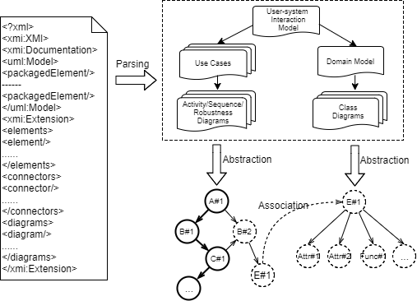
Design Artifact Analysis
Briding modeling platforms with our Analysis tool.
Unitform data structure for indexing, connecting, and organizing design objects using USIM.
Automated transaction identification and classifications.
Design metrics calculation.
Data profiling.

Slide 5
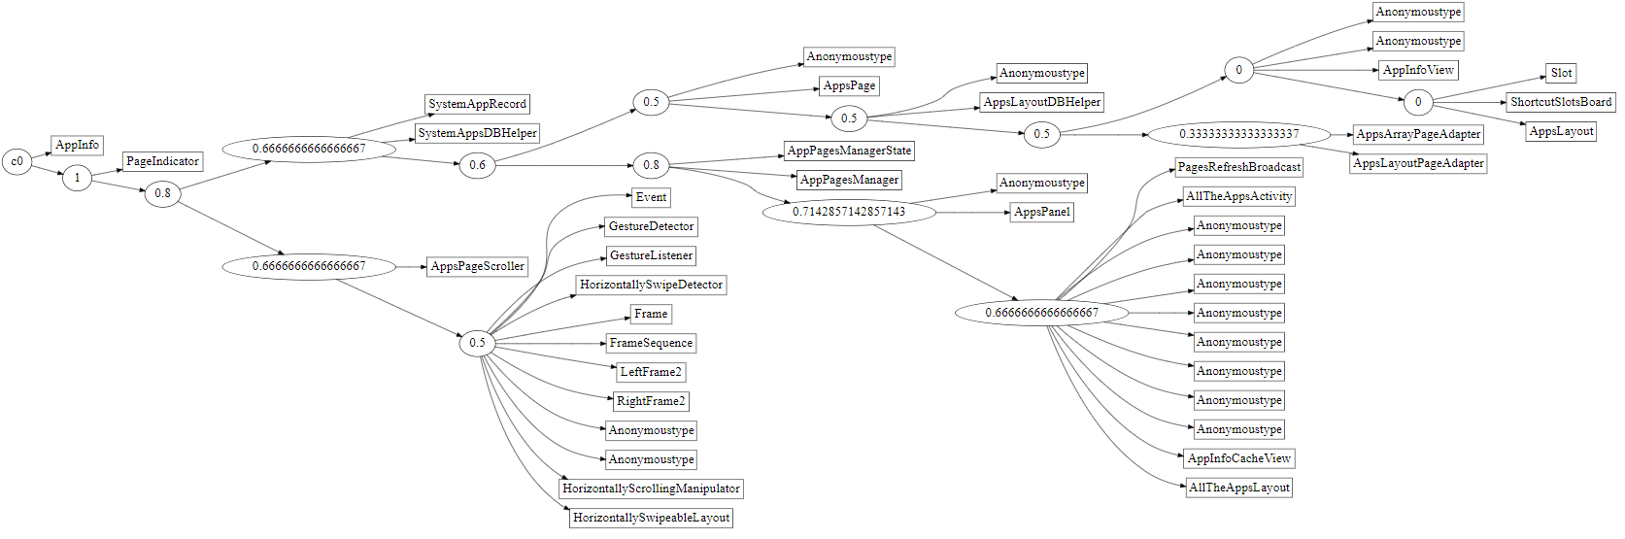
Source Code Analysis
Source code analysis for low level graph representations.
Component identification and control flow constructions.
Automated software functional sizing.

Slide 6
Design Metrics
NOET
Number of entity type
NOAAE
Number of attributes of all the entities
NORT
Number of relationship types
NEM
Number of External Methods
NSR
Number of Services Requested
NOA
Number of Attributes
NOS
Number of use cases/scenario scripts
WMC
Weighted methods per class
MPC
Methods per class
NOCH
Number of children
CBO
Coupling between objects
NIVPC
Number of instance variables per class
NUMS
Number of unique messages sent
NCI
Number of classes inherited
NCIF
Number of classes inherited from
RR
Reuse ration
NTLC
Number of top level classes
ANWMC
Average number of weighted methods per classes
NOCPBC
Average number of children per base class
NT
Number of Transactions
NOC
Number of use cases
NOA
Number of actors
NOUC
Number of use cases
NOR
Number of roles
ANAPUC
Average number of actors per use case
ANRPUC
Average number of roles per use case
UCP
Use Case Points
NOC
Number of classes
NOIR
Number of Inheritance Relationships
NOUR
Number of use relationships
NORR
Number of realize relationships
NOM
Number of methods
NOP
Number of parameters
NOCAL
Number of class attributes
NOASSOC
Number of associations
ANMC
Average number of methods per class
ANPC
Average Number of parameters per class
ANCAC
Average number of class attributes per class
ANASSOCC
Average number of associations per class
ANRELC
Average number of relationships per class
NOC
Number of classes
NOAPC
Number of attributes per class
NODET
Number of data element types
NORET
Number of records
NOA
Number of associations
NOMPC
Number of methods per class
NPPM
Number of parameters per method
NMT
Number of method types
NOC
Number of classes
NUC
Number of use cases
NOR
Number of roles
ANA_UC
Average number of actors per use case
ANR_UC
Average number of roles per use case
NOIR
Number of inheritance relationships
NOUR
Number of use relationships
NORR
Number of realize relationships
NOP
Number of parameters
NOCA
Number of class attributes
ANM_CLS
Average number of methods per class
ANP_CLS
Average Number of parameters per class
ANCA_CLS
Average number of class attributes per class
ANASSOC_CLS
Average number of associations per class
ANREL_CLS
Average number of relationships per class
NOT
Number of transactions
EI
External input
EO
External output
EQ
External inquiry
ILF
Internal logical files
EIF
External interface files
DETs
Data element types
FTRs
File types referenced
NOSS
Number of scenario scripts
WMC
Weighted methods per class
MPC
Methods per class
NOC
Number of children
DIT
Depth in Inheritance tree
LOC
Method size
CBO
Coupling Between Objects
NIV
Number of instance variables per class
NUM
Number of unique messages sent
derived classes
Number of classes inherited
base classes
Number of classes inherited from
TLC
Number of Top Level Classes
WMC
Average number of weighted methods per classes
ADIT
Average Depth of Inheritance Tree
NOC
Average number of children per base class
IS
Input services
OS
Output services
IQS
Inquiry services
OD
Object data

Slide 7
Design Metrics
NOET
Number of entity type
NOAAE
Number of attributes of all the entities
NORT
Number of relationship types
NEM
Number of External Methods
NSR
Number of Services Requested
NOA
Number of Attributes
NOS
Number of use cases/scenario scripts
WMC
Weighted methods per class
MPC
Methods per class
NOCH
Number of children
DIT
Depth in inheritance tree
CBO
Coupling between objects
NIVPC
Number of instance variables per class
NUMS
Number of unique messages sent
NOUC
Number of use cases
NOR
Number of roles
ANAPUC
Average number of actors per use case
ANRPUC
Average number of roles per use case
UCP
Use Case Points
NOIR
Number of Inheritance Relationships
NOUR
Number of use relationships
NORR
Number of realize relationships
NOM
Number of methods
NOP
Number of parameters
NOCAL
Number of class attributes
NOASSOC
Number of associations
ANMC
Average number of methods per class
ANPC
Average Number of parameters per class
ANCAC
Average number of class attributes per class
ANASSOCC
Average number of associations per class
ANRELC
Average number of relationships per class
NOC
Number of classes
NOAPC
Number of attributes per class
NODET
Number of data element types
NORET
Number of records
NOA
Number of associations
NOMPC
Number of methods per class
NPPM
Number of parameters per method
NMT
Number of method types
NOA
Number of Attributes
ANP_CLS
Average Number of parameters per class
ANCA_CLS
Average number of class attributes per class
ANASSOC_CLS
Average number of associations per class
ANREL_CLS
Average number of relationships per class
NOT
Number of transactions
EI
External input
EO
External output
EQ
External inquiry
ILF
Internal logical files
EIF
External interface files
DETs
Data element types
FTRs
File types referenced
NOSS
Number of scenario scripts
NOC
Number of children
LOC
Method size
CBO
Coupling Between Objects
NIV
Number of instance variables per class
NUM
Number of unique messages sent
derived classes
Number of classes inherited
base classes
Number of classes inherited from
RR
reuse ration
TLC
Number of Top Level Classes
WMC
Average number of weighted methods per classes
DIT
Average Depth of Inheritance Tree
NOC
Average number of children per base class
IS
Input services
OS
Output services
IQS
Inquiry services
OD
Object data
EIF
External interface files
NCI
Number of classes inherited
NCIF
Number of classes inherited from
RR
Reuse ration
NTLC
Number of top level classes
ANWMC
Average number of weighted methods per classes
ADIT
Average depth of inheritance tree
NOCPBC
Average number of children per base class
EIF
External interface files
ILF
Internal logic files
DET
Data element types
FTR
File type referenced
NT
Number of Transactions
NOC
Number of use cases
NOA
Number of actors
NEM
Number of external methods
NOA
Number of actors
NUC
Number of use cases
ANA_UC
Average number of actors per use case
ANR_UC
Average number of roles per use case
NOM
Number of methods
NOCA
Number of class attributes
NOASSOC
Number of associations
ANM_CLS
Average number of methods per class

Slide 8
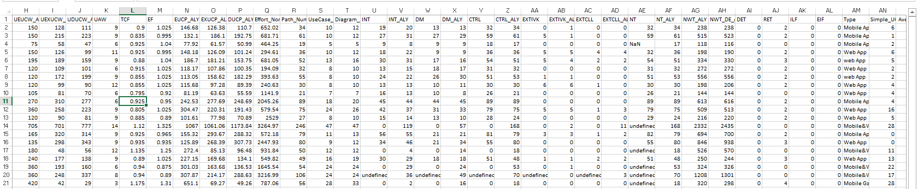
Model Profiling
The modeling information are evaluated and output for various decisions.
The plugin framework. Evaluators (plugins) are pluggable into the analysis procedure.
Multi-level/aspect evaluation: UML elements, transaction, use case, model (project), repo levels, use case points and its variants.

Slide 9
Incremental Effort Estimation Model
Functional software size based effort estimation.
Bayesian analysis to integrate expert estimates and sample estimates.
Design metrics based effort estimation
Regression mdoels based on significant feature selection
Neural Network Model
3. Dynamic Models for continuous/incremental effort estimation.

Slide 10
Model Estimation Accuracy
Linear Model
Bayesian Model
Neural Network
Dynamic model (Ongoing)

Slide 11
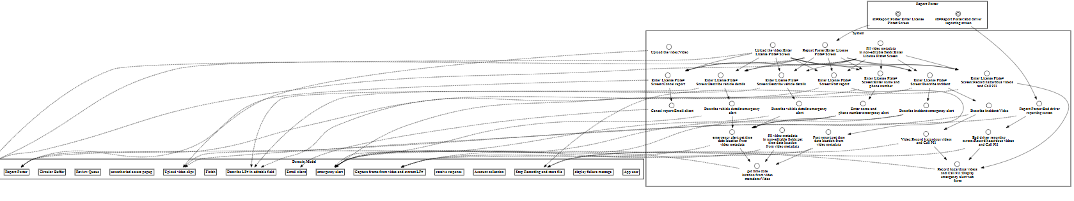
Recovered User System Interaction Model Example

Slide 12
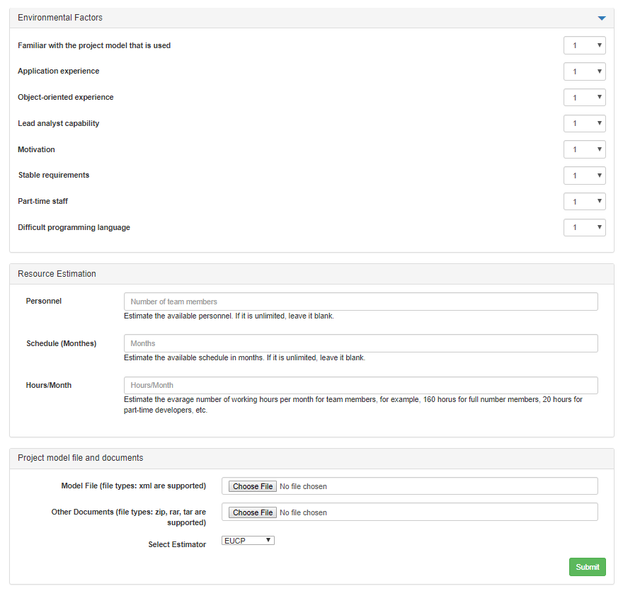
Specifying Technical and Environmental Factors
Tool Demo:
http://18.223.102.195:8081/estimationPage
Specifying available resources for feasibility analysis
Upload Design Artifacts

Slide 13
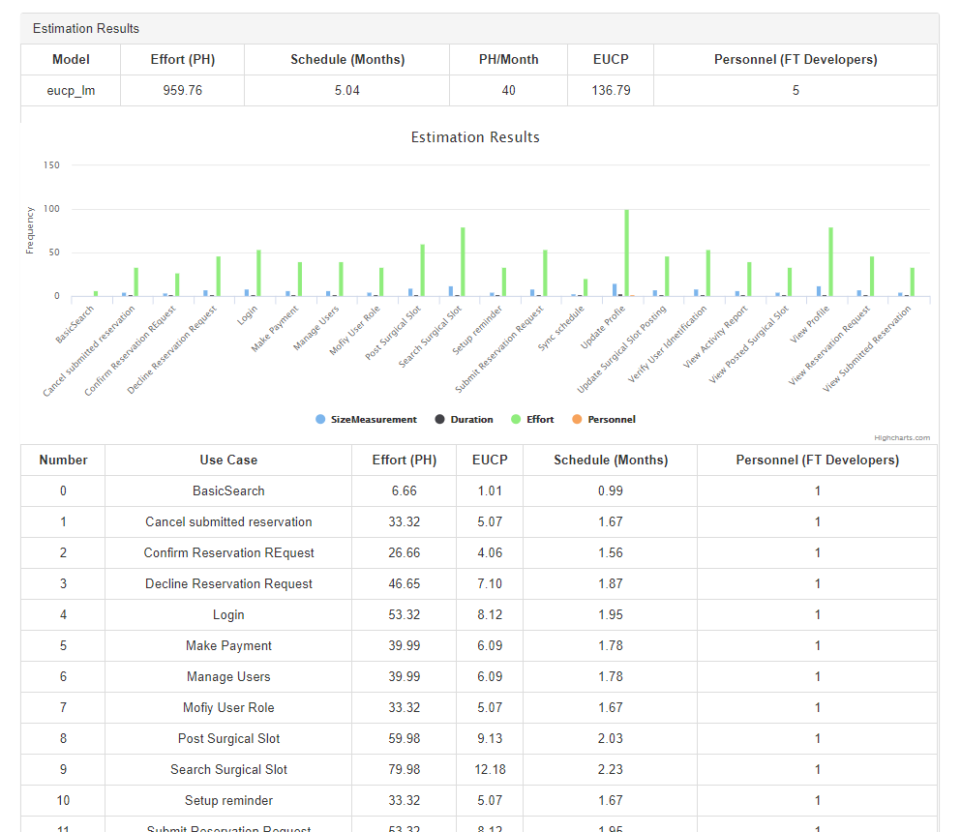
Feasibility/Risk Analysis
Tool Demo:
http://18.223.102.195:8081/estimationPage
Use Case Prioritization
Resources/Personnel Allocation

Slide 14
Tasks
The code pieces, analytical scripts, data are not fully integrated.
Better structure of the framework to streamline the data processing procedure.
Better ways to visualize the data and models. Some visualizations are not fully integrated to the web page.
Explore model calibration and evaluation models.

Slide 15
Questions?

Slide 16
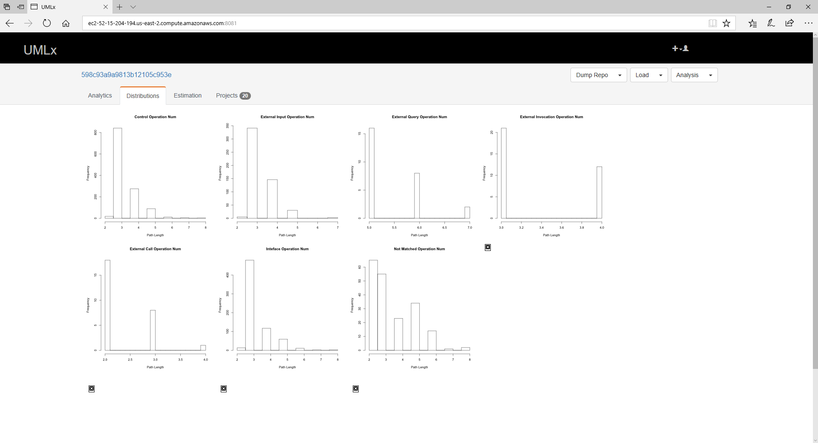
Screenshots

Slide 17
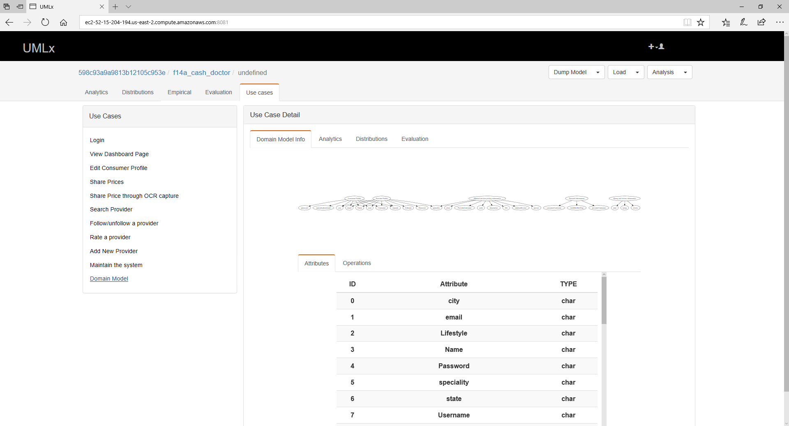
Screenshots

Slide 18
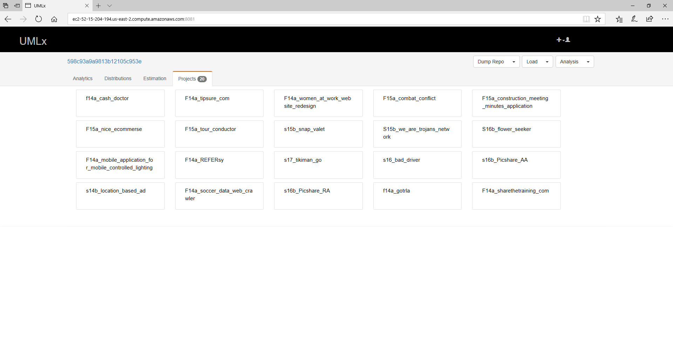
Screenshots

Slide 19
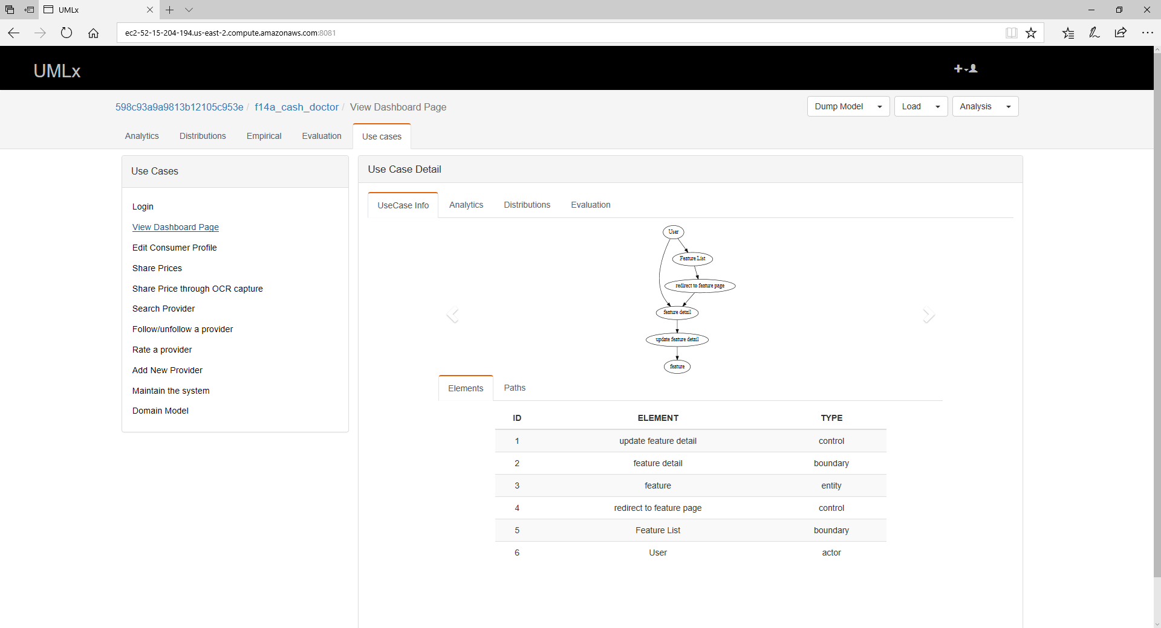
Screenshots

Slide 20
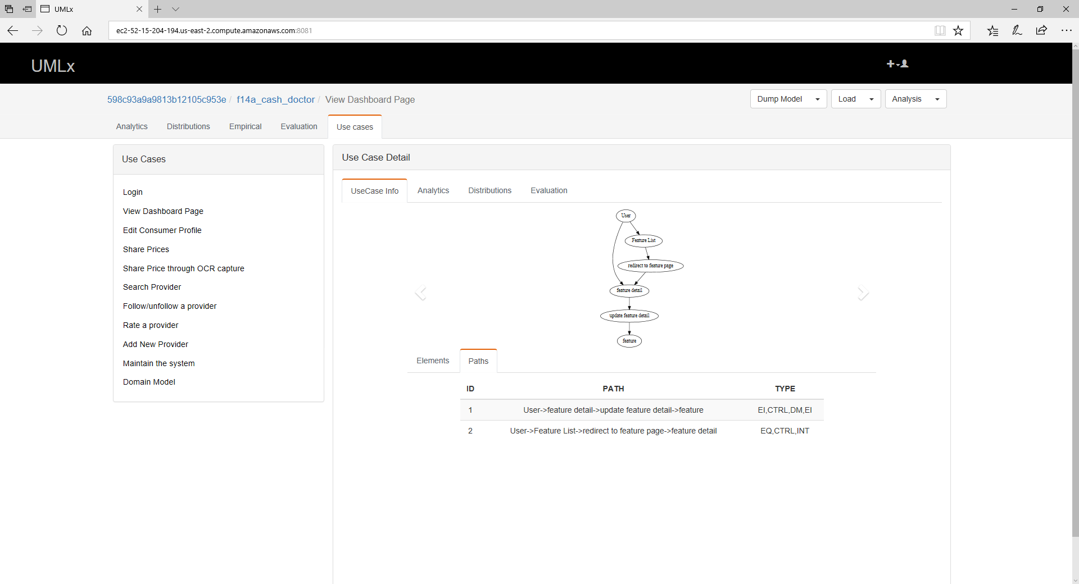
Screenshots

