Slide 1
UMLx Automated software sizing and effort estimaiton
Kan Qi

Slide 2
Purposes
Work as data mining platform to extract useful information that can facilitate decision making in software engineering.
Software size metrics for scope management, resource allocation, etc.
Effort estimation for planning, risk mitigation, task assignment, etc.
Software understanding for testing, maintenance, and architecture, etc.

Slide 3
The approaches
Automated Software Sizing
Design Artifacts/ Source Code Analysis
User stories, Use cases, Design artifact
Architecture recovery – components, transactions, data elements.
Functional Size
Automated transaction identification and classification
50+ design and code metrics
Incremental Effort Estimation
Continuous effort estimation over the process
Data-driven Software Management
Prioritization of development tasks
Resource allocation
Feasibility analysis
Productivity Measuing.

Slide 4
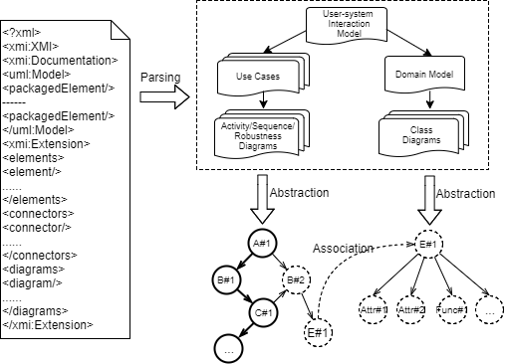
Design Artifact Analysis
Briding modeling platforms with our Analysis tool.
Unitform data structure for indexing, connecting, and organizing design objects using USIM.
Automated transaction identification and classifications.
Design metrics calculation.
Data profiling.

Slide 5
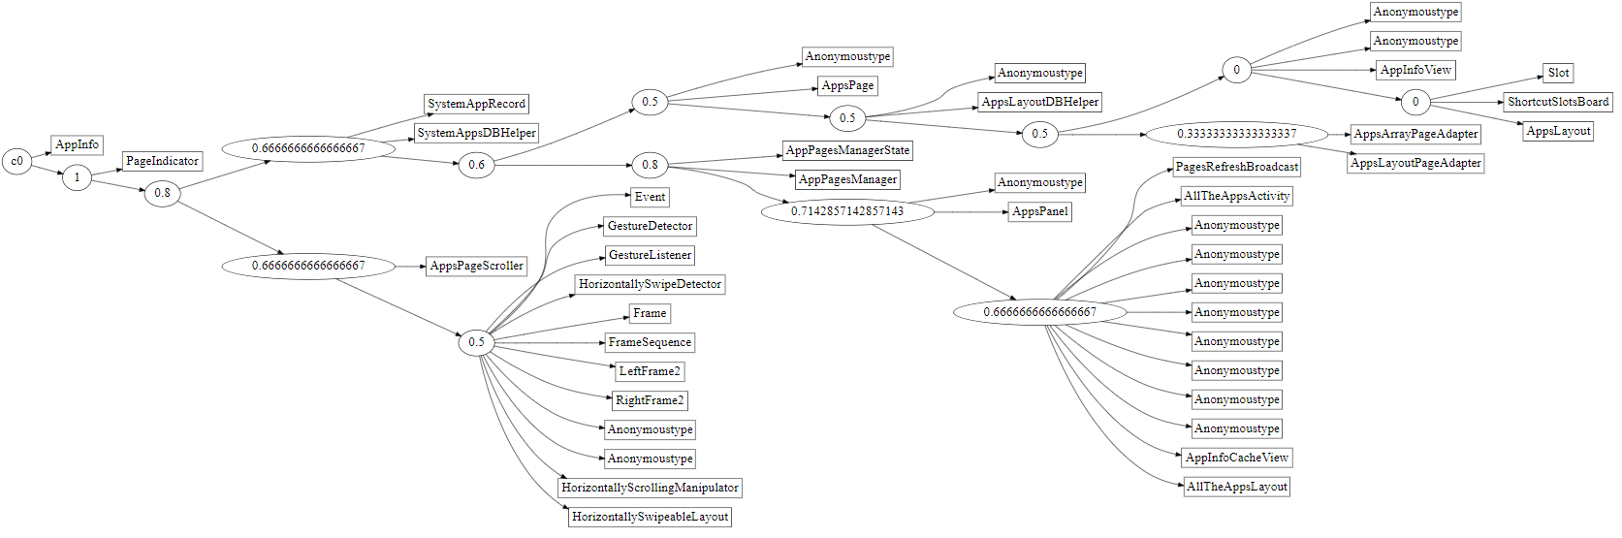
Source Code Analysis
Source code analysis for low level graph representations.
Component identification and control flow constructions.
Automated software functional sizing.

Slide 6
Design Metrics
NOET
NOAAE
NORT
NEM
NSR
NOA
NOS
WMC
MPC
NOCH
DIT
CBO
NIVPC
NUMS
NCI
NCIF
RR
NTLC
ANWMC
ADIT
NOCPBC
EIF
ILF
DET
FTR
NT
NOC
NOA
NOUC
NOR
ANAPUC
ANRPUC
UCP
NOC
NOIR
NOUR
NORR
NOM
NOP
NOCAL
NOASSOC
ANMC
ANPC
ANCAC
ANASSOCC
ANRELC
NOC
NOAPC
NODET
NORET
NOA
NOMPC
NPPM
NMT
NOC
NOA
NEM
NOA
NUC
NOR
ANA_UC
ANR_UC
NOIR
NOUR
NORR
NOM
NOP
NOCA
NOASSOC
ANM_CLS
ANP_CLS
ANCA_CLS
ANASSOC_CLS
ANREL_CLS
NOT
EI
EO
EQ
ILF
EIF
DETs
FTRs
Number of use cases/scenario scripts
WMC
Methods per class
NOC
DIT
LOC
CBO
NIV
NUM
derived classes
base classes
RR
TLC
WMC
DIT
NOC
IS
OS
IQS
OD
EIF

Slide 7
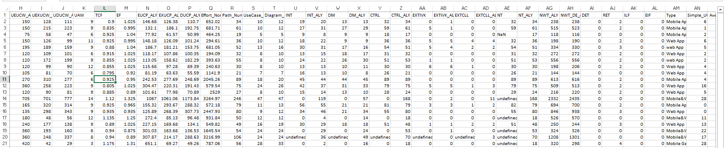
Model Profiling
The modeling information are evaluated and output for various decisions.
The plugin framework. Evaluators (plugins) are pluggable into the evaluation paradigm.
Multi-level/aspect evaluation: UML elements, transaction, use case, model (project), repo levels, use case points and its variants.

Slide 8
Incremental Effort Estimation Model
Functional software size based effort estimation.
Bayesian analysis to integrate expert estimates and sample estimates.
Design metrics based effort estimation
Regression mdoels based on significant feature selection
Neural Network Model
3. Dynamic Models for continuous/incremental effort estimation.

Slide 9
Model Estimation Accuracy
Linear Model ()
Bayesian Model ()
Neural Network()
Dynamic models.

Slide 10
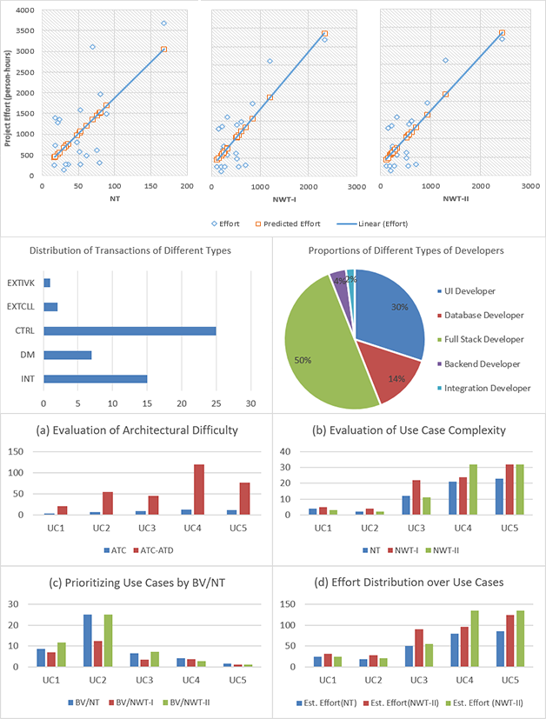
Requirements/Use Case Prioritization

Slide 11
Resources/Personnel Allocation

Slide 12
Feability/Risk Analysis

Slide 13
Tasks
The code pieces, analytical scripts, data are not fully integrated.
Better structure of the framework to streamline the data processing procedure.
Better ways to visualize the data and models. Some visualizations are not fully integrated to the web page.
Explore model calibration and evaluation models.

Slide 14
Questions?

Slide 15
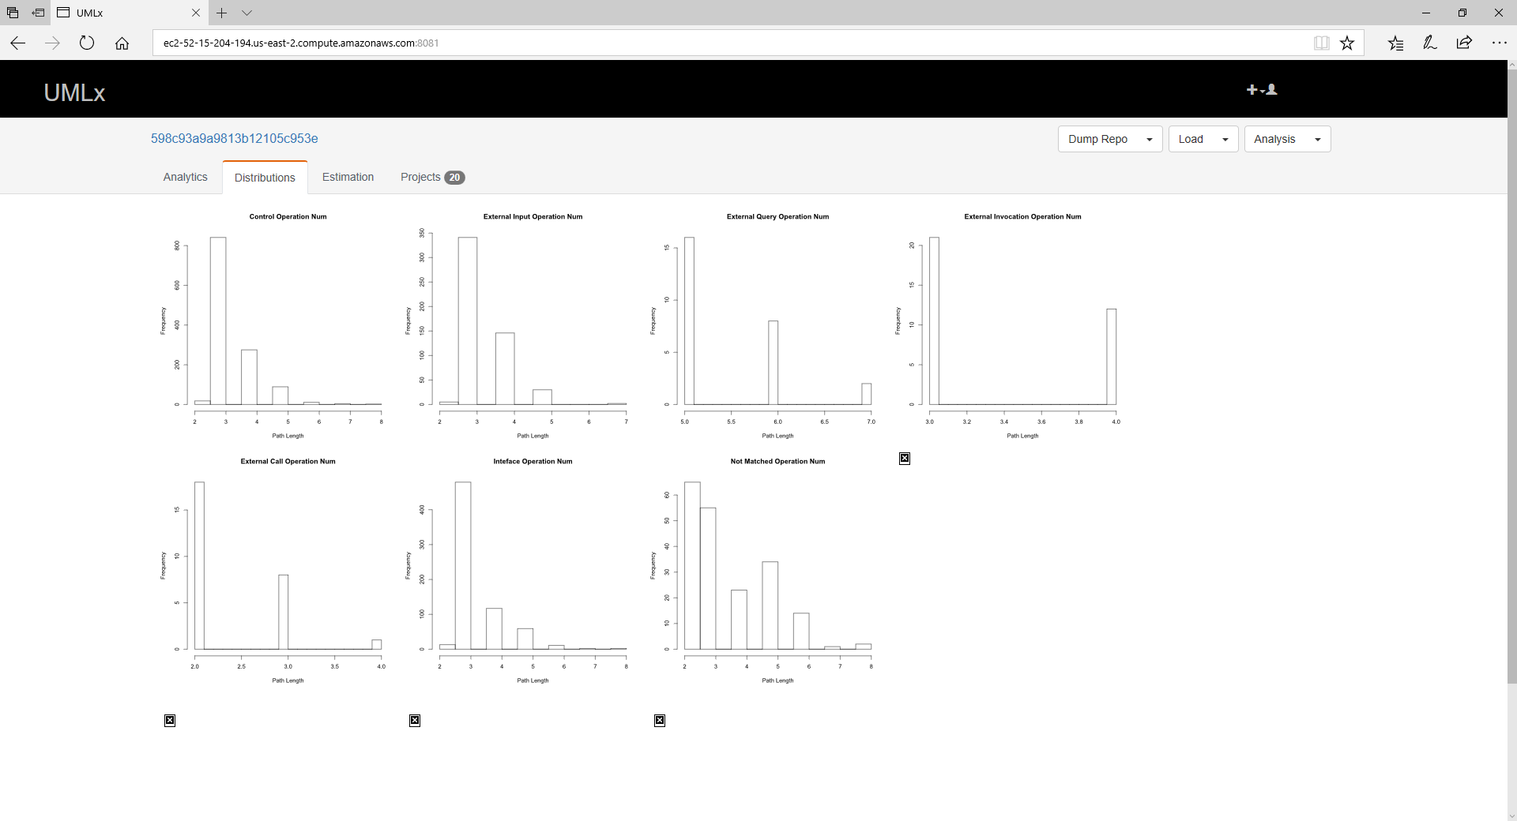
Screenshots

Slide 16
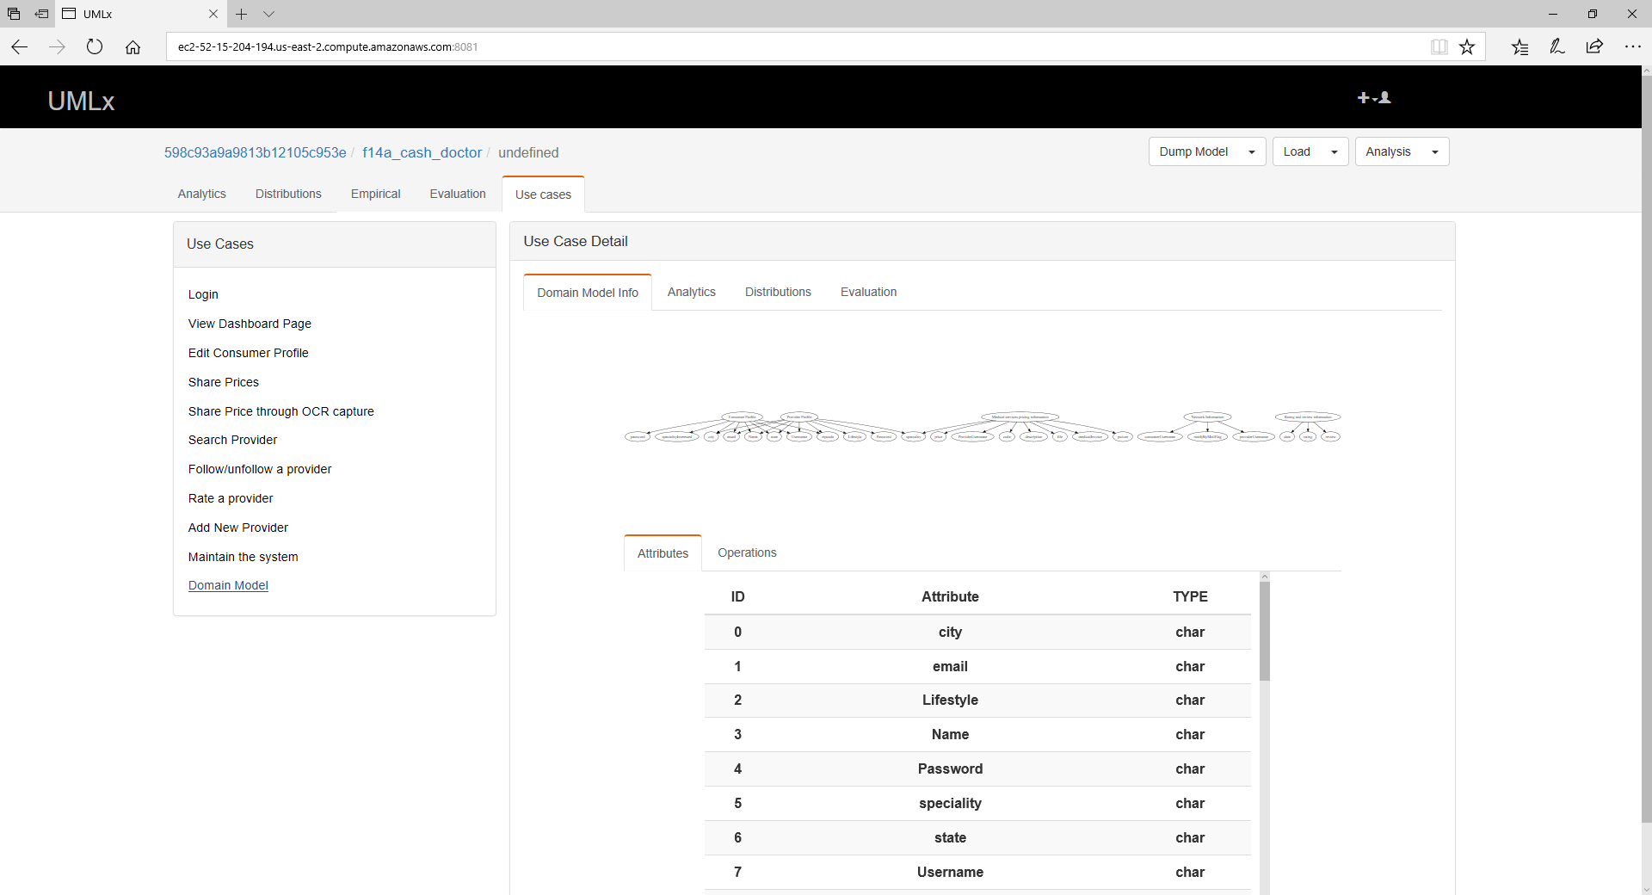
Screenshots

Slide 17
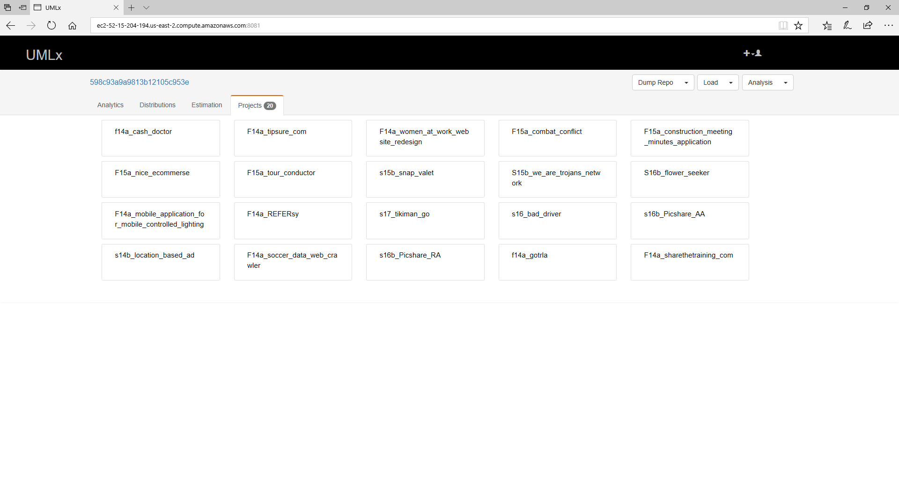
Screenshots

Slide 18
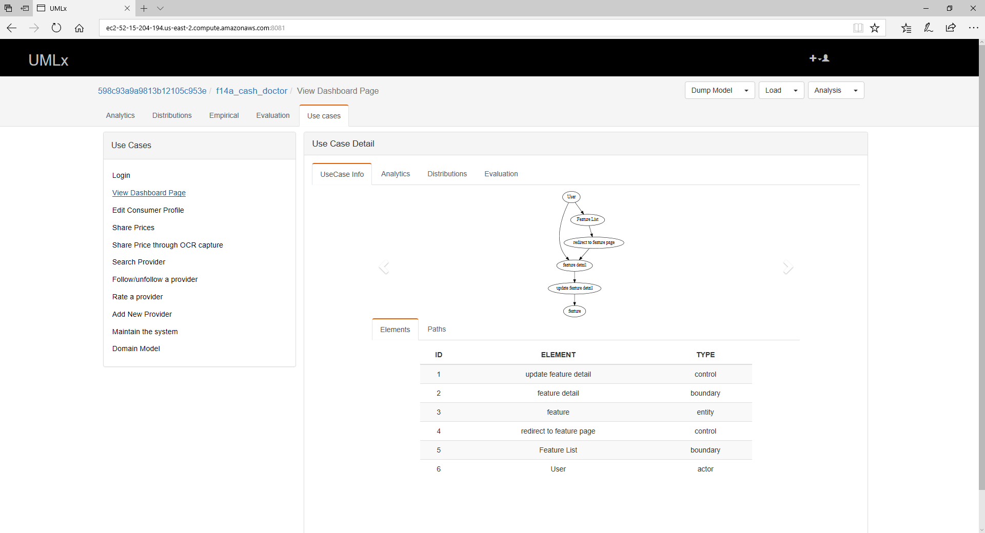
Screenshots

Slide 19
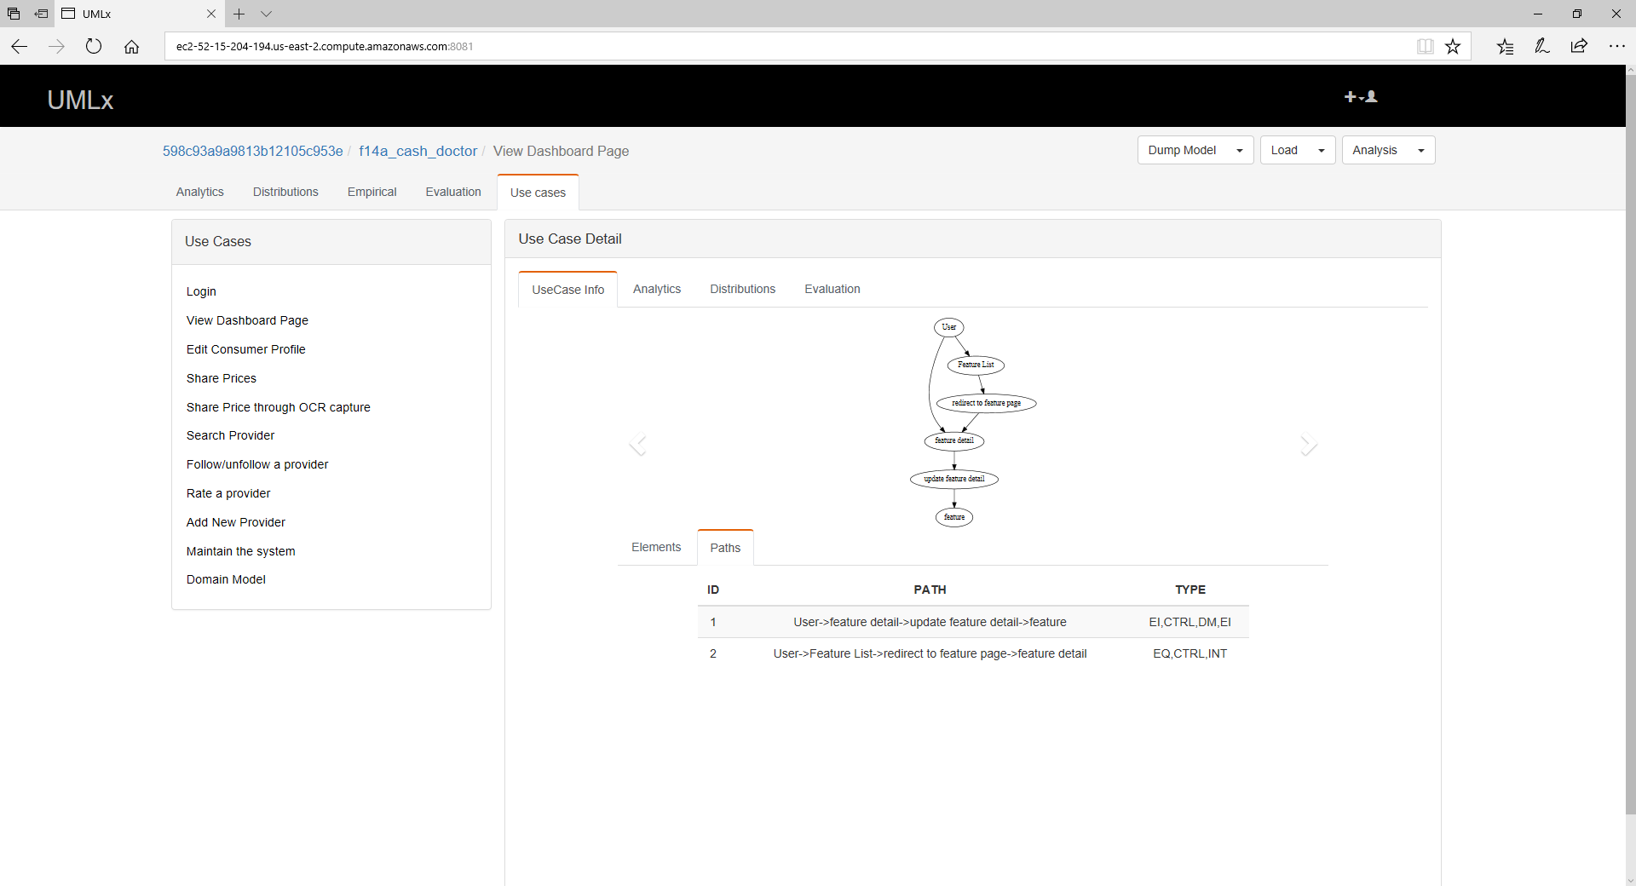
Screenshots

