Slide 1
教材檔案上傳管理與授權範例

Slide 2
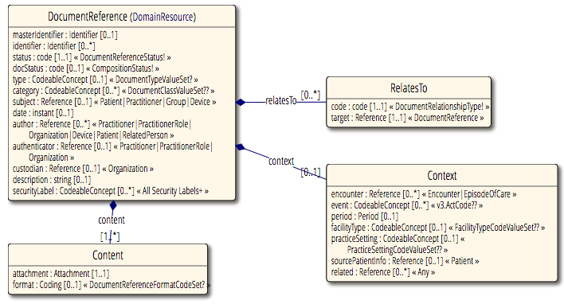
表示註冊文件類型
授權者
PractitionerRole（教師）
授權內容:
File url

Slide 3
步驟一、檔案上傳與詮釋資料建立
上傳檔案（以QT application, 上傳到content server）
如使用網頁上傳：上傳後可直接有檔案連結列表
Ftp 上傳，需有api提供檔案連結列表查詢 or 程式抓取同檔案夾理的檔案列表
負責：舒雅、盈如
DocumentReference建立並註冊
檔案擁有者（PractitionerRole）➔ DocumentReference.authenticator
檔案儲存所屬組織 (PractitionerRole.organization)➔DocumentReference.custodian
Documentreference.status=“current”
取得檔案列表，建立DocumentReference.content
上傳至portal註冊，並進入至 授權流程

Slide 4
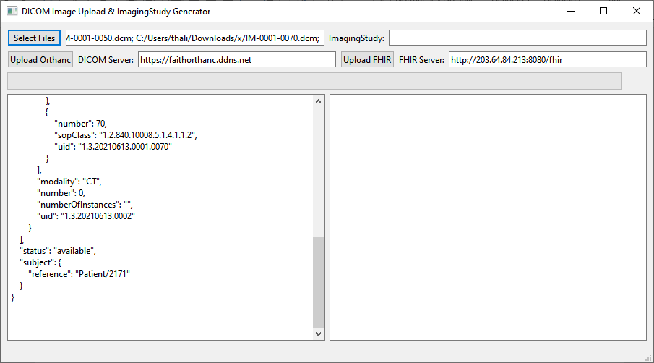
Step1 : 多選預計上傳檔案
Step2 : 取得檔案資訊（檔名、格式）
Step3 :上傳到ftp
Step4 : 使用檔案資訊、檔案上傳ftp後的url 組成DocumentReference
File
DocumentReference
file
FTP

Slide 5
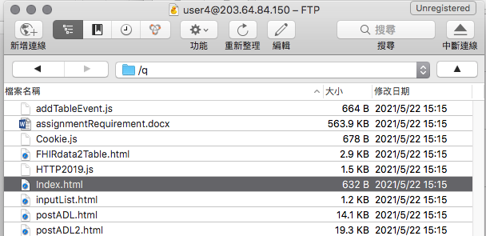
url :

Slide 6
DocumentReference範例
Name | Flags | Card. | Type | Note | Description & Constraints
DocumentReference | TU |  | DomainResource | 讓文件擁有者可以取得文件列表，以供授權; 擁有者授權，將此Documentreference對應到 Consent.provision.data中 | A reference to a document
 |  |  |  |  | Elements defined in Ancestors: id, meta, implicitRules, language, text, contained, extension, modifierExtension
- masterIdentifier | Σ | 0..1 | Identifier |  | Master Version Specific Identifier
- identifier | Σ | 0..* | Identifier |  | Other identifiers for the document
- status | ?!Σ | 1..1 | code | 描述文件 狀態如何？（目前 \ 被取代 \ 輸入錯誤） | current | superseded | entered-in-error
 |  |  |  |  | DocumentReferenceStatus (Required)
- docStatus | Σ | 0..1 | code | 欲 註冊的文件 狀態如何 | preliminary | final | amended | entered-in-error
 |  |  |  |  | CompositionStatus (Required)
- type | Σ | 0..1 | CodeableConcept | 提供系統判斷查詢，表示註冊文件類型 | Kind of document (LOINC if possible)
 |  |  |  | 如：https://www.hl7.org/fhir/valueset-c80-doc-typecodes.html 18842-5 Discharge summary | Document Type Value Set (Preferred)
- category | Σ | 0..* | CodeableConcept |  | Categorization of document
 |  |  |  | 如：https://www.hl7.org/fhir/valueset-document-classcodes.html 18842-5 Discharge summary | Document Class Value Set (Example)
- subject | Σ | 0..1 | Reference(Patient | Practitioner | Group | Device) |  | Who/what is the subject of the document
- date | Σ | 0..1 | instant |  | When this document reference was created
- author | Σ | 0..* | Reference(Practitioner | PractitionerRole | Organization | Device | Patient | RelatedPerson) |  | Who and/or what authored the document
- authenticator |  | 0..1 | Reference(Practitioner | PractitionerRole | Organization) | 誰認證此文件、也代表授權者（如：主治醫師） | Who/what authenticated the document
- custodian |  | 0..1 | Reference(Organization) | 管理文件的組織（如：醫院） | Organization which maintains the document
- relatesTo | Σ | 0..* | BackboneElement |  | Relationships to other documents
- - code | Σ | 1..1 | code |  | replaces | transforms | signs | appends
 |  |  |  |  | DocumentRelationshipType (Required)
- - target | Σ | 1..1 | Reference(DocumentReference) |  | Target of the relationship
- description | Σ | 0..1 | string |  | Human-readable description
- securityLabel | Σ | 0..* | CodeableConcept |  | Document security-tags
 |  |  |  |  | SecurityLabels (Extensible)
- content | Σ | 1..* | BackboneElement | 欲註冊內容（預設以Bundle.type=document來進行註冊） | Document referenced
- - attachment | Σ | 1..1 | Attachment | 如：Document : [gatewayLink]/Bundle/[id] | Where to access the document
- - format | Σ | 0..1 | Coding |  | Format/content rules for the document
 |  |  |  |  | DocumentReference Format Code Set (Preferred)
- context | Σ | 0..1 | BackboneElement |  | Clinical context of document
- - encounter |  | 0..* | Reference(Encounter | EpisodeOfCare) |  | Context of the document content
- - event |  | 0..* | CodeableConcept |  | Main clinical acts documented
 |  |  |  |  | v3 Code System ActCode (Example)
- - period | Σ | 0..1 | Period |  | Time of service that is being documented
- - facilityType |  | 0..1 | CodeableConcept |  | Kind of facility where patient was seen
 |  |  |  |  | Facility Type Code Value Set (Example)
- - practiceSetting |  | 0..1 | CodeableConcept |  | Additional details about where the content was created (e.g. clinical specialty)
 |  |  |  |  | Practice Setting Code Value Set (Example)
- - sourcePatientInfo |  | 0..1 | Reference(Patient) |  | Patient demographics from source
- - related |  | 0..* | Reference(Any) |  | Related identifiers or resources

Slide 7
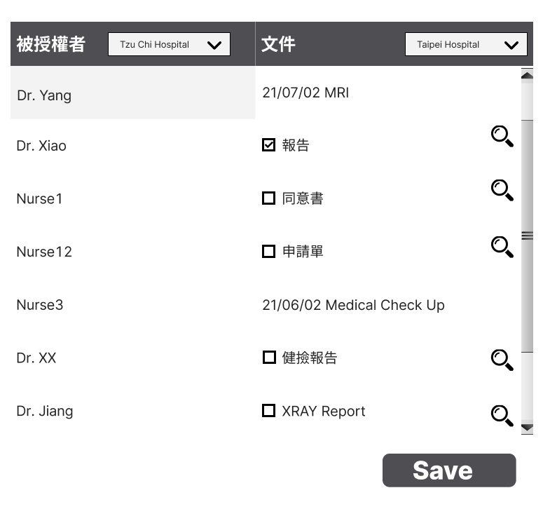
步驟二、授權
1. 選擇 [組織]
3. 點選 [組織]
2. 選擇組織下的被授權者
點選此按鈕可顯示文件容
5. 點選 [儲存] 按鈕
4. 選取欲授權的 Resource

Slide 8
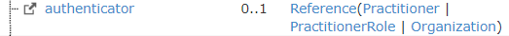
Document Reference 範例
醫療院所產生的資料
{
"resourceType": "DocumentReference",
"type": {
"coding": [
{
"system": "http://loinc.org",
"code": "34108-1",
"display": "Outpatient Note"
}
]
},
"authenticator": {
"reference": "PractitionerRole/1764"
},
"custodian": {
"reference": "Organization/2572"
}
}
Src: DocumentReference/3330
個人化醫療 (e.g. 居家照護)
{
"resourceType": "DocumentReference",
"type": {
"coding": [
{
"system": "http://loinc.org",
"code": "34108-1",
"display": "Outpatient Note"
}
]
},
"authenticator": {
"reference": "Patient/2240"
},
"custodian": {
"reference": "Organization/2572"
}
}
Problem: authenticator 不能參考 Patient
授權者
(資源擁有者)
產生文件的醫療組織

Slide 9
授權介面-步驟
取得被授權者資料
取得文件資料
執行授權或取消授權
判斷文件已授權過的方式有2個：
查詢 FHIR server 下所有 PractitionerRole
查詢 FHIR server 下所有 [組織]
稽核種類 | 前面稽核 | 後面稽核（放置consent管理）
做法 | 撈資料時，判斷文件是否已授權過。不用顯示已授權過的文件 (或者可以顯示並加上 checkbox==true 表示此文件已授權過) | 顯示所有文件。按 submit 後，若文件已授權過， alert “已授權”（不用再產生 consent)
優點 | 避免使用者重複授權的動作 | 速度較快，因為只檢查單一文件
缺點 | 資料量多影響速度 | 若使用者選擇已授權的文件得重新做授權的動作
透過 organization 欄位來歸類此醫師屬於哪個組織
依據 DocumentReference.aut
henticator (授權者) & custodian (組織) 來查詢 Document Reference 列表
列出屬於此 user 的 resources (DocumentReference.content)
判斷有哪些 resource 已授權給被授權者 (FHIR Consent)
已選取Resources製作consent
取消選取Resources 刪除 consent (?)
Notes:
Get all practitioner role
透過 organization 欄位來歸類此醫師屬於哪個組織
Check all Organization in FHIR server
Get all DocumentReference below the selected Organization and related authenticator 列出屬於此Patient 所屬Resource
get http://203.64.84.213:8080/fhir/DocumentReference?custodian=Organization/id&authenticator=Patient/id
Show date, service category(e.g. MRI, medical check up, etc.)
Get all resources of related DocumentReference (DocumentReference.content)
Check which resource has been authorized to the chosen practitioner (FHIR Consent)
☑ = 所選組織下已授權的Document Reference
☐ = 所選組織下未授權的Document Reference
執行授權或取消授權
已選取Resources製作consent
取消選區Resources (?)
Question
If person has 2 status: patient and practitioner. We let user choose by themselves?

