Slide 1

SMART INDIA HACKATHON 2026
SHAAS
Smart High-Altitude Automation System
Problem Statement ID –SIH26049
Problem Statement Title-Modification of electrical and electronic equiment
Theme-Smart Automation
PS Category- Hardware
Team ID-
Team Name -HackNova

Slide 2

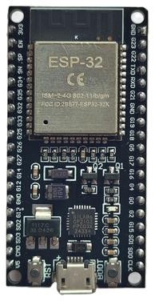
IDEA SOLUTION
Hack Nova
Sense → Analyze → Decide → Act → Protect → Predict
Modular retrofit Smart Automation Unit for existing electrical/electronic equipment.
Real-time sensing of temperature, pressure, humidity, voltage, current and vibration.
Intelligent controller (ESP32/STM32) analyzes conditions and selects the appropriate operating mode.
Automatic thermal control using heaters and cooling fans.
Smart battery protection with temperature-based charging/discharging control.
Automatic fault detection and protection to prevent equipment damage.
Data logging and trend analysis for early fault prediction and
predictive maintenance.
Remote equipment-health monitoring through a dashboard.
Adaptive operation for Normal, Cold and High-Altitude Extreme
conditions.

Slide 3
TECHNICAL APPROACH
Hack Nova
Sensors → ESP32/STM32 → Decision Algorithm → Automatic Control → Equipment Protection → Data Logging & Monitoring
Smart Battery Protection:
Battery temperature
Voltage
Current
Charging/discharging condition
Sensors continuously measure:
Temperature
Atmospheric pressure
Humidity
Voltage & current
Vibration
Embedded Control & Decision Making:
An ESP32/STM32 microcontroller receives all sensor values.
It compares the values with predefined safe limits.
Based on the condition, it automatically decides what action is required.
Fault Detection & Protection The
For example:
Excessive current → possible electrical fault
Rapid temperature rise → cooling problem
Abnormal vibration → possible equipment problem

Slide 4
FEASIBILITY AND VIABILITY
Hack Nova
Uses readily available sensors, ESP32/STM32 and control components
Modular retrofit design can be integrated with existing equipment
Real-time sensing enables automatic protection
Prototype can simulate subzero temperature and low-pressure conditions
Can be upgraded to industrial-grade components for field deployment
Challenge | SHAAS Solution
Extreme subzero temperature | Automatic closed-loop heating
Battery performance drop | Battery temperature monitoring + controlled charging
Low atmospheric pressure | Pressure sensing + high-altitude operating mode
Condensation/moistu re | Humidity monitoring + controlled enclosure heating
Limited power availability | Adaptive/PWM control
Equipment faults | Detect → Alert → Protect → Log
readily available technology Adaptive closed-loop energy control Modular retrofit + scalable architecture
Continuous monitoring + automatic protection Longer equipment life + reduced maintenance

Slide 5

IMPACT AND BENEFITS
Hack Nova
Improved Reliability
  Reduces equipment failures
  Provides continuous monitoring
2. Energy Efficiency
Heater/fan operate only when required
Reduces unnecessary power consumption
3. Longer Equipment Life
Protects batteries and electronic components
Reduces thermal and electrical stress
4. Autonomous Operation
Automatic Sense → Decide → Act
Reduces need for continuous human
intervention
Predictive Maintenance
  Records equipment health data
  Detects abnormal trends before major fai@lure
LIMITATIONS
Extreme Environmental Conditions
  Very low temperature and low pressure may affect sensor and electronic performance.
Power Availability
  Heating and continuous monitoring can increase power consumption.
Sensor Reliability
  Sensors may require calibration and rugged protection for long-term high-altitude operation.
Prototype Limitations
  Our low-cost prototype can simulate extreme conditions but cannot fully replicate actual Ladakh HAA/SHAA environments.
Field Deployment Challenges
  Industrial-grade components, secure communication and extensive field testing are required before real DRDO deployment.

Slide 6
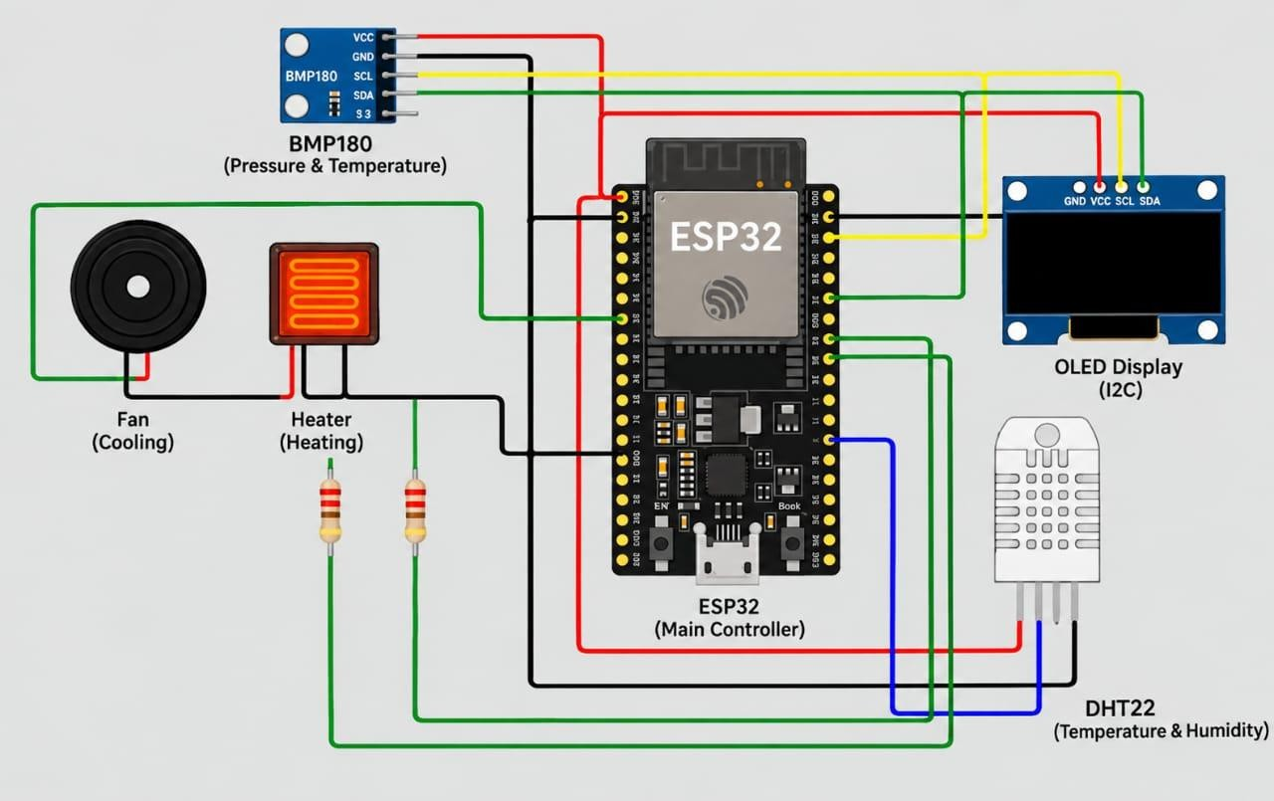
REFERENCE OF A PROTOTYPE
Hack Nova

