Slide 1
Automobile Sales Dashboard (2010–2024)
Data Visualization using Power BI -presented by, Kanagaraj .k

Slide 2
What is Power BI?
Power BI is a business intelligence and data visualization tool developed by Microsoft. It helps people turn raw data into meaningful insights through interactive dashboards and reports.
It connects to different data sources like excel, SQL, and cloud services, allowing users to analyze and visualize data easily.
In simple words, power bi helps you understand your data better and make informed decisions.

Slide 3
Power BI – Key Features & Specifications
some key features of power BI tool:
Data connectivity – connects to multiple sources like excel, SQL, web, and cloud.
Data cleaning – transform and prepare data using power query.
Visualizations – create beautiful and interactive charts, graphs, and maps.
Dax functions – perform advanced calculations and data modeling.
Power bi service – share and collaborate through online dashboards.
Data security – ensures privacy with role-based access control.

Slide 4
Project Overview
Goal: Analyze automobile sales performance using Power BI.
Tool: Microsoft Power BI for modeling, and visualization.
Focus: Brand, Model, Year, Fuel Type, Region, and Revenue insights.
Outcome: Identify sales trends and top-performing brands.

Slide 5
Dataset Summary
Columns used:
Sales_id , brand, model_type, year
Fuel_type, transmission, color, region
Units_sold, revenue_usd, selling price per unit
Manufacture price per unit
Customer_rating, dealer_id, warranty_years

Slide 6
Power BI Dashboard Overview
Interactive visuals for Revenue, Units Sold, and Profit.
Filters for Year, Region, and Brand.
Charts: Bar, Pie, and Line visuals for easy understanding.
Helps identify top brands, customer preferences, and sales growth.

Slide 7
Key Insights
Total revenue: $62B | total units sold: 1.39m
Hyundai, ford, and Nissan are top-performing brands.
Automatic cars dominate sales.
West region shows slightly higher sales volume.

Slide 8
Trends and Patterns
Sedans and suv’s are the most popular models.
Growing demand for hybrid and electric vehicles.
Revenue increased from 2010–2020 with minor dips.
Customer ratings are higher for models with longer warranty.

Slide 9
Recommendations
Focus marketing on SUV and hybrid models.
Expand dealer network in low-performing regions.
Improve customer service and warranty programs.
Use power bi regularly for real-time tracking.

Slide 10
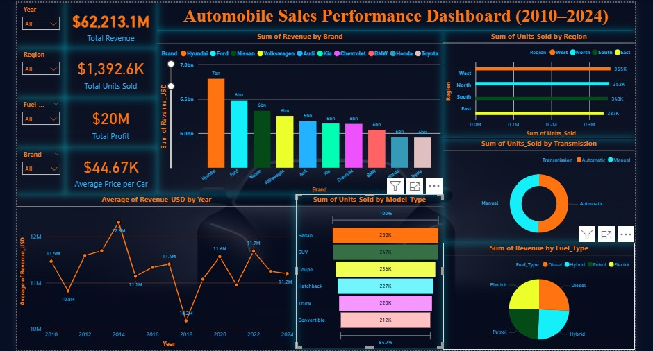
Automobiles Sales Dashboard

