Slide 1

Web Developer
STUDENT NAME : KANAGAVALLI.S
REG NO:34624U18033 & NMID:astvu346m24604
DEPARTMENT: B.SC.COMPUTER SCIENCE
COLLEGE : M.M.E.S.
WOMEN’S ARTS AND SCIENCES COLLEGE

Slide 2
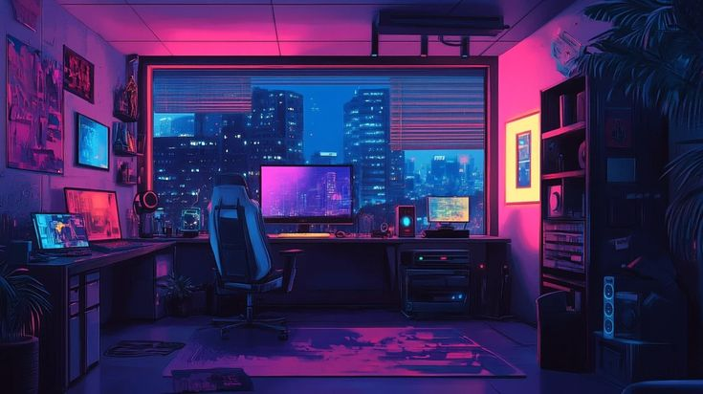
TABLE OF CONTENT
PROBLEM STATEMENT
PROJECT OVERVIEW
END USERS
TOOLS & TECHNOLOGIES
PORTFOLIO DESIGN & LAYOUT
FEATURES & FUNCTIONALITY
RESULTS & SCREENSHOTS
CONCLUSIO

Slide 3
PROBLEM STATEMENT
Many existing websites are outdated and lack modern design.
Users face poor navigation and slow loading times.
Most sites are not fully responsive across devices.
Limited accessibility reduces user engagement.
Businesses struggle to showcase their services effectively.
There is a need for a responsive, user-friendly, and interactive website.

Slide 4
PROJECT OVERVIEW
The project aims to develop a modern and responsive web application.
It highlights core web development skills and practices.
The website showcases personal portfolio, skills, and projects.
It is built using HTML, CSS, JavaScript, and modern frameworks.
The design ensures user-friendly navigation and accessibility.
The project demonstrates ability to create interactive, scalable web solutions.

Slide 5
END USERS
Business Owners – to showcase their products/services online.
Students & Learners – to access educational content and portfolios.
Job Seekers – to present personal portfolios and resumes.
E-commerce Customers – to browse and purchase products.
General Public – for accessing blogs, news, and information.
Organizations & Companies – to maintain websites for communication and branding.

Slide 6
TOOLS & TECHNOLOGIES
HTML, CSS, JavaScript – for structure, styling, and interactivity.
Frameworks – React, Angular, or Vue.js for front-end development.
Backend Technologies – Node.js, PHP, or Python (Django/Flask).
Databases – MySQL, MongoDB, or PostgreSQL.
Version Control – Git & GitHub for code management.
Development Tools – VS Code, Chrome DevTools, Postman.

Slide 7

FEATURES & FUNCTIONALITY
PORTFOLIO DESIGN & LAYOUT
User login and registration system.
Contact form with validation.
Interactive portfolio/project showcase.
Mobile-friendly responsive design.
Database connectivity for dynamic content.
Fast loading and SEO-friendly structure.
PORTFOLIO DESIGN & LAYOUT
Modern and attractive visual design.
Responsive layout for all devices.
Easy-to-use navigation menu.
Consistent color scheme and fonts.
Organized sections (Home, About, Projects, Contact).
User-focused and professional look.

Slide 8
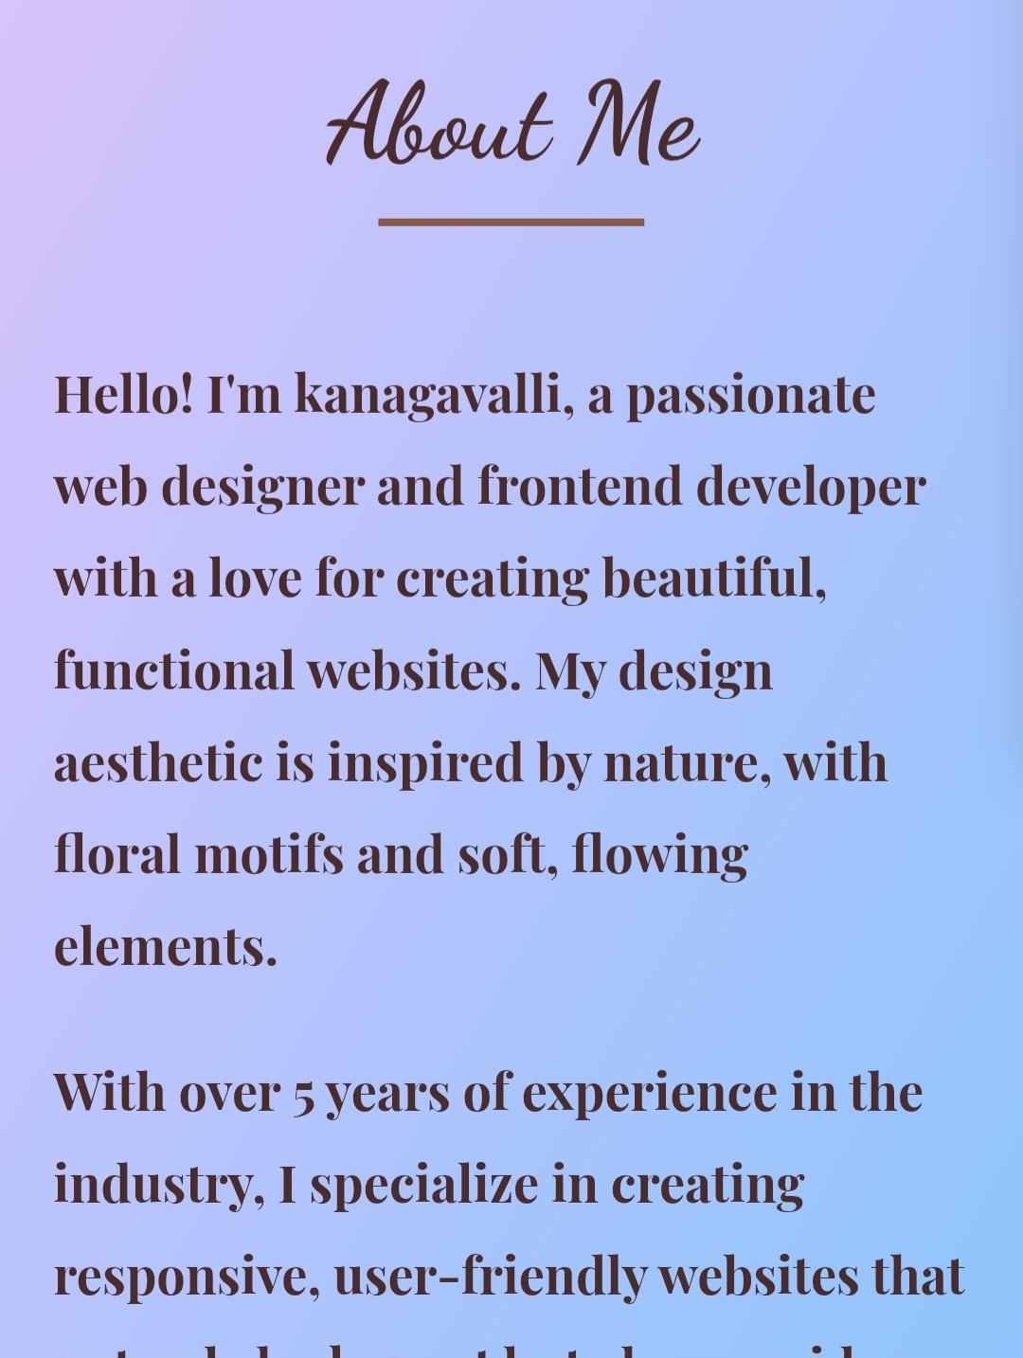
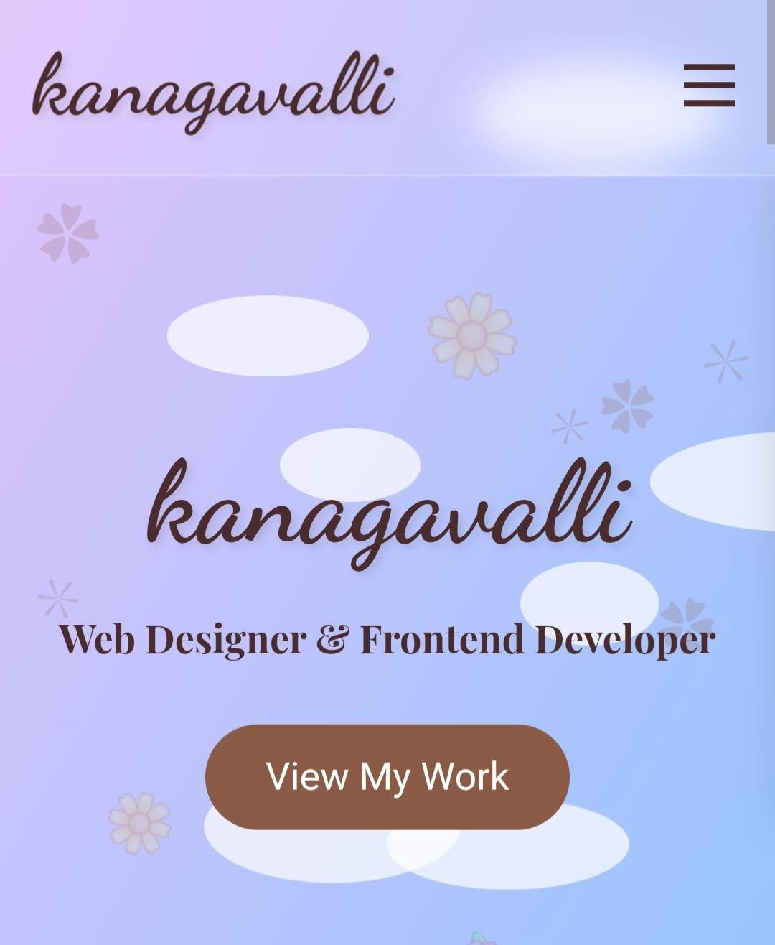
RESULTS & SCREENSHOTS
Homepage design output.
About/Portfolio page screenshot.
Contact page with working form.
Responsive view on mobile and desktop.
Functional demo of interactive features.
Proof of smooth navigation and usability.

Slide 9
CONCLUSION
Successfully built a functional portfolio website.
Applied web development skills effectively.
Improved design and user experience.
Achieved cross-device compatibility.
Learned practical usage of tools & technologies.
Future scope: add advanced features (chatbot, analytics, e-commerce).

Slide 10
Thank You

