Slide 1
Docker
OrsProject10

Slide 2
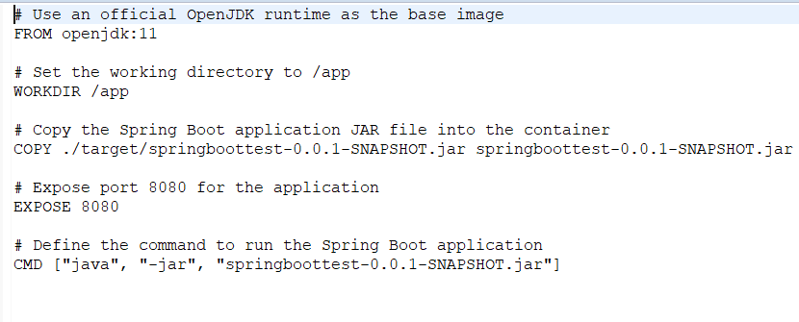
Create docker file in backend

Slide 3
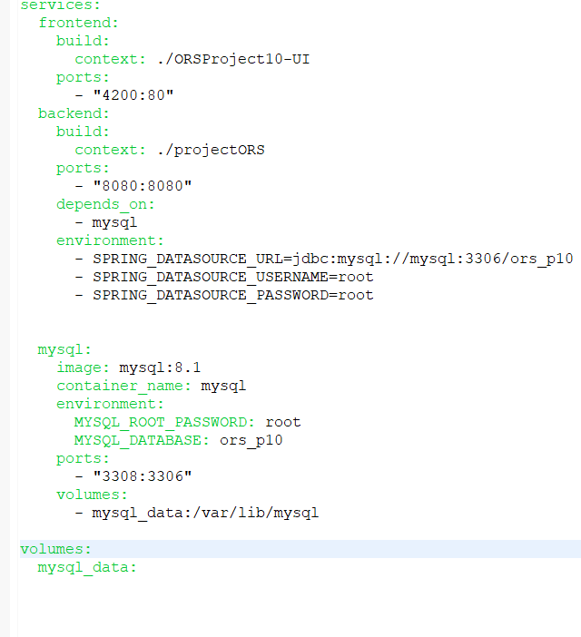
2. Create docker-compose.yml file in backend

Slide 4
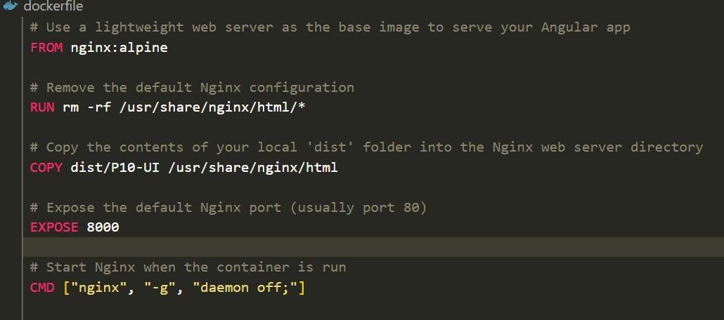
Create docker file in frontend

Slide 5
Now last step 1.copy the back backend file dockercompose.yml and paste with frontend and backend this is connector file. 2. now run the command “docker-compose build “ and docker-compose up

