Slide 1



Introduction
Introduction of Jira :-
Jira is a project management and issue-tracking tool developed by Atlassian. It is widely used by software development teams to plan, track, and manage projects efficiently.
Features of Jira :-
Issue & Bug Tracking
Agile Project Management
Custom Workflows
Dashboards & Reports
Integration with Other Tools

Slide 2
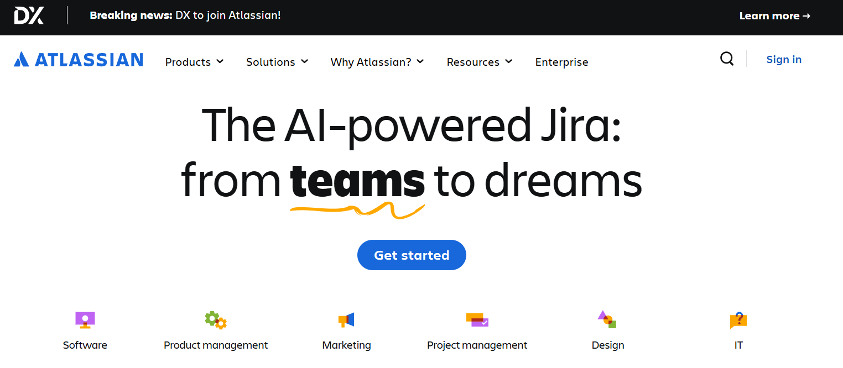
Account Creation
Step 1: Go to Atlassian’s Official Website
Open your browser and visit:
https://www.atlassian.com/
Step 2: Click on “Log in” or “Try for free”
On the top-right corner, click “Try for free” if you want to create a new account.
Or, click “Log in” → “Sign up for an account” if you’re registering fresh.
Step 3: Enter Your Email Address
Type your email ID (preferably your work or Gmail account).
Click “Continue”.
You may also choose to sign up using Google or Microsoft account for faster login.
Step 5: Set Up Your Password
After verification, you’ll be asked to create a password for your account.
Choose a strong password and click Next.

Slide 3
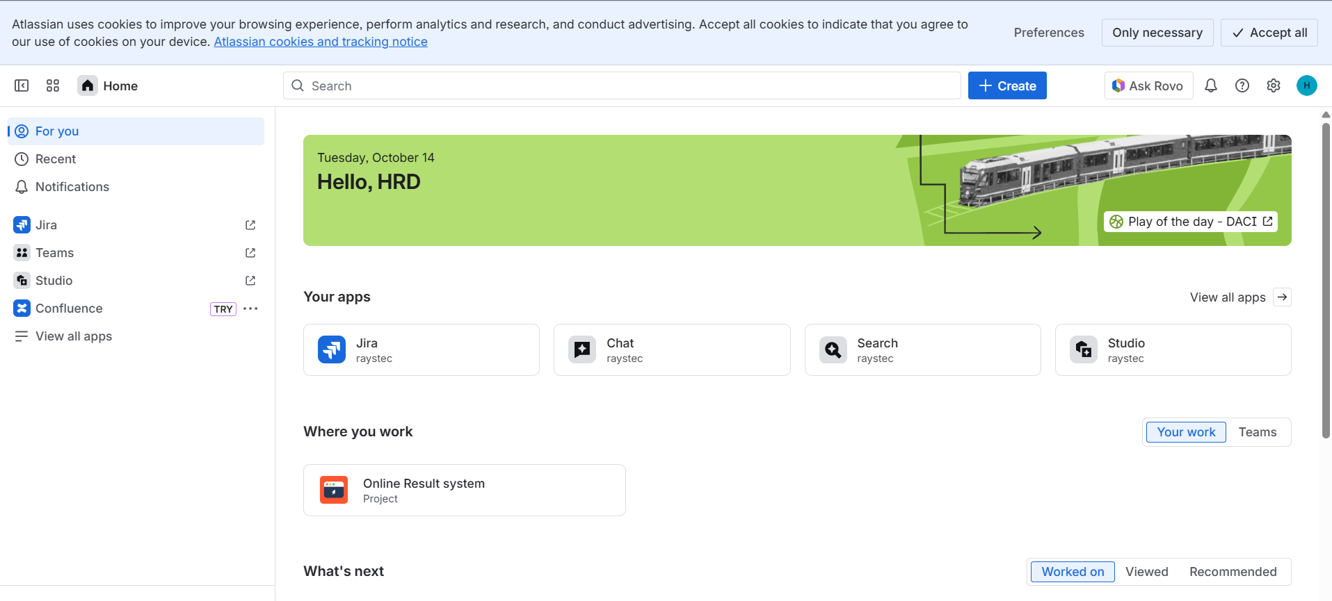
Step 6: Choose Your Product
You’ll now see options like:
Jira Software
Select Jira Software and click “Try it free”.
Step 7: Create Your Site
Enter your team name or project name.
Choose a site URL (example: rays.atlassian.net).
Click “Continue”.
Step 8: Set Up Your First Project
Choose your project type: Scrum
Jira will create a sample project dashboard for you.
Step 9: Start Using Jira
You’re done!
You can now start creating issues, boards, and sprints in Jira from your dashboard.

Slide 4
Agile Structure / Hierarchy Format
In agile project management, Epics, User Stories, Tasks, and Sprints are related in a hierarchical and organizational manner:
Epic
A large feature of a project's requirements. which is broken down into smaller, manageable parts.
Epic contains user stories
User Stories:
Smaller components derived from an Epic.
Describes specific features or functionalities from the user's perspective.
User stories contain tasks
Tasks:
  User stories are broken into tasks.
They are actions required to complete a User Story.
Sprint
Spring contains user stories.
Spring is an iteration, in which planned user stories are coded and tested. One spring is completed in 2 to 4 weeks. In our project, our sprint is of 2 weeks.

Slide 5
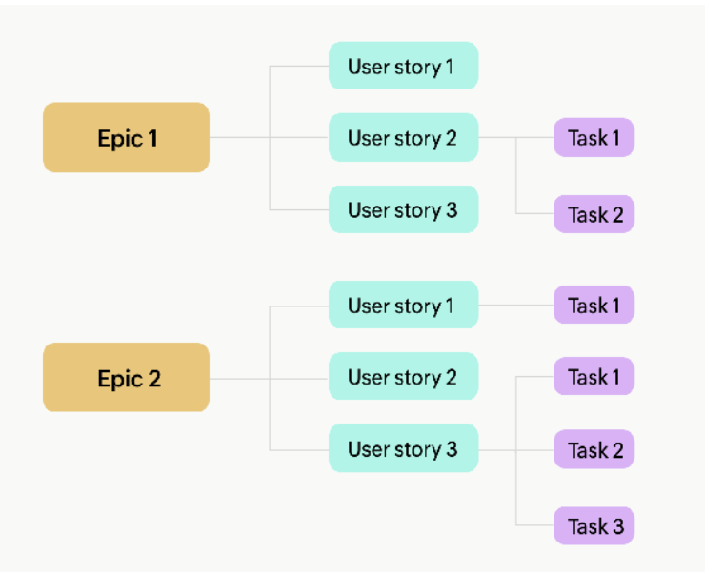
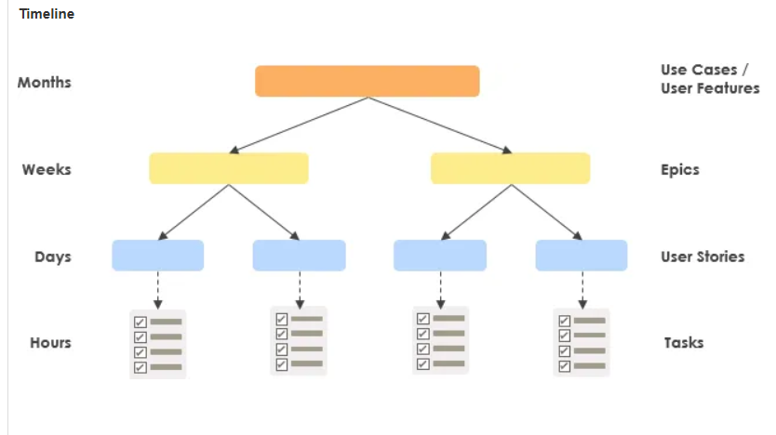
Relationship Flow:
Epics are divided into User Stories.
User Stories are further broken down into Tasks.
Tasks are planned and executed within a Sprint.

Slide 7


Slide 8
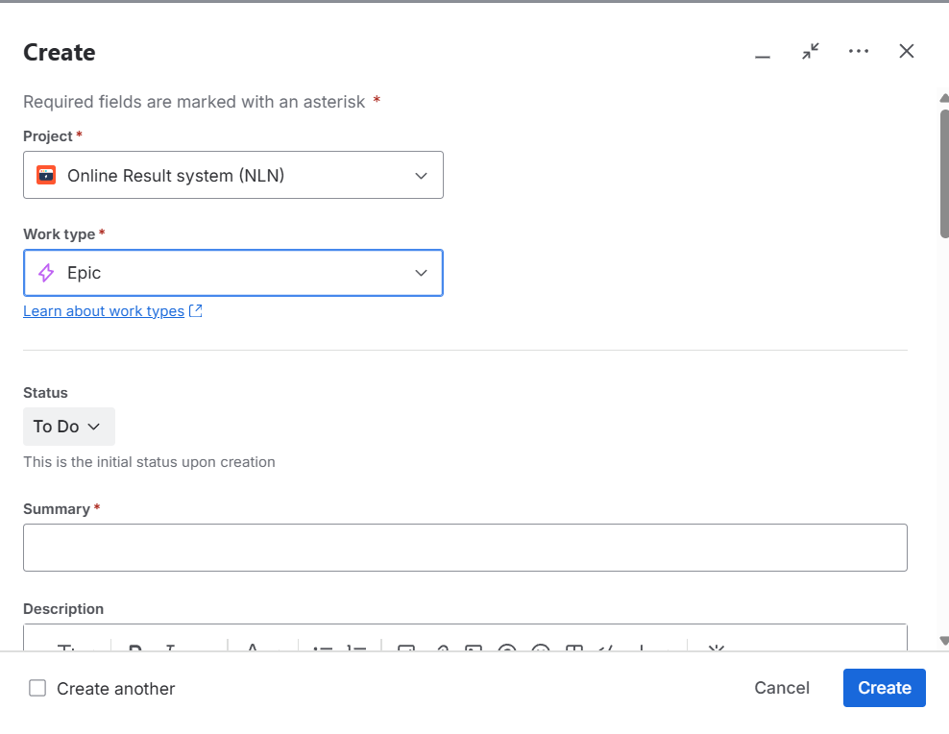
Create Epic
Click on “+ Create Epic.”
Fill in the details:
Epic Name: e.g., “User Authentication System”
Summary: Short description of the epic’s purpose.
Click Create.

Slide 9
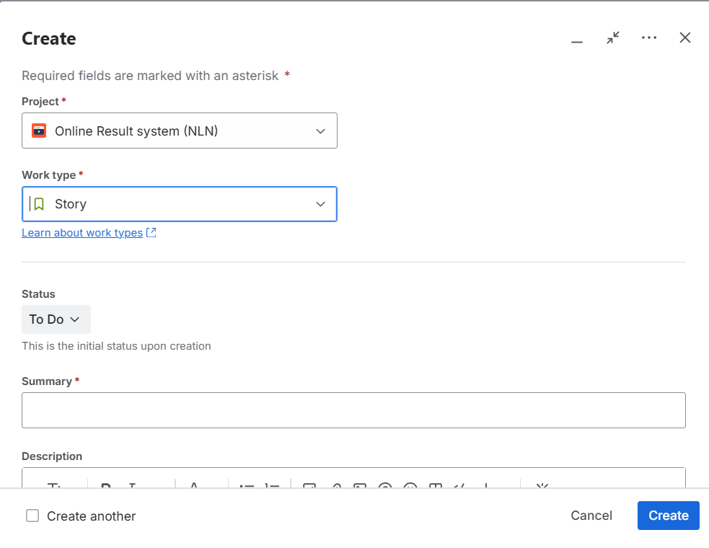
Create Epic
In your project, click “Create” (top navigation bar).
From the Issue Type dropdown, select “Story.”
Fill in details:
Summary: e.g., “As a user, I want to log in using my email and password.”
Description: Write acceptance criteria or more details.
Epic Link: Select the Epic you created earlier.
Click Create.
User Story is now linked to your Epic.

Slide 10
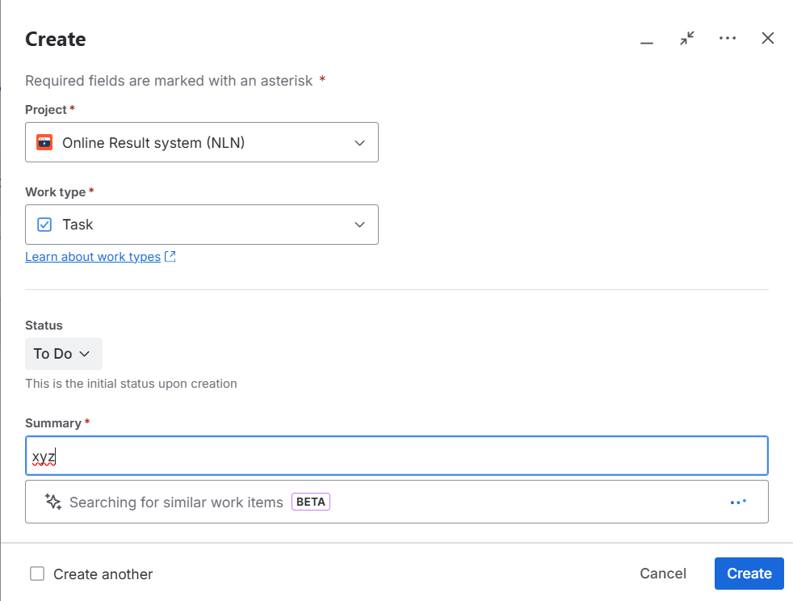
Create Task
Open the User Story where you want to add the task.
Choose Issue Type → Task.
Enter task title like:
Design login page UI
Connect backend API for login
Click Create.
The Task will now appear under that User Story.

Slide 11
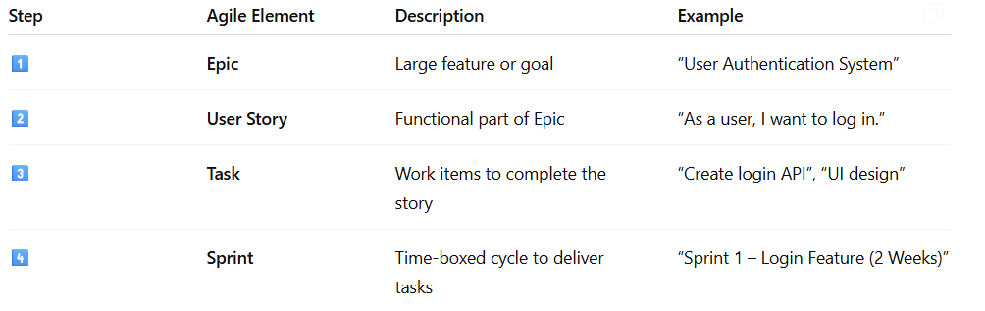
Summary

Slide 12


