Slide 1




MongoDB

Slide 2
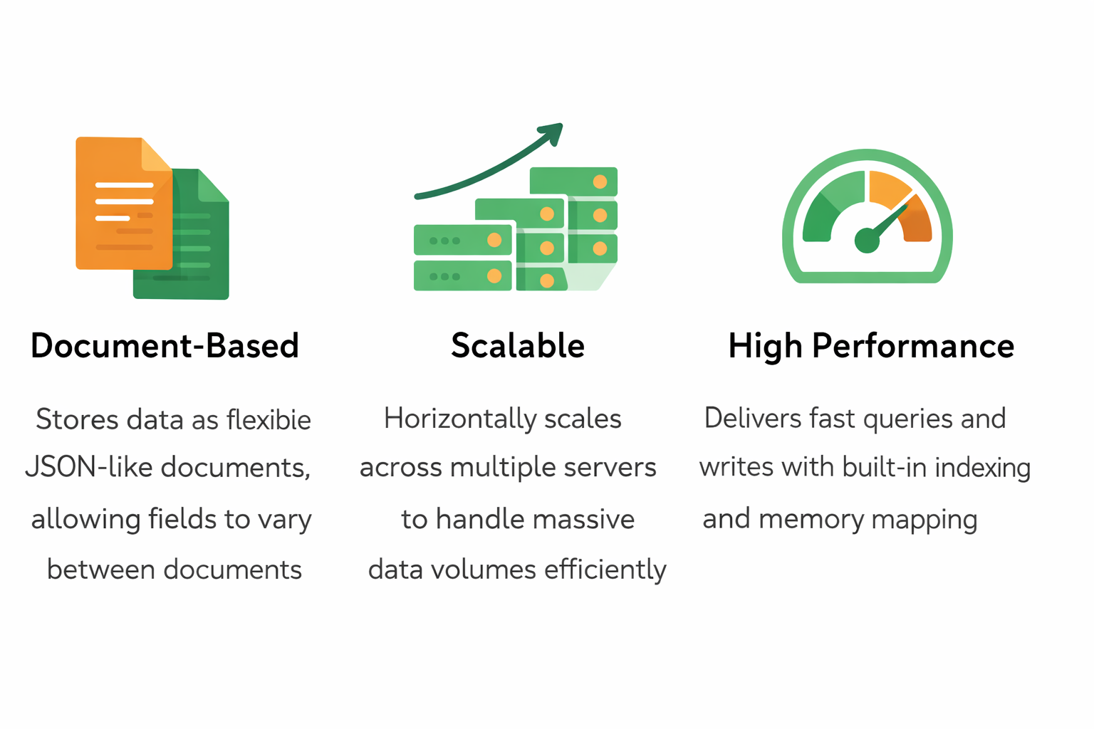
Introduction
What is MongoDB ?
MongoDB is a NoSQL database that provides high performance, high availability, and easy scalability for modern web applications.

Slide 3
SQL vs NoSQL
SQL vs NoSQL
MySQL (SQL)
Structured, predefined schema
Tables with fixed columns
Rows represent records
Joins between tables
ACID transactions
Vertical scaling
MongoDB (NoSQL)
Dynamic, flexible schema
collections with documents
Documents store data
Embedded data structures
Eventual consistency
Horizontal scaling

Slide 4
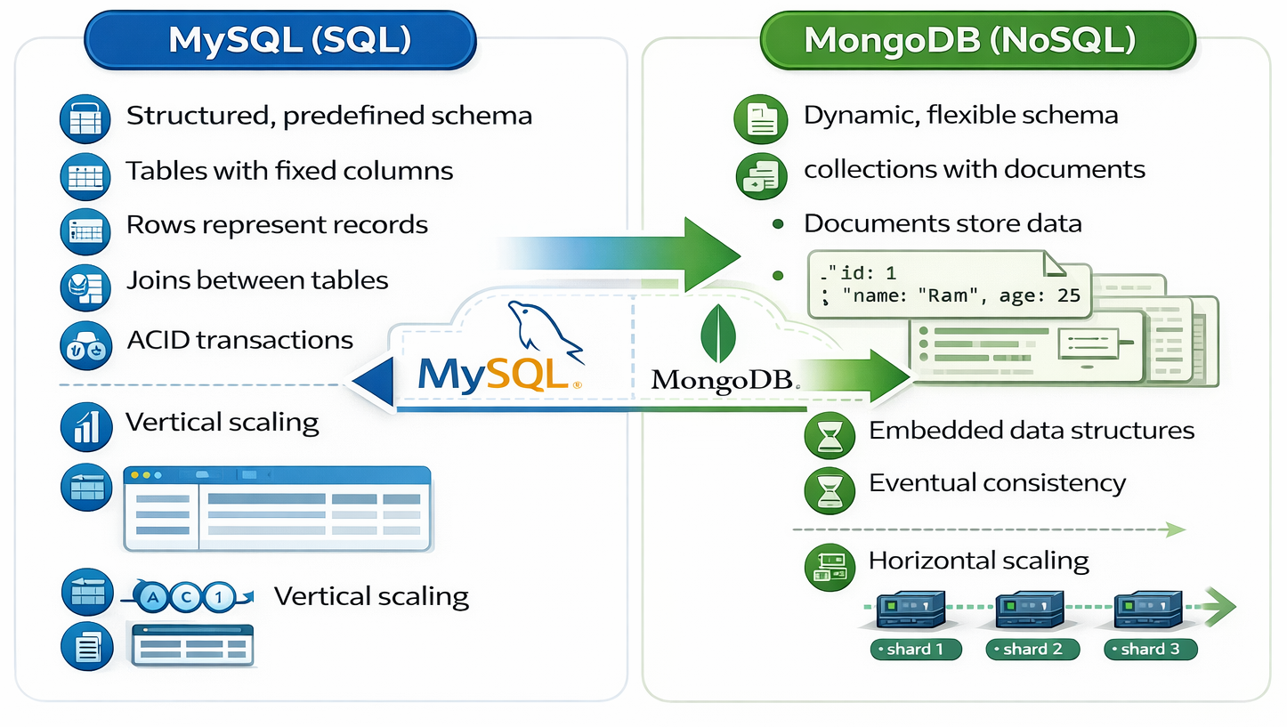
SQL vs NoSQL

Slide 5
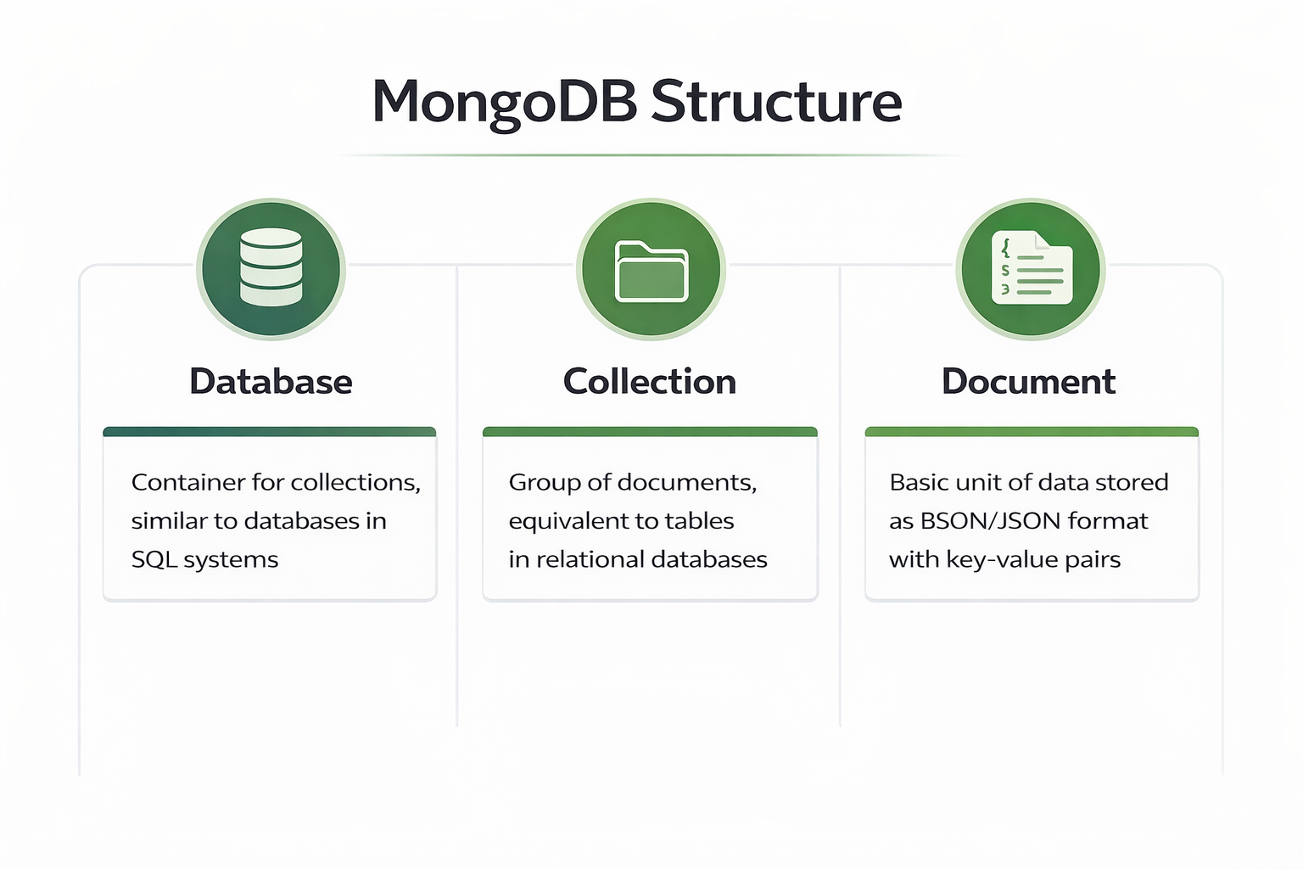
MongoDB Architecture
BSON (Binary JSON) extends JSON to support additional data types like dates and binary data

Slide 6
Query Operations
Comparison Operators
$gt - Greater Than
$lt - Less Than
$gte - Greater or Equal
$lte - Less or Equal
$ne - Not Equal
EX:-
db.users.find({
$and: [
{ age: { $gte: 18 } }, (<=)
{ status: "active" }
]
})

Slide 7
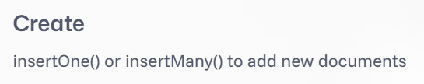

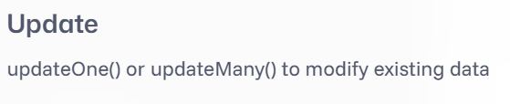

CRUD Operations

Slide 8



Sorting, Pagination & Aggregation
sort()
Sort results by one or more fields in ascending (1) or descending (-1) order
limit()
Limit the number of documents returned in the result set
skip()
Skip a specified number of documents for pagination implementation

Slide 9
Aggregation
Count
Count documents in collection
sum
Calculate sum of numeric fields
avg
Calculate average values
group
Group documents by field

Slide 10


