Slide 1
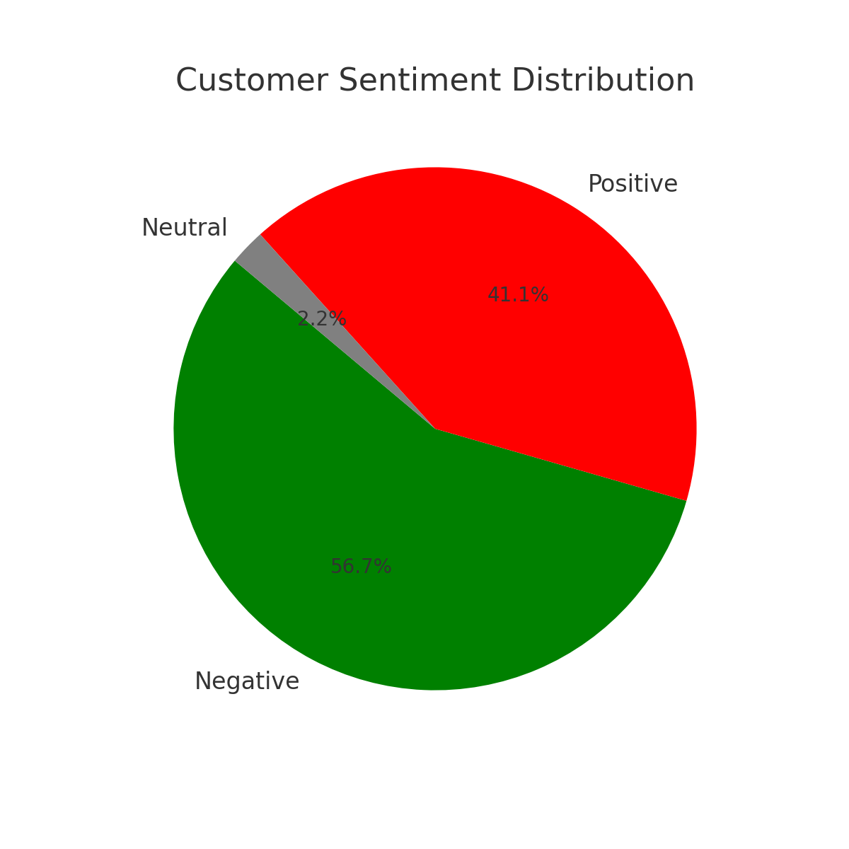
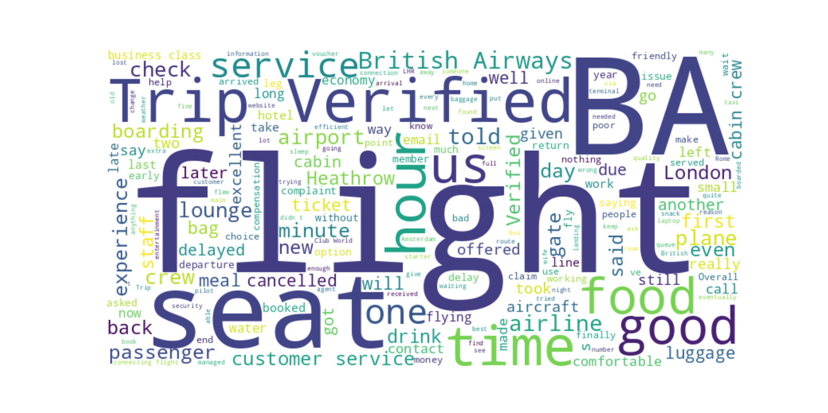
British Airways – Customer Sentiment Analysis
🔹 **Key Metrics**
• Total Reviews Analyzed: 90
• Positive: 37
• Negative: 51
• Neutral: 2
🔍 **Summary Insight**
Majority of feedback is negative, with delays, baggage issues, and staff behavior being common complaints. However, customers praised punctual flights and onboard services. Improving operational communication and recovery processes may enhance customer satisfaction.

