Slide 1
NexTask
Multi-Tenant SaaS Project Management Platform
FS-04 Internship Project | Kanaka Durga Pitchuka
github.com/kanakadurgapitchuka/nextask-fs04

Slide 2
Problem and tenant isolation
Companies need their own private workspace for boards, sprints and billing
Shared PostgreSQL schema: every record carries a workspace id
A user reaches data only through a membership in that workspace
Related objects (project, status, sprint) are checked against the same workspace
Tests prove user A cannot read or write user B's workspace

Slide 3
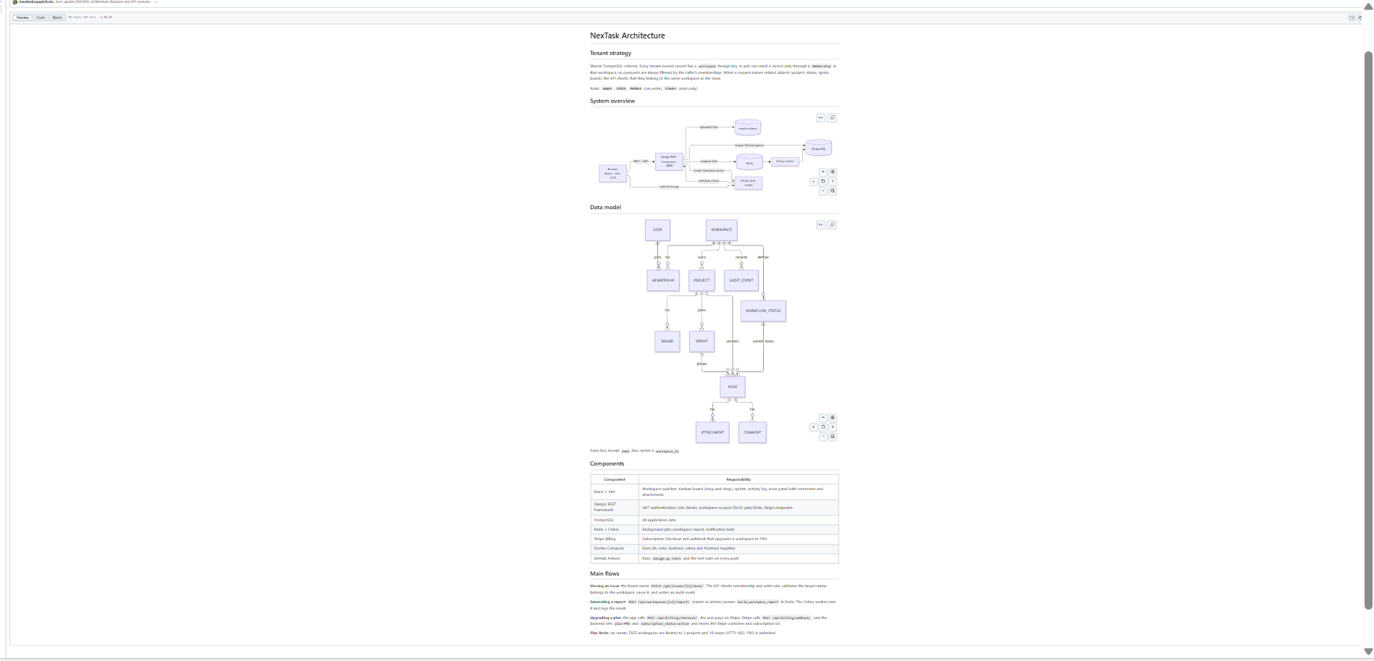
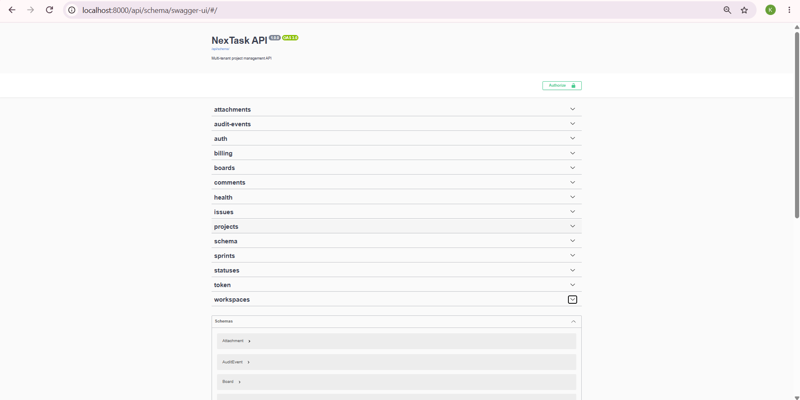
Architecture and tech stack
React + Vite frontend with drag-and-drop (@dnd-kit)
Django REST Framework API with JWT login and role checks
PostgreSQL for data; Redis + Celery for background jobs
Stripe Billing in test mode: Checkout and webhook
Docker Compose runs five services; GitHub Actions tests every push

Slide 4
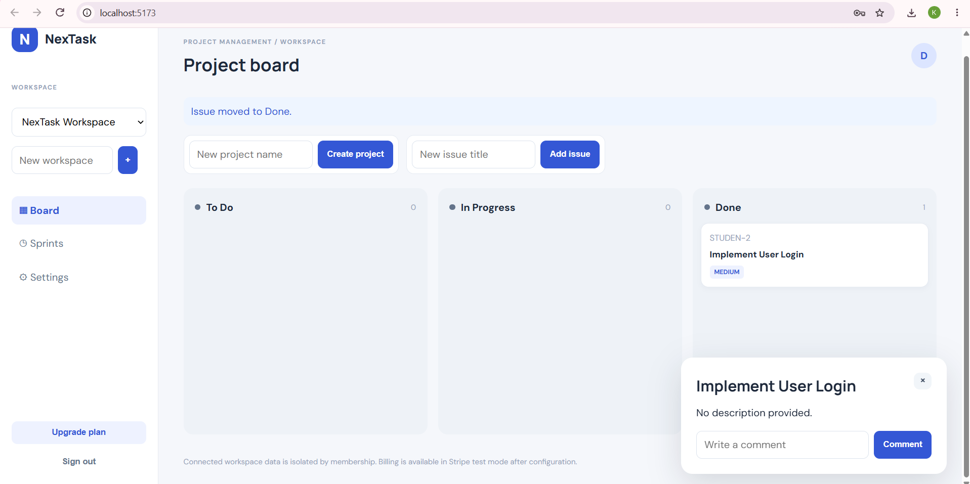
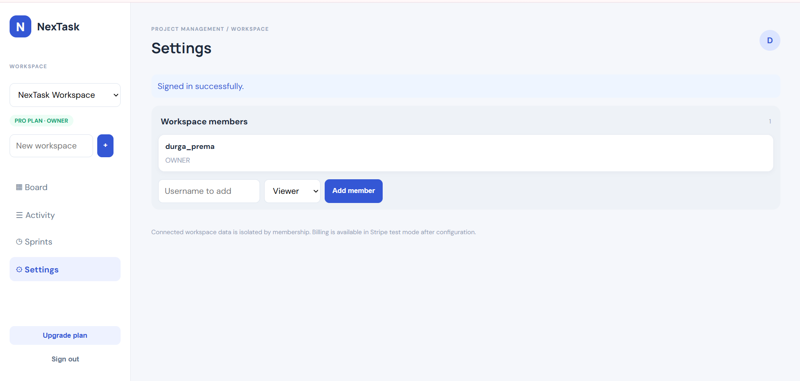
Features and roles (live demo)
Kanban board: drag issues across To Do, In Progress, Done (saved to the server)
Sprints with backlog assignment, comments, file attachments
Activity page records every create, move, comment and upload
Roles: Owner, Admin, Member, Viewer; owners add members from Settings
Viewer is read-only: the API returns 403, "Your role does not allow this action"

Slide 5
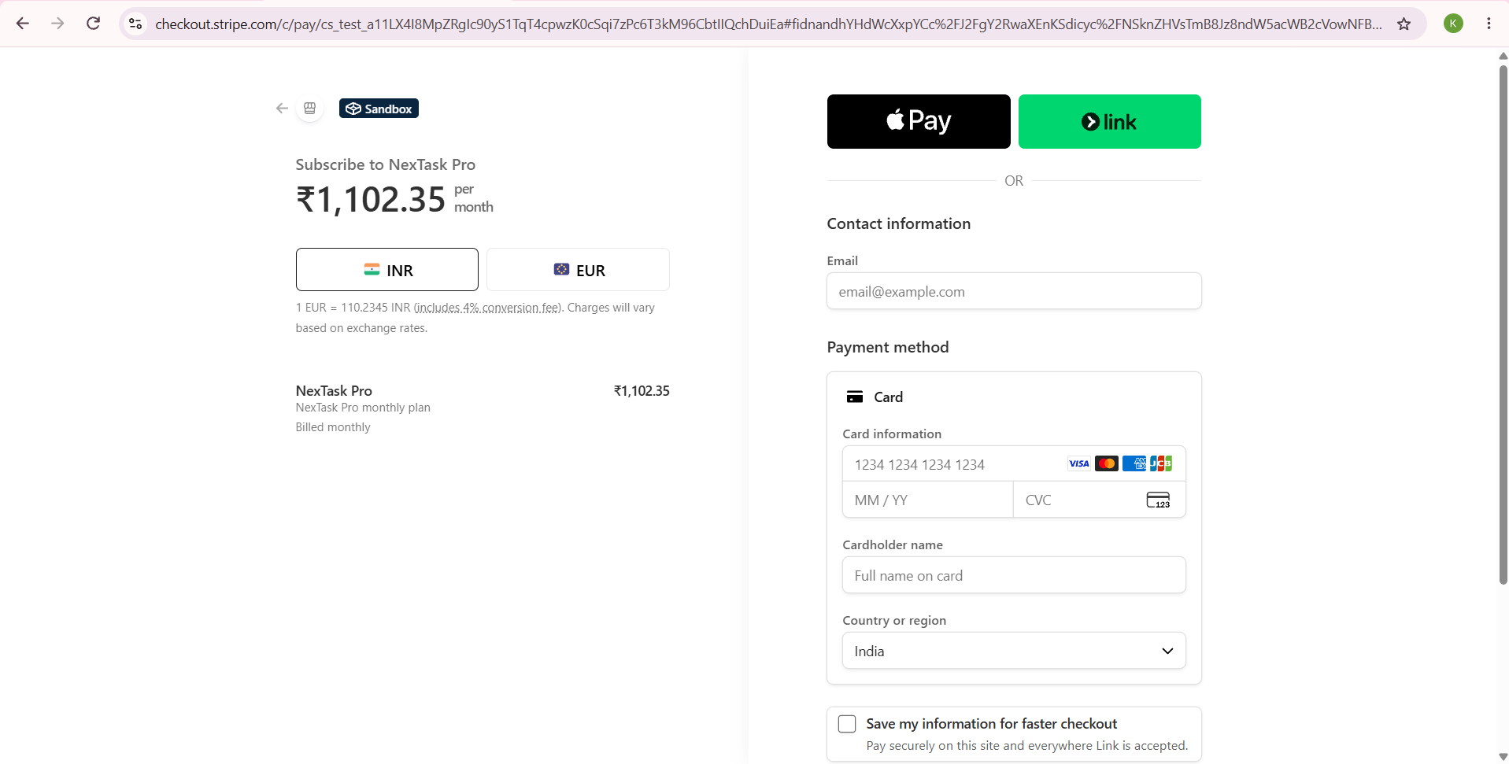
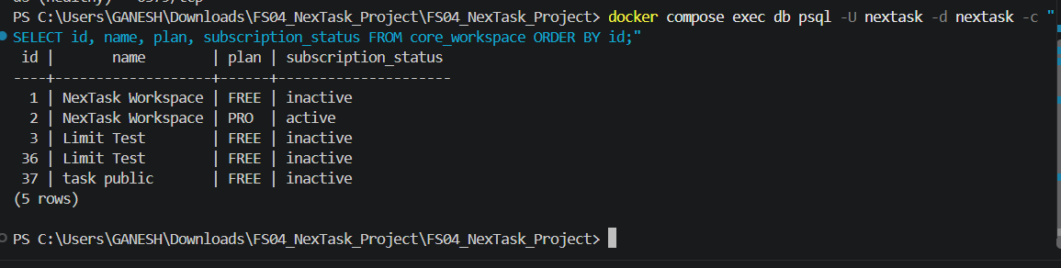
Background jobs and billing
Celery: workspace report queued by the API and completed by the worker
Stripe: Upgrade plan, test-card checkout, webhook returns 200
Webhook sets the workspace to PRO and stores Stripe customer and subscription ids
FREE plan limit: 3 projects and 10 issues; the 4th project returns HTTP 402
PRO plan is unlimited

Slide 6
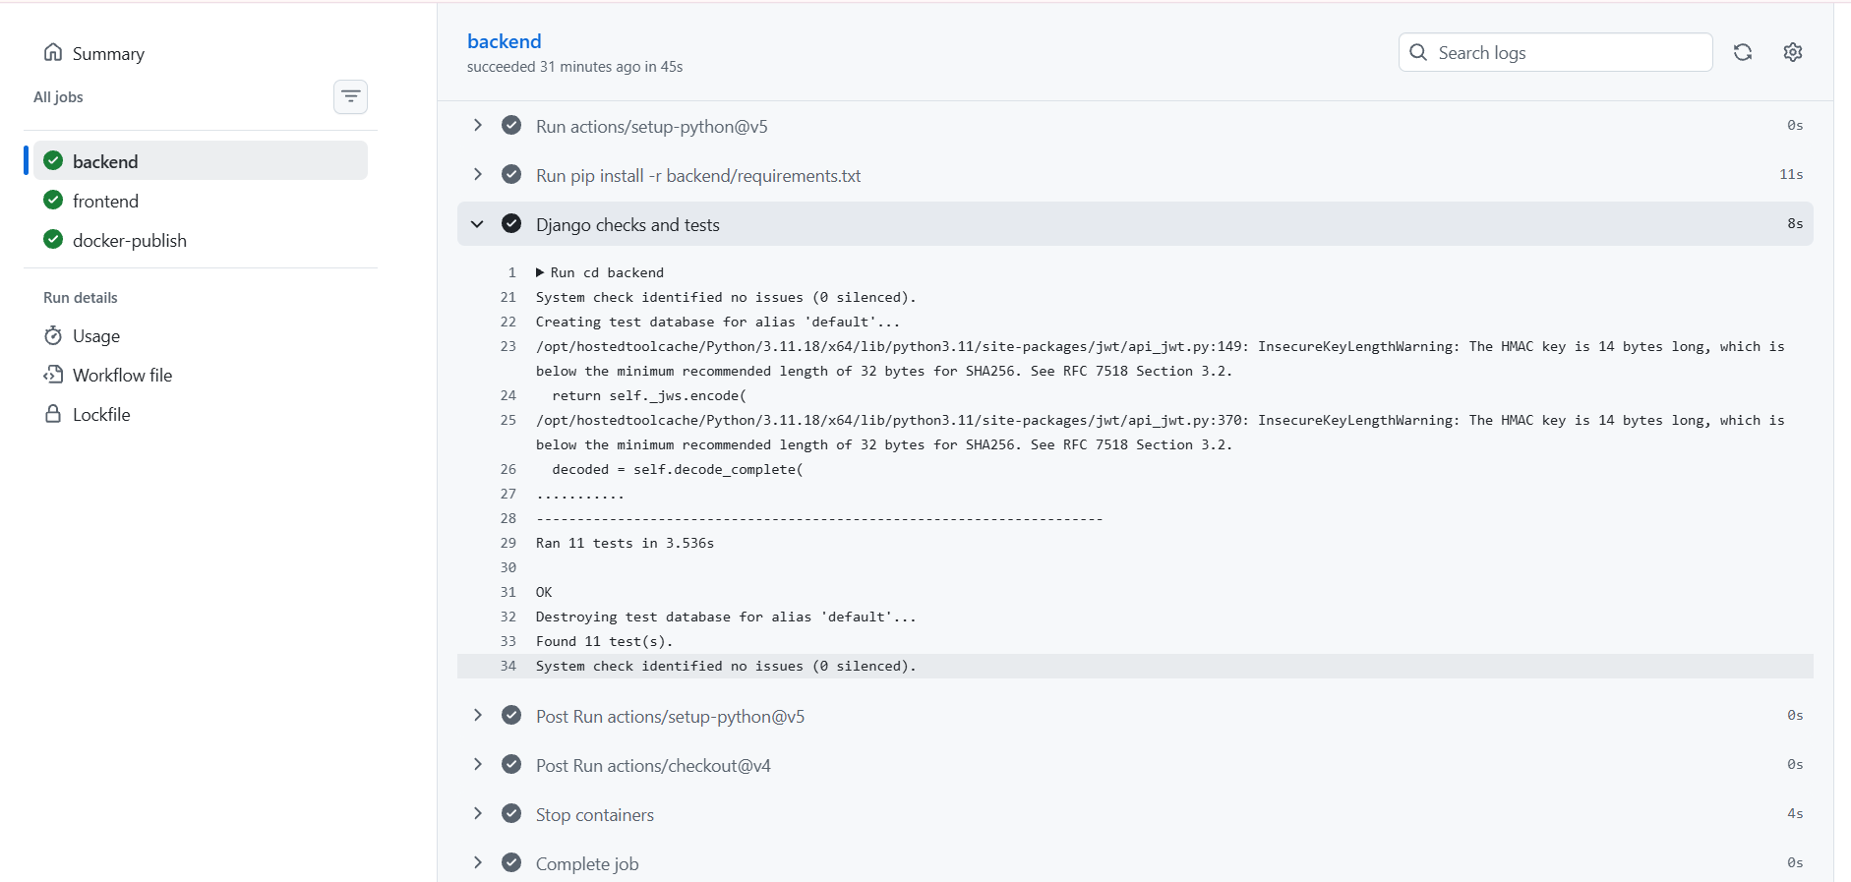
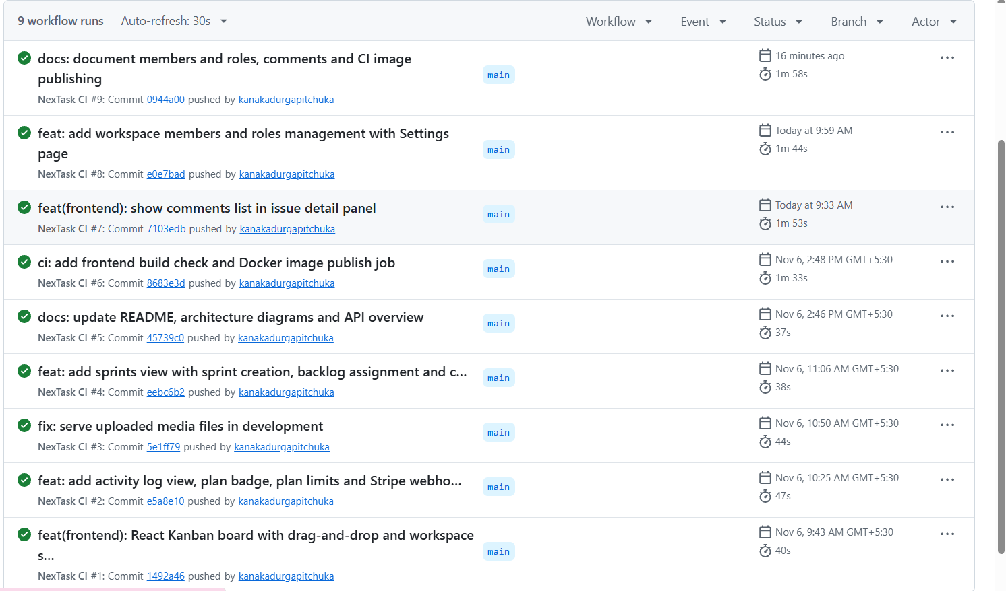
Testing and results
11 automated tests pass: isolation, roles, plan limits, webhook, sprints, members
GitHub Actions: backend tests, frontend build, Docker images published
Clean-clone check: fresh clone + docker compose up --build works from scratch
Secrets stay out of Git (.env is ignored; .env.example is committed)

Slide 7
Challenges, lessons and next steps
Challenge: drag-and-drop did not drop; fixed with droppable columns and better collision detection
Challenge: Stripe cannot reach localhost; solved with the Stripe CLI webhook forwarder
Lesson: block on the server (403), and validate related objects across tenants
Next: email invitations, Celery notifications, custom workflow columns
Next: deploy to a hosting service and store uploads in object storage

