Slide 1
ANALOG TO DIGITAL CONVERTOR
ADC
Electronics Club, IIT Bombay

Slide 2
ADC
An ADC converts an input voltage into a number and has a resolution.
A 10 Bit ADC has a range of 0-1023. (2^10=1024)
The ADC also has a Reference voltage(ARef).
When input voltage is GND the output is 0
When input voltage is equal to ARef the output is 1023
So the input range is 0-ARef and digital output is 0-1023.

Slide 3
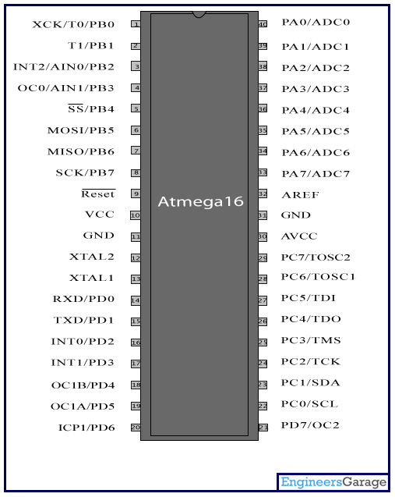
ADC PINS in ATMega 16

Slide 4
ADC REGISTERS
To configure the working of the ADC we have different registers :
ADC Multiplexer Selection Register – ADMUX : For selecting the reference voltage and the input channel.
ADC Control and Status Register A – ADCSRA : As the name says it has the status of ADC and is also use for controlling it.
The ADC Data Register – ADCL and ADCH : The final result of conversion is here.

Slide 5
Algorithm for using ADC
Enable global interrupts
Selecting the correct clock frequency for maximum resolution ( 50 – 200 KHz)
Selecting the input pin
Set the ADC Interrupt Enable
Enabling the ADC
Start the ADC conversion

Slide 6
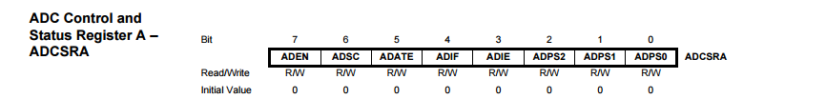

The Control and Selection Registers for ADC

Slide 7
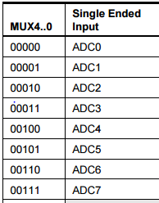
Setting the Input Pin

Slide 8
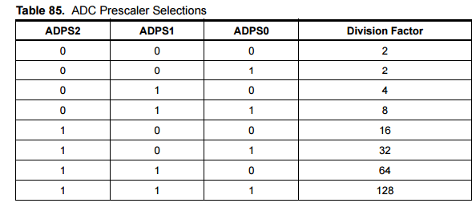
Setting the Pre-Scaler for ADC conversion

Slide 9
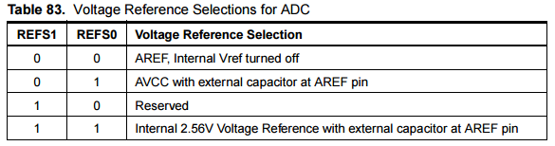
Setting the Reference Voltage

Slide 10


Storing the Output Number

Slide 11
Our Code Finally ! For ADLAR = 0
#include <avr/io.h> #include <avr/interrupt.h> int main(void) { ADCSRA |= 1<<ADPS2; ADMUX |= (1<<REFS0) | (1<<REFS1); ADCSRA |= 1<<ADIE; ADCSRA |= 1<<ADEN; sei(); ADCSRA |= 1<<ADSC; while (1){}
} ISR(ADC_vect) { uint8_t low_1 = ADCL; uint16_t output_ans = ADCH<<8 | low_1; ADCSRA |= 1<<ADSC; }

Slide 12
Our Code Finally ! For ADLAR = 1
#include <avr/io.h> #include <avr/interrupt.h> int main(void) { ADCSRA |= 1<<ADPS2; ADMUX |= (1<<REFS0) | (1<<REFS1) | ( 1<< ADLAR ) ; ADCSRA |= 1<<ADIE; ADCSRA |= 1<<ADEN; sei( ); ADCSRA |= 1<<ADSC; while (1){}
} ISR(ADC_vect) { uint8_t low_1 = ADCL; uint16_t output_ans = ADCH<<2 | low_1>>6; ADCSRA |= 1<<ADSC; }

Slide 13
THANK YOU

