Slide 1
Introduction to PWM
Electronics Club, IIT Bombay

Slide 2
Pulse Width Modulation
Its main use is to allow the control of the power supplied to electrical devices, especially to inertial loads such as motors.
The average value of voltage (and current) fed to the load is controlled by turning the switch between supply and load on and off at a fast rate. The longer the switch is on compared to the off periods, the higher the total power supplied to the load.

Slide 3
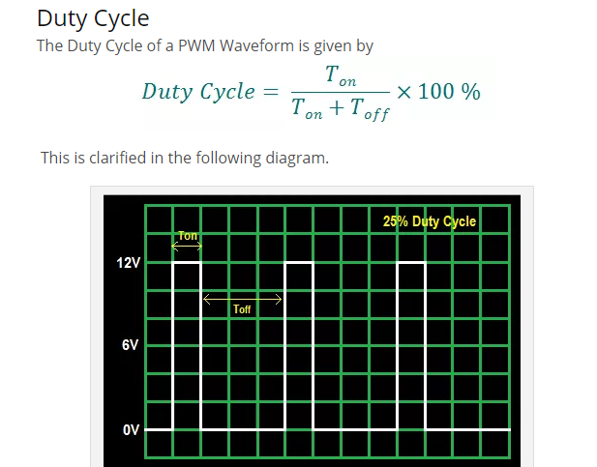
Duty Cycle

Slide 4
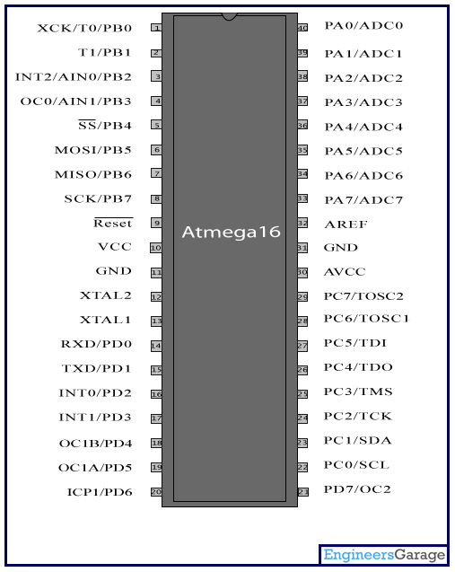
PWM Pins on ATMega 16
The PWM pins are –
OC0
OC1A
OC1B
OC2

Slide 5
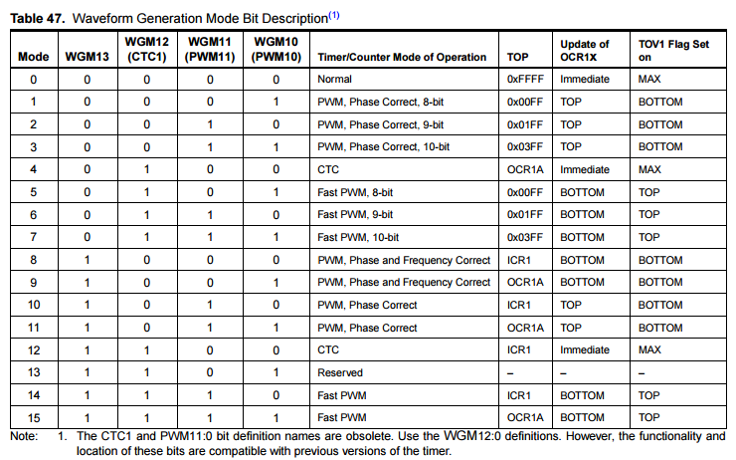
Generating the required waveform

Slide 6
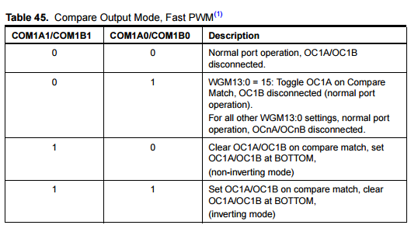
Setting the PWM pins to output

Slide 7
Our Code for PWM
#include <avr/io.h> int main(void) {
DDRD |= 0xFF; TCCR1A |= 1<<WGM11 | 1<<COM1A1 | 1<<COM1A0; TCCR1B |= 1<<WGM13 | 1<<WGM12 | 1<<CS10; ICR1A = 24999; // We assume the frequency we want, and divide it by F_CPU to get the count // In this case, we have set a frequency of 40 Hz OCR1A = ICR1A - t; // t is the time for which u want the pulse to be high // We are using the inverted mode, hence we assign from the end
// t can be any value from 1 – 24998 :P while (1) { }
}

