Slide 1
SalaryShield
AI-Driven, Inflation-Adaptive Compensation Intelligence
Quantify real-wage erosion. Justify fair corrections. Retain talent.
Two-sided platform for employees and employers — powered by a City-Level Inflation Index (CLII) and a GenAI Copilot.
React 19
Vite 8
Google Gemini AI
CLII Engine
Live Employer Console
Hackathon Submission · Scored across 10 parameters

Slide 2
SCORING PARAMETER 1 · PROBLEM DEFINITION
Nominal salary is not real income
▸ Inflation in India's tech hubs silently erodes purchasing power — Hyderabad 8.4%, Mumbai 9.1%, Bengaluru 7.9%.
▸ National CPI (MOSPI) under-weights the urban tech-worker basket: IT-corridor rent, education, food delivery, commute.
▸ Employees can't quantify their real-wage loss or defend a corrective hike with data.
▸ Employers lose talent to inflation lag but lack city-level visibility — each exit costs ~₹37.5L in replacement.
▸ Net effect: mis-priced compensation, avoidable attrition, and unfair pay across geographies.

Slide 3
SOLUTION OVERVIEW
One platform, both sides of the pay table
▸ Employee: personal inflation rate, real-wage score, 12-month savings-depletion forecast, break-even raise %, an investment allocator, and an AI negotiation coach.
▸ Employer: live compensation budget simulator, attrition-risk ROI, city inflation heatmap, and a computed pay-fairness audit.
▸ CLII Engine: a City-Level Inflation Index fusing rent, food, transport, utilities and education per city.
▸ GenAI Copilot: Google Gemini, answering natural-language questions grounded in the user's own live numbers.
▸ Every module reads one shared model — so the story stays consistent end to end.

Slide 4
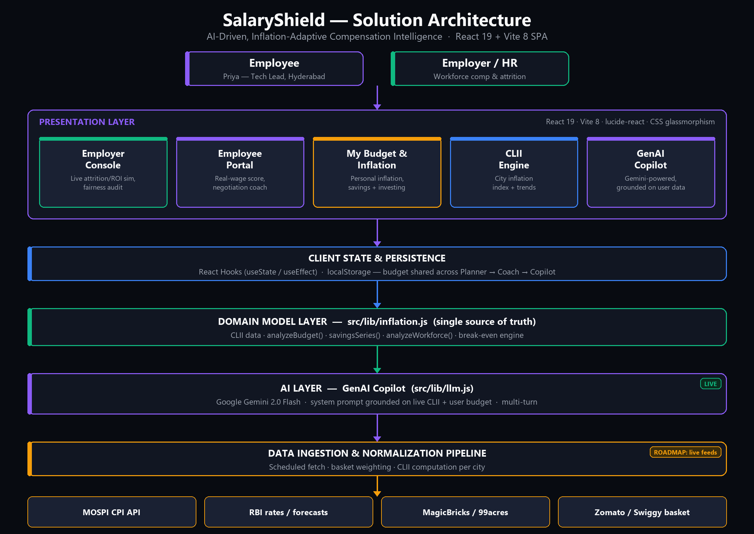
SCORING PARAMETER 2 · SOLUTION ARCHITECTURE
Layered, model-driven architecture

Slide 5
SCORING PARAMETER 3 · ENGINEERING / BUILD QUALITY
Clean, verifiable, production-shaped
▸ React 19 + Vite 8 SPA; one component per module; lucide-react icons; a CSS-variable design system (glassmorphism).
▸ Domain logic extracted into src/lib/inflation.js — a single source of truth reused by all 5 modules (DRY), incl. analyzeWorkforce() for the Employer Console.
▸ Pure, deterministic, testable functions: analyzeBudget(), savingsSeries(), analyzeWorkforce(), break-even & personal-inflation engine.
▸ Cross-module consistency: changing city/salary in the Budget Planner live-syncs the Employee Portal, Coach and Copilot within 1 second.
▸ Production build passes — 1,780 modules, ~86 KB gzip. oxlint clean. localStorage persistence survives refresh.
▸ Verified live in-browser during development (real DOM checks, zero console errors).
In this build: the whole app compiles and runs; the model layer is unit-test-ready pure functions.

Slide 6
SCORING PARAMETER 4 · AI APPROPRIATENESS
AI only where it earns its place
▸ The hard numbers — inflation, break-even, ROI — stay in deterministic code for accuracy and auditability.
▸ The LLM does what it is uniquely good at: reasoning over the numbers and turning them into plain-language guidance.
▸ Clear split — Engine computes, AI explains. No AI-for-AI's-sake; no hallucinated math.
▸ Output is genuinely language-shaped: personalized advice and ready-to-send negotiation scripts.

Slide 7
SCORING PARAMETER 5 · AI IMPLEMENTATION
A real, live LLM — grounded and multi-turn
▸ GenAI Copilot calls Google Gemini 2.0 Flash directly — a real model call, not a scripted response.
▸ RAG-style grounding: a system prompt injects the user's live budget, computed metrics, and the full CLII dataset for every city — answers cite the user's real ₹ figures, not model priors.
▸ Multi-turn: full conversation history is passed on every call, so follow-up questions stay in context.
▸ One data story across surfaces: Budget Planner → Negotiation Coach → Copilot all read src/lib/inflation.js.
▸ Error-handled: a clear in-chat message (not a silent failure) if the API key or network is unavailable.
In this build: the Copilot is wired to a real Gemini API call (src/lib/llm.js) with the user's live personal-inflation, break-even and target-salary numbers as grounding context.

Slide 8
SCORING PARAMETER 6 · AI IMPACT
Invisible loss becomes a clear action
▸ Employee: surfaces a hidden ~₹1.03L/yr loss and generates a copy-paste, data-backed pitch → higher raise success.
▸ Employer: converts attrition risk into ROI — retain a key hire, avoid ~₹37.5L in replacement cost.
▸ Personalized inflation (e.g. 7.7% vs a 8.4% city average) — an insight no generic salary calculator gives.
▸ Data → decision in seconds, for both the individual and the organization.

Slide 9
SCORING PARAMETER 7 · BUSINESS RELEVANCE
A large, recurring, two-sided need
▸ Addressable users: 5M+ Indian IT professionals and every enterprise running India delivery centers.
▸ The pain is universal and recurring — it resurfaces at every appraisal cycle.
▸ Maps directly to top HR priorities: retention, pay equity, and compensation-budget optimization.
▸ Two-sided design means both the employee and the employer have a reason to adopt.

Slide 10
SCORING PARAMETER 8 · BENEFITS & VIABILITY
Clear model, low cost, real moat
▸ Freemium employee tier drives acquisition; B2B SaaS (per-seat / per-audit) drives revenue from employers.
▸ Data moat: the proprietary CLII index compounds in value as coverage and history grow.
▸ Lean infrastructure — static SPA + serverless LLM calls — keeps unit economics healthy.
▸ Viable path: MVP is built; remaining pieces (live feeds, HRMS integration, auth) are known and incremental.

Slide 11
SCORING PARAMETER 9 · WORKING DEMO
Live, interactive, end to end
▸ A running MVP — not slideware. Four-minute flow:
▸ 1 Budget Planner — enter salary, city & expenses → live personal inflation, savings-depletion chart, break-even raise; push rent up → deficit alert fires.
▸ 2 Negotiation Coach — the pitch auto-cites those exact numbers → one-click copy.
▸ 3 GenAI Copilot — ask 'Am I underpaid?' → a real Gemini call answers with the same live figures.
▸ 4 Employer Console — move the hike slider → attrition risk, ROI and fairness metrics recompute live.

Slide 12
SCORING PARAMETER 10 · DIFFERENTIATION
Why this is not another salary calculator
▸ Personal, city-level, expense-weighted inflation — not a one-size national average.
▸ Two-sided: employee guidance AND employer workforce economics in one product.
▸ AI output is an artifact you can act on — a negotiation script — not just a number.
▸ A single, consistent data story flows across every module.
▸ The CLII index is defensible IP that strengthens over time.

Slide 13
ROADMAP & ASK
From MVP to production
▸ Now: MVP live — CLII model, 5 modules, live Employer Console, budget engine, Gemini-powered Copilot.
▸ Next: live data ingestion (MOSPI/RBI/rent/basket) feeding the CLII pipeline.
▸ Next: server-side LLM proxy (key security, rate limiting) + response streaming.
▸ Then: HRMS integration, auth, multi-user, historical CLII moat.
The one-line pitch
SalaryShield turns invisible inflation into a fair, data-backed pay decision — for the employee and the employer.
Built with React 19 + Vite 8, a deterministic CLII engine, and a Gemini-powered GenAI Copilot grounded in the user's real numbers.

