Slide 1
Customer Segmentation Analysis
Segmenting retail customers using K-Means Clustering

Slide 2
Objective
Segment customers into meaningful groups instead of treating them all the same
1
Identify the statistically optimal number of segments
2
Build a K-Means model that assigns new customers to the right segment
3
Translate clusters into business-friendly profiles for marketing use
4

Slide 3
Methodology
Raw Data
Cleaning &
Preprocessing
Feature
Scaling
Optimal k
(Elbow)
K-Means
Training
Cluster
Assignment
Visualization
& Evaluation
Business
Insights
A sequential, reproducible pipeline: each stage's output feeds directly into the next — from raw customer data to actionable business insight.

Slide 4
Dataset
Source: Mall Customer Segmentation Dataset (Kaggle)
Records: 200 customers, no missing values
Format: Structured CSV
Split: 80% train (160) / 20% holdout (40)
Column | Type
CustomerID | Integer
Gender | Categorical
Age | Integer
Annual Income (k$) | Integer
Spending Score (1-100) | Integer

Slide 5
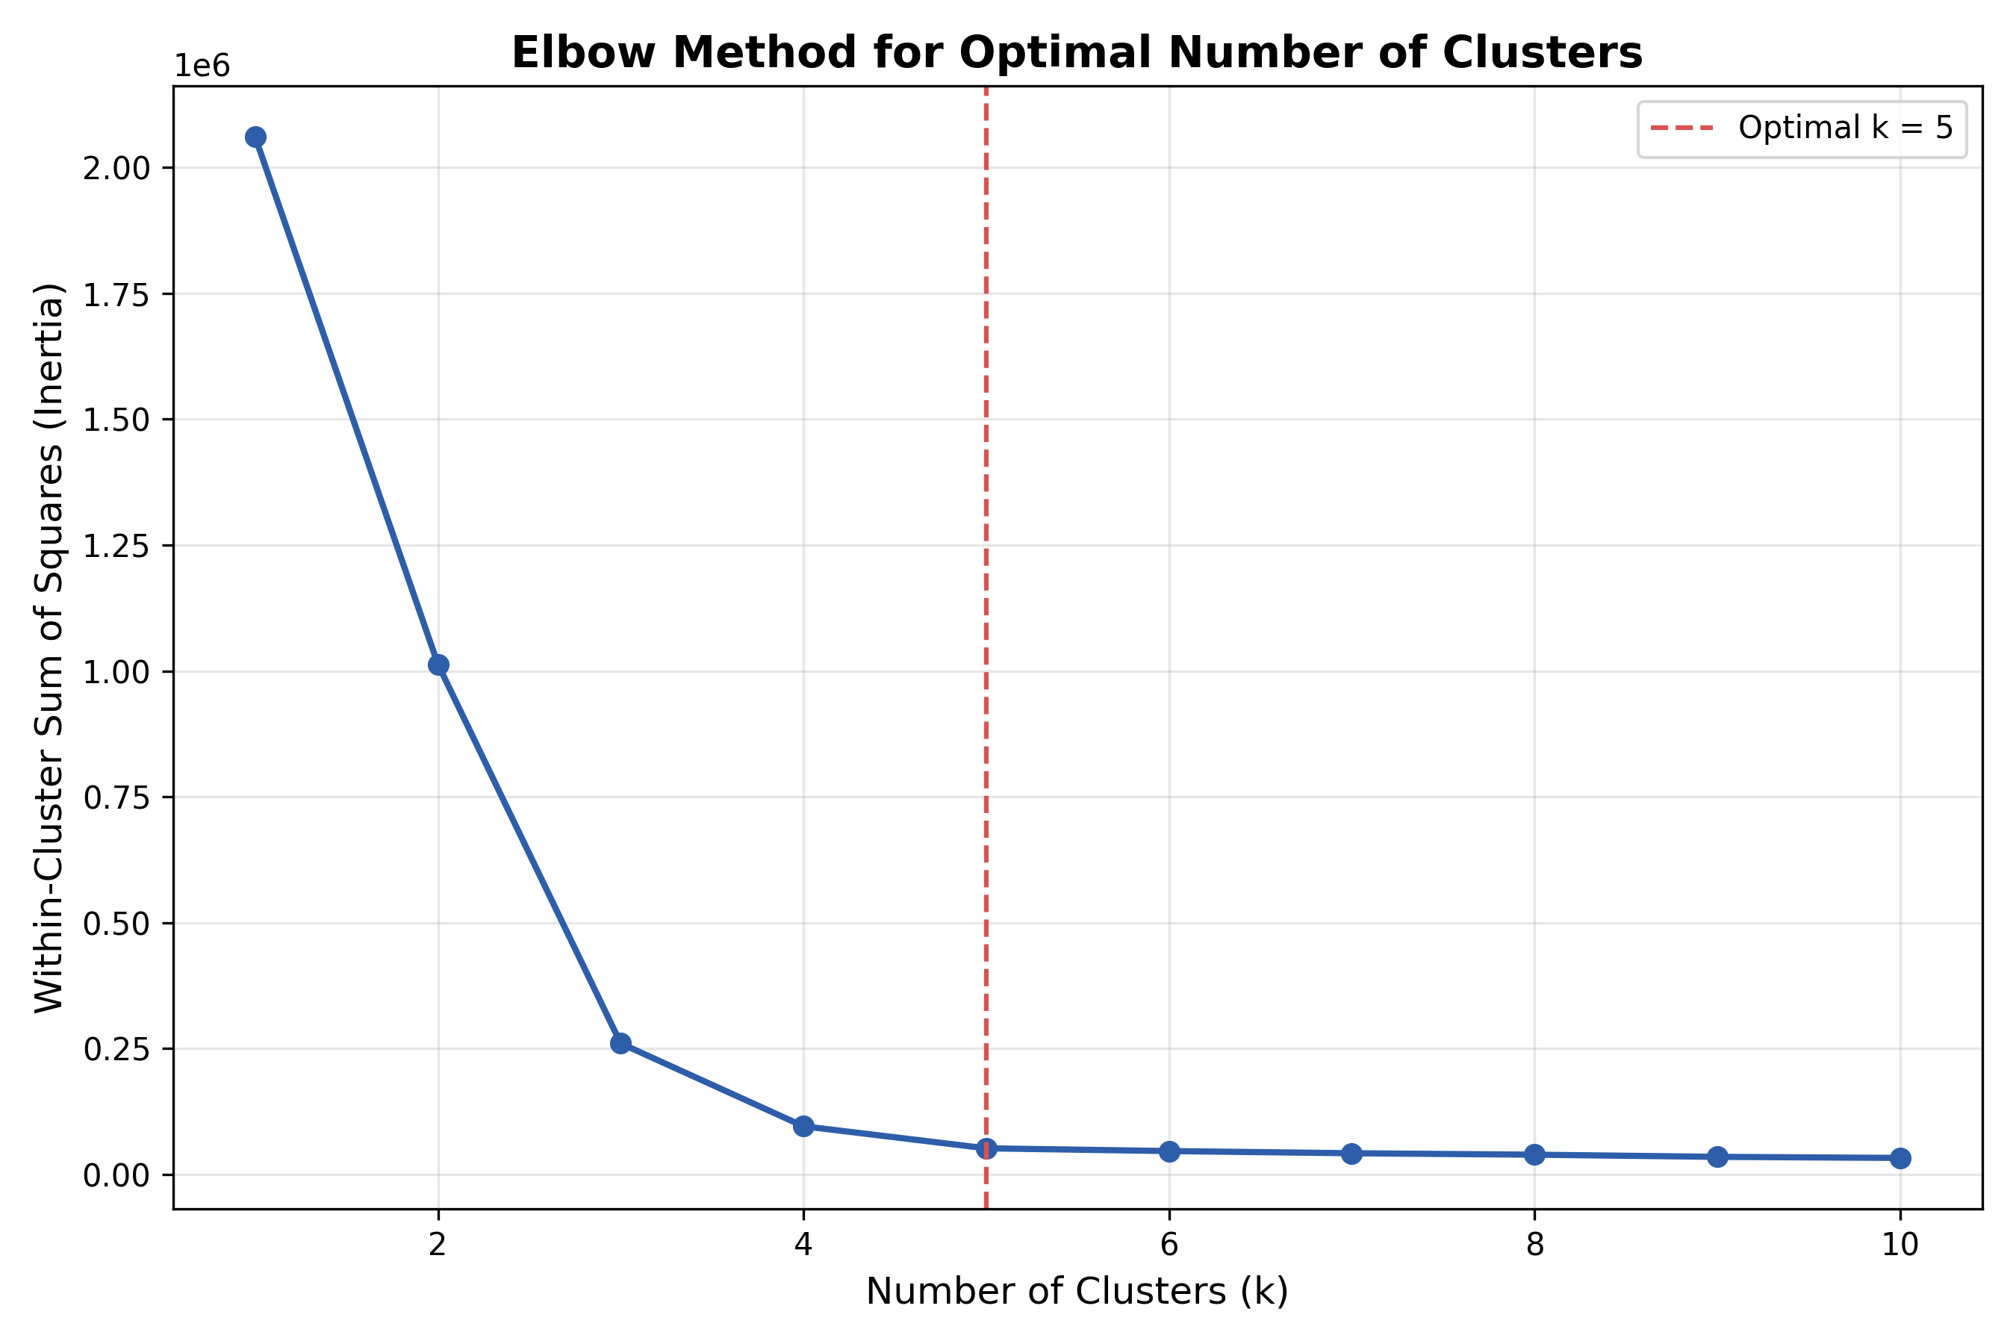
Algorithm
Technique
K-Means Clustering — partitions customers into k groups by minimizing within-cluster variance (WCSS). Hierarchical clustering used to validate structure.
Optimal k Selection
Elbow Method (WCSS vs. k) + Silhouette Score — both point to k = 5 as optimal (silhouette ≈ 0.61).
Elbow Method: optimal k = 5

Slide 6
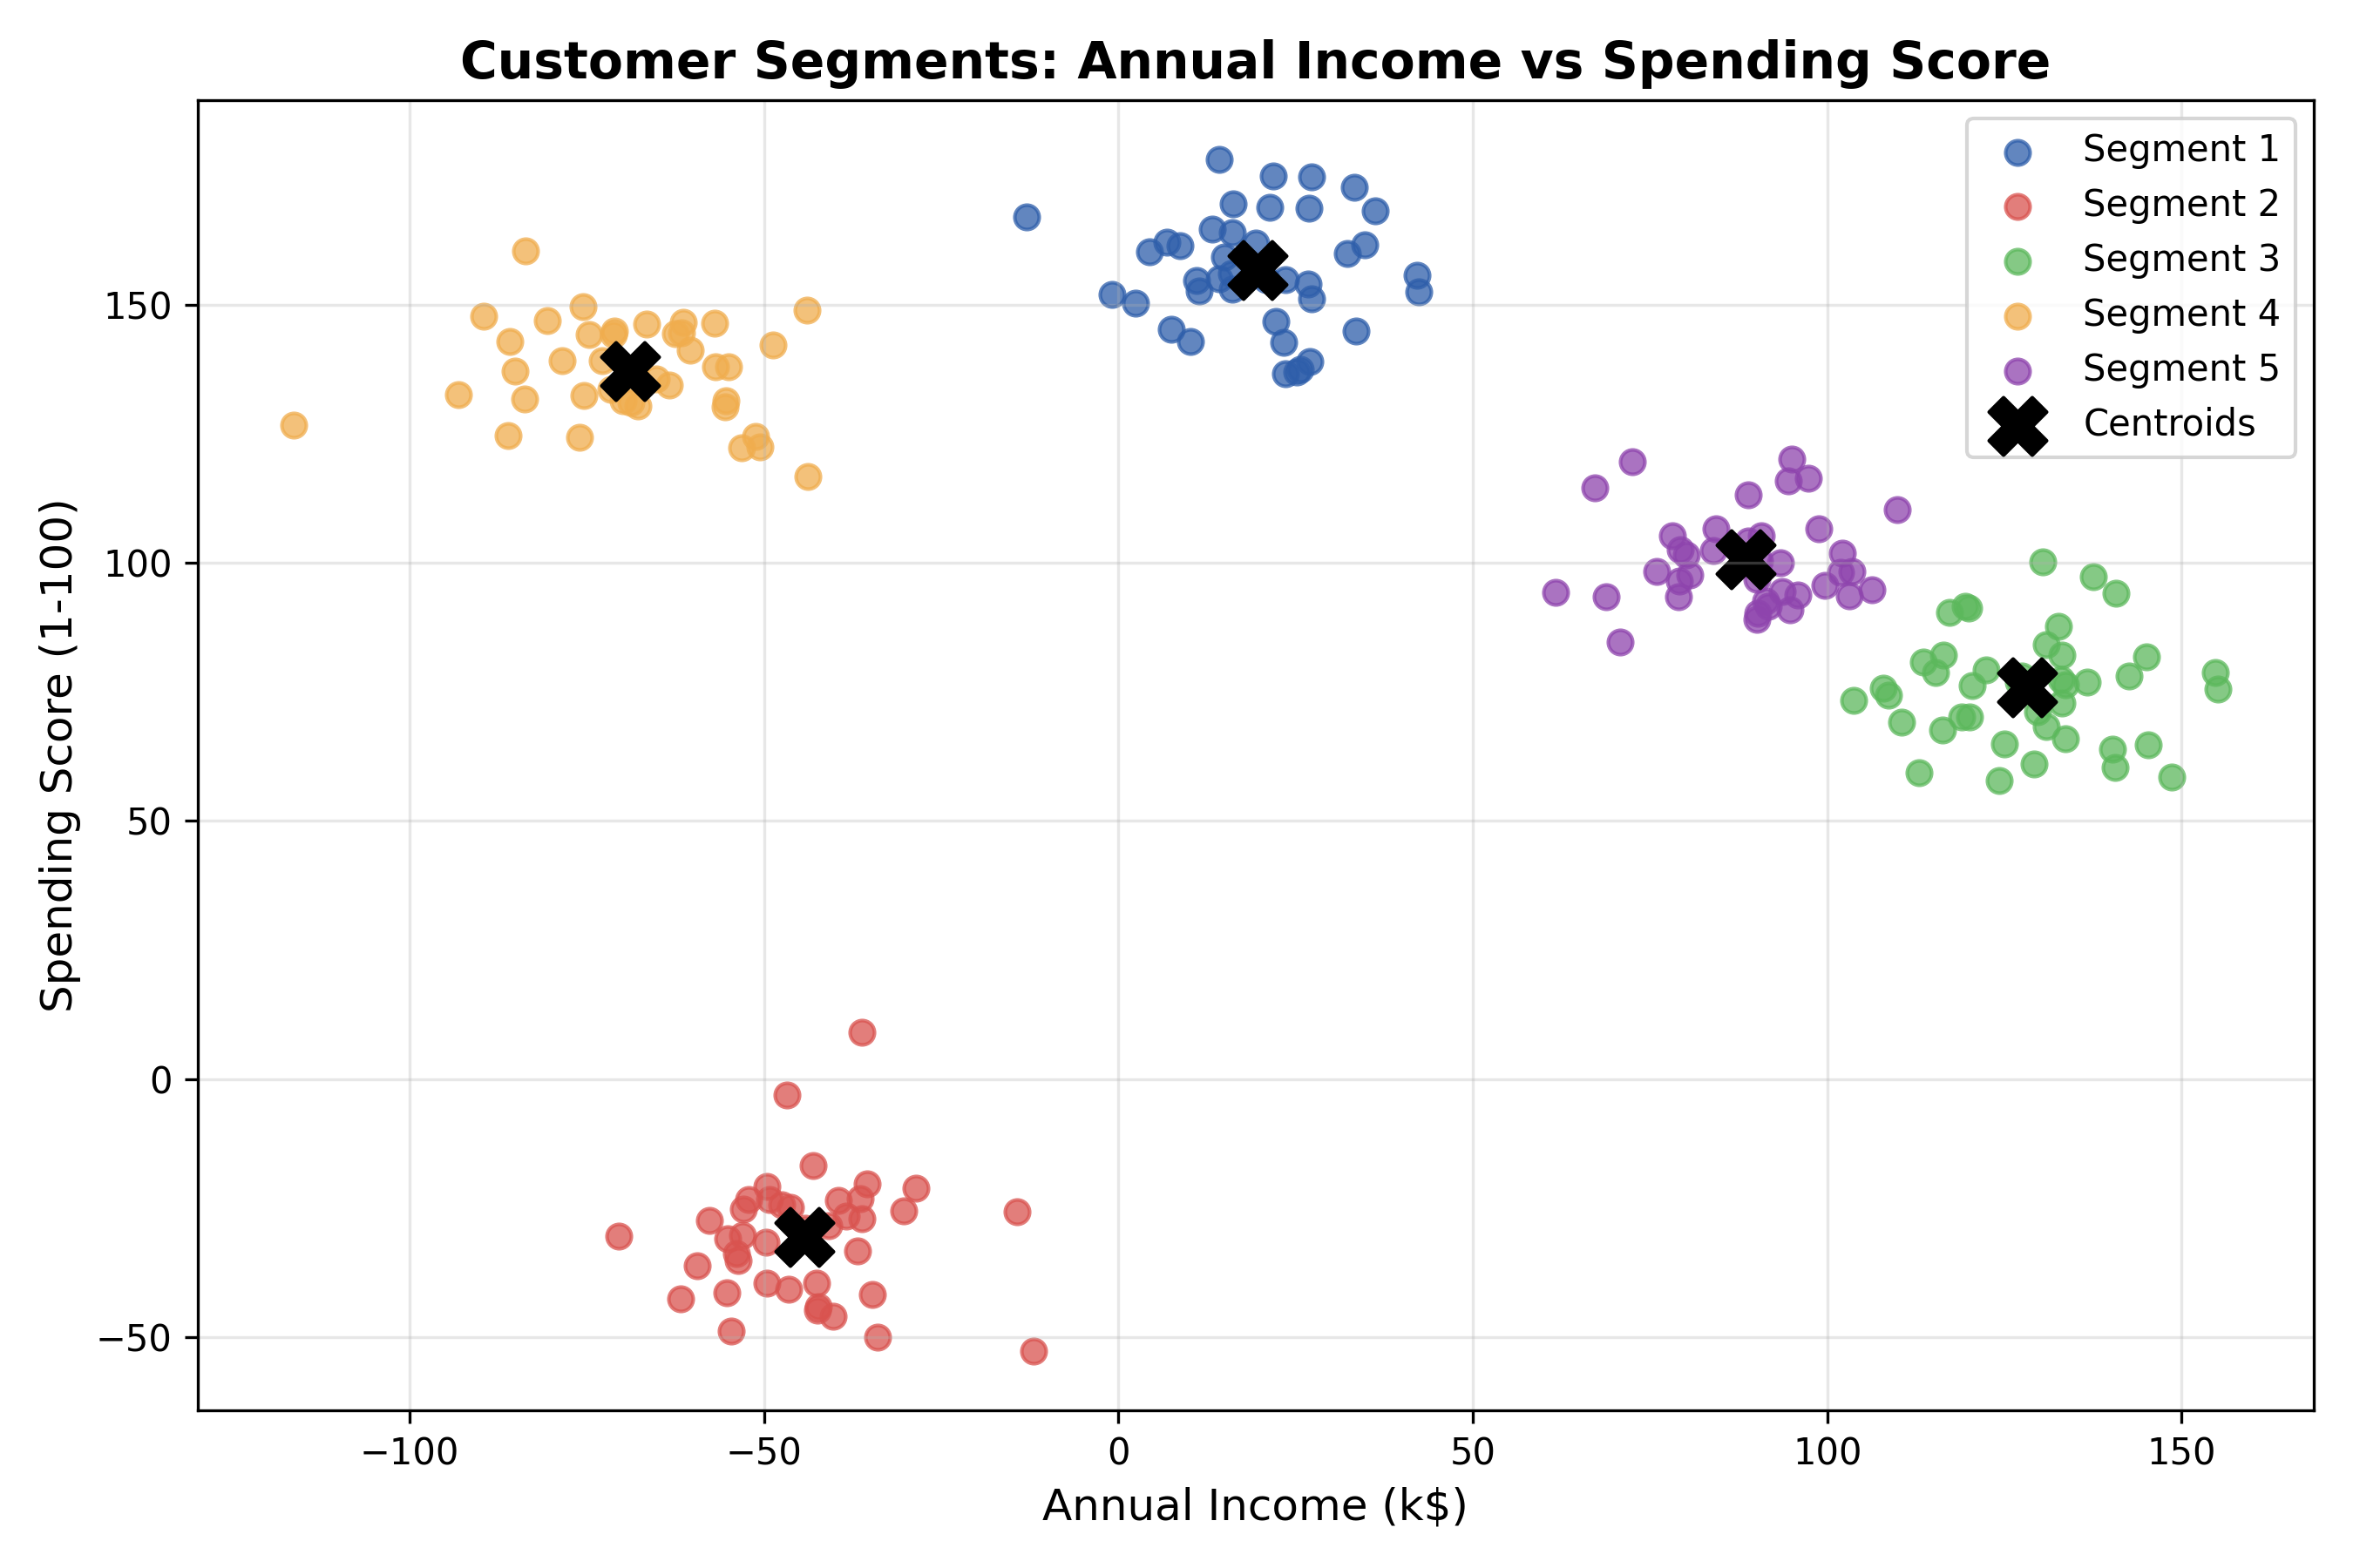
Results
Cluster | Profile | Count
0 | High Income - Low Spend | 41
1 | High Income - High Spend | 49
2 | Low Income - High Spend | 38
3 | Low Income - Low Spend | 38
4 | Average Customers | 34
Silhouette Score at k=5: ≈ 0.61 (well-separated clusters)

Slide 7
Conclusion
K-Means successfully separated customers into 5 distinct, well-validated segments
Clear business labels: High/Low Income × High/Low Spend, plus an Average group
Enables targeted marketing, loyalty programs, and re-engagement campaigns
Foundation for future work: real-time segmentation, predictive customer value

