Slide 1

FULL-STACK PROJECT
Vehicle Driver Mapping System
A fleet assignment platform with an on-premise AI assistant that answers questions in plain English
Spring Boot 4
Angular 21
PostgreSQL 16
Local LLM (Ollama)
Docker
[Your name] · [Institution / course] · [Date]
Notes:
Introduce the project: a complete web platform for mapping drivers to vehicles over time, built with Spring Boot, Angular and PostgreSQL, plus an AI assistant that runs on our own server.

Slide 2
OVERVIEW
Agenda
01
Problem & objectives
06
Frontend
Why the system is needed
Angular pages and UX
02
Solution & users
07
AI assistant
Admin, driver and AI roles
Local LLM with tool calling
03
Architecture & stack
08
Quality & security
How the pieces fit
Tests, CI, safeguards
04
Database & business rules
09
Deployment
Data model and scheduling logic
Docker and free cloud hosting
05
Backend & REST API
10
Results & future scope
Layers, endpoints, errors
Outcomes and next steps
2
Notes:
Ten parts: problem, solution, design, the AI layer, quality, deployment and results.

Slide 3



PROBLEM STATEMENT
Fleet schedules live in sheets and calls
Double bookings
Slow answers
Drivers left out
The same car is promised to two drivers, or one driver is booked on two cars at once.
“Who has the Alto right now?” means searching sheets or calling around.
Drivers can’t see, accept or reject their assignments in one place.
Goal: one source of truth for who drives which vehicle, and when, that anyone can query in plain English.
3
Notes:
Frame the pain points. Each one maps to a feature: overlap rules, the AI assistant, and the driver portal.

Slide 4





OBJECTIVES
What we set out to build
Manage the fleet
Register drivers and vehicles; send, accept, reject and cancel time-boxed assignments.
Enforce the rules
Never allow overlapping bookings for a vehicle or a driver.
Answer questions instantly
An AI assistant that answers “Who is driving the Alto TS 09 AB 1234?” from live data.
Keep data private
Run the language model on our own server; no third-party chatbot API.
Ship it for real
Automated tests, CI on every change, one-command deployment on free hosting.
4
Notes:
Five objectives. The rest of the talk shows how each was met.

Slide 5


SOLUTION
One platform, three ways to use it
Admin panel
Driver portal
AI assistant
Add, list and delete drivers and vehicles
Assign a vehicle to a driver for a time window
Filter assignments by status
Search drivers by name or phone
Unassign; find nearby on-duty drivers
Self-registration with a password
Secure login (BCrypt)
See pending and accepted assignments
Accept or reject requests in one click
Ask questions in plain English
Answers from live database data
Shows which lookups it used
Runs fully on our own server
5
Notes:
Three kinds of user. Admins manage the fleet, drivers respond to requests, and anyone can ask the AI assistant.

Slide 6



ARCHITECTURE
Four components, clear boundaries
Angular 21 UI
HTTP /api (JSON)
Spring Boot API
JPA / JDBC
PostgreSQL 16
Admin pages, driver portal, AI chat (browser)
REST controllers, services, rules, AI orchestration
Drivers, vehicles, assignments (Flyway schema)
question + tools
tool calls
Ollama LLM
Key principle
Llama 3.2 / Qwen 2.5 with tool calling
The LLM never touches the database. It can only request read-only lookups that the API runs.
In production, nginx serves the UI and proxies /api, so only port 80 is public.
6
Notes:
The browser only talks to the Spring Boot API. The API owns all data access through JPA. For AI questions, the API sends the question and tool definitions to Ollama; the model replies with tool calls, which the API executes and sends back.

Slide 7

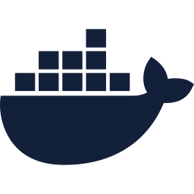

TECHNOLOGY STACK
Chosen for reliability and zero cost
FRONTEND
BACKEND
DATABASE
Angular 21 + TypeScript
Spring Boot 4, Java 21
PostgreSQL 16 + Flyway
Standalone components, signals, zoneless change detection
Spring MVC, Data JPA, Bean Validation, RestClient
Versioned SQL migrations, constraints enforced in the DB
AI
DELIVERY
QUALITY
Ollama + Llama 3.2 / Qwen 2.5
Docker Compose, nginx
JUnit 5, MockMvc, GitHub Actions
Open-source models, native tool (function) calling
Whole stack in one command; nginx serves the SPA
Tests and a production build on every pull request
7
Notes:
Everything is open source and free to run. Java 21 and Spring Boot 4 for a robust API; Angular for a typed single-page app; PostgreSQL for integrity; Ollama to host the language model locally.

Slide 8
DATABASE DESIGN
Three tables with built-in integrity
drivers
assignments
vehicles
id bigint
PK
id bigint
PK
id bigint
PK
name varchar
driver_id → drivers
FK
make_model varchar
email unique
UQ
vehicle_id → vehicles
FK
license_plate unique
UQ
phone unique
UQ
start_time timestamp
password_hash bcrypt
end_time timestamp
location_x/y double
status SENT|ACC|REJ
Database-level safeguards
CHECK end_time > start_time
CHECK status in (SENT, ACCEPTED, REJECTED)
ON DELETE CASCADE on foreign keys
Indexes on (driver, start) and (vehicle, start)
Schema is created by a Flyway migration (V1__init_schema.sql) on first start; Hibernate only validates it.
8
Notes:
An assignment links one driver and one vehicle for a time window. Uniqueness, the time-window check and the allowed statuses are enforced by PostgreSQL itself, not just by Java code.

Slide 9


BUSINESS LOGIC
Assignment lifecycle and scheduling rules
Lifecycle
ACCEPTED
Driver accepts → the driver is scheduled on that vehicle for the window.
Admin creates request
SENT
REJECTED
Driver rejects → the request is closed. Admin can unassign at any time.
Vehicle rule
Driver rule
Time rule
When checked
A vehicle can’t have two overlapping ACCEPTED assignments.
A driver can’t hold two overlapping ACCEPTED assignments.
End time must be after start time (API and database).
On creating a request and again when the driver accepts it.
9
Notes:
Overlap is checked with a query: start < other.end and end > other.start, against accepted assignments only. A clash returns HTTP 409 with a clear message, e.g. 'Vehicle TS 09 AB 1234 is already assigned between ...'.

Slide 10



BACKEND
Layered Spring Boot design
Controllers
Consistent error handling
DriverController, VehicleController, AssignmentController, AuthController, AssistantController
400
Validation failed (field details)
Services
401
Invalid email or password
DriverService, VehicleService, AssignmentService: validation, overlap rules, transactions
404
Driver / vehicle not found
Repositories
409
Overlap or duplicate email / plate
Spring Data JPA interfaces with custom JPQL for overlap and time-window queries
DTOs (Java records) keep entities and password hashes out of API responses. A global @RestControllerAdvice maps exceptions to a uniform JSON error body.
PostgreSQL
Entities: Driver, Vehicle, Assignment (+ AssignmentStatus enum)
10
Notes:
Classic three layers. Services are transactional; read operations run read-only. Errors are mapped centrally so the frontend can show exact messages.

Slide 11
REST API
22 JSON endpoints under /api
Method | Endpoint | Purpose
GET / POST | /api/drivers | List drivers / register a driver
GET / PUT / DELETE | /api/drivers/{id} | Read, update, delete a driver
GET | /api/drivers/search?type=NAME|PHONE&term= | Search drivers
GET | /api/drivers/nearby?x=&y=&range=&at= | On-duty drivers near a point, nearest first
GET | /api/drivers/{id}/assignments?status= | One driver’s assignments
POST | /api/auth/driver/login | Driver login (BCrypt check)
GET / POST / PUT / DELETE | /api/vehicles[/{id}] | Manage vehicles
GET / POST | /api/assignments | List / create assignment requests
GET | /api/assignments/search?type=&term=&status= | Assignments by driver and status
POST | /api/assignments/{id}/accept | reject | Driver’s response
DELETE | /api/assignments/{id} | Unassign
POST / GET | /api/ai/ask · /api/ai/status | Ask the assistant · model status
11
Notes:
All endpoints speak JSON. Request bodies are validated with Bean Validation annotations; dates use ISO-8601 local date-times.

Slide 12

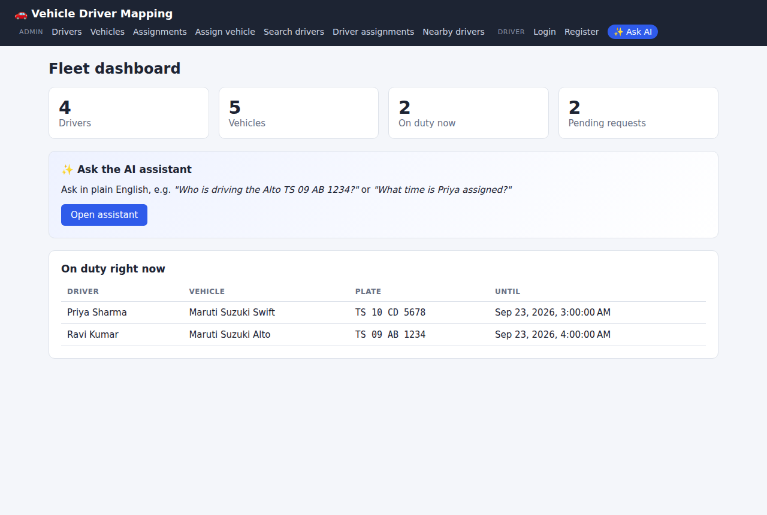



FRONTEND
Angular single-page app
12 routed pages
Dashboard, 7 admin pages, 3 driver pages, AI chat
Modern Angular
Standalone components, signals, zoneless change detection
Typed API layer
One ApiService; shared models mirror the backend DTOs
Driver session
Route guard protects “My assignments”; session in browser storage
Responsive
Works on phones and tablets as well as desktops
Fleet dashboard: live counts and who is on duty now
12
Notes:
The UI is a single-page app. During development the Angular dev server proxies /api to Spring Boot; in production nginx does the same.

Slide 13

THE AI LAYER
Ask the fleet a question in plain English
Private
No API fees
Grounded
Data never leaves our server
Open-source model, free to run
Answers come from the database
13
Notes:
We deliberately did not use a hosted chatbot API. The model (Llama 3.2 or Qwen 2.5) runs inside our deployment through Ollama.

Slide 14

AI ASSISTANT
How an answer is produced: tool calling
1. Question
2. LLM plans
3. API looks up
4. Answer
User asks: “Who is driving the alto TS09AB1234?”
Model sees the question, today’s date and 5 tool definitions; replies with a tool call.
Backend runs find_vehicle as a read-only JPA query and returns JSON.
Model writes the reply from that JSON only. UI shows the tools used.
Implementation details
Up to 4 tool rounds, then the model must answer · temperature 0.1 to stay factual · system prompt forbids inventing data
Last 6 chat turns are sent for follow-ups (“and his phone number?”) · talks to Ollama’s /api/chat over HTTP
14
Notes:
This pattern is called tool or function calling. The model never writes SQL. It can only choose one of our five tools, and the Java code decides what data comes back.

Slide 15


AI ASSISTANT
Five read-only tools the model can call
Tool | Input | Returns
find_vehicle | plate or model, optional time | Who drives it at that time, pending requests, schedule
find_driver | name, phone or email; status; day | Contact details, current vehicle, assignment times
list_assignments | status, day (optional) | Matching assignments across the fleet
check_availability | start, end (default: now) | Free vehicles and free drivers in the window
fleet_summary | none | Counts, pending requests, who is on duty now
Fuzzy plate matching
Lenient dates
Errors go back to the model
“ts09ab1234” = “TS 09 AB 1234”; “alto” lists every Alto
Accepts ISO, “today”, “tomorrow”, “now”
e.g. “‘query’ is required”, so it can ask the user
15
Notes:
Each tool is a Java method with a JSON schema description. The same tools also power the rule-based fallback.

Slide 16
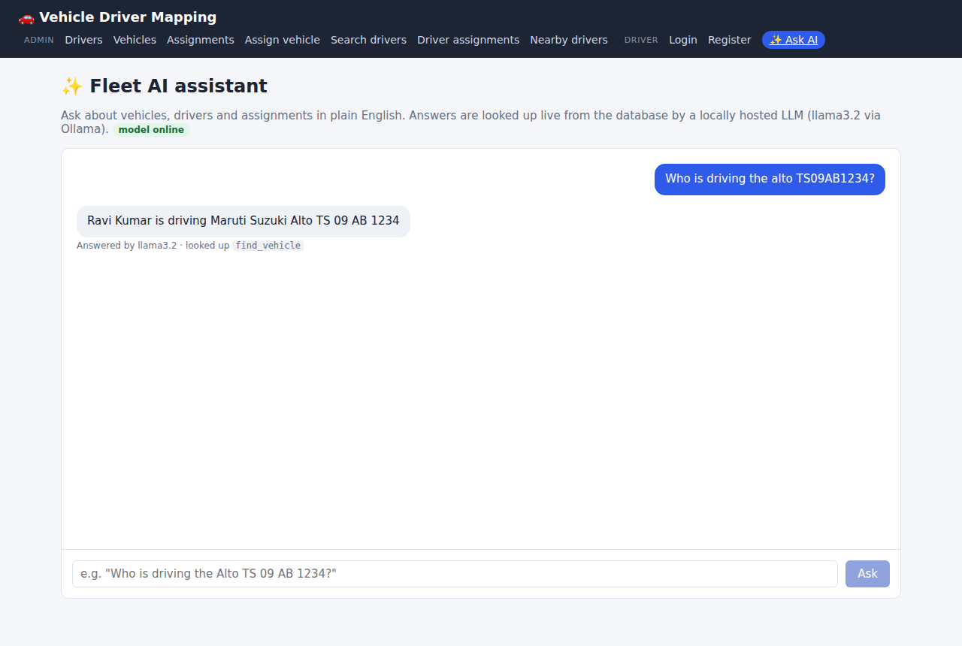
AI ASSISTANT
In action
Who is driving the alto TS09AB1234?
Ravi Kumar (9876543210) is driving the Maruti Suzuki Alto TS 09 AB 1234, assigned 10:00 to 18:00 today.
looked up find_vehicle
What is the time assigned to Priya?
Priya Sharma drives the Swift TS 10 CD 5678 today, 11:00 to 17:00. Pending: Hyundai i20 tomorrow, 18:00 to 22:00.
looked up find_driver
Examples use the built-in demo data. Answers are generated live from the database.
16
Notes:
These two are exactly the questions from the brief. Note the fleet has two Altos; giving the plate picks the right one.

Slide 17


AI ASSISTANT
Designed not to fail silently
Rule-based fallback
Handles small-model quirks
If the model is offline or errors, a deterministic responder answers common questions from the same tools, with a notice in the UI.
Some small models print a tool call as text; the assistant detects that JSON and still runs the tool.
Timeouts
Transparency
Configurable time limit per model call; the user always gets a response.
Every answer lists the tools used and whether the LLM or the rules answered.
17
Notes:
Resilience matters for a demo and in production: the page never shows a blank error because the model is down.

Slide 18

SECURITY
Safeguards built in from day one
Password hashing
Input validation
Read-only AI
BCrypt; hashes are never returned by the API
Bean Validation on every request body
The model can query, never modify, data
No secrets in code
Secret scanning
Minimal exposure
DB password generated on the server into a private .env
GitGuardian checks every pull request
Only port 80 is public; DB and LLM stay internal; CORS restricted
Known gap: admin pages do not require login yet; Spring Security with JWT is planned (see Future scope).
18
Notes:
Be upfront about the one open item: admin authentication.

Slide 19

QUALITY
Tested automatically on every change
17
4
2
0
automated backend tests
test suites
CI jobs per pull request
failing tests at release
AssignmentServiceTest
Overlap rules for vehicles and drivers, time validation, nearby-driver search
ApiIntegrationTest
Login checks the password, validation errors, duplicates (409), search endpoint
RuleBasedAssistantTest
“Who is driving the Alto…”, “time assigned to Priya”, availability, summary
FleetAssistantTest
Tool-calling loop with a scripted LLM, text tool calls, bad arguments, fallback
19
Notes:
Tests run on an in-memory H2 database in PostgreSQL mode with a fixed clock, so time-based answers are deterministic. GitHub Actions runs the backend tests and a production frontend build on every pull request.

Slide 20
DEPLOYMENT
One command, locally or in the cloud
Docker Compose stack
Local
nginx + Angular
:80 public
docker compose up --build
UI on http://localhost:4200, API on :8080
Spring Boot API
internal
PostgreSQL
internal volume
Free cloud: Oracle Cloud Always Free VM
Ollama
internal volume
curl -fsSL …/deploy/oracle/setup.sh | bash
Model pull
one-off job
Ampere A1: 4 CPU, 24 GB RAM, enough for the LLM. The script opens the firewall, installs Docker, builds, and downloads the model. Re-run to update.
20
Notes:
The same containers run everywhere. On the free Oracle VM, the database password is generated on the server and never committed.

Slide 21
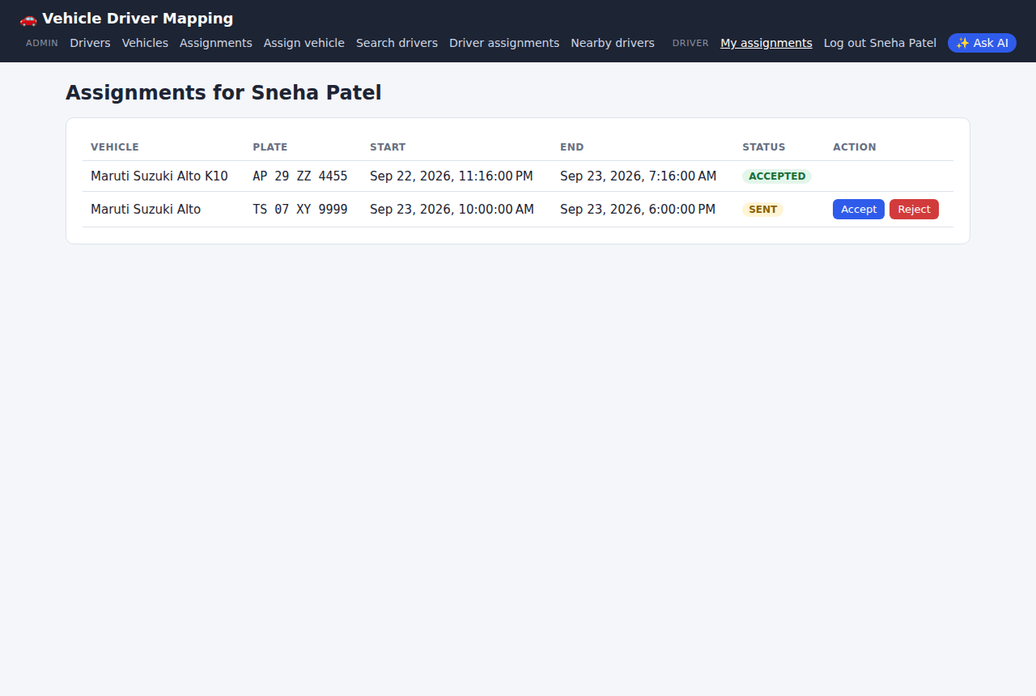
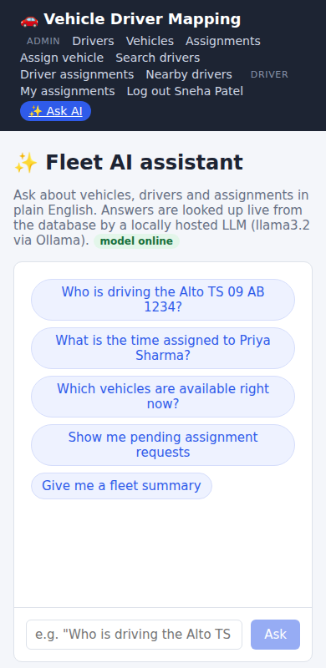
USER INTERFACE
Driver portal and mobile
Driver accepts a request (status turns ACCEPTED)
AI assistant on a phone
21
Notes:
Show that the same app works on a phone: open the deployed link during the demo.

Slide 22
ENGINEERING
Challenges and how we solved them
Challenge | Solution
LLMs can invent answers | Tool calling + strict system prompt: answers only from database results
Small models sometimes print tool calls as text | Detect JSON tool calls in the reply and execute them anyway
Model may be offline or slow | Timeouts + rule-based fallback using the same tools
Plates typed many ways (“ts09ab1234”) | Normalise plates; match ignoring spaces, dashes and case
“Now” makes tests flaky | Injected Clock; tests pin time to a fixed instant
Free hosting that can run an LLM | Oracle Always Free ARM VM (24 GB) with one-command setup
Keeping credentials out of Git | Env-based config; server-generated password; secret scanning in CI
22
Notes:
These are the most interesting problems we hit and the decisions they led to.

Slide 23
RESULTS
What the finished system delivers
22
12
5
REST endpoints
UI pages
AI tools
3
17
Free
database tables
automated tests
hosting and AI costs
23
Notes:
Numbers from the codebase. Everything runs on free, open-source software and free cloud hosting.

Slide 24

FUTURE SCOPE
Where the project goes next
Admin authentication
Domain + HTTPS
Spring Security with JWT and roles
Friendly address with a free TLS certificate
Live GPS
Faster AI
Real locations on a map instead of x/y coordinates
Larger model or GPU; streaming answers
Notifications
Voice & languages
SMS / email when a request is sent or accepted
Ask in Telugu or Hindi; speech input
24
Notes:
Admin authentication is the first priority before any public use.

Slide 25



Thank you
Questions and live demo
github.com/kanakamamidiakhil/Vehicle-Driver-Mapping-System
Live app: http://[YOUR_VM_IP]
Notes:
Keep the repository and live link on screen during questions. Demo logins: ravi@fleet.com / driver123.

