Slide 1

Customer Shopping Behavior Analysis
Uncovering spending patterns, segments, and product preferences from 3,900 transactions to guide strategic decisions.

Slide 2
Dataset at a Glance
3,900
18
Purchases
Columns
37
$59.76
Missing Values
Avg Purchase
Review Rating only
Features span demographics, purchase details, and shopping behavior.

Slide 3


Data Preparation in Python
Clean & Standardize
Imputed missing ratings, renamed columns to snake_case
Feature Engineering
Created age_group and purchase_frequency_days
Load to PostgreSQL
Cleaned DataFrame exported for SQL analysis

Slide 4
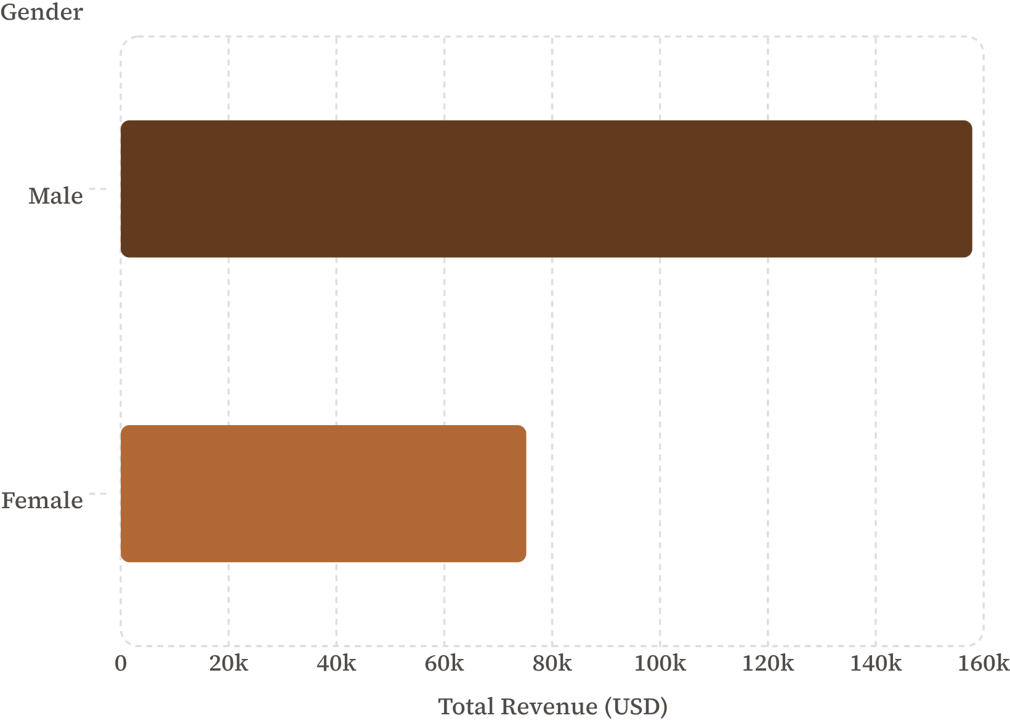

Revenue by Gender
Key Insight
Male customers generated 2.1× more revenue than female customers.
Top product: Blouse (171 orders)

Slide 5
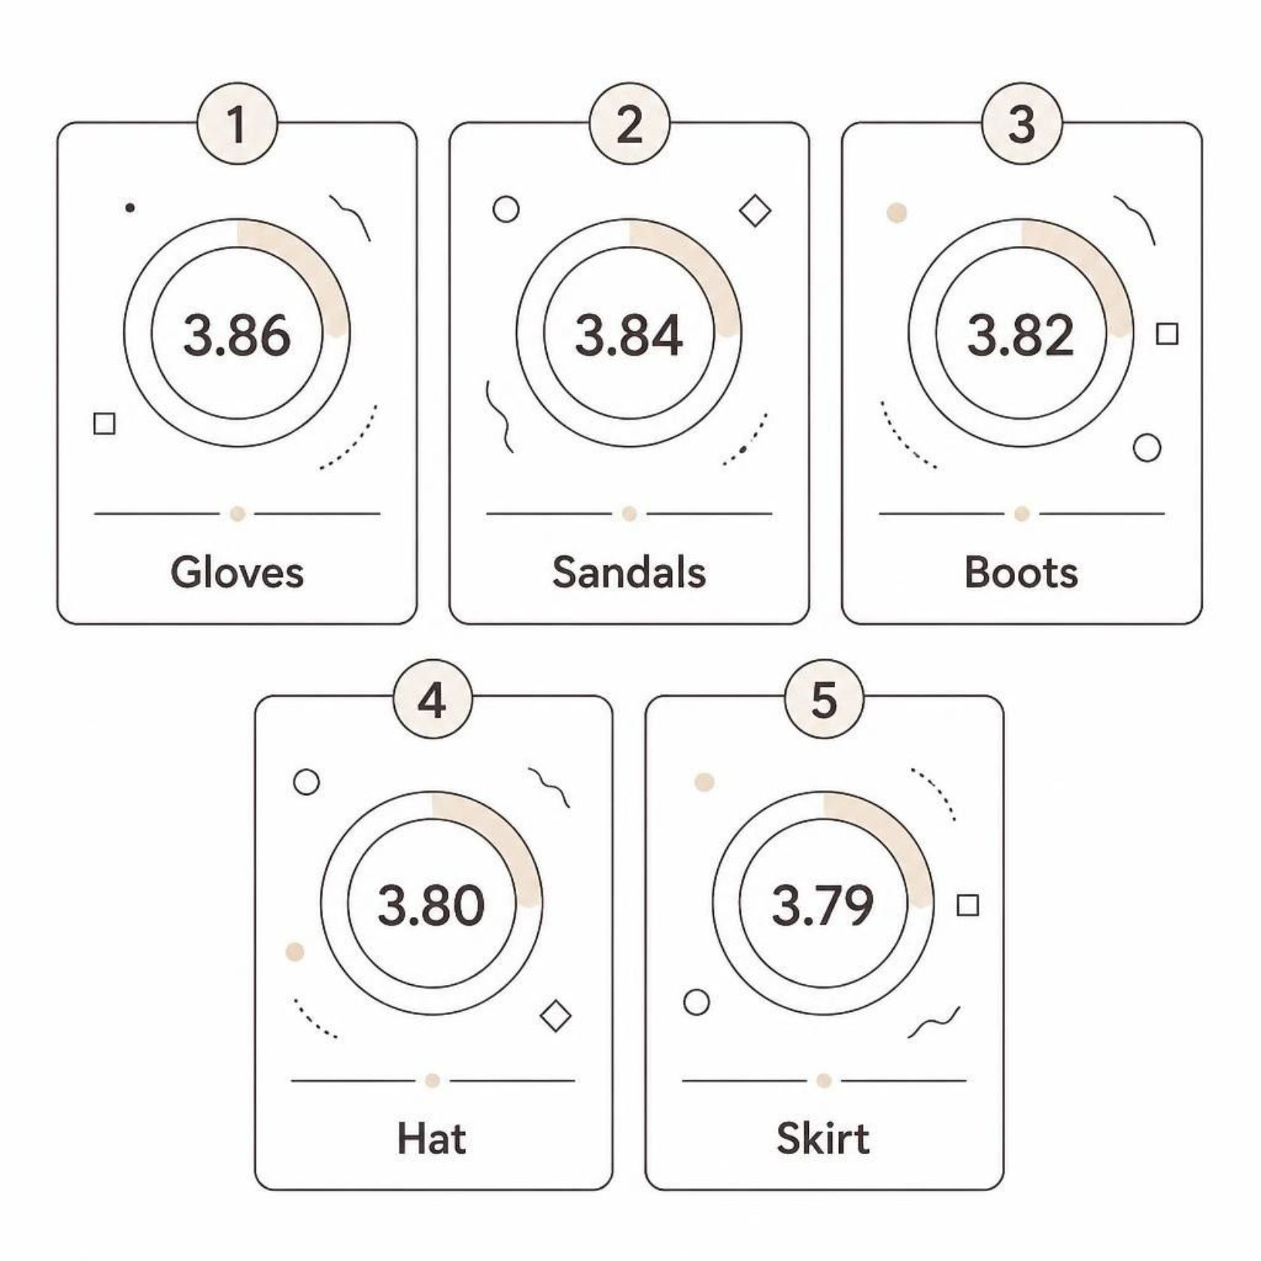

Product Ratings & Discount Sensitivity
Most Discount-Dependent Products
Hat
50% discounted
Sneakers
49.66% discounted
Coat
49.07% discounted

Slide 6
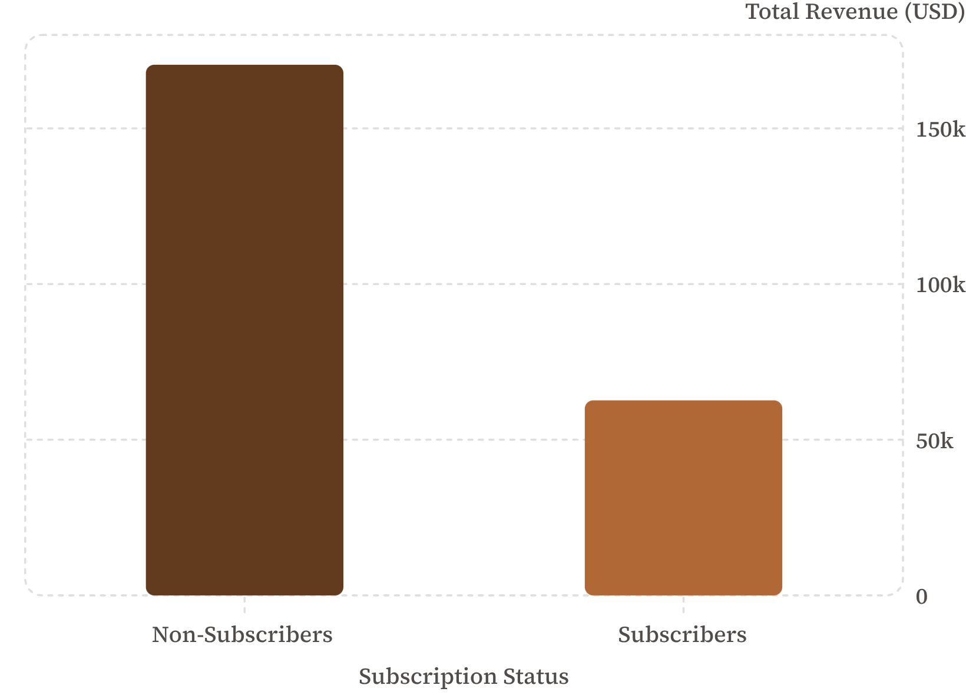
Subscribers vs. Non-Subscribers
Surprising Finding
Non-subscribers drive 73% of total revenue, despite near-identical average spend.
Avg spend: $59.87 (No) vs. $59.49 (Yes)

Slide 7

Customer Segmentation
🏆 Loyal
🔄 Returning
3,192 customers
625 customers
🆕 New
83 customers
Only 2518 repeat buyers are non-subscribers — opportunity to convert.

Slide 8
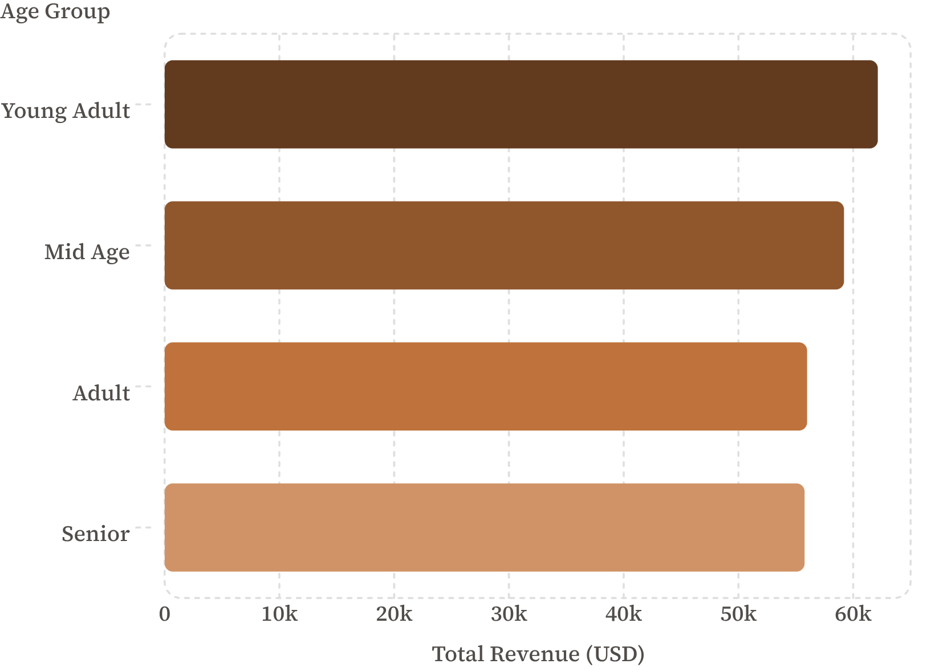

Revenue by Age Group
Takeaway
Young adults lead revenue, but spend is remarkably even across all age groups.
Avg age: 44 years (range 18–70)

Slide 9




Power BI Dashboard
Key Metrics
Avg Purchase $59.76 · Avg Rating 3.75 · 3.9K Customers
Interactive Filters
Subscription, Gender, Category, Shipping Type
Visual Charts
Revenue by age, top categories, subscription split

Slide 10
Business Recommendations
Boost Subscriptions
1
Promote exclusive subscriber benefits
Loyalty Programs
2
Reward repeat buyers → Loyal segment
Review Discount Policy
3
Balance sales lift vs. margin
Product Positioning
4
Highlight top-rated, best-selling items
Targeted Marketing
5
Focus on high-revenue age groups & express-shipping users

