Slide 1
ShiftSwap
Clinic shift swaps with manager approval
Bharath Reddy
Software Development Intern Hackathon
10 October 2026
Notes:
Introduce the clinic coverage problem. ShiftSwap lets colleagues request a handover while managers protect the scheduling rules. This is the actual submitted application, supported by the public repository.
Sources:
https://github.com/kanamakindhabharathreddy/shiftswap/blob/b13816e76bb8a8549f0b61fdc4290f6a4b8b8c6b/README.md

Slide 2
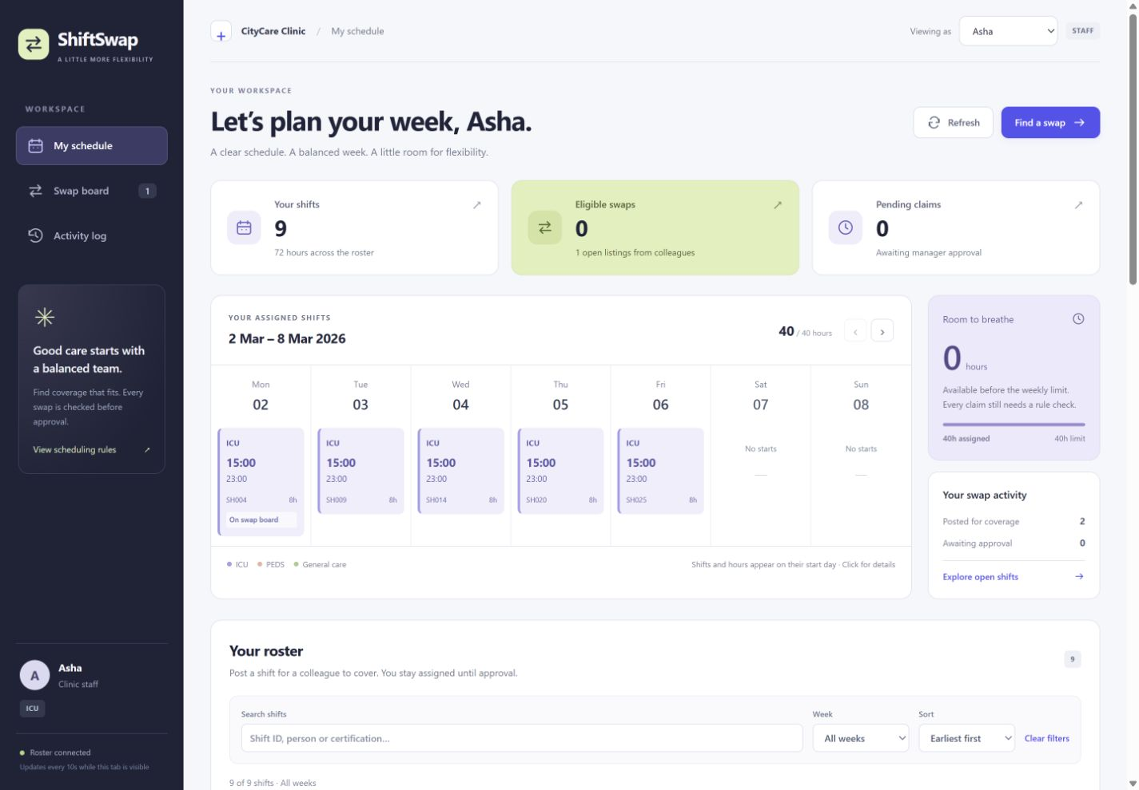
Staff workspace
Clinic coverage
Staff offer assigned shifts for a colleague to cover.
The calendar shows assignments and listing status.
The swap board explains eligibility before a claim.
Notes:
Use the screenshot to point out person selection, My schedule, Swap board and Activity log. Staff can post or withdraw from the roster or shift dialog. Pending claims appear separately. The screenshot is a product capture from development, not a promise about the current number of listings. Screenshot source: the local ShiftSwap application.
Sources:
https://github.com/kanamakindhabharathreddy/shiftswap/blob/b13816e76bb8a8549f0b61fdc4290f6a4b8b8c6b/public/app.js
https://github.com/kanamakindhabharathreddy/shiftswap/blob/b13816e76bb8a8549f0b61fdc4290f6a4b8b8c6b/public/index.html

Slide 3
Swap workflow
01
02
03
OPEN
CLAIMED
APPROVED
The owner posts a shift.
Eligible colleagues can claim it.
A colleague requests coverage.
The manager reviews the claim.
The manager rechecks the rules.
Approval assigns the claimant.
The original owner remains assigned until approval.
Unclaim or reject reopens a claim. The poster can withdraw an OPEN listing.
Notes:
Explain that a pending claim is not an assignment and consumes no assigned weekly hours. A shift has at most one OPEN or CLAIMED listing. Only the poster may withdraw OPEN listings. Only the claimant may unclaim. Managers alone approve or reject. Withdrawn listings remain in history, and the current owner may post again after a completed or withdrawn listing.
Sources:
https://github.com/kanamakindhabharathreddy/shiftswap/blob/b13816e76bb8a8549f0b61fdc4290f6a4b8b8c6b/store.js
https://github.com/kanamakindhabharathreddy/shiftswap/blob/b13816e76bb8a8549f0b61fdc4290f6a4b8b8c6b/test/shiftswap.test.js

Slide 4
Scheduling rules
01
The claimant must differ from the current owner.
02
The claimant must hold the required certification.
03
The proposed shift must not overlap assigned shifts.
04
Every nonoverlapping assignment needs at least 11 hours of rest.
05
Assigned hours, including the shift, must stay at or below 40 per week.
Exactly 11 hours and 40 hours pass. Weeks start Monday.
Notes:
All times are clinic-local. Overlap uses A.start < B.end and B.start < A.end. Each overnight shift belongs entirely to its start week. For an OPEN listing, report every applicable violation and identify conflicting shifts. Own-shift claims report only rule 1. Non-OPEN claims report only no longer available. Approval reruns rules 2 to 5 against current assignments. The real clock never affects eligibility.
Sources:
https://github.com/kanamakindhabharathreddy/shiftswap/blob/b13816e76bb8a8549f0b61fdc4290f6a4b8b8c6b/rules.js
https://github.com/kanamakindhabharathreddy/shiftswap/blob/b13816e76bb8a8549f0b61fdc4290f6a4b8b8c6b/test/shiftswap.test.js

Slide 5
Architecture and stack
Layer | Technology | Responsibility
Frontend | HTML, CSS, JavaScript | Calendar, listings and history
Backend | Node.js 24 HTTP server | API, permissions and validation
Storage | Built-in SQLite | Saved state and atomic updates
Testing | Node test runner | Rules, workflows and persistence
The browser exchanges JSON with the backend using fetch.
GET /api/state loads data. POST /api/actions submits a change.
Notes:
The project uses no React, Express or external npm packages. The small API fits Node's built-in HTTP server, and vanilla JavaScript keeps local setup simple. SQLite avoids a separate database service. The tradeoff is manual UI state management and a single JSON state document rather than normalized tables. Those choices suit this roster, not a large production deployment.
Sources:
https://github.com/kanamakindhabharathreddy/shiftswap/blob/b13816e76bb8a8549f0b61fdc4290f6a4b8b8c6b/package.json
https://github.com/kanamakindhabharathreddy/shiftswap/blob/b13816e76bb8a8549f0b61fdc4290f6a4b8b8c6b/server.js
https://github.com/kanamakindhabharathreddy/shiftswap/blob/b13816e76bb8a8549f0b61fdc4290f6a4b8b8c6b/store.js
https://github.com/kanamakindhabharathreddy/shiftswap/blob/b13816e76bb8a8549f0b61fdc4290f6a4b8b8c6b/README.md

Slide 6
Persistence and concurrent actions
Saved state
SQLite stores people, shifts, listings and action history.
First startup
The backend loads the organizer seed only when no saved state exists.
Atomic approval
One transaction saves the assignment, listing status and history together.
Competing requests
BEGIN IMMEDIATE serializes writes before reading and validating state.
Notes:
The database path defaults to data/shiftswap.sqlite. Initialization and each domain action use BEGIN IMMEDIATE. Each action reads the latest state, validates, mutates, adds history, updates the JSON document and commits. A database failure rolls back the whole operation. A validation refusal preserves assignments and listings while recording the refusal. Competing claims cannot both succeed. External hosting needs persistent storage.
Sources:
https://github.com/kanamakindhabharathreddy/shiftswap/blob/b13816e76bb8a8549f0b61fdc4290f6a4b8b8c6b/store.js
https://github.com/kanamakindhabharathreddy/shiftswap/blob/b13816e76bb8a8549f0b61fdc4290f6a4b8b8c6b/test/persistence.test.js
https://github.com/kanamakindhabharathreddy/shiftswap/blob/b13816e76bb8a8549f0b61fdc4290f6a4b8b8c6b/test/http.test.js

Slide 7
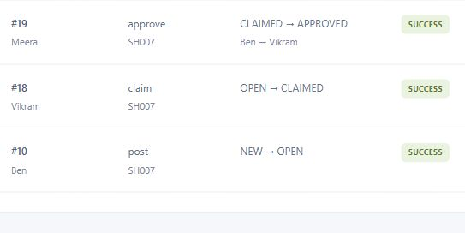
Verification results
32
SH007 after a backend restart
Vikram retained the assignment.
The listing remained APPROVED.
automated tests passed
Exact rule boundaries
Permissions and state transitions
Concurrent claims and approvals
Restart persistence and rollback
2,000 simulated actions also preserved roster integrity.
Notes:
The 32 tests include a 140-case role/action/status matrix, inclusive 11-hour and 40-hour limits, overnight weeks, combined refusal reasons, approval revalidation, cross-process concurrency, immediate durability, seed independence and forced-write rollback. A separate 2,000-action simulation checked invariants. The live database was compared before and after a real restart using npm start. SH007 remained assigned to S8, Vikram, with listing l10 APPROVED. Event 18 recorded the claim and event 19 recorded Meera's approval. The screenshot captures those actual events. Later demo actions do not alter this restart evidence. Screenshot source: local application Activity log filtered to SH007.
Sources:
https://github.com/kanamakindhabharathreddy/shiftswap/blob/b13816e76bb8a8549f0b61fdc4290f6a4b8b8c6b/VERIFICATION.md
https://github.com/kanamakindhabharathreddy/shiftswap/blob/b13816e76bb8a8549f0b61fdc4290f6a4b8b8c6b/PERSISTENCE_AUDIT.md
https://github.com/kanamakindhabharathreddy/shiftswap/blob/b13816e76bb8a8549f0b61fdc4290f6a4b8b8c6b/test/persistence.test.js

Slide 8
Run and review
Local setup
Demo walkthrough
Node.js 24 or newer
npm start
http://localhost:3000
npm test
Ben posts SH001.
Uma claims it.
Meera approves it.
The activity log records the handover.
Public repository
github.com/kanamakindhabharathreddy/shiftswap
Notes:
Clone the public repository, open its directory and run npm start. No npm install, API keys or paid services are needed. The demo assumes a fresh seed-based installation. Preserve existing saved data. README documents assumptions and run steps. AI_USAGE documents coding and polishing assistance from Codex and Astra. The application implementation commit is b13816e. Presentation and documentation updates follow it. No deployment link is claimed. The presentation accompanies the GitHub submission and is included under docs/ in the repository.
Sources:
https://github.com/kanamakindhabharathreddy/shiftswap/blob/b13816e76bb8a8549f0b61fdc4290f6a4b8b8c6b/README.md
https://github.com/kanamakindhabharathreddy/shiftswap/blob/b13816e76bb8a8549f0b61fdc4290f6a4b8b8c6b/AI_USAGE.md

