Slide 1

HOUSE PRICE PREDICTION
Prepared by
- Arpan Kanani

Slide 2
CONTENTS
Introduction
Proposed System
System Flow
Tools and Technology
Implementations and Enhancements
Limitations and Future Scope
Conclusion
References

Slide 3
INTRODUCTION
In day to day life population is increasing, everyone wants house for living.
Real estate is the least transparent industry in our ecosystem.
Housing prices keep changing day in and day out and sometimes are hyped rather than being based on valuation.
Predicting housing prices with real factors is the main aim of our project.
Here we aim to make our evaluations based on every basic parameter that is considered while determining the price.

Slide 4
PROPESED SYSTEM
There are several approaches that can be used to determine the price of the house, one of them is the prediction analysis.
Based on data, several regression techniques are used to predict the price.
This prediction is based on certain variables like location of house, area of house, number of bath and bedroom.
For accurate result we used different data visualization concepts like data cleaning, feature engineering etc.
We used K fold cross validation algorithm and GridsearchCV Method for measure accuracy of model.

Slide 5
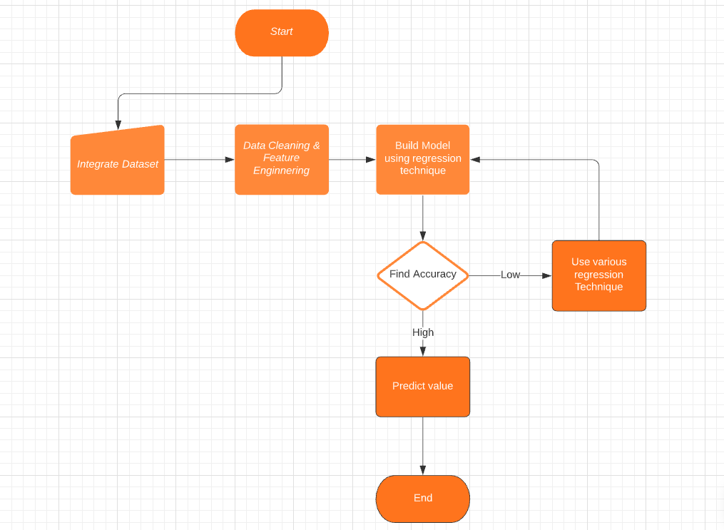
SYSTEM FLOW

Slide 6
TOOLS AND TECHNOLOGY
Editor : PyCharm, Jupyter Notebook
Languages : Python, HTML/CSS/JavaScript
Library : Numpy, Pandas, Matplotlib, Sklearn, Flask
Cloud: Aws EC2 System
Tools: Nginx, Postman

Slide 7
IMPLEMENTATION
We used Bangalore house price analysis dataset from Kaggle.
Three regression techniques used for accuracy in results.
Linear Regression
Lasso Regression
SVM
Neural Networks
Finding accuracy of regression model we used K fold cross validation algorithm.
Our main goal is to get more accurate result. So Gridsearchcv method is use to find out best model.

Slide 8
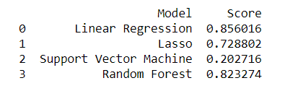
IMPLEMENTATION
We can find that the linear regression is suitable for our project.

Slide 9
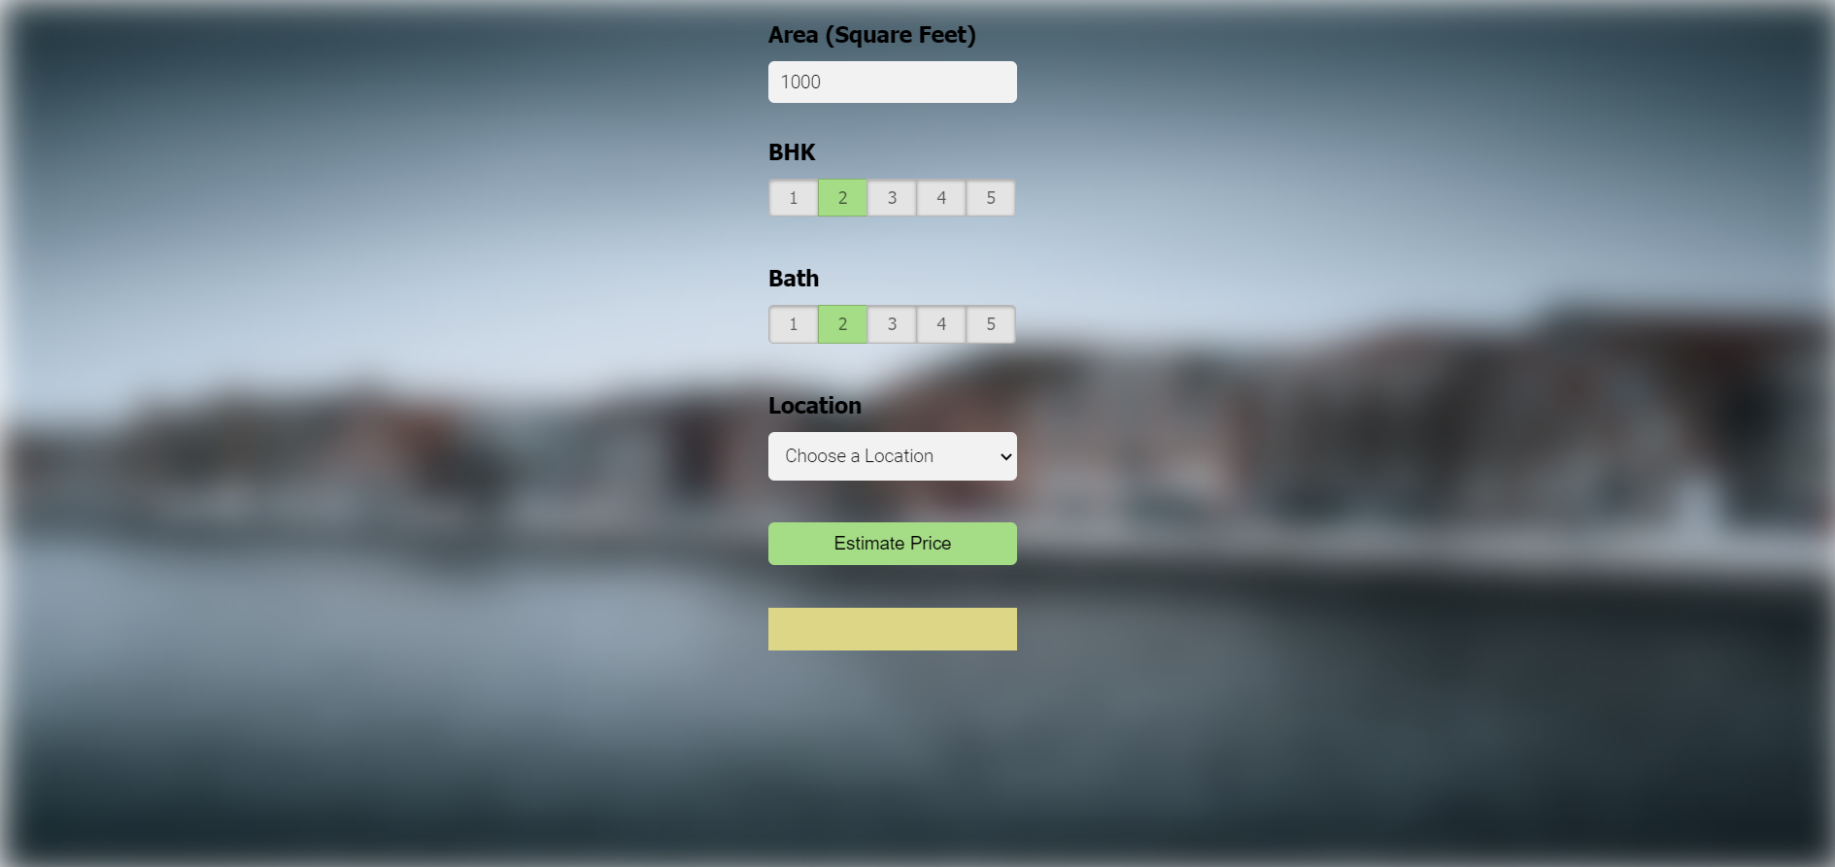
USER INTERFACE

Slide 10
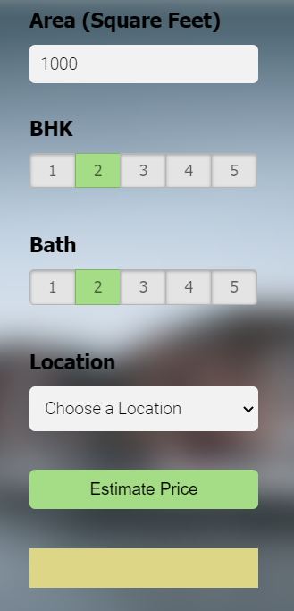
USER INTERFACE

Slide 11
LIMITATION AND FUTURE ENHANCEMENTS
Limitations
Here we used only Bangalore city database.
Price of houses is predicted through only basic features location, area, numbers of bedrooms and bath.
Future Enhancements
Expand the Dataset for other cities.
Improve the model accuracy.
Add more filters.

Slide 12
CONCLUSION
We have managed that how user get their dream house price more accurate so they get more optimal solutions for their problems that is facing while buying houses.
Include All the more functionalities under the model, we can give choices for client with select a location of particular area according to dataset and get their price of house.

Slide 13
REFERENCES
"House Price Prediction Using Machine Learning" by G. Naga Satish, Ch. V. Raghavendran, M.D.Sugnana Rao, Ch.Srinivasulu.
https://flaskdoc.readthedocs.io/en/latest/
https://matplotlib.org/stable/contents.html
http://cs229.stanford.edu/proj2016/report/WuYu_HousingPrice_report.pdf
https://towardsdatascience.com/predicting-hdb-housing-prices-using-neural-networks-94ab708cccf8

Slide 14
Thanks!
Any questions?

