Slide 1

Trash2 Points

Slide 2


Agenda
Introduction to Trash2Points | 3
PREAMBLE | 4
Review of Literature | 5
Technical Discription | 6
System Design | 7
DataBase Design | 12
System Testing | 22
Technology Used | 24
System Architecture | 25
Trash2Points Features | 26
Security and Privacy | 32
Future Enhancements | 33
Conclusion | 34

Slide 3
Users: Report garbage spots by uploading images, adding descriptions, and marking locations.
Goal: Promote cleanliness and create a bridge between citizens and authorities.
Introduction to Trash2Points
A smart waste-reporting application with User and Admin panels.
Admins: Manage reports, update status (Pending, Cleaned, Rejected), and take action.

Slide 4
Encourages citizens to report garbage/unclean areas.
Uses mobile (Android – Kotlin) and web (MERN stack) technologies.
Provides easy reporting with photo, location, and description.
Ensures transparency through report tracking and status updates.
Preamble
Promotes cleanliness and community participation.

Slide 5
Swachhata App
Developed by the Indian Government.
Allows reporting of garbage, drains, and road damage
Users can upload photos, add descriptions, and mark location.
Review Of
Literature

Slide 6
Hardware Requirements
Android (User Panel): Android 8.0+, 2GB RAM, Camera + GPS, Internet.
Admin Panel (Web): Intel i3+, 4GB RAM, Browser (Chrome/Firefox), Internet.
Technical
Discription
Sofware Requirements
Android App: Android Studio, Kotlin, Google Maps SDK, Internet permission.
Admin Panel: VS Code, React.js, Tailwind/Material UI, Node.js, Express.js, Retrofit.

Slide 7
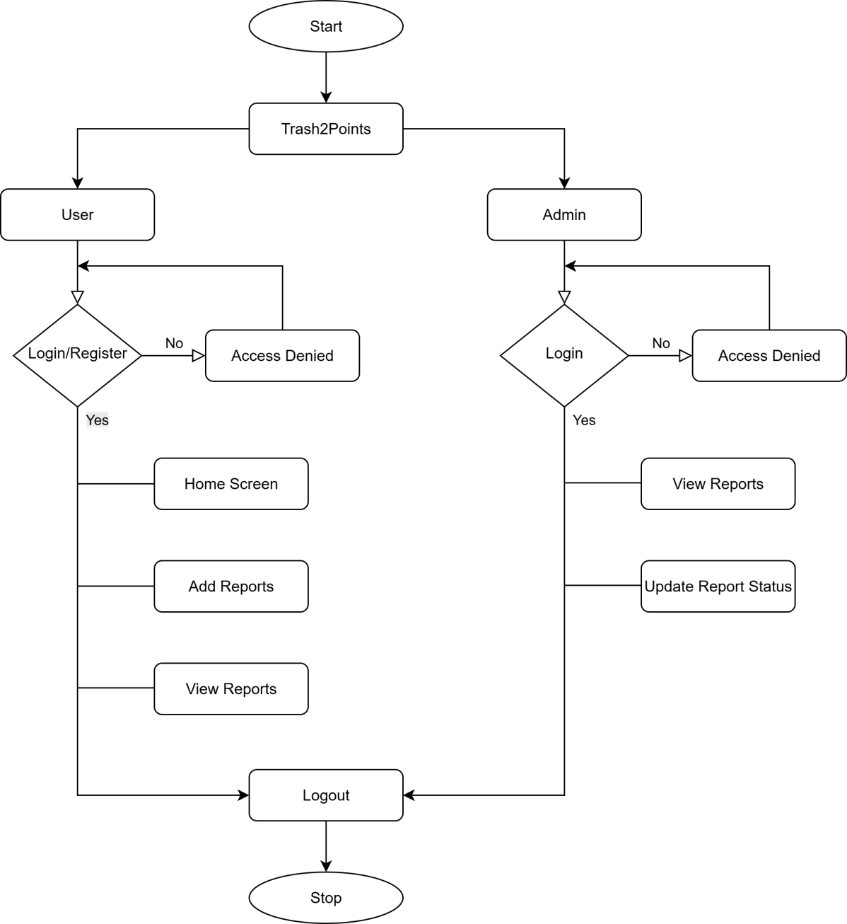
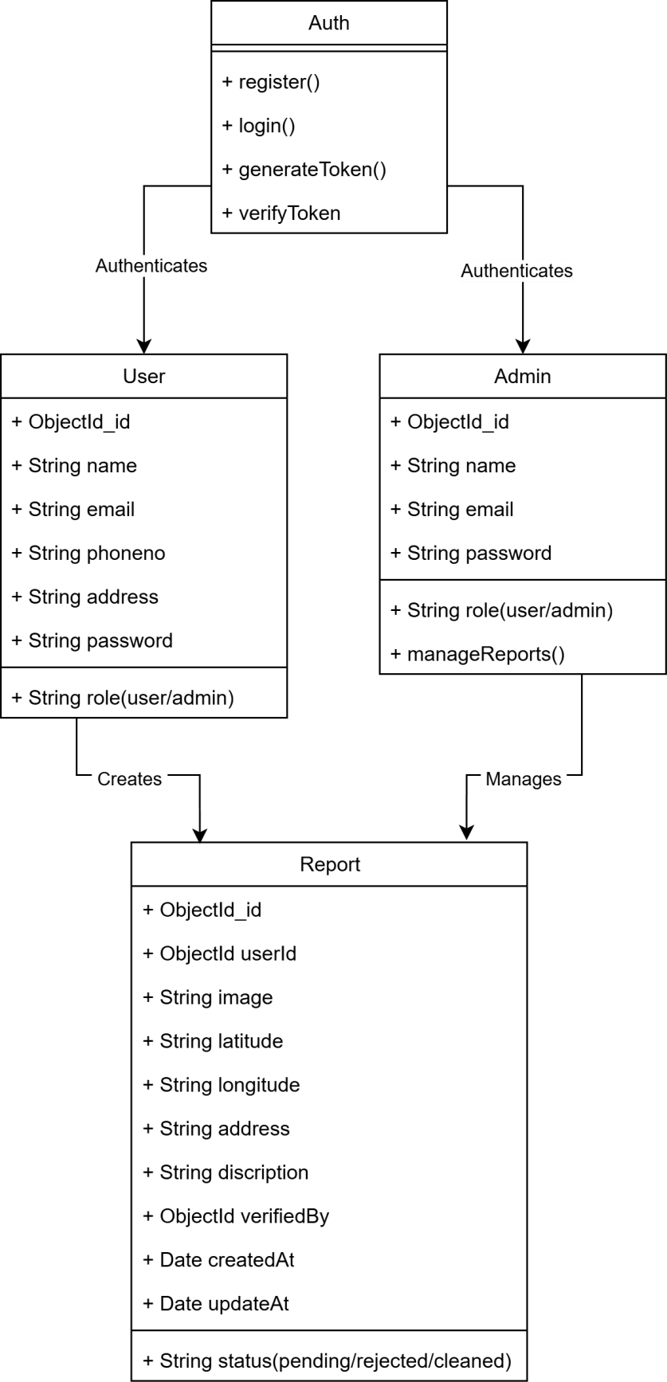
System
Design
Flow Chart
Class Diagram

Slide 8
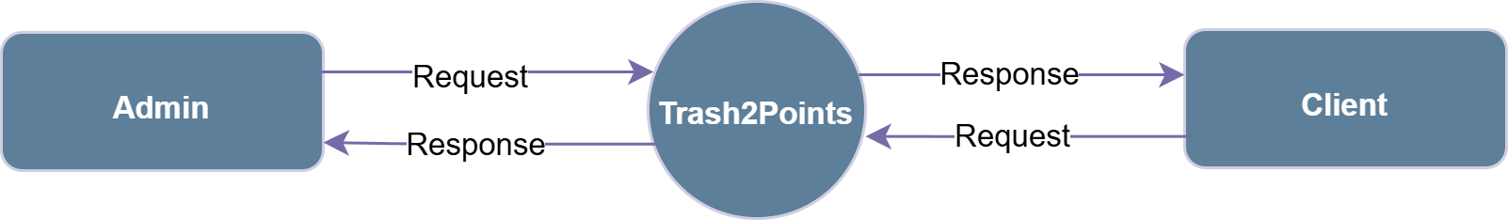
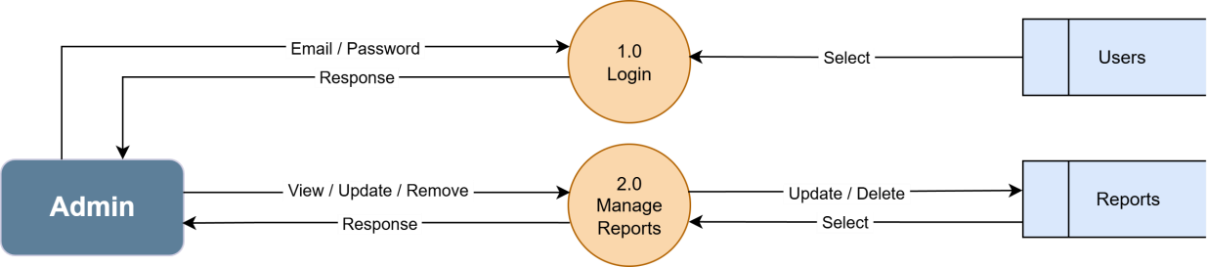
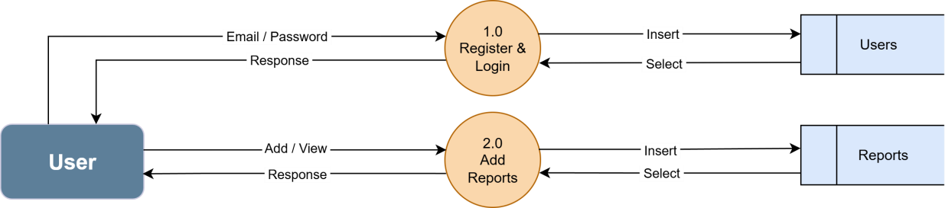
System
Design
DFD Level 0
DFD Level 1(Admin)
DFD Level 1(User)

Slide 9
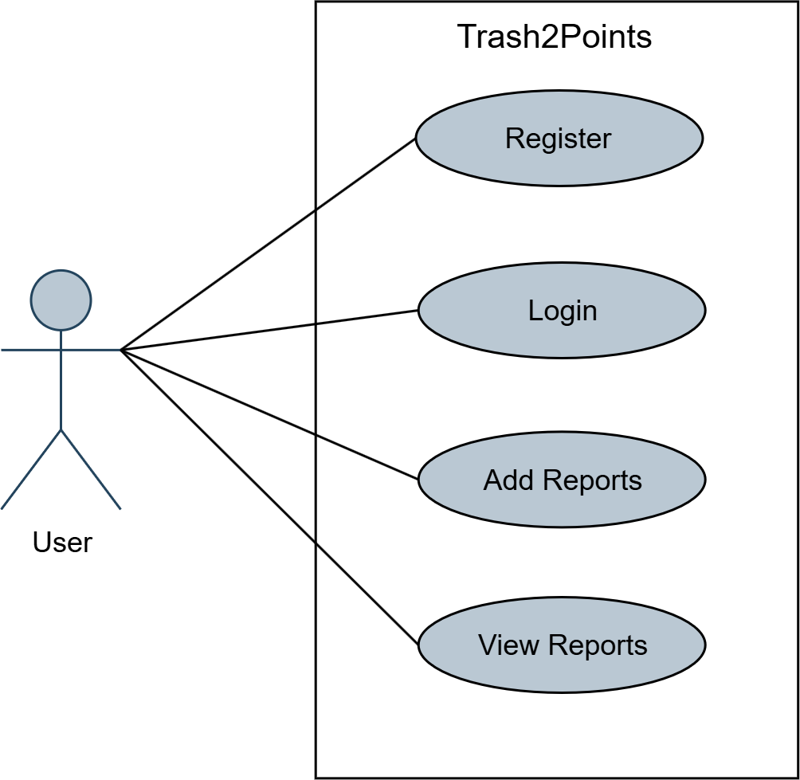
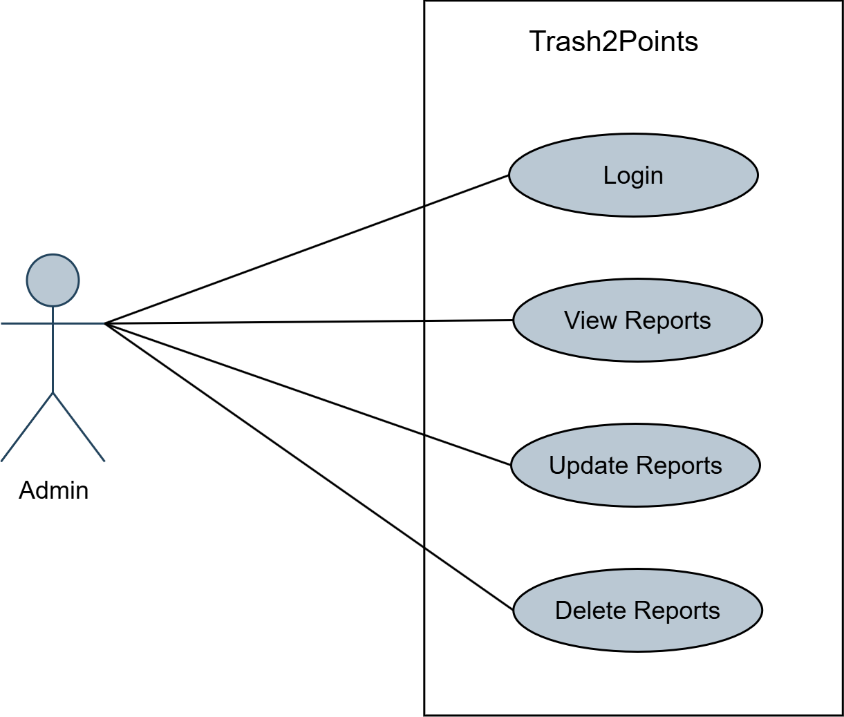
System
Design
Use Case (User)
Use Case (Admin)

Slide 10
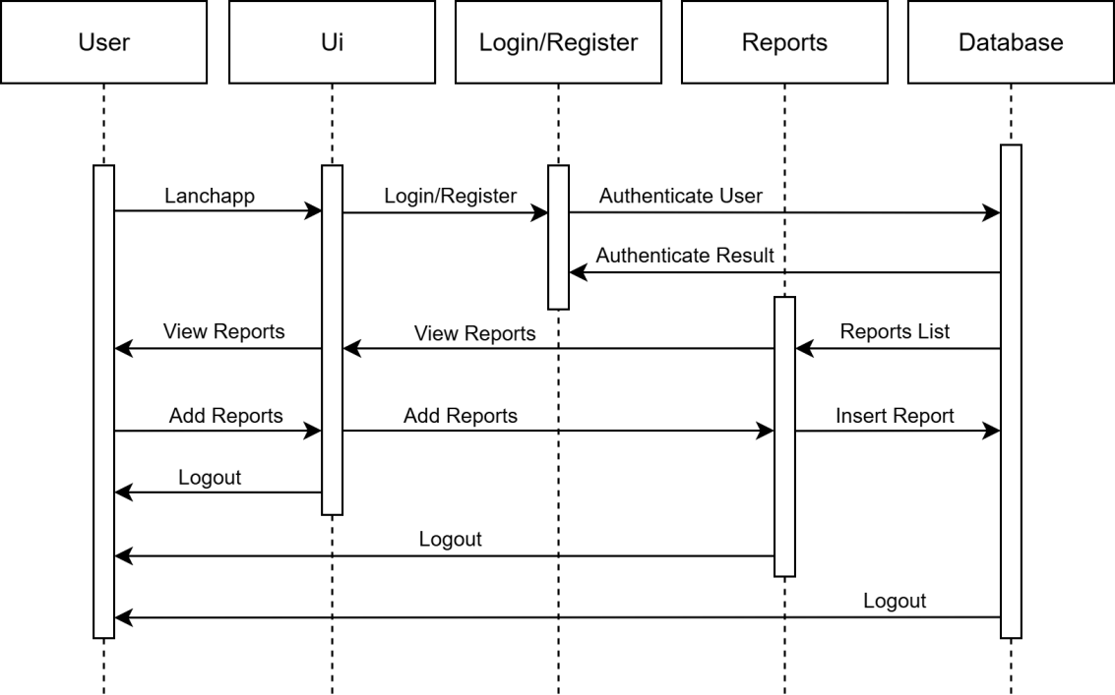
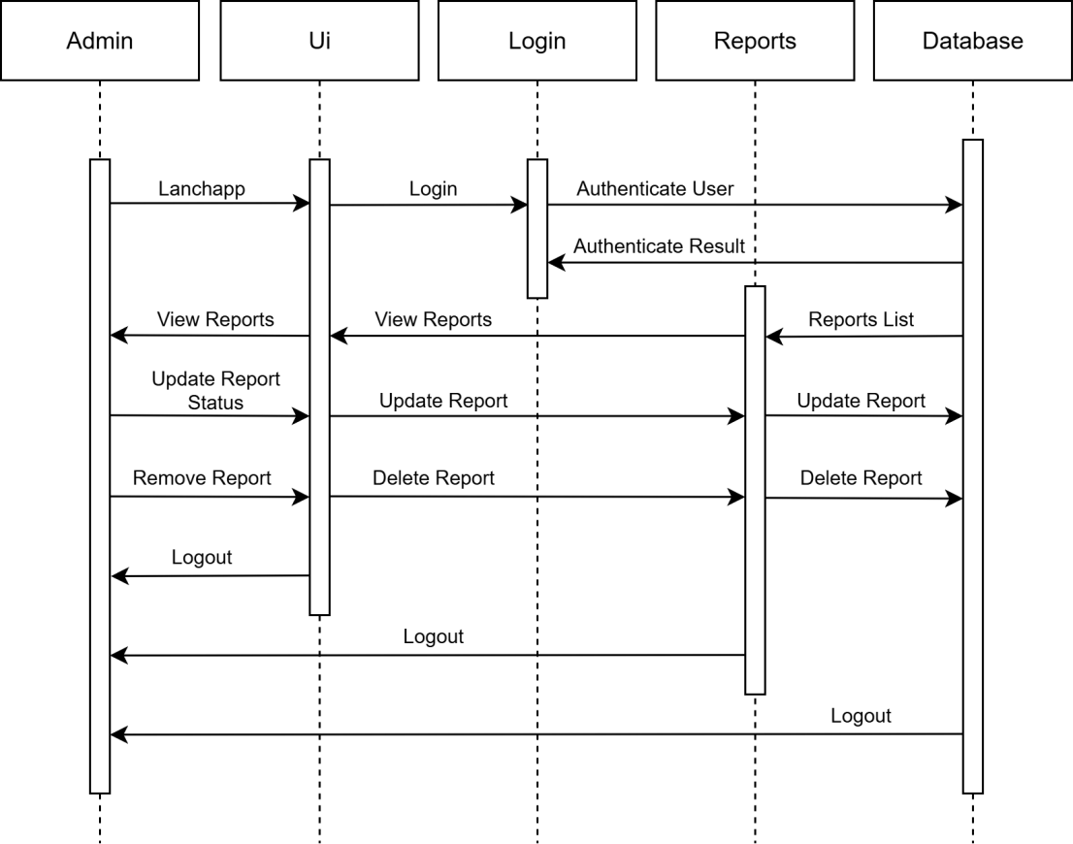
System
Design
Sequence Diagram (User)
Sequence Diagram(Admin)

Slide 11
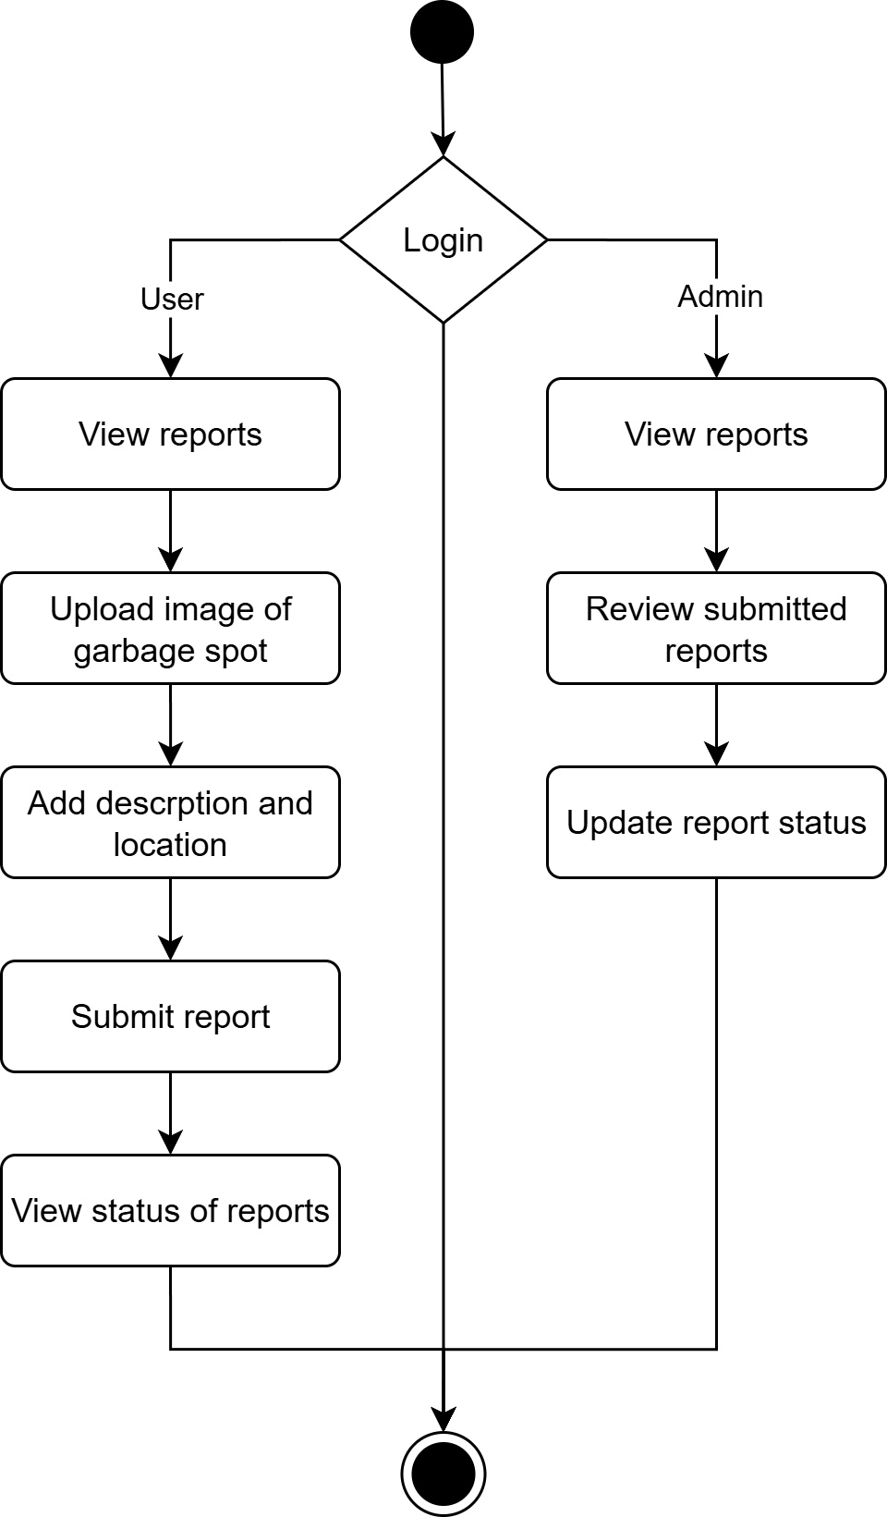
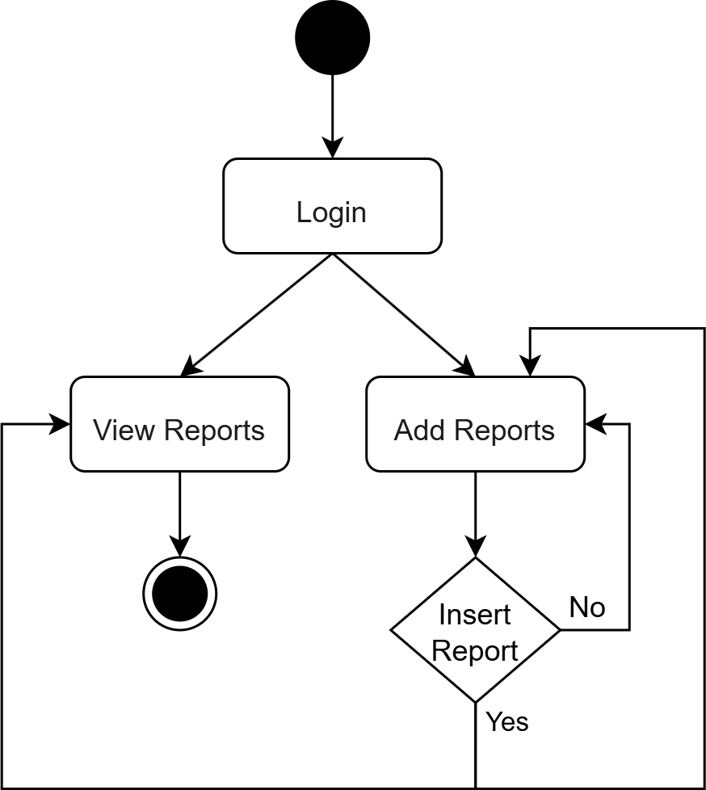
System
Design
Activity Diagram
State Diagram

Slide 12
Database
Design
Users
Reports
Colum Name | Data Type | Constrain
_id | ObjectId | Auto-Generated, Primary Key
name | String | Required
email | String | Required, Unique
phoneno | String(10) | Required, Unique
address | String | Required
password | String(6) | Required
role | String | Default(‘user’), Required
Colum Name | Data Type | Constrain
_id | ObjectId | Auto-Generated, Primary Key
userId | ObjectId | Foreign Key (References Table: users, Colum:_id), Required
image | String | Required
locatation | Object | Required
description | String | Default(‘ ’)
status | String | Default(‘pending’),
verifiedBy | ObjectId | Foreign Key (References Table: users, Colum:_id), Required
createdAt | Date | Auto-Add, Timestamps
updatedAt | Date | Auto-Add, Timestamps

Slide 13
Data Management
Database Used MongoDB Atlas (Cloud-based NoSQL database).
Users Stores user information (name, email, phone, address, password, role).
Reports Stores garbage spot details (image, description, location, status, timestamps, verifiedBy).
User Panel Fetches only user-specific reports.
Admin Panel Fetches and manages all submitted reports.
Database Design

Slide 14
Core Functionalities and Code Implementation
Create User submits a garbage report (image + location + description).
Read User view own submitted reports with status and Admin view all reports
Database Connectivity : Backend (Node.js + Express.js) connects to MongoDB Atlas.
Error Handling: Managing authentication failures, data conflicts, and connectivity issues.
Database Design

Slide 15
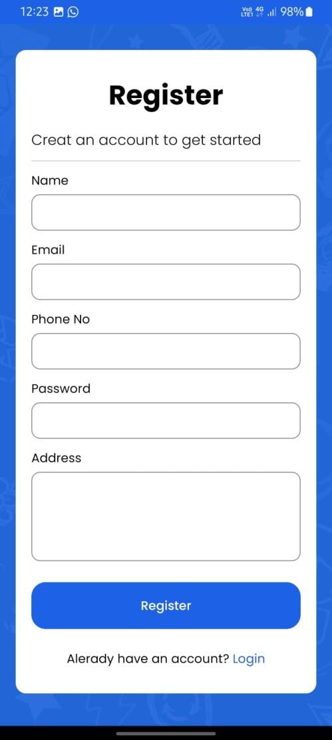
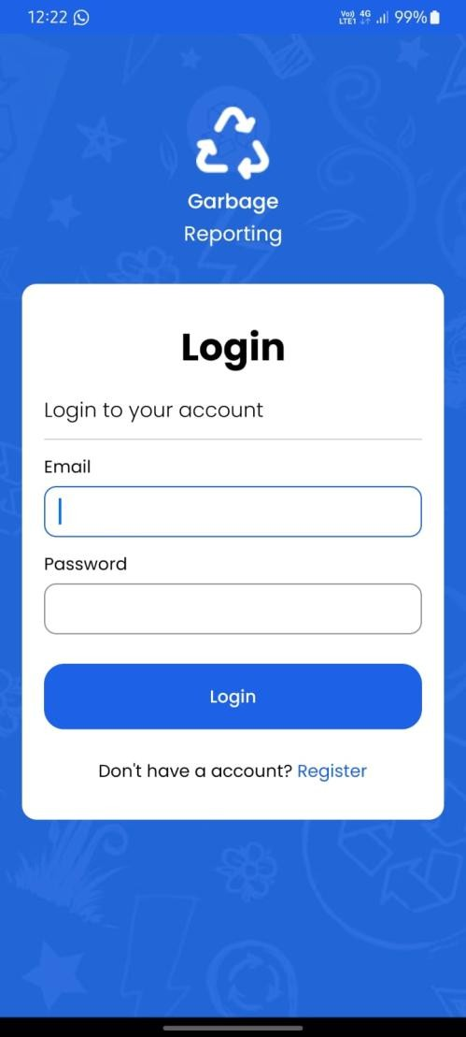
Register Screen
Login Screen
User
System Design

Slide 16
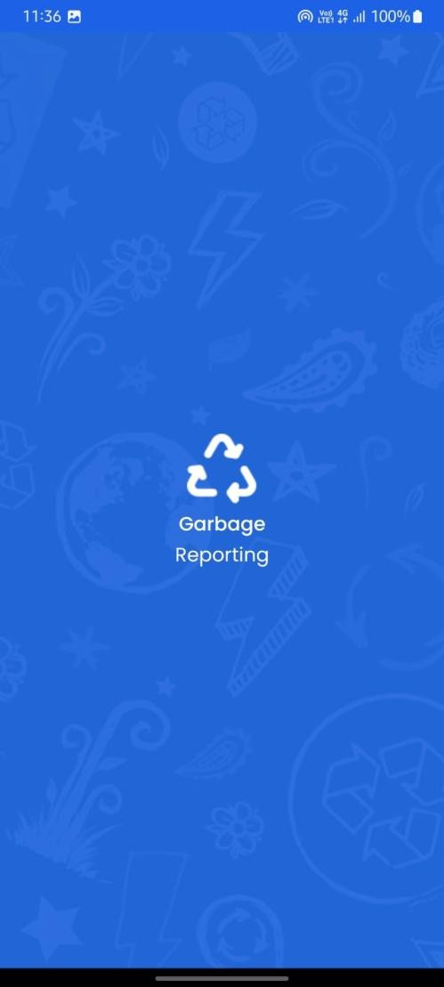
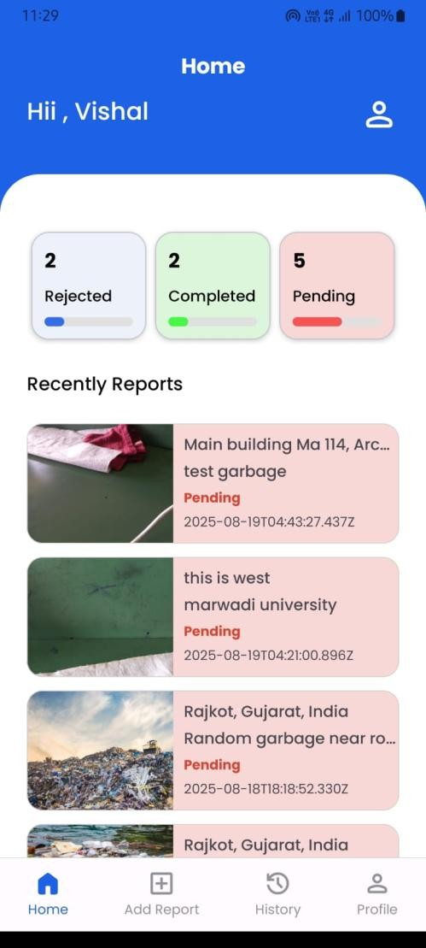
Splash Screen
Home Screen
User
System Design

Slide 17
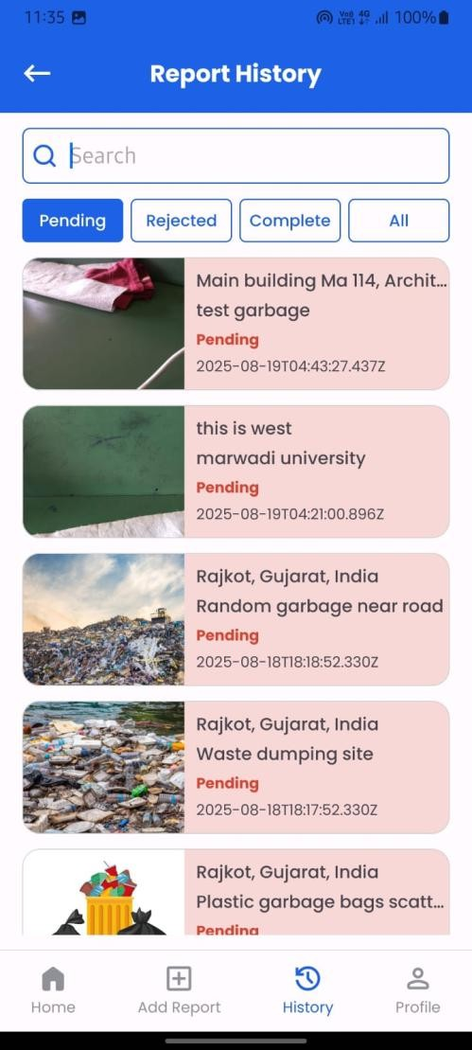
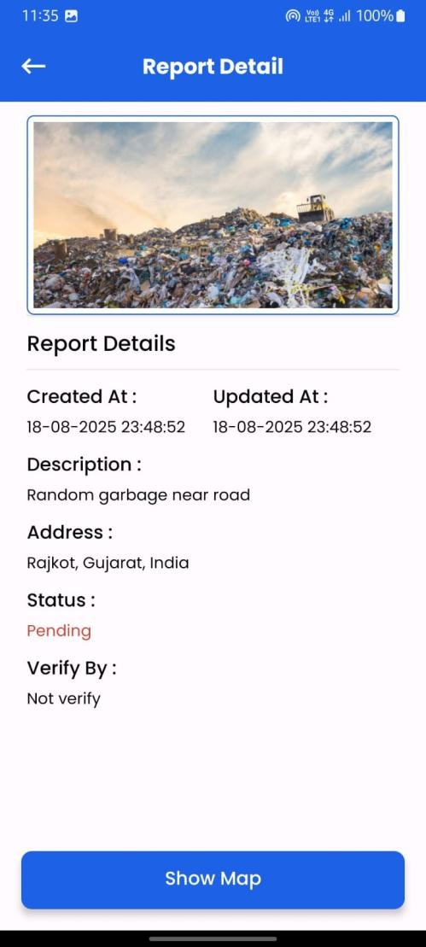
Report History Screen
Report Details Screen
User
System Design

Slide 18
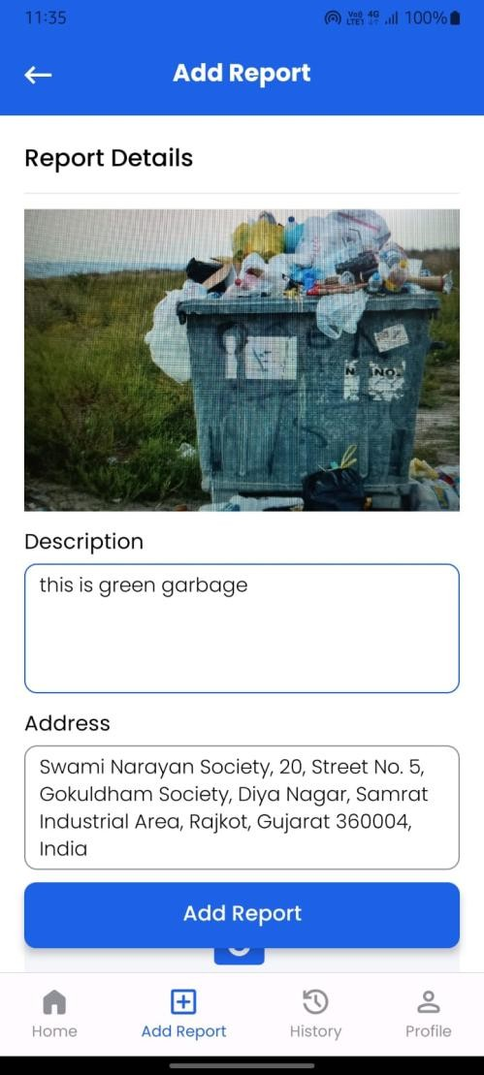
Add Report Screen
User
System Design

Slide 19
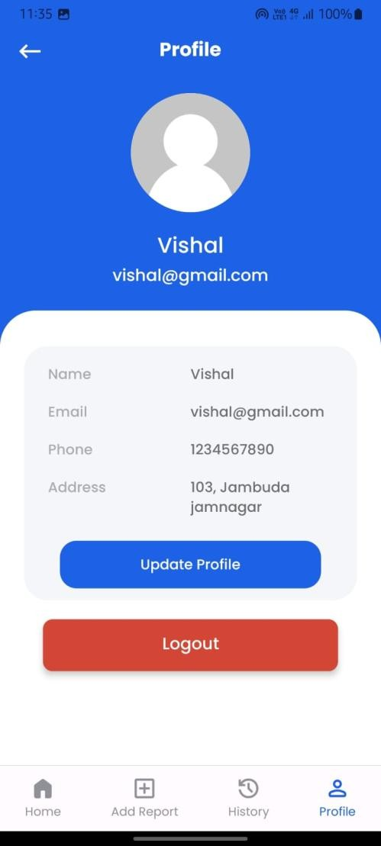
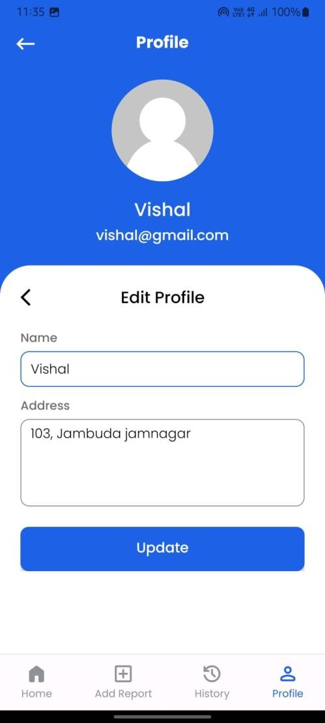
Profile Screen
Profile Edit Screen
User
System Design

Slide 20
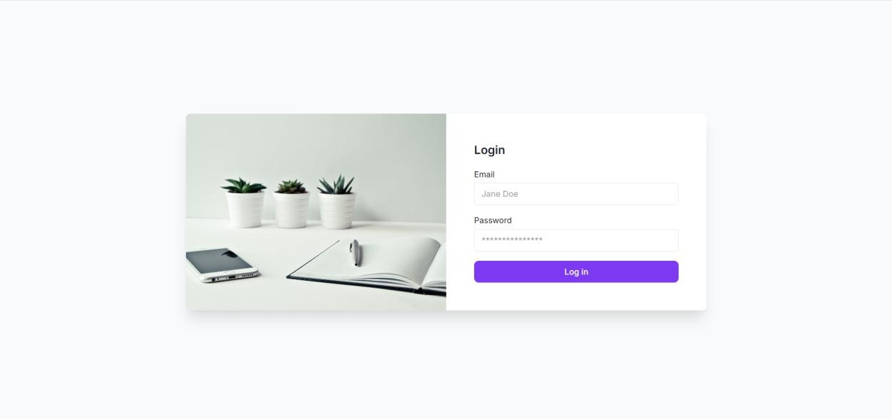
Login Screen
Admin
System Design
Login Screen: This screen allows the admin to log in securely using their email and password to access the panel.

Slide 21
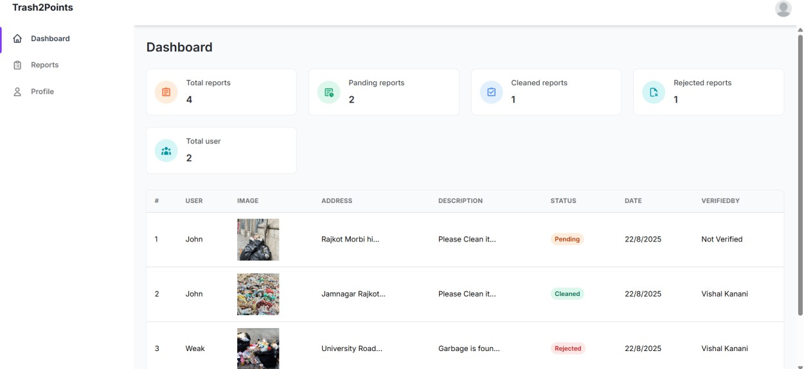
Dashboard Screen
Admin
System Design

Slide 22
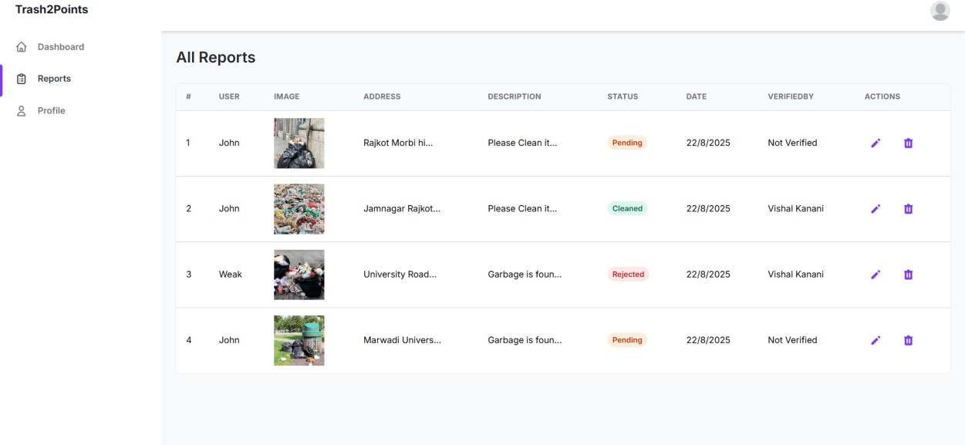
Report Screen
Admin
System Design

Slide 23
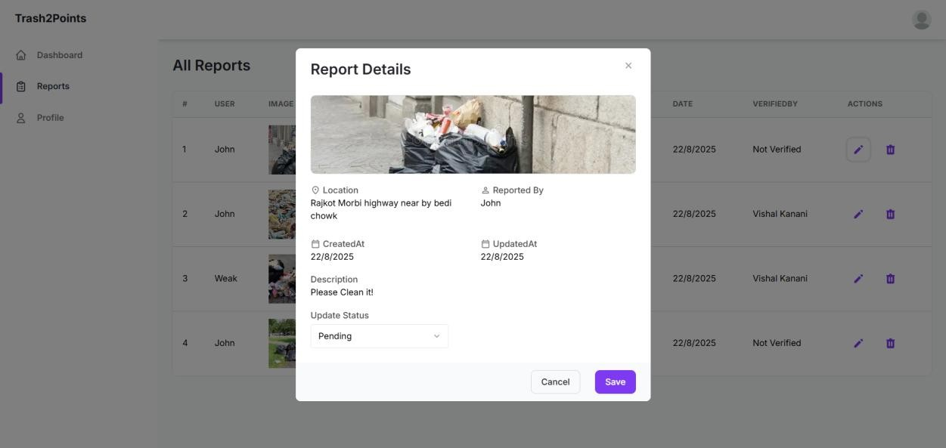
Update Report Screen
Admin
System Design

Slide 24
System
Testing
Registration Test Case
Login Test Case
Test Case ID | Test Case Description | Test Steps | Input Data | Expected Result | Actual Result | Pass /Fail
TC001 | Valid Register | Open register page Fill details Click register | Name: Vishal Email: Vishal@gmail.com Phone: 9876543210 Password: vishal@123 | Display Dashboard | Display Dashboard | Pass
TC002 | Invalid Email | Open register page Fill details Click register | Name: Vishal Email: Vishalgmail.com Phone: 9876543210 Password: vishal@123 | Display error | Error displayed | Pass
TC003 | Invalid Password | Open register page Fill details Click register | Name: Vishal Email: Vishal@gmail.com Phone: 9876543210 Password: vishal | Display error | Error displayed | Pass
TC004 | Empty Fields | Open register page Fill details Click register | Name: Email: Vishal@gmail.com Phone: 9876543210 Password: vishal@123 | Display error | Error displayed | Pass
TC005 | Duplicate Email | Open register page Fill details Click register | Name: Vishal Email: Vishal@gmail.com Phone: 9876543210 Password: vishal@123 | Display error | Error displayed | Pass
Test Case ID | Test Case Description | Test Steps | Input Data | Expected Result | Actual Result | Pass /Fail
TC001 | Valid Login | Open login page Fill details Click login | Email: Vishal@gmail.com Password: vishal@123 | Display Dashboard | Display Dashboard | Pass
TC002 | Invalid Email | Open login page Fill details Click login | Email: Vishalgmail.com Password: vishal@123 | Display error | Error displayed | Pass
TC003 | Invalid Password | Open login page Fill details Click login | Email: Vishal@gmail.com Password: vishal@546 | Display error | Error displayed | Pass
TC004 | Empty Fields | Open login page Fill details Click login | Email: Vishal@gmail.com Password: | Display error | Error displayed | Pass

Slide 25
System
Testing
User Report Submission
Admin Action
Test Case ID | Test Case Description | Test Steps | Input Data | Expected Result | Actual Result | Pass /Fail
TC001 | Valid Report Submission | Login as user Go to report form Upload image, add location, description Click submit | Image: photo.jpg Location: Rajkot Desc: Garbage near street | Report saved, status "Pending" | Report created | Pass
TC002 | Missing Image | Fill all details but leave image blank Click submit | No image | Error "Image required" | Error displayed | Pass
TC003 | Invalid Location | Fill form with invalid coordinates Click submit | Latitude: --- | Error message "Invalid location" | Error displayed | Pass
Test Case ID | Test Case Description | Test Steps | Input Data | Expected Result | Actual Result | Pass /Fail
TC001 | Approve Report | Login as admin Open pending report Update status | Report ID: 123 | Report status updated | Status updated | Pass
TC002 | Reject Report | Login as admin Reject report Save | Report ID: 123 | Status changed to "Rejected" | Status updated | Pass
TC003 | Delete Report | Login as admin Select report Click delete | Report ID: 123 | Report removed from DB | Deleted | Pass

Slide 26
Frontend
Frontend (User Panel): Android (XML).
Frontend (Admin Panel): React.js, Tailwind CSS / Material UI.
Tools: Android Studio, VS Code, GitHub, Postman
Technology Used
Backend
Backend: Node.js, Express.js
Database: MongoDB Atlas (Cloud-based, NoSQL)
APIs: RESTful APIs for smooth communication

Slide 27
Tow-tier Design
User Panel (Mobile App) Sends reports with images, descriptions, GPS location.
Admin Panel (Web App) Manages reports, updates status, analytics.
Centralized MongoDB Atlas Database Stores users, reports, and images
Backend (Node.js + Express.js) Acts as middleware for handling requests.
System Architecture

Slide 28
Admin Features
View, update, or delete reports
Manage report status (Pending, Cleaned, Rejected)
Secure access via login
Features of Trash2Points
User Features
Registration & Login
Submit garbage reports (photo, location, description)
Track status of reports
User Profile Edit

Slide 29
Submit Garbage Report
Users can capture or upload an image of the garbage site.
Add a description (e.g., "Overflowing dustbin near market").
Location is automatically detected using GPS or can be selected manually.
User Features
Trash2Points
User Registraction & Login
View & Track Status Of Reports
New users can create an account with their details (name, email, phone number, password,address).
Authentication ensures secure access using JWT.
Returning users can log in with credentials.
Users can check whether their complaint is Pending, Cleaned, or Rejected.
Profile Management
Users can edit personal details (name, phone, email, address).

Slide 30
Admin Features
Trash2Points
Manage Reports
Ability to update report status (e.g., mark as “Pending”, “Cleaned”, or “Rejected”).
Delete irrelevant or duplicate reports to maintain a clean database.
View Reports
Admins can see all reports submitted by users.
Each report displays image, location, description, and timestamp.
Data Storage & Security
Reports are stored in MongoDB Atlas ensuring availability and scalability.
Admin panel uses React.js for smooth and interactive management.

Slide 31



Add Report
Workflow
2
Report Processing
(Admin Side)
1
Report Creation
Data Storage
User can add reports.
Handle report at admin side
Status Update
3

Slide 32
Authentication: Secure login & registration using JWT (JSON Web Tokens).
Access Control: Separate roles for users and admins.
Data Anonymity: No unauthorized data sharing.
Privacy: Unique IDs, password protection, restricted access to reports.
Security and Privacy

Slide 33
Reward System: Points or badges for active reporters.
Push Notifications: Updates when report status changes.
Multi-language Support: Local language access.
Future Enhancements

Slide 34
Trash2Points is a small step toward keeping our surroundings clean.
Simple reporting system capture a photo, add location, and send the report.
Admin panel for authorities view, update, and take action on reports quickly.
Conclusion

Slide 35
THANK YOU

