Slide 1
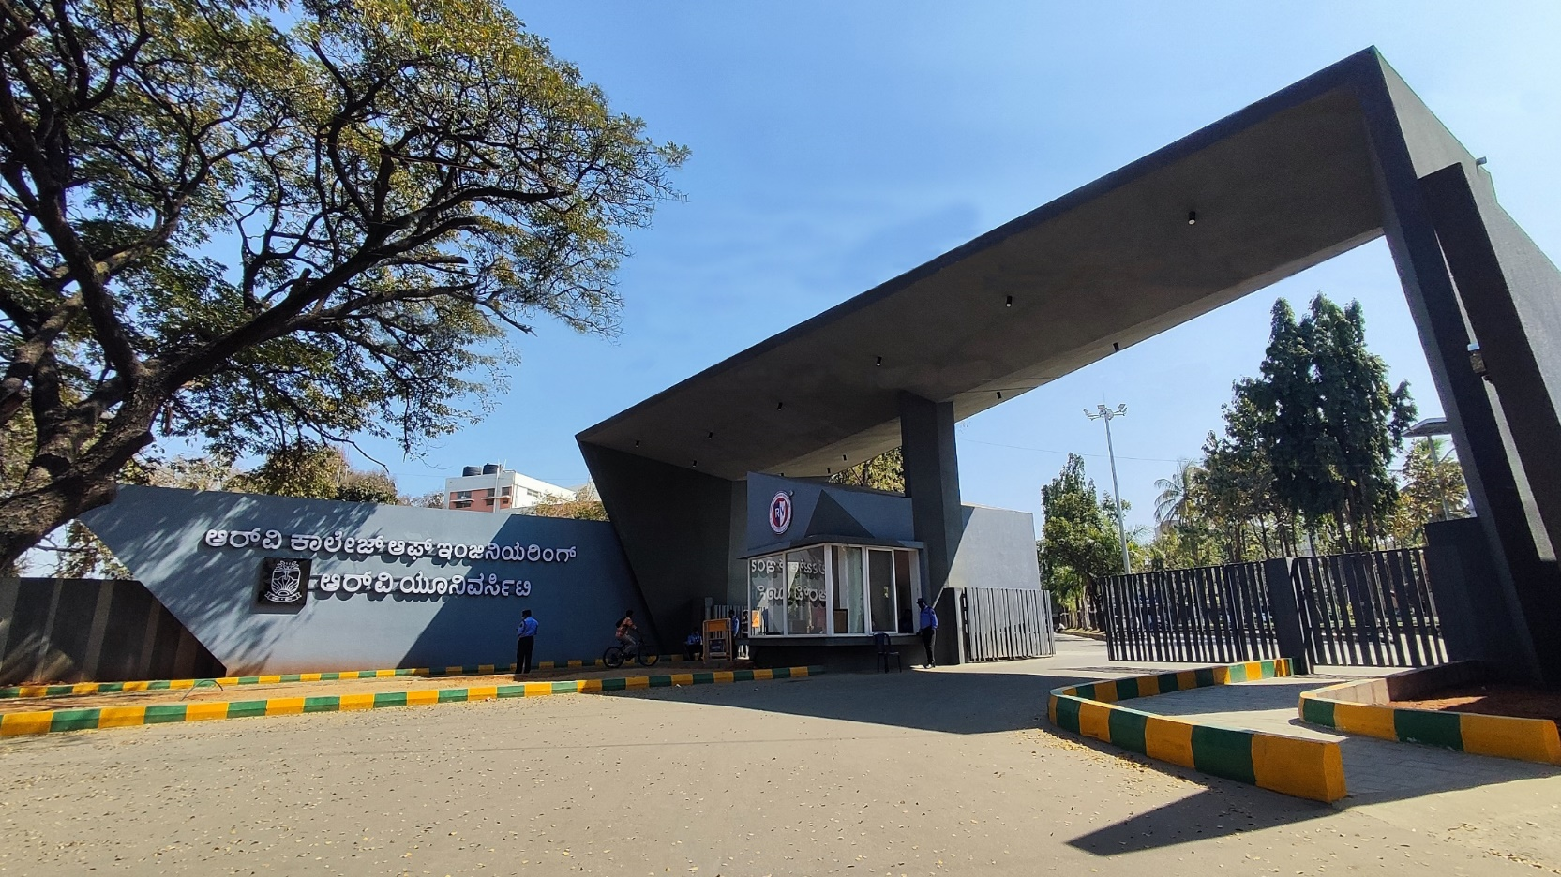
ML-Based Real-Time Thermal Throttling Optimizer
Kanan Jethwani 1RV24CS118
Ibrahim Zahi Shahidi 1RV24CS10

Slide 2
EL Phase-I
Presentation Outline
Introduction
Literature Review
Problem Definition
Objectives
Methodology
Tools and Techniques Used
Proposed Outcomes
Conclusion
References

Slide 3
Introduction
Overview of the topic:
  Predictive Proactivity: Replaces reactive CPU throttling with ML that forecasts temperature spikes, allowing gentle pre-emptive adjustments.
  Real-Time ML Forecasting: Uses a lightweight model with live sensor data (load, temp, etc.) to predict CPU temperature 3-5 seconds ahead.
  Triple-Benefit Outcome: Simultaneously achieves smoother performance (no lag), lower device heat, and longer battery life through efficient power management.
Importance of the topic:
  Enhances user experience by eliminating performance lag and stutters.
  Improves device longevity and battery life through efficient thermal management.
  Enables sustainable computing by reducing energy waste and heat generation.

Slide 4
Literature Review
S. No. | Author(s) | Year of Publication | Contribution | Objective
1 | Skadron et al. | 2003 | Introduced temperature-aware microarchitecture and exposed the limits of threshold-based throttling. | Build foundational understanding of CPU thermal behavior.
2 | Donald & Martonosi | 2006 | Showed that reactive thermal management reduces performance and efficiency. | Identify why proactive thermal solutions outperform reactive throttling.
3 | Zhang, Huang & Stan | 2015 | Developed predictive thermal management enabling smoother CPU scaling. | Show that predictive throttling improves CPU smoothness.
4 | Mittal | 2016 | Reviewed modern energy-efficient embedded computing techniques including DVFS. | Identify DVFS and throttling as key tools in power and thermal management.
5 | Shah, Patel & Mehta | 2017 | Analyzed workload-based heat generation patterns in smartphone processors. | Understand workload-driven thermal trends to support ML prediction models.
6 | Liao, Kim & Venkataramani | 2018 | Demonstrated that delayed thermal throttling causes performance stutters in mobile devices. | Emphasize the need for early prediction to avoid performance drops.

Slide 5
Literature Review
S. No. | Author(s) | Year of Publication | Contribution | Objective
7 | Hoffmann & Marinescu | 2018 | Showed that temperature forecasting improves CPU frequency and energy optimization. | Strengthen the argument for prediction-based frequency scaling.
8 | Gniady, Hu & Zong | 2019 | Applied ML for proactive power and thermal management to improve stability. | Demonstrate ML’s potential for real-time device stability.
9 | Yang, Lee & Kim | 2019 | Used regression-based DVFS to maintain stable temperatures with minimal performance loss. | Support the use of DVFS as a control strategy in thermal systems.
10 | Magaña, Martín & Andrade | 2020 | Proved that ML models are effective for CPU temperature forecasting. | Support the use of ML-based predictive modeling for thermal control.
11 | Bai, Han & Kim | 2020 | Demonstrated that predictive power modeling outperforms reactive throttling. | Justify shifting from reactive to predictive thermal control.
12 | Wang, Liu & Xu | 2021 | Showed that predicting temperature 3–5 seconds in advance reduces overheating. | Validate the ideal prediction window for proactive throttling.

Slide 6
Literature Review
S. No. | Author(s) | Year of Publication | Contribution | Objective
13 | Choi, Park & Chung | 2021 | Developed lightweight neural networks for real-time thermal prediction in mobile processors. | Explore NN models for efficient and fast temperature forecasting.
14 | Islam, Ahmed & Lee | 2022 | Found lightweight regression models suitable for real-time embedded thermal prediction. | Guide selection of low-overhead ML models for real-time use.
15 | Kumar, Singh & Xu | 2023 | Proposed hybrid ML-based thermal regulation improving power efficiency in edge devices. | Inspire hybrid or advanced ML strategies for future thermal optimization.

Slide 7
Literature Review
Trends in Literature: Recent research shows a clear shift from reactive thermal throttling to predictive, ML-based thermal management. Studies focus on forecasting CPU temperature using lightweight models, improving performance stability, and reducing thermal spikes. The trend is toward real-time prediction, energy efficiency, and smooth CPU frequency control.
Relevance to current research: This project aligns directly with modern research that uses machine learning for proactive thermal control. Current studies highlight the need for accurate temperature forecasting, real-time optimization, and performance stability—exactly what this ML-based thermal throttling system aims to achieve.

Slide 8
Problem Definition
Clear statement of the problem: Traditional CPU thermal management reacts to overheating by abruptly slowing performance, causing noticeable lag. This reactive approach also wastes battery life and generates excess heat.
Context of the Problem: Modern mobile devices and laptops struggle with heat buildup during intensive tasks. Conventional thermal throttling reacts too late, forcing aggressive performance cuts that create user-noticeable stutters and inefficient power spikes.
Significance of Addressing the Problem: Proactively preventing overheating maintains consistent performance during critical tasks like gaming or video editing. It also directly extends battery life and improves long-term device reliability by reducing thermal stress.

Slide 9
Objectives
Develop a machine learning model to accurately predict CPU temperature 3-5 seconds in advance using real-time system metrics.
Design a proactive control algorithm that smoothly scales CPU frequency based on predictions to prevent thermal throttling.
Achieve a measurable improvement in system stability by reducing performance stutters and FPS drops during intensive workloads.
Enhance power efficiency to extend battery life and reduce overall device operating temperatures.diagnosis.

Slide 10
Methodology
Data Collection & Preprocessing:
Develop a data logger to collect real-time sensor data (CPU temp, load, frequency, power draw) at high frequency.
Execute diverse workloads (idle to gaming) to create comprehensive dataset.
Clean and normalize data, then structure it for supervised learning with future temperature as the target label.
Model Training & Selection:
Test multiple algorithms: Linear Regression (baseline), Gradient Boosting (XGBoost), and a simple Neural Network.
Use time-series cross-validation to evaluate prediction accuracy (Mean Absolute Error).
Select the best-performing model that balances accuracy with low computational overhead.
Real-Time System Integration:
Create a background daemon that continuously samples system sensors.
Implement the trained model for live inference, generating temperature forecasts every 1-2 seconds.
Develop a control algorithm that translates predictions into smooth CPU frequency adjustments, preventing thermal thresholds from being reached.
Performance Evaluation:
Conduct A/B testing comparing the ML optimizer against standard OS throttling.
Measure key metrics: performance consistency (FPS stability), thermal peaks, battery consumption, and system overhead.
Iterate on the control parameters to optimize the balance between temperature management and performance.

Slide 11
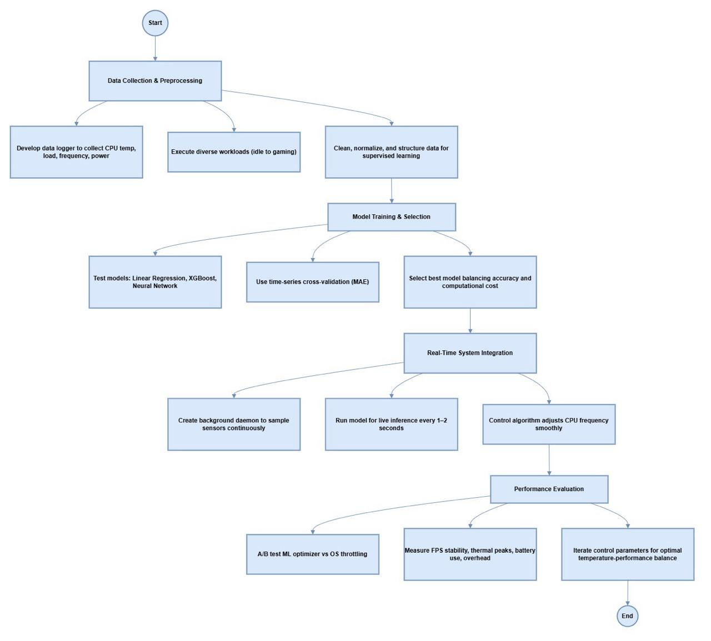
Methodology

Slide 12
Tools And Techniques Used
Data Collection & Processing:
Tools: Python, System monitoring tools (pySMBIOS, Intel Power Gadget), Custom data logger
Techniques: Time-series data aggregation, Feature engineering, Data normalization (StandardScaler)
ML Development:
Tools: Scikit-learn, XGBoost, PyTorch/TensorFlow, Jupyter Notebooks
Techniques: Regression modeling, Hyperparameter tuning, Cross-validation, Feature importance analysis
System Implementation:
Tools: C++/Rust for daemon development, Linux CPUFreq subsystem, Systemd services
Techniques: Real-time inference, Control algorithms, Frequency scaling APIs, Inter-process communication
Testing & Evaluation:
Tools: Custom benchmark scripts, Performance monitoring tools, Power measurement equipment
Techniques: A/B testing, Statistical analysis, Performance profiling, Thermal imaging

Slide 13
Proposed Outcomes
Expected Results:
  Predictive Thermal Management: A working system that anticipates temperature spikes 3-5 seconds in advance, replacing the current reactive throttling model.
  Enhanced Performance Stability: A measurable reduction in performance stutters and frame rate drops during intensive tasks, leading to a smoother user experience.
  Improved Power Efficiency: A demonstrable extension of battery life and reduction in overall power consumption through more optimized CPU frequency control.
  Lower Operating Temperatures: A consistent decrease in peak and average device temperatures, improving user comfort and contributing to long-term hardware reliability.

Slide 14
Conclusion
Summary of Key Points:
Proactive Beats Reactive: Shifting from emergency thermal throttling to ML-powered prediction prevents overheating before it starts.
Performance and Efficiency Unified: The solution simultaneously delivers smoother user experience and longer battery life.
Practical ML Integration: A lightweight, real-time model can be effectively embedded into an OS for tangible system-level improvements.
Final Thoughts: This project demonstrates that intelligent, predictive resource management is the next frontier for enhancing mobile computing. By leveraging simple machine learning, we can move beyond the limitations of reactive algorithms and create devices that are not only more powerful but also smarter and more efficient in their operation.

Slide 15
References
Donald, J., & Martonosi, M. — 2006: Techniques for multicore thermal management.
Skadron, K., Stan, M. R., Huang, W., Velusamy, S., Sankaranarayanan, K., & Tarjan, D. — 2003: Temperature-aware microarchitecture: Modeling and implementation.
Liao, Z., Kim, T., & Venkataramani, G. — 2018: An empirical study of thermal throttling and performance stuttering in mobile devices.
Magaña, E., Martín, M., & Andrade, M. — 2020: Machine learning-based thermal prediction for mobile SoCs.
Wang, H., Liu, Q., & Xu, Y. — 2021: Predictive CPU temperature forecasting for proactive thermal control in smartphones.
Gniady, C., Hu, W., & Zong, M. — 2019: Proactive power and thermal management using machine learning.
Islam, F., Ahmed, S., & Lee, J. — 2022: Lightweight regression models for embedded thermal prediction.
Project Presentation Source (Student Project Slides) — 2025: ML-Based Real-Time Thermal Throttling Optimizer

Slide 16
References
Zhang, W., Huang, W., & Stan, M. — 2015: A predictive thermal management system for mobile processors using machine learning.
Bai, Q., Han, S., & Kim, Y. — 2020: Dynamic thermal and power management for mobile CPUs using predictive modeling.
Yang, Y., Lee, S., & Kim, N. — 2019: Thermal-aware DVFS using regression-based prediction models.
Choi, J., Park, D., & Chung, E. — 2021: Real-time thermal prediction for heterogeneous mobile processors using lightweight neural networks.
Hoffmann, J., & Marinescu, R. — 2018: Temperature forecasting for energy-efficient CPU frequency control.
Mittal, S. — 2016: A survey of techniques for improving energy efficiency in embedded computing systems.
Kumar, P., Singh, M., & Xu, L. — 2023: Edge-device thermal regulation using hybrid machine learning models.

Slide 17


