Slide 1
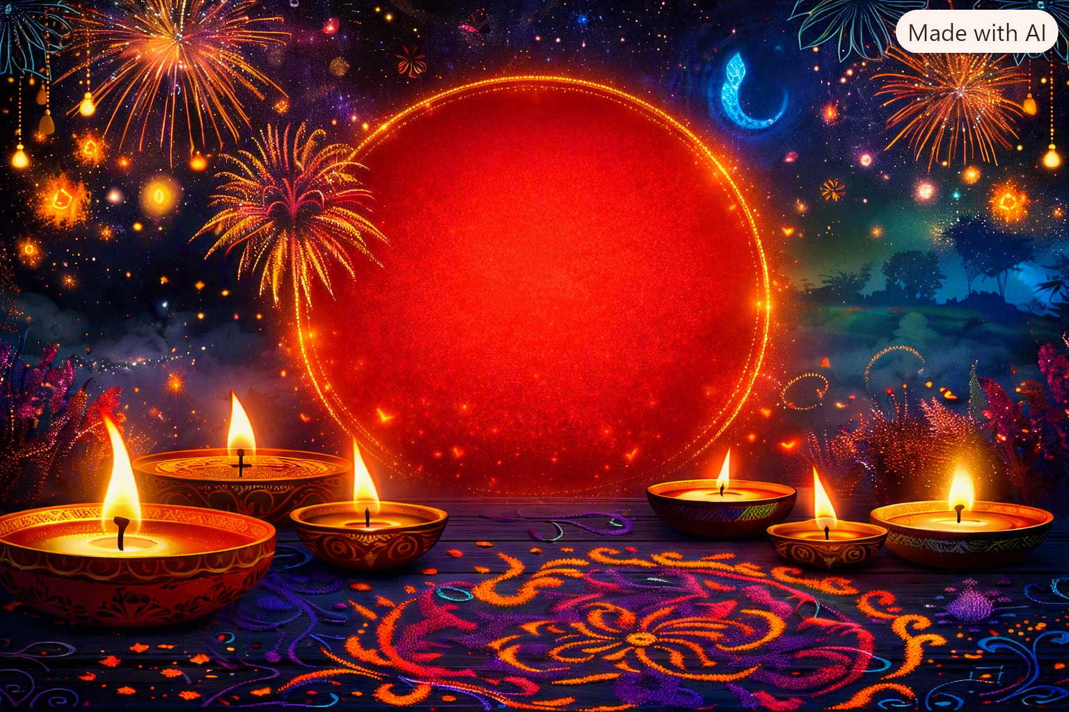
HAPPY
DIWALI
Wish you a very happy and joyous
Festival of lights !

