Slide 1
Linux Administration Homelab
Practical Linux Administration Project

Slide 2
Project Overview
Hands-on configuration and verification in a Linux lab environment
• Linux system and network configuration
• SSH service setup and verification
• LVM storage configuration and inspection
• NFS export configuration and verification

Slide 3
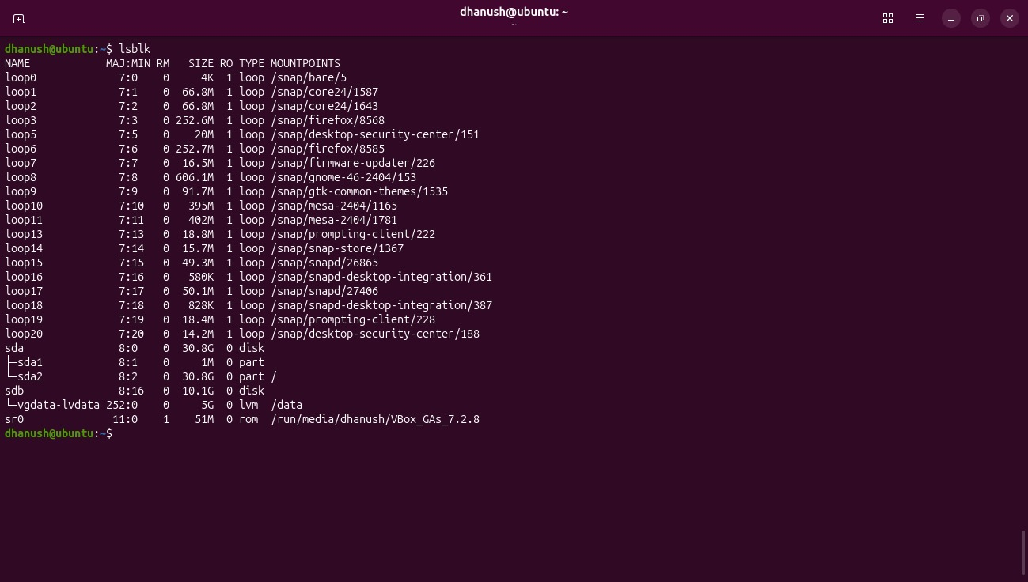
LVM Storage Configuration

Slide 4
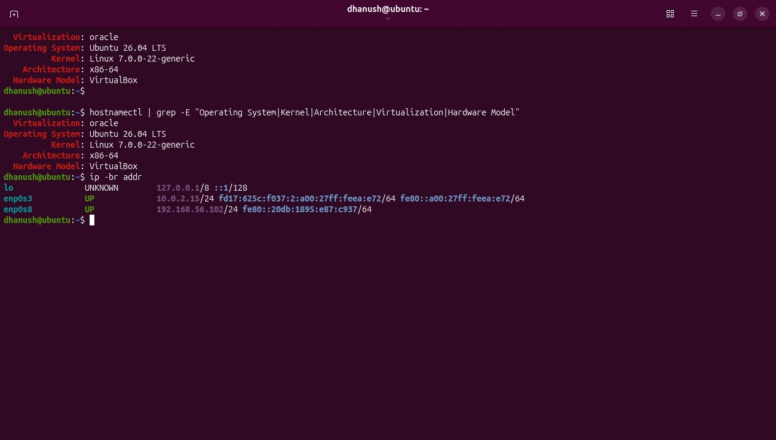
Linux System & Network Configuration

Slide 5
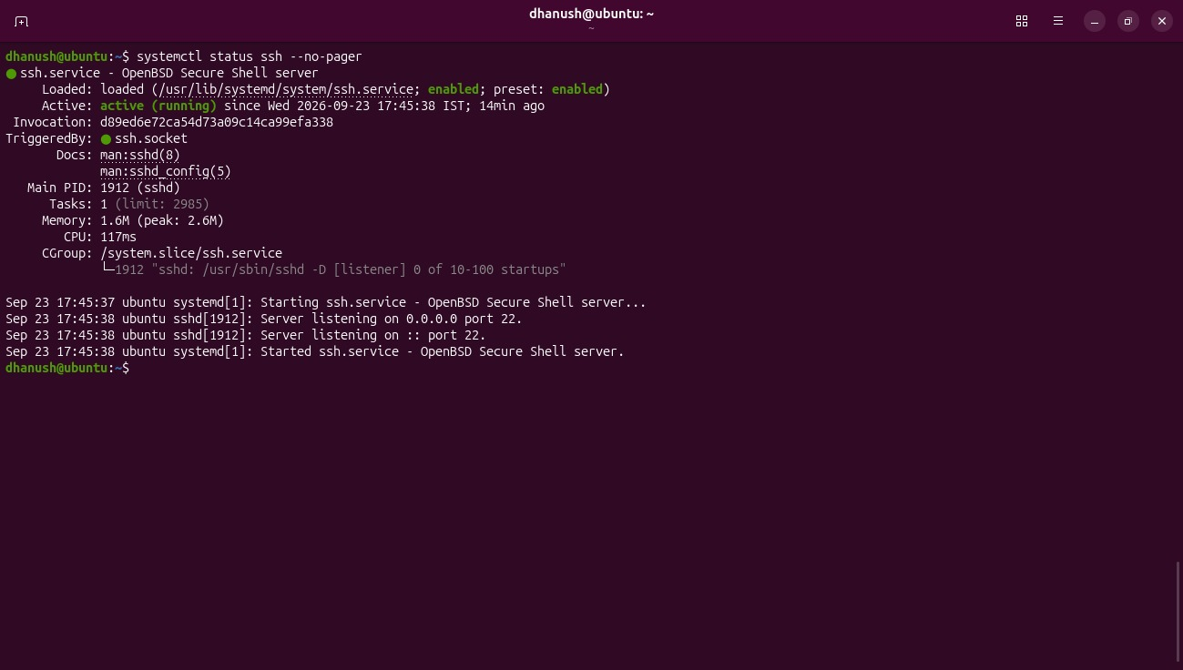
SSH Service Configuration

Slide 6
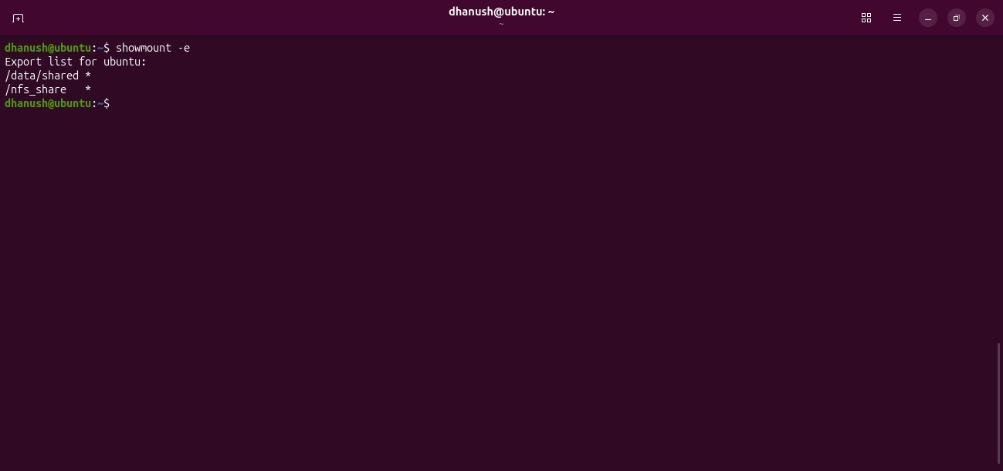
NFS Export Configuration

Slide 7
Thank You
Linux Administration Homelab

