Slide 1
Personal Expense Management
Python + MySQL Project

Slide 2
Project Overview
A Python and MySQL application for managing income and expenses
• Records income and expense transactions
• Uses MySQL for persistent data storage
• Supports CRUD operations and validation
• Provides totals, balance, and reporting

Slide 3
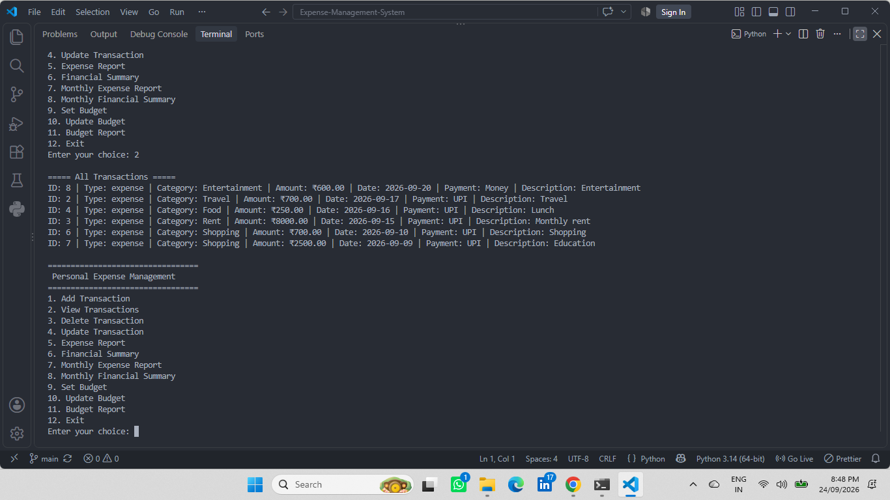
Personal Expense Management — Application

Slide 4
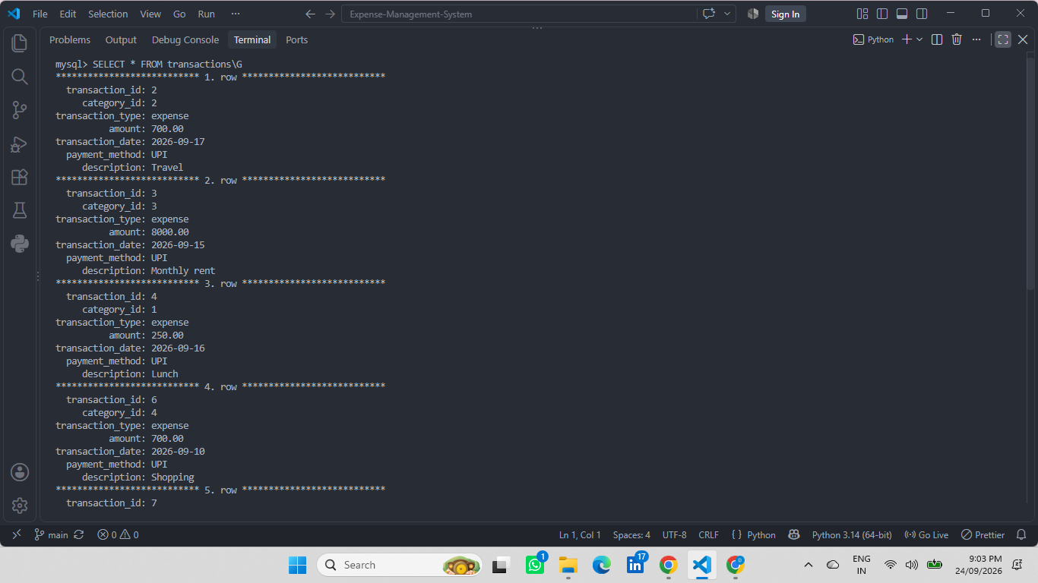
Income and Expense Management

Slide 5
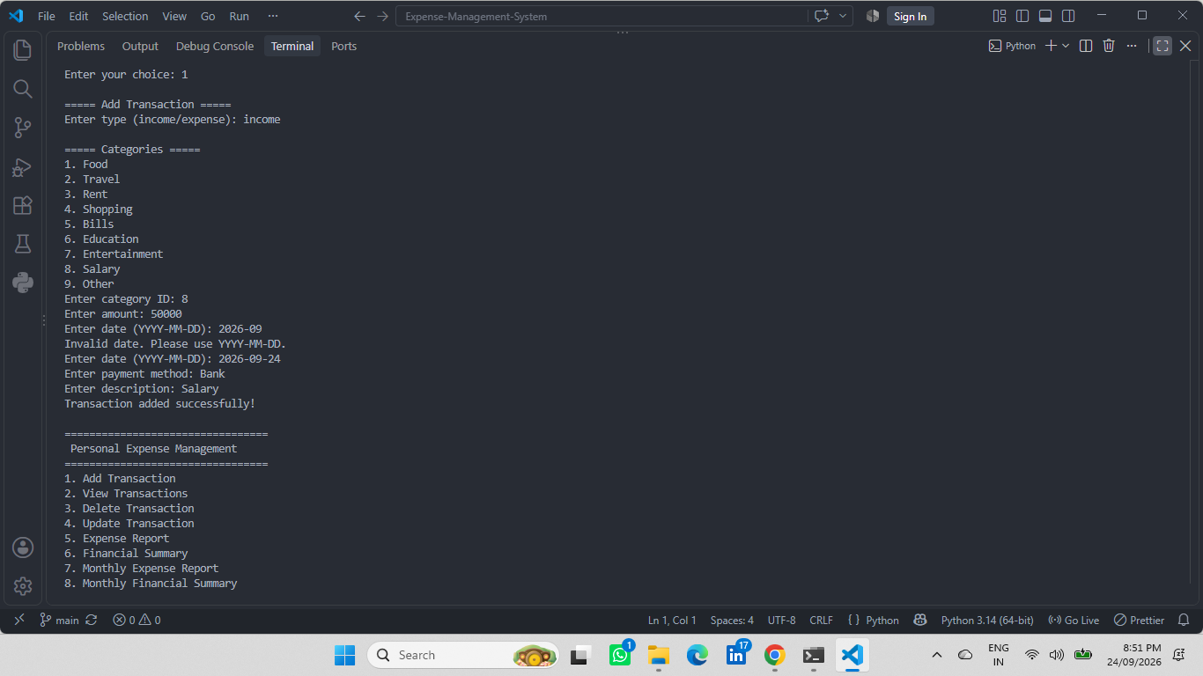
Transaction Records and Reports

Slide 6
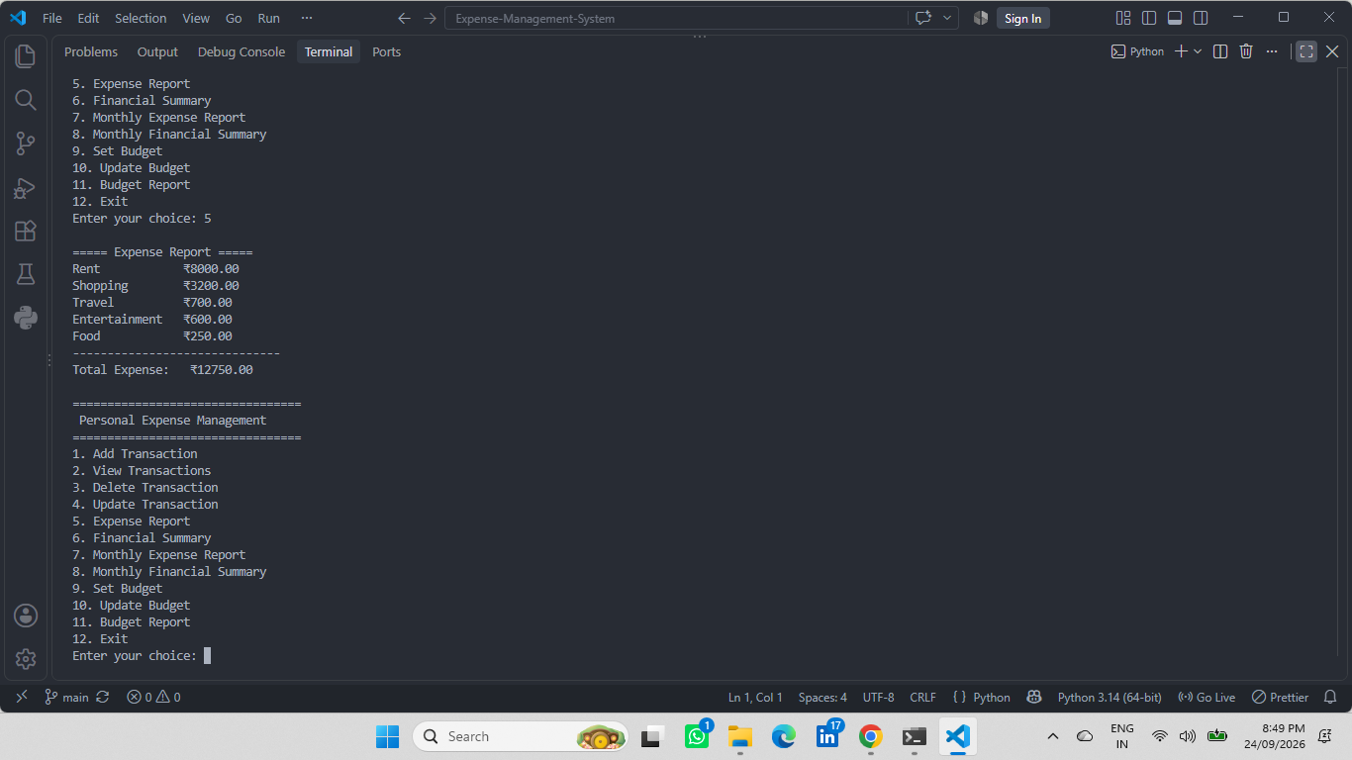
MySQL Database / CRUD Operations

Slide 7
Thank You
Personal Expense Management

