Slide 1
~/var/log/auth.log
LINUX SECURITY LOG ANALYZER
A Python CLI Tool for Detecting Suspicious SSH Activity
and Generating Structured Security Reports
$ python main.py
--log auth.log
> 8 failed attempts
K. Venkata Dhanush
github.com/kanasanidhanush7-dev
Notes:
Welcome everyone — today I'll be presenting my project, the Linux Security Log Analyzer. It's a Python-based command-line tool I built to automatically scan Linux SSH authentication logs, detect suspicious login activity, and generate a clean, structured security report. I'll walk through the problem it solves, how it works under the hood, a live demo of the output, and where I plan to take it next.

Slide 2
WHY THIS PROJECT
Problem Statement & Objective
THE PROBLEM
THE OBJECTIVE
Linux servers exposed to SSH are constantly targeted by automated brute-force login attempts.
Authentication logs (/var/log/auth.log) grow large and fast — manually scanning them for threats is slow and error-prone.
Without tooling, admins can miss repeated failed logins from the same IP until it's too late.
Build a lightweight Python CLI tool that parses raw Linux authentication logs.
Automatically extract failed SSH attempts, source IPs, usernames, and timestamps.
Flag suspicious IP addresses using a configurable failed-attempt threshold.
Generate a clear, structured security report an admin can act on immediately.
Goal: Turn raw, hard-to-read Linux auth logs into an actionable security report in seconds, not hours.
Linux Security Log Analyzer
2
Notes:
Every Linux server that exposes SSH is a target for brute-force login attempts — bots constantly try usernames and passwords hoping to get in. The raw log files that record this activity are large, plain-text, and genuinely painful to read manually. My objective with this project was to automate that process: parse the log, pull out the important signals — failed attempts, source IPs, usernames, timestamps — and flag any IP address that crosses a suspicious threshold, which by default is five or more failed attempts. The end result is a structured report the admin can read in seconds instead of scrolling through thousands of log lines.

Slide 3
WHAT IT DOES
Key Features & Scope
1
Failed Login Detection
2
IP & Username Extraction
3
Timestamp Tracking
Scans SSH auth logs and flags every failed login attempt.
Pulls source IP addresses and attempted usernames from each event.
Extracts and logs the exact time of every failed attempt.
4
Suspicious IP Scoring
5
Event & Error Detection
6
Structured Reporting
Counts attempts per IP and flags any IP at 5+ failures.
Identifies SSH security events plus general log errors/warnings.
Compiles findings into a clean, readable security report.
Also supports: CLI log-file input • modular Python architecture • menu-driven workflow
Linux Security Log Analyzer
3
Notes:
The tool covers the core workflow an admin actually needs. It detects every failed SSH login attempt in the log, extracts the source IP and the username that was tried, and timestamps each event. It then scores IP addresses by how many times they've failed — by default, five or more failed attempts marks an IP as suspicious. Beyond that, it picks up broader SSH security events plus generic errors and warnings in the log, and rolls everything into one structured report. It's all driven from the command line with a simple interactive menu, and the codebase is split into modular components rather than one big script.

Slide 4
UNDER THE HOOD
Tech Stack & Architecture
TECH STACK
HOW IT WORKS
Python 3
Linux Auth Log
Regular Expressions (re)
argparse (CLI input)
Log Analyzer
(log_analyzer.py)
File Handling / I-O
Lists & Dictionaries
Security Analysis
(threshold scoring)
Modular Functions
PROJECT STRUCTURE
Report Generator
(report_generator.py)
main.py • log_analyzer.py • report_generator.py • sample_auth.log • screenshots/
Security Report
Linux Security Log Analyzer
4
Notes:
The project is written in pure Python 3 with no heavy external dependencies — it relies on the built-in `re` module for regular-expression log parsing, `argparse` for command-line input, and standard file handling. The codebase is split into three modules: main.py runs the CLI menu, log_analyzer.py does the actual log parsing and threat detection, and report_generator.py builds the final report. On the right you can see the data flow: a raw Linux authentication log goes into the Log Analyzer, which performs the security analysis — counting failed attempts per IP against the suspicious threshold — and hands that off to the Report Generator, which produces the final structured Security Report.

Slide 5
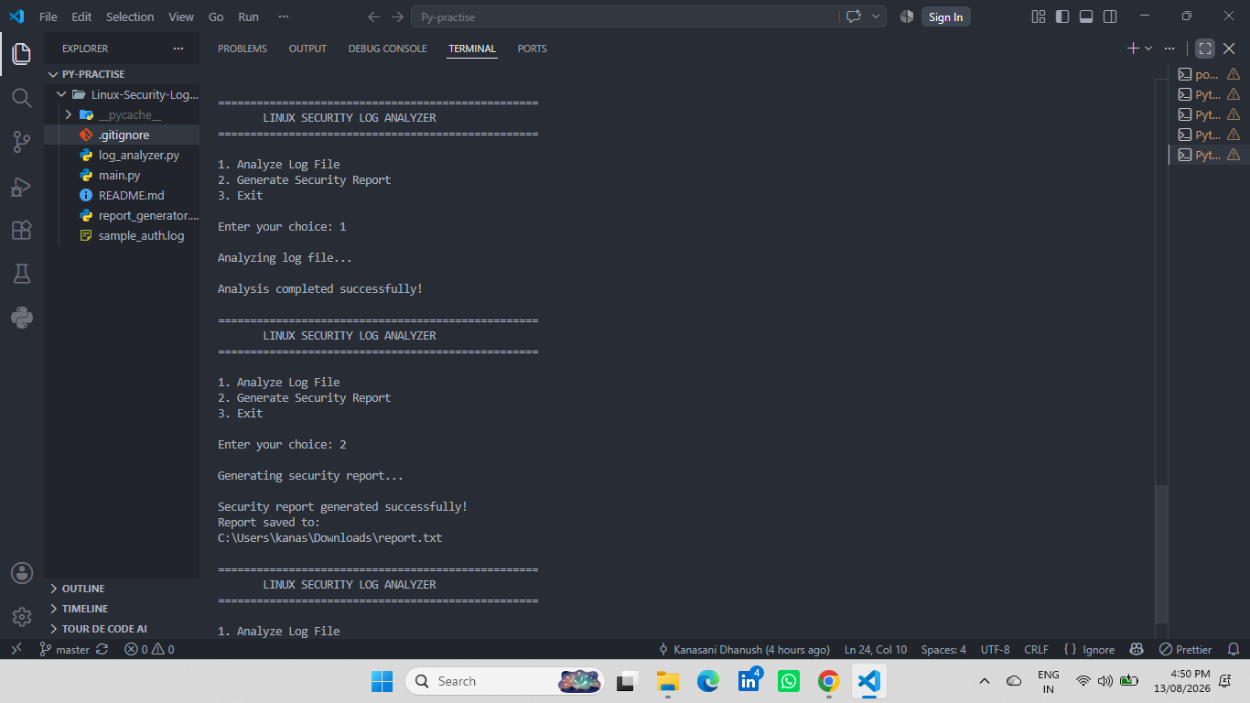
LIVE DEMO • PART 1
Core Functionality Walkthrough: Running the Analyzer
Clone the repo and run: python main.py --log "sample_auth.log"
An interactive menu appears with three options: Analyze Log File, Generate Security Report, Exit.
Selecting option 1 parses the sample log and extracts every failed SSH login event.
This is where log_analyzer.py does its work — regex pattern matching pulls out IPs, usernames, and timestamps.
================================================== LINUX SECURITY LOG ANALYZER ================================================== 1. Analyze Log File 2. Generate Security Report 3. Exit
Running the analyzer — VS Code terminal output
Linux Security Log Analyzer
5
Notes:
Now let's look at it running. The repo ships with a sample authentication log, so you can try it out immediately with `python main.py --log sample_auth.log`. That launches an interactive menu with three options. I'll select option 1 to analyze the log file — this is the point where log_analyzer.py takes over, using regular expressions to scan every line of the log, pull out failed SSH login events, and extract the IP address, the username that was attempted, and the timestamp for each one. [Show the analyzer.png screenshot here and briefly narrate what's on screen.]

Slide 6
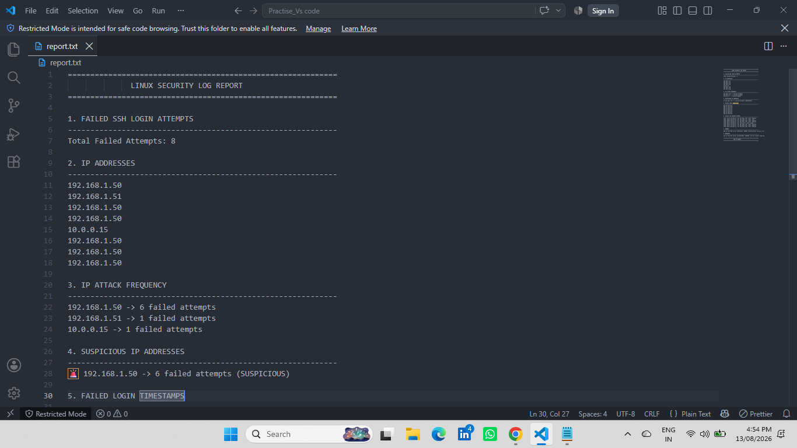
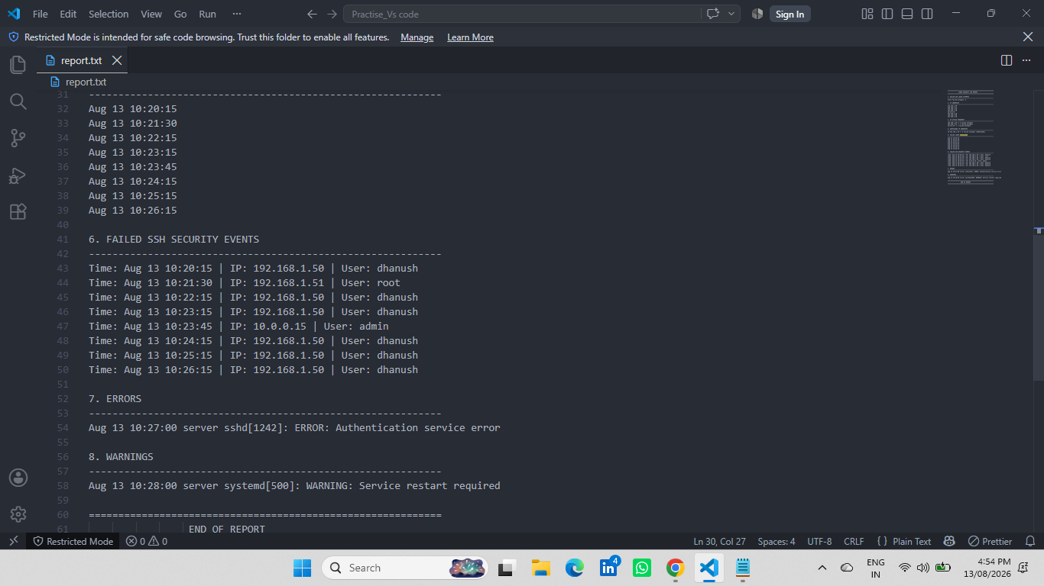
LIVE DEMO • PART 2
Core Functionality Walkthrough: Security Report Output
Selecting option 2 hands the analyzed data to report_generator.py.
The report totals failed SSH attempts and breaks down attempts by IP address — any IP with 5+ failed attempts is flagged 🚨 SUSPICIOUS.
The full report also includes failed-login timestamps, SSH security events, errors, and warnings.
Security report — summary (attempts, IPs, suspicious flags)
Security report — details (events, errors, warnings)
Linux Security Log Analyzer
6
Notes:
Selecting option 2 generates the full security report. In the sample data, there are 8 total failed attempts across three IP addresses. One of them, 192.168.1.50, is responsible for six of those eight attempts, so it crosses the suspicious threshold and gets flagged automatically. The full report goes further than this summary — it also lists failed-login timestamps, SSH security events, and any errors or warnings found in the log. [Show the security-report-summary.png and security-report-details.png screenshots here and walk through the fields.]

Slide 7
WHAT I LEARNED
Challenges Faced & Solutions
1
Linux auth logs vary in structure across distros and services. Built targeted regex patterns and tested them against varied sample log lines to reliably extract IPs, users, and timestamps.
Parsing inconsistent log formats
2
A single failed login shouldn't trigger an alert. Introduced a configurable threshold (default: 5 failed attempts) so only genuinely repeated attempts are flagged as suspicious.
Avoiding false positives
3
Kept analysis and reporting logic in separate modules (log_analyzer.py, report_generator.py) instead of one script, so each piece can be tested and extended independently.
Keeping the codebase maintainable
Note: customize this slide with the specific hurdles you hit while building — these are the most common ones for a project like this.
Linux Security Log Analyzer
7
Notes:
A few real challenges came up while building this. Log formats aren't perfectly uniform, so getting the regex patterns robust enough to reliably pull out IPs, usernames, and timestamps took iteration against varied sample lines. I also had to think carefully about false positives — one failed login is normal, so I added a configurable threshold, five attempts by default, before an IP gets flagged as suspicious. And to keep the project maintainable as it grew, I split the analysis logic and the report-generation logic into separate modules rather than one monolithic script. [This slide is a starting point — swap in the specific challenges you personally ran into.]

Slide 8
WHAT'S NEXT
Future Enhancements
1
Real-time log monitoring (live tailing, not just static files)
2
Support for additional Linux log formats beyond SSH auth logs
3
CSV and JSON export for the security report
4
Email alerts triggered automatically for suspicious activity
5
IP geolocation to show where attacks originate
6
Graphical security statistics / dashboard view
7
Additional CLI options for finer-grained control
8
Detection of more Linux security event types
Linux Security Log Analyzer
8
Notes:
Looking ahead, there's a clear roadmap for where this project can grow. The biggest jump would be real-time monitoring — tailing the log live instead of analyzing a static file after the fact — paired with automatic email alerts when a suspicious IP is detected. I'd also like to support additional Linux log formats beyond SSH auth logs, add CSV and JSON export so the report can feed into other tools, layer in IP geolocation to see where attacks are coming from, and eventually build a simple graphical dashboard on top of the existing analysis engine.

Slide 9
CONCLUSION
A Practical Step Toward
Smarter Linux Security
Delivers a working, modular Python tool that turns raw Linux auth logs into actionable security reports.
Demonstrates practical skills in regex-based parsing, file handling, CLI design, and security-focused logic.
Built as a portfolio and learning project — with a clear, realistic roadmap for future growth.
🛡
Linux • Python
Security
Thank you — Questions?
K. Venkata Dhanush • github.com/kanasanidhanush7-dev
Linux Security Log Analyzer
9
Notes:
To wrap up: this project delivers a genuinely useful, working tool — a modular Python application that turns raw, unreadable Linux authentication logs into a structured, actionable security report. Building it let me practice regex-based text parsing, file handling, command-line application design, and security-focused logic like threshold-based threat scoring. It started as a portfolio and learning project, and I've laid out a clear, realistic roadmap for where it can go next. Thank you — happy to take any questions.

