Slide 1
Online Fraud Payment Detection
Using Balanced Machine Learning Algorithms
Project Demonstration & Screenshots

Slide 2
Project Overview
Web-based application for detecting fraudulent payment transactions.
Uses machine learning models to classify transactions as normal or fraudulent.
Includes dataset loading, class balancing with SMOTE, model training, and fraud prediction.
Screenshots in this presentation show the project running and its main application workflow.
2

Slide 3
Technology / ML Components
• Python
• Django
• Pandas & NumPy
• Scikit-learn
• Imbalanced-learn / SMOTE
• Matplotlib & Seaborn
• Random Forest and Naive Bayes
3

Slide 4
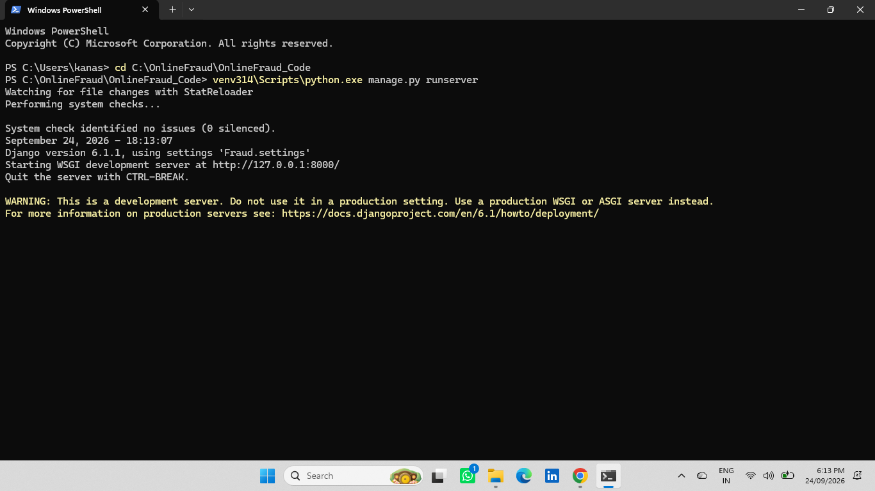
Project Running in Django
Project Running in Django
4

Slide 5
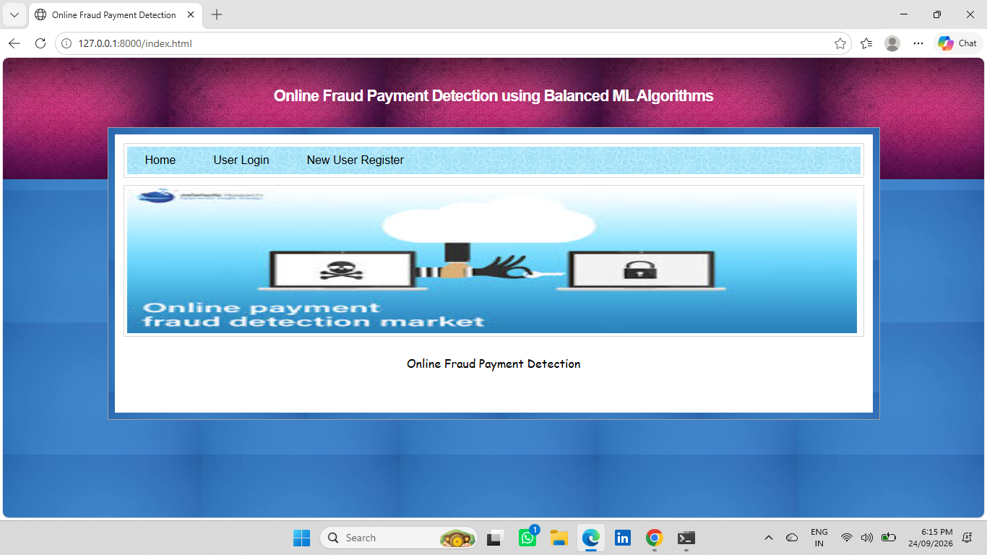
Project Home Page
Project Home Page
5

Slide 6
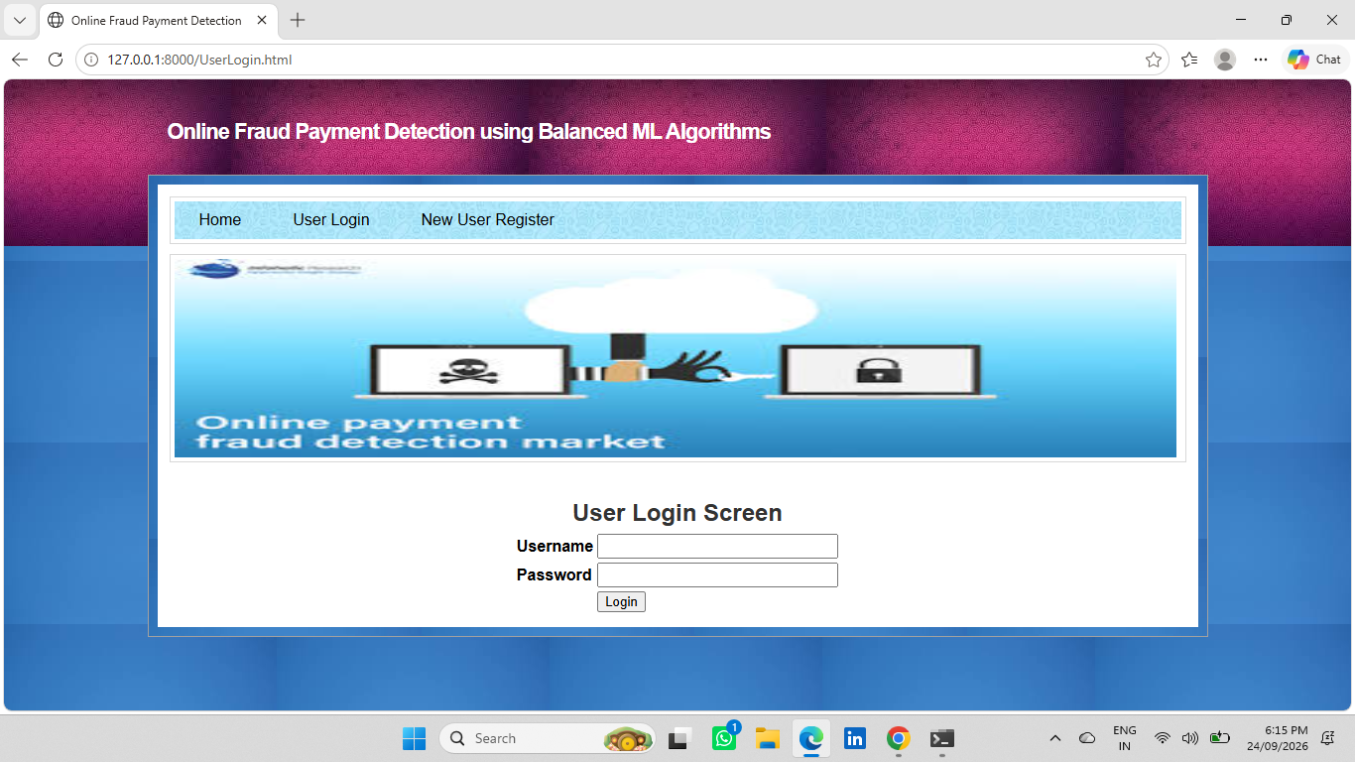
User Login Screen
User Login Screen
6

Slide 7
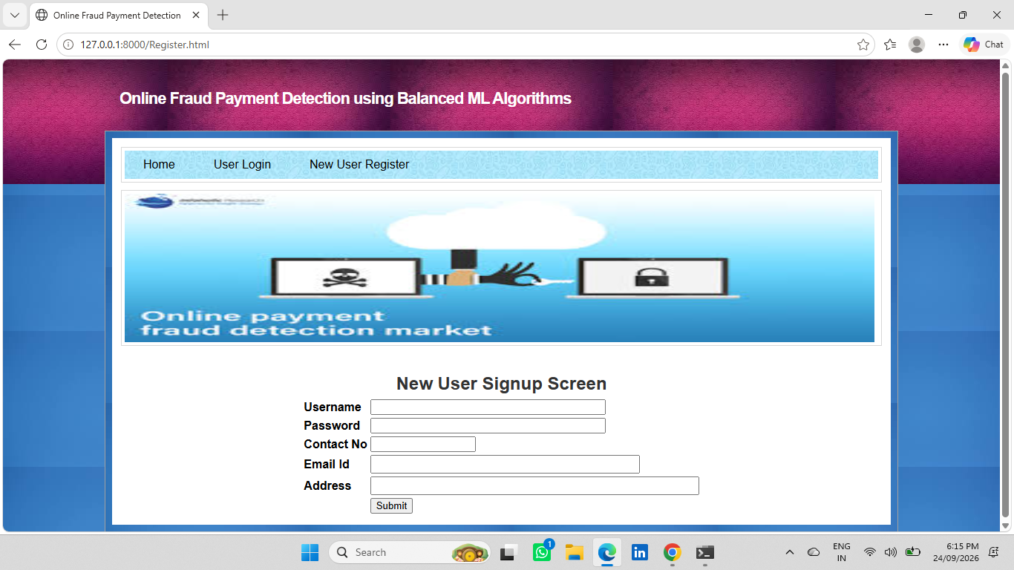
New User Registration Screen
New User Registration Screen
7

Slide 8
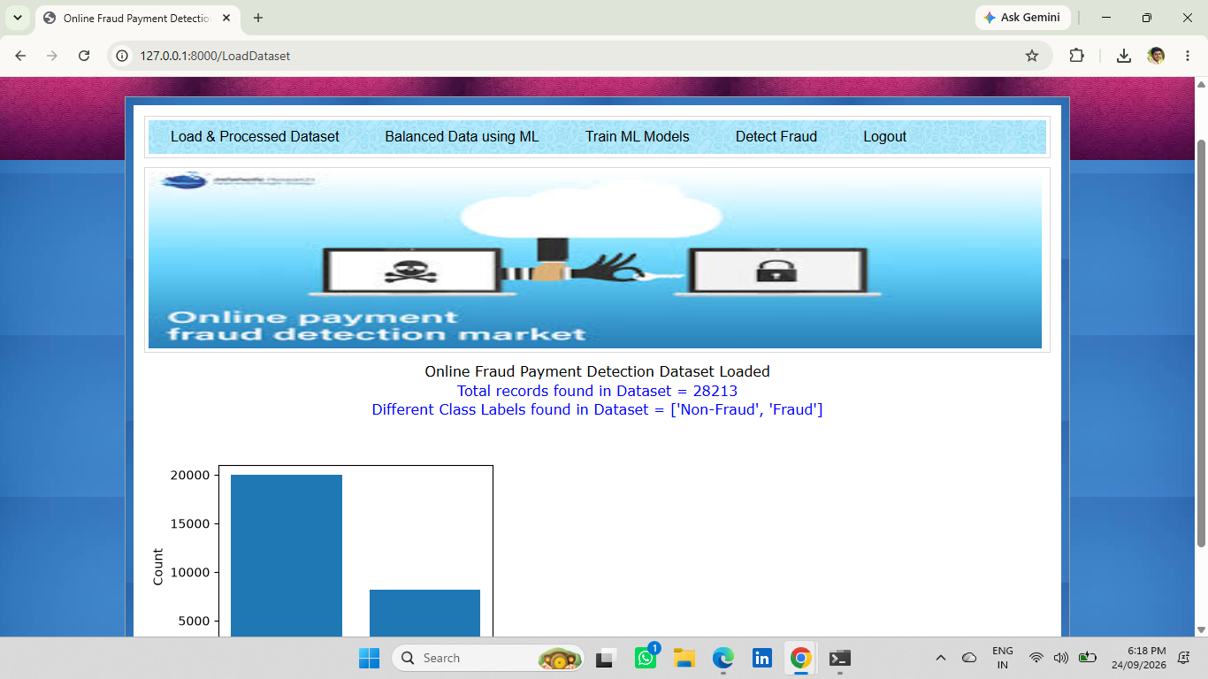
Loaded Dataset and Class Distribution
Loaded Dataset and Class Distribution
8

Slide 9
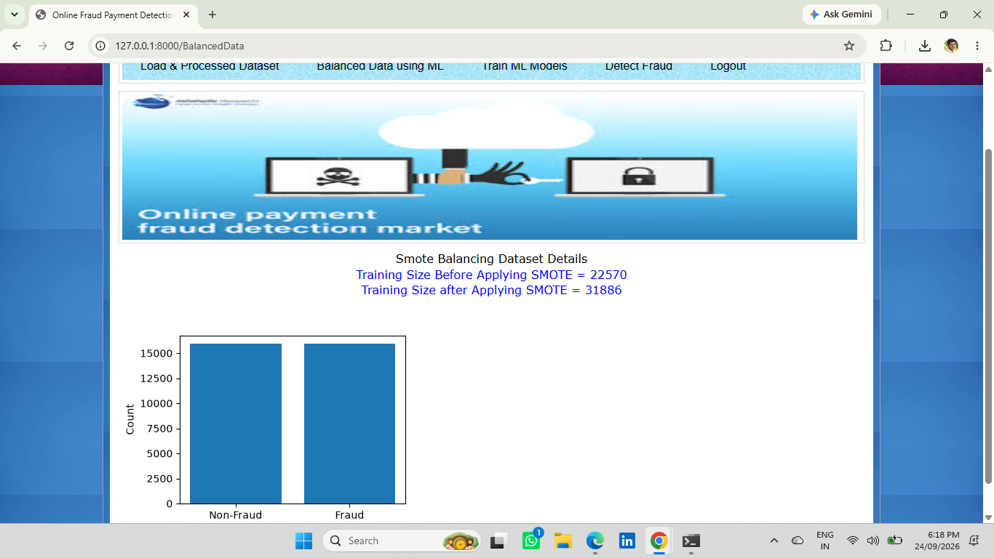
Balanced Dataset Using SMOTE
Balanced Dataset Using SMOTE
9

Slide 10
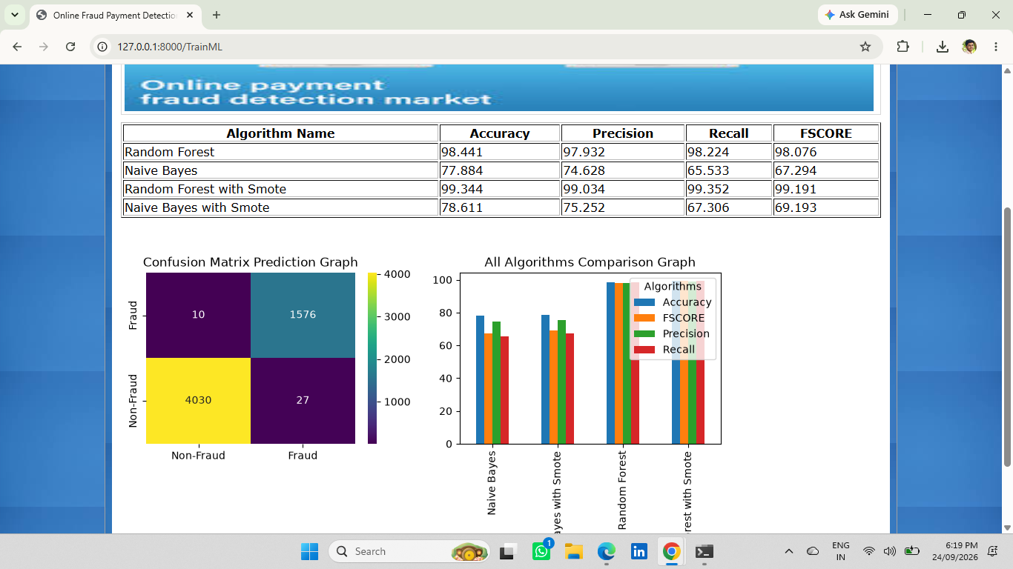
ML Model Training and Results
ML Model Training and Results
10

Slide 11
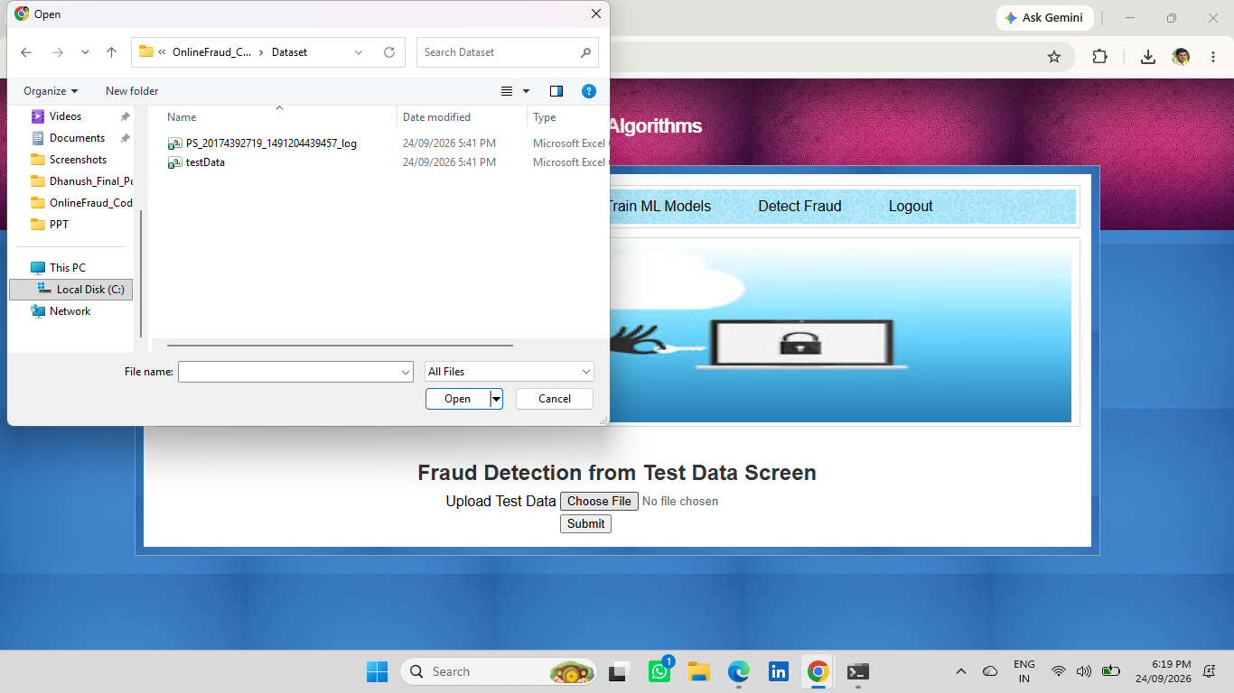
Fraud Detection Using Test Data
Fraud Detection Using Test Data
11

Slide 12
Project Demonstration Complete
Online Fraud Payment Detection using Balanced ML Algorithms
12

