Slide 1
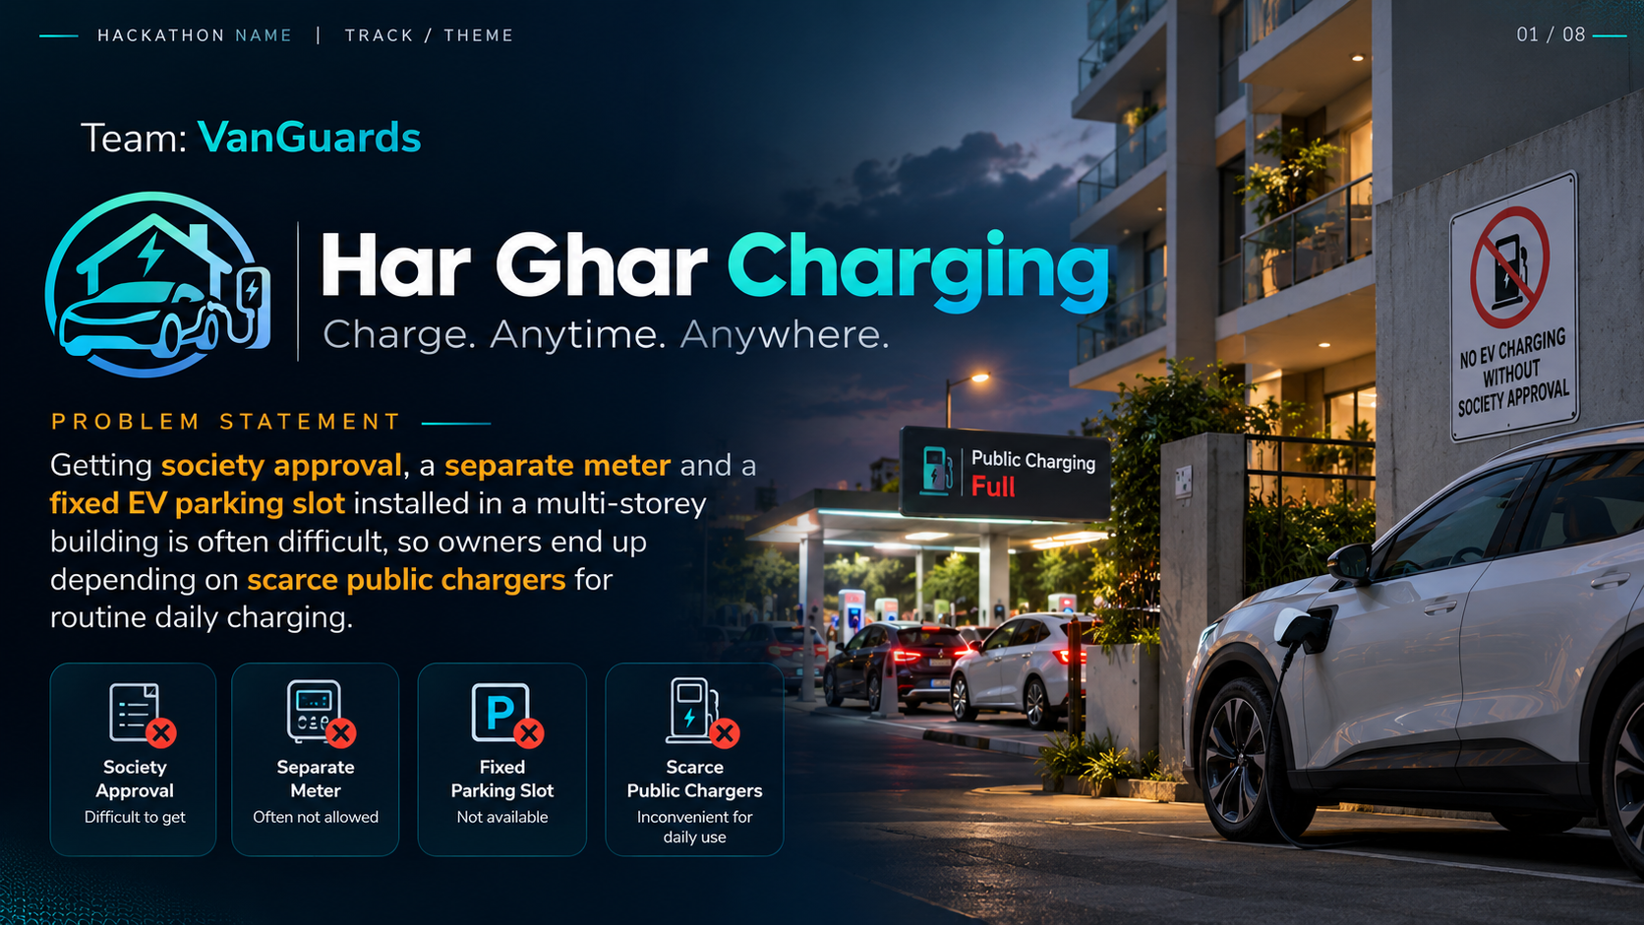

Slide 2
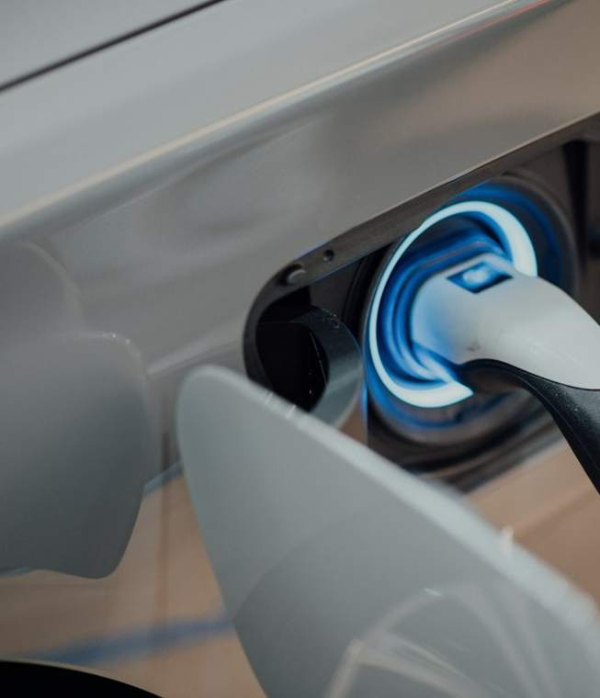
EXECUTIVE PITCH DECK
GLOBAL: ~20% of UK EV owners lack home charging. 82% of US multi-family residents have no in-building charger.
INDIA CONTEXT: 42%+ of urban EV owners live in apartments with zero designated charging bays.
SOURCE: Zapmap 2024 · US DOE · India CEA
You don't need to find a charger.
We bring charging to you.
One unified platform · Two strategic models · Zero range anxiety
Urban concierge hubs combined with secure distributed highway charging.
MODEL 1 — URBAN HUB + VALET
MODEL 2 — HIGHWAY DISTRIBUTED
• Concierge Valet: Vehicle collected 9 PM, returned 7 AM at 100% SoC
• Highway Hosts: Private & hotel chargers unlocked via Bluetooth token
• Bank-Grade Trust: Virtual 3-zone security perimeter + automated escrow
• Capital Efficiency: Owned vertical hubs (margin) + host network (scale)
⚠ RESEARCH NOTE: In dense metros, 42%+ lack home charging. Reliability is improving (12% fail rate, down from 14%), so convenience—not permanent failure—is the primary value driver.
⚠ RESEARCH NOTE: Data revised with J.D. Power (2024), Zapmap, NREL, and Frontiers in Sustainable Cities (2026). Sourced empirical corrections applied throughout.

Slide 3
THE PROBLEM & MARKET OPPORTUNITY
Why public EV charging fails drivers today — and the data behind it
High-control urban overnight charging paired with an end-to-end digital valet flow.
🏢
⚡
🛣️
• Doorstep Return: Pre-conditioned vehicle back at owner's bay by 7 AM.
• Escrow Settlement: Post-delivery photo verified; payment auto-released with digital receipt.
No Home Charger Access
Unreliable Public Charging
Highway Corridor Gaps
Millions of Idle Chargers
GLOBAL: ~20% of UK EV owners lack home charging. 82% of US multi-family residents have no in-building charger.
INDIA CONTEXT: 42%+ of urban EV owners reside in apartment complexes with zero designated charging bays.
SOURCE: Zapmap 2024 · US DOE · India CEA
FAILURE RATE: 12% to 20% of public charging sessions fail depending on measurement standard.
BROKEN CHARGERS: 52.4% of non-Tesla drivers encountered defective chargers in 2023. Public charging reliability is improving, so pitch must emphasize convenience over permanent failure.
SOURCE: J.D. Power 2024 · PlugShare
CHARGING DESERTS: Fast-charging gaps persist along inter-city highway corridors.
RANGE BOTTLENECKS: Long-distance travel outside metropolitan rings suffers from severe non-Tesla charger queueing and broken hardware.
SOURCE: NREL Corridor Analysis 2024
UNEXPLOITED ASSETS: Private residential, workplace, and hotel chargers sit idle 20+ hours daily.
DISTRIBUTED POTENTIAL: High CapEx public networks lag while private capacity remains locked behind closed gates.
SOURCE: Frontiers Sustainable Cities 2026
⚠ RESEARCH NOTE: Original deck's '42% lack home charging' was unsourced globally (85% of US EV drivers have home garages). However, 42%+ is accurate for metropolitan apartment dwellers in India and dense EU cities. Reliability is improving (12% fail rate, down from 14%), so convenience—not permanent public failure—is the primary value driver.

Slide 4
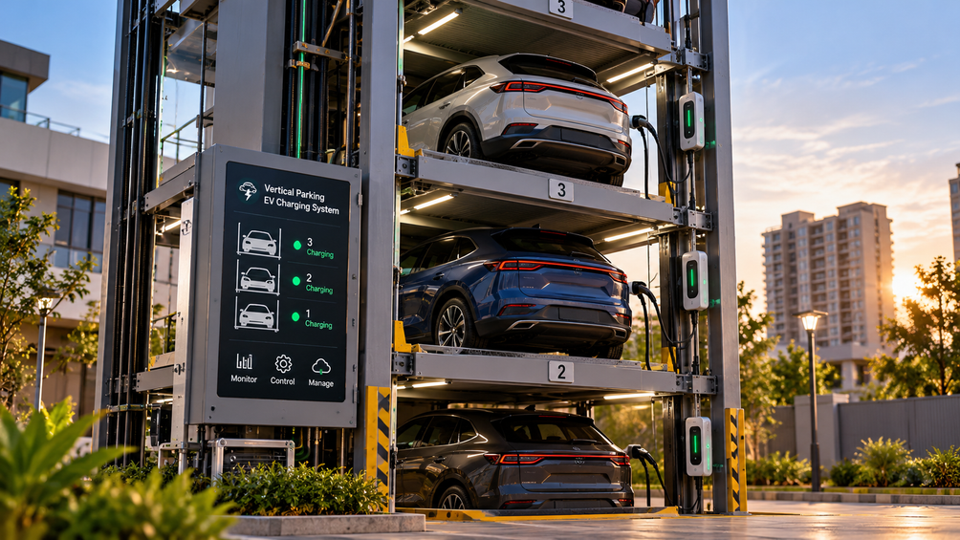
MODEL 1 — URBAN CHARGING HUB + VALET
Company-owned vertical parking towers with concierge pickup & return
P2P corridor charging network backed by smart locks, automated escrow, and 5-phase onboarding.
END-TO-END DIGITAL CONCIERGE FLOW
STAGE 1: SCHEDULE (9:00 PM)
• Monetize Idle Assets: Turn driveway, hotel, or workplace chargers into income.
• Low-CapEx Kit: Platform ships plug-and-play smart lock, IoT gateway, and CCTV sensor.
• Virtual Perimeter: 3-zone fence automatically cuts power if guest crosses boundaries.
• Automated Payouts: Weekly direct bank deposits with comprehensive $1M insurance.
• Escrow Lock: Platform holds estimated session + valet fee in digital escrow.
STAGE 2: PICKUP (9:30 PM)
Upload charger spec, breaker size & kWh price.
• 360° AI Scan: Smartphone camera records vehicle panels to eliminate damage disputes.
• Route Search: Filter corridor chargers by plug type, power, and verified host rating.
• 45-Min Reservation: Guaranteed slot with payment locked in secure escrow.
• Contactless BLE Token: Unlock gate and charger via Bluetooth — zero host interaction.
• Live Telemetry: Real-time tracking of kWh delivered, speed, and cost.
Electrician reviews panel capacity & earthing.
• Tower Stacking: Vehicle automatically parked in vertical automated stall.
KEY ENGINEERING CHOICES
• 7–11 kW AC per stall: Mass EVs cap at 11 kW; 22 kW adds cost for zero overnight gain.
• ~2× Stacker Density: Proven vendor spec (avoids single-point failure carousel risk).
• Solar + BESS Microgrid: Lowers peak grid tariffs and enables green charging.
• Value-Add Concierge: Windshield wash, tyre check, and interior vacuum.
• Smart AC Charging: 7–11 kW charge curve with continuous thermal & battery health monitoring.
STAGE 4: RETURN (7:00 AM)
• Doorstep Delivery: Pre-conditioned vehicle returned to owner's parking bay ready for work.
• Escrow Settlement: Post-delivery photo verified; payment auto-released with digital receipt.
⚠ RESEARCH NOTE: Valet unit economics warning: US startups (Luxe, Zirx) collapsed over labour overheads. Fewer than 1/3 of EV drivers need daily charging. Solution: Offer weekly subscription packages (1–2x/week) to raise break-even probability from 10–15% to 25–35%.

Slide 5
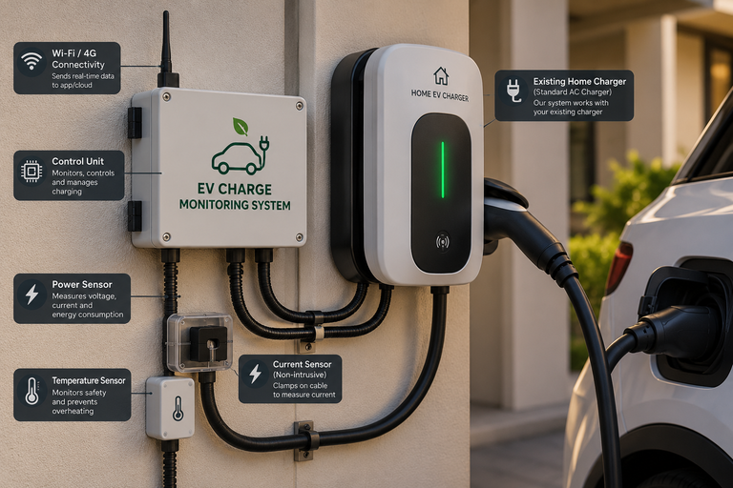
MODEL 2 — HIGHWAY DISTRIBUTED CHARGING & ONBOARDING
Unlocking private and commercial chargers with frictionless host onboarding
3-zone virtual perimeter, cryptographic smart locks, and sub-second hardware shutoffs.
🚗 FOR HIGHWAY TRAVELLERS
🏠 FOR CHARGER HOSTS
• Route Search: Filter corridor chargers by plug type, power, and verified host rating.
• Permanent cryptographic master key on mobile app.
• Instant manual override or session termination.
• Real-time earnings, kWh sold, and escrow tracking.
• Zone reconfiguration & whitelist trusted neighbours.
• 45-Min Reservation: Guaranteed charging slot with payment held in secure escrow.
• Low-CapEx Kit: Platform ships plug-and-play smart lock, IoT gateway, and CCTV sensor.
Permitted vehicle footprint and charger radius. Active BLE token authorizes power flow; telemetry streams to host dashboard.
• Virtual Perimeter: 3-zone fence automatically cuts power if guest crosses boundaries.
Distributed charger with smart lock & CCTV sensor kit.
• Live Telemetry: Real-time tracking of kWh delivered, charging speed, and cost.
SESSION ECONOMICS (Illustrative)
• Automated Payouts: Weekly direct bank deposits with comprehensive $1M insurance.
Traveller: ~$12.50 · Host: ~$9.80 (78%) · Platform: ~$2.70 (22%)
HOST ONBOARDING — 5 PHASES FROM SIGNUP TO PAYOUT
01
Sensor: Dual NTC thermistors inside connector pins.
Trigger: Terminal temp >60°C or rises >3°C/min.
Action: Current throttled 50%; contactor opens in 30s.
Sensor: Integrated Type-B RCD sampling at 1,000 Hz.
Trigger: DC leakage >6 mA or AC residual >30 mA.
Action: High-voltage relay cuts power in <30 ms.
Verification
03
Kit Install
04
Go-Live
05
Earn & Review
Upload charger spec, breaker size & kWh price.
Electrician reviews panel capacity & earthing.
⚠ RESEARCH NOTE: Hardware Safety Standards: All host smart locks and IoT gateways comply with UL 2231, IEC 61851, and SAE J1772 with pre-session automated self-diagnostic testing.
Calibrate 3-zone fence; listing published to map.
Automated weekly bank payouts & host rating.
⚠ RESEARCH NOTE: Arithmetic & Corridor Reality: A 45-min slot at 7.4 kW yields ~5.5 kWh (~20 miles of range), NOT 14.8 kWh (which takes 2 hours). Strategic pivot: Partner with hotels & fuel plazas for DC fast charging (scoring highest in NREL driver satisfaction), using host chargers for local top-ups.

Slide 6
SECURITY, ACCESS CONTROL & SAFETY ARCHITECTURE
Bank-grade trust, multi-tier permissions, and automated failsafe cutoffs
3-zone virtual perimeter, cryptographic smart locks, and sub-second hardware shutoffs
🛡️ 3-ZONE VIRTUAL PERIMETER
🔐 DUAL-MODE SMART LOCKS
⚠️ 3 FAILSAFE CUTOFF TRIGGERS
🟢 GREEN ZONE (Charging Bay)
🏠 OWNER MODE (Full Admin)
🌡️ Thermal Overheat Probe
Permitted vehicle footprint and charger radius.
Active BLE token authorizes power flow; telemetry streams to host dashboard.
• Permanent cryptographic master key on mobile app.
Sensor: Dual NTC thermistors inside connector pins.
Trigger: Terminal temp >60°C or rises >3°C/min.
Action: Current throttled 50%; contactor opens in 30s.
• Instant manual override or session termination.
• Real-time earnings, kWh sold, and escrow tracking.
🟡 YELLOW ZONE (5m Buffer)
⚡ Ground-Fault (RCD) Monitor
5-meter warning boundary around vehicle.
Movement triggers push alert to host and traveller; CCTV switches to 4K recording.
• Zone reconfiguration & whitelist trusted neighbours.
Sensor: Integrated Type-B RCD sampling at 1,000 Hz.
Trigger: DC leakage >6 mA or AC residual >30 mA.
Action: High-voltage relay cuts power in <30 ms.
🚗 TRAVELLER MODE (Time-Boxed)
• Ephemeral Bluetooth LE key valid only during slot.
🔴 RED ZONE (Property Breach)
• Operates offline (no cellular signal needed at driveway).
📷 AI Vision Damage Inspection
Residence entrance or private garage boundary.
Instant high-voltage power kill in <30 ms; 105 dB alarm + security alert.
Sensor: 4K optical sensor with night-vision IR.
Trigger: Cable dragged, connector dropped, panel scuff.
Action: Escrow frozen; dispute ticket generated with photos.
• Zero access to host home premises or hardware settings.
• Automated lock re-engagement when window elapses.
⚠ Hardware complies with UL 2231, IEC 61851, and SAE J1772 with pre-session automated self-diagnostics before every charge.

Slide 7
BUSINESS MODEL & ECOSYSTEM FLYWHEEL
Balancing high-margin owned assets with zero-CapEx distributed scale
7 diversified revenue streams powered by a self-reinforcing three-sided network
THE 3-SIDED ECOSYSTEM FLYWHEEL
7 DIVERSIFIED REVENUE STREAMS
SUPPLY CHANNELS
⚡
Charging Margin
Retail electricity markup at owned hubs ($0.12/kWh) and host spread ($0.05/kWh).
Urban vertical stacker hubs (owned), residential host driveways, hotel corridors, commercial fleet depots.
🚗
Valet Concierge Fee
$15–$25 flat fee per vehicle pickup, charge, and morning return event.
⇅ Self-Reinforcing Network Effects ⇅
CORE PLATFORM
📱
Platform Booking Fee
10%–15% transaction fee charged to guest traveller on each reserved slot.
Matching engine, dynamic pricing, BLE token smart locks, escrow clearinghouse, AI vision & safety telemetry.
🏠
Host Revenue Spread
20%–22% platform cut deducted from host payouts (covering insurance & hardware).
⇅ Self-Reinforcing Network Effects ⇅
DEMAND CHANNELS
Urban apartment EV drivers, inter-city road-trippers, ride-hail (Uber/Ola), and last-mile delivery fleets.
💎
Driver Membership
$19.99/mo subscription unlocking priority booking, waived fees, and valet perks.
🚌
Commercial Fleet SLAs
$120–$180/vehicle/mo bulk overnight charging contracts for delivery/ride-hail.
FLYWHEEL: Each 50 corridor hosts cut detour distance by 3.2 miles → higher conversion → more bookings → higher host earnings attract more supply.
⭐
Value-Add Services
$10–$30 per add-on: overnight windshield wash, tyre pressure, and battery diagnostics.
⚠ RESEARCH NOTE: Owned urban hubs deliver 32% EBITDA margins; distributed host chargers provide exponential geographic scale with near-zero CapEx.

Slide 8
ROADMAP, BREAK-EVEN ODDS & RESEARCH EVIDENCE
Execution milestones paired with verified empirical industry research
5 probability-weighted rollout phases and 10 verified research citations
5-PHASE ROADMAP & BREAK-EVEN ODDS
10 CORE RESEARCH CITATIONS
Phase 1
Urban Concierge Pilot
35%
• J.D. Power (2024):
Public EV Charging Study: Failed attempts fell to 12% (down from 14%); non-Tesla fail rate 52.4%.
1 owned hub + valet in 1 metro; 200 users. (CapEx: $650K)
• Zapmap & US DOE (2024):
~20% of UK EV drivers lack home chargers; 82% of US multi-family residents have no in-building charging.
Phase 2
Multi-Family Apartment Sharing
40%
• Frontiers in Sustainable Cities (2026):
UK P2P sharing has ~9,000 hosts (<1% EV drivers); privacy and thin demand are main barriers.
250 host chargers in apartments (EVmatch model). (CapEx: $200K (MVP))
• EVmatch Case Study:
124 chargers across 21 California apartment complexes generated 6,200+ annual sessions (~1/charger/week).
Phase 3
Highway Corridor Network
25%
• CBInsights / Luxe Post-Mortem:
Nightly valet failed over labour unit economics; validates weekly subscription model as viable path.
75 hotel & fuel plaza DC fast charging partners. (CapEx: $450K)
• NREL Highway Study (2024):
Mapped corridor charging deserts; hotel-located chargers scored highest in dwell-time satisfaction.
Phase 4
Regional Scale-Up
20%
• Autoparkit Whitepaper:
Automated parking stackers double density (~2×); carousels go higher but carry single-point failure risk.
10 urban hubs, 2,500 hosts, membership tiers. (CapEx: $3.5M)
• Myenergi & Alibaba Guides:
Mass-market EVs max at 11 kW AC charging; 22 kW AC adds cost with zero overnight benefit.
Phase 5
Enterprise Fleet SLAs & V2G
15%
• Charging Physics (Verified):
45-min at 7.4 kW yields 5.5 kWh (~20 mi range). Fast DC charging required for highway corridor segments.
Commercial fleet contracts; V2G utility integration. (Series B Raise)
• Probability Methodology:
Break-even odds reflect author's synthesis of unit economics, utilization benchmarks, and startup survival data.
⚠ RESEARCH NOTE: Lead with Phase 2 (Apartment community sharing — EVmatch model). Treat valet as a high-margin concierge tier. Partner with hotels and fuel plazas for fast DC corridor charging.

Slide 9
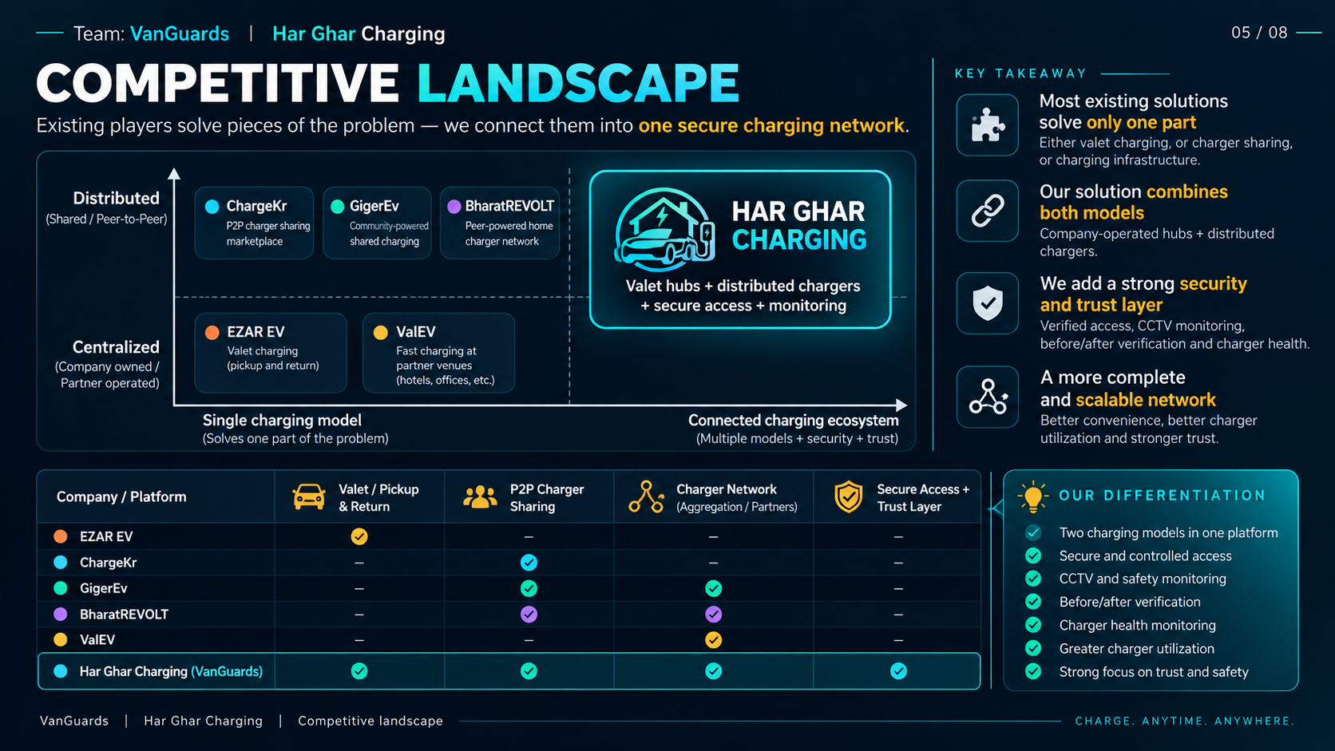

Slide 10
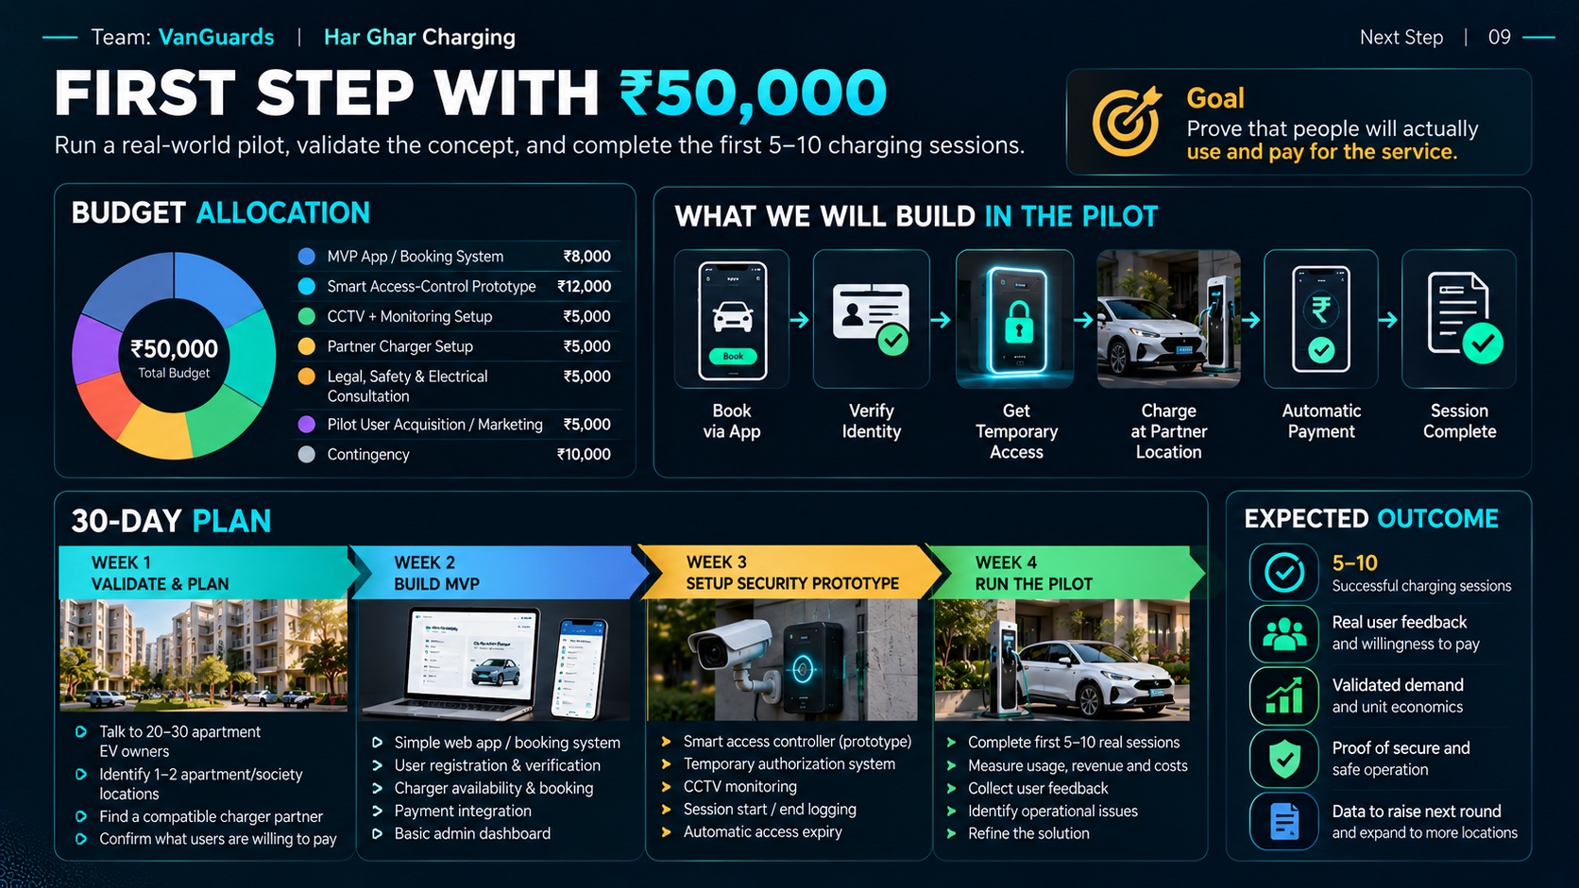

Slide 11
