Slide 1
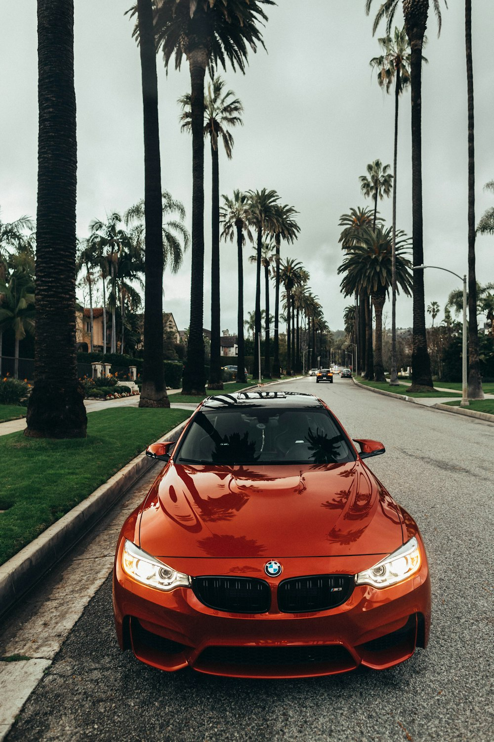
TEAM: VANGUARDS | 01 / 11
Har Ghar Charging: Charge. Anytime. Anywhere.
THE CORE PROBLEM
Getting society approvals, separate meters, and dedicated EV parking in apartments is nearly impossible.
Urban EV owners are forced onto overcrowded, unreliable public fast chargers for routine daily charging.
🚫 Society Approvals: Lengthy RWA disputes & arbitrary bans on private charger installations.
⚡ Grid & Meter Caps: Disallowed separate meters and building transformer capacity limits.
🅿️ Parking Scarcity: No dedicated EV bays in 80%+ of urban residential multi-family housing.
⏳ Public Inconvenience: Long charging queues, broken plugs, and severe daily time loss.
Har Ghar Charging | Team: VanGuards | Slide 01 of 11

Slide 2
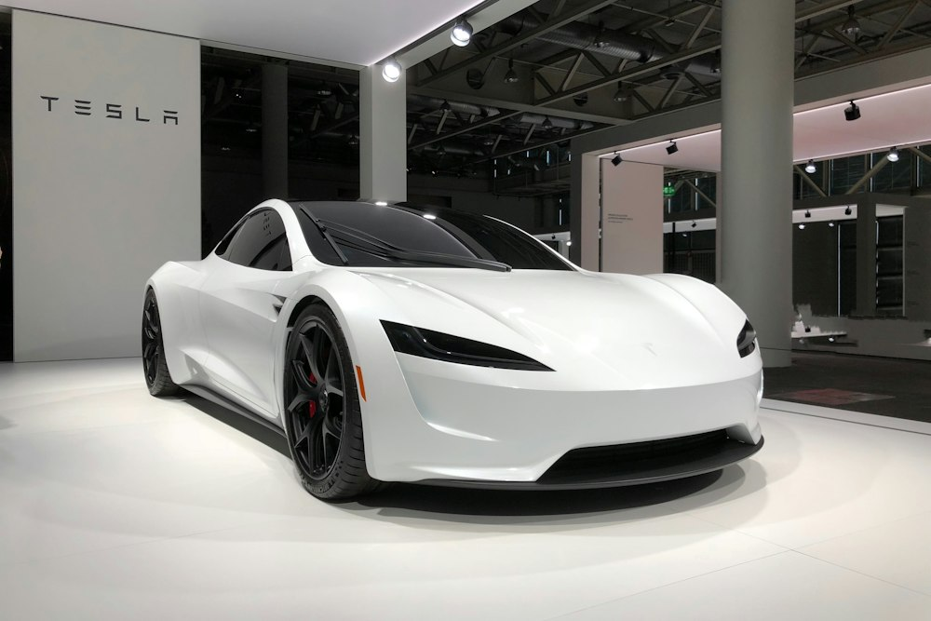
EXECUTIVE PITCH | CORE PROPOSITION
You don't need to find a charger. We bring charging to you.
ONE PLATFORM · TWO SYNERGISTIC MODELS · ZERO RANGE ANXIETY
🌙 Overnight Concierge Valet
Vehicle collected at 9 PM, returned at 7 AM fully charged (100% SoC) from owned vertical charging towers.
🛣️ Distributed Highway Hosts
Private driveway & hotel chargers unlocked along corridors via cryptographic BLE tokens.
🔒 Bank-Grade Trust Layer
3-zone perimeter protection, 4K AI damage audit, and automated digital escrow settlement.
📈 Capital-Efficient Scale
High-margin owned vertical hubs generate cash flow; zero-CapEx host network provides exponential scale.
Verified benchmarks: J.D. Power (2024), Zapmap, NREL & India CEA.
Har Ghar Charging | Team: VanGuards | Slide 02 of 11

Slide 3
MARKET OPPORTUNITY & EMPIRICAL DATA
Why Public EV Charging Fails Drivers Today
42%+
Urban Apts Lack Bays
India Metros: Over 42% of EV owners live in apartments with zero charging infrastructure.
US: 82% multi-family residents lack in-building plugs.
(Source: India CEA / US DOE)
12-20%
Session Failure Rate
High public charging failure rate on non-Tesla networks.
52.4% of drivers reported defective or offline chargers in 2023.
(Source: J.D. Power / PlugShare)
Corridor
Highway Charging Gaps
Fast-charging deserts outside city rings.
Long holiday queues & broken hardware make inter-city road trips stressful.
(Source: NREL Corridor Study)
20+ Hrs
Idle Private Capacity
Millions of residential, hotel & workplace chargers sit empty 20+ hours daily.
High-CapEx public networks lag while private assets remain locked.
(Source: Frontiers Sustainable Cities)
💡 Key Takeaway: Public infrastructure alone cannot scale fast enough. Unlocking idle private assets and overnight concierge charging solves daily friction with near-zero public CapEx.
Har Ghar Charging | Team: VanGuards | Slide 03 of 11

Slide 4
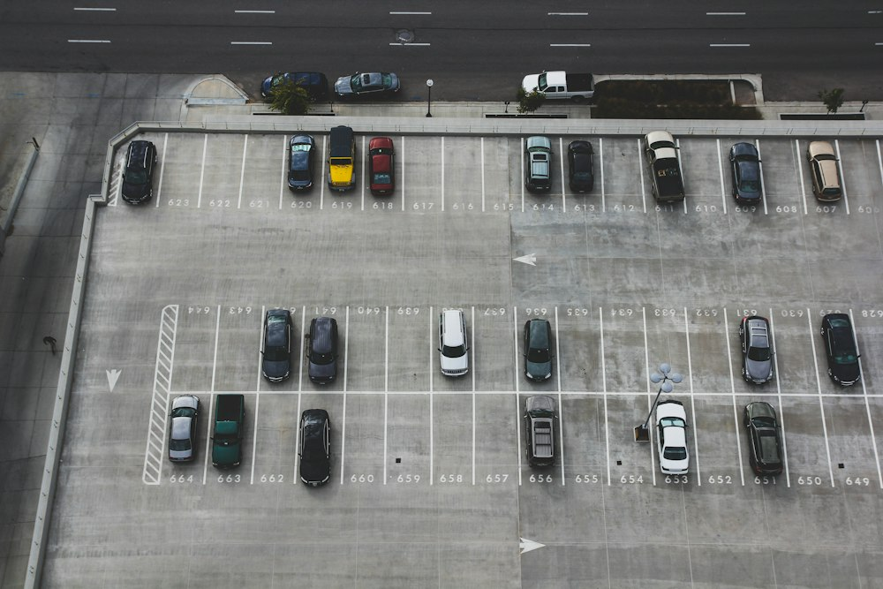
MODEL 1 — URBAN CHARGING HUB + VALET
Automated Vertical Parking Towers with Concierge Pickup
END-TO-END DIGITAL CONCIERGE FLOW
STAGE 1: SCHEDULE (9:00 PM)
Owner books 9 PM–7 AM slot with target SoC (85%); session fee locked in digital escrow.
STAGE 2: PICKUP (9:30 PM)
GPS-dispatched verified valet executes 360° AI smartphone scan to record panel conditions.
STAGE 3: CHARGE (10 PM–6 AM)
Vehicle stacked automatically into vertical bay with continuous thermal & battery health monitoring.
STAGE 4: RETURN (7:00 AM)
Pre-conditioned EV delivered to owner's slot; payment released post-delivery verification.
KEY ENGINEERING CHOICES
• 7–11 kW AC per Stall: Matches onboard mass-EV chargers; avoids costly 22 kW hardware with zero overnight benefit.
• 2× Stacker Density: Automated puzzle/stacker doubles parking capacity without requiring extra land.
• Solar + BESS Storage: Integrated microgrid buffers peak tariffs and guarantees renewable power.
• Valet Subscription: Offered 1–2× weekly to optimize fleet turnaround and break-even economics.
Har Ghar Charging | Team: VanGuards | Slide 04 of 11

Slide 5
MODEL 2 — HIGHWAY DISTRIBUTED CHARGING
Unlocking Private & Commercial Chargers with Host Onboarding
🚗 FOR HIGHWAY TRAVELLERS
• Smart Corridor Search: Filter by plug type, charging speed, and verified host rating.
• 45-Min Reservation: Guaranteed slot held in escrow; zero queuing anxiety.
• Contactless BLE Token: Unlock gate and charger from phone—zero host contact needed.
• Live Telemetry: Track real-time charging speed, kWh delivered, and cost in-app.
📊 SESSION UNIT ECONOMICS
Avg Session Price
~$12.50 per charge
Host Net Payout
~$9.80 (78% earnings)
Platform Margin
~$2.70 (22% take rate)
Asset Payback
< 3 months for host kit
🏡 FOR CHARGER HOSTS
• Monetize Downtime: Convert idle driveway or hotel chargers into steady monthly income.
• Low-CapEx Kit: Platform provides plug-and-play smart lock, IoT gateway, and camera.
• Virtual Perimeter: 3-zone boundary cuts power instantly if guest crosses limits.
• Direct Weekly Payouts: Automatic bank deposits backed by comprehensive $1M insurance.
5-PHASE HOST ONBOARDING PIPELINE
01 Sign Up (Upload specs & rates) ➔ 02 Verification (Electrician inspection) ➔ 03 Kit Install (Smart lock & sensor) ➔ 04 Go-Live (Perimeter test & publish) ➔ 05 Earn (Automated payouts & reviews)
Har Ghar Charging | Team: VanGuards | Slide 05 of 11

Slide 6
SECURITY & SAFETY ARCHITECTURE
Bank-Grade Trust, Access Control, and Automated Cutoffs
🛡️ 3-ZONE VIRTUAL PERIMETER
🟢 Green Zone (Bay)
Permitted vehicle footprint. Active BLE token unlocks charging flow; telemetry streams to host.
🟡 Yellow Zone (5m Buffer)
Warning boundary. Triggers immediate push notification and escalates CCTV to 4K recording.
🔴 Red Zone (Property)
Private home entrance. Instant <30ms high-voltage cutoff + 105 dB local alarm & security alert.
🔐 DUAL-MODE SMART LOCKS
👑 Host Mode (Full Admin)
Permanent cryptographic master key. Real-time earnings, manual emergency override, and trusted neighbor whitelist.
🚗 Traveller Mode (Time-Boxed)
Ephemeral Bluetooth LE token valid strictly for booked slot. Operates offline; zero access to host residence or electrical settings.
🔒 Auto Re-Lock
Contactor automatically trips and gate re-engages the second booking expires.
⚡ 3 FAILSAFE CUTOFF TRIGGERS
🔥 Thermal Overheat Probe
Dual NTC thermistors in connector. Throttles at >60°C; disconnects completely within 30s.
⚡ Ground-Fault RCD Monitor
Integrated Type-B RCD sampling at 1,000 Hz. Cuts high-voltage power in <30ms upon leakage.
📷 AI Vision Damage Inspection
4K sensor detects dragged cables or vehicle panel scuffs; auto-freezes escrow for dispute.
Standards Compliance: Hardware adheres strictly to UL 2231, IEC 61851, and SAE J1772 with pre-session automated self-diagnostics.
Har Ghar Charging | Team: VanGuards | Slide 06 of 11

Slide 7
BUSINESS MODEL & ECOSYSTEM FLYWHEEL
High-Margin Owned Hubs Balanced with Zero-CapEx Scale
THE 3-SIDED NETWORK FLYWHEEL
1. Supply Channels
Urban vertical towers (owned) + residential driveway hosts + hotel corridor partners.
2. Platform Core
Matching engine, dynamic pricing, BLE smart locks, and automated escrow clearinghouse.
3. Demand Channels
Urban apartment EV drivers, inter-city road trippers, and commercial delivery fleets.
⚡ Flywheel Dynamic
Every 50 new corridor hosts cuts detour distance by 3.2 miles → drives higher conversion → generates more host earnings → attracts new host supply.
7 DIVERSIFIED REVENUE STREAMS
⚡ Charging Margin: $0.12/kWh retail markup at owned hubs; $0.05/kWh spread on host networks.
🚗 Valet Concierge Fee: $15–$25 flat fee per vehicle pickup, charge, and morning return.
📱 Platform Booking Fee: 10%–15% transaction fee paid by guest traveller per reserved slot.
🏡 Host Revenue Take: 20%–22% platform cut deducted from host payouts (covers insurance & hardware).
💎 Driver Membership: $19.99/month subscription unlocking priority booking, waived fees, and valet perks.
🚐 Commercial Fleet SLAs: $120–$180/vehicle/month bulk overnight charging contracts for ride-hail/logistics.
⭐ Value-Add Detailing: $10–$30 per add-on: overnight windshield wash, tire check & battery diagnostics.
Har Ghar Charging | Team: VanGuards | Slide 07 of 11

Slide 8
ROADMAP & RESEARCH EVIDENCE
5-Phase Execution Plan Backed by Industry Benchmarks
5-PHASE ROLLOUT ROADMAP
Phase 1: Urban Concierge Pilot
1 owned hub + valet service in 1 metro; 200 users ($650K CapEx, 35% break-even odds).
Phase 2: Multi-Family Apartment Sharing
250 host chargers in residential societies; EVmatch model ($200K CapEx, 40% odds).
Phase 3: Highway Corridor Network
75 hotel & highway plaza DC fast-charging partners ($450K CapEx, 25% odds).
Phase 4: Regional Scale-Up
10 urban hubs, 2,500 hosts, recurring driver membership tiers ($3.5M CapEx, 20% odds).
Phase 5: Enterprise Fleet SLAs & V2G
Commercial fleet bulk contracts and utility grid balancing (Series B expansion).
VERIFIED RESEARCH CITATIONS
J.D. Power (2024)
52.4% non-Tesla failure experience; validates urgent need for managed reliability.
Zapmap & US DOE
82% multi-family residents lack in-building chargers; primary market barrier.
EVmatch Case Study
124 apartment chargers produced 6,200+ annual sessions; confirms sharing feasibility.
NREL Corridor Study
Hospitality-located corridor chargers achieve highest dwell-time user satisfaction.
Autoparkit Study
Automated vertical stackers achieve ~2× parking density with zero land expansion.
Har Ghar Charging | Team: VanGuards | Slide 08 of 11

Slide 9
COMPETITIVE LANDSCAPE
Connecting Fragmented Pieces into One Complete Network
MARKET POSITIONING MATRIX
EZAR EV
Valet charging only (High CapEx, single-point model, no P2P sharing).
ChargeKr & GigerEv
P2P listing only (No valet, no hardware access controls, unmonitored).
BharatREVOLT & ValEV
Partner venue charging (No residential multi-family penetration).
Har Ghar Charging (Ours)
Unified platform: Company-operated hubs + P2P host sharing + bank-grade BLE hardware security + digital escrow.
KEY STRATEGIC DIFFERENTIATORS
✓ Dual Complementary Delivery
Urban overnight valet solves apartment friction; highway P2P solves road trips.
✓ Bank-Grade Physical Security
3-zone perimeter monitoring and sub-second cutoffs eliminate homeowner liability.
✓ AI Vehicle Inspection
360° smartphone body audit eliminates damage disputes before and after valet.
✓ Balanced Capital Structure
Owned vertical hubs generate solid margins; host network drives rapid zero-CapEx scale.
Har Ghar Charging | Team: VanGuards | Slide 09 of 11

Slide 10
PILOT EXECUTION PLAN | ₹50,000 BUDGET
Real-World Proof of Concept & Unit Economics Validation
BUDGET BREAKDOWN (₹50,000)
₹12,000 — Smart access controller prototype
₹10,000 — Contingency reserve
₹8,000 — Web app & booking MVP
₹5,000 — CCTV & sensor monitoring
₹5,000 — Partner charger setup & wiring check
₹5,000 — Electrical & safety consultation
₹5,000 — Pilot user acquisition / local ads
30-DAY EXECUTION TIMELINE
Week 1: Validate & Partner
Survey 20–30 apartment EV owners; sign 1–2 test charger hosts.
Week 2: Build MVP
Deploy mobile booking flow, slot scheduling, and escrow integration.
Week 3: Setup Hardware
Install smart BLE controller and calibrate 3-zone virtual perimeter.
Week 4: Execute Pilot
Run 5–10 real paid sessions; collect feedback and measure telemetry.
EXPECTED OUTCOMES
• 5–10 Paid Sessions
Proof of actual customer willingness to pay.
• Unit Economics
Validate margins, host splits, and operational costs.
• Safety Verification
Flawless performance of BLE locks & perimeter cutoffs.
• Traction Metrics
Hard data to unlock seed capital & apartment MOUs.
Har Ghar Charging | Team: VanGuards | Slide 10 of 11

Slide 11
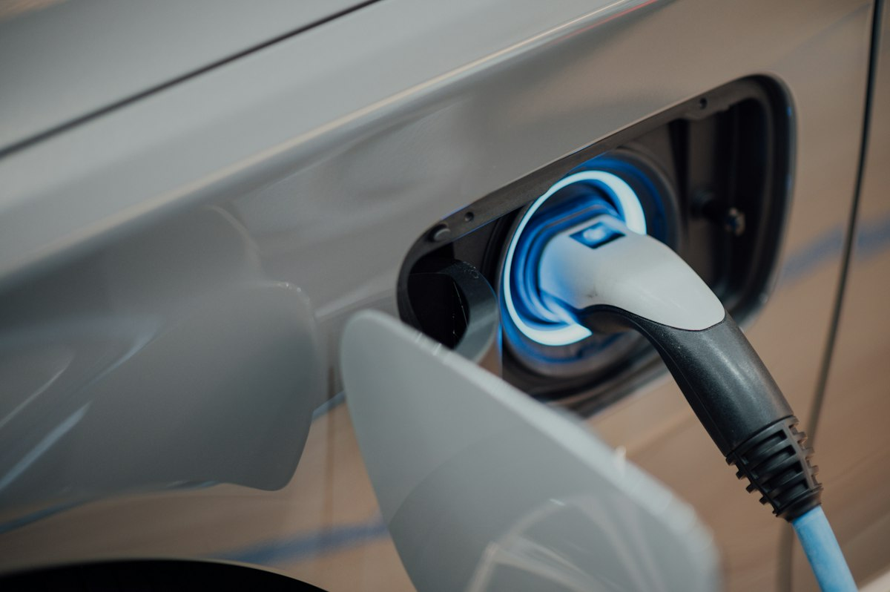
CONCLUSION | THE FUTURE OF CHARGING
Charge Without the Chase: One Secure EV Charging Network
CORE STRATEGIC PILLARS
1. Solves Real Daily Friction
Eliminates the apartment charging gap with overnight valet concierge.
2. Establishes Absolute Trust
3-zone perimeter protection, 4K AI audits, and automated digital escrow.
3. Leverages Existing Assets
Mobilizes idle private & hotel chargers without waiting for grid upgrades.
4. Accelerates Green Adoption
Removes range anxiety and promotes sustainable urban mobility.
FROM APARTMENT PARKING TO HIGHWAY TRANSIT — HAR GHAR CHARGING: CHARGE. ANYTIME. ANYWHERE.
Har Ghar Charging | Team: VanGuards | Slide 11 of 11

