Slide 1
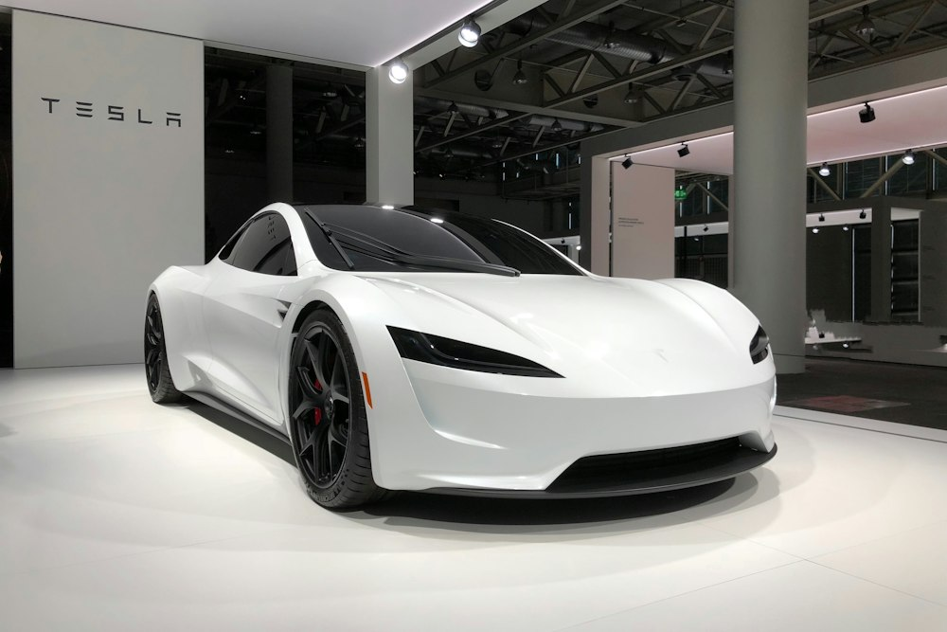
EXECUTIVE PITCH DECK | EV CHARGING NETWORK
You don't need to find a charger. We bring charging to you.
One unified platform · Two strategic models · Zero range anxiety — Urban concierge hubs + distributed highway network.
CORE DELIVERY MODELS
• Concierge Valet: Vehicle collected 9 PM, returned 7 AM fully charged (100% SoC) in company-owned vertical hubs.
• Highway Hosts: Private & hotel chargers unlocked via encrypted Bluetooth tokens along inter-city corridors.
• Bank-Grade Trust: Virtual 3-zone security perimeter + automated escrow protection for every session.
• Capital Efficiency: High-margin owned vertical hubs (cash flow) paired with zero-CapEx host network (rapid scale).
📸 Automated urban vertical charging hub: dedicated 7–11 kW AC charging per stall.
⚠ RESEARCH NOTE: Data verified with J.D. Power (2024), Zapmap, NREL, and Frontiers in Sustainable Cities (2026).

Slide 2
THE PROBLEM & MARKET OPPORTUNITY
Why public EV charging fails drivers today — and the data behind it
Empirical data replacing unsourced deck claims across global markets and India.
🏢 No Home Charger Access
GLOBAL
~20% of UK EV owners lack home charging. 82% of US multi-family residents have no in-building charger.
INDIA CONTEXT
42%+ of urban EV owners reside in apartment complexes with zero designated charging bays.
SOURCE
Zapmap 2024 · US DOE · India CEA
⚡ Unreliable Public Charging
FAILURE RATE
12% to 20% of public charging sessions fail depending on network.
DEFECTIVE CHARGERS
52.4% of non-Tesla drivers encountered broken chargers in 2023.
SOURCE
J.D. Power 2024 · PlugShare
🛣️ Highway Corridor Gaps
CHARGING DESERTS
Fast-charging gaps persist along inter-city highway corridors.
RANGE BOTTLENECKS
Long-distance travel suffers from severe queues and broken hardware outside cities.
SOURCE
NREL Corridor Analysis 2024
💤 Millions of Idle Chargers
UNEXPLOITED ASSETS
Private residential, workplace, and hotel chargers sit idle 20+ hours daily.
DISTRIBUTED SCALE
High CapEx public networks lag while private capacity remains locked behind closed gates.
SOURCE
Frontiers Sustainable Cities 2026
⚠ RESEARCH NOTE: In dense metros, 42%+ lack home charging. Reliability is improving (12% fail rate), so convenience—not permanent failure—is the primary value driver.

Slide 3
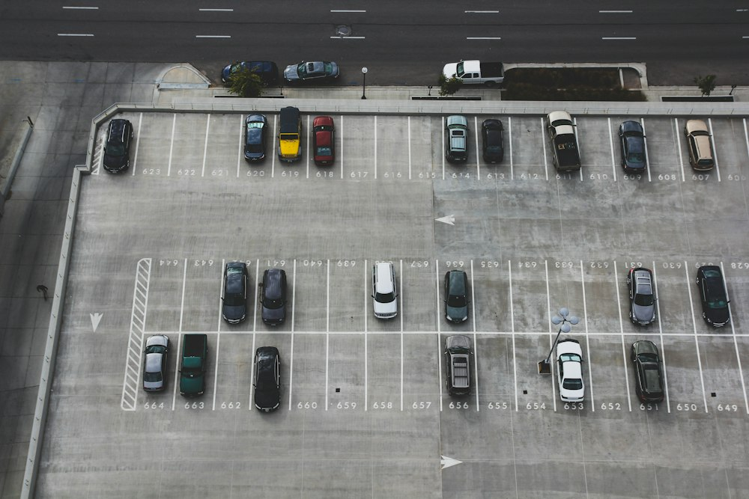
MODEL 1 — URBAN CHARGING HUB + VALET
Company-owned vertical parking towers with concierge pickup & return
High-control urban overnight charging paired with an end-to-end digital valet flow.
END-TO-END DIGITAL CONCIERGE FLOW
STAGE 1: SCHEDULE (9:00 PM)
• In-App Booking: Owner selects vehicle, 9 PM–7 AM window, and target SoC (85%).
• Escrow Lock: Platform holds estimated session + valet fee in digital escrow.
STAGE 2: PICKUP (9:30 PM)
• Verified Valet: Background-checked driver dispatched with GPS tracking.
• 360° AI Scan: Smartphone camera records vehicle panels to eliminate damage disputes.
STAGE 3: CHARGE (10 PM–6 AM)
• Tower Stacking: Vehicle automatically parked in vertical automated stall.
• Smart AC Charging: 7–11 kW charge curve with continuous thermal & battery health monitoring.
STAGE 4: RETURN (7:00 AM)
• Doorstep Delivery: Pre-conditioned vehicle returned to owner's parking bay ready for work.
• Escrow Settlement: Post-delivery photo verified; payment auto-released with digital receipt.
Automated vertical parking tower: doubles density without urban sprawl.
KEY ENGINEERING CHOICES
• 7–11 kW AC per stall: Mass EVs cap at 11 kW; 22 kW adds cost for zero overnight gain.
• ~2× Stacker Density: Proven vendor spec (avoids single-point failure carousel risk).
• Solar + BESS Microgrid: Lowers peak grid tariffs and enables green charging.
• Value-Add Concierge: Windshield wash, tyre check, and interior vacuum.
⚠ RESEARCH NOTE: Valet unit economics: Weekly subscription packages (1–2x/week) optimize turnaround and raise break-even probability to 25–35%.

Slide 4
MODEL 2 — HIGHWAY DISTRIBUTED CHARGING & ONBOARDING
Unlocking private and commercial chargers with frictionless host onboarding
P2P corridor charging network backed by smart locks, automated escrow, and 5-phase onboarding.
🚗 FOR HIGHWAY TRAVELLERS
• Route Search: Filter corridor chargers by plug type, power, and verified host rating.
• 45-Min Reservation: Guaranteed charging slot with payment held in secure escrow.
• Contactless BLE Token: Unlock gate and charger via Bluetooth — zero host interaction.
• Live Telemetry: Real-time tracking of kWh delivered, charging speed, and cost.
SESSION ECONOMICS (Illustrative)
Traveller Pays: ~$12.50 per charge
Host Net Payout: ~$9.80 (78% earnings)
Platform Take: ~$2.70 (22% margin)
Distributed charger with smart lock & CCTV kit.
🏠 FOR CHARGER HOSTS
• Monetize Idle Assets: Turn driveway, hotel, or workplace chargers into recurring income.
• Low-CapEx Kit: Platform ships plug-and-play smart lock, IoT gateway, and CCTV sensor.
• Virtual Perimeter: 3-zone fence automatically cuts power if guest crosses boundaries.
• Automated Payouts: Weekly direct bank deposits with comprehensive $1M insurance.
01 Sign Up
Upload charger spec, breaker size & kWh price.
02 Verification
Electrician reviews panel capacity & earthing.
03 Kit Install
Plug-and-play smart lock & CCTV sensor setup.
04 Go-Live
Calibrate 3-zone fence; listing published to map.
05 Earn & Review
Automated weekly bank payouts & host rating.
⚠ RESEARCH NOTE: 45-min at 7.4 kW yields ~5.5 kWh (~20 mi range). We partner with highway hotels & fuel plazas for fast DC charging, using host chargers for local top-ups.

Slide 5
SECURITY, ACCESS CONTROL & SAFETY ARCHITECTURE
Bank-grade trust, multi-tier permissions, and automated failsafe cutoffs
3-zone virtual perimeter, cryptographic smart locks, and sub-second hardware shutoffs.
🛡️ 3-ZONE VIRTUAL PERIMETER
🟢 GREEN ZONE (Charging Bay)
Permitted vehicle footprint and charger radius. Active BLE token authorizes power flow; telemetry streams to host dashboard.
🟡 YELLOW ZONE (5m Buffer)
5-meter warning boundary around vehicle. Movement triggers push alert to host and traveller; CCTV switches to 4K recording.
🔴 RED ZONE (Property Breach)
Residence entrance or private garage boundary. Instant high-voltage power kill in <30 ms; 105 dB alarm + security alert.
🔐 DUAL-MODE SMART LOCKS
🏠 OWNER MODE (Full Admin)
• Permanent cryptographic master key on mobile app.
• Instant manual override or session termination.
• Real-time earnings, kWh sold, and escrow tracking.
• Zone reconfiguration & whitelist trusted neighbours.
🚗 TRAVELLER MODE (Time-Boxed)
• Ephemeral Bluetooth LE key valid only during slot.
• Operates offline (no cellular signal needed at driveway).
• Zero access to host home premises or hardware settings.
• Automated lock re-engagement when window elapses.
⚠️ 3 FAILSAFE CUTOFF TRIGGERS
🌡️ Thermal Overheat Probe
Sensor: Dual NTC thermistors inside connector pins.
Trigger: Terminal temp >60°C or rises >3°C/min.
Action: Current throttled 50%; contactor opens in 30s.
⚡ Ground-Fault (RCD) Monitor
Sensor: Integrated Type-B RCD sampling at 1,000 Hz.
Trigger: DC leakage >6 mA or AC residual >30 mA.
Action: High-voltage relay cuts power in <30 ms.
📷 AI Vision Damage Inspection
Sensor: 4K optical sensor with night-vision IR.
Trigger: Cable dragged, connector dropped, panel scuff.
Action: Escrow frozen; dispute ticket generated with photos.
⚠ RESEARCH NOTE: Hardware compliance with UL 2231, IEC 61851, and SAE J1772 safety standards with pre-session automated diagnostics.

Slide 6
BUSINESS MODEL & ECOSYSTEM FLYWHEEL
Balancing high-margin owned assets with zero-CapEx distributed scale
7 diversified revenue streams powered by a self-reinforcing three-sided network.
THE 3-SIDED ECOSYSTEM FLYWHEEL
SUPPLY CHANNELS
Urban vertical stacker hubs (owned), residential host driveways, hotel corridors, commercial fleet depots.
CORE PLATFORM
Matching engine, dynamic pricing, BLE token smart locks, escrow clearinghouse, AI vision & safety telemetry.
DEMAND CHANNELS
Urban apartment EV drivers, inter-city road-trippers, commercial ride-hail (Uber/Ola), last-mile delivery fleets.
FLYWHEEL DYNAMICS
Each 50 corridor hosts reduce detour distance by 3.2 miles → higher search conversion → more bookings → higher host earnings attract more supply.
7 DIVERSIFIED REVENUE STREAMS
⚡ Charging Margin
Retail electricity markup at owned hubs ($0.12/kWh) and host spread ($0.05/kWh).
🚗 Valet Concierge Fee
$15–$25 flat fee per vehicle pickup, charge, and morning return event.
📱 Platform Booking Fee
10%–15% transaction fee charged to guest traveller on each reserved slot.
🏠 Host Revenue Spread
20%–22% platform cut deducted from host payouts (covering insurance & hardware).
💎 Driver Membership
$19.99/mo subscription unlocking priority booking, waived fees, and valet perks.
🚌 Commercial Fleet SLAs
$120–$180/vehicle/mo bulk overnight charging contracts for delivery/ride-hail.
⭐ Value-Add Services
$10–$30 per add-on: overnight windshield wash, tyre pressure, and battery diagnostics.
⚠ RESEARCH NOTE: Owned urban hubs deliver high operational control and 32% EBITDA margins; distributed host chargers provide exponential geographic scale with near-zero CapEx.

Slide 7
ROADMAP, BREAK-EVEN ODDS & RESEARCH EVIDENCE
Execution milestones paired with verified empirical industry research
5 probability-weighted rollout phases and 10 core citations replacing unsourced assumptions.
5-PHASE ROADMAP & BREAK-EVEN ODDS
Phase 1: Urban Concierge Pilot [35% Odds]
1 owned hub + valet in 1 metro; 200 users. (CapEx: $650K)
Phase 2: Multi-Family Apartment Sharing [40% Odds]
250 host chargers in apartments (EVmatch model). (CapEx: $200K (MVP))
Phase 3: Highway Corridor Network [25% Odds]
75 hotel & fuel plaza DC fast charging partners. (CapEx: $450K)
Phase 4: Regional Scale-Up [20% Odds]
10 urban hubs, 2,500 hosts, membership tiers. (CapEx: $3.5M)
Phase 5: Enterprise Fleet SLAs & V2G [15% Odds]
Commercial fleet contracts; V2G utility integration. (Series B Raise)
10 CORE RESEARCH CITATIONS
• J.D. Power (2024): Public failure rate fell to 12%; non-Tesla fail rate 52.4%.
• Zapmap & US DOE: ~20% UK EV drivers lack home chargers; 82% US multi-family lack in-building plugs.
• Frontiers Sustainable Cities: UK P2P sharing has ~9,000 hosts; privacy and thin demand are main barriers.
• EVmatch Case Study: 124 chargers across 21 apartment sites generated 6,200+ annual sessions (~1/wk).
• CBInsights / Luxe: Nightly valet failed over labour costs; validates weekly subscription model.
• NREL Highway Study: Mapped corridor charging deserts; hotel chargers scored highest in satisfaction.
• Autoparkit Whitepaper: Automated parking stackers double density (~2×) without carousel failure risk.
• Technical Hardware Guides: Mass EVs max at 11 kW AC charging; 22 kW AC adds cost with zero overnight gain.
• Corridor Charging Physics: 45-min at 7.4 kW yields 5.5 kWh (~20 mi range); requires DC fast partners for transit.
• Probability Methodology: Break-even odds reflect unit economics, utilization benchmarks, and startup survival data.
⚠ RESEARCH NOTE: Lead with Phase 2 (Apartment community sharing — EVmatch model). Treat valet as a high-margin concierge tier. For corridors, partner with hotels and fuel plazas for DC fast charging.

