Slide 1
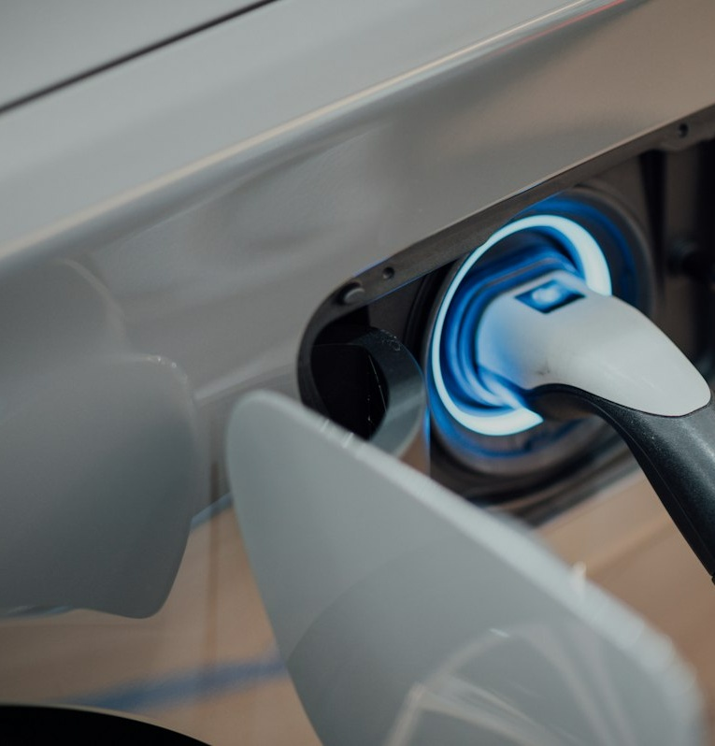
TECHNICAL ARCHITECTURE DECK
EV CHARGING NETWORK
A secure, convenient and scalable charging ecosystem
"YOU DON'T NEED TO FIND A CHARGER. WE BRING CHARGING TO YOU."
MODEL 1 : URBAN
Charging Hub + Valet
Vertical parking towers with dedicated chargers & solar. Scheduled evening pickup and 7:00 AM delivery.
MODEL 2 : HIGHWAY
Secure Distributed
Verified host network with smart lock & virtual security. Monetizes private residential & commercial EVSEs.
INFRASTRUCTURE VISION
Coordinated automated charging for urban & highway mobility.
Dual-model architecture unifies high-density urban demand with distributed highway long-distance transit.
EV CHARGING NETWORK : Slide 01 of 13

Slide 2

01 : PROBLEM
The problem in one picture
Empirical friction in urban EV ownership and long-distance travel
[ Node 01 ] Apartment
No Dedicated Charger
Shared garages lack dedicated 240V circuits. Level 1 outlet adds only 4 miles/hr; full recharge requires 40+ hours.
URBAN BARRIER METRIC
42% of urban EV drivers lack home charging
[ Node 02 ] EV OWNER
Needs Routine Charging
Requires predictable schedule without losing 3-4 hours every week sitting at crowded public charging hubs.
[ Node 03 ] Public Charger
Travel + Wait + Availability Uncertainty
15%-25% dispenser failure rate, 20-45 minute peak queues, and unpredictable station availability.
HIGHWAY RANGE GAP
Long-distance corridors have charging voids while private chargers sit idle.
Opportunity: connect convenience with underutilized charging capacity.
EV CHARGING NETWORK : Slide 02 of 13

Slide 3
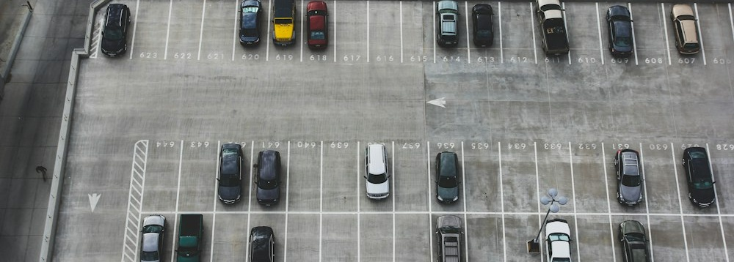

02 : SOLUTION
One platform. Two charging models.
Unifying high-density company-owned hubs with an asset-light distributed network
COMPANY-OWNED INFRASTRUCTURE
ASSET-LIGHT HOST HARDWARE
MODEL 1 : CHARGING HUB
- Company-owned hub: Dedicated multi-megawatt facility.
- Vertical parking: 3x vehicle density per land footprint.
- Dedicated chargers: Every stall has dedicated 22kW port.
- Optional solar: Rooftop array with battery storage peak shaving.
Valet Concierge: Scheduled evening pickup and 7:00 AM delivery to owner bay.
MODEL 2 : DISTRIBUTED NETWORK
- Verified host chargers: Monetizes private residential & commercial EVSEs.
- Secure self-service: Zero host contact or physical keys required.
- Highway availability: Fills long-distance route gaps between fast chargers.
- Smart IoT control: Solenoid holster locks only during booked windows.
Distributed Scaling: Expands coverage across highways with zero construction CapEx.
EV CHARGING NETWORK : Slide 03 of 13

Slide 4
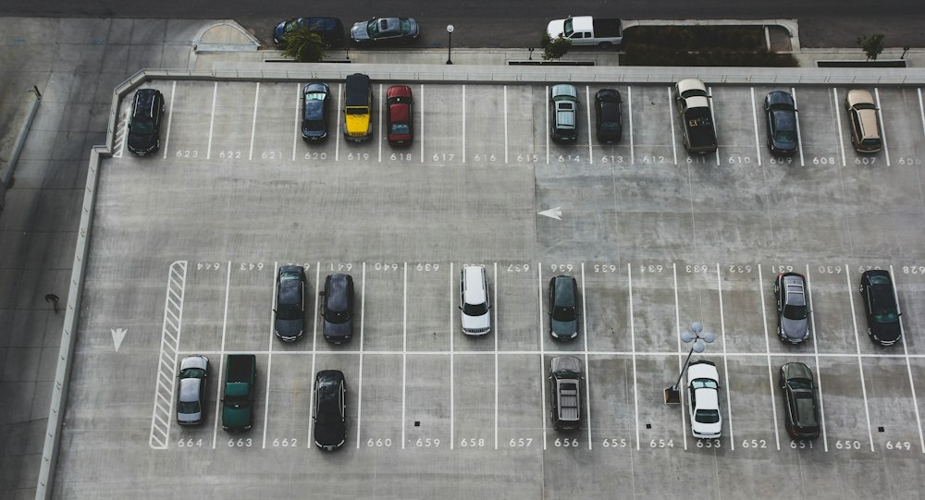
03 : URBAN
Model 1 - Charging Hub + Valet
Interactive Lifecycle Demonstration: 5-step operational workflow
01 : BOOK
Schedule
02 : PICKUP
Verified Valet
03 : TOWER
Stack Parking
04 : CHARGE
Solar + 22kW
05 : RETURN
Morning Drop
STAGE 01 : BOOKING
Owner Schedules Pickup Window via Mobile App
Owner specifies target state of charge (80% or 100%) and selects 9:00 PM pickup with 7:00 AM delivery. Cloud platform reserves dedicated vertical hub stall and dispatches verified concierge valet.
Status: Reserved | Target SoC: 80% | Route: Optimal Stacking Level 3
TOWER STACKING SYSTEM
Automated car lift positions vehicle in dedicated stall.
VERTICAL PARKING:
3x land density through multi-tier automated stacking.
DEDICATED CHARGERS:
Each parking stall wired with dedicated 22kW AC port.
SOLAR POTENTIAL:
Rooftop generation captures clean power for peak shaving.
EV CHARGING NETWORK : Slide 04 of 13

Slide 5

04 : HIGHWAY
Model 2 - Secure Distributed Charging
Turn unused charging capacity into verified network capacity.
01 : LIST
Host Node
02 : BOOK
Route Reserve
03 : AUTH
BLE Token
04 : CHARGE
Self-Plug
05 : LOCK
Auto-Latch
PHASE 01 : LISTING
Host Publishes Availability Window & Tariff
Homeowner configures idle hours (e.g., 9:00 AM - 5:00 PM). Smart controller links to platform with zero manual host intervention. Platform coordinates identity, payment escrow, and charger solenoid unlocking.
Hardware: 240V / 32A | Availability: Mon-Fri 8 hrs | Rate: Tariff + Margin
VERIFIED HOST HARDWARE
Residential Level 2 charger unlocked for road trip stopovers.
CRITICAL DESIGN DECISION
Autonomous Self-Service Access
A highway traveller should not need a company driver at every residential charger. The system therefore supports secure self-service: automated smart solenoid locks, Bluetooth cryptographic handshake, and virtual perimeter surveillance.
EV CHARGING NETWORK : Slide 05 of 13

Slide 6

05 : TRUST
Security: a charger is not an open door
Interactive Virtual Perimeter: 3-Zone CCTV monitoring framework
ZONE 1 : GREEN
Safe Authorized Stall
ZONE 2 : YELLOW
Warning Buffer (3m)
ZONE 3 : RED
Restricted Residence
ACTIVE ZONE : GREEN (SAFE)
Driveway Staging Bay & Charger Port Area
Vehicle parked in bay. Charging cable connected. No unauthorized proximity detected. Host family perimeter is untouched. Optical AI verifies human presence is restricted exclusively to vehicle charging port.
Perimeter Status: Normal | Audio Alert: Inactive | Solenoid Lock: Engaged
CAM 01 : GREEN SAFE ZONE | REC 1080P
Vehicle in Bay : Normal Charging Allowed
CONCEPTUAL SAFETY FRAMEWORK
CCTV + Virtual Perimeter Monitoring
CCTV + virtual perimeter monitoring keeps the charging interaction controlled. The zones are a conceptual safety framework designed to reduce unwanted movement and false alarms: green allows charging, yellow sounds polite audio guidance, red trips security alerts and terminates the session.
EV CHARGING NETWORK : Slide 06 of 13

Slide 7

06 : ACCESS
Smart charger control
Hardware-level access security and dual-mode separation
MODE 01 : OWNER
Owner Authenticates -> Uses -> Locks
MODE 02 : TRAVELLER
Temporary Token Authorization -> Locks
FIRMWARE MODE : OWNER MODE
Owner NFC / Smartphone Bypass
Owner registers master keycard or smartphone. Instant proximity tap releases holster latch. No billing fees or reservations required for personal electricity usage. System switches automatically to Guest Mode when reservation begins.
Authorization: Master Key | Billing: Direct Home | Latch: Instant Tap
NFC & BLE TAP INTERFACE
Hardware unlocks only upon verified digital key handshake.
SAFETY SPECIFICATION
Dual-Channel Separation
Safety: the external module is a security/monitoring controller. High-current charging remains under a properly rated EVSE and supported control mechanisms. Solenoid holster latch prevents unauthorized plug removal until session completion.
EV CHARGING NETWORK : Slide 07 of 13

Slide 8
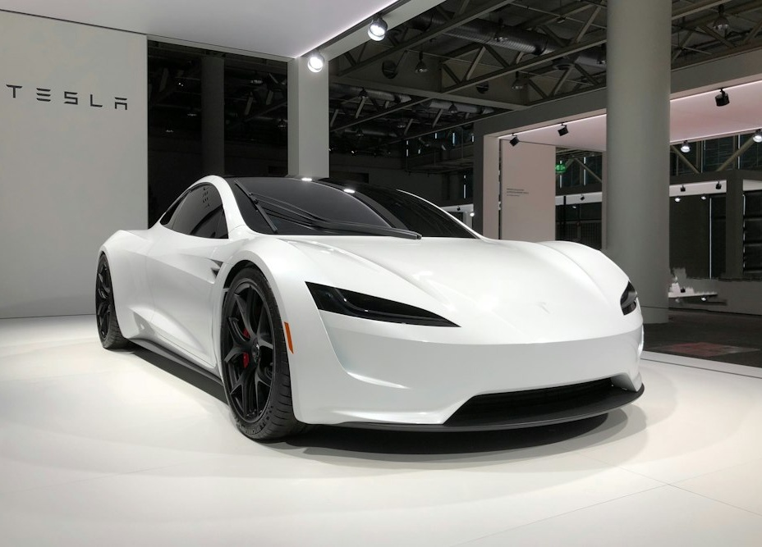
07 : VERIFICATION
Every session leaves evidence
Tripartite photographic inspection workbench & computer vision comparison
[ 01 : BEFORE ] Pre-Session Baseline Scan
Vehicle port flap, connector pins, cable sheath, and driveway baseline recorded prior to charging.
[ 02 : CHARGING ] Continuous Session Logging
1 Hz telemetry stream + CCTV perimeter motion clip recording throughout the active charging session.
PORT LATCH & CONTACT VERIFICATION
Automated high-resolution macro visual evidence logging.
[ 03 : AFTER ] Post-Session Diff
Repeat matching photos + computer vision condition comparison to verify zero damage or cable strain.
AUTOMATED AI DIFFERENCE VERIFICATION
16-Point Computer Vision Diff Analysis
Algorithms compare pre-charge and departure imagery to detect cosmetic scratches, cable strain, or mechanical port wear before liability escrow is released. Status: Verified Baseline Passed (Zero Anomaly Detected).
EV CHARGING NETWORK : Slide 08 of 13

Slide 9

08 : MONITORING
Protect the charger and the vehicle
Real-time sensor telemetry and automated fault isolation controls
TEMPERATURE
32.4 deg C
Thermocouple (Safe)
VOLT / CURRENT
230V / 32A
Phase Health: Nominal
POWER DELIVERY
7.36 kW
Class 1 Meter Output
FAULT CODE
0x00 NORMAL
GFCI State: Active Protected
LIVE TELEMETRY SUPERVISION
Continuous monitoring protects charger hardware and vehicle battery.
1. Detect anomaly
<10ms polling on voltage, current & ground.
2. Safe EVSE response
<100ms pilot trip disengages main contactor safely.
3. Notify
Instant alerts delivered to driver and host devices.
4. Inspect if needed
Remote diagnostics logs flagged for technical review.
EV CHARGING NETWORK : Slide 09 of 13

Slide 10
09 : PLATFORM
The ecosystem
Unifying demand, intelligence, and distributed electrical supply
[ DEMAND LAYER ]
EV OWNER
Convenient charging
- Urban apartment valet scheduling
- Highway corridor route reservations
- Transparent fixed per-kWh tariffs
- Real-time battery status tracking
Zero charging chore for urban owners.
[ CORE ENGINE ]
PLATFORM
Booking - Security - Payment
- Dynamic slot booking optimization
- Cryptographic JWT token auth broker
- Automated payment clearing & escrow
- Computer vision condition comparator
Coordinates identity, hardware, and billing.
[ SUPPLY LAYER ]
CHARGER PROVIDERS
Hubs - Homes - Hotels
- Hubs: Owned automated vertical towers
- Homes: Residential private driveways
- Businesses: Commercial hospitality
- Hardware telemetry & lock relays
Turns idle electrical assets into revenue.
EV CHARGING NETWORK : Slide 10 of 13

Slide 11
10 : BUSINESS
Scale without building every charger
Asset-right hybrid capital strategy balancing high-margin anchors with network scaling
OWNED HUBS
Controlled Urban Operations
- Vertical parking land efficiency
- Premium white-glove valet service
- High volume and predictability
- Solar and battery margin capture
+ DISTRIBUTED ASSETS
Verified Unused Chargers
- Zero civil construction CapEx
- Rapid geographic corridor coverage
- Automated self-service operations
- Host revenue-share alignment
= CHARGING NETWORK
Maximum Capital Efficiency
More access with less infrastructure duplication. Expands across highway miles without building billions in single-use charger concrete.
7 DIVERSIFIED REVENUE STREAMS
Charging Fee
Per-kWh markup
Valet Fee
Pickup service
Platform Fee
Clearing fee
Host Cut
Marketplace split
Membership
Monthly tier
Fleet Plans
B2B contracts
Premium
Care & detail
EV CHARGING NETWORK : Slide 11 of 13

Slide 12
11 : ROADMAP
Pilot -> network -> scale
Strategic 5-phase growth pathway to nationwide market leadership
01
Pilot
Charging hub + valet in one city
Validate valet turnaround logistics, app booking, and subscriber retention in flagship metro.
Phase 1
02
Connect
Verified residential / commercial
Onboard first 250 private host chargers with external smart lock controllers and CCTV kits.
Phase 2
03
Self-service
Secure highway charging
Deploy automated IoT smart locks along key highway transit corridors for unassisted travel.
Phase 3
04
Expand
Geographic network growth
Multi-city launch with 10 urban hubs and 2,500+ host locations across high-adoption states.
Phase 4
05
Integrate
Fleets, hotels, parking
Commercial fleet partnerships, hospitality chains, and utility grid peak-shaving demand response.
Phase 5
EV CHARGING NETWORK : Slide 12 of 13

Slide 13

EXECUTIVE SUMMARY
CHARGE WITHOUT THE CHASE.
From apartment charging to highway mobility - one secure EV charging network.
CONVENIENCE
Eliminates charging chores for apartment residents via scheduled valet service.
SECURITY
3-zone perimeter, CCTV event logs, smart hardware lock, and evidence verification.
UTILIZATION
Monetizes idle private chargers, bridging highway range gaps with zero CapEx.
SCALABILITY
Owned hubs combined with asset-light host network scales rapidly.
CORRIDOR FREEDOM
Connected highway route travel with verified host chargers.
EXECUTIVE CONCLUSION
By integrating company-owned high-density vertical hubs with a verified distributed host network, the platform resolves both urban residential charging barriers and long-distance highway travel anxiety without capital duplication.
Charging infrastructure transitions from an inconvenient stationary destination into a seamless, coordinated network service: delivering high utilization for hosts and effortless convenience for EV owners.
Proposed concept - technology, hardware and operational details should be validated during pilot implementation.
EV CHARGING NETWORK : Slide 13 of 13

