Slide 1
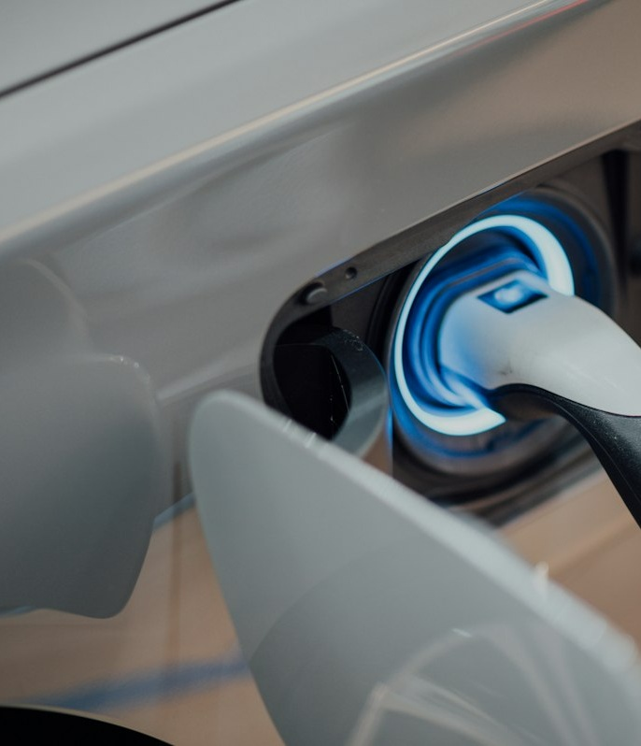
TECHNICAL ARCHITECTURE DECK
EV CHARGING NETWORK
A secure, convenient and scalable charging ecosystem
"YOU DON'T NEED TO FIND A CHARGER. WE BRING CHARGING TO YOU."
MODEL 1 : URBAN [CLICK TO VIEW]
Charging Hub + Valet
Vertical parking towers with dedicated chargers & solar. Scheduled evening pickup with morning return.
MODEL 2 : HIGHWAY [CLICK TO VIEW]
Secure Distributed
Verified host network with smart lock & virtual security. Monetizes private residential and business chargers.
INFRASTRUCTURE VISION
Coordinated automated charging for urban & highway mobility.
Interactive Deck: In Slide Show mode (F5), click on cards and buttons to watch demonstrations update.
EV CHARGING NETWORK : Slide 01 of 13
Next >

Slide 2

01 : PROBLEM
The problem in one picture
Empirical friction in urban EV ownership and long-distance travel
[ Node 01 ] Apartment
No Dedicated Charger
Shared garages lack dedicated 240V circuits. Level 1 outlet adds only 4 miles/hr; full recharge requires 40+ hours.
URBAN BARRIER METRIC
42% of urban EV drivers lack home charging
[ Node 02 ] EV OWNER
Needs Routine Charging
Requires predictable schedule without losing 3-4 hours every week sitting at crowded public charging hubs.
[ Node 03 ] Public Charger
Travel + Wait + Availability Uncertainty
15%-25% dispenser failure rate, 20-45 minute peak queues, and unpredictable station availability.
HIGHWAY RANGE GAP
Long-distance corridors have charging voids while private chargers sit idle.
Opportunity: connect convenience with underutilized charging capacity.
EV CHARGING NETWORK : Slide 02 of 13
< Prev
Next >
Home

Slide 3
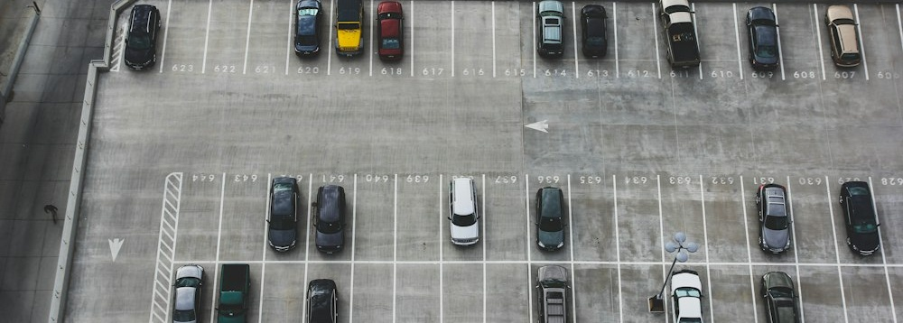

02 : SOLUTION
One platform. Two charging models.
Unifying high-density company-owned hubs with an asset-light distributed network
COMPANY-OWNED INFRASTRUCTURE [CLICK TO INSPECT]
ASSET-LIGHT HOST HARDWARE [CLICK TO INSPECT]
MODEL 1 : CHARGING HUB
- Company-owned hub: Dedicated multi-megawatt facility.
- Vertical parking: 3x vehicle density per land footprint.
- Dedicated chargers: Every stall has dedicated 22kW port.
- Optional solar: Rooftop array with battery storage peak shaving.
Valet Concierge: Scheduled evening pickup and 7:00 AM delivery to owner bay. (Click card to inspect)
MODEL 2 : DISTRIBUTED NETWORK
- Verified host chargers: Monetizes private residential & commercial EVSEs.
- Secure self-service: Zero host contact or physical keys required.
- Highway availability: Fills long-distance route gaps between fast chargers.
- Smart IoT control: Solenoid holster locks only during booked windows.
Distributed Scaling: Expands coverage across highways with zero construction CapEx. (Click card to inspect)
EV CHARGING NETWORK : Slide 03 of 13
< Prev
Next >
Home

Slide 4
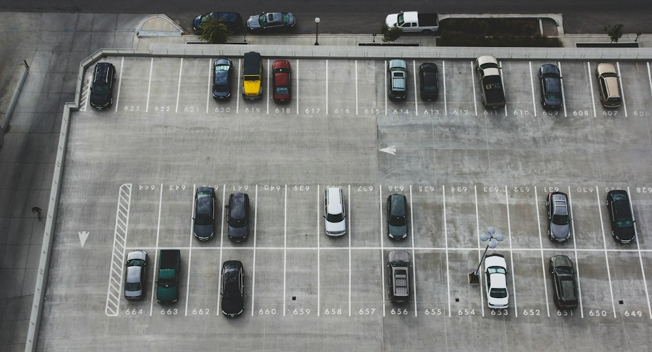
03 : URBAN
Model 1 - Charging Hub + Valet
Interactive Lifecycle Demonstration: Click steps to inspect operations
01 : BOOK
Schedule
02 : PICKUP
Verified Valet
03 : TOWER
Stack Parking
04 : CHARGE
Solar + 22kW
05 : RETURN
Morning Drop
STAGE 01 : BOOKING
Owner Schedules Pickup Window via Mobile App
Owner specifies target state of charge (80% or 100%) and selects 9:00 PM pickup with 7:00 AM delivery. Cloud platform reserves dedicated vertical hub stall and dispatches concierge valet.
Status: Reserved | Target SoC: 80% | Route: Optimal Stacking Level 3
TOWER STACKING SYSTEM
Automated car lift positions vehicle in dedicated stall.
VERTICAL PARKING:
3x land density through multi-tier automated stacking.
DEDICATED CHARGERS:
Each parking stall wired with dedicated 22kW AC port.
SOLAR POTENTIAL:
Rooftop generation captures clean power for peak shaving.
EV CHARGING NETWORK : Slide 04 of 13
< Prev
Next >
Home

Slide 5
03 : URBAN
Model 1 - Charging Hub + Valet
Interactive Lifecycle Demonstration: Click steps to inspect operations
01 : BOOK
Schedule
02 : PICKUP
Verified Valet
03 : TOWER
Stack Parking
04 : CHARGE
Solar + 22kW
05 : RETURN
Morning Drop
STAGE 02 : VERIFIED PICKUP
Concierge Valet Dispatched to Residence
Trained, insured valet arrives at apartment garage during scheduled window. Conducts digital 360-degree walkaround scan, scans vehicle RFID tag, and drives EV to the hub.
Valet ID: #V-882 (Verified) | Inspection: Complete | Transit ETA: 12 min
TOWER STACKING SYSTEM
Automated car lift positions vehicle in dedicated stall.
VERTICAL PARKING:
3x land density through multi-tier automated stacking.
DEDICATED CHARGERS:
Each parking stall wired with dedicated 22kW AC port.
SOLAR POTENTIAL:
Rooftop generation captures clean power for peak shaving.
EV CHARGING NETWORK : Slide 04 of 13
< Prev
Next >
Home

Slide 6
03 : URBAN
Model 1 - Charging Hub + Valet
Interactive Lifecycle Demonstration: Click steps to inspect operations
01 : BOOK
Schedule
02 : PICKUP
Verified Valet
03 : TOWER
Stack Parking
04 : CHARGE
Solar + 22kW
05 : RETURN
Morning Drop
STAGE 03 : TOWER STACKING
Automated Car Lift Positions Vehicle in Bay
Vehicle arrives at centralized hub and is positioned onto automated turntable. Mechanical car lift stacks vehicle vertically across multi-tier steel structure, tripling density.
Lift Mechanism: Automated Pallet | Bay: Stall 24-B | Safety Latch: Engaged
TOWER STACKING SYSTEM
Automated car lift positions vehicle in dedicated stall.
VERTICAL PARKING:
3x land density through multi-tier automated stacking.
DEDICATED CHARGERS:
Each parking stall wired with dedicated 22kW AC port.
SOLAR POTENTIAL:
Rooftop generation captures clean power for peak shaving.
EV CHARGING NETWORK : Slide 04 of 13
< Prev
Next >
Home

Slide 7
03 : URBAN
Model 1 - Charging Hub + Valet
Interactive Lifecycle Demonstration: Click steps to inspect operations
01 : BOOK
Schedule
02 : PICKUP
Verified Valet
03 : TOWER
Stack Parking
04 : CHARGE
Solar + 22kW
05 : RETURN
Morning Drop
STAGE 04 : CHARGE & STORAGE
Dedicated 22kW AC Port Delivers Overnight Charge
Dedicated 22kW port charges battery at manufacturer-recommended rate. Rooftop solar generation and on-site BESS buffer grid peaks to capture green power savings.
Charge Rate: 22 kW AC | Battery Level: 42% -> 80% | Peak Shaving: Active
TOWER STACKING SYSTEM
Automated car lift positions vehicle in dedicated stall.
VERTICAL PARKING:
3x land density through multi-tier automated stacking.
DEDICATED CHARGERS:
Each parking stall wired with dedicated 22kW AC port.
SOLAR POTENTIAL:
Rooftop generation captures clean power for peak shaving.
EV CHARGING NETWORK : Slide 04 of 13
< Prev
Next >
Home

Slide 8
03 : URBAN
Model 1 - Charging Hub + Valet
Interactive Lifecycle Demonstration: Click steps to inspect operations
01 : BOOK
Schedule
02 : PICKUP
Verified Valet
03 : TOWER
Stack Parking
04 : CHARGE
Solar + 22kW
05 : RETURN
Morning Drop
STAGE 05 : MORNING RETURN
Vehicle Returned Fully Charged by 7:00 AM
Valet retrieves car from vertical tower at 6:30 AM and parks it in owner's assigned stall before 7:00 AM. Driver receives mobile notification with session evidence log.
Delivery Status: Completed 6:45 AM | Final SoC: 80% (310 mi) | Valet Signed: Yes
TOWER STACKING SYSTEM
Automated car lift positions vehicle in dedicated stall.
VERTICAL PARKING:
3x land density through multi-tier automated stacking.
DEDICATED CHARGERS:
Each parking stall wired with dedicated 22kW AC port.
SOLAR POTENTIAL:
Rooftop generation captures clean power for peak shaving.
EV CHARGING NETWORK : Slide 04 of 13
< Prev
Next >
Home

Slide 9

04 : HIGHWAY
Model 2 - Secure Distributed Charging
Turn unused charging capacity into verified network capacity.
01 : LIST
Host Node
02 : BOOK
Route Reserve
03 : AUTH
BLE Token
04 : CHARGE
Self-Plug
05 : LOCK
Auto-Latch
PHASE 01 : LISTING
Host Publishes Availability Window & Tariff
Homeowner configures idle hours (e.g., 9:00 AM - 5:00 PM). Smart controller links to platform with zero manual host intervention. Platform coordinates identity, payment escrow, and charger solenoid unlocking.
Hardware: 240V / 32A | Availability: Mon-Fri 8 hrs | Rate: Tariff + Margin
VERIFIED HOST HARDWARE
Residential Level 2 charger unlocked for road trip stopovers.
CRITICAL DESIGN DECISION
Autonomous Self-Service Access
A highway traveller should not need a company driver at every residential charger. The system therefore supports secure self-service: automated smart solenoid locks, Bluetooth cryptographic handshake, and virtual perimeter surveillance.
EV CHARGING NETWORK : Slide 05 of 13
< Prev
Next >
Home

Slide 10
04 : HIGHWAY
Model 2 - Secure Distributed Charging
Turn unused charging capacity into verified network capacity.
01 : LIST
Host Node
02 : BOOK
Route Reserve
03 : AUTH
BLE Token
04 : CHARGE
Self-Plug
05 : LOCK
Auto-Latch
PHASE 02 : ROUTE RESERVATION
Highway Driver Discovers & Books En-Route Bay
Long-distance traveler identifies verified host along transit corridor via navigation app. Pre-reserves 45-minute slot. Platform holds charge fee in escrow.
Reservation ID: #HW-491 | Arrival Window: 1:30 PM | Escrow Deposit: $12.50 Held
VERIFIED HOST HARDWARE
Residential Level 2 charger unlocked for road trip stopovers.
CRITICAL DESIGN DECISION
Autonomous Self-Service Access
A highway traveller should not need a company driver at every residential charger. The system therefore supports secure self-service: automated smart solenoid locks, Bluetooth cryptographic handshake, and virtual perimeter surveillance.
EV CHARGING NETWORK : Slide 05 of 13
< Prev
Next >
Home

Slide 11
04 : HIGHWAY
Model 2 - Secure Distributed Charging
Turn unused charging capacity into verified network capacity.
01 : LIST
Host Node
02 : BOOK
Route Reserve
03 : AUTH
BLE Token
04 : CHARGE
Self-Plug
05 : LOCK
Auto-Latch
PHASE 03 : CRYPTOGRAPHIC AUTH
Driver Arrives & Initiates Bluetooth Unlock
Driver arrives at host driveway. Mobile app connects to charger lock controller via Bluetooth Low Energy (BLE) or NFC. Signed digital key verifies authorization.
Auth Method: BLE Token 256-bit | Holster Latch: Unlocked | Proximity: 1.2m
VERIFIED HOST HARDWARE
Residential Level 2 charger unlocked for road trip stopovers.
CRITICAL DESIGN DECISION
Autonomous Self-Service Access
A highway traveller should not need a company driver at every residential charger. The system therefore supports secure self-service: automated smart solenoid locks, Bluetooth cryptographic handshake, and virtual perimeter surveillance.
EV CHARGING NETWORK : Slide 05 of 13
< Prev
Next >
Home

Slide 12
04 : HIGHWAY
Model 2 - Secure Distributed Charging
Turn unused charging capacity into verified network capacity.
01 : LIST
Host Node
02 : BOOK
Route Reserve
03 : AUTH
BLE Token
04 : CHARGE
Self-Plug
05 : LOCK
Auto-Latch
PHASE 04 : AUTONOMOUS CHARGE
Self-Service Plug-in & Telemetry Streaming
Driver plugs vehicle in without disturbing host. Smart controller engages main contactor, monitors ground leakage, and streams 1 Hz telemetry to mobile app.
Power: 7.4 kW | Delivered: 14.8 kWh | GFCI: Normal | Session: In Progress
VERIFIED HOST HARDWARE
Residential Level 2 charger unlocked for road trip stopovers.
CRITICAL DESIGN DECISION
Autonomous Self-Service Access
A highway traveller should not need a company driver at every residential charger. The system therefore supports secure self-service: automated smart solenoid locks, Bluetooth cryptographic handshake, and virtual perimeter surveillance.
EV CHARGING NETWORK : Slide 05 of 13
< Prev
Next >
Home

Slide 13
04 : HIGHWAY
Model 2 - Secure Distributed Charging
Turn unused charging capacity into verified network capacity.
01 : LIST
Host Node
02 : BOOK
Route Reserve
03 : AUTH
BLE Token
04 : CHARGE
Self-Plug
05 : LOCK
Auto-Latch
PHASE 05 : AUTO-LATCH & ESCROW
Session Concluded, Cable Re-Latched, Payout Cleared
Driver unplugs, re-holsters connector into smart dock where solenoid lock re-engages. Optical inspection validates site condition; escrow clears automatically.
Holster Latch: Locked | Departure Verified: Yes | Host Payout: $9.80 Cleared
VERIFIED HOST HARDWARE
Residential Level 2 charger unlocked for road trip stopovers.
CRITICAL DESIGN DECISION
Autonomous Self-Service Access
A highway traveller should not need a company driver at every residential charger. The system therefore supports secure self-service: automated smart solenoid locks, Bluetooth cryptographic handshake, and virtual perimeter surveillance.
EV CHARGING NETWORK : Slide 05 of 13
< Prev
Next >
Home

Slide 14

05 : TRUST
Security: a charger is not an open door
Interactive Virtual Perimeter: Click zones to test CCTV monitoring states
ZONE 1 : GREEN
Safe Authorized Stall
ZONE 2 : YELLOW
Warning Buffer (3m)
ZONE 3 : RED
Restricted Residence
ACTIVE ZONE : GREEN (SAFE)
Driveway Staging Bay & Charger Port Area
Vehicle parked in bay. Charging cable connected. No unauthorized proximity detected. Host family perimeter is untouched. Optical AI verifies human presence is restricted exclusively to vehicle charging port.
Perimeter Status: Normal | Audio Alert: Inactive | Solenoid Lock: Engaged
CAM 01 : GREEN SAFE ZONE | REC 1080P
Vehicle in Bay : Normal Charging Allowed
CONCEPTUAL SAFETY FRAMEWORK
CCTV + Virtual Perimeter Monitoring
CCTV + virtual perimeter monitoring keeps the charging interaction controlled. The zones are a conceptual safety framework designed to reduce unwanted movement and false alarms: green allows charging, yellow sounds polite audio guidance, red trips security alerts and terminates the session.
EV CHARGING NETWORK : Slide 06 of 13
< Prev
Next >
Home

Slide 15
05 : TRUST
Security: a charger is not an open door
Interactive Virtual Perimeter: Click zones to test CCTV monitoring states
ZONE 1 : GREEN
Safe Authorized Stall
ZONE 2 : YELLOW
Warning Buffer (3m)
ZONE 3 : RED
Restricted Residence
ACTIVE ZONE : YELLOW (WARNING BUFFER)
3-Meter Buffer Zone Around Driveway Stall
Pedestrian motion detected near driveway boundary. External smart speaker emits friendly audio guidance: 'Please remain near your vehicle during charging.' Strobe pulse alerts host app silently.
Perimeter Status: Buffer Alert | Audio Alert: Active (Warning) | Solenoid Lock: Engaged
CAM 01 : YELLOW BUFFER ZONE | WARNING 3M
Driver Outside Stall : Polite Audio Guidance Emitted
CONCEPTUAL SAFETY FRAMEWORK
CCTV + Virtual Perimeter Monitoring
CCTV + virtual perimeter monitoring keeps the charging interaction controlled. The zones are a conceptual safety framework designed to reduce unwanted movement and false alarms: green allows charging, yellow sounds polite audio guidance, red trips security alerts and terminates the session.
EV CHARGING NETWORK : Slide 06 of 13
< Prev
Next >
Home

Slide 16
05 : TRUST
Security: a charger is not an open door
Interactive Virtual Perimeter: Click zones to test CCTV monitoring states
ZONE 1 : GREEN
Safe Authorized Stall
ZONE 2 : YELLOW
Warning Buffer (3m)
ZONE 3 : RED
Restricted Residence
ACTIVE ZONE : RED (RESTRICTED RESIDENCE)
Private Home Entryway & Backyard Perimeter
Unauthorized presence detected near private residence doors. System immediately trips power contactor, triggers strobe alarm, and alerts host and local security dispatch.
Perimeter Status: CRITICAL BREACH | EVSE Contactor: DISENGAGED | Alert: Security Dispatched
CAM 01 : RED RESTRICTED | BREACH ALARM
Boundary Crossed : Contactor Tripped & Alarm Sounded
CONCEPTUAL SAFETY FRAMEWORK
CCTV + Virtual Perimeter Monitoring
CCTV + virtual perimeter monitoring keeps the charging interaction controlled. The zones are a conceptual safety framework designed to reduce unwanted movement and false alarms: green allows charging, yellow sounds polite audio guidance, red trips security alerts and terminates the session.
EV CHARGING NETWORK : Slide 06 of 13
< Prev
Next >
Home

Slide 17

06 : ACCESS
Smart charger control
Hardware-level access security and dual-mode separation
MODE 01 : OWNER
Owner Authenticates -> Uses -> Locks
MODE 02 : TRAVELLER
Temporary Token Authorization -> Locks
FIRMWARE MODE : OWNER MODE
Owner NFC / Smartphone Bypass
Owner registers master keycard or smartphone. Instant proximity tap releases holster latch. No billing fees or reservations required for personal electricity usage. System switches automatically to Guest Mode when reservation begins.
Authorization: Master Key | Billing: Direct Home | Latch: Instant Tap
NFC & BLE TAP INTERFACE
Owner Master NFC Bypass: Instant latch release for household residents.
SAFETY SPECIFICATION
Dual-Channel Separation
Safety: the external module is a security/monitoring controller. High-current charging remains under a properly rated EVSE and supported control mechanisms. Solenoid holster latch prevents unauthorized plug removal until session completion.
EV CHARGING NETWORK : Slide 07 of 13
< Prev
Next >
Home

Slide 18
06 : ACCESS
Smart charger control
Hardware-level access security and dual-mode separation
MODE 01 : OWNER
Owner Authenticates -> Uses -> Locks
MODE 02 : TRAVELLER
Temporary Token Authorization -> Locks
FIRMWARE MODE : TRAVELLER GUEST MODE
Time-Bound Cryptographic Reservation Token
Transient traveller verifies via platform mobile app. Cloud broker generates 60-minute signed JWT token over BLE. Power flow metered for automated billing and host payout.
Authorization: JWT 256-Bit | Billing: Platform Escrow | Latch: Booked Window
NFC & BLE TAP INTERFACE
Traveller Cryptographic Token: Ephemeral BLE session handshake.
SAFETY SPECIFICATION
Dual-Channel Separation
Safety: the external module is a security/monitoring controller. High-current charging remains under a properly rated EVSE and supported control mechanisms. Solenoid holster latch prevents unauthorized plug removal until session completion.
EV CHARGING NETWORK : Slide 07 of 13
< Prev
Next >
Home

Slide 19
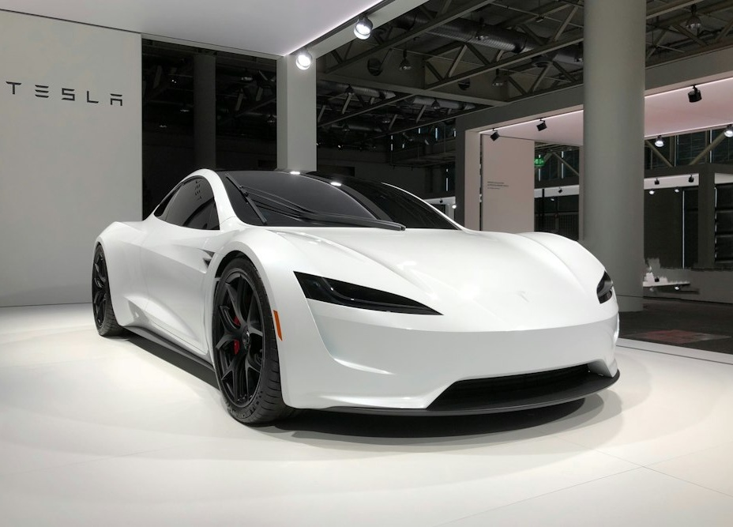
07 : VERIFICATION
Every session leaves evidence
Tripartite photographic inspection workbench & computer vision comparison
[ 01 : BEFORE ] Pre-Session Baseline Scan
Vehicle port flap, connector pins, cable sheath, and driveway baseline recorded prior to charging.
[ 02 : CHARGING ] Continuous Session Logging
1 Hz telemetry stream + CCTV perimeter motion clip recording throughout the active charging session.
PORT LATCH & CONTACT VERIFICATION
Automated high-resolution macro visual evidence logging.
[ 03 : AFTER ] Post-Session Diff
Repeat matching photos + computer vision condition comparison to verify zero damage or cable strain.
AUTOMATED AI DIFFERENCE VERIFICATION
Pre-Session Baseline Scanned & Standby
Algorithms await post-session photo capture to execute 16-point feature diff across baseline and departure imagery.
[ Click to Run CV Diff Analysis ]
EV CHARGING NETWORK : Slide 08 of 13
< Prev
Next >
Home

Slide 20
07 : VERIFICATION
Every session leaves evidence
Tripartite photographic inspection workbench & computer vision comparison
[ 01 : BEFORE ] Pre-Session Baseline Scan
Vehicle port flap, connector pins, cable sheath, and driveway baseline recorded prior to charging.
[ 02 : CHARGING ] Continuous Session Logging
1 Hz telemetry stream + CCTV perimeter motion clip recording throughout the active charging session.
VERIFICATION COMPLETE (100% PASSED)
Zero cosmetic scratches or contact wear detected.
[ 03 : AFTER ] Post-Session Diff
Repeat matching photos + computer vision condition comparison to verify zero damage or cable strain.
AUTOMATED AI DIFFERENCE VERIFICATION
16-Point Computer Vision Diff Complete
Comparison verified: zero scratches, zero cable sheath abrasions, zero pin oxidation. Host equipment protected. Escrow payment released.
[ Reset Scan ]
EV CHARGING NETWORK : Slide 08 of 13
< Prev
Next >
Home

Slide 21

08 : MONITORING
Protect the charger and the vehicle
Real-time sensor telemetry and automated fault isolation controls
SIM 01 : NORMAL
Normal 7.4 kW
SIM 02 : THERMAL
Thermal Rise (72 deg C)
SIM 03 : GFCI TRIP
Ground Fault Trip GFCI
TEMPERATURE
32.4 deg C
Thermocouple (Safe)
VOLT / CURRENT
230V / 32A
Phase Health: Nominal
POWER DELIVERY
7.36 kW
Class 1 Meter Output
FAULT CODE
0x00 NORMAL
GFCI State: Active Protected
LIVE TELEMETRY SUPERVISION
Continuous monitoring protects charger hardware and vehicle battery.
1. Detect anomaly
<10ms polling on voltage, current & ground.
2. Safe EVSE response
<100ms pilot trip disengages main contactor safely.
3. Notify
Instant alerts delivered to driver and host devices.
4. Inspect if needed
Remote diagnostics logs flagged for technical review.
EV CHARGING NETWORK : Slide 09 of 13
< Prev
Next >
Home

Slide 22
08 : MONITORING
Protect the charger and the vehicle
Real-time sensor telemetry and automated fault isolation controls
SIM 01 : NORMAL
Normal 7.4 kW
SIM 02 : THERMAL
Thermal Rise (72 deg C)
SIM 03 : GFCI TRIP
Ground Fault Trip GFCI
TEMPERATURE
72.8 deg C
THERMAL WARNING EXCEEDED
VOLT / CURRENT
230V / 16A
Amperage Throttled 50%
POWER DELIVERY
3.68 kW
Protective Derating Active
FAULT CODE
0x11 TEMP_WARN
Pilot Trip Warning Emitted
LIVE TELEMETRY SUPERVISION
Continuous monitoring protects charger hardware and vehicle battery.
1. Detect anomaly
<10ms polling on voltage, current & ground.
2. Safe EVSE response
<100ms pilot trip disengages main contactor safely.
3. Notify
Instant alerts delivered to driver and host devices.
4. Inspect if needed
Remote diagnostics logs flagged for technical review.
EV CHARGING NETWORK : Slide 09 of 13
< Prev
Next >
Home

Slide 23
08 : MONITORING
Protect the charger and the vehicle
Real-time sensor telemetry and automated fault isolation controls
SIM 01 : NORMAL
Normal 7.4 kW
SIM 02 : THERMAL
Thermal Rise (72 deg C)
SIM 03 : GFCI TRIP
Ground Fault Trip GFCI
TEMPERATURE
28.1 deg C
System Disengaged
VOLT / CURRENT
0V / 0A
Contactor Disconnected (<10ms)
POWER DELIVERY
0.00 kW
Power Flow Terminated
FAULT CODE
0xFA GFCI_TRIP
Ground Leakage >5mA Tripped
LIVE TELEMETRY SUPERVISION
Continuous monitoring protects charger hardware and vehicle battery.
1. Detect anomaly
<10ms polling on voltage, current & ground.
2. Safe EVSE response
<100ms pilot trip disengages main contactor safely.
3. Notify
Instant alerts delivered to driver and host devices.
4. Inspect if needed
Remote diagnostics logs flagged for technical review.
EV CHARGING NETWORK : Slide 09 of 13
< Prev
Next >
Home

Slide 24
09 : PLATFORM
The ecosystem
Unifying demand, intelligence, and distributed electrical supply
[ DEMAND LAYER ]
EV OWNER
Convenient charging
- Urban apartment valet scheduling
- Highway corridor route reservations
- Transparent fixed per-kWh tariffs
- Real-time battery status tracking
Zero charging chore for urban owners.
[ CORE ENGINE ]
PLATFORM
Booking - Security - Payment
- Dynamic slot booking optimization
- Cryptographic JWT token auth broker
- Automated payment clearing & escrow
- Computer vision condition comparator
Coordinates identity, hardware, and billing.
[ SUPPLY LAYER ]
CHARGER PROVIDERS
Hubs - Homes - Hotels
- Hubs: Owned automated vertical towers
- Homes: Residential private driveways
- Businesses: Commercial hospitality
- Hardware telemetry & lock relays
Turns idle electrical assets into revenue.
EV CHARGING NETWORK : Slide 10 of 13
< Prev
Next >
Home

Slide 25
10 : BUSINESS
Scale without building every charger
Asset-right hybrid capital strategy balancing high-margin anchors with network scaling
OWNED HUBS
Controlled Urban Operations
- Vertical parking land efficiency
- Premium white-glove valet service
- High volume and predictability
- Solar and battery margin capture
+ DISTRIBUTED ASSETS
Verified Unused Chargers
- Zero civil construction CapEx
- Rapid geographic corridor coverage
- Automated self-service operations
- Host revenue-share alignment
= CHARGING NETWORK
Maximum Capital Efficiency
More access with less infrastructure duplication. Expands across highway miles without building billions in single-use charger concrete.
7 DIVERSIFIED REVENUE STREAMS
Charging Fee
Per-kWh markup
Valet Fee
Pickup service
Platform Fee
Clearing fee
Host Cut
Marketplace split
Membership
Monthly tier
Fleet Plans
B2B contracts
Premium
Care & detail
EV CHARGING NETWORK : Slide 11 of 13
< Prev
Next >
Home

Slide 26
11 : ROADMAP
Pilot -> network -> scale
Strategic 5-phase growth pathway to nationwide market leadership
01
Pilot
Charging hub + valet in one city
Validate valet turnaround logistics, app booking, and subscriber retention in flagship metro.
Phase 1
02
Connect
Verified residential / commercial
Onboard first 250 private host chargers with external smart lock controllers and CCTV kits.
Phase 2
03
Self-service
Secure highway charging
Deploy automated IoT smart locks along key highway transit corridors for unassisted travel.
Phase 3
04
Expand
Geographic network growth
Multi-city launch with 10 urban hubs and 2,500+ host locations across high-adoption states.
Phase 4
05
Integrate
Fleets, hotels, parking
Commercial fleet partnerships, hospitality chains, and utility grid peak-shaving demand response.
Phase 5
EV CHARGING NETWORK : Slide 12 of 13
< Prev
Next >
Home

Slide 27

EXECUTIVE SUMMARY
CHARGE WITHOUT THE CHASE.
From apartment charging to highway mobility - one secure EV charging network.
CONVENIENCE
Eliminates charging chores for apartment residents via scheduled valet service.
SECURITY
3-zone perimeter, CCTV event logs, smart hardware lock, and evidence verification.
UTILIZATION
Monetizes idle private chargers, bridging highway range gaps with zero CapEx.
SCALABILITY
Owned hubs combined with asset-light host network scales rapidly.
CORRIDOR FREEDOM
Connected highway route travel with verified host chargers.
EXECUTIVE CONCLUSION
By integrating company-owned high-density vertical hubs with a verified distributed host network, the platform resolves both urban residential charging barriers and long-distance highway travel anxiety without capital duplication.
Charging infrastructure transitions from an inconvenient stationary destination into a seamless, coordinated network service: delivering high utilization for hosts and effortless convenience for EV owners.
Restart Deck (Slide 1)
EV CHARGING NETWORK : Slide 13 of 13
< Prev
Home

