Slide 1
Advanced Java Programming first ICA
By: Kiril Anastasov
Student in Teesside University Computer Science
13, December 2012

Slide 2
Mediator

Slide 3

Lecture Outline
Introduction to the Mediator pattern
Examples of the Mediator pattern
Advantages and Disadvantages
The relation of the Mediator pattern with the other patterns
A summary

Slide 4

Mediator Pattern
We have to develop a Mars Based Alpha application
At the moment we have four classes
  Jedi which represent a Jedi from a real world
  DroneConstruction which is responsible for building
  RobotPressurizedRover which is responsible for exploring
  Scientist which represent a computer scientist that programs
  All of them are on a mission to the Mars.

Slide 5
Mediator Pattern
First we send the pressurized rovers to explore the surface of Mars
If the rovers sense any danger warn the headquarters
Headquarters sends the Jedis
If the negotiations are not successful
Jedis kills the enemies
Send the Drones to build defense system and labs
Scientist start to program

Slide 6
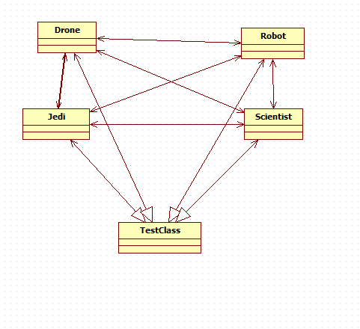
Mediator Pattern
All the classes needs to know about each other

Slide 7
The GoF pattern
This is the classic GoF definition of the Mediator pattern:
  “Define an object that encapsulates how a set of objects interact. Mediator promotes loose coupling by keeping objects from referring to each other explicitly, and it lets you vary their interaction independently”.

Slide 8
The GoF pattern
Mediator is a behavioral pattern
When we have heavy interaction between components, and they depend on a group of components the logic gets hard to understand and maintain this is where we want to use the mediator
Help the object to communicate in decoupled manner and reduce complexity

Slide 9
The GoF pattern
Use the mediator pattern to encapsulate the navigation code out of the separate classes and place it into a mediator object instead
From then on each class has to communicate with the mediator when changes occur and the mediator knows what class to send the information to
If all of the appliance objects need to know about each other and they are all tightly coupled use the Mediator pattern to centralize complex communications and control between related objects

Slide 10
Applying the Mediator
Jedi/Robot/Drone/Scientist are the concrete classes that communicate with each other via the mediator
Mediator is the mediator class that needs objects from all the concrete classes and defines methods that can be called by from them
Command is interface responsible for communication between the Mediator and the concrete classes
In TestClass is the main method and correspond with the concrete classes through the mediator

Slide 11
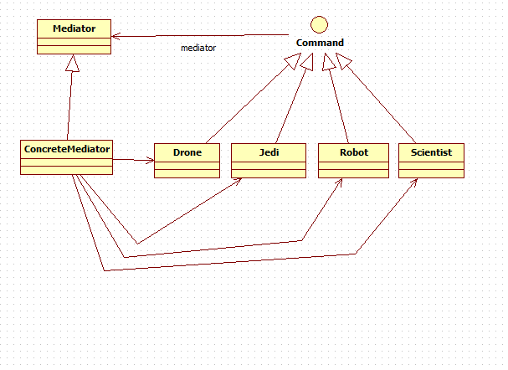
Applying the Mediator
Now the classes don't need to interact with each other but only with the Mediator through the Command interface

Slide 12
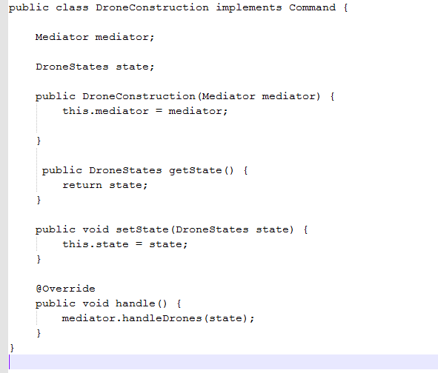
Applying the Mediator
We create a mediator object
In the constructors we initialize the mediator object
That is how the mediator is going to communicate with the DroneConsctuction
In the handle() method we call the handleDrones through the mediator

Slide 13
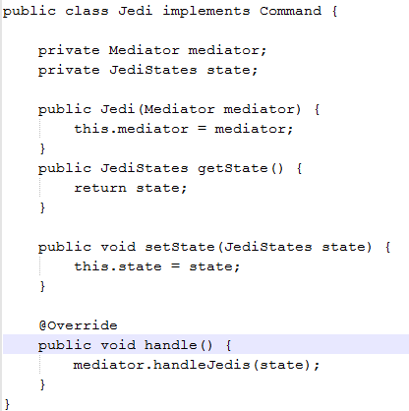
Applying the Mediator
We create a mediator object
In the constructors we initialize the mediator object
That is how the mediator is going to communicate with the Jedi
In the handle() method we call the handleJedis through the mediator

Slide 14
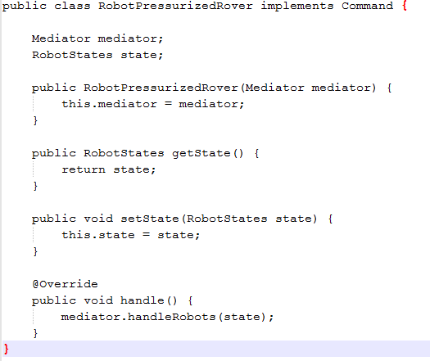
Applying the Mediator
We create a mediator object
In the constructors we initialize the mediator object
That is how the mediator is going to communicate with the RobotPressurizedRover
In the handle() method we call the handleRobots through the mediator

Slide 15
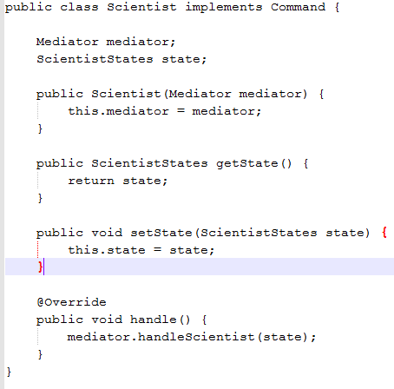
Applying the Mediator
We create a mediator object
In the constructors we initialize the mediator object
That is how the mediator is going to communicate with the Scientist
In the handle() method we call the handleScientist through the mediator

Slide 16
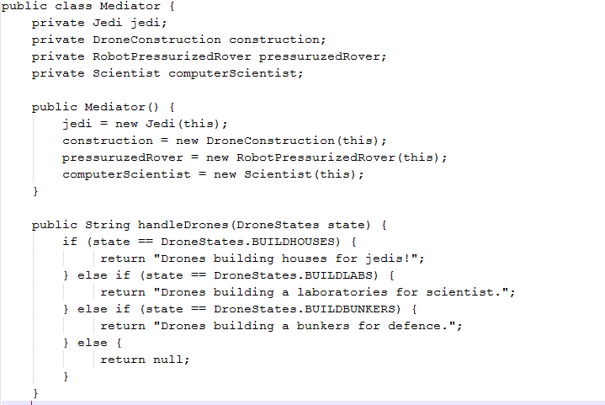
Applying the Mediator
We create objects from each concrete class and initialize them in the constructor
Then we handle the drones in handleDrones

Slide 17
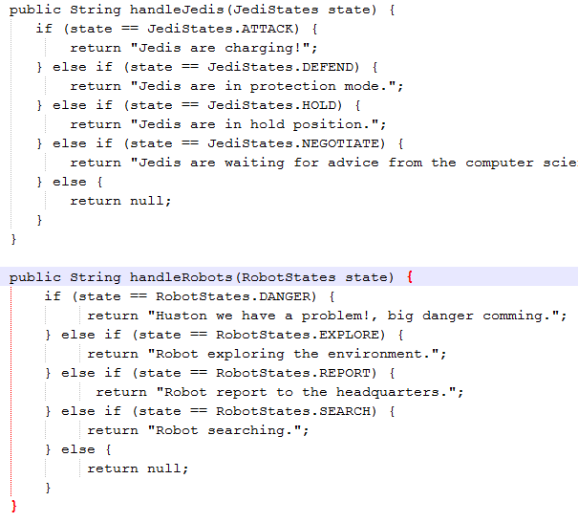
Applying the Mediator
According to the corresponding state of the Jedi or Robot we return the appropriate message
This is where we implement the logic of the concrete classes

Slide 18
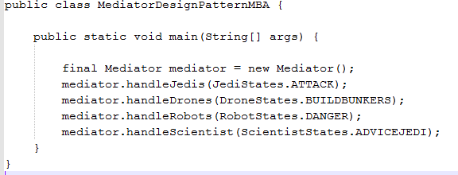
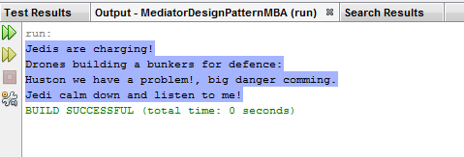
Applying the Mediator
We create a mediator object
We call the methods which are implemented in the Mediator
So we do not have to deal with each class individually

Slide 19
Examples with the Mediator
java.util.Timer(all scheduleXXX() methods)
java.util.concurrent.Executor#execute()
java.util.concurent.ExecutorService(the invokeXXX() and the submit methods)
java.util.concurent.ScheduledExecutorService(all scheduleXXX() methods)
java.lang.reflect.Method#invoke()
The mediator pattern is used in many GUI framework applications and in the Chat applications

Slide 20
Advantages of the Mediator
While we are maintaining our project we need to add more functionalities. So our project needs to be updated regularly for example we need to add weather station to our project which will alert drones, rovers, jedi and scientist for the weather on Mars
So because of the Mediator pattern that we have used there is only WeatherStation <==> Mediator relationship to implement
Instread of:
WeatherStation <==> Robot
WeatherStation <==> Drone
WeatherStation <==> Jedi
WeatherStation <==> Scientist

Slide 21
Advantages of the Mediator
If we need to add twenty more classes like Chef to prepare the food on Mars and Waiter to server the food and Politician who will be in charge the complexity will grow exponentially and it is far harder to implement it and maintain it without the Mediator
Limits subclasses, localizes behavior that would otherwise be distributed among several objects
The Mediator promotes high level of re usability: So we do not violate the DRY rule

Slide 22
Advantages of the Mediator
Comprehension, the mediator encapsulate the logic of mediation between the concrete classes. From this reason it is more easier to understand the logic since it is kept in only one class the mediator.
Decoupled Classes - The concrete classes are totally decoupled. Adding a new class is relatively easy due to
this decoupling level.
Due to loose coupling, both the mediator and concrete classes can be reused independently of each other

Slide 23
Advantages of the Mediator
Increases the re usability of the objects supported by the Mediator by decoupling them from the system
Simplifies maintenance of the system by centralizing control logic
Simplifies and reduces the variety of messages sent between objects in the system
Partition a system into pieces or small objects
Centralize control to manipulate participating objects
Most of the complexity involved in managing dependencies is shifted from other objects to the mediator object. This makes other objects easier to implement and maintain

Slide 24
Disadvantages of the Mediator
Usually not a good practice for a relatively small group of objects.
Without proper design, the Mediator object itself can become overly complex. In practice the mediators tends to become more complex. A good practice is to make sure the mediator classes are responsible only for the communication part.
Centralized control mediator encapsulates protocols and is more complex than individual classes, as a result it might become harder to maintain.

Slide 25
SOLID
The code we used is a good example of SOLID
Every class and method have exactly one responsibility. Jedi class deals only with Jedis and the handleJedis method in the Mediator handles only Jedis. A bad example would be to have one method in the Mediator that deals with everything.
We also follow the Open-closed principle which is open for extension and closed for modification. So if we modify our code we will need to test it again which is cost effective and not desirable.
Liskov substitution principle states that functions that use references to base classes must be able to use objects of derived classes without knowing it

Slide 26
SOLID and GRASP
Interface segregation principle: splits interfaces which are very large into smaller and more specific ones in order to ensure that the clients will only have to use the methods that are necessary for them
Dependency Inversion Principle: High-level modules should not depend on low-level modules. Both should depend on abstraction and abstraction should not depend upon details. Details should depend upon abstractions.
A lot of G.R.A.S.P principles are covered in SOLID like low coupling, high cohesion, polymorphism and pure fabrication

Slide 27
Summary
You should use the mediator pattern when you have to centralize complex communications and control between related objects.
There are a few design patterns that are closely related to the Mediator pattern and are often used in conjunction with it.
Facade Patter: a simplified mediator becomes a facade pattern if the mediator is the only active class and the concrete classes are passive. A facade pattern is just an implementation of the mediator pattern where mediator is the only object triggering and invoking actions on passive concrete classes. The Facade is being call by some external classes.

Slide 28
Summary
Adapter Pattern: the mediator patter just "mediate" the requests between the concrete classes. It is not supposed to change the messages it receives and sends. If it alters those messages then it is an Adapter pattern.
Observer Pattern: the observer and mediator are similar patterns, solving the same problem. The main difference between them is the problem they address. The observer pattern handles the communication between observers and subjects or subject. It's very probable to have new observable objects added. On the other side in the mediator pattern the mediator class is the the most likely class to be inherited.

Slide 29
References
1. Gang of Four August 1994
2. Head First Design Patterns 2004 O'REILLY
3.Design Patterns for Dummies 2006 by Wiley Publishing, Inc., Indianapolis, Indiana
4. http://www.slideshare.net/devel123/solid-grasp-9816996#btnNext
5.http://snehaprashant.blogspot.co.uk/2009/01/mediator-pattern-in-java.html
6.http://www.oodesign.com/index2.php?option=com_content&do_pdf=1&id=24
7. http://stackoverflow.com/questions/1673841/examples-of-gof-design-patterns

