Slide 1
Multi-Dimensional Apriori-Window:
Exact Mining of Dense Itemset Regions over Arbitrary Dimensions
IEEE DSAA 2026 #25
Kanata Takayasu, Tahei Takahashi, Satoshi Suga, Satoshi Kurihara
Keio University, Kansai University, Japan

Slide 2
Agenda
Introduction
  Motivation : The "When, Where, What" Question
  Existing Methods Cannot Answer Both Questions
  This Paper : Multi-Dimensional Apriori-Window
Background
Proposed Method
Experiments
Conclusion

Slide 3
Motivation : The “What, When, Where” Question
Analysts need to know what is co-occurring and where & when it is dense — simultaneously. Neither question alone is actionable.
Transaction DataBase
What
Where
When
Dense Pattern

Slide 4
Motivation : The “What, When, Where” Question
Analysts need to know what is co-occurring and where & when it is dense — simultaneously. Neither question alone is actionable.
Transaction DataBase
What
Where
When
Action
Dense Pattern

Slide 5
Motivation : The “What, When, Where” Question
Analysts need to know what is co-occurring and where & when it is dense — simultaneously. Neither question alone is actionable.
What
Where
When
Action
Retail
Beer & chips
In Area A
Friday night
Coupon
Crime
Assault &
Battery
In Downtown
midnight
Deploy Patrol
Epidemiology
Dispatch Medical Team
Fever & Cough
In District 7
week 12-14

Slide 6
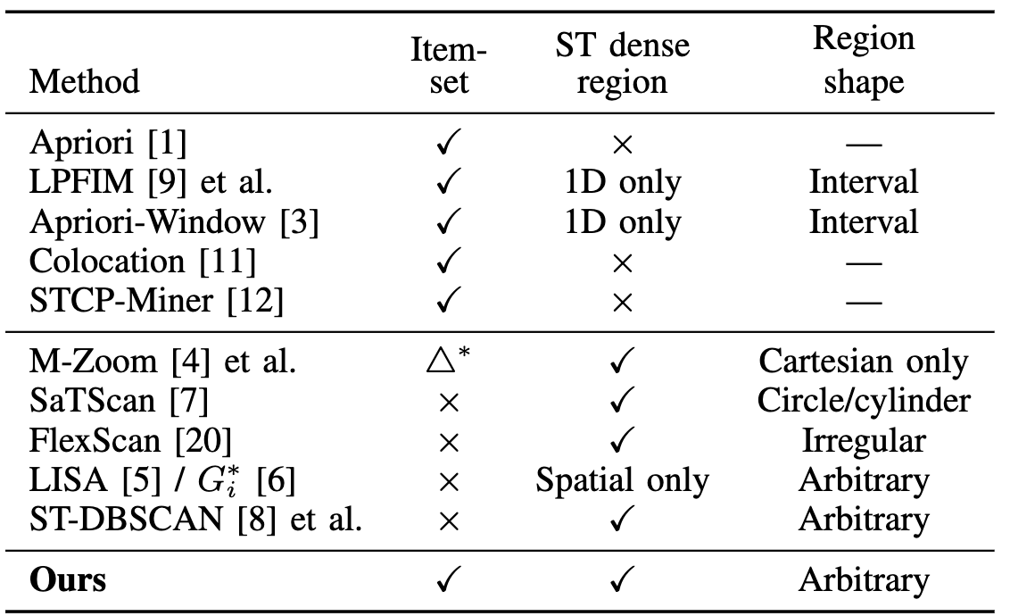
Existing Methods Cannot Answer Both Question
Pattern mining cannot output regions. Region detection cannot enumerate itemsets. This is a structural incompatibility — not fixable by tuning parameters.

Slide 7
This Paper - Multi-Dimensional Apriori-Window
We propose three techniques that together exactly enumerate all dense itemsets and their arbitrary-shaped dense regions over any d-dimensional grid.
Reduction to 1D per fixed spatial start point
Apriori pruning via (k-1)-subset
interval map intersection
Duplicate-aware t-axis stride

Slide 8
Agenda
Introduction
Background
  Multi-Dimentional Transaction Data
  Frequent Pattern & Dense Pattern
  The Apriori Property
Proposed Method
Experiments
Conclusion

Slide 9
Multi-Dimensional Transaction Data
1A transaction = coordinate vector + itemset. Extend from 1D time to d-dim by adding spatial axes.
t
t
C
C
AC
AB
BC
BC
BC
BC
・・・
A
A
B
B
AB
AB
BC
C
AB
：Transaction
x
1-Dimension
2-Dimension

Slide 10
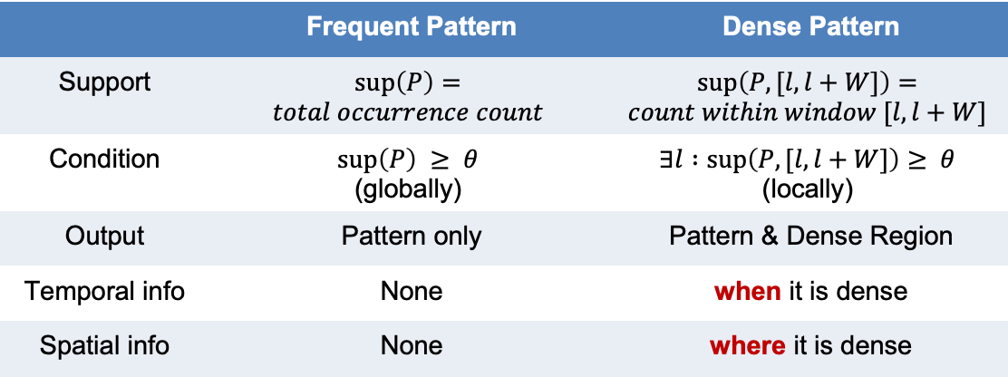
Frequent Pattern & Dense Pattern
Frequent pattern = global count ≥ θ, no time info. Dense pattern = window count ≥ θ somewhere — gives both what and when/where.
 | Frequent Pattern | Dense Pattern
Support | $$\sup\left(P\right)=$$ $$total occurrence count$$ | $$\sup\left(P, [l, l+W]\right)=$$ $$count within window [l, l+W]$$
Condition | $$\sup\left(P\right) ≥ θ$$ (globally) | $$∃l :\sup\left(P, [l, l+W]\right)≥ θ$$ (locally)
Output | Pattern only | Pattern & Dense Region
Temporal info | None | when it is dense
Spatial info | None | where it is dense

Slide 11

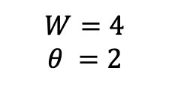
Frequent Pattern & Dense Pattern
Frequent pattern = global count ≥ θ, no time info. Dense pattern = window count ≥ θ somewhere — gives both what and when/where.
Frequent Pattern
1
AB
Dense Pattern
2
AB
$$W=4$$
$$θ =2$$
$$θ=4$$
3
AB
4
C
5
D
6
C
7
D
8
AB

Slide 12

Frequent Pattern & Dense Pattern
Frequent pattern = global count ≥ θ, no time info. Dense pattern = window count ≥ θ somewhere — gives both what and when/where.
Frequent Pattern
1
AB
Dense Pattern
2
AB
$$W=4$$
$$θ =2$$
$$θ=4$$
3
AB
4
C
$$\sup\left(AB\right)=4 ≥θ$$
5
D
6
C
7
D
AB
8
AB

Slide 13



Frequent Pattern & Dense Pattern
Frequent pattern = global count ≥ θ, no time info. Dense pattern = window count ≥ θ somewhere — gives both what and when/where.
Frequent Pattern
1
AB
Dense Pattern
2
AB
$$W=4$$
$$θ =2$$
$$θ=4$$
3
AB
4
C
$$\sup\left(AB, [1, 4]\right)=3 ≥ θ$$
$$\sup\left(AB\right)=4 ≥θ$$
5
D
$$\sup\left(AB, [2, 5]\right)=2 ≥ θ$$
6
C
AB [1, 5]
$$\sup\left(AB, [3, 6]\right)=1 < θ$$
7
D
AB
8
AB

Slide 14
Frequent Pattern & Dense Pattern
Frequent pattern = global count ≥ θ, no time info. Dense pattern = window count ≥ θ somewhere — gives both what and when/where.
Frequent Pattern
1
AB
Dense Pattern
2
AB
$$W=4$$
$$θ =2$$
$$θ=4$$
3
AB
4
C
$$\sup\left(AB, [1, 4]\right)=3 ≥ θ$$
$$\sup\left(AB\right)=4 ≥θ$$
5
D
$$\sup\left(AB, [2, 5]\right)=2 ≥ θ$$
6
C
AB [1, 5]
$$\sup\left(AB, [3, 6]\right)=1 < θ$$
7
D
AB
8
AB

Slide 15
The Apriori Property ^{[1]} for Frequent Pattern
If a pattern is frequent, all its subsets are frequent. Equivalently: if any subset is not frequent, the pattern cannot be frequent.
P is frequent ⟹ every subset Q ⊂ P is also frequent
Some subset Q ⊂ P is not frequent ⟹ P cannot be frequent
The Apriori Property

Slide 16
The Apriori Property ^{[1]} for Dense Pattern
If a pattern is dense, all its subsets are dense. Equivalently: if any subset is not dense, the pattern cannot be dense.
P is dense ⟹ every subset Q ⊂ P is also dense
Some subset Q ⊂ P is not dense ⟹ P cannot be dense
The Apriori Property

Slide 17
The Apriori Property ^{[1]} for Dense Region
The dense region of Pattern is contained within the intersection of its subsets' dense regions — only evaluate inside that intersection. Empty intersection → skip entirely.
A
Dense Region
t
B
Dense Region
AB
Candidate
t
AB
Candidate
AB
Candidate
t
[1]Rakesh Agrawal and Ramakrishnan Srikant. Fast algorithms for mining association rules. In Proc. 20th Int. Conf. Very Large Data Bases, VLDB,Vol. 1215, pp. 487–499. Citeseer, 1994

Slide 18
Agenda
Introduction
Background
Proposed Method
  Reduction to 1D per fixed spatial start point
  Apriori pruning via (k-1)-subset interval map intersection
  Duplicate-aware t-axis stride
Experiments
Conclusion

Slide 19
Multi-Dimensional Apriori-Window
Reduce d-dim to 1D per fixed spatial start point. Then fight the cost blowup with interval map intersection, and fix the broken t-stride with duplicate awareness.
Reduction to 1D per fixed spatial start point
increase in
computational cost
incompatibility of
the t-axis stride
Apriori pruning via (k-1)-subset
interval map intersection
Duplicate-aware t-axis stride

Slide 20
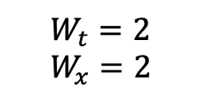
Reduction to 1D per fixed spatial start point
Slice the d-dim data per spatial start point → each slice becomes a 1D multiset → solve with 1D Apriori-Window.
$$W_{t}=2$$
$$W_{x}=2$$
t
D
A
B
C
C
D
A
B
B
C
D
A
A
B
C
D
x

Slide 21
Reduction to 1D per fixed spatial start point
Slice the d-dim data per spatial start point → each slice becomes a 1D multiset → solve with 1D Apriori-Window.
$$W_{t}=2$$
$$W_{x}=2$$
t
D
D
A
A
B
C
C
C
D
D
A
B
B
B
C
C
D
A
A
A
B
B
C
D
x

Slide 22
Reduction to 1D per fixed spatial start point
Slice the d-dim data per spatial start point → each slice becomes a 1D multiset → solve with 1D Apriori-Window.
$$W_{t}=2$$
$$W_{x}=2$$
t
D
A
B
C
D
A
C
D
A
B
C
D
B
C
D
A
B
C
A
B
C
D
A
B
x

Slide 23
Reduction to 1D per fixed spatial start point
Slice the d-dim data per spatial start point → each slice becomes a 1D multiset → solve with 1D Apriori-Window.
$$W_{t}=2$$
$$W_{x}=2$$
t
D
A
A
B
B
C
D
A
C
D
D
A
A
B
C
D
B
C
C
D
D
A
B
C
A
B
B
C
C
D
A
B
x

Slide 24
Reduction to 1D per fixed spatial start point
Slice the d-dim data per spatial start point → each slice becomes a 1D multiset → solve with 1D Apriori-Window.
$$W_{t}=2$$
$$W_{x}=2$$
t
D
A
B
C
D
A
A
B
C
D
A
B
C
D
D
A
B
C
D
A
B
C
C
D
A
B
C
D
A
B
B
C
x

Slide 25
Reduction to 1D per fixed spatial start point
Slice the d-dim data per spatial start point → each slice becomes a 1D multiset → solve with 1D Apriori-Window.
$$W_{t}=2$$
$$W_{x}=2$$
t
D
A
B
B
C
C
D
A
A
B
C
D
A
A
B
B
C
D
D
A
B
C
D
D
A
A
B
C
C
D
A
B
C
C
D
D
A
B
B
C
x

Slide 26
Reduction to 1D per fixed spatial start point
Slice the d-dim data per spatial start point → each slice becomes a 1D multiset → solve with 1D Apriori-Window.
$$W_{t}=2$$
$$W_{x}=2$$
t
D
A
B
C
D
A
A
B
B
C
C
D
A
B
C
D
D
A
A
B
B
C
D
A
B
C
C
D
D
A
A
B
C
D
A
B
B
C
C
D
x

Slide 27
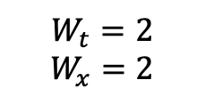
Reduction to 1D per fixed spatial start point
Slice the d-dim data per spatial start point → each slice becomes a 1D multiset → solve with 1D Apriori-Window.
$$W_{t}=2$$
$$W_{x}=2$$
D
A
A
B
B
C
C
D
D
A
A
B
B
C
C
D
D
A
A
B
B
C
C
D

Slide 28
Reduction to 1D per fixed spatial start point
Slice the d-dim data per spatial start point → each slice becomes a 1D multiset → solve with 1D Apriori-Window.
$$W_{t}=2$$
$$W_{x}=2$$
D
A
A
B
B
C
C
D
D
A
A
B
B
C
C
D
D
A
A
B
B
C
C
D

Slide 29
Reduction to 1D per fixed spatial start point
Slice the d-dim data per spatial start point → each slice becomes a 1D multiset → solve with 1D Apriori-Window.
$$W_{t}=2$$
$$W_{x}=2$$
D
A
A
B
B
C
C
D
D
A
A
B
B
C
C
D
D
A
A
B
B
C
C
D

Slide 30
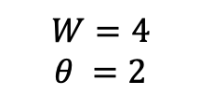
Determine density using sliding window
Counts pattern occurrences within a sliding window and identifies start positions that meet the threshold.
$$W=4$$
$$θ =2$$
1
2
3
4
5
6
7
8
AB
AB
AB
AB
D
C
D
AB
B
BC
C
A
B
B

Slide 31

Determine density using sliding window
Counts pattern occurrences within a sliding window and identifies start positions that meet the threshold.
$$W=4$$
$$θ =2$$
1
2
3
4
5
6
7
8
AB
AB
AB
AB
D
C
D
AB
B
BC
C
A
B
B
$$\sup\left(AB, [1, 4]\right)=4 ≥ θ$$
→AB[1,4] is Dense

Slide 32

Determine density using sliding window
Counts pattern occurrences within a sliding window and identifies start positions that meet the threshold.
$$W=4$$
$$θ =2$$
1
2
3
4
5
6
7
8
AB
AB
AB
AB
D
C
D
AB
B
BC
C
A
B
B
$$\sup\left(AB, [2, 5]\right)=3 ≥ θ$$
→AB[2,5] is Dense

Slide 33

Determine density using sliding window
Counts pattern occurrences within a sliding window and identifies start positions that meet the threshold.
$$W=4$$
$$θ =2$$
1
2
3
4
5
6
7
8
AB
AB
AB
AB
D
C
D
AB
B
BC
C
A
B
B
$$\sup\left(AB, [3, 6]\right)=2 ≥ θ$$
→AB[3,6] is Dense

Slide 34

Determine density using sliding window
Counts pattern occurrences within a sliding window and identifies start positions that meet the threshold.
$$W=4$$
$$θ =2$$
1
2
3
4
5
6
7
8
AB
AB
AB
AB
D
C
D
AB
B
BC
C
A
B
B
$$\sup\left(AB, [4, 7]\right)=1 < θ$$
→AB[4,7] is not Dense

Slide 35
Duplicate-aware t-axis stride
Skip guaranteed dense & non-dense gaps by jumping l to the next useful position — avoids scanning every window.
$$W=4$$
$$θ =2$$
1
2
3
4
5
6
7
8
AB
AB
AB
AB
D
C
D
AB
B
BC
C
A
B
B
$$\sup\left(AB, [1, 4]\right)=4 ≥ θ$$
→AB[1,4] is Dense

Slide 36

Duplicate-aware t-axis stride
Skip guaranteed dense & non-dense gaps by jumping l to the next useful position — avoids scanning every window.
$$W=4$$
$$θ =2$$
1
2
3
4
5
6
7
8
AB
AB
AB
AB
D
C
D
AB
B
BC
C
A
B
B
$$\sup\left(AB, [2, 5]\right)=3or4 ≥ θ$$
→AB[2,5] is definitely Dense
→Skippable

Slide 37

Duplicate-aware t-axis stride
Skip guaranteed dense & non-dense gaps by jumping l to the next useful position — avoids scanning every window.
$$W=4$$
$$θ =2$$
1
2
3
4
5
6
7
8
AB
AB
AB
AB
D
C
D
AB
B
BC
C
A
B
B
$$\sup\left(AB, [3, 6]\right)=2or3or4 ≥ θ$$
→AB[3,6] is definitely Dense
→Skippable

Slide 38

Duplicate-aware t-axis stride
Skip guaranteed dense & non-dense gaps by jumping l to the next useful position — avoids scanning every window.
$$W=4$$
$$θ =2$$
1
2
3
4
5
6
7
8
A
B
B
AB
D
AB
D
A
B
BC
C
A
B
B
$$\sup\left(AB, [1, 4]\right)=1 < θ$$
→AB[1,4] is not Dense

Slide 39

Duplicate-aware t-axis stride
Skip guaranteed dense & non-dense gaps by jumping l to the next useful position — avoids scanning every window.
$$W=4$$
$$θ =2$$
1
2
3
4
5
6
7
8
A
B
B
AB
D
AB
D
A
B
BC
C
A
B
B
$$\sup\left(AB, [2, 5]\right)=1 < θ$$
→AB[1,4] is definitely not Dense
→Skippable

Slide 40
Duplicate-aware t-axis stride
Skip guaranteed dense & non-dense gaps by jumping l to the next useful position — avoids scanning every window.
$$W=4$$
$$θ =2$$
1
2
3
4
5
6
7
8
A
B
B
AB
D
AB
D
A
B
BC
C
A
B
B
$$\sup\left(AB, [2, 5]\right)=1 < θ$$
→AB[1,4] is definitely not Dense
→Skippable

Slide 41

Duplicate-aware t-axis stride
Skip guaranteed dense & non-dense gaps by jumping l to the next useful position — avoids scanning every window.
$$W=4$$
$$θ =2$$
1
2
3
4
5
6
7
8
A
B
B
AB
D
AB
D
A
B
BC
C
A
B
B
$$\sup\left(AB, [2, 5]\right)=1or2 < θ$$
→Is AB[1,4] Dense or not Dense?
→Scan

Slide 42

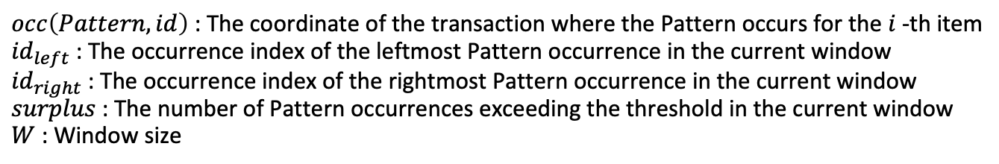
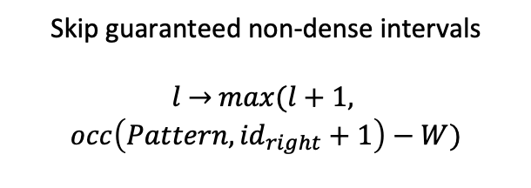

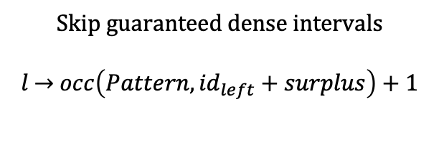
Duplicate-aware t-axis stride
Skip guaranteed dense & non-dense gaps by jumping l to the next useful position — avoids scanning every window.
$$count≥θ$$
$$count<θ$$
Skip guaranteed dense intervals
$l$ → $occ\left(Pattern,{id}_{left}+surplus\right)+1$
Skip guaranteed non-dense intervals
$l$ → $max(l+1,$
$$occ\left(Pattern,{id}_{right}+1\right)−W)$$
$occ\left(Pattern, id\right)$ : The coordinate of the transaction where the Pattern occurs for the $i$-th item
${id}_{left}$ : The occurrence index of the leftmost Pattern occurrence in the current window
${id}_{right}$ : The occurrence index of the rightmost Pattern occurrence in the current window
$surplus$ : The number of Pattern occurrences exceeding the threshold in the current window
$W$ : Window size

Slide 43
Apriori pruning via (k-1)-subset interval map intersection
The dense region of Pattern is contained within the intersection of its subsets' dense regions — only evaluate inside that intersection. Empty intersection → skip entirely.
A
Dense Region
t
B
Dense Region
AB
Candidate
t
AB
Candidate
AB
Candidate
t

Slide 44
Agenda
Introduction
Background
Proposed Method
Experiments
  EX-1 : Exactness Verification on Synthetic Data
  EX-2 : Scalability (Synthetic Data)
  EX-3 : Application to Real-World Data (d=3–4)
Conclusion

Slide 45
EX-1 : Exactness Verification on Synthetic Data
To test exact region recovery, we embed 4-shape GT in synthetic data — proposed outputs the exact solution by definition.
Baselines
Shape | Name | Description
A | Rectangle | Fixed-size orthogonal dense band
B | Drift | Dense band shifts spatially over time
C | Intermittent | Dense band appears and disappears
D | Expanding | Dense region grows larger over time
Colocation
STCP Miner
LISA
M-Zoom
ST-DBSCAN
Setup: $T$=100 × $S$=100 grid, 20 GT patterns, $W$=(20,5), $θ$=30

Slide 46
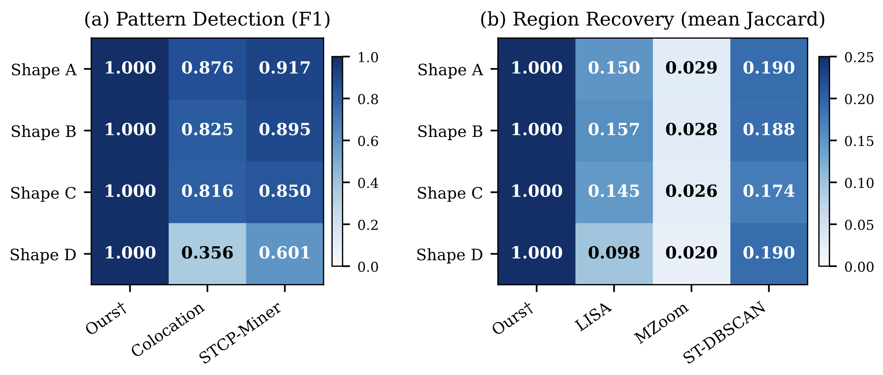
EX-1 : Exactness Verification on Synthetic Data
To test exact region recovery, we embed 4-shape GT in synthetic data — proposed outputs the exact solution by definition.

Slide 47
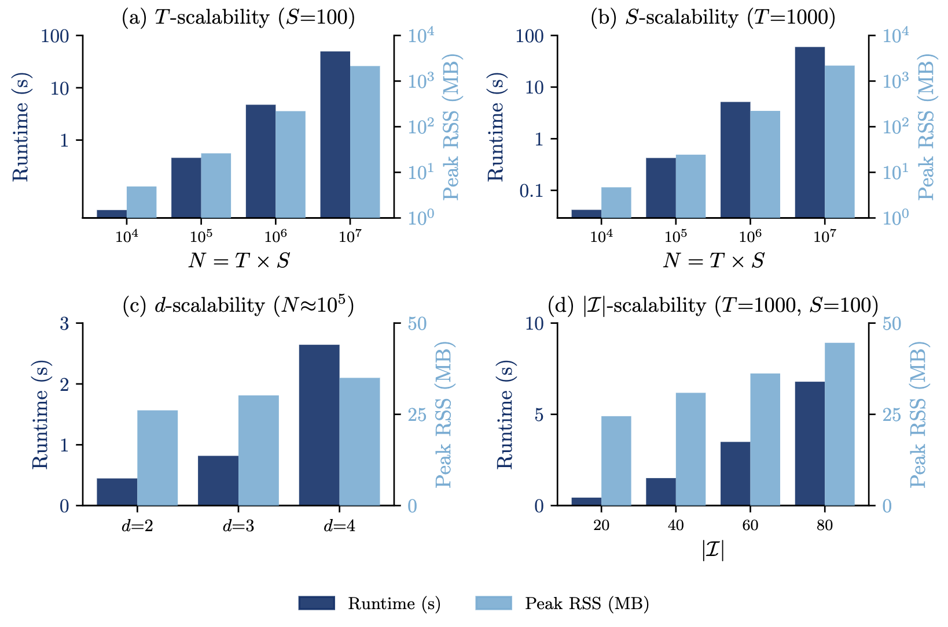
EX-2 : Scalability (Synthetic Data)
To test scalability, we vary N from 10⁴ to 10⁸ — linear scaling, 10⁸ in ~9 min.

Slide 48
EX-3 : Application to Real-World Data (d=3-4)
To verify interpretability, we apply to d=3–4 real data — domain-consistent patterns, no labeled GT needed.
Dataset | Dimension | Axes (items)
Chicago Crime | 3 | week × lat-bin × lon-bin (crime types)
NYPD Crime | 3 | week × borough × precinct (crime categories)
NYC 311 | 3 | week × community district × complaint type (service requests)
USGS Earthquake | 4 | week × lat-bin × lon-bin × depth-bin (magnitude class)

Slide 49
EX-3 : Application to Real-World Data (d=3-4)
To verify interpretability, we apply to d=3–4 real data — domain-consistent patterns, no labeled GT needed.
Dataset | Finding
Chicago Crime | ASSAULT+BATTERY chronic hotspot in South/West Side; 3-way compound co-occurrence
NYPD Crime | Felony + misdemeanor co-occur in specific borough × week windows
NYC 311 | Noise + illegal parking cluster in residential districts
USGS Earthquake | Shallow vs. mid-depth quakes split along depth axis

Slide 50
Agenda
Introduction
Background
Proposed Method
Experiments
Conclusion

Slide 51
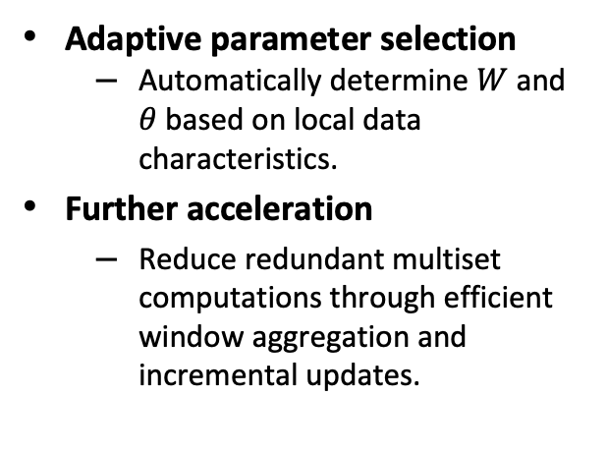
Conclusion
We propose Multi-Dimensional Apriori-Window, a method that exactly enumerates dense patterns and their arbitrarily-shaped dense regions in arbitrary d-dimensional grids. This unifies pattern enumeration with spatial-temporal region detection, enabling exact and interpretable results.
Limitation
Future Work
Grid discretization
  Results depend on parameter choices.
Scalability in high dimensions
  Computational cost increases with dimensionality.
No causal explanation
  Cannot explain the causes of detected patterns.
Adaptive parameter selection
  Automatically determine $W$ and $θ$ based on local data characteristics.
Further acceleration
  Reduce redundant multiset computations through efficient window aggregation and incremental updates.

