Slide 1
Video Analytics -sbi
Solution is prepared by Karan Kanaujiya
See my presentation and find right solution
Acomplete solution for Bank security through surveillance

Slide 2
Problem being solved
12 PILLARS OF ESURVEILLANCE PROTECTING THE BANKING SECTOR
1.Hinder robberies
2.Wrongdoing investigation
3.Extortion check
4.Battle “Apparition ATM withdrawals”
5.Coordinate information from multiple locations
6.Reconciliation with alarm systems.

Slide 3
Check these points 😀😀😀😀
7.canny functionality
8.computerized storage
9.ceaseless surveillance
10.information recognition
11.remote access
12.upgraded customer confidence

Slide 4
Approaches taken. To create the model
This model is created with the help of a content which I have stored in my computer for security purposes in the different places and companies.
Also with the help of some internet knowledge and with some common knowledge I prepared this Model.

Slide 5
Prerequisites
By the help of encryption method we safe our data .
A financial instrumentor assets that can be easily traded in the open market.standard 24 fps is taken for movies and videos.
For the security of Bank system a trained professionals are needed.

Slide 6


Slide 7
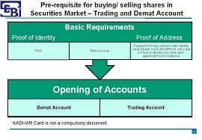

Slide 8


Slide 9
Prerequisites :- That’s means complete KYC is necessary for account holder.
Adhar card is mandatory for account holder
Pan card is mandatory for account holder

Slide 10
Reasons why my solution is considered
1.meet business requirements
2.delivered and maintened within budget
3.return on investment
4.delivered and maintened on schedule.

Slide 11
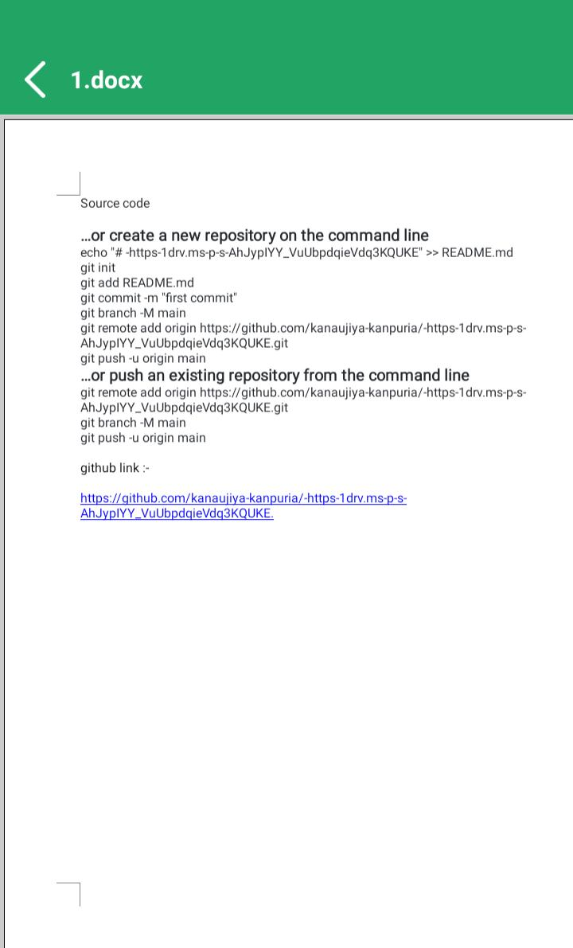

Slide 12
Thank you
Submitted by:- Karan Kanaujiya
Email id :- karankanaujiya@gmail.com
Mobile no:- +91-8853070019

