Slide 1

WeCare
By- Kanav Bhasin

Slide 2
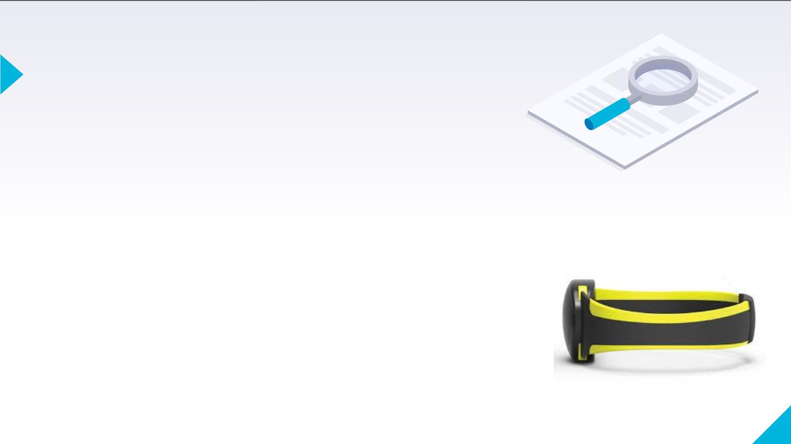
Introduction:
WeCare is a comprehensive multiservice wearable belt
integrated with an Android app, a motivation to help the
visually impaired elderly suffering from cataract/glaucoma
and the problems which they face in their everyday
lives.
It brings a plethora of features at just 5% the cost. We set our
minds to come up with a device that provides much more than
just a sense of sight and most importantly is affordable to all.
We see this product as an effort building up on the futuristic
development of Assistive technologies.
3

Slide 3
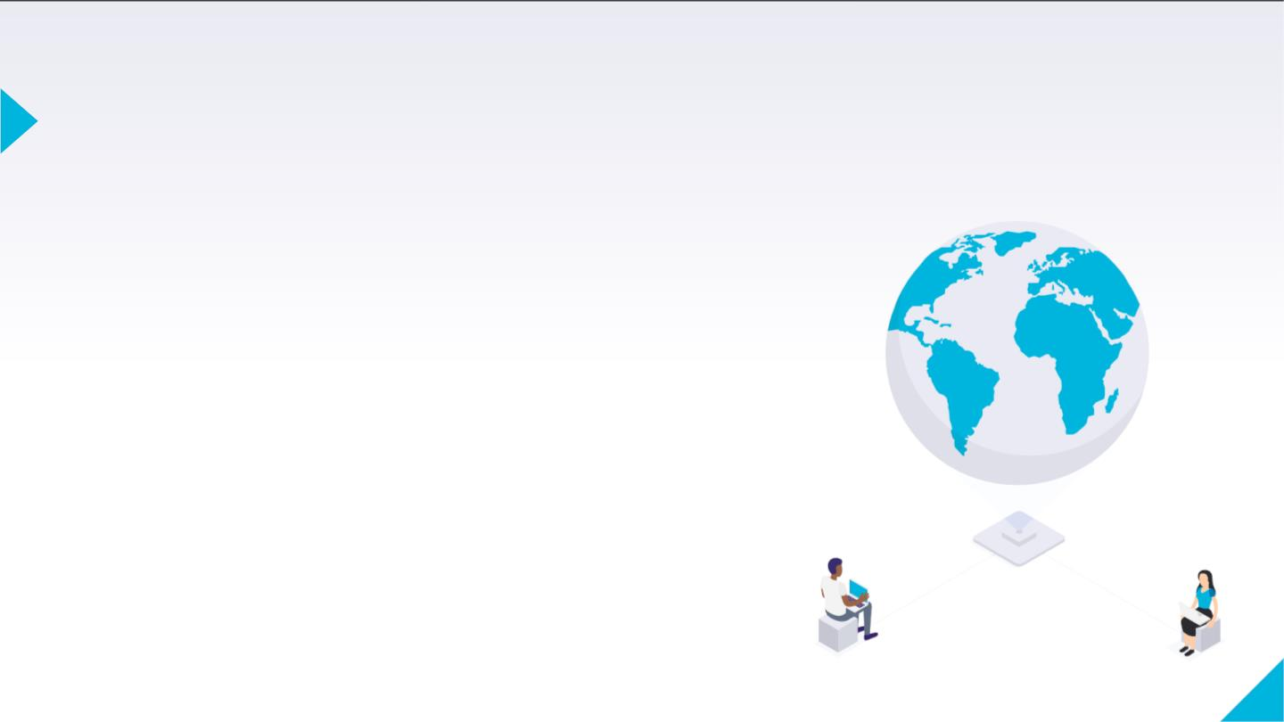
Our Vision: Insight into the Project:
Envisioning the role of technology in transforming everyday life, we constantly strive to provide the best solutions to the problems faced by the families of the elderly in monitoring them closely due to their busy schedules.
Have an Ola or Uber for a joyous ride? Why not use the same technology to send a request notification to all the near proximity users on the app database instead of just his relatives (who perchance may not be able to provide faster relief in emergency). Such users will then indicate their willingness and ability to help and accordingly the nearest user will be mapped.
1

Slide 4
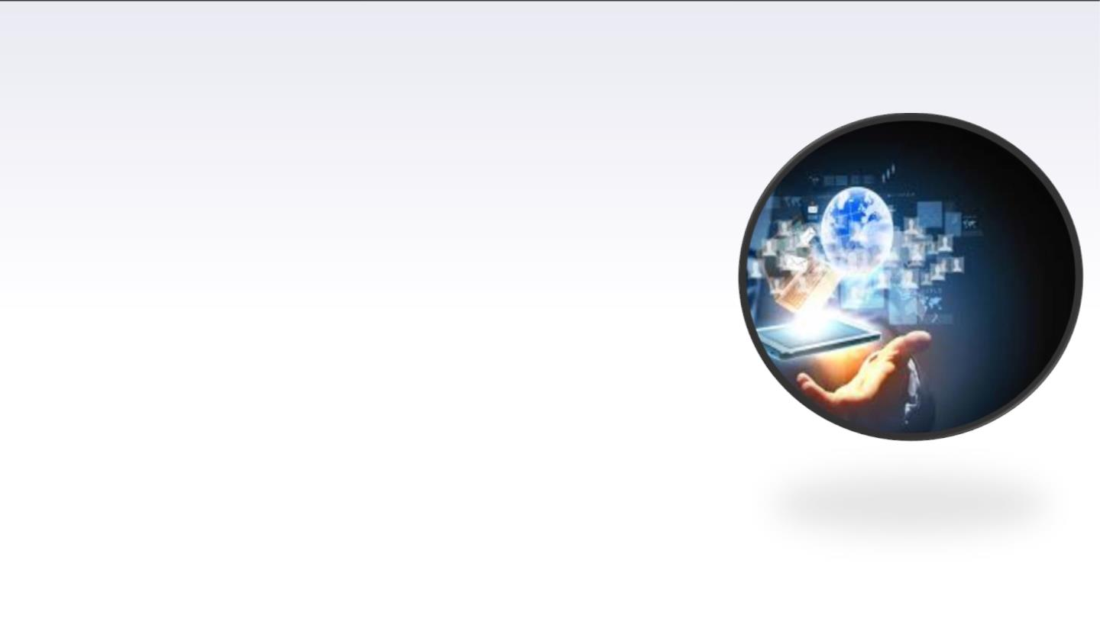
Technical Aspects:
The wearable is implemented using the third eye and the fall detection systems.
Third eye system on the belt helps the visually impaired to navigate with speed and confidence by detecting the nearby obstacles using the help of ultrasonic sensors and notifying them with a buzzer sound or vibration thus saving him from falling or any accident while making a turn (left or right).
The fall detection system can detect the elderly's fall by acceleration analysis and act as a reliable surveillance to mitigate the negative effects of falls. It will get the elderly's geographic position and send fall alarm notification to caregivers.
The relative and his doctor whoever will be added on his WeCare app will get an SMS and a pop up on their phone with the patient's exact location so that they can help him as soon as possible.

Slide 5
Mobile Application
Features of WeCare app
Healthcare Tips
Profile integration with wearable
Aging mythbusters in one place.
Add the elderly’s profile for a better time management
Live chat
Chat with doctors through the app.
Notifications
Monitoring System
People on the app database notified in case of emergency and shortest path mapped for help.
Get real-time location of the elderly.

Slide 6
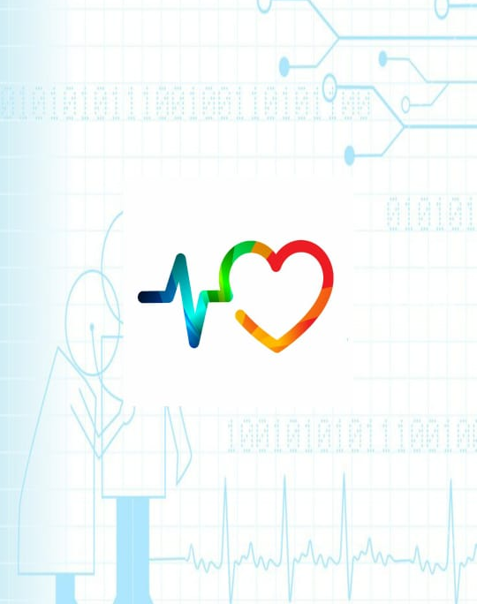
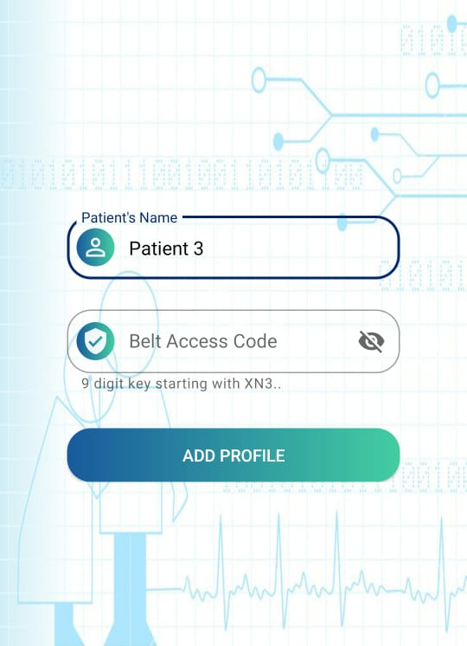
WeCare
The mobile app has been developed as a smart portal for end-users integrated with a push notification service with the wearable.
It also has other features like adding the patient’s profile particularly synced with the wearable for live monitoring.

Slide 7
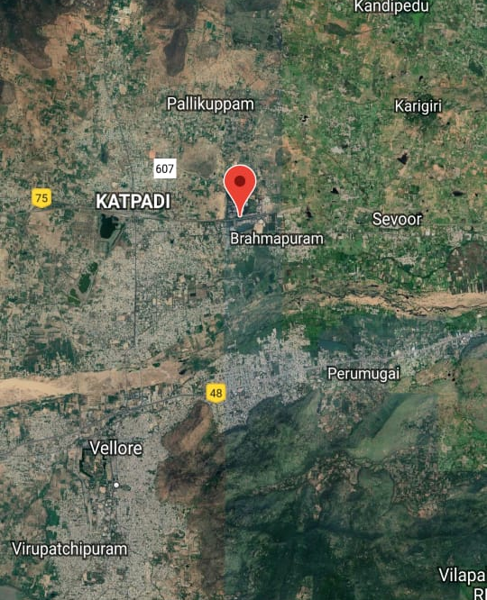
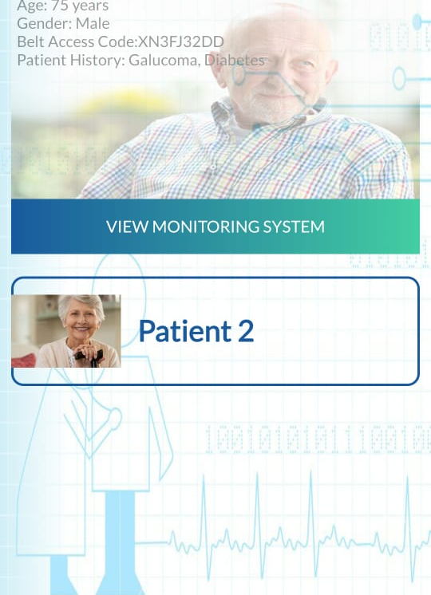
Another module in the app allows the relatives to get real-time location of the elderly with all his health specifications.

Slide 8
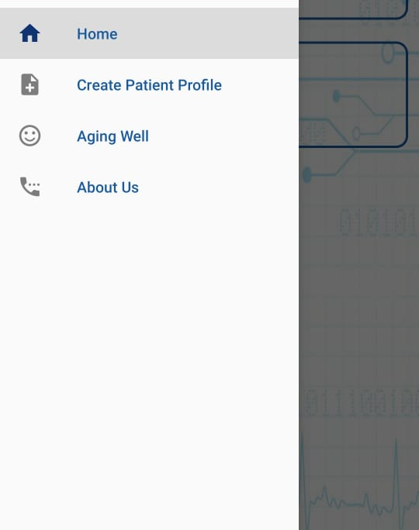
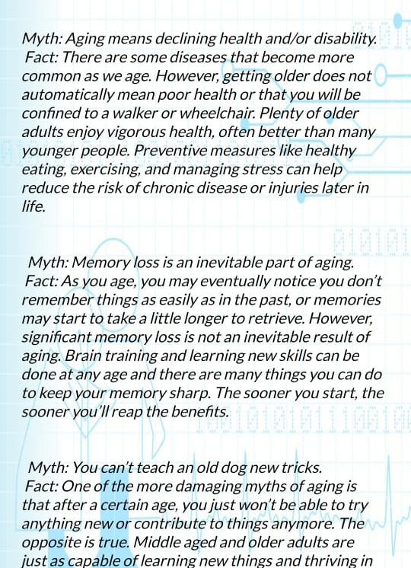
Controls which allow the user to interact will be simple and clear providing ease of use.
A module on some common myth-busters for the elderly to age well!

Slide 9
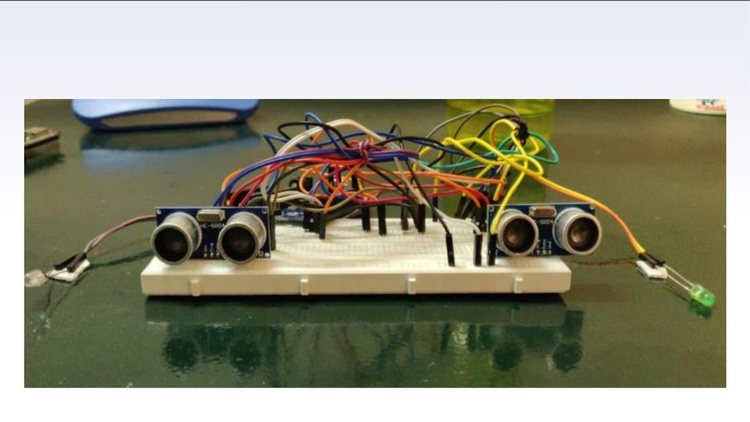
Wearable Device
R
L

Slide 10

Components Required:
Hardware:
▪GSM Module
▪Wifi Module Node MCU
▪Arduino
▪Buzzer
▪Gps module
▪Vibration sensors
▪Ultrasonic sensor(sonar)
▪Accelerometer-Gyroscope(GY-521)
Software:
▪Android Studio

Slide 11

Components and uses:
GSM Module-
It is a chip or circuit that is used to establish communication between a mobile device or a
computing machine and a GSM or GPRS system.
This module will help in sending message in case of emergency to the Patient’s relatives and
doctors
Wi-Fi module Node MCU-
An open source development board and firmware based in the widely used ESP8266 Wi-Fi
module. It allows you to program the wifi module with a simple and powerful LUA
programming language.
This Module will help in connecting to internet and also upload the location of the Patient on
the app/cloud.

Slide 12
Arduino-
An open-source electronics platform based on easy-to-use hardware and
software. These boards are able to read inputs - light on a sensor, a finger on a
button etc and turn it into an output - activating a motor, turning on an LED.
This microcontroller helps in making the third eye system for the patient.
GPS Module-
A radio navigation system that calculates the positioning of a particular object
using man made reference points.
Helps in retrieving location of Patient.
Vibration sensors-
This sensor uses the piezoelectric effects while measuring the changes within
acceleration, pressure, temperature, force otherwise strain by changing to an
electrical charge.
This Sensor is a part of Third eye system and hence will help the patient in walking
by giving a Vibration sensation on left if there is a obstacle on the left and vice
versa.

Slide 13
Ultrasonic sensor-
It is an instrument that measures the distance to an object using ultrasonic sound
waves. This sensor uses a transducer to send and receive ultrasonic pulses that
relay back information about an object's proximity.
Accelerometer-Gyroscope(GY-521):
The GY-521 module is a breakout board for the MPU-6050 MEMS (Microelectromechanical
systems) that features a 3-axis gyroscope, a 3-axis accelerometer, a digital motion
processor (DMP), and a temperature sensor. The digital motion processor can be used to
process complex algorithms directly on the board.
GY-521 helps in detecting if the person falls or is in a case of emergency by the movement of
person in 3- Axis.

Slide 14
Budget:
Considering the breakdown of all
components we will use in our project, the
Budget of our wearable would be
approximately around Rs.3500.

Slide 15
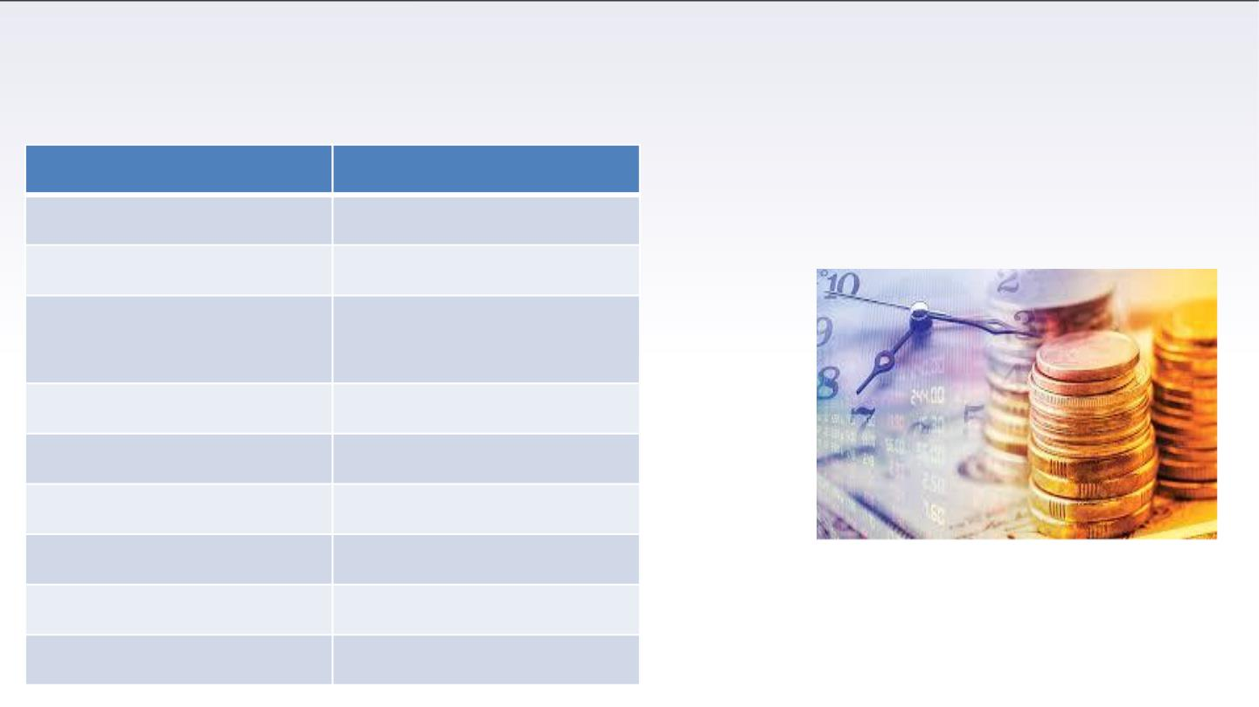
Cost Analysis:
Components
Arduino
Cost (in Rupees)
500
Ultrasonic sensors
90 per sensor*2
2 per piece
LEDs (as vibration
sensor)
Wires
25
Node MCU
GY-521
320
300
60*2
600
929
Vibration Sensors
GPS Module
GSM Module

Slide 16
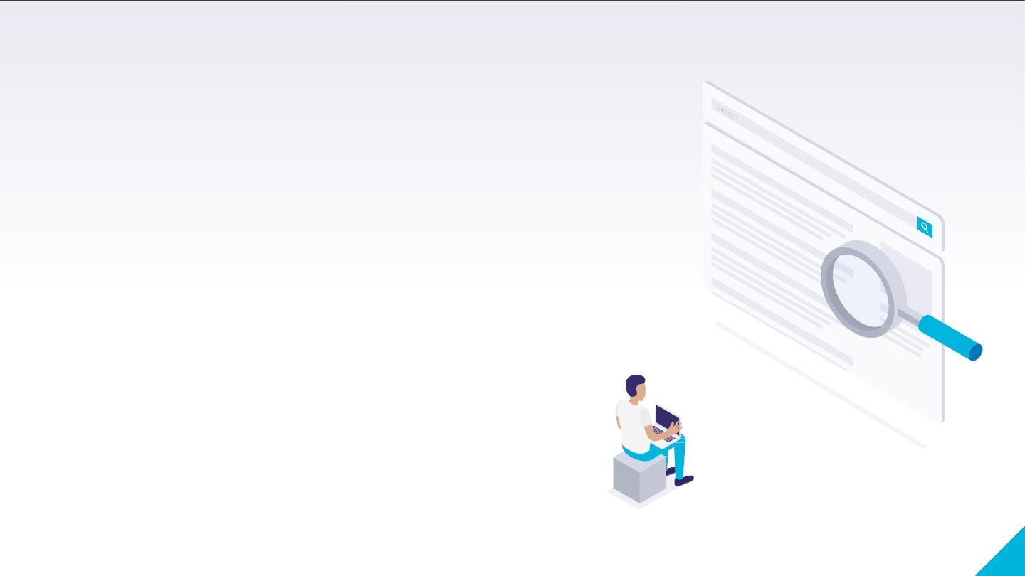
THANK YOU!
1

