Slide 1

Chapter 1
Introduction
Copyright © The McGraw-Hill Companies, Inc. Permission required for reproduction or display.

Slide 2
1-1 DATA COMMUNICATIONS
The term telecommunication means communication at a distance. The word data refers to information presented in whatever form is agreed upon by the parties creating and using the data. Data communications are the exchange of data between two devices via some form of transmission medium such as a wire cable.
Topics discussed in this section:
Components
Data Representation Data Flow

Slide 3
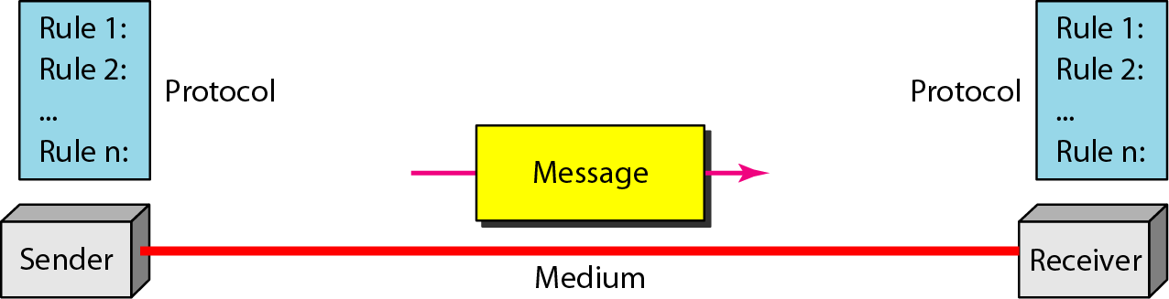
Figure 1.1 Five components of data communication

Slide 4
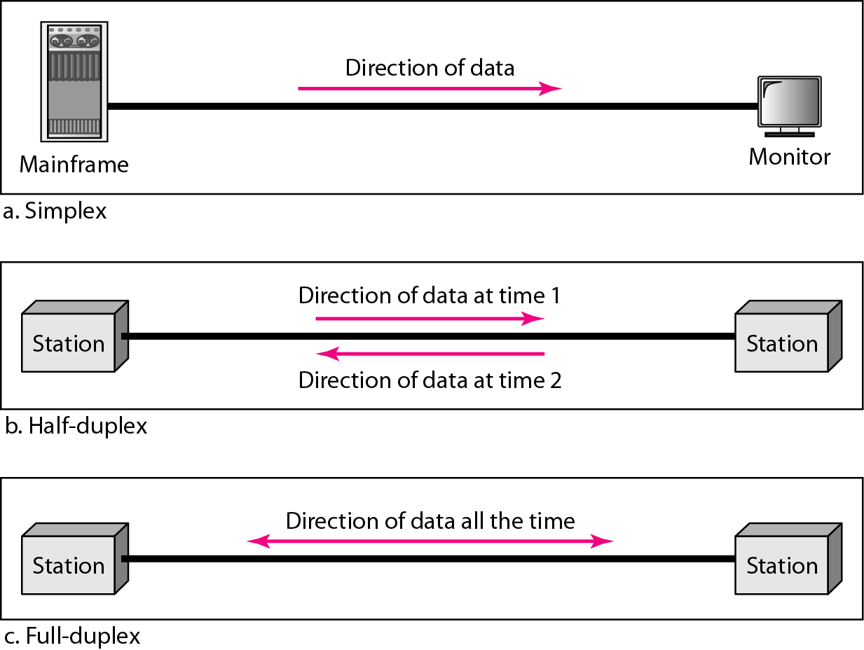
Figure 1.2 Data flow (simplex, half-duplex, and full-duplex)

Slide 5
1-2 NETWORKS
A network is a set of devices (often referred to as nodes) connected by communication links. A node can be a computer, printer, or any other device capable of sending and/or receiving data generated by other nodes on the network.
Topics discussed in this section:
Distributed Processing
Network Criteria Physical Structures Network Models Categories of Networks Interconnection of Networks: Internetwork

Slide 6
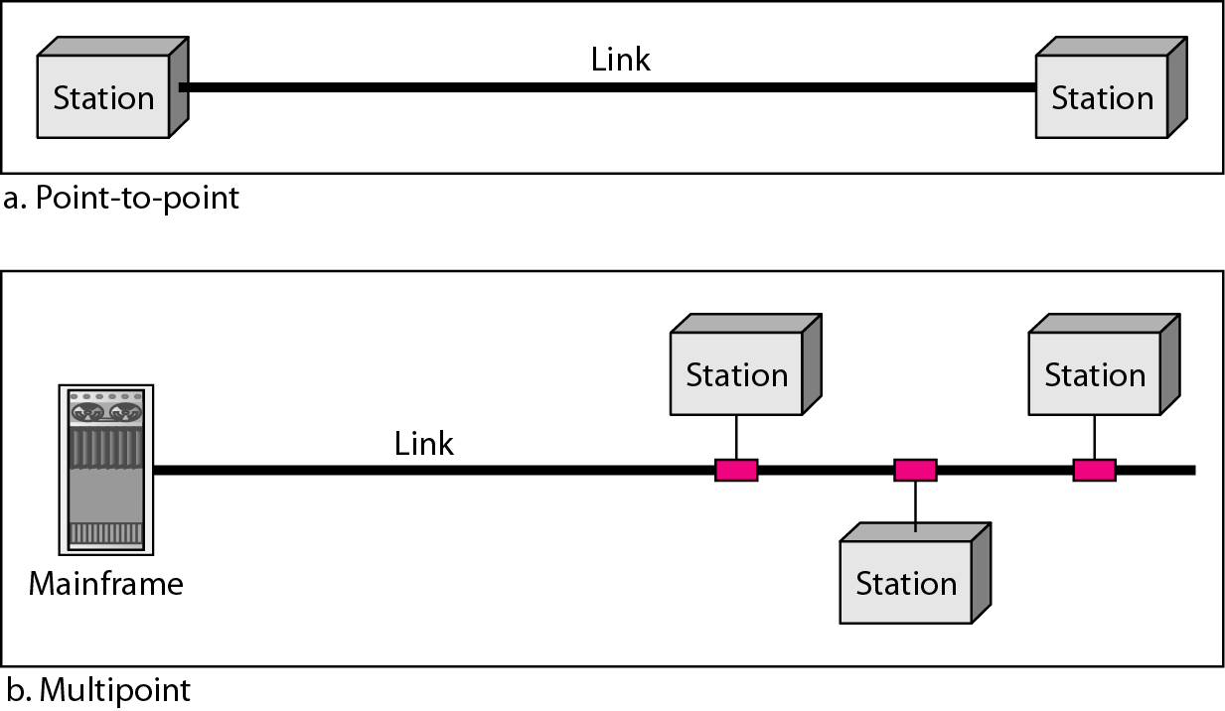
Figure 1.3 Types of connections: point-to-point and multipoint

Slide 7
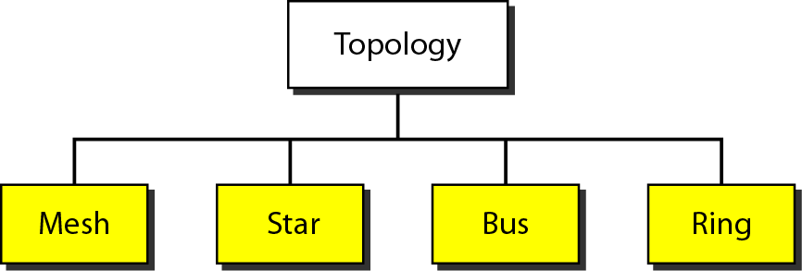
Figure 1.4 Categories of topology

Slide 8
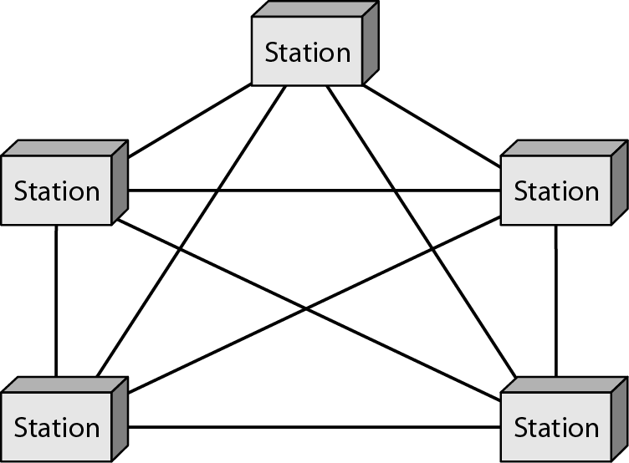
Figure 1.5 A fully connected mesh topology (five devices)

Slide 9
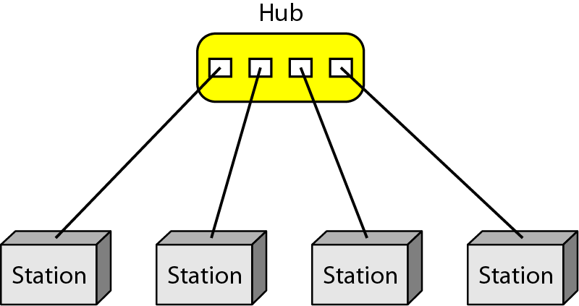
Figure 1.6 A star topology connecting four stations

Slide 10
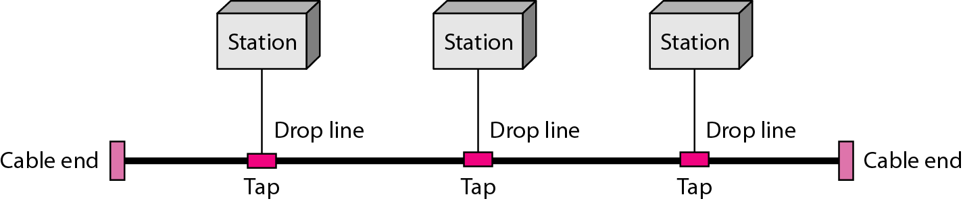
Figure 1.7 A bus topology connecting three stations

Slide 11
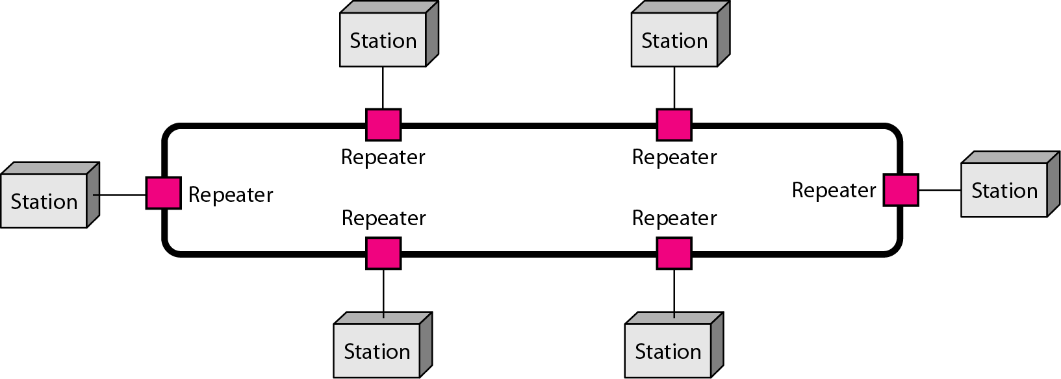
Figure 1.8 A ring topology connecting six stations

Slide 12
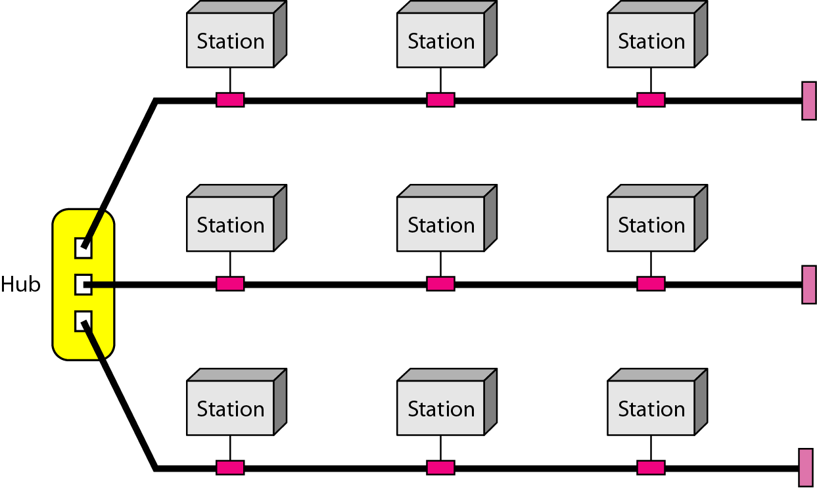
Figure 1.9 A hybrid topology: a star backbone with three bus networks

Slide 13
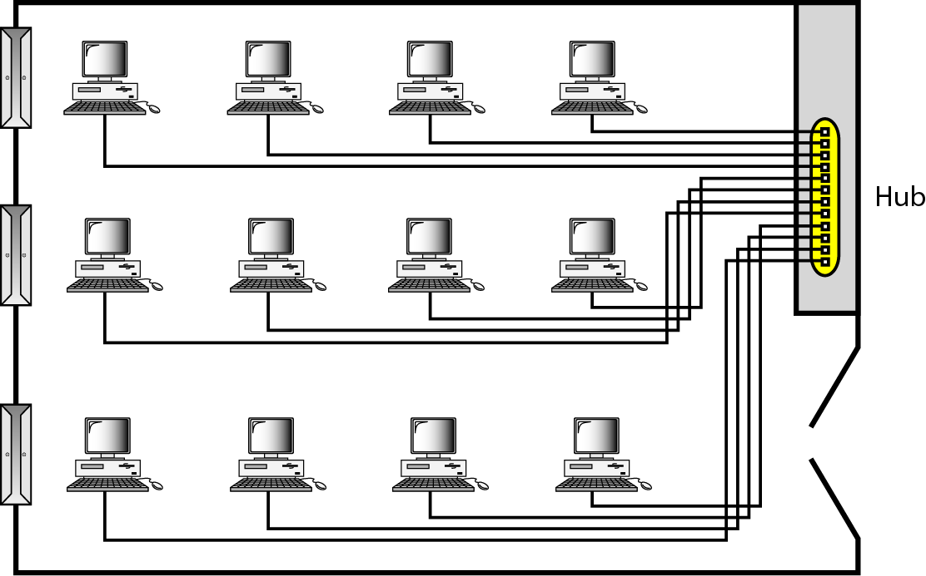
Figure 1.10 An isolated LAN connecting 12 computers to a hub in a closet

Slide 14
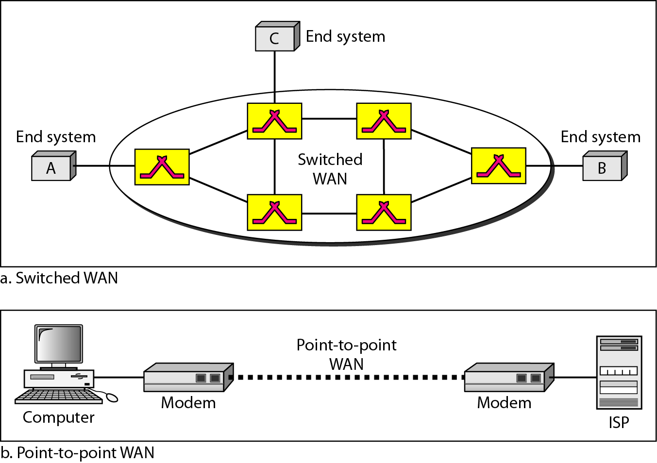
Figure 1.11 WANs: a switched WAN and a point-to-point WAN

Slide 15
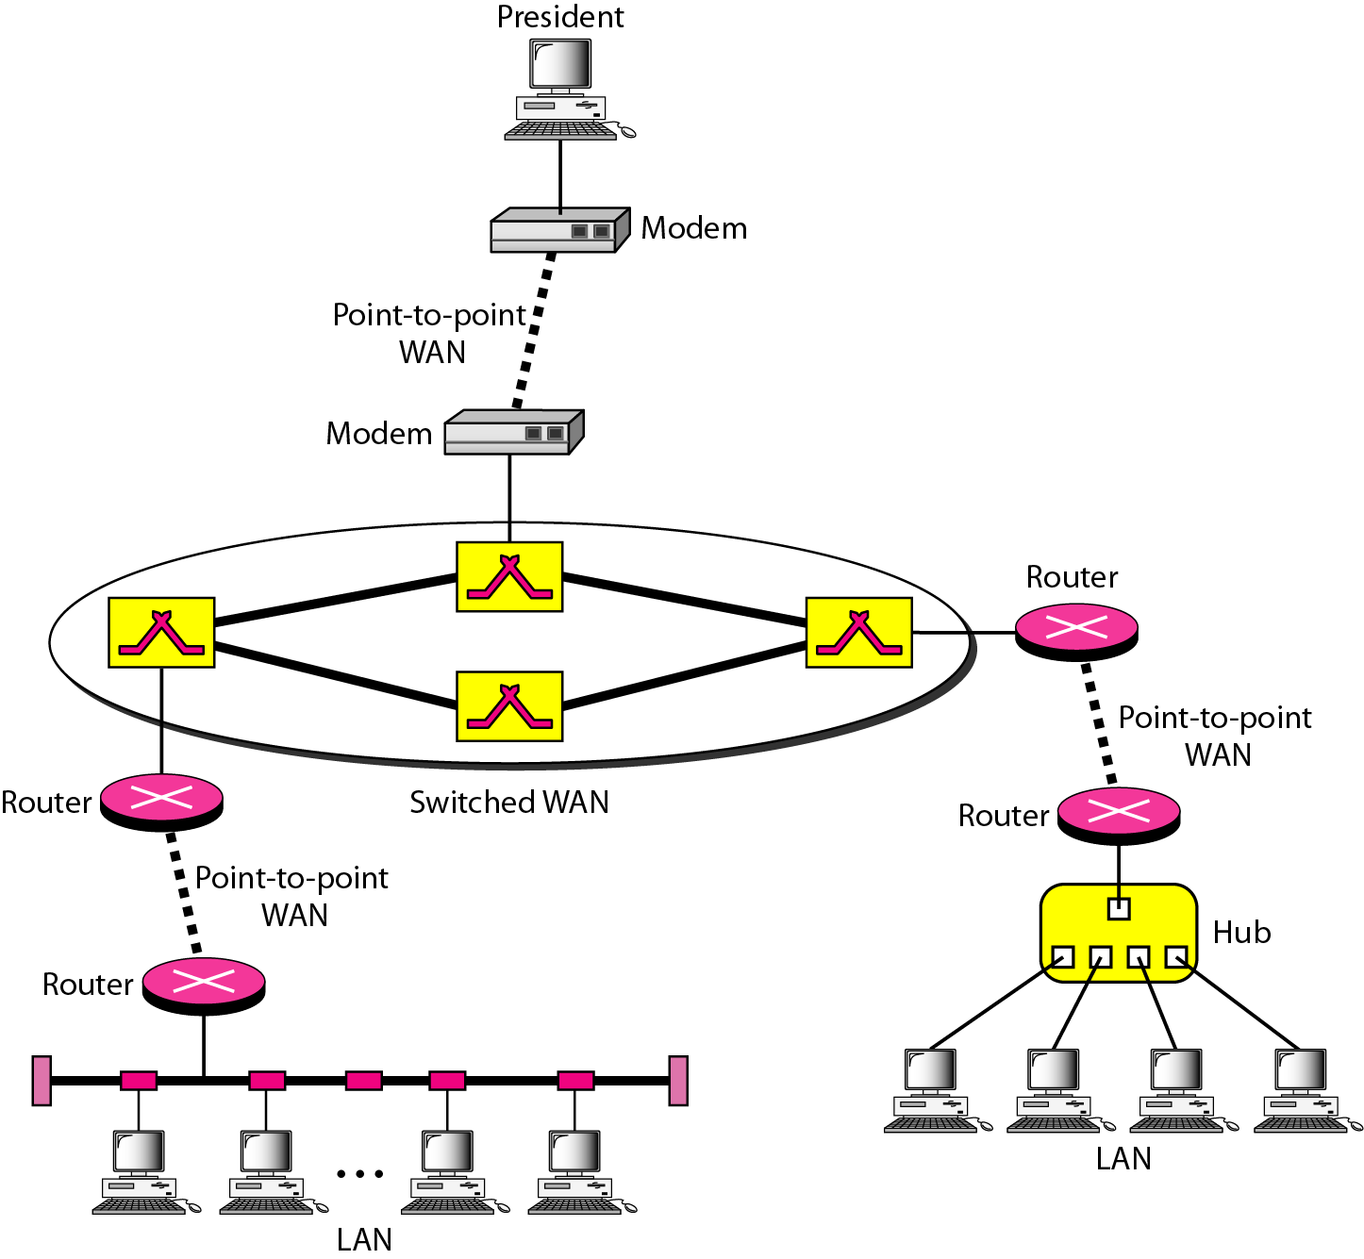
Figure 1.12 A heterogeneous network made of four WANs and two LANs

Slide 16
1-3 THE INTERNET
The Internet has revolutionized many aspects of our daily lives. It has affected the way we do business as well as the way we spend our leisure time. The Internet is a communication system that has brought a wealth of information to our fingertips and organized it for our use.
Topics discussed in this section:
A Brief History
The Internet Today (ISPs)

Slide 17
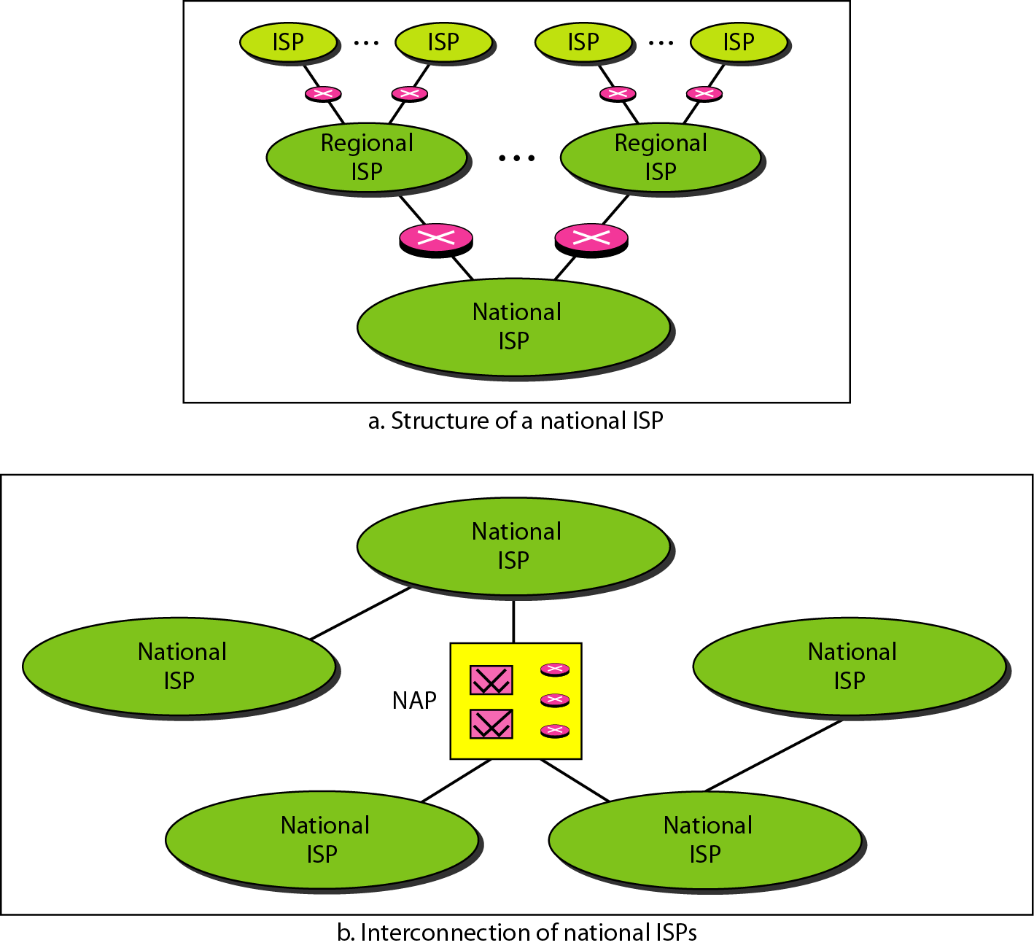
Figure 1.13 Hierarchical organization of the Internet

Slide 18
1-4 PROTOCOLS AND STANDARDS
In this section, we define two widely used terms: protocols and standards. First, we define protocol, which is synonymous with rule. Then we discuss standards, which are agreed-upon rules.
Topics discussed in this section:
Protocols Standards
Standards Organizations Internet Standards

