Slide 1

Chapter 10
Error Detection and Correction
Copyright © The McGraw-Hill Companies, Inc. Permission required for reproduction or display.

Slide 2

Note
Data can be corrupted during transmission.
Some applications require that errors be detected and corrected.

Slide 3
10-1 INTRODUCTION
Let us first discuss some issues related, directly or indirectly, to error detection and correction.
Topics discussed in this section:
Types of Errors Redundancy Detection Versus Correction Forward Error Correction Versus Retransmission Coding
Modular Arithmetic

Slide 4
Note
In a single-bit error, only 1 bit in the data unit has changed.

Slide 5
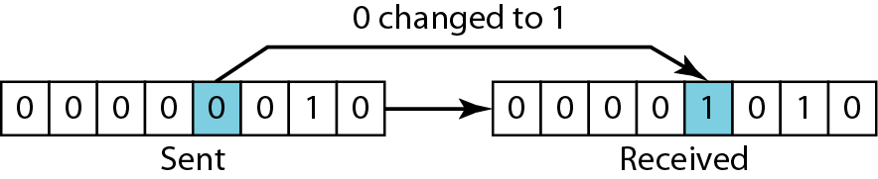
Figure 10.1 Single-bit error

Slide 6
Note
A burst error means that 2 or more bits in the data unit have changed.

Slide 7
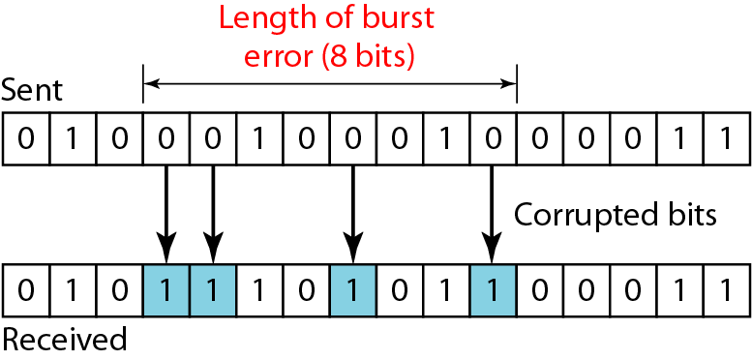
Figure 10.2 Burst error of length 8

Slide 8
Note
To detect or correct errors, we need to send extra (redundant) bits with data.

Slide 9
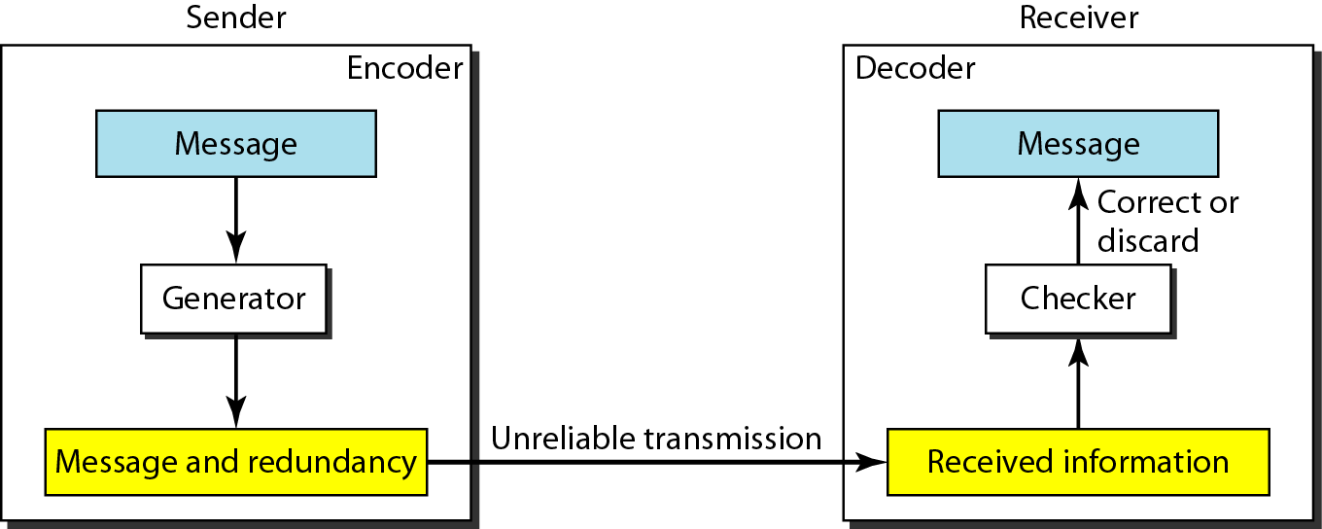
Figure 10.3 The structure of encoder and decoder

Slide 10
Note
In this book, we concentrate on block codes; we leave convolution codes to advanced texts.

Slide 11
Note
In modulo-N arithmetic, we use only the integers in the range 0 to N −1, inclusive.

Slide 12
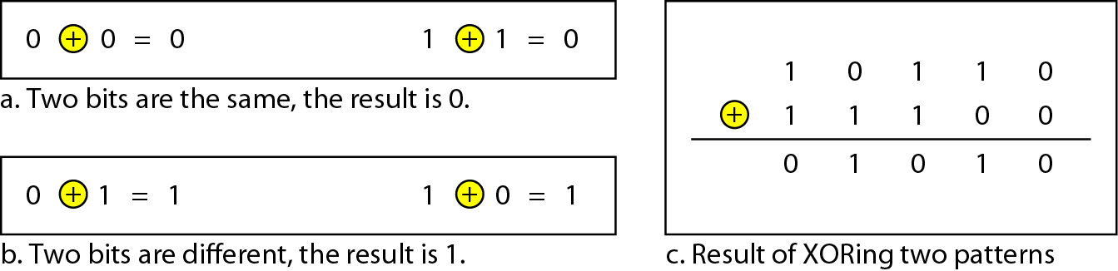
Figure 10.4 XORing of two single bits or two words

Slide 13
10-2 BLOCK CODING
In block coding, we divide our message into blocks, each of k bits, called datawords. We add r redundant bits to each block to make the length n = k + r. The resulting n-bit blocks are called codewords.
Topics discussed in this section:
Error Detection Error Correction Hamming Distance
Minimum Hamming Distance

Slide 14
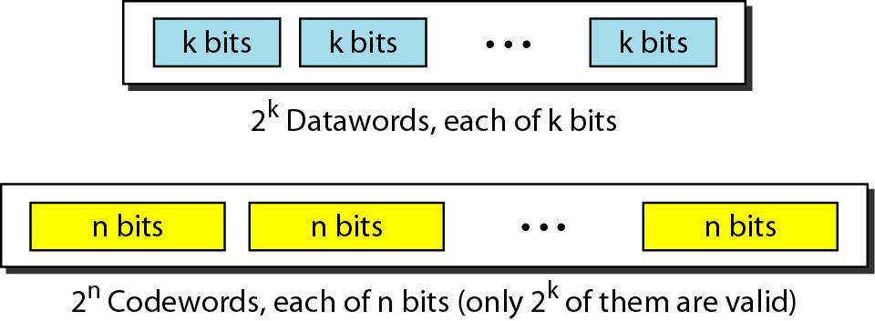
Figure 10.5 Datawords and codewords in block coding

Slide 15
Example 10.1
The 4B/5B block coding discussed in Chapter 4 is a good example of this type of coding. In this coding scheme, k = 4 and n = 5. As we saw, we have 2^{k} = 16 datawords and 2^{n} = 32 codewords. We saw that 16 out of 32 codewords are used for message transfer and the rest are either used for other purposes or unused.

Slide 16
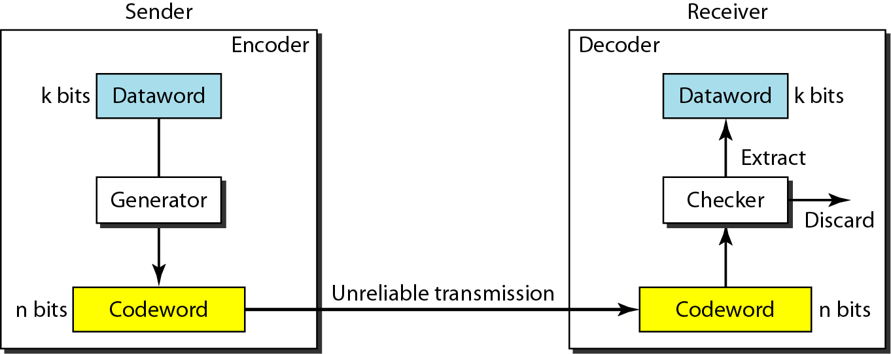
Figure 10.6 Process of error detection in block coding

Slide 17
Example 10.2
Let us assume that k = 2 and n = 3. Table 10.1 shows the list of datawords and codewords. Later, we will see how to derive a codeword from a dataword.
Assume the sender encodes the dataword 01 as 011 and
sends it to the receiver. Consider the following cases:
1. The receiver receives 011. It is a valid codeword. The receiver extracts the dataword 01 from it.

Slide 18
Example 10.2 (continued)
2. The codeword is corrupted during transmission, and 111 is received. This is not a valid codeword and is discarded.
3. The codeword is corrupted during transmission, and 000 is received. This is a valid codeword. The receiver incorrectly extracts the dataword 00. Two corrupted bits have made the error undetectable.

Slide 19
Table 10.1 A code for error detection (Example 10.2)

Slide 20
Note
An error-detecting code can detect only the types of errors for which it is designed; other types of errors may remain undetected.

Slide 21
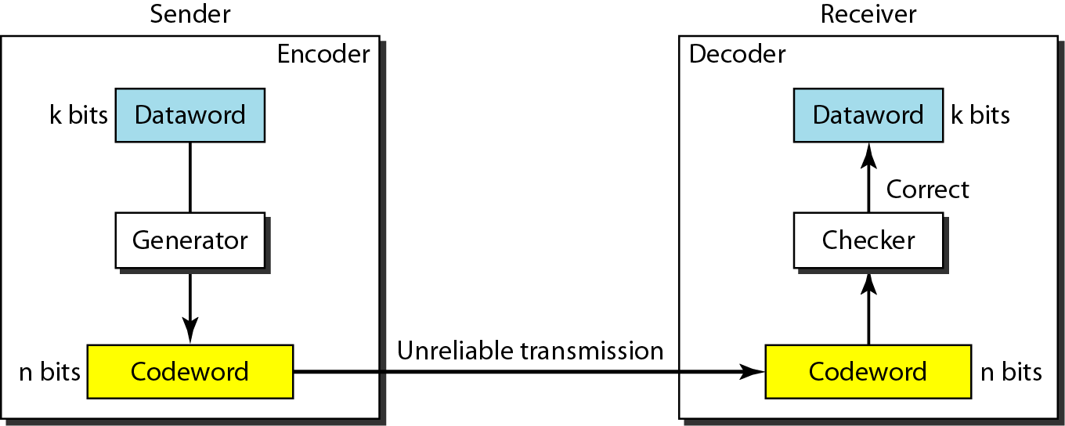
Figure 10.7 Structure of encoder and decoder in error correction

Slide 22
Example 10.3
Let us add more redundant bits to Example 10.2 to see if the receiver can correct an error without knowing what was actually sent. We add 3 redundant bits to the 2-bit dataword to make 5-bit codewords. Table 10.2 shows the datawords and codewords. Assume the dataword is 01. The sender creates the codeword 01011. The codeword is corrupted during transmission, and 01001 is received. First, the receiver finds that the received codeword is not in the table. This means an error has occurred. The receiver, assuming that there is only 1 bit corrupted, uses the following strategy to guess the correct dataword.

Slide 23
Example 10.3 (continued)
1. Comparing the received codeword with the first codeword in the table (01001 versus 00000), the receiver decides that the first codeword is not the one that was sent because there are two different bits.
2. By the same reasoning, the original codeword cannot be the third or fourth one in the table.
3. The original codeword must be the second one in the table because this is the only one that differs from the received codeword by 1 bit. The receiver replaces 01001 with 01011 and consults the table to find the dataword 01.

Slide 24
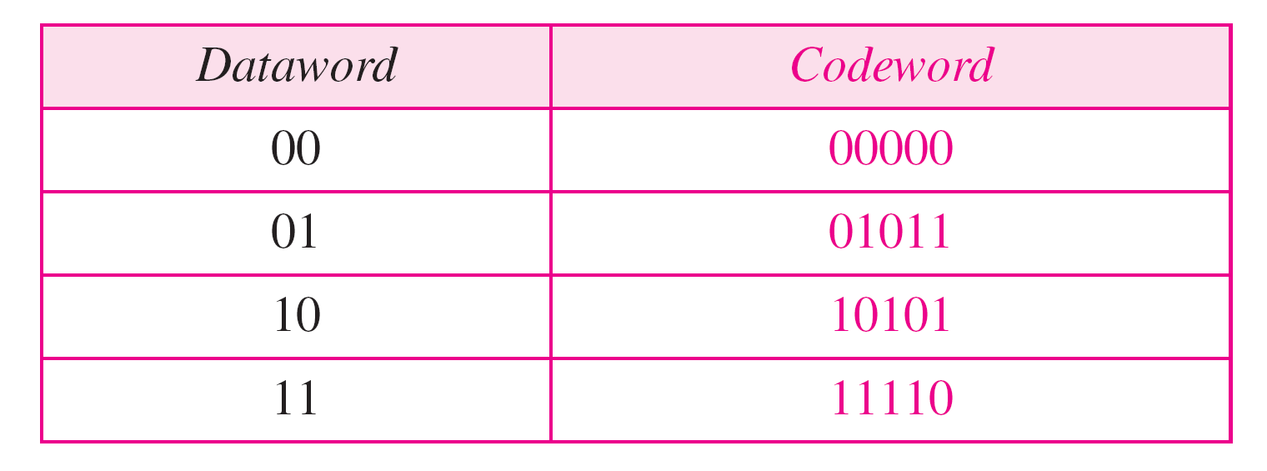
Table 10.2 A code for error correction (Example 10.3)

Slide 25
Note
The Hamming distance between two words is the number of differences between corresponding bits.

Slide 26
Example 10.4
Let us find the Hamming distance between two pairs of words.
1. The Hamming distance d(000, 011) is 2 because
2. The Hamming distance d(10101, 11110) is 3 because

Slide 27
Note
The minimum Hamming distance is the smallest Hamming distance between all possible pairs in a set of words.

Slide 28
Example 10.5
Find the minimum Hamming distance of the coding scheme in Table 10.1.
Solution
We first find all Hamming distances.
The d_{min} in this case is 2.

Slide 29
Example 10.6
Find the minimum Hamming distance of the coding scheme in Table 10.2.
Solution
We first find all the Hamming distances.
The d_{min} in this case is 3.

Slide 30
Note
To guarantee the detection of up to s errors in all cases, the minimum
Hamming distance in a block code must be d_{min} = s + 1.

Slide 31
Example 10.7
The minimum Hamming distance for our first code scheme (Table 10.1) is 2. This code guarantees detection of only a single error. For example, if the third codeword (101) is sent and one error occurs, the received codeword does not match any valid codeword. If two errors occur, however, the received codeword may match a valid codeword and the errors are not detected.

Slide 32
Example 10.8
Our second block code scheme (Table 10.2) has d_{min} = 3. This code can detect up to two errors. Again, we see that when any of the valid codewords is sent, two errors create a codeword which is not in the table of valid codewords. The receiver cannot be fooled.
However, some combinations of three errors change a valid codeword to another valid codeword. The receiver accepts the received codeword and the errors are undetected.

Slide 33
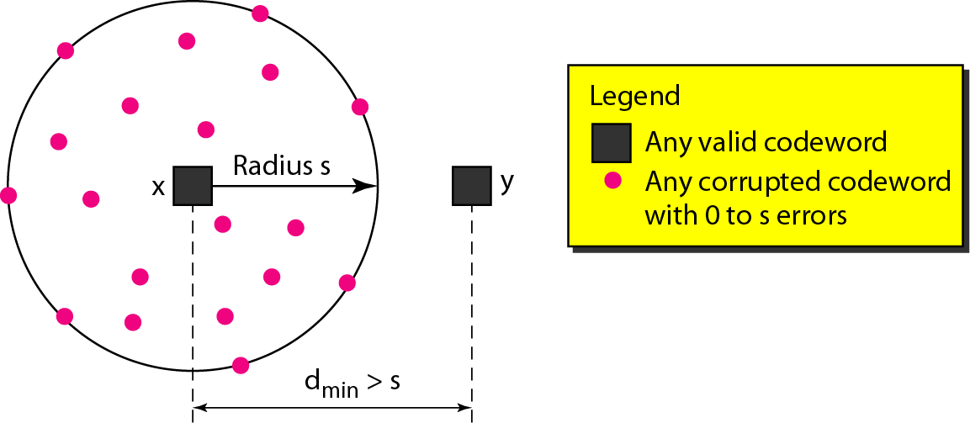
Figure 10.8 Geometric concept for finding d_{min} in error detection

Slide 34
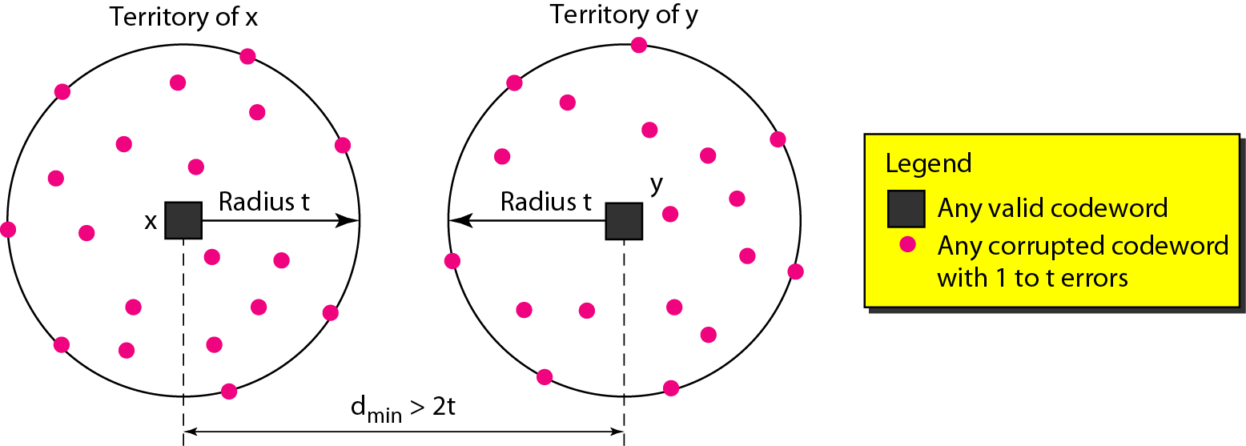
Figure 10.9 Geometric concept for finding d_{min} in error correction

Slide 35
Note
To guarantee correction of up to t errors in all cases, the minimum Hamming distance in a block code must be d_{min} = 2t + 1.

Slide 36
Example 10.9
A code scheme has a Hamming distance d_{min} = 4. What is the error detection and correction capability of this scheme?
Solution
This code guarantees the detection of up to three errors (s = 3), but it can correct up to one error. In other words, if this code is used for error correction, part of its capability is wasted. Error correction codes need to have an odd minimum distance (3, 5, 7, . . . ).

Slide 37
10-3 LINEAR BLOCK CODES
Almost all block codes used today belong to a subset called linear block codes. A linear block code is a code in which the exclusive OR (addition modulo-2) of two valid codewords creates another valid codeword.
Topics discussed in this section:
Minimum Distance for Linear Block Codes Some Linear Block Codes

Slide 38
Note
In a linear block code, the exclusive OR (XOR) of any two valid codewords creates another valid codeword.

Slide 39
Example 10.10
Let us see if the two codes we defined in Table 10.1 and Table 10.2 belong to the class of linear block codes.
1. The scheme in Table 10.1 is a linear block code because the result of XORing any codeword with any other codeword is a valid codeword. For example, the XORing of the second and third codewords creates the fourth one.
2. The scheme in Table 10.2 is also a linear block code. We can create all four codewords by XORing two other codewords.

Slide 40
Example 10.11
In our first code (Table 10.1), the numbers of 1s in the nonzero codewords are 2, 2, and 2. So the minimum Hamming distance is d_{min} = 2. In our second code (Table 10.2), the numbers of 1s in the nonzero codewords are 3, 3, and 4. So in this code we have d_{min} = 3.

Slide 41
Note
A simple parity-check code is a single-bit error-detecting code in which n = k + 1 with d_{min} = 2.

Slide 42
Table 10.3 Simple parity-check code C(5, 4)

Slide 43
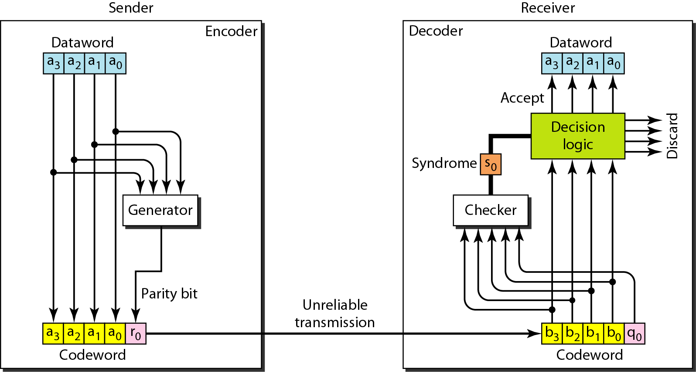
Figure 10.10 Encoder and decoder for simple parity-check code

Slide 44
Example 10.12
Let us look at some transmission scenarios. Assume the sender sends the dataword 1011. The codeword created from this dataword is 10111, which is sent to the receiver. We examine five cases:
1. No error occurs; the received codeword is 10111. The syndrome is 0. The dataword 1011 is created.
2. One single-bit error changes a₁ . The received codeword is 10011. The syndrome is 1. No dataword is created.
3. One single-bit error changes r₀ . The received codeword is 10110. The syndrome is 1. No dataword is created.

Slide 45
Example 10.12 (continued)
4. An error changes r₀ and a second error changes a₃ .
The received codeword is 00110. The syndrome is 0. The dataword 0011 is created at the receiver. Note that
here the dataword is wrongly created due to the
syndrome value.
5. Three bits—a₃, a₂, and a₁—are changed by errors. The received codeword is 01011. The syndrome is 1. The dataword is not created. This shows that the simple parity check, guaranteed to detect one single error, can also find any odd number of errors.

Slide 46
Note
A simple parity-check code can detect an odd number of errors.

Slide 47
Note
All Hamming codes discussed in this book have d_{min} = 3.
The relationship between m and n in these codes is n = 2m − 1.

Slide 48
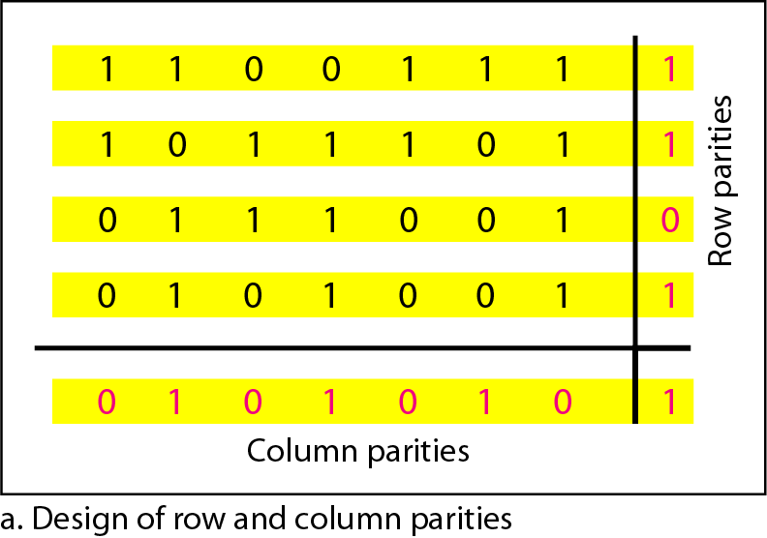
Figure 10.11 Two-dimensional parity-check code

Slide 49
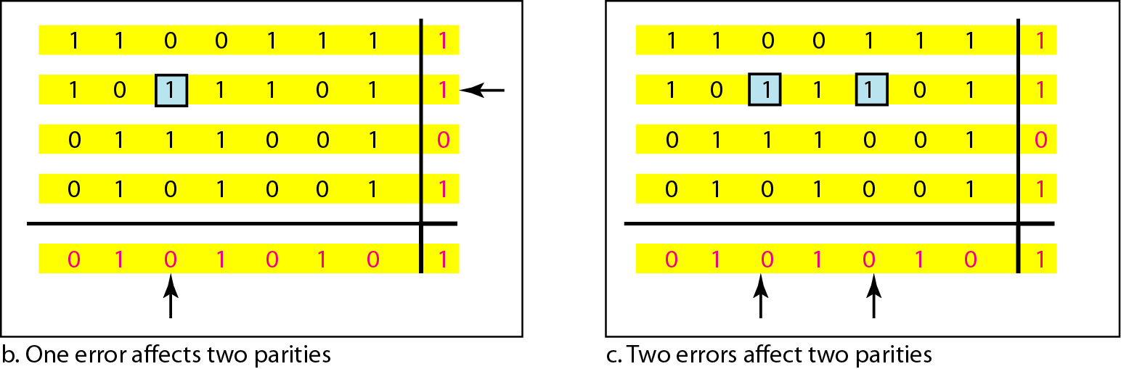
Figure 10.11 Two-dimensional parity-check code

Slide 50
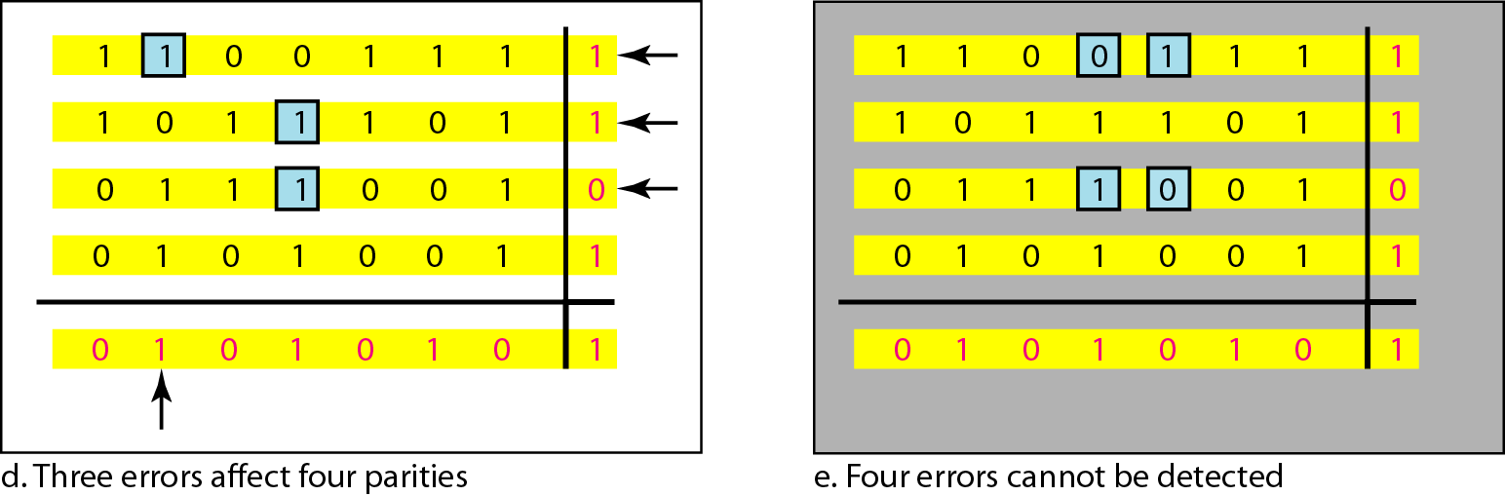
Figure 10.11 Two-dimensional parity-check code

Slide 51
Table 10.4 Hamming code C(7, 4)

Slide 52
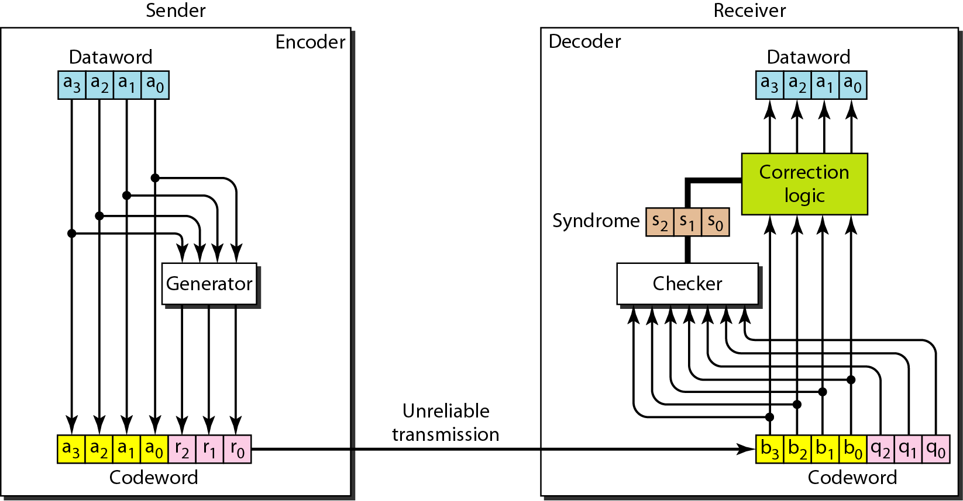
Figure 10.12 The structure of the encoder and decoder for a Hamming code

Slide 53
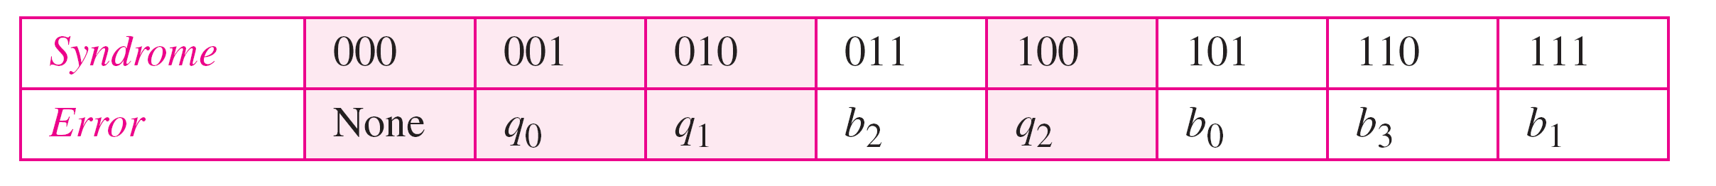
Table 10.5 Logical decision made by the correction logic analyzer

Slide 54
Example 10.13
Let us trace the path of three datawords from the sender to the destination:
1. The dataword 0100 becomes the codeword 0100011. The codeword 0100011 is received. The syndrome is 000, the final dataword is 0100.
2. The dataword 0111 becomes the codeword 0111001. The syndrome is 011. After flipping b₂ (changing the 1 to 0), the final dataword is 0111.
3. The dataword 1101 becomes the codeword 1101000. The syndrome is 101. After flipping b₀, we get 0000, the wrong dataword. This shows that our code cannot correct two errors.

Slide 55
Example 10.14
We need a dataword of at least 7 bits. Calculate values of k and n that satisfy this requirement.
Solution
We need to make k = n − m greater than or equal to 7, or 2m − 1 − m ≥ 7.
1. If we set m = 3, the result is n = 23 − 1 and k = 7 − 3, or 4, which is not acceptable.
2. If we set m = 4, then n = 24 − 1 = 15 and k = 15 − 4 = 11, which satisfies the condition. So the code is
C(15, 11)

Slide 56
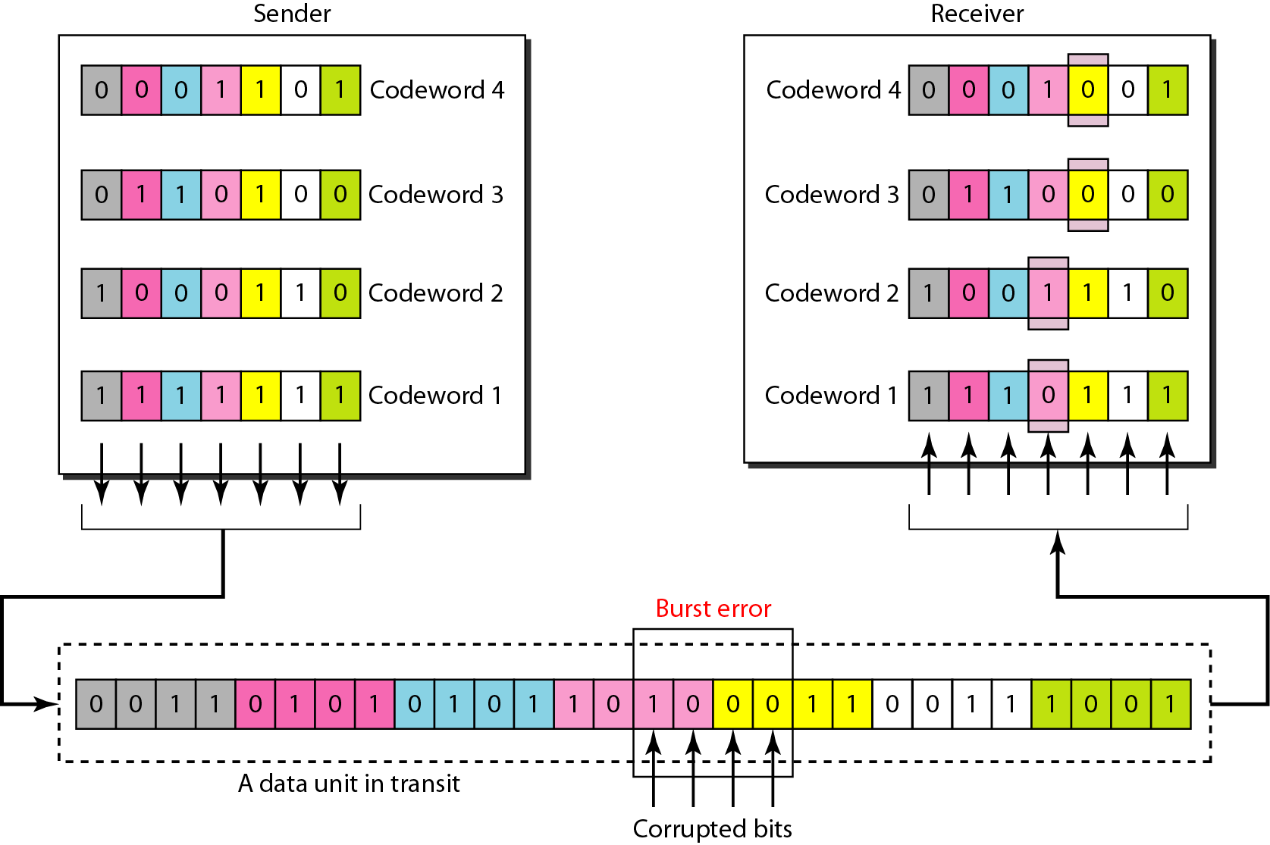
Figure 10.13 Burst error correction using Hamming code

Slide 57
10-4 CYCLIC CODES
Cyclic codes are special linear block codes with one extra property. In a cyclic code, if a codeword is cyclically shifted (rotated), the result is another codeword.
Topics discussed in this section:
Cyclic Redundancy Check Hardware Implementation Polynomials Cyclic Code Analysis
Advantages of Cyclic Codes Other Cyclic Codes

Slide 58
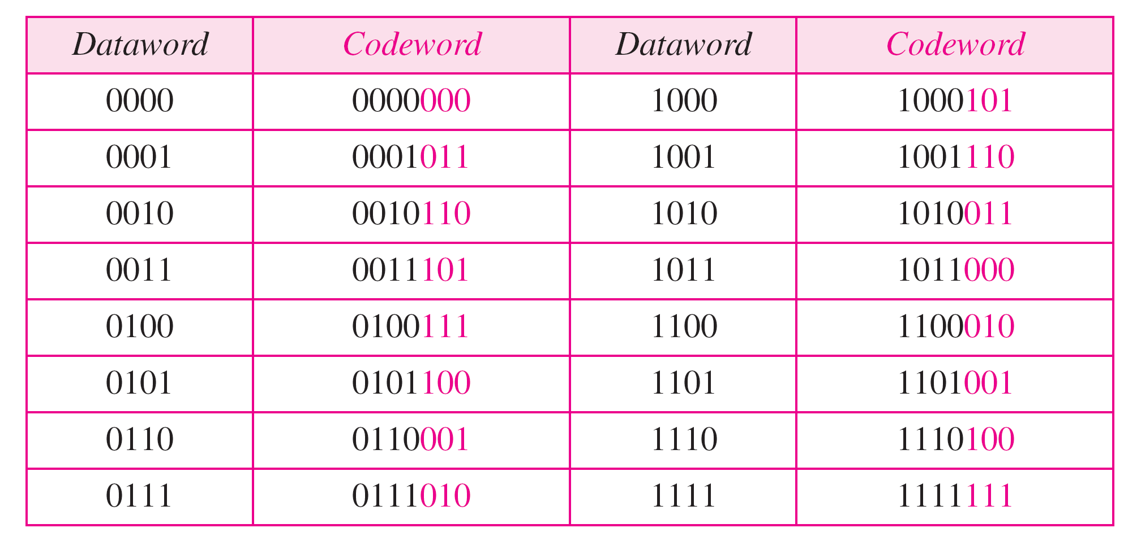
Table 10.6 A CRC code with C(7, 4)

Slide 59
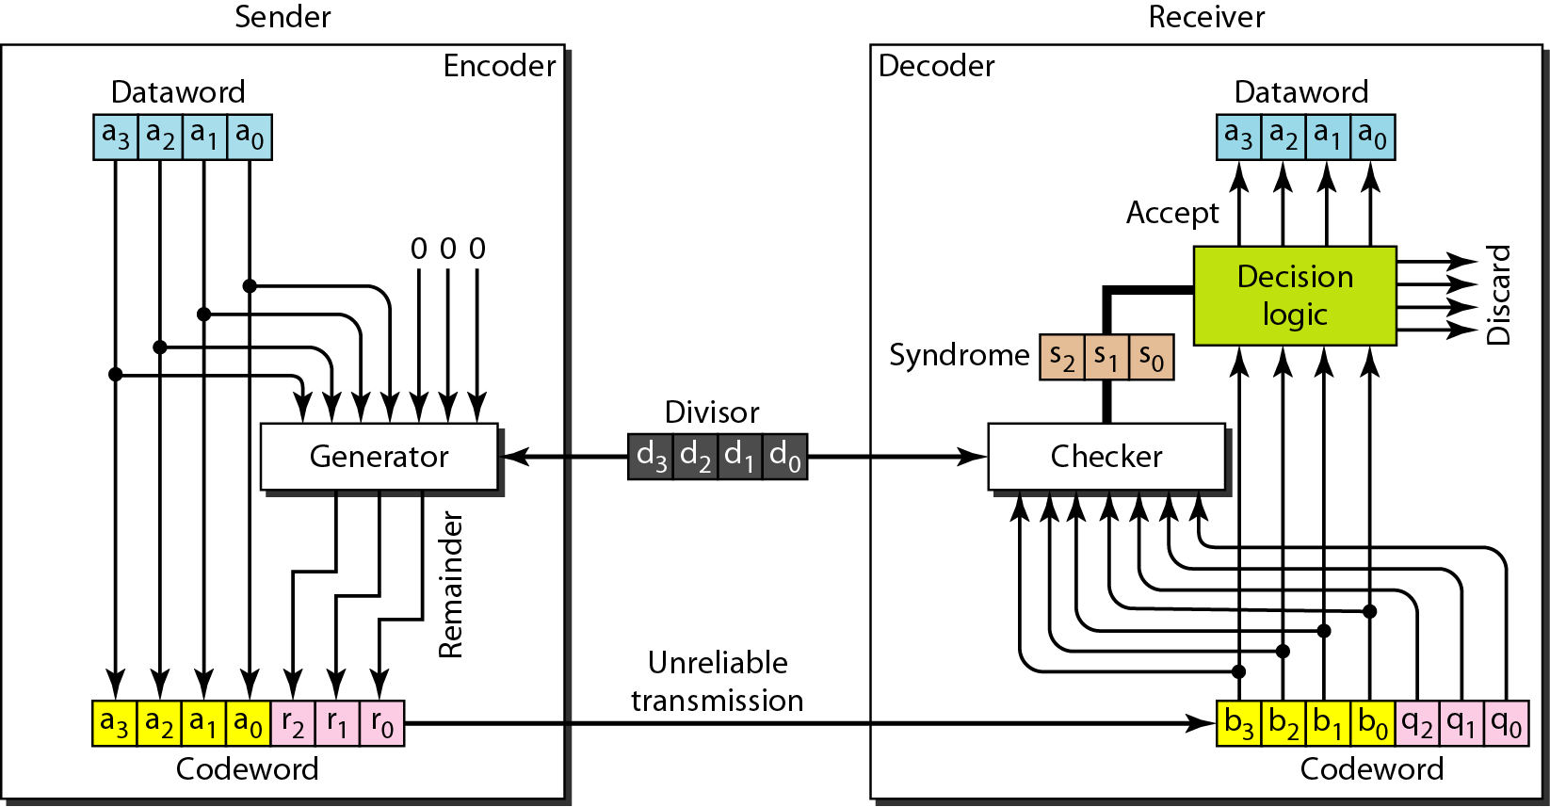
Figure 10.14 CRC encoder and decoder

Slide 60
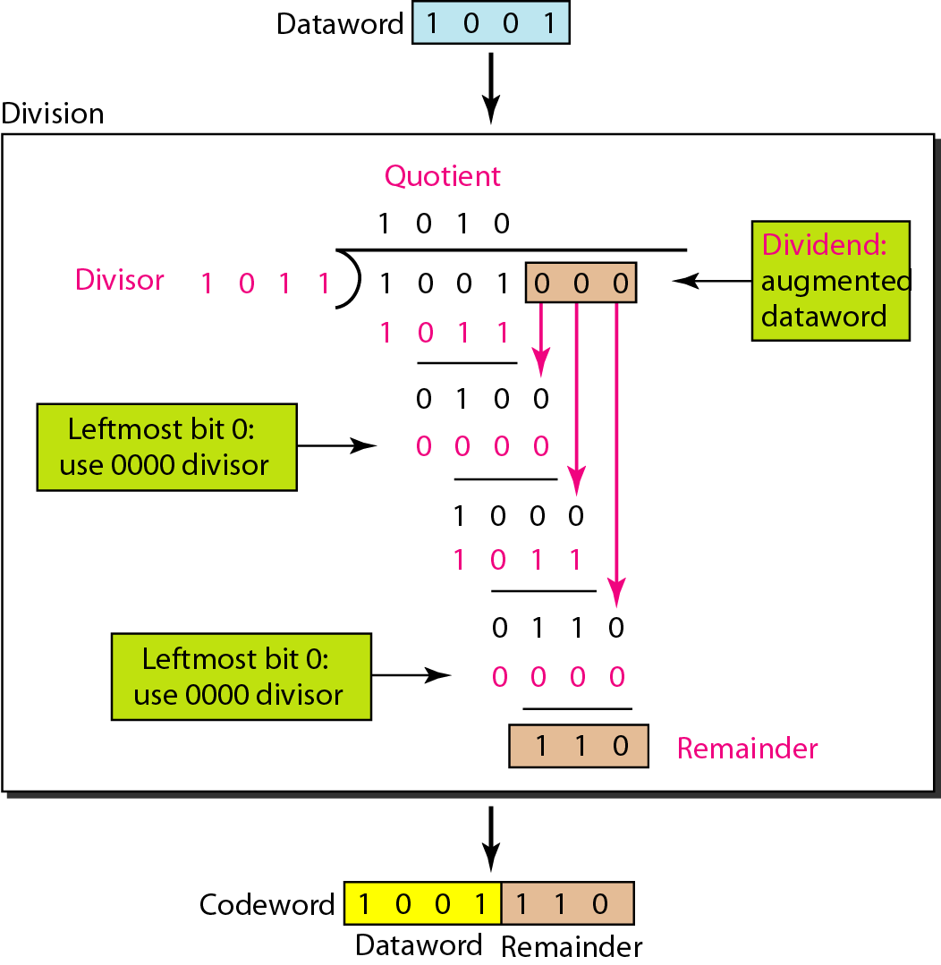
Figure 10.15 Division in CRC encoder

Slide 61
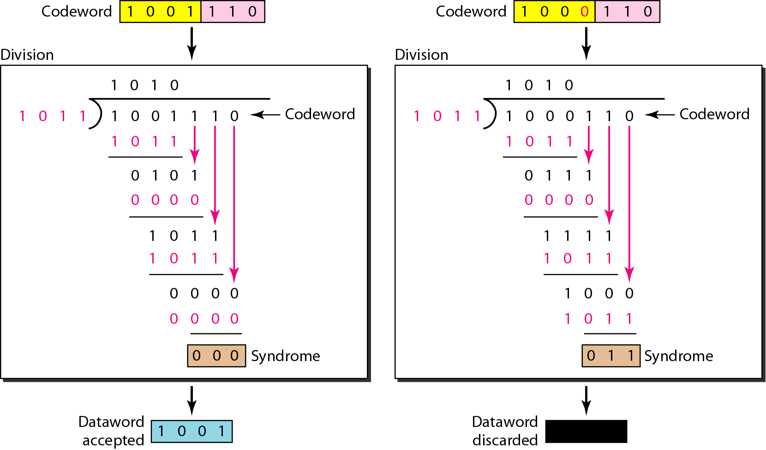
Figure 10.16 Division in the CRC decoder for two cases

Slide 62
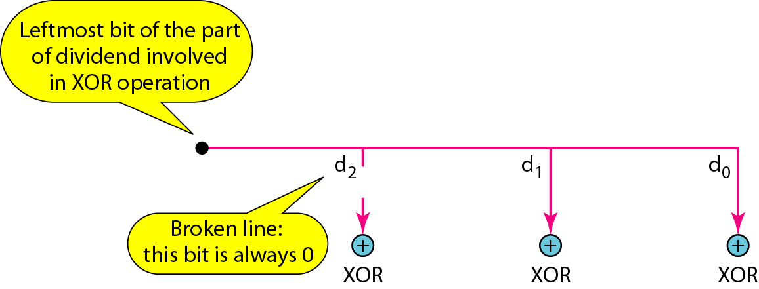
Figure 10.17 Hardwired design of the divisor in CRC

Slide 63
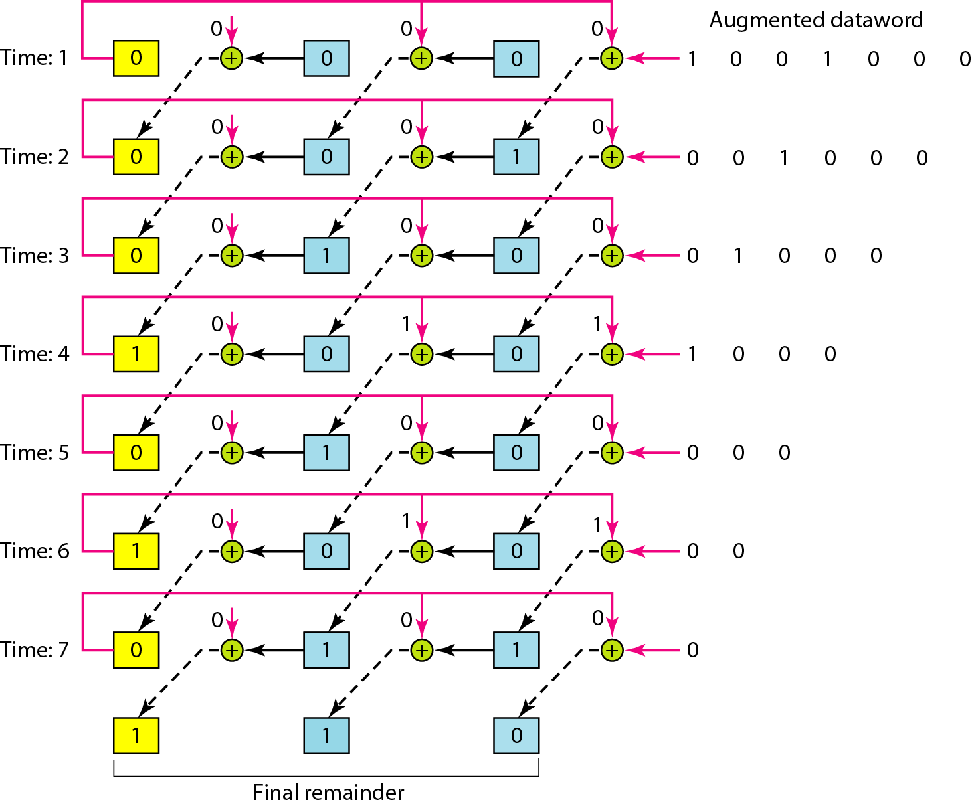
Figure 10.18 Simulation of division in CRC encoder

Slide 64
Figure 10.19 The CRC encoder design using shift registers

Slide 65
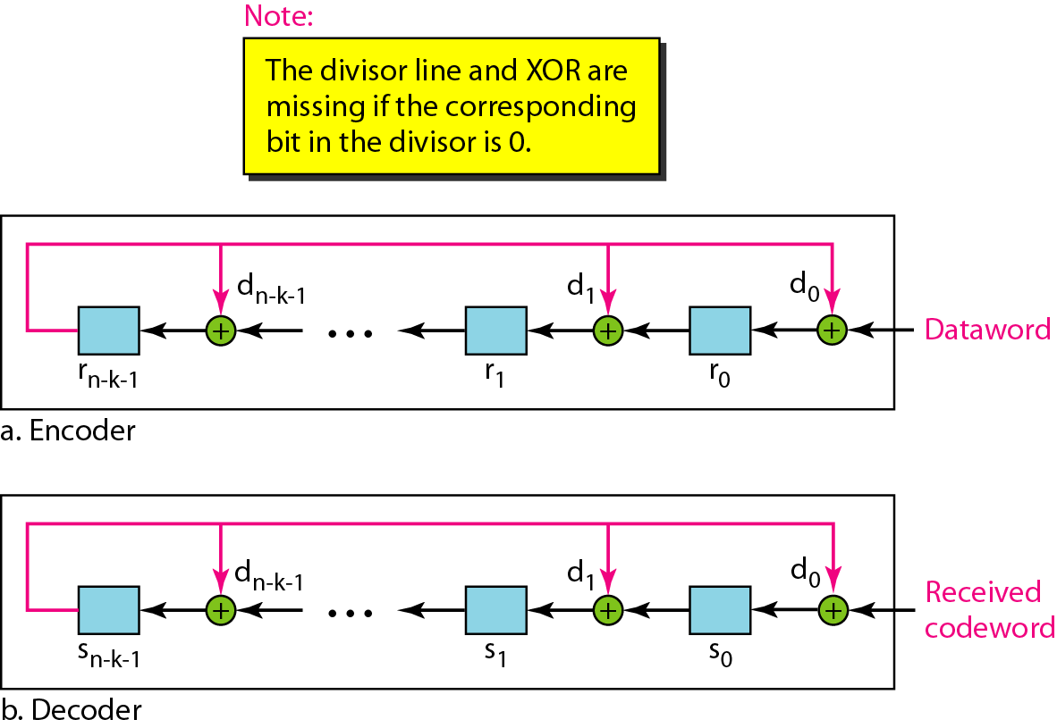
Figure 10.20 General design of encoder and decoder of a CRC code

Slide 66
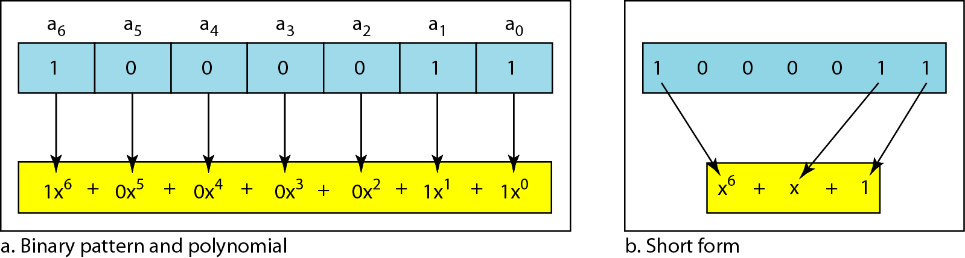
Figure 10.21 A polynomial to represent a binary word

Slide 67
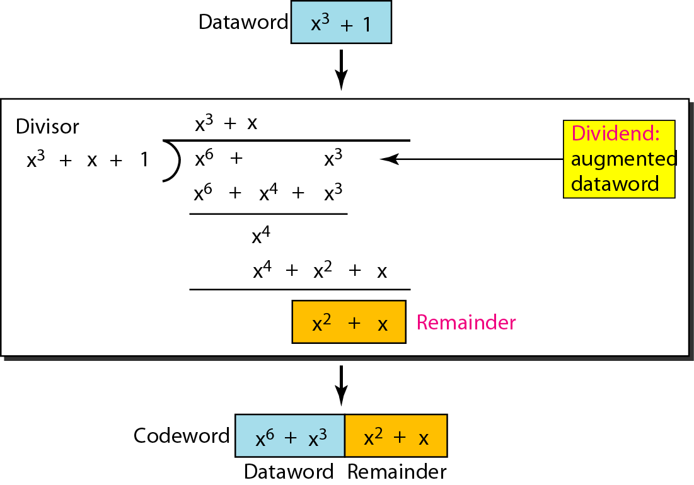
Figure 10.22 CRC division using polynomials

Slide 68
Note
The divisor in a cyclic code is normally called the generator polynomial
or simply the generator.

Slide 69
Note
In a cyclic code,
If s(x) ≠ 0, one or more bits is corrupted.
If s(x) = 0, either
a. No bit is corrupted. or
b. Some bits are corrupted, but the decoder failed to detect them.

Slide 70
Note
In a cyclic code, those e(x) errors that are divisible by g(x) are not caught.

Slide 71
Note
If the generator has more than one term and the coefficient of x⁰ is 1, all single errors can be caught.

Slide 72
Example 10.15
Which of the following g(x) values guarantees that a single-bit error is caught? For each case, what is the error that cannot be caught?
a. x + 1 b. x³ c. 1
Solution
a. No x^{i} can be divisible by x + 1. Any single-bit error can be caught.
b. If i is equal to or greater than 3, x^{i} is divisible by g(x). All single-bit errors in positions 1 to 3 are caught.
c. All values of i make x^{i} divisible by g(x). No single-bit error can be caught. This g(x) is useless.

Slide 73
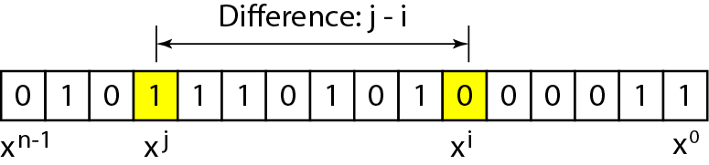
Figure 10.23 Representation of two isolated single-bit errors using polynomials

Slide 74
Note
If a generator cannot divide x^{t} + 1 (t between 0 and n – 1),
then all isolated double errors can be detected.

Slide 75
Example 10.16
Find the status of the following generators related to two isolated, single-bit errors.
a. x + 1 b. x⁴ + 1 c. x⁷ + x⁶ + 1 d. x¹⁵ + x¹⁴ + 1
Solution
a. This is a very poor choice for a generator. Any two errors next to each other cannot be detected.
b. This generator cannot detect two errors that are four positions apart.
c. This is a good choice for this purpose.
d. This polynomial cannot divide x^{t} + 1 if t is less than 32,768. A codeword with two isolated errors up to 32,768 bits apart can be detected by this generator.

Slide 76
Note
A generator that contains a factor of x + 1 can detect all odd-numbered errors.

Slide 77
Note
❏ All burst errors with L ≤ r will be detected.
❏ All burst errors with L = r + 1 will be detected with probability 1 – (1/2)^{r–1}.
❏ All burst errors with L > r + 1 will be detected with probability 1 – (1/2)^{r}.

Slide 78
Example 10.17
Find the suitability of the following generators in relation to burst errors of different lengths.
a. x⁶ + 1 b. x¹⁸ + x⁷ + x + 1 c. x³² + x²³ + x⁷ + 1
Solution
a. This generator can detect all burst errors with a length less than or equal to 6 bits; 3 out of 100 burst errors with length 7 will slip by; 16 out of 1000 burst errors of length 8 or more will slip by.

Slide 79
Example 10.17 (continued)
b. This generator can detect all burst errors with a length less than or equal to 18 bits; 8 out of 1 million burst errors with length 19 will slip by; 4 out of 1 million burst errors of length 20 or more will slip by.
c. This generator can detect all burst errors with a length less than or equal to 32 bits; 5 out of 10 billion burst errors with length 33 will slip by; 3 out of 10 billion burst errors of length 34 or more will slip by.

Slide 80
Note
A good polynomial generator needs to have the following characteristics:
1. It should have at least two terms.
2. The coefficient of the term x⁰ should be 1.
3. It should not divide x^{t} + 1, for t between 2 and n − 1.
4. It should have the factor x + 1.

Slide 81
Table 10.7 Standard polynomials

Slide 82
10-5 CHECKSUM
The last error detection method we discuss here is called the checksum. The checksum is used in the Internet by several protocols although not at the data link layer. However, we briefly discuss it here to complete our discussion on error checking
Topics discussed in this section:
Idea One’s Complement Internet Checksum

Slide 83
Example 10.18
Suppose our data is a list of five 4-bit numbers that we want to send to a destination. In addition to sending these numbers, we send the sum of the numbers. For example, if the set of numbers is (7, 11, 12, 0, 6), we send (7, 11, 12, 0, 6, 36), where 36 is the sum of the original numbers. The receiver adds the five numbers and compares the result with the sum. If the two are the same, the receiver assumes no error, accepts the five numbers, and discards the sum. Otherwise, there is an error somewhere and the data are not accepted.

Slide 84
Example 10.19
We can make the job of the receiver easier if we send the negative (complement) of the sum, called the checksum. In this case, we send (7, 11, 12, 0, 6, −36). The receiver can add all the numbers received (including the checksum). If the result is 0, it assumes no error; otherwise, there is an error.

Slide 85
Example 10.20
How can we represent the number 21 in one’s complement arithmetic using only four bits?
Solution
The number 21 in binary is 10101 (it needs five bits). We can wrap the leftmost bit and add it to the four rightmost bits. We have (0101 + 1) = 0110 or 6.

Slide 86
Example 10.21
How can we represent the number −6 in one’s complement arithmetic using only four bits?
Solution
In one’s complement arithmetic, the negative or complement of a number is found by inverting all bits. Positive 6 is 0110; negative 6 is 1001. If we consider only unsigned numbers, this is 9. In other words, the complement of 6 is 9. Another way to find the complement of a number in one’s complement arithmetic is to subtract the number from 2^{n} − 1 (16 − 1 in this case).

Slide 87
Example 10.22
Let us redo Exercise 10.19 using one’s complement arithmetic. Figure 10.24 shows the process at the sender and at the receiver. The sender initializes the checksum to 0 and adds all data items and the checksum (the checksum is considered as one data item and is shown in color). The result is 36. However, 36 cannot be expressed in 4 bits. The extra two bits are wrapped and added with the sum to create the wrapped sum value 6. In the figure, we have shown the details in binary. The sum is then complemented, resulting in the checksum value 9 (15 − 6 = 9). The sender now sends six data items to the receiver including the checksum 9.

Slide 88
Example 10.22 (continued)
The receiver follows the same procedure as the sender. It adds all data items (including the checksum); the result is 45. The sum is wrapped and becomes 15. The wrapped sum is complemented and becomes 0. Since the value of the checksum is 0, this means that the data is not corrupted. The receiver drops the checksum and keeps the other data items. If the checksum is not zero, the entire packet is dropped.

Slide 89
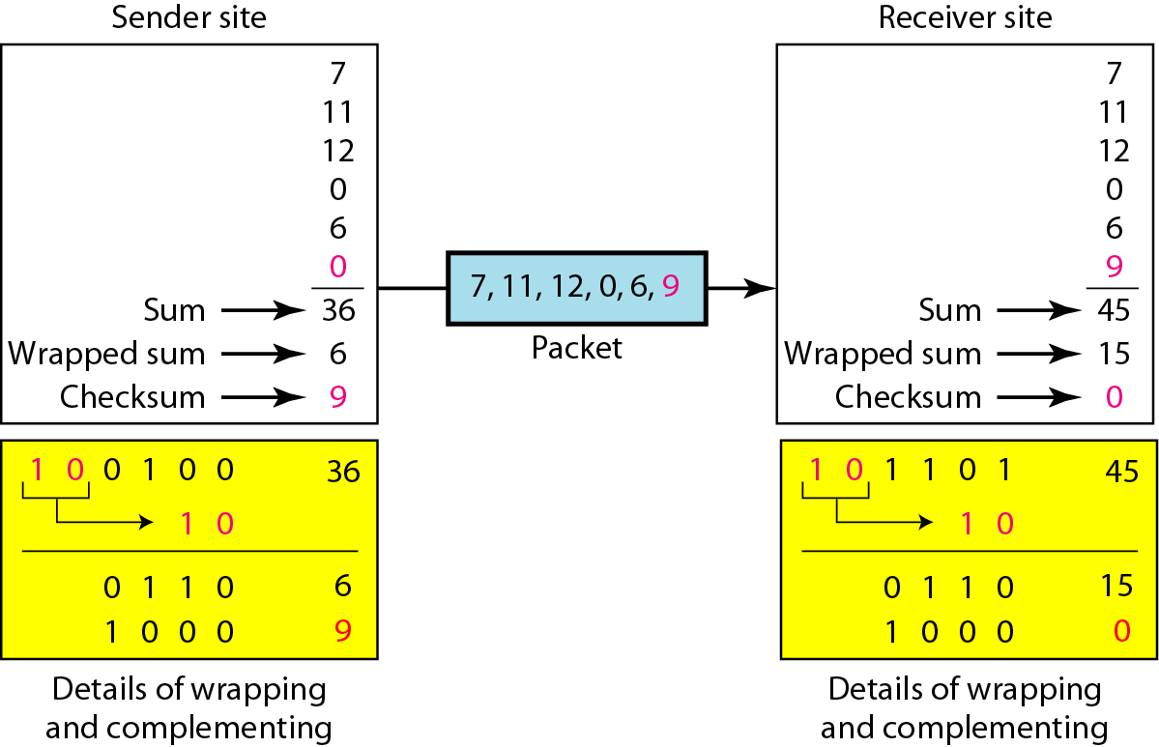
Figure 10.24 Example 10.22

Slide 90
Note
Sender site:
1. The message is divided into 16-bit words.
2. The value of the checksum word is set to 0.
3. All words including the checksum are added using one’s complement addition.
4. The sum is complemented and becomes the checksum.
5. The checksum is sent with the data.

Slide 91
Note
Receiver site:
1. The message (including checksum) is divided into 16-bit words.
2. All words are added using one’s complement addition.
3. The sum is complemented and becomes the new checksum.
4. If the value of checksum is 0, the message is accepted; otherwise, it is rejected.

Slide 92
Example 10.23
Let us calculate the checksum for a text of 8 characters (“Forouzan”). The text needs to be divided into 2-byte (16-bit) words. We use ASCII (see Appendix A) to change each byte to a 2-digit hexadecimal number. For example, F is represented as 0x46 and o is represented as 0x6F. Figure 10.25 shows how the checksum is calculated at the sender and receiver sites. In part a of the figure, the value of partial sum for the first column is 0x36. We keep the rightmost digit (6) and insert the leftmost digit (3) as the carry in the second column. The process is repeated for each column. Note that if there is any corruption, the checksum recalculated by the receiver is not all 0s. We leave this an exercise.

Slide 93
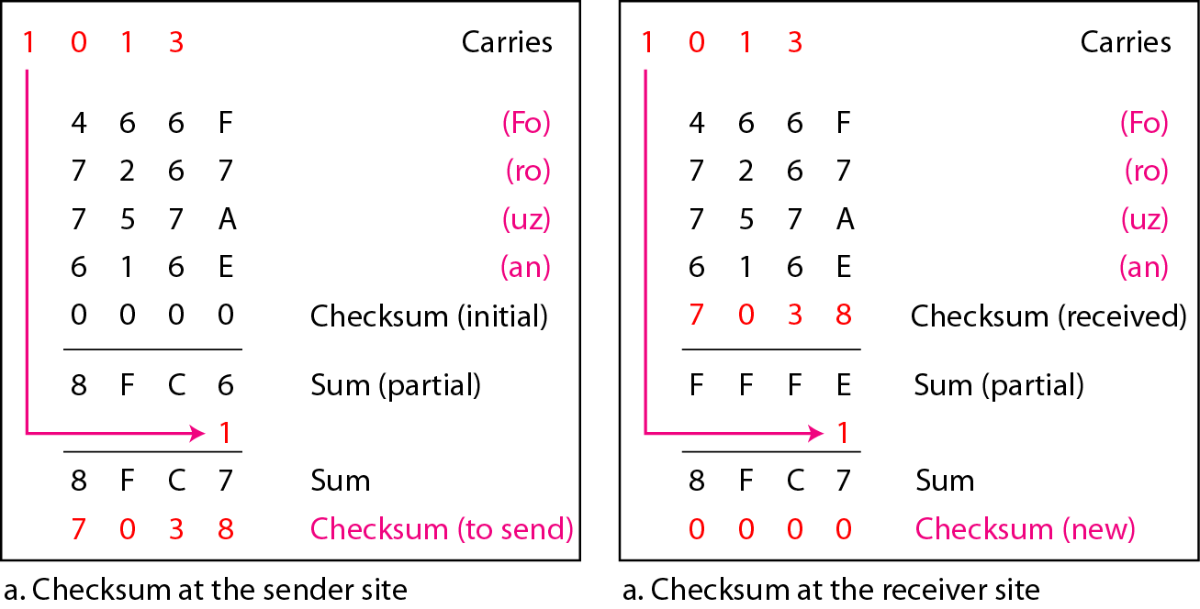
Figure 10.25 Example 10.23

