Slide 1

Chapter 12
Multiple Access
Copyright © The McGraw-Hill Companies, Inc. Permission required for reproduction or display.

Slide 2
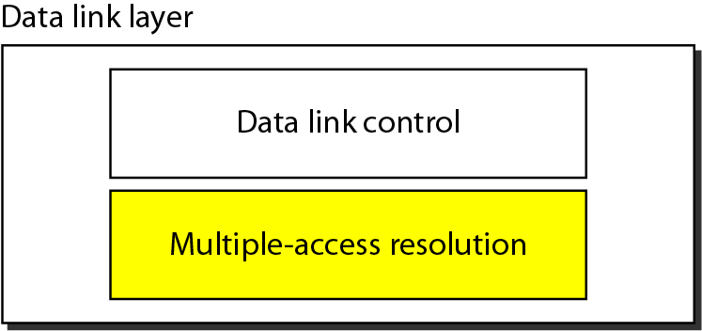
Figure 12.1 Data link layer divided into two functionality-oriented sublayers

Slide 3
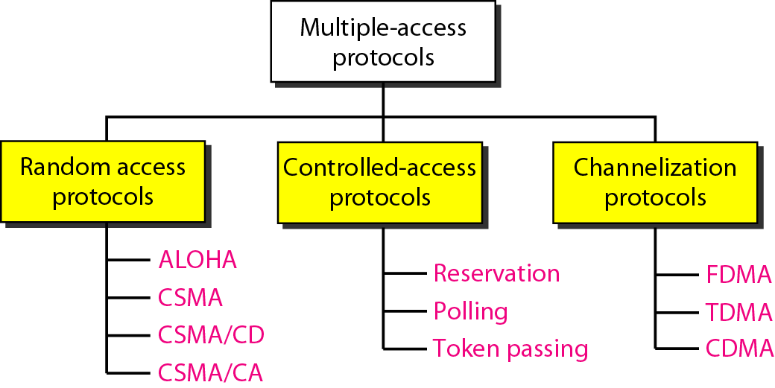
Figure 12.2 Taxonomy of multiple-access protocols discussed in this chapter

Slide 4
12-1 RANDOM ACCESS
In random access or contention methods, no station is superior to another station and none is assigned the control over another. No station permits, or does not permit, another station to send. At each instance, a station that has data to send uses a procedure defined by the protocol to make a decision on whether or not to send.
Topics discussed in this section:
ALOHA Carrier Sense Multiple Access
Carrier Sense Multiple Access with Collision Detection
Carrier Sense Multiple Access with Collision Avoidance

Slide 5
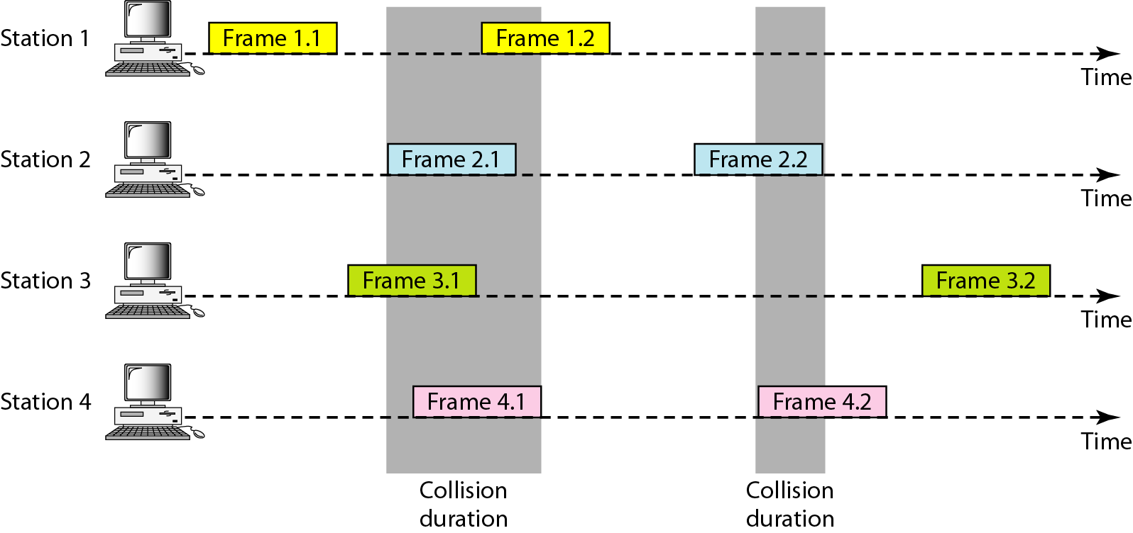
Figure 12.3 Frames in a pure ALOHA network

Slide 6
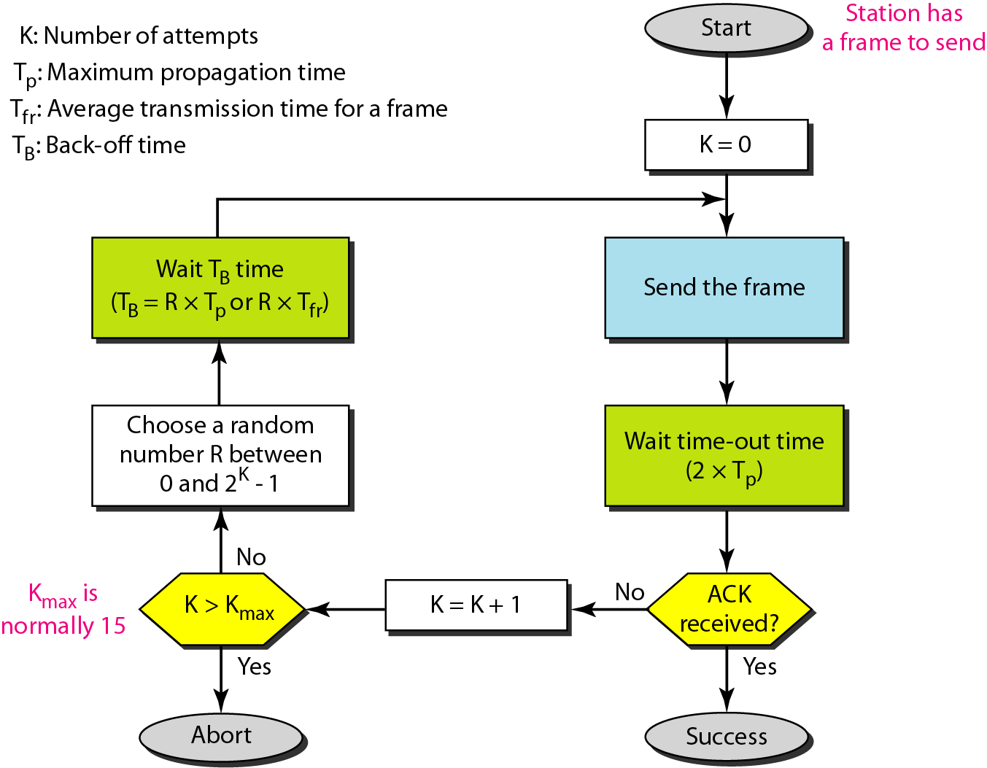
Figure 12.4 Procedure for pure ALOHA protocol

Slide 7
Example 12.1
The stations on a wireless ALOHA network are a maximum of 600 km apart. If we assume that signals propagate at 3 × 10⁸ m/s, we find
Tp = (600 × 10⁵ ) / (3 × 10⁸ ) = 2 ms.
Now we can find the value of T_{B} for different values of K .
a. For K = 1, the range is {0, 1}. The station needs to| generate a random number with a value of 0 or 1. This means that T_{B} is either 0 ms (0 × 2) or 2 ms (1 × 2), based on the outcome of the random variable.

Slide 8
Example 12.1 (continued)
b. For K = 2, the range is {0, 1, 2, 3}. This means that T_{B} can be 0, 2, 4, or 6 ms, based on the outcome of the random variable.
c. For K = 3, the range is {0, 1, 2, 3, 4, 5, 6, 7}. This means that T_{B} can be 0, 2, 4, . . . , 14 ms, based on the outcome of the random variable.
d. We need to mention that if K > 10, it is normally set to 10.

Slide 9
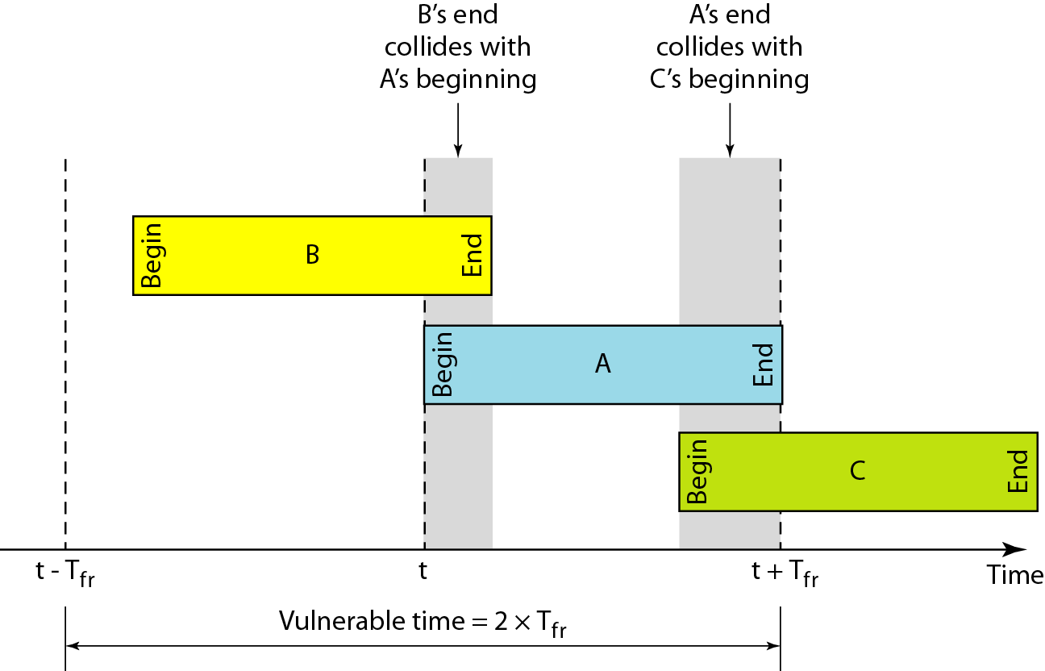
Figure 12.5 Vulnerable time for pure ALOHA protocol

Slide 10
Example 12.2
A pure ALOHA network transmits 200-bit frames on a shared channel of 200 kbps. What is the requirement to make this frame collision-free?
Solution
Average frame transmission time T_{fr} is 200 bits/200 kbps or 1 ms. The vulnerable time is 2 × 1 ms = 2 ms. This means no station should send later than 1 ms before this station starts transmission and no station should start sending during the one 1-ms period that this station is sending.

Slide 11

Note
The throughput for pure ALOHA is S = G × e ^{−2G} .
The maximum throughput
S_{max} = 0.184 when G= (1/2).

Slide 12
Example 12.3
A pure ALOHA network transmits 200-bit frames on a shared channel of 200 kbps. What is the throughput if the system (all stations together) produces
a. 1000 frames per second b. 500 frames per second
c. 250 frames per second.
Solution
The frame transmission time is 200/200 kbps or 1 ms.
a. If the system creates 1000 frames per second, this is 1 frame per millisecond. The load is 1. In this case S = G× e^{−2 G} or S = 0.135 (13.5 percent). This means that the throughput is 1000 × 0.135 = 135 frames. Only 135 frames out of 1000 will probably survive.

Slide 13
Example 12.3 (continued)
b. If the system creates 500 frames per second, this is (1/2) frame per millisecond. The load is (1/2). In this case S = G × e ^{−2G} or S = 0.184 (18.4 percent). This means that the throughput is 500 × 0.184 = 92 and that only 92 frames out of 500 will probably survive. Note that this is the maximum throughput case, percentagewise.
c. If the system creates 250 frames per second, this is (1/4) frame per millisecond. The load is (1/4). In this case S = G × e −^{2G} or S = 0.152 (15.2 percent). This means that the throughput is 250 × 0.152 = 38. Only 38 frames out of 250 will probably survive.

Slide 14
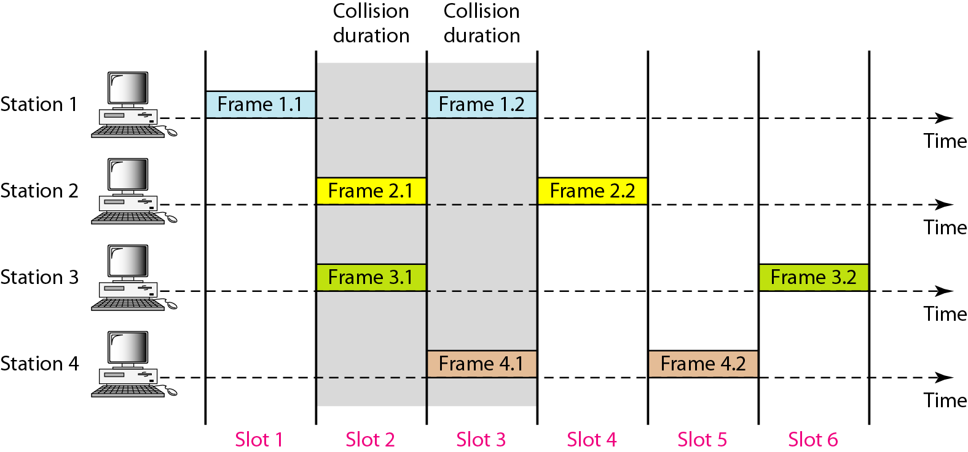
Figure 12.6 Frames in a slotted ALOHA network

Slide 15
Note
The throughput for slotted ALOHA is S = G × e^{−G} .
The maximum throughput S_{max} = 0.368 when G = 1.

Slide 16
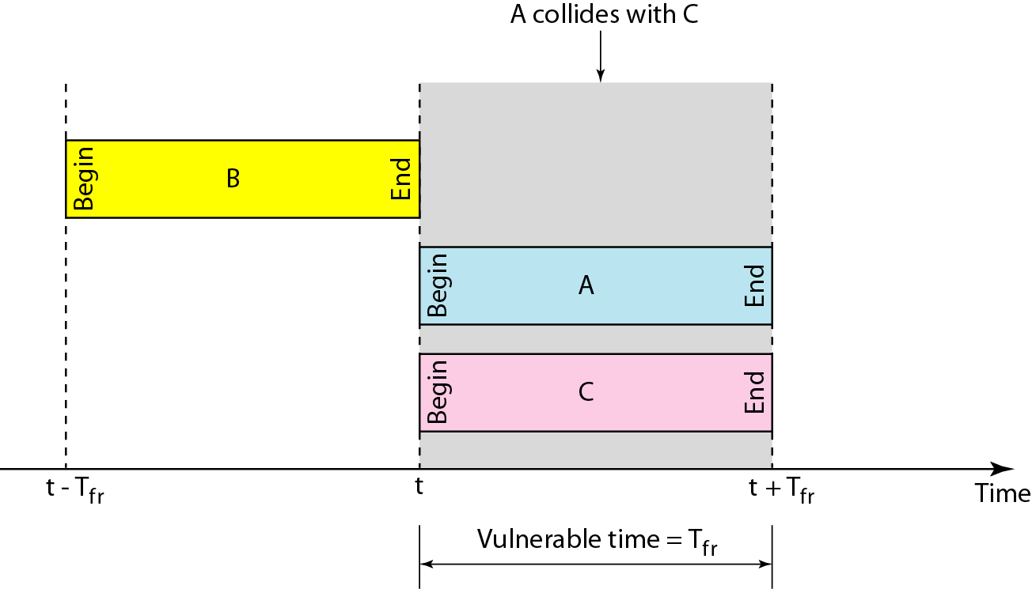
Figure 12.7 Vulnerable time for slotted ALOHA protocol

Slide 17
Example 12.4
A slotted ALOHA network transmits 200-bit frames on a shared channel of 200 kbps. What is the throughput if the system (all stations together) produces
a. 1000 frames per second b. 500 frames per second
c. 250 frames per second.
Solution
The frame transmission time is 200/200 kbps or 1 ms.
a. If the system creates 1000 frames per second, this is 1 frame per millisecond. The load is 1. In this case S = G× e^{−G} or S = 0.368 (36.8 percent). This means that the throughput is 1000 × 0.0368 = 368 frames. Only 386 frames out of 1000 will probably survive.

Slide 18
Example 12.4 (continued)
b. If the system creates 500 frames per second, this is (1/2) frame per millisecond. The load is (1/2). In this case S = G × e^{−G} or S = 0.303 (30.3 percent). This means that the throughput is 500 × 0.0303 = 151. Only 151 frames out of 500 will probably survive.
c. If the system creates 250 frames per second, this is (1/4) frame per millisecond. The load is (1/4). In this case S = G × e ^{−G} or S = 0.195 (19.5 percent). This means that the throughput is 250 × 0.195 = 49. Only 49 frames out of 250 will probably survive.

Slide 19
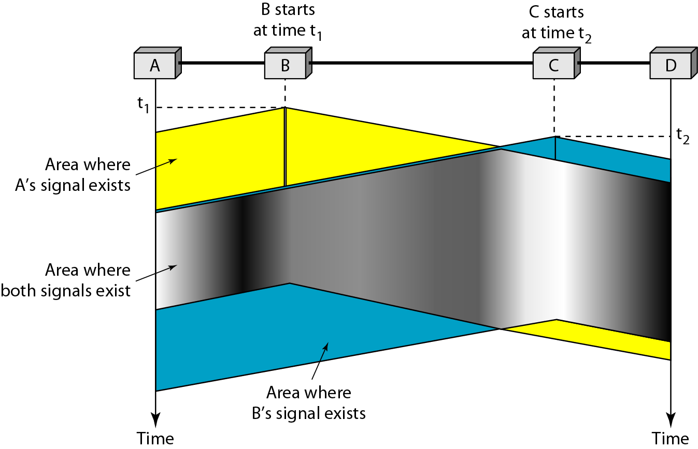
Figure 12.8 Space/time model of the collision in CSMA

Slide 20
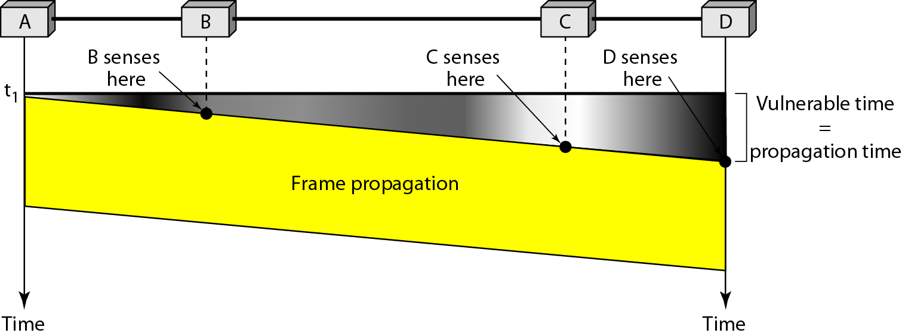
Figure 12.9 Vulnerable time in CSMA

Slide 21
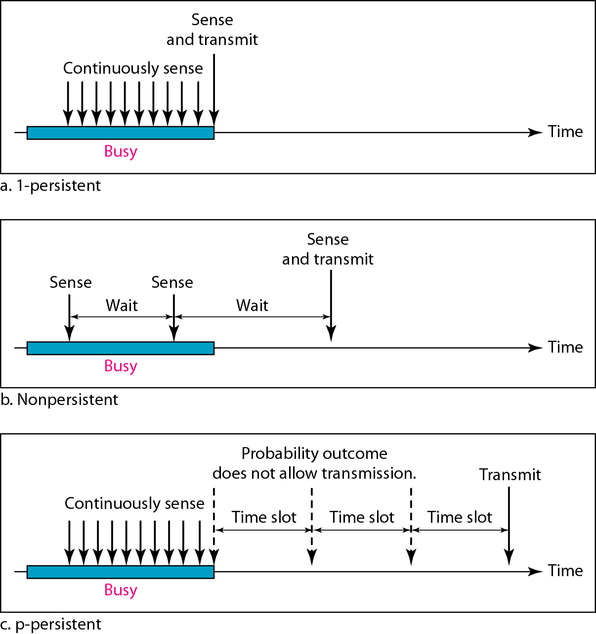
Figure 12.10 Behavior of three persistence methods

Slide 22
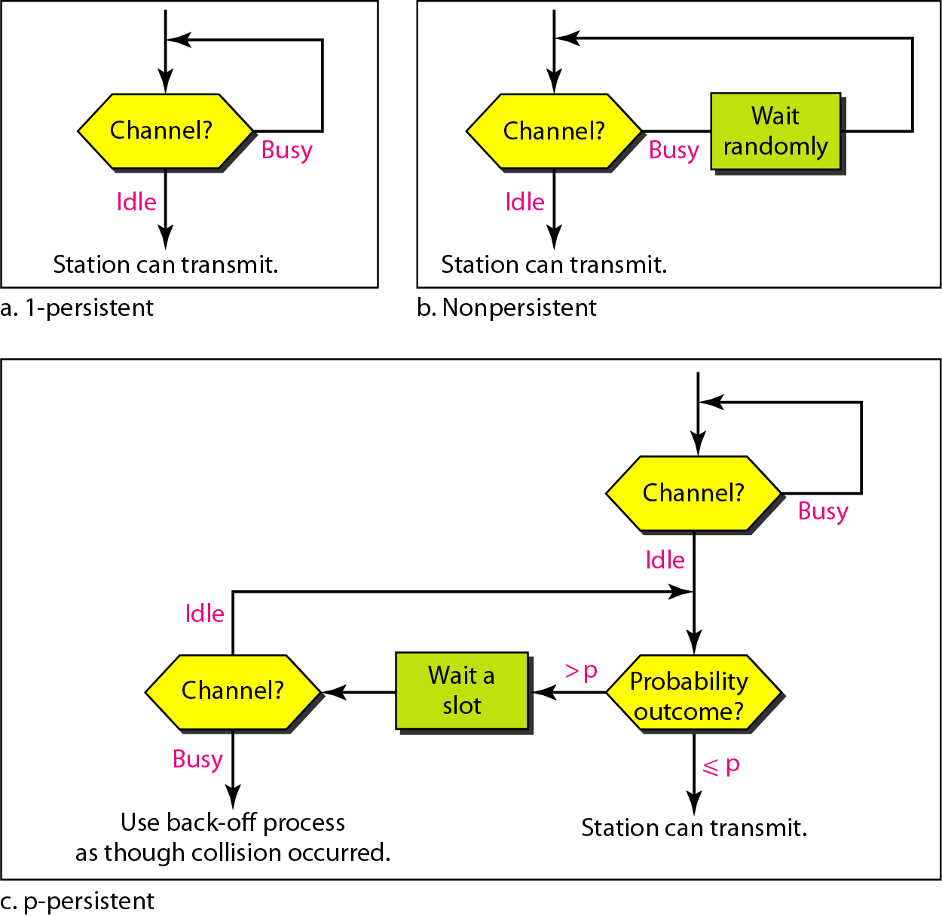
Figure 12.11 Flow diagram for three persistence methods

Slide 23
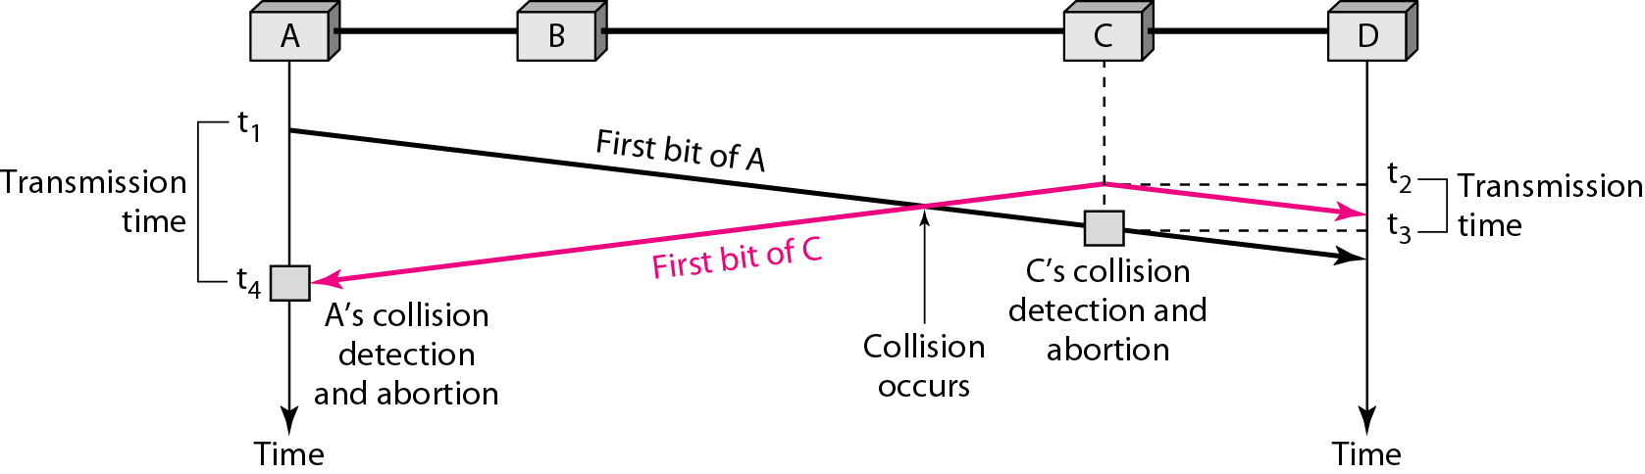
Figure 12.12 Collision of the first bit in CSMA/CD

Slide 24
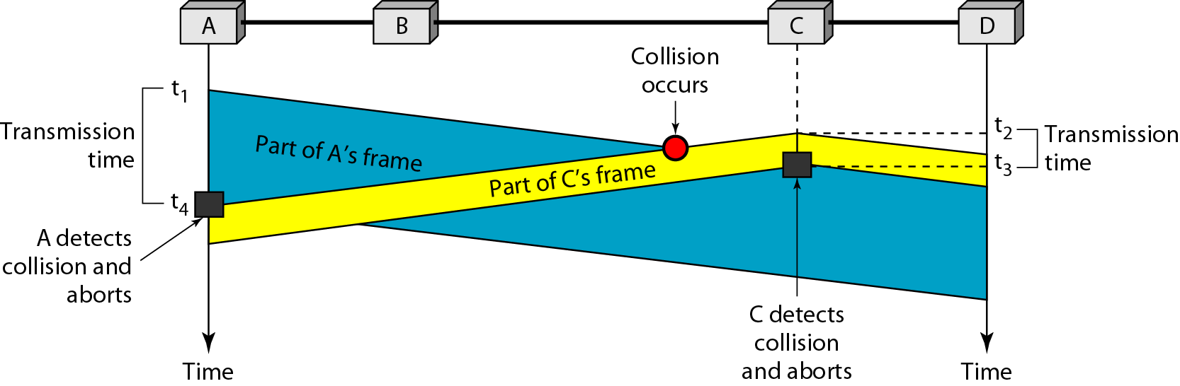
Figure 12.13 Collision and abortion in CSMA/CD

Slide 25
Example 12.5
A network using CSMA/CD has a bandwidth of 10 Mbps. If the maximum propagation time (including the delays in the devices and ignoring the time needed to send a jamming signal, as we see later) is 25.6 μs, what is the minimum size of the frame?
Solution
The frame transmission time is T_{fr} = 2 × T_{p} = 51.2 μs. This means, in the worst case, a station needs to transmit for a period of 51.2 μs to detect the collision. The minimum size of the frame is 10 Mbps × 51.2 μs = 512 bits or 64 bytes. This is actually the minimum size of the frame for Standard Ethernet.

Slide 26
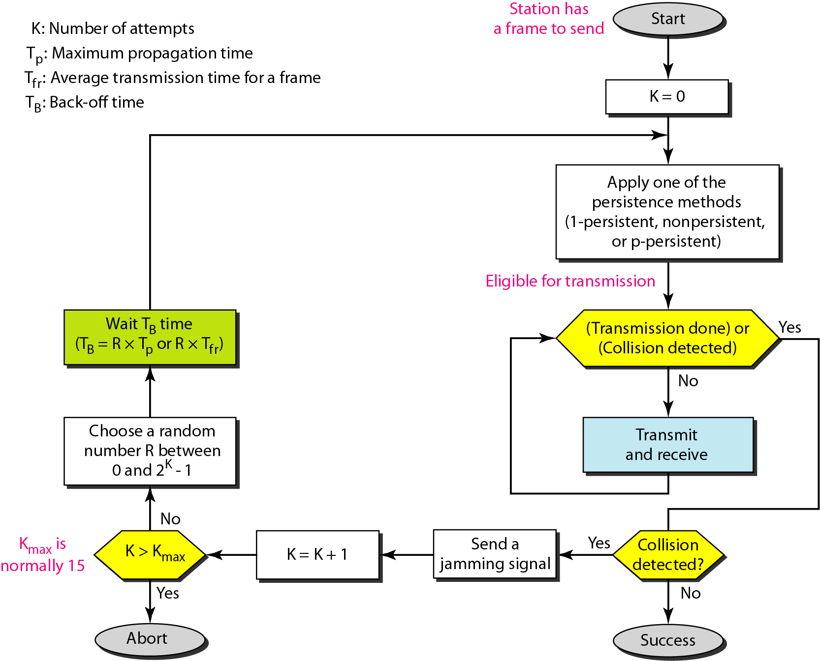
Figure 12.14 Flow diagram for the CSMA/CD

Slide 27
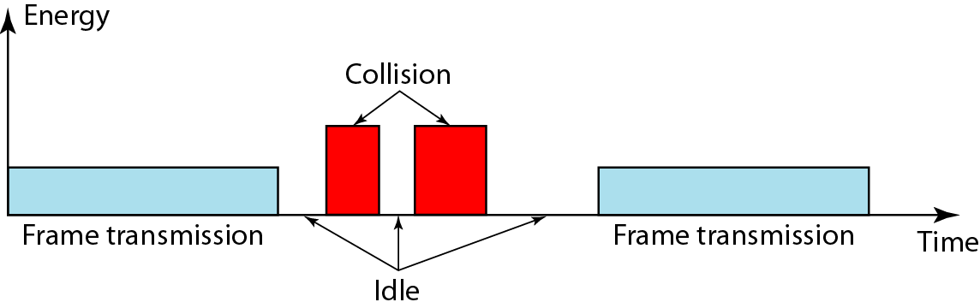
Figure 12.15 Energy level during transmission, idleness, or collision

Slide 28
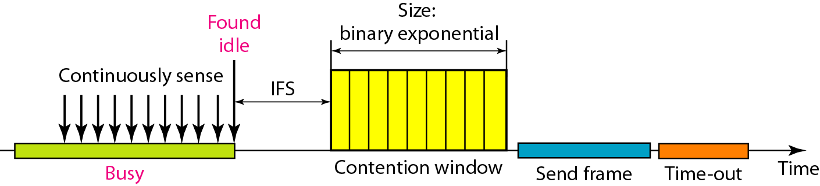
Figure 12.16 Timing in CSMA/CA

Slide 29
Note
In CSMA/CA, the IFS can also be used to define the priority of a station or a frame.

Slide 30
Note
In CSMA/CA, if the station finds the channel busy, it does not restart the timer of the contention window;
it stops the timer and restarts it when the channel becomes idle.

Slide 31
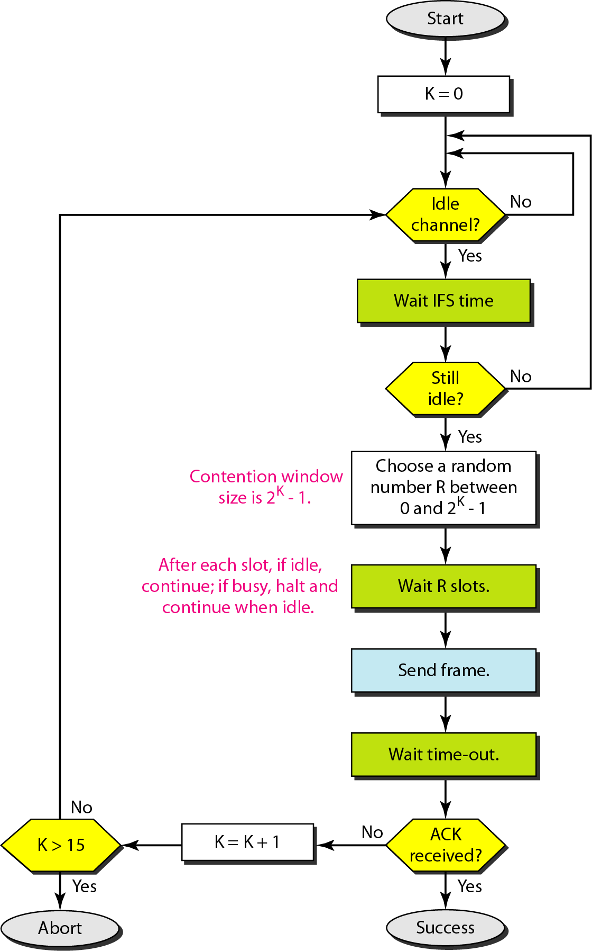
Figure 12.17 Flow diagram for CSMA/CA

Slide 32
12-2 CONTROLLED ACCESS
In controlled access, the stations consult one another to find which station has the right to send. A station cannot send unless it has been authorized by other stations. We discuss three popular controlled-access methods.
Topics discussed in this section:
Reservation Polling Token Passing

Slide 33
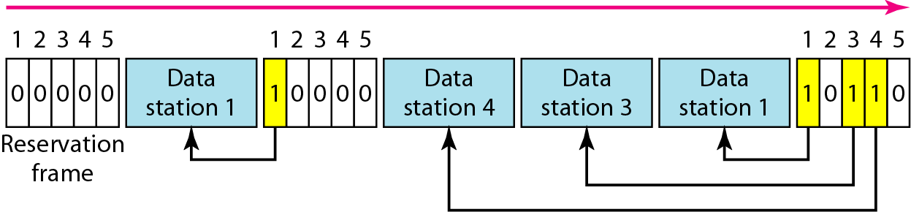
Figure 12.18 Reservation access method

Slide 34
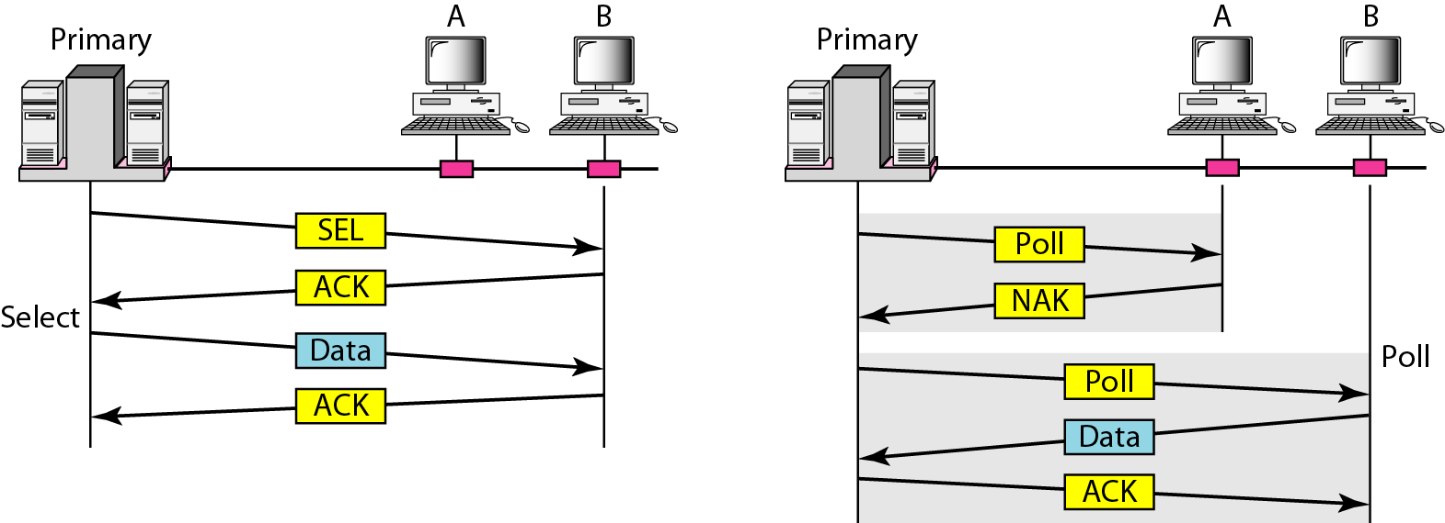
Figure 12.19 Select and poll functions in polling access method

Slide 35
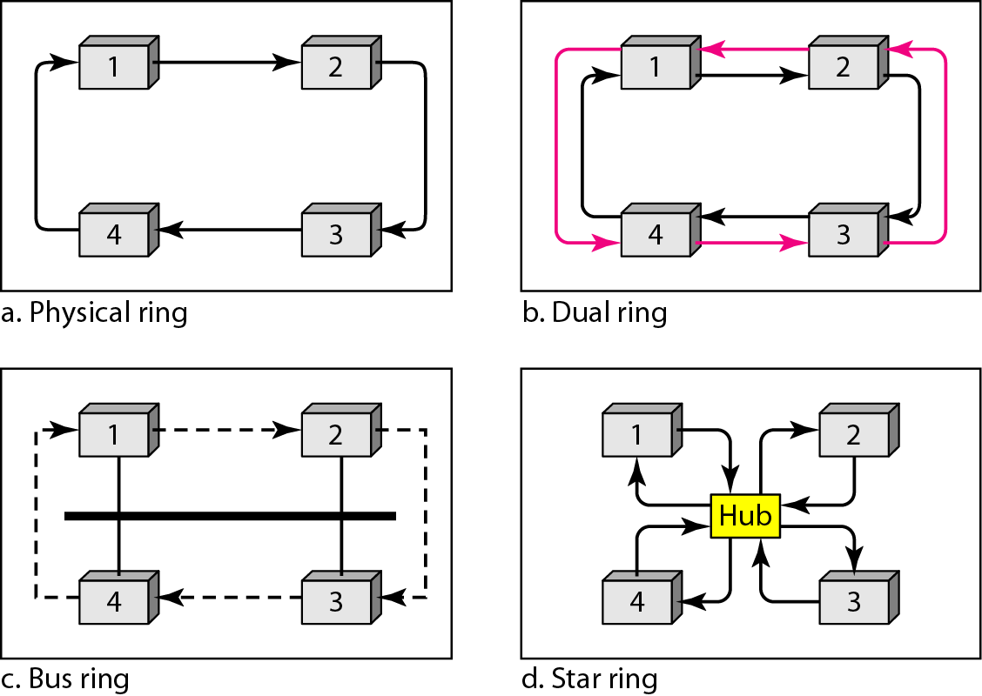
Figure 12.20 Logical ring and physical topology in token-passing access method

Slide 36
12-3 CHANNELIZATION
Channelization is a multiple-access method in which the available bandwidth of a link is shared in time, frequency, or through code, between different stations. In this section, we discuss three channelization protocols.
Topics discussed in this section:
Frequency-Division Multiple Access (FDMA) Time-Division Multiple Access (TDMA)
Code-Division Multiple Access (CDMA)

Slide 37
Note
We see the application of all these methods in Chapter 16 when we discuss cellular phone systems.

Slide 38
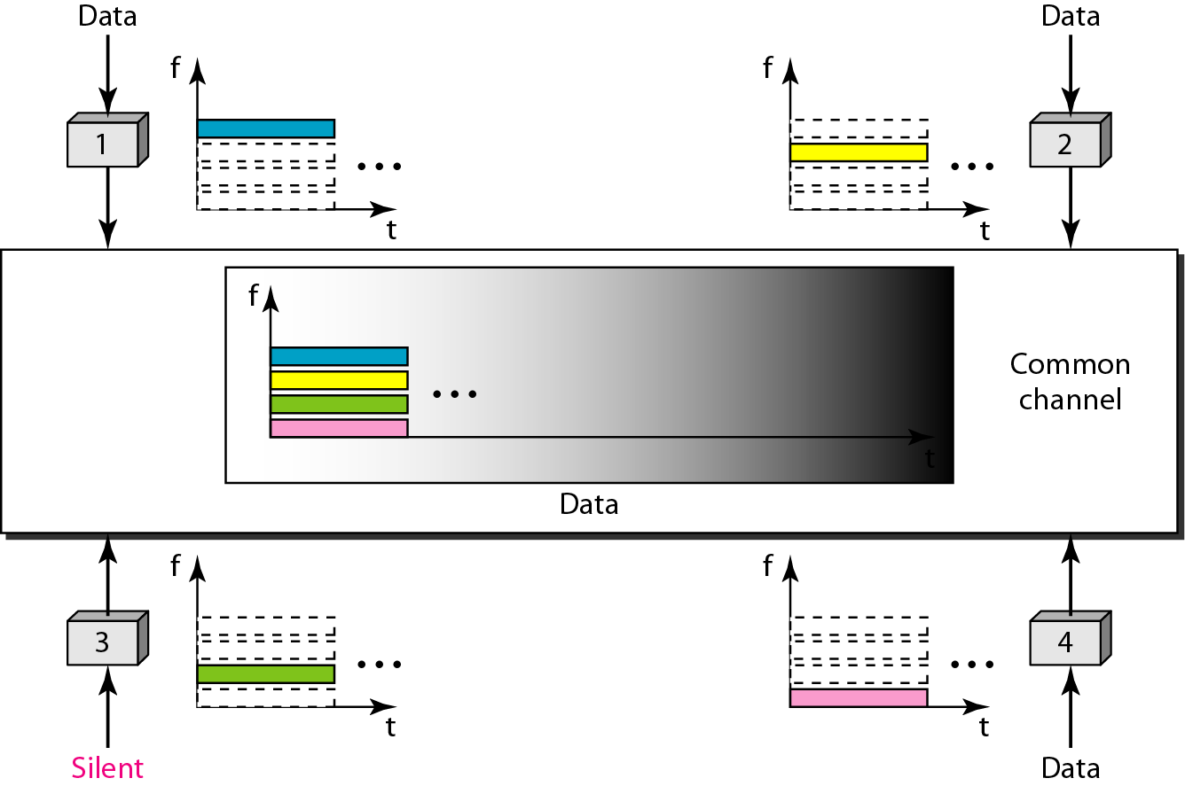
Figure 12.21 Frequency-division multiple access (FDMA)

Slide 39
Note
In FDMA, the available bandwidth of the common channel is divided into bands that are separated by guard bands.

Slide 40
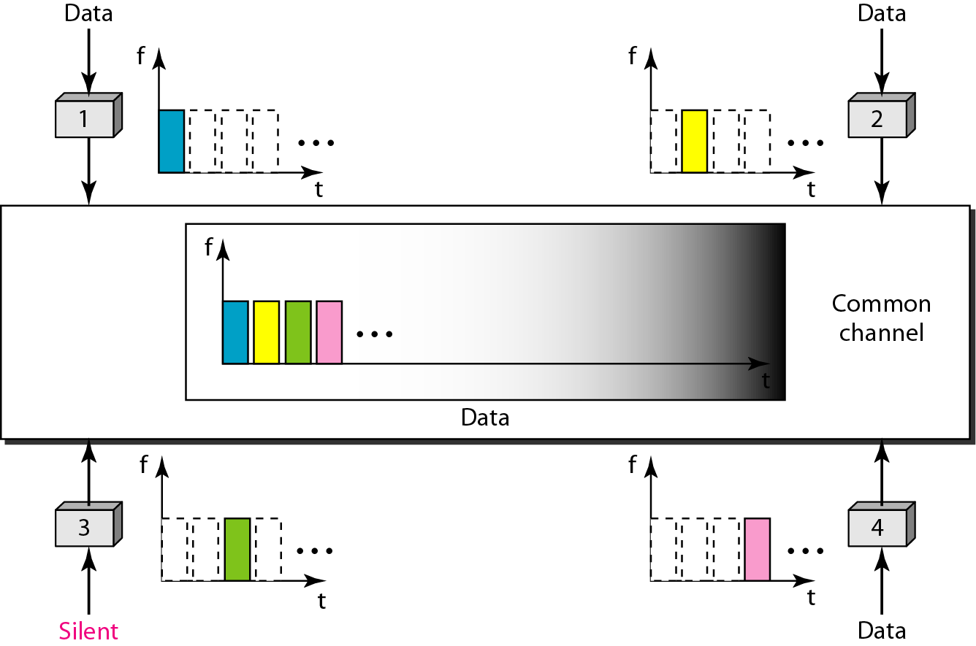
Figure 12.22 Time-division multiple access (TDMA)

Slide 41
Note
In TDMA, the bandwidth is just one channel that is timeshared between different stations.

Slide 42
Note
In CDMA, one channel carries all transmissions simultaneously.

Slide 43
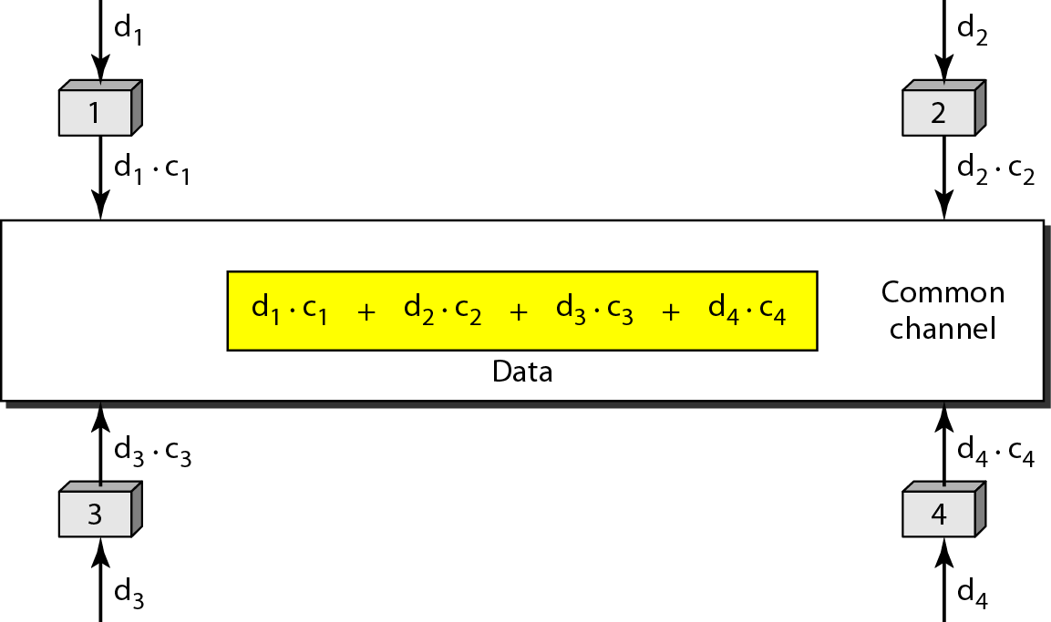
Figure 12.23 Simple idea of communication with code

Slide 44
Figure 12.24 Chip sequences

Slide 45
Figure 12.25 Data representation in CDMA

Slide 46
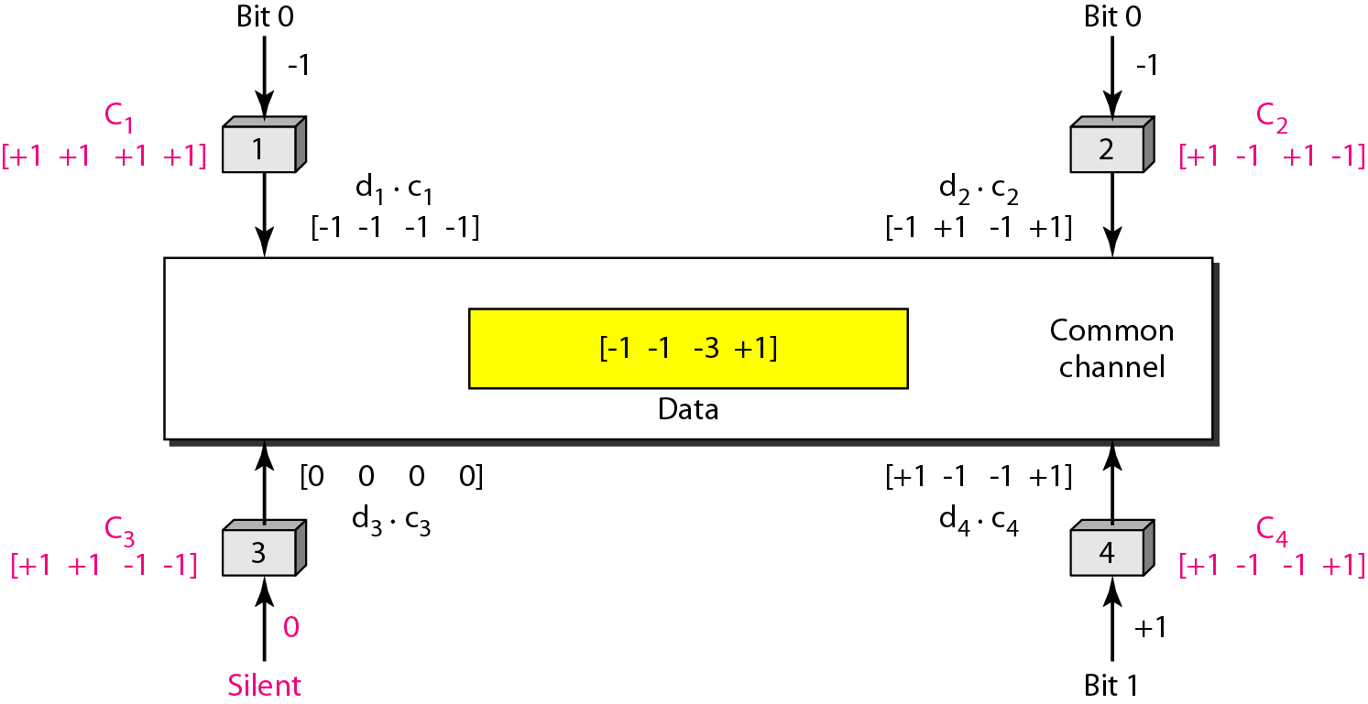
Figure 12.26 Sharing channel in CDMA

Slide 47
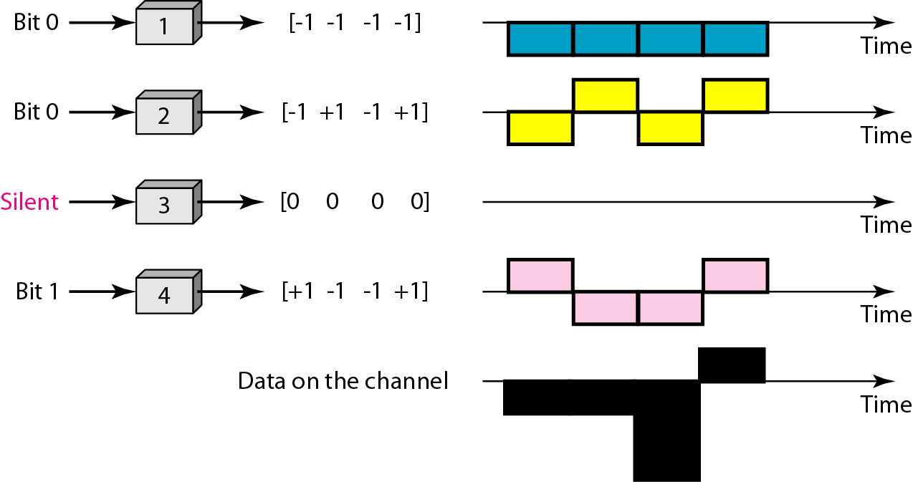
Figure 12.27 Digital signal created by four stations in CDMA

Slide 48
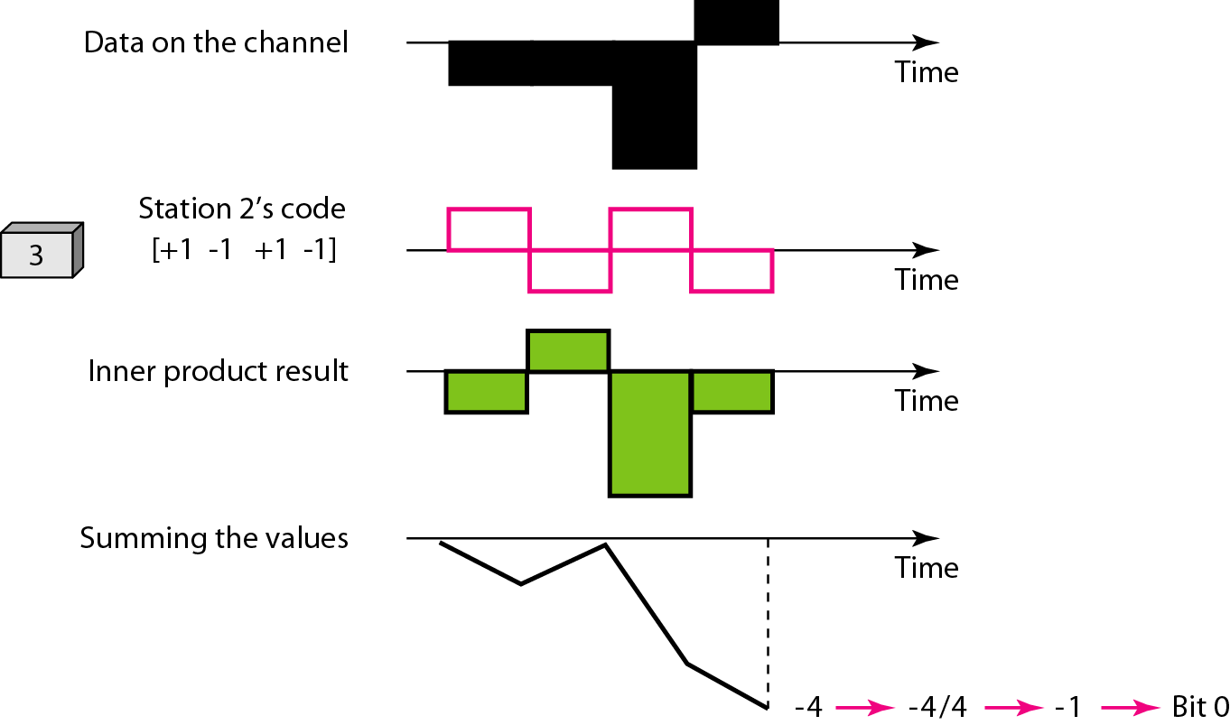
Figure 12.28 Decoding of the composite signal for one in CDMA

Slide 49
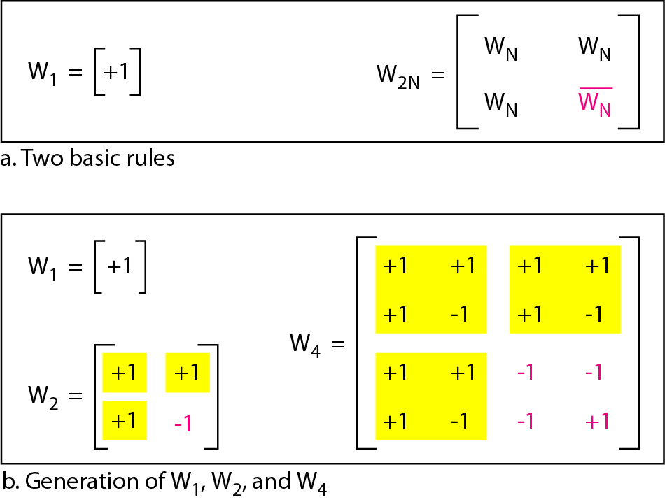
Figure 12.29 General rule and examples of creating Walsh tables

Slide 50
Note
The number of sequences in a Walsh table needs to be N = 2^{m}.

Slide 51
Example 12.6
Find the chips for a network with
a. Two stations b. Four stations
Solution
We can use the rows of W2 and W4 in Figure 12.29:
a. For a two-station network, we have [+1 +1] and [+1 −1].
b. For a four-station network we have [+1 +1 +1 +1], [+1 −1 +1 −1], [+1 +1 −1 −1], and [+1 −1 −1 +1].

Slide 52
Example 12.7
What is the number of sequences if we have 90 stations in our network?
Solution
The number of sequences needs to be 2^{m}. We need to choose m = 7 and N = 2⁷ or 128. We can then use 90 of the sequences as the chips.

Slide 53
Example 12.8
Prove that a receiving station can get the data sent by a specific sender if it multiplies the entire data on the channel by the sender’s chip code and then divides it by the number of stations.
Solution
Let us prove this for the first station, using our previous four-station example. We can say that the data on the channel D = (d1 ⋅ c1 + d2 ⋅ c2 + d3 ⋅ c3 + d4 ⋅ c4). The receiver which wants to get the data sent by station 1 multiplies these data by c1.

Slide 54
Example 12.8 (continued)
When we divide the result by N, we get d1 .

