Slide 1

Chapter 14
Wireless LANs
Copyright © The McGraw-Hill Companies, Inc. Permission required for reproduction or display.

Slide 2
14-1 IEEE 802.11
IEEE has defined the specifications for a wireless LAN, called IEEE 802.11, which covers the physical and data link layers.
Topics discussed in this section:
Architecture MAC Sublayer
Physical Layer

Slide 3

Note
A BSS without an AP is called an ad hoc network;
a BSS with an AP is called an infrastructure network.

Slide 4
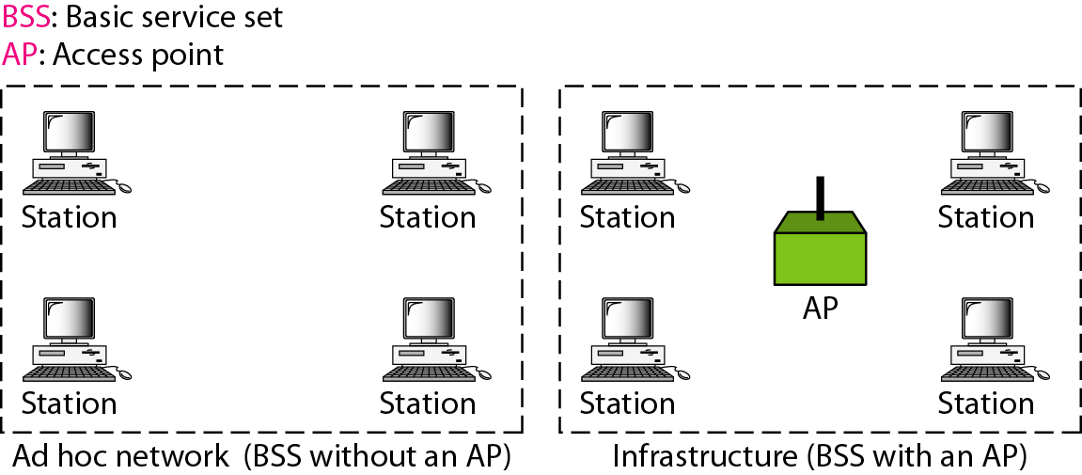
Figure 14.1 Basic service sets (BSSs)

Slide 5
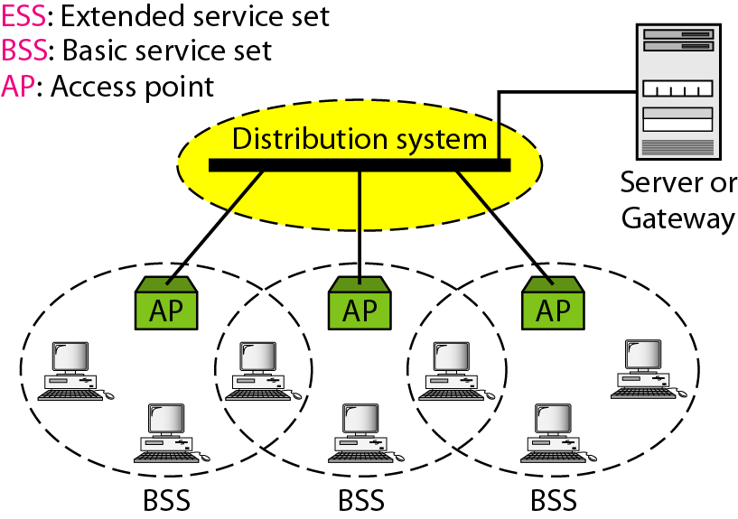
Figure 14.2 Extended service sets (ESSs)

Slide 6
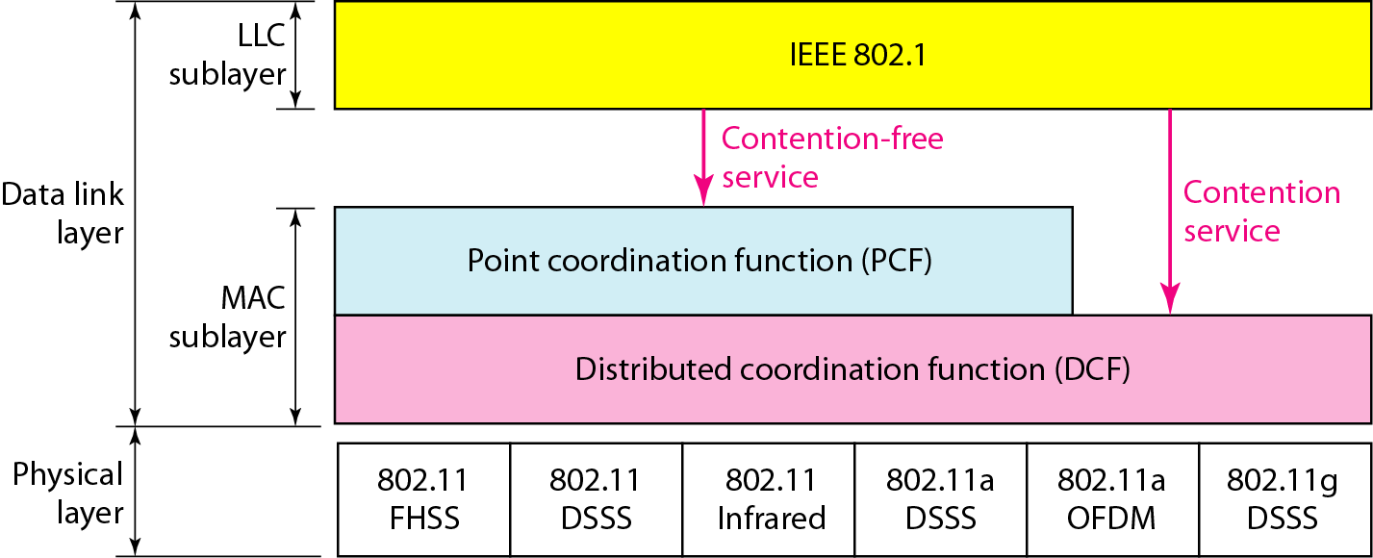
Figure 14.3 MAC layers in IEEE 802.11 standard

Slide 7
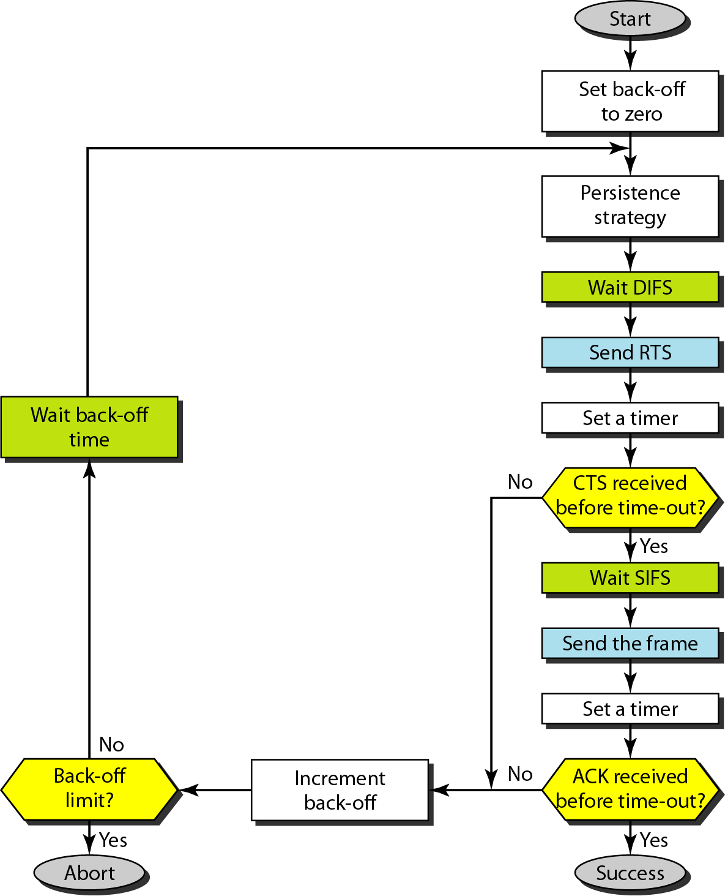
Figure 14.4 CSMA/CA flowchart

Slide 8
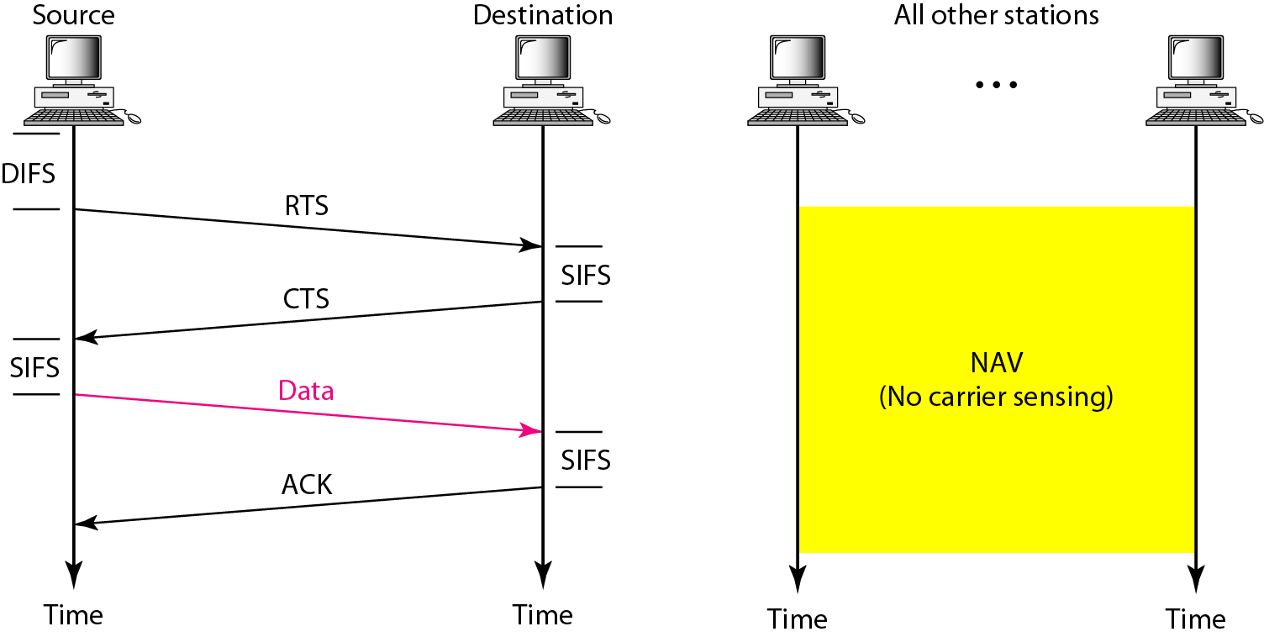
Figure 14.5 CSMA/CA and NAV

Slide 9
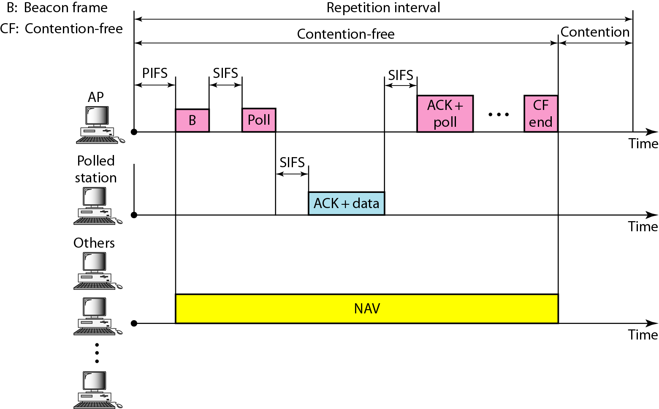
Figure 14.6 Example of repetition interval

Slide 10
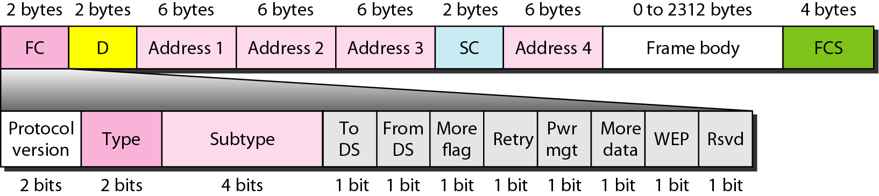
Figure 14.7 Frame format

Slide 11
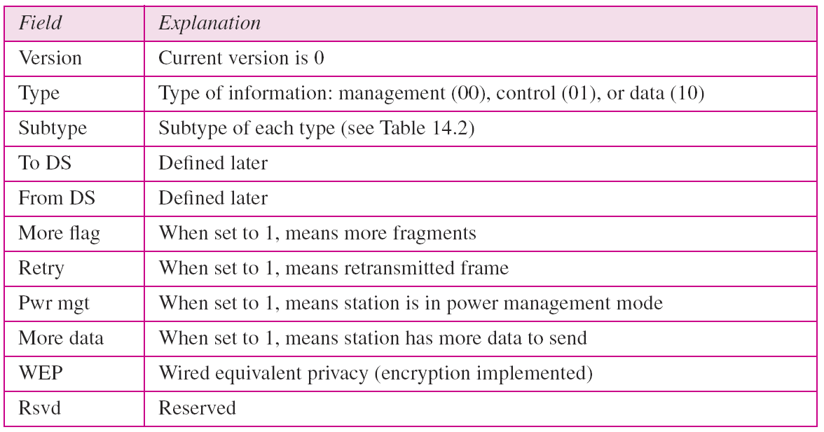
Table 14.1 Subfields in FC field

Slide 12
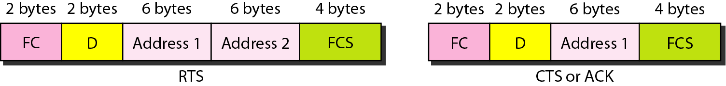
Figure 14.8 Control frames

Slide 13
Table 14.2 Values of subfields in control frames

Slide 14
Table 14.3 Addresses

Slide 15
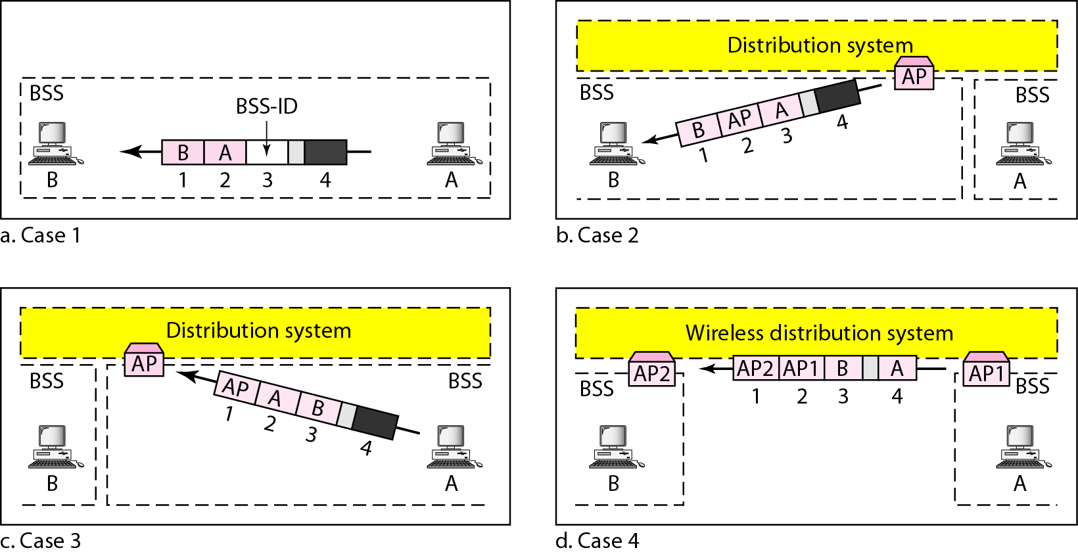
Figure 14.9 Addressing mechanisms

Slide 16
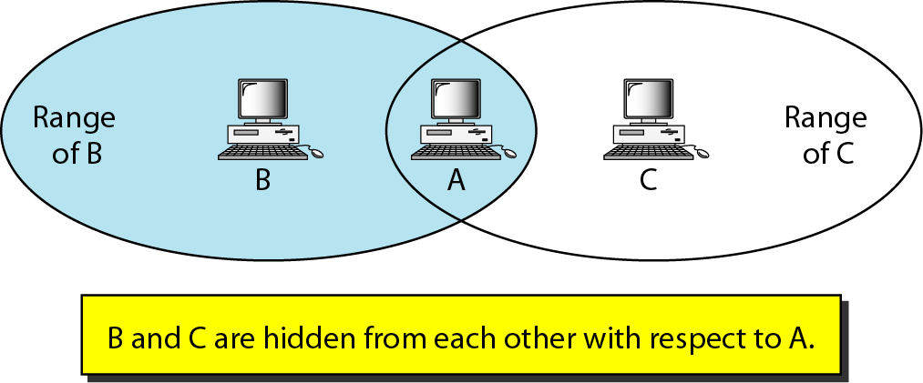
Figure 14.10 Hidden station problem

Slide 17
Note
The CTS frame in CSMA/CA handshake can prevent collision from a hidden station.

Slide 18
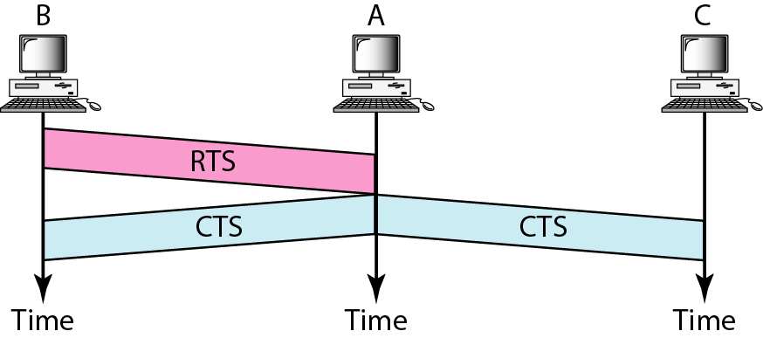
Figure 14.11 Use of handshaking to prevent hidden station problem

Slide 19
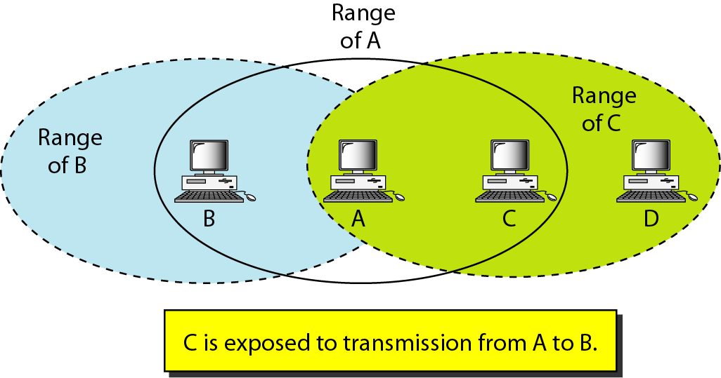
Figure 14.12 Exposed station problem

Slide 20
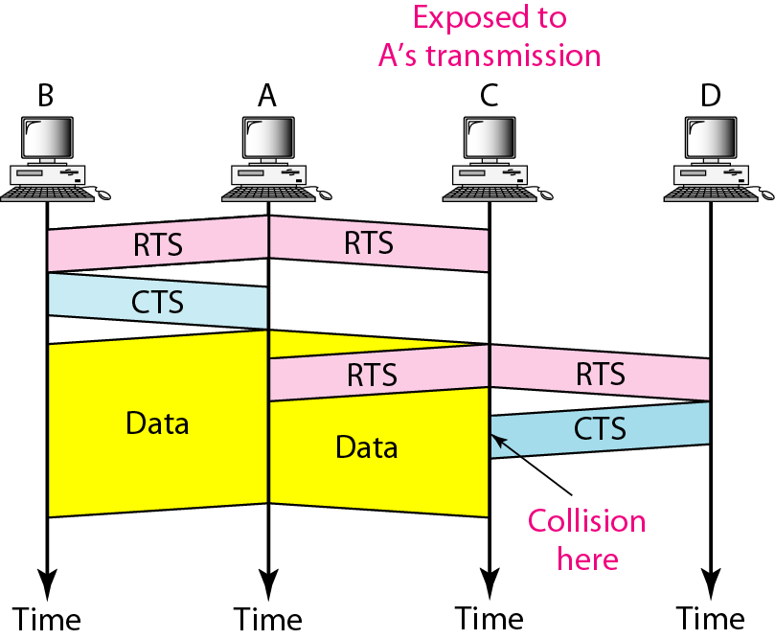
Figure 14.13 Use of handshaking in exposed station problem

Slide 21
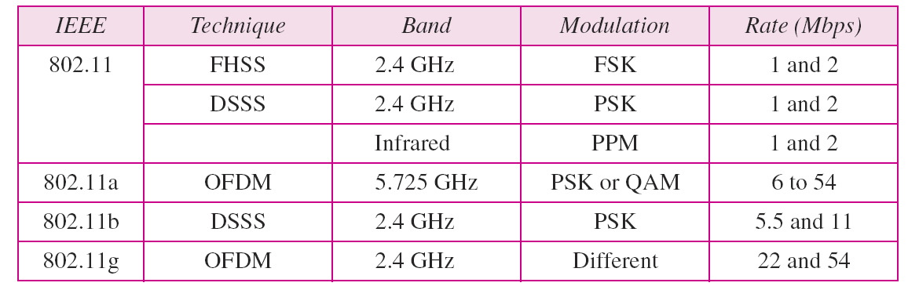
Table 14.4 Physical layers

Slide 22
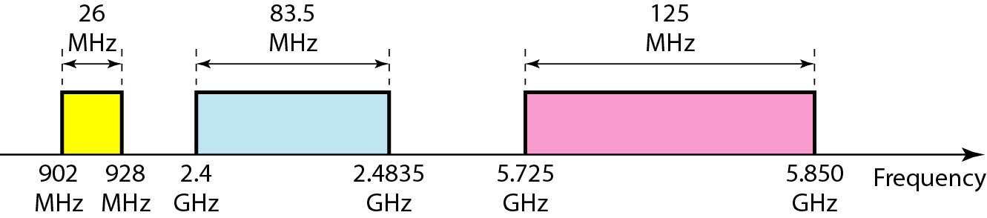
Figure 14.14 Industrial, scientific, and medical (ISM) band

Slide 23
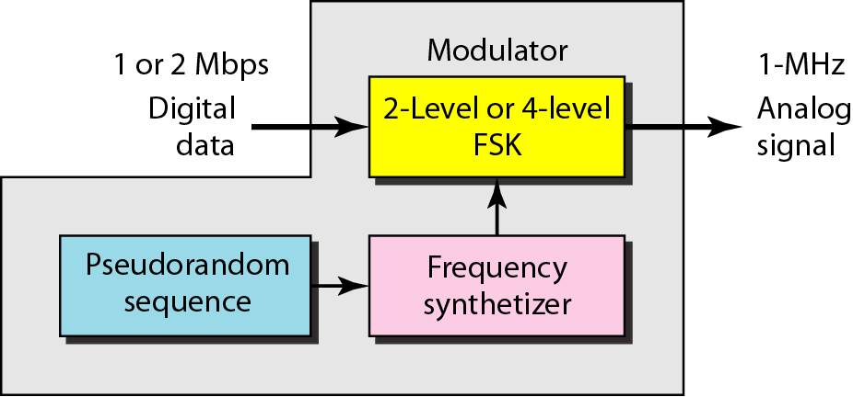
Figure 14.15 Physical layer of IEEE 802.11 FHSS

Slide 24
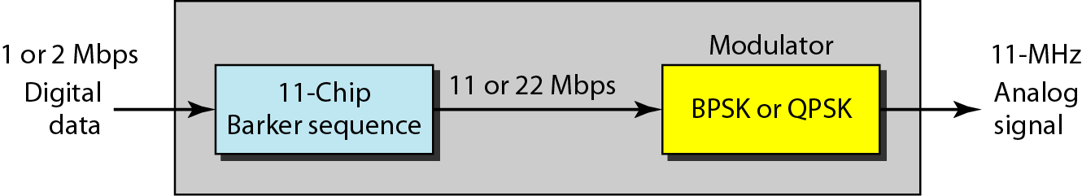
Figure 14.16 Physical layer of IEEE 802.11 DSSS

Slide 25
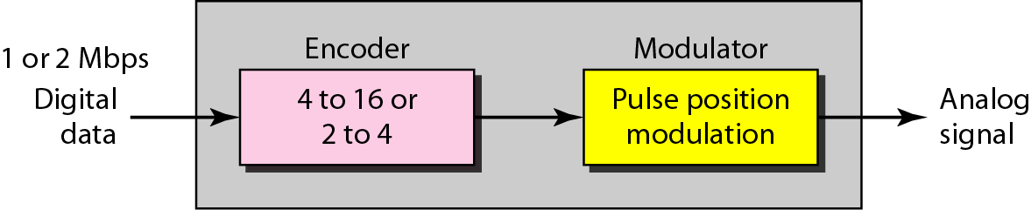
Figure 14.17 Physical layer of IEEE 802.11 infrared

Slide 26
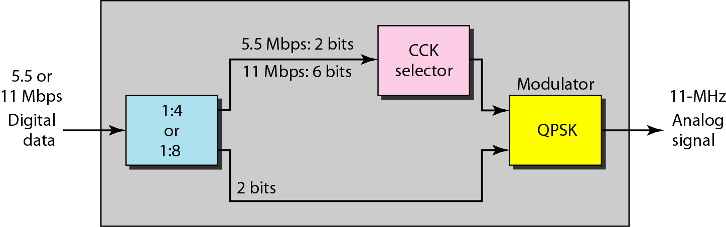
Figure 14.18 Physical layer of IEEE 802.11b

Slide 27
14-2 BLUETOOTH
Bluetooth is a wireless LAN technology designed to connect devices of different functions such as telephones, notebooks, computers, cameras, printers, coffee makers, and so on. A Bluetooth LAN is an ad hoc network, which means that the network is formed spontaneously.
Topics discussed in this section:
Architecture Bluetooth Layers Baseband Layer
L2CAP

Slide 28
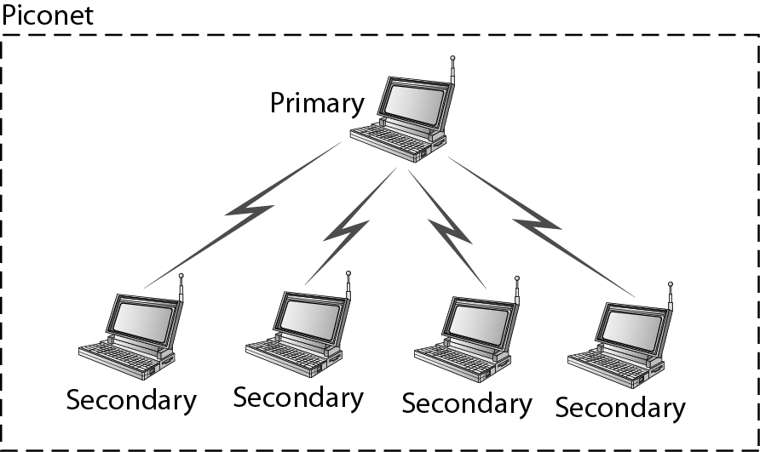
Figure 14.19 Piconet

Slide 29
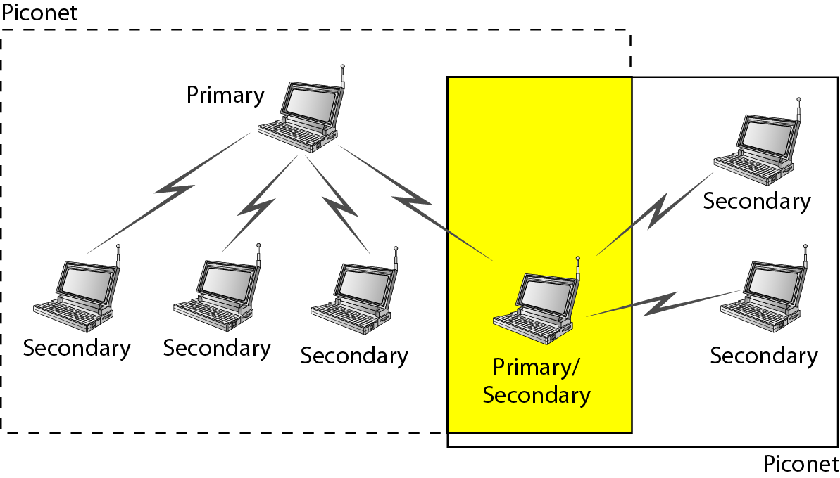
Figure 14.20 Scatternet

Slide 30
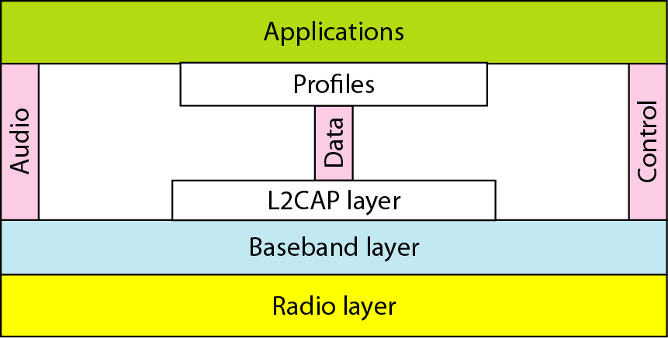
Figure 14.21 Bluetooth layers

Slide 31
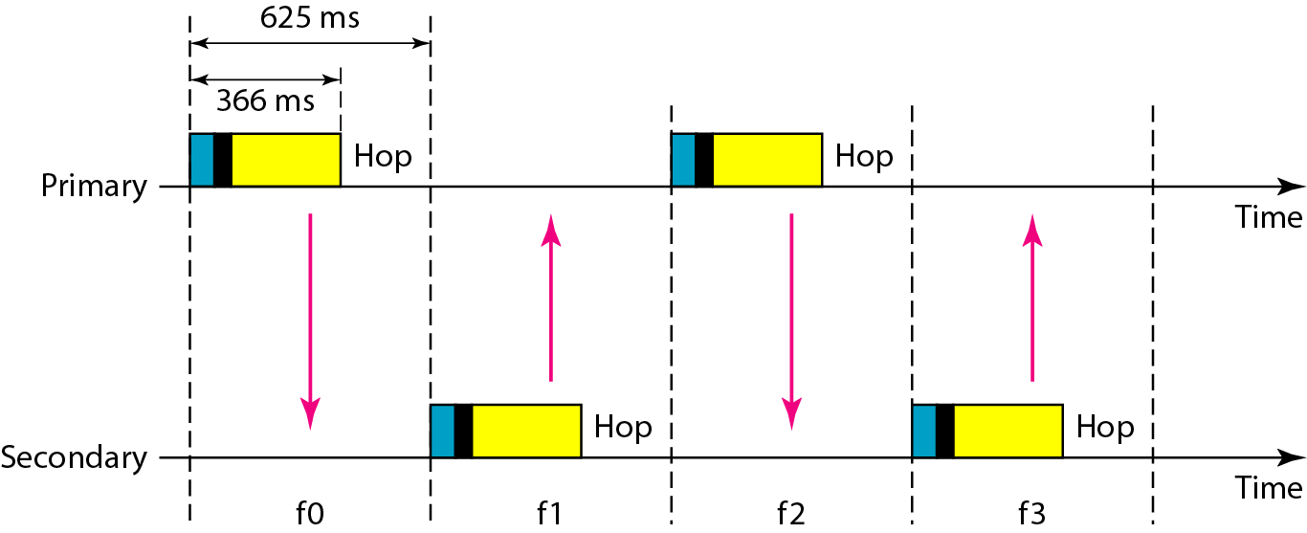
Figure 14.22 Single-secondary communication

Slide 32
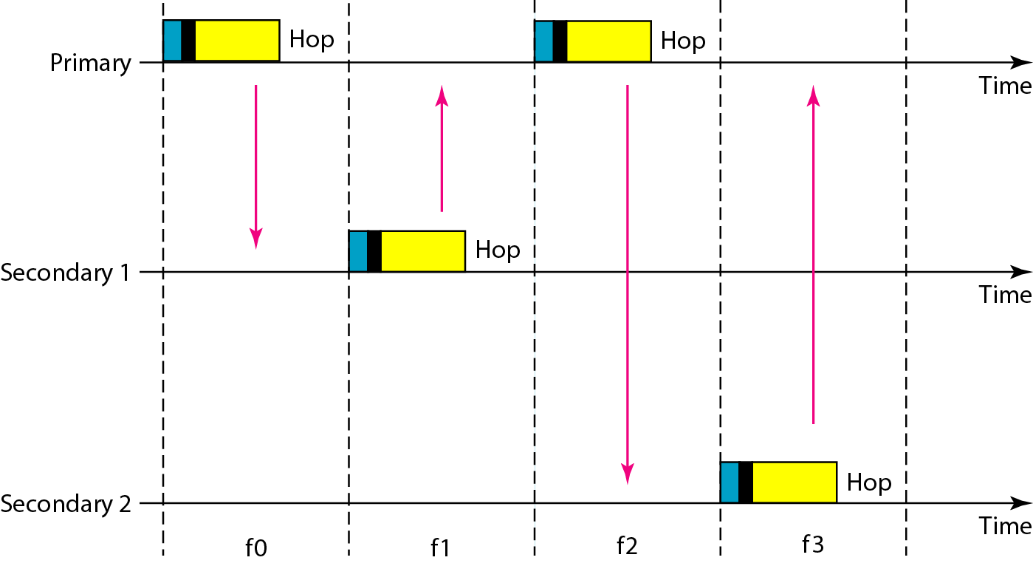
Figure 14.23 Multiple-secondary communication

Slide 33
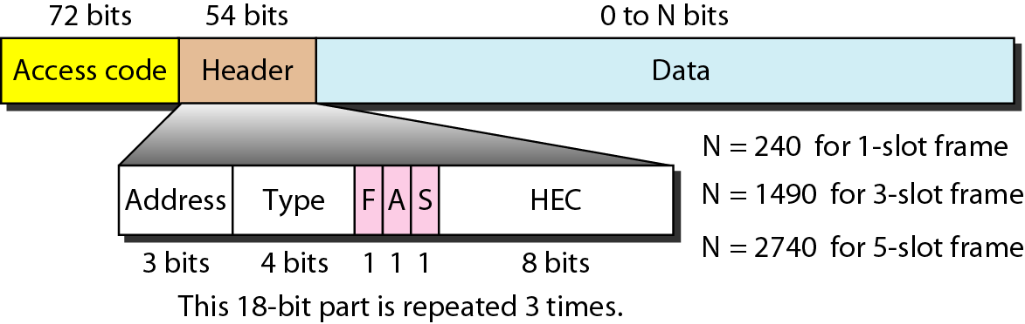
Figure 14.24 Frame format types

Slide 34

Figure 14.25 L2CAP data packet format

