Slide 1

Chapter 16
Wireless WANs: Cellular Telephone
and Satellite Networks
Copyright © The McGraw-Hill Companies, Inc. Permission required for reproduction or display.

Slide 2
16-1 CELLULAR TELEPHONY
Cellular telephony is designed to provide communications between two moving units, called mobile stations (MSs), or between one mobile unit and one stationary unit, often called a land unit.
Topics discussed in this section:
Frequency-Reuse Principle Transmitting
Receiving
Roaming
First Generation
Second Generation
Third Generation

Slide 3
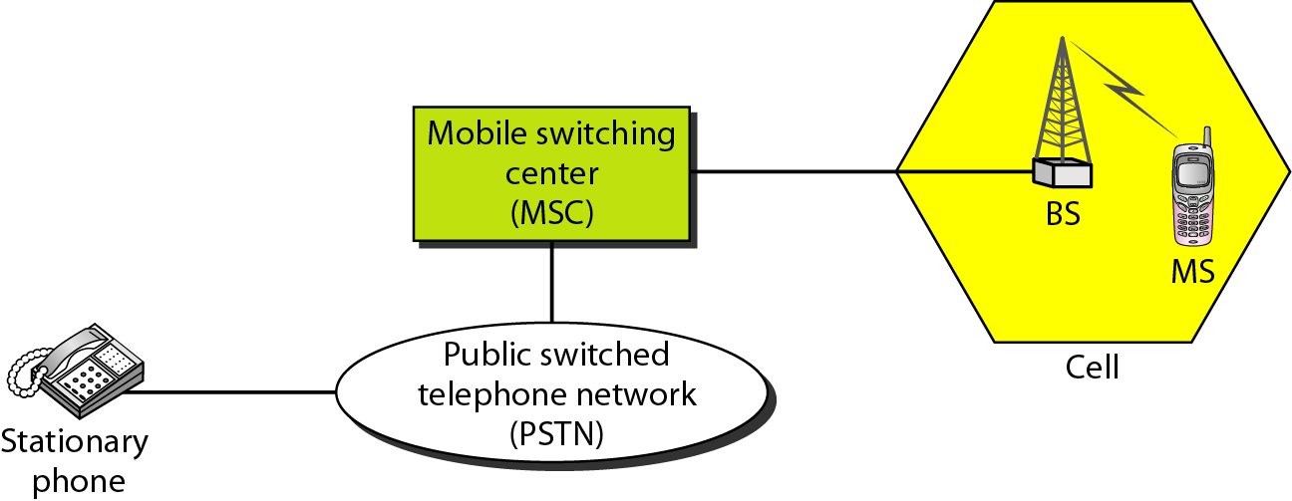
Figure 16.1 Cellular system

Slide 4
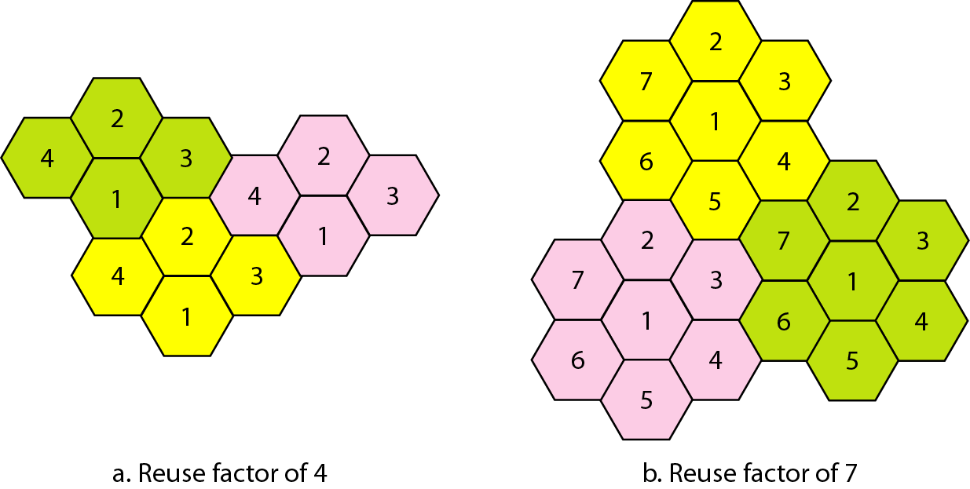
Figure 16.2 Frequency reuse patterns

Slide 5

Note
AMPS is an analog cellular phone system using FDMA.

Slide 6
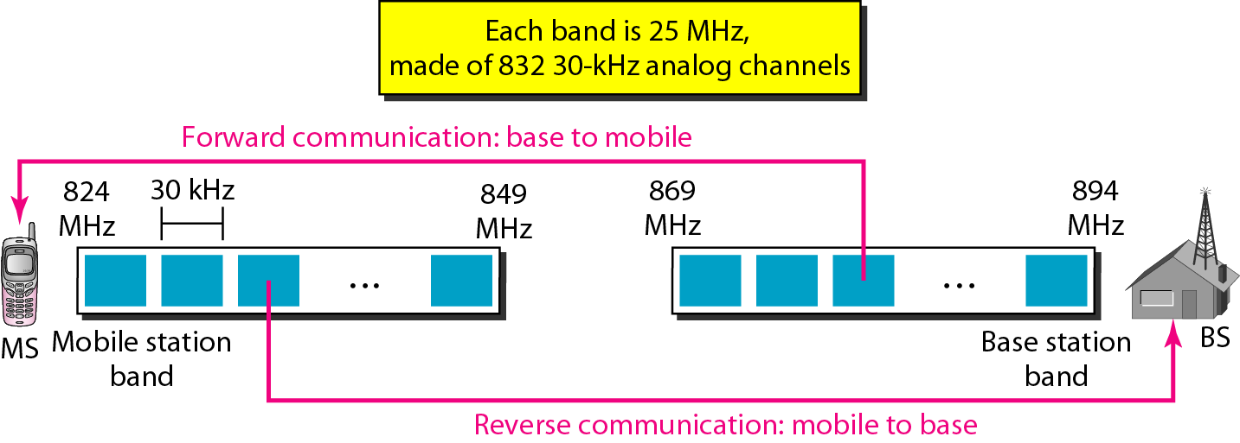
Figure 16.3 Cellular bands for AMPS

Slide 7
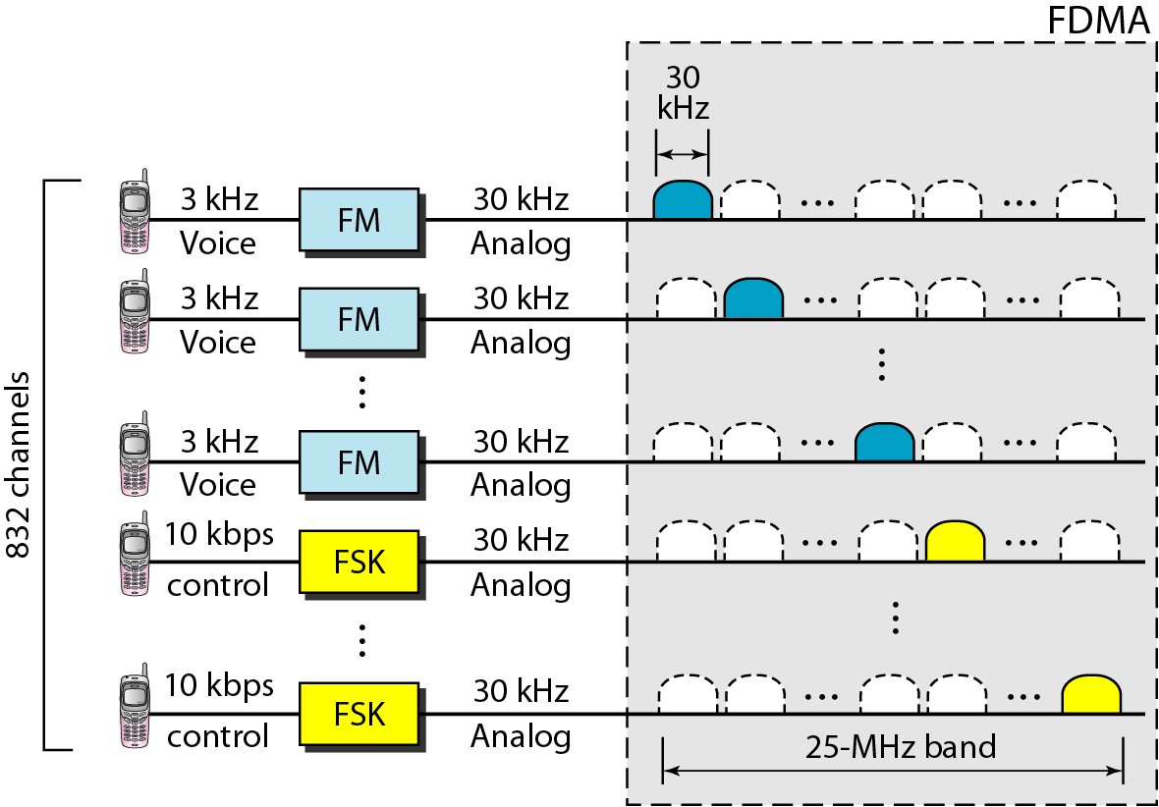
Figure 16.4 AMPS reverse communication band

Slide 8
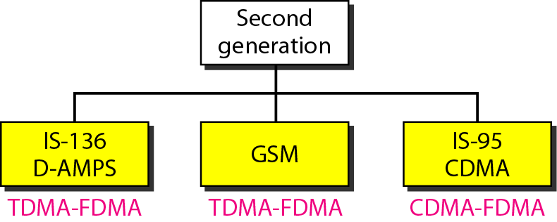
Figure 16.5 Second-generation cellular phone systems

Slide 9
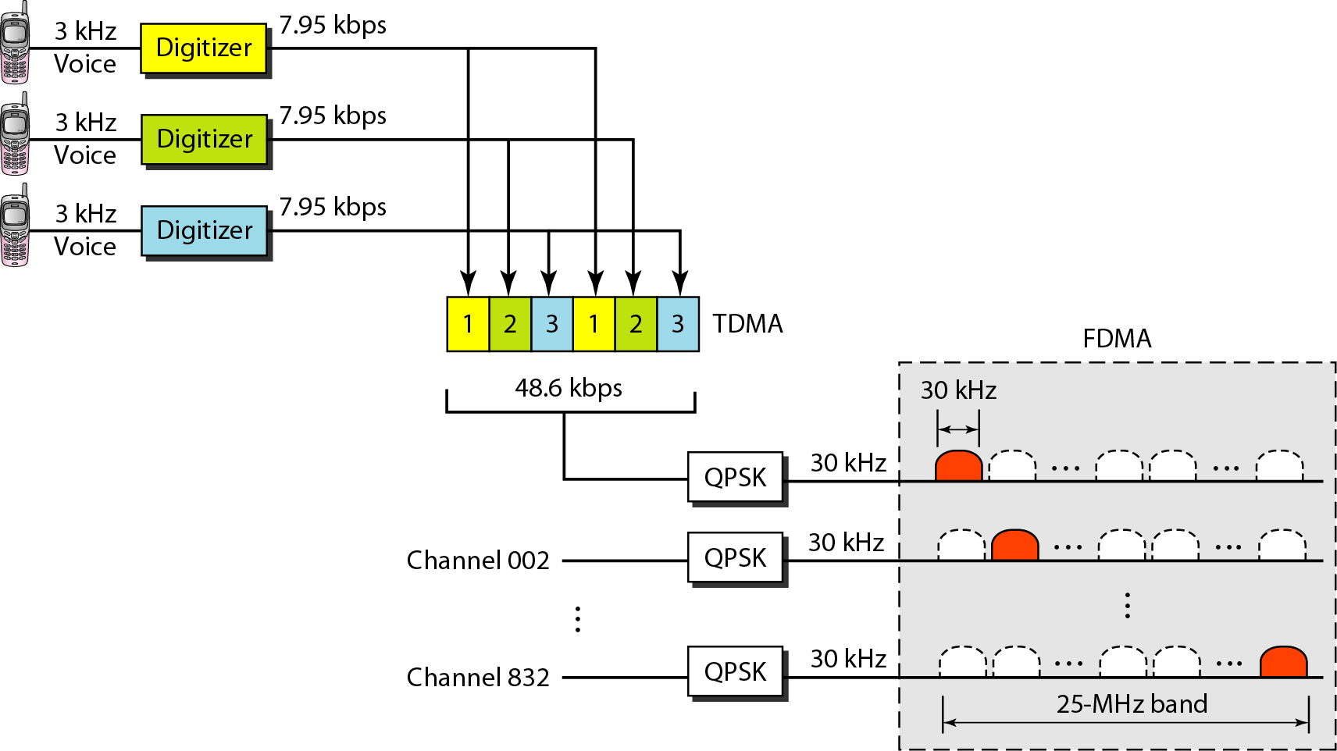
Figure 16.6 D-AMPS

Slide 10
Note
D-AMPS, or IS-136, is a digital cellular phone system using TDMA and FDMA.

Slide 11
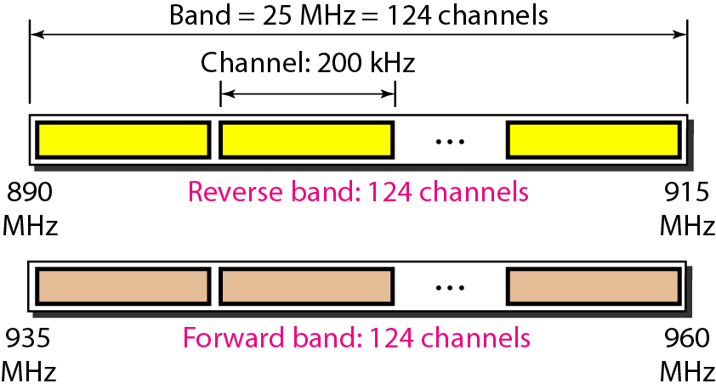
Figure 16.7 GSM bands

Slide 12
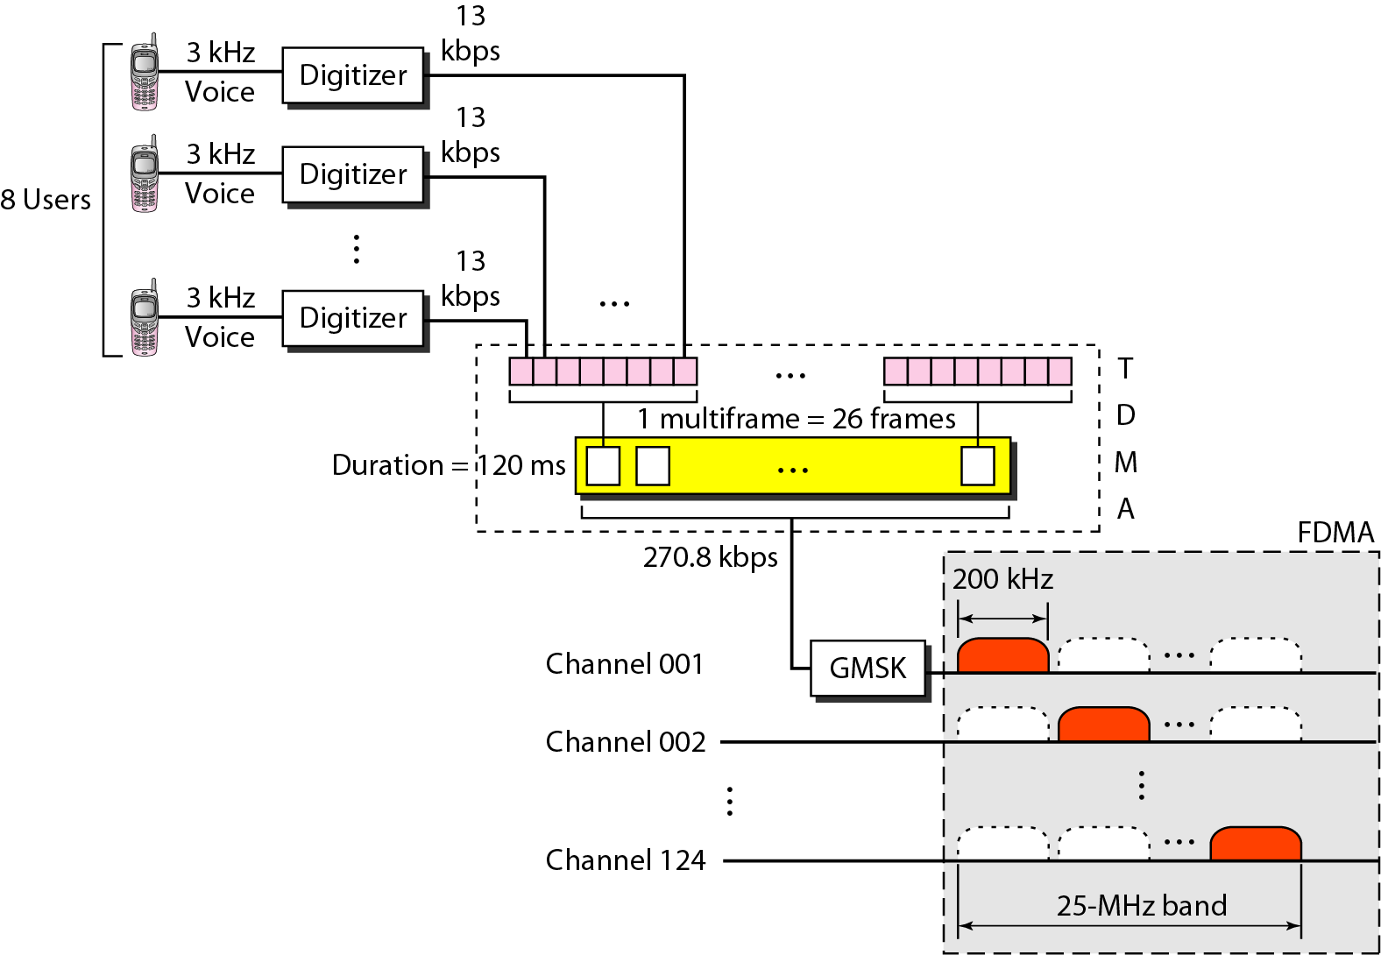
Figure 16.8 GSM

Slide 13
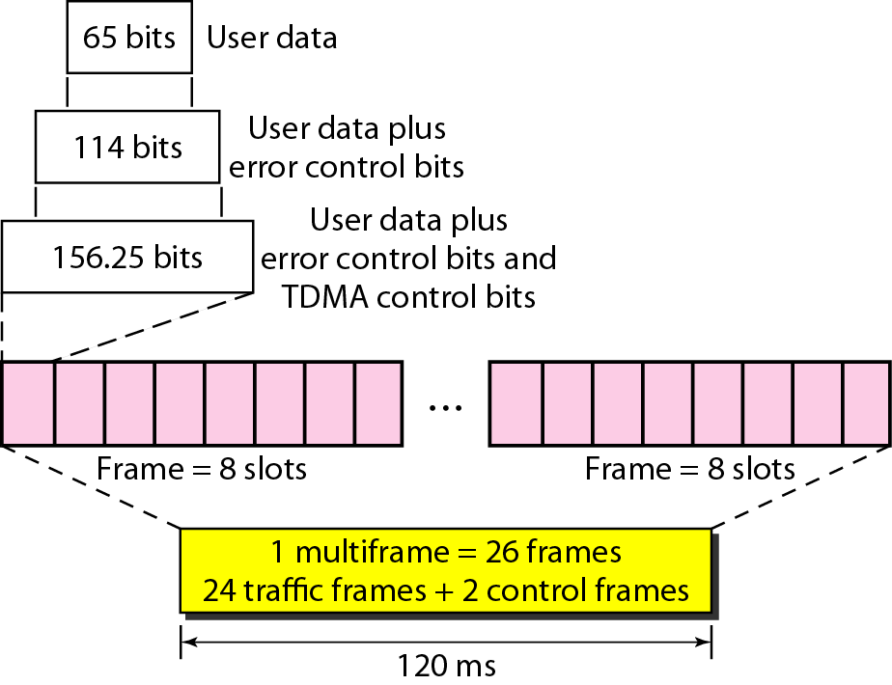
Figure 16.9 Multiframe components

Slide 14
Note
GSM is a digital cellular phone system using TDMA and FDMA.

Slide 15
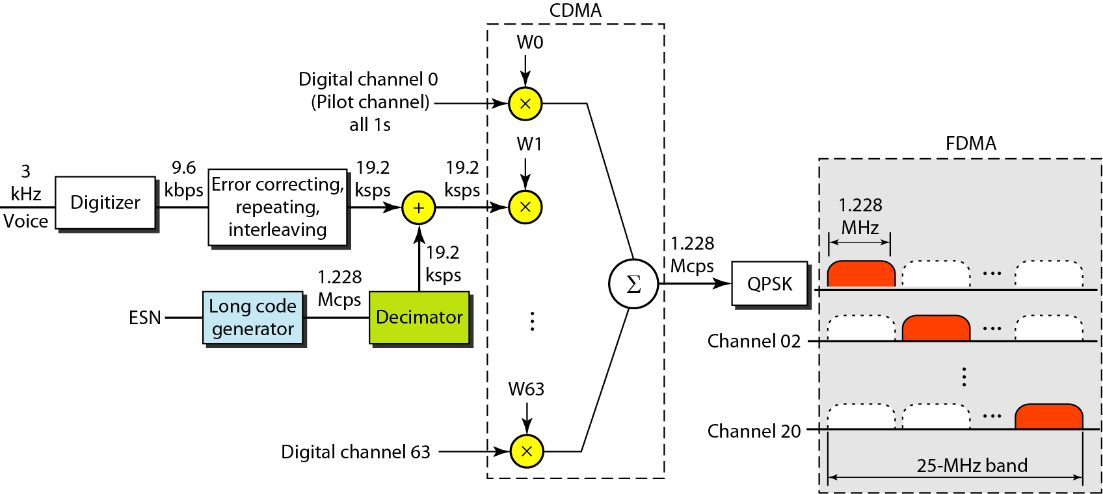
Figure 16.10 IS-95 forward transmission

Slide 16
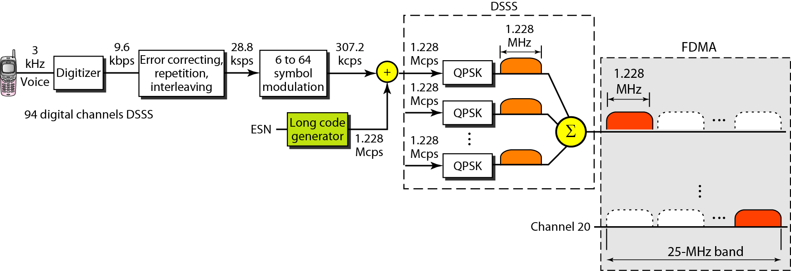
Figure 16.11 IS-95 reverse transmission

Slide 17
Note
IS-95 is a digital cellular phone system using CDMA/DSSS and FDMA.

Slide 18
Note
The main goal of third-generation cellular telephony is to provide
universal personal communication.

Slide 19
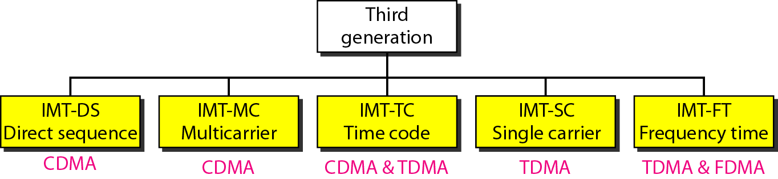
Figure 16.12 IMT-2000 radio interfaces

Slide 20
16-2 SATELLITE NETWORKS
A satellite network is a combination of nodes, some of which are satellites, that provides communication from one point on the Earth to another. A node in the network can be a satellite, an Earth station, or an end-user terminal or telephone.
Topics discussed in this section:
Orbits Footprint
Three Categories of Satellites
GEO Satellites
MEO Satellites
LEO Satellites

Slide 21
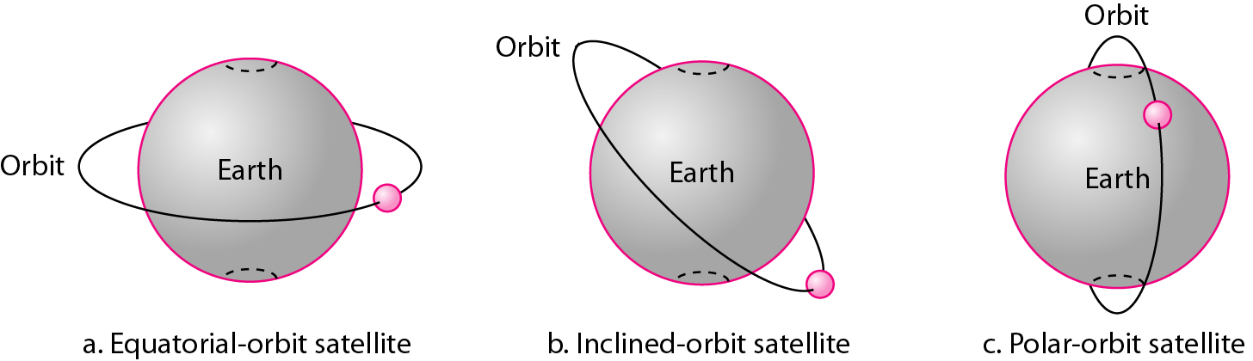
Figure 16.13 Satellite orbits

Slide 22
Example 16.1
What is the period of the Moon, according to Kepler’s law?
Here C is a constant approximately equal to 1/100. The period is in seconds and the distance in kilometers.

Slide 23
Example 16.1 (continued)
Solution
The Moon is located approximately 384,000 km above the Earth. The radius of the Earth is 6378 km. Applying the formula, we get.

Slide 24
Example 16.2
According to Kepler’s law, what is the period of a satellite that is located at an orbit approximately 35,786 km above the Earth?
Solution
Applying the formula, we get

Slide 25
Example 16.2 (continued)
This means that a satellite located at 35,786 km has a period of 24 h, which is the same as the rotation period of the Earth. A satellite like this is said to be stationary to the Earth. The orbit, as we will see, is called a geosynchronous orbit.

Slide 26
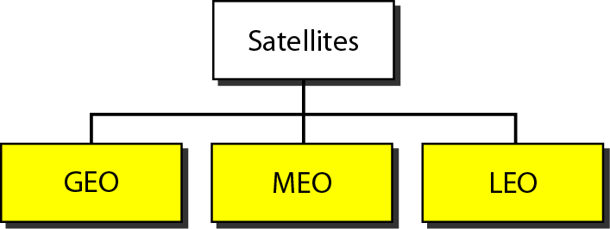
Figure 16.14 Satellite categories

Slide 27
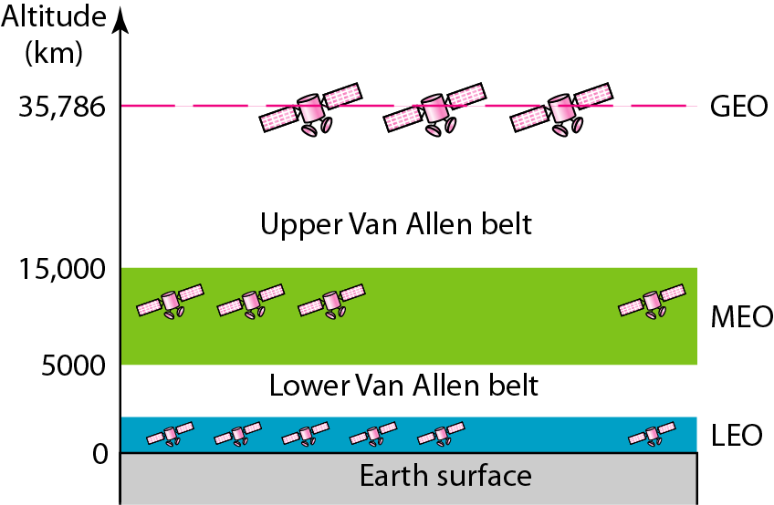
Figure 16.15 Satellite orbit altitudes

Slide 28
Table 16.1 Satellite frequency bands

Slide 29
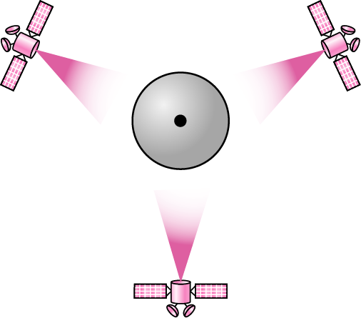
Figure 16.16 Satellites in geostationary orbit

Slide 30
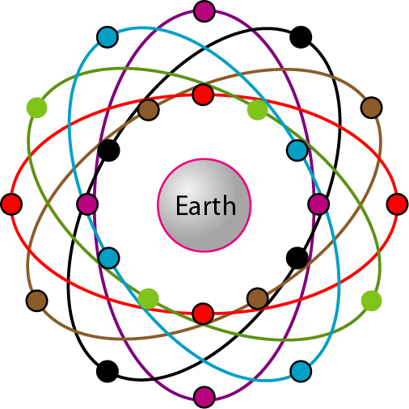
Figure 16.17 Orbits for global positioning system (GPS) satellites

Slide 31
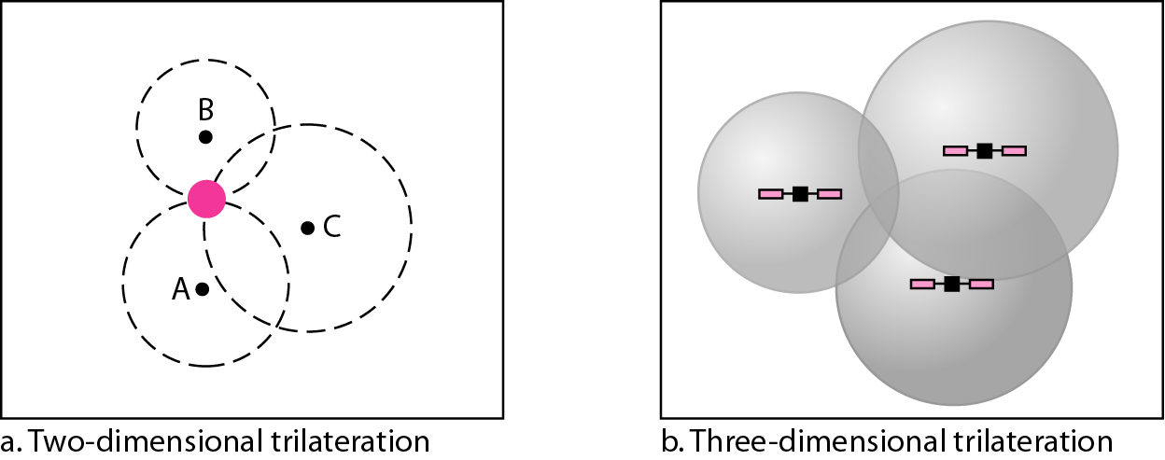
Figure 16.18 Trilateration

Slide 32
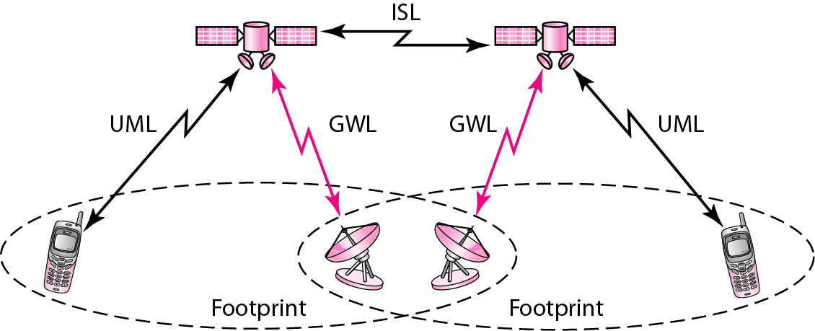
Figure 16.19 LEO satellite system

Slide 33
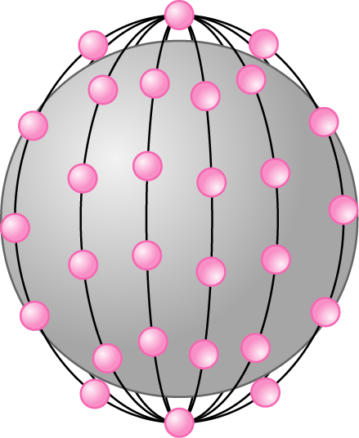
Figure 16.20 Iridium constellation

Slide 34
Note
The Iridium system has 66 satellites in six LEO orbits, each at an altitude of 750 km.

Slide 35
Note
Iridium is designed to provide direct worldwide voice and data communication using
handheld terminals, a service similar to cellular telephony but on a global scale.

Slide 36
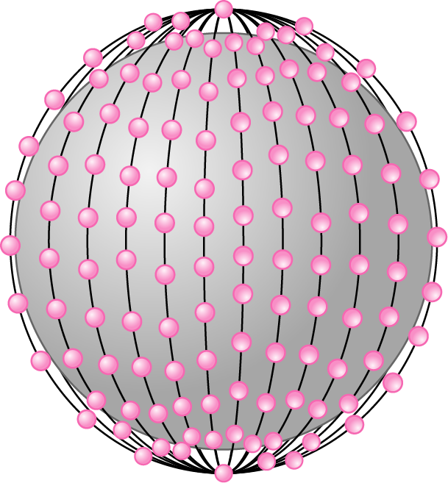
Figure 16.20 Teledesic

Slide 37
Note
Teledesic has 288 satellites in 12 LEO orbits, each at an altitude of 1350 km.

