Slide 1

Chapter 17
SONET/SDH
Copyright © The McGraw-Hill Companies, Inc. Permission required for reproduction or display.

Slide 2

Note
SONET was developed by ANSI; SDH was developed by ITU-T.

Slide 3
17-1 ARCHITECTURE
Let us first introduce the architecture of a SONET system: signals, devices, and connections.
Topics discussed in this section:
Signals SONET Devices Connections

Slide 4
Table 17.1 SONET/SDH rates

Slide 5
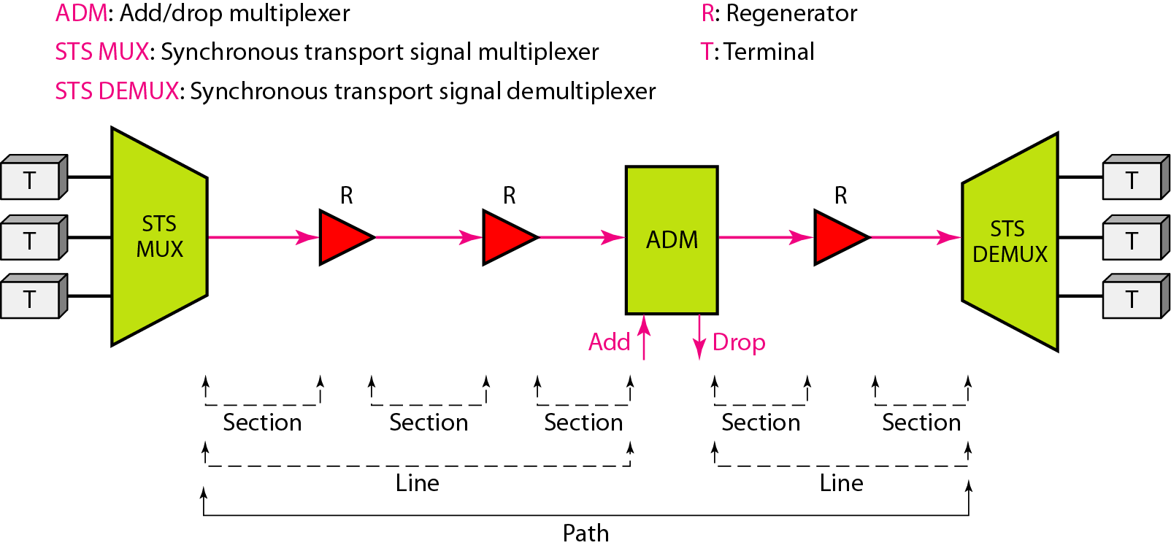
Figure 17.1 A simple network using SONET equipment

Slide 6
17-2 SONET LAYERS
The SONET standard includes four functional layers: the photonic, the section, the line, and the path layer. They correspond to both the physical and the data link layers.
Topics discussed in this section:
Path Layer
Line Layer Section Layer
Photonic Layer
Device–Layer Relationships

Slide 7
Note
SONET defines four layers: path, line, section, and photonic.

Slide 8
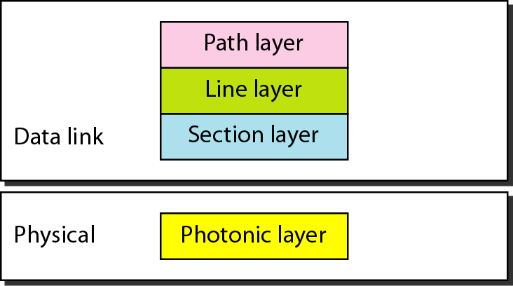
Figure 17.2 SONET layers compared with OSI or the Internet layers

Slide 9
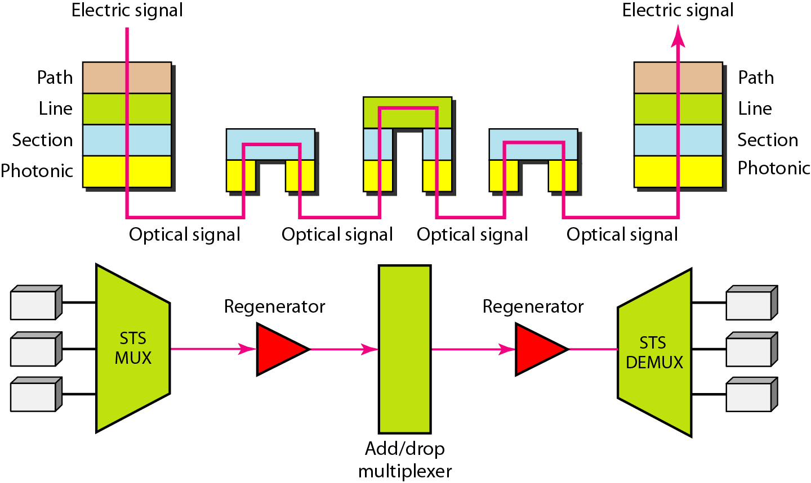
Figure 17.3 Device–layer relationship in SONET

Slide 10
17-3 SONET FRAMES
Each synchronous transfer signal STS-n is composed of 8000 frames. Each frame is a two-dimensional matrix of bytes with 9 rows by 90 × n columns.
Topics discussed in this section:
Frame, Byte, and Bit Transmission STS-1 Frame Format Encapsulation

Slide 11
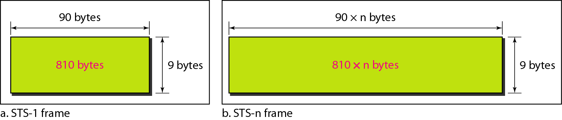
Figure 17.4 An STS-1 and an STS-n frame

Slide 12
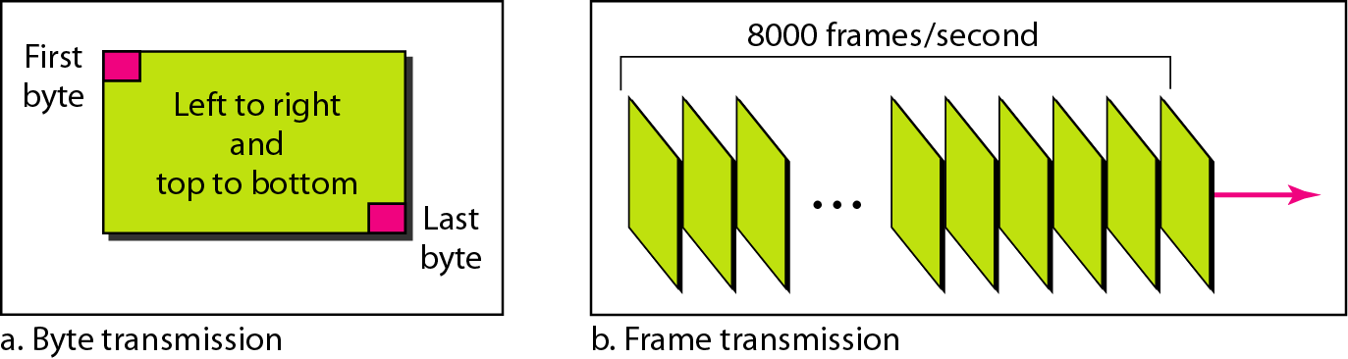
Figure 17.5 STS-1 frames in transmission

Slide 13
Note
A SONET STS-n
signal is transmitted at 8000 frames per second.

Slide 14
Note
Each byte in a SONET frame can carry a digitized voice channel.

Slide 15
Example 17.1
Find the data rate of an STS-1 signal.
Solution
STS-1, like other STS signals, sends 8000 frames per second. Each STS-1 frame is made of 9 by (1 × 90) bytes. Each byte is made of 8 bits. The data rate is

Slide 16
Example 17.2
Find the data rate of an STS-3 signal.
Solution
STS-3, like other STS signals, sends 8000 frames per second. Each STS-3 frame is made of 9 by (3 × 90) bytes. Each byte is made of 8 bits. The data rate is

Slide 17
Note
In SONET, the data rate of an STS-n
signal is n times the data rate
of an STS-1 signal.

Slide 18
Example 17.3
What is the duration of an STS-1 frame? STS-3 frame? STS-n frame?
Solution
In SONET, 8000 frames are sent per second. This means that the duration of an STS-1, STS-3, or STS-n frame is the same and equal to 1/8000 s, or 125 μs.

Slide 19
Note
In SONET, the duration of any frame is 125 μs.

Slide 20
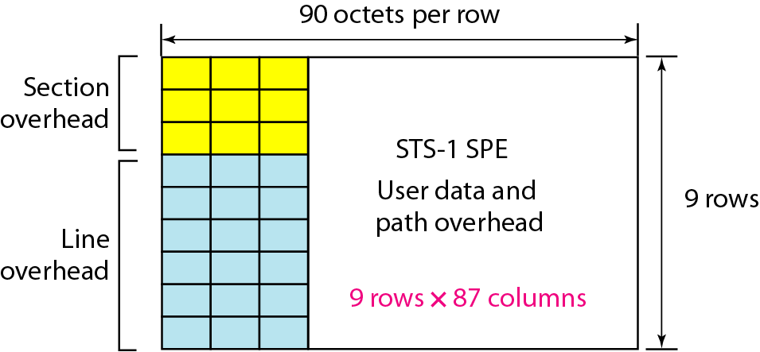
Figure 17.6 STS-1 frame overheads

Slide 21
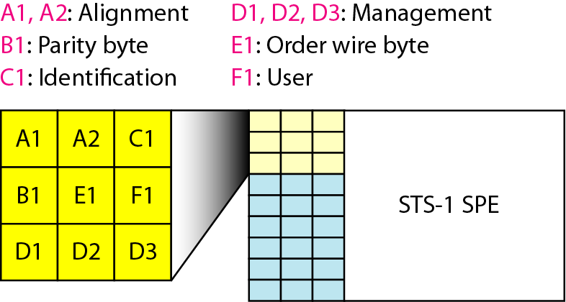
Figure 17.7 STS-1 frame: section overhead

Slide 22
Note
Section overhead is recalculated for each SONET device
(regenerators and multiplexers).

Slide 23
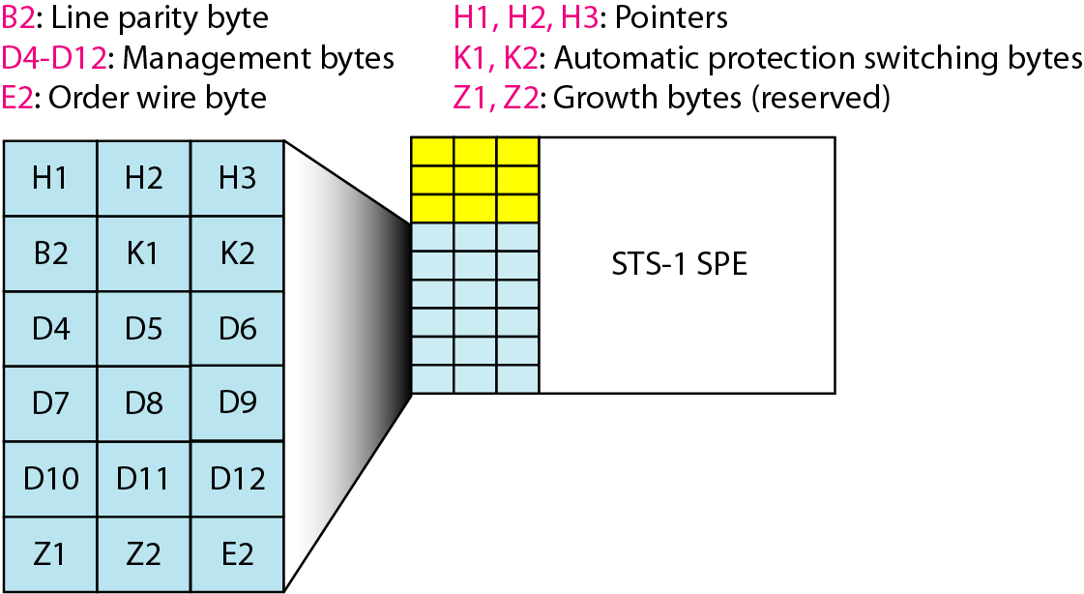
Figure 17.8 STS-1 frame: line overhead

Slide 24
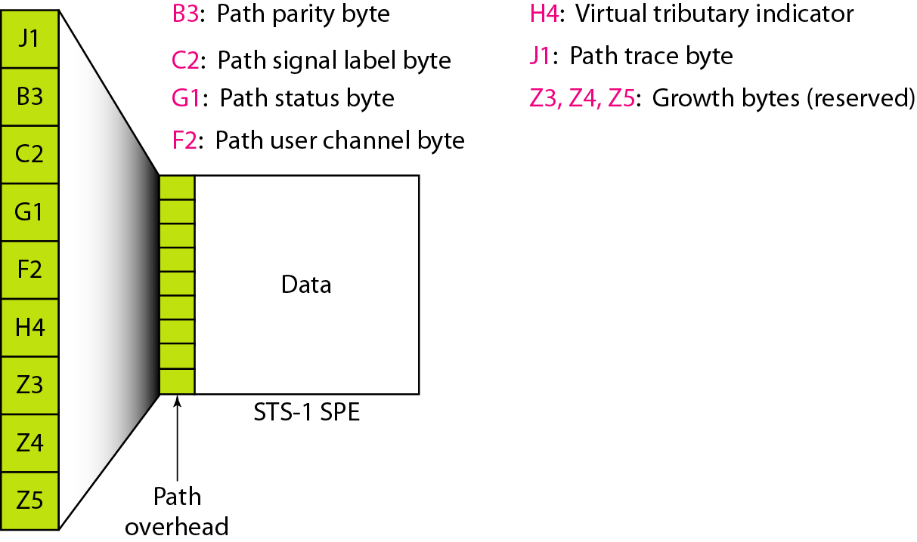
Figure 17.9 STS-1 frame: path overhead

Slide 25
Note
Path overhead is only calculated for end-to-end (at STS multiplexers).

Slide 26
Table 17.2 Overhead bytes

Slide 27
Example 17.4
What is the user data rate of an STS-1 frame (without considering the overheads)?
Solution
The user data part in an STS-1 frame is made of 9 rows and 86 columns. So we have

Slide 28
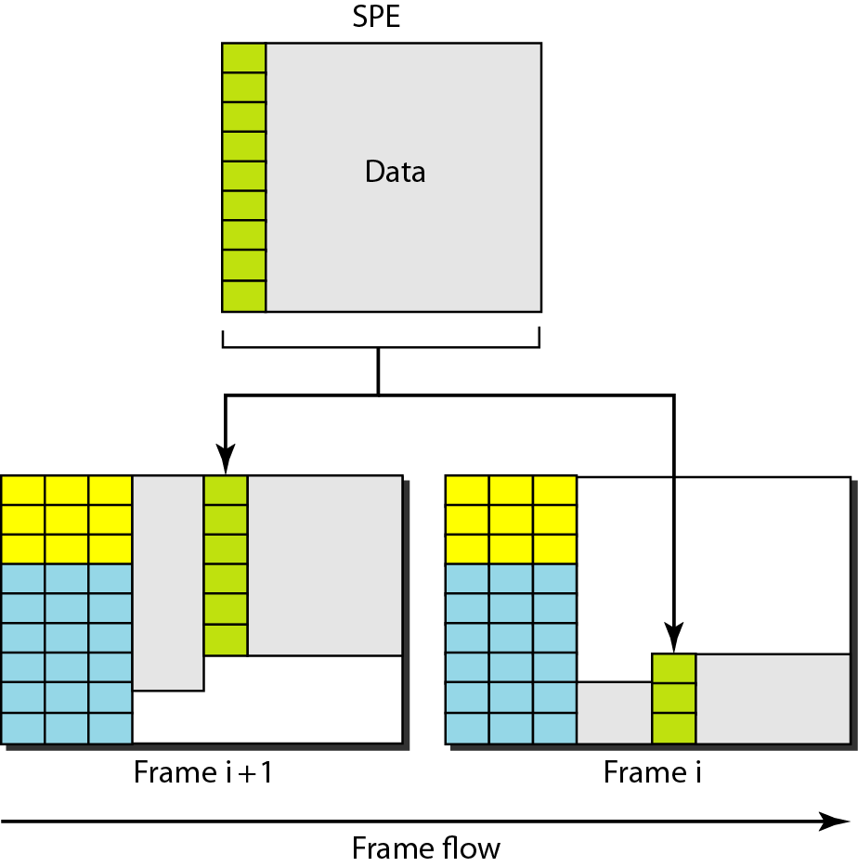
Figure 17.10 Offsetting of SPE related to frame boundary

Slide 29
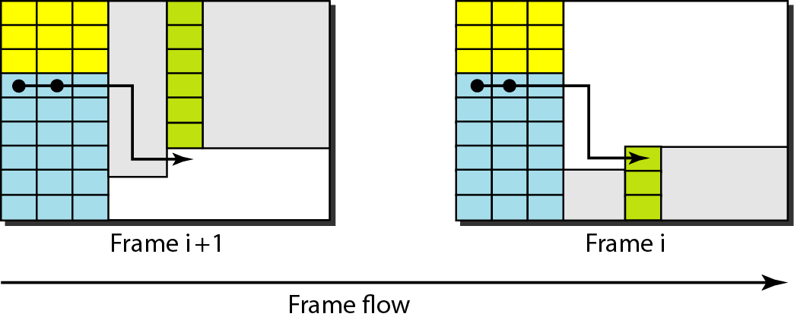
Figure 17.11 The use of H1 and H2 pointers to show the start of an SPE in a frame

Slide 30
Example 17.5
What are the values of H1 and H2 if an SPE starts at byte number 650?
Solution
The number 650 can be expressed in four hexadecimal digits as 0x028A. This means the value of H1 is 0x02 and the value of H2 is 0x8A.

Slide 31
17-4 STS MULTIPLEXING
In SONET, frames of lower rate can be synchronously time-division multiplexed into a higher-rate frame. For example, three STS-1 signals (channels) can be combined into one STS-3 signal (channel), four STS-3s can be multiplexed into one STS-12, and so on.
Topics discussed in this section:
Byte Interleaving Concatenated Signal Add/Drop Multiplexer

Slide 32
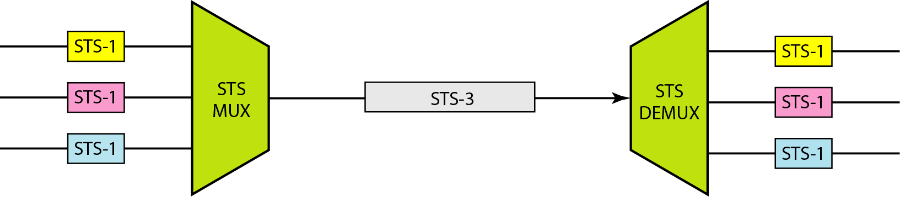
Figure 17.12 STS multiplexing/demultiplexing

Slide 33
Note
In SONET, all clocks in the network are locked to a master clock.

Slide 34
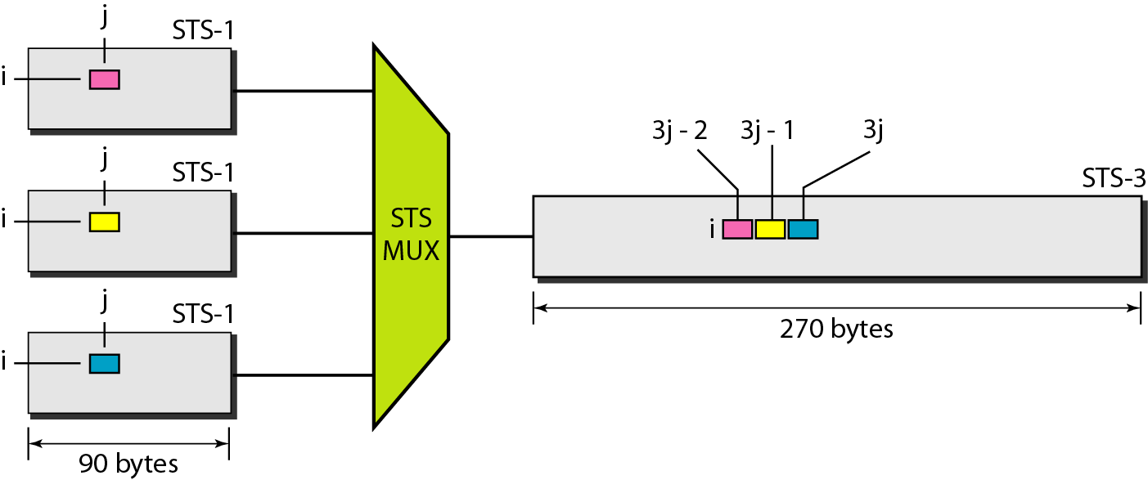
Figure 17.13 Byte interleaving

Slide 35
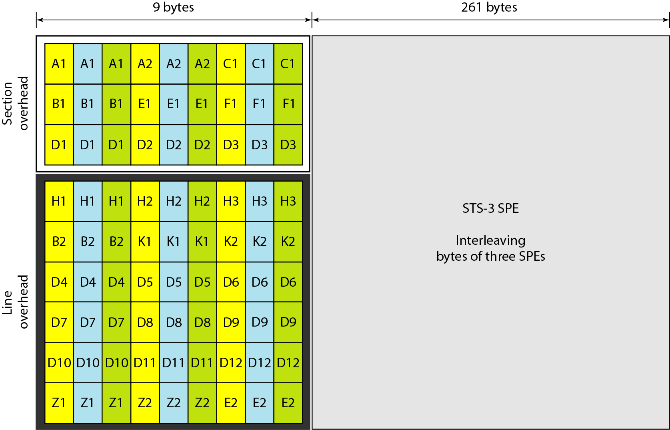
Figure 17.14 An STS-3 frame

Slide 36
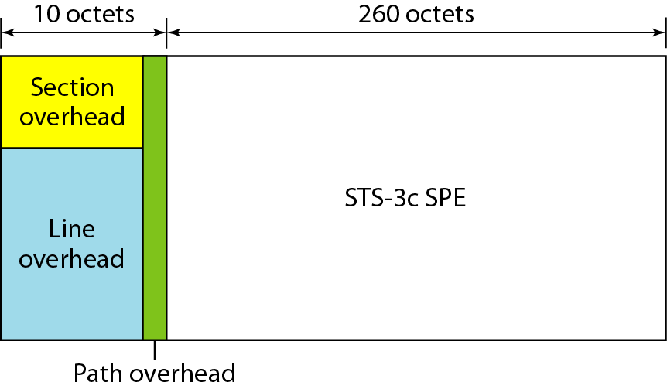
Figure 17.15 A concatenated STS-3c signal

Slide 37
Note
An STS-3c signal can carry 44 ATM cells as its SPE.

Slide 38
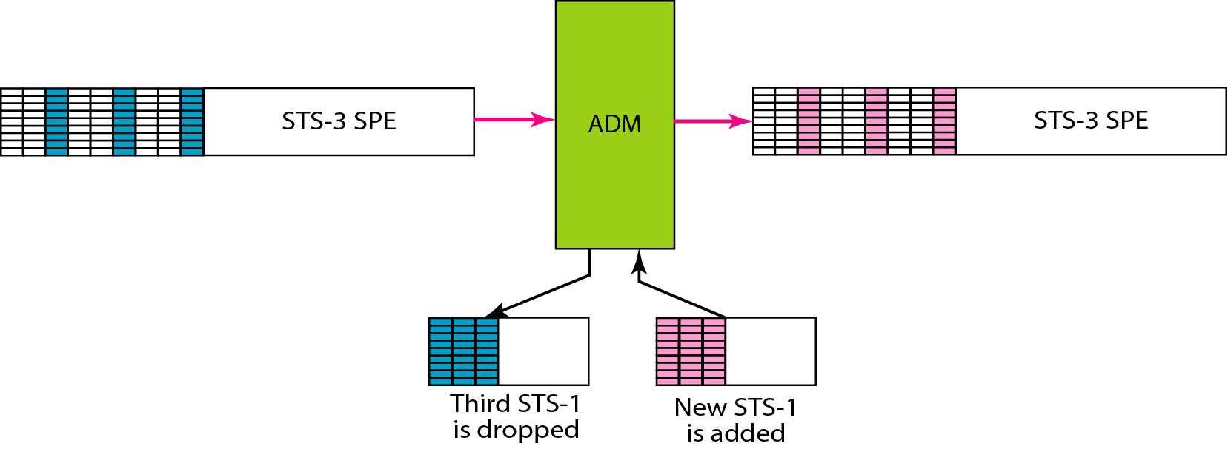
Figure 17.16 Dropping and adding STS-1 frames in an add/drop multiplexer

Slide 39
17-5 SONET NETWORKS
Using SONET equipment, we can create a SONET network that can be used as a high-speed backbone carrying loads from other networks. We can roughly divide SONET networks into three categories: linear, ring, and mesh networks.
Topics discussed in this section:
Linear Networks Ring Networks Mesh Networks

Slide 40
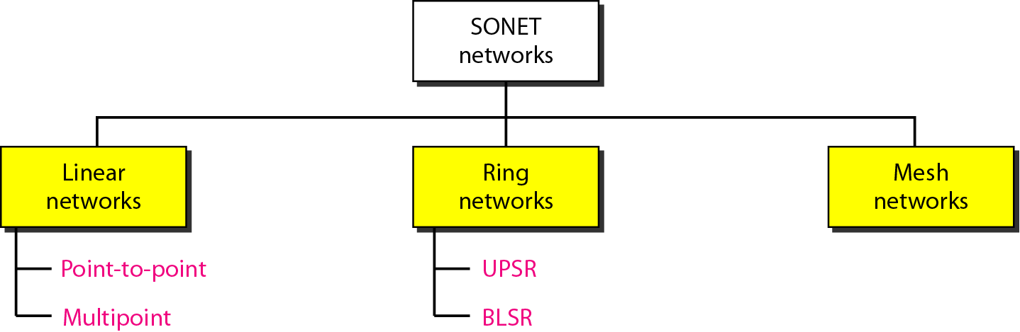
Figure 17.17 Taxonomy of SONET networks

Slide 41
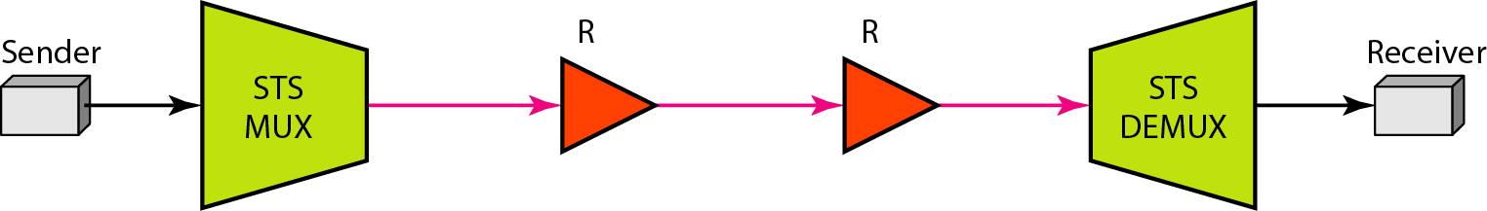
Figure 17.18 A point-to-point SONET network

Slide 42
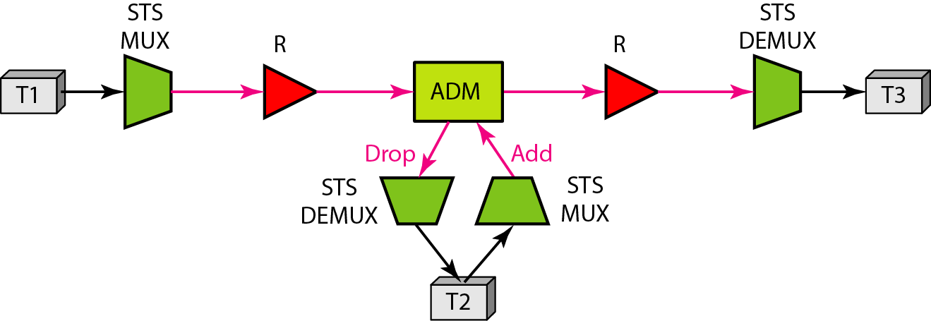
Figure 17.19 A multipoint SONET network

Slide 43
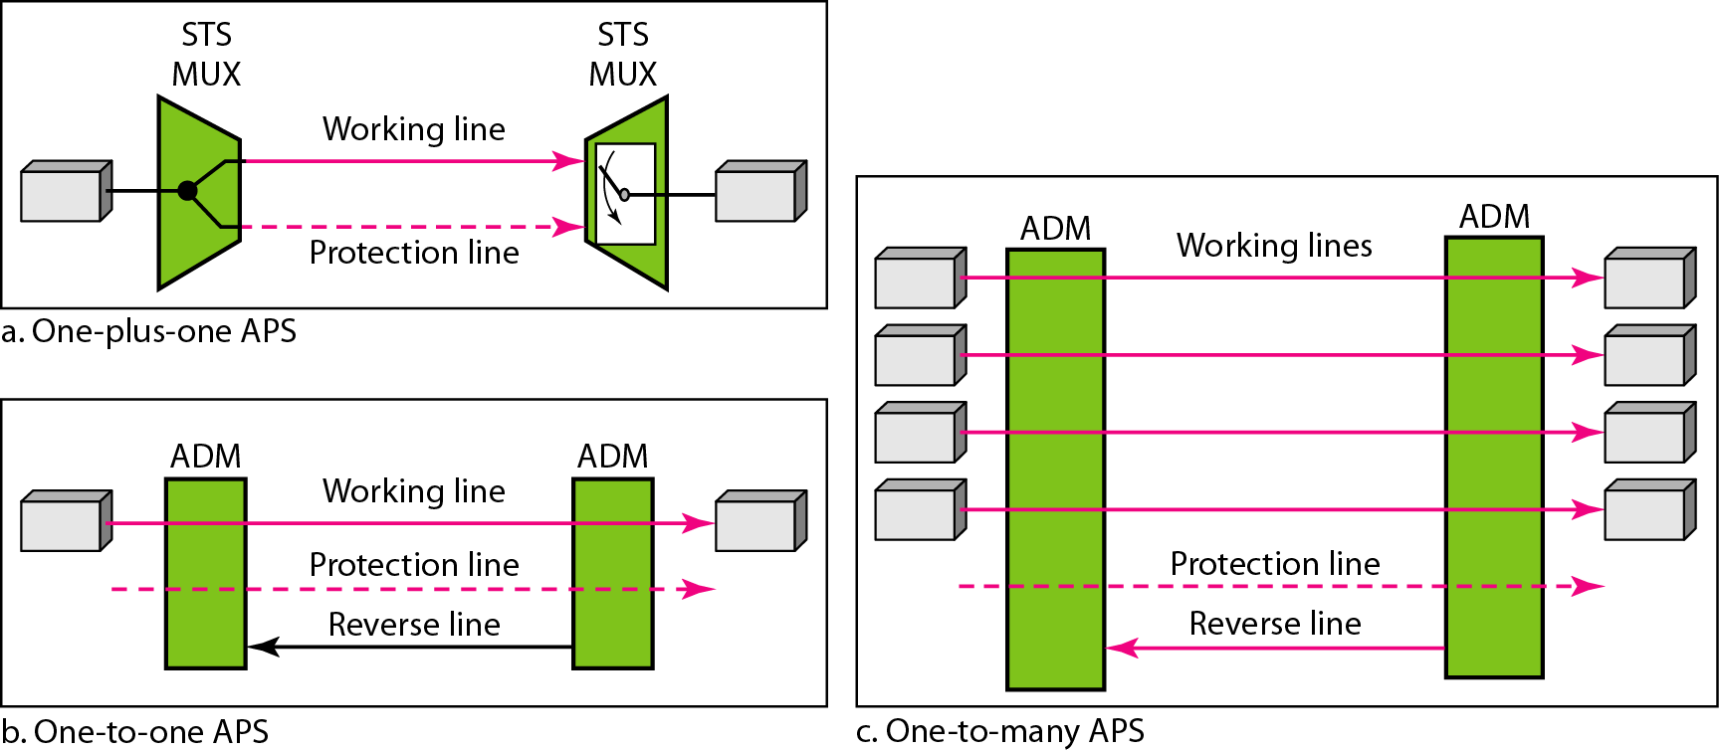
Figure 17.20 Automatic protection switching in linear networks

Slide 44
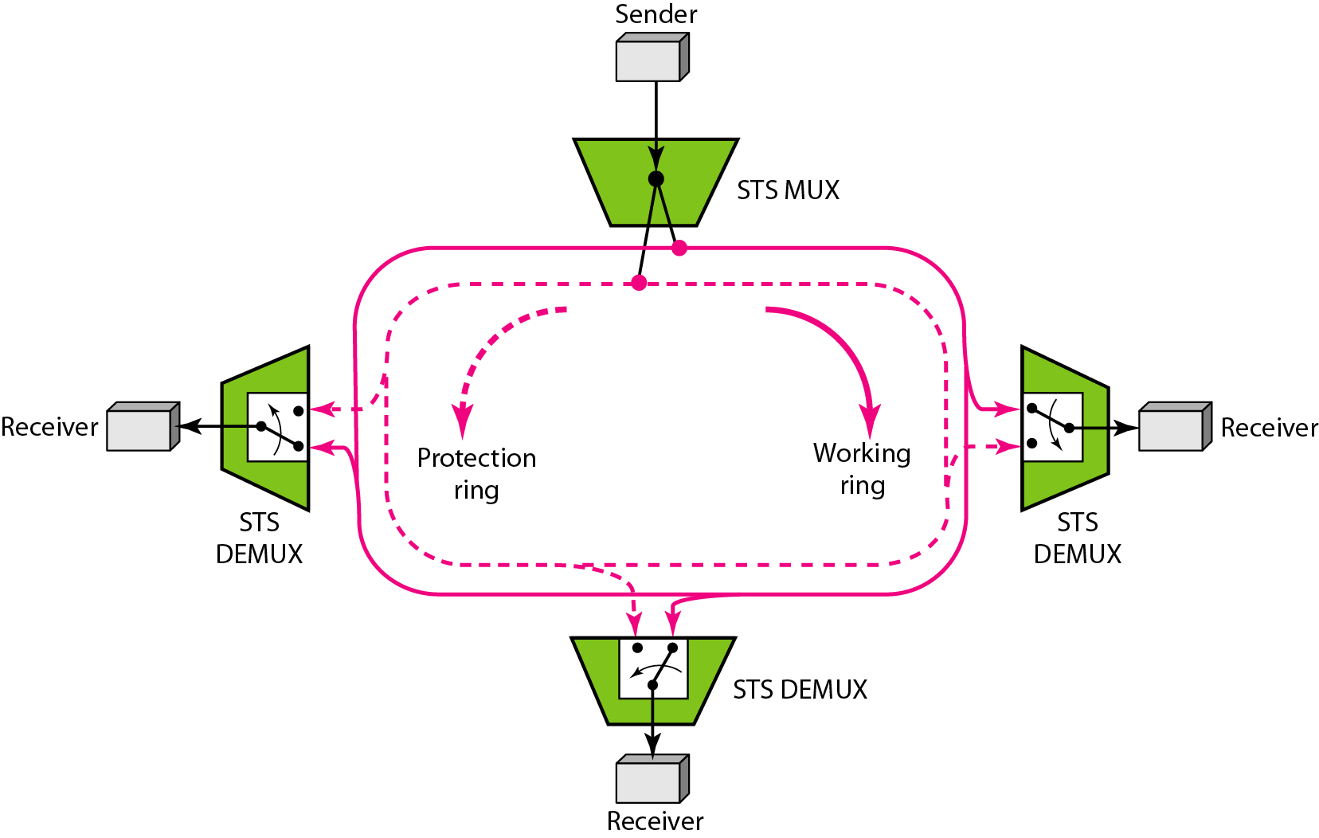
Figure 17.21 A unidirectional path switching ring

Slide 45
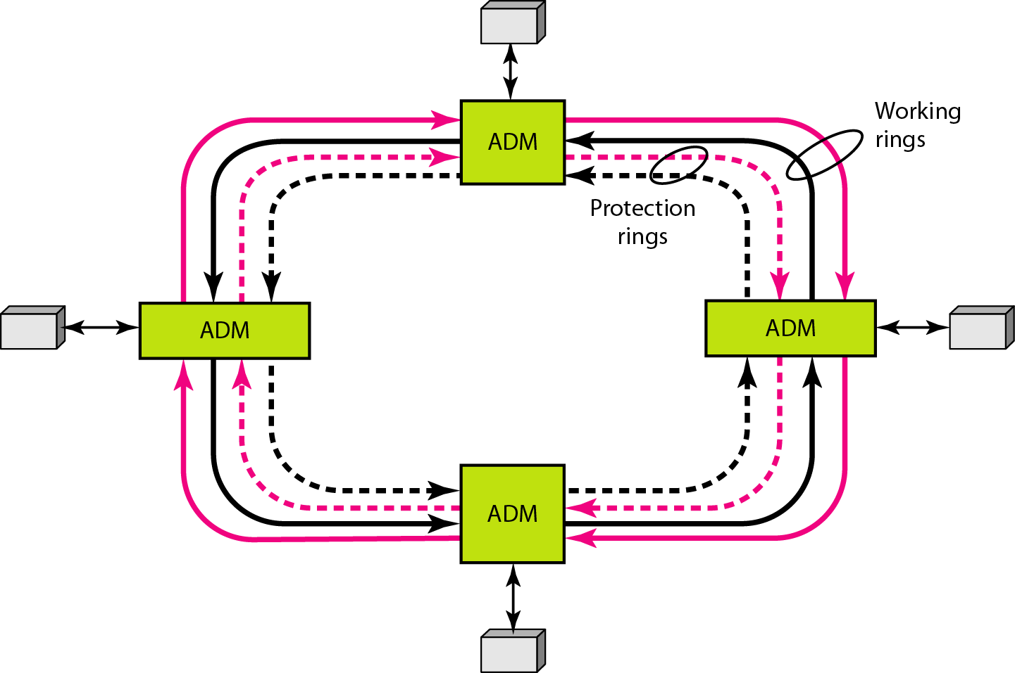
Figure 17.22 A bidirectional line switching ring

Slide 46
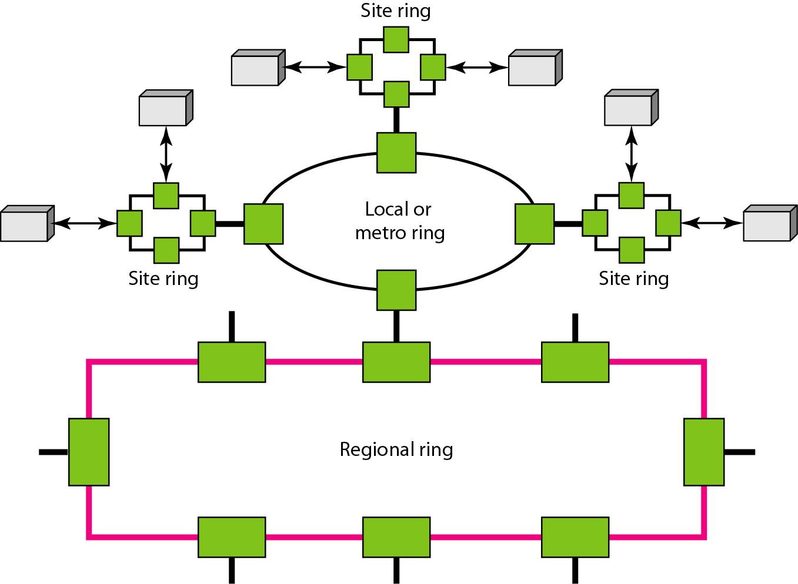
Figure 17.23 A combination of rings in a SONET network

Slide 47
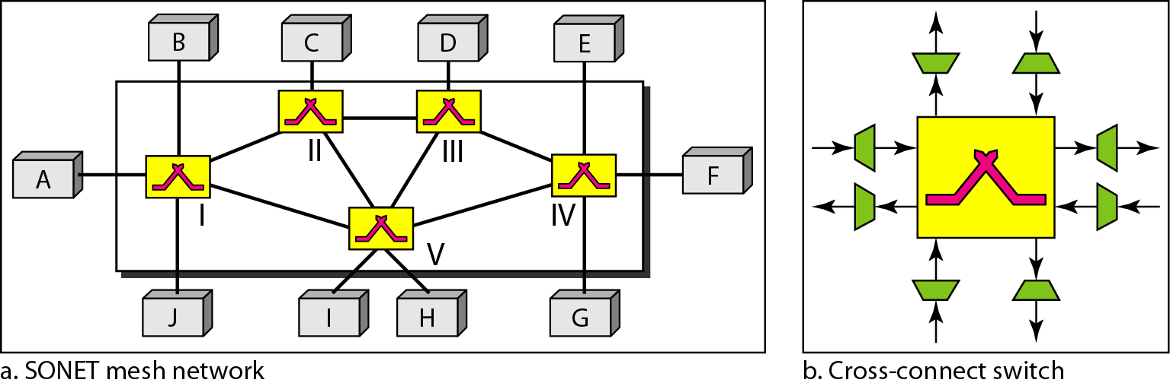
Figure 17.24 A mesh SONET network

Slide 48
17-6 VIRTUAL TRIBUTARIES
SONET is designed to carry broadband payloads. Current digital hierarchy data rates, however, are lower than STS-1. To make SONET backward-compatible with the current hierarchy, its frame design includes a system of virtual tributaries (VTs). A virtual tributary is a partial payload that can be inserted into an STS-1.
Topics discussed in this section:
Types of VTs

Slide 49
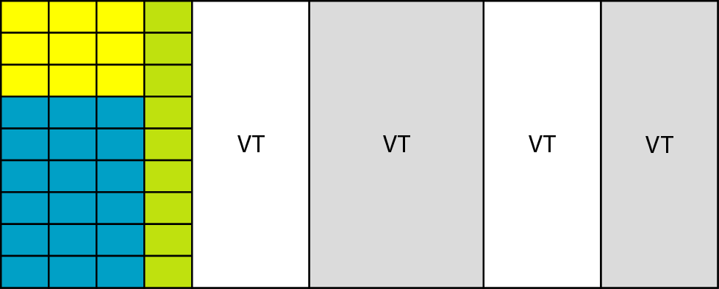
Figure 17.25 Virtual tributaries

Slide 50
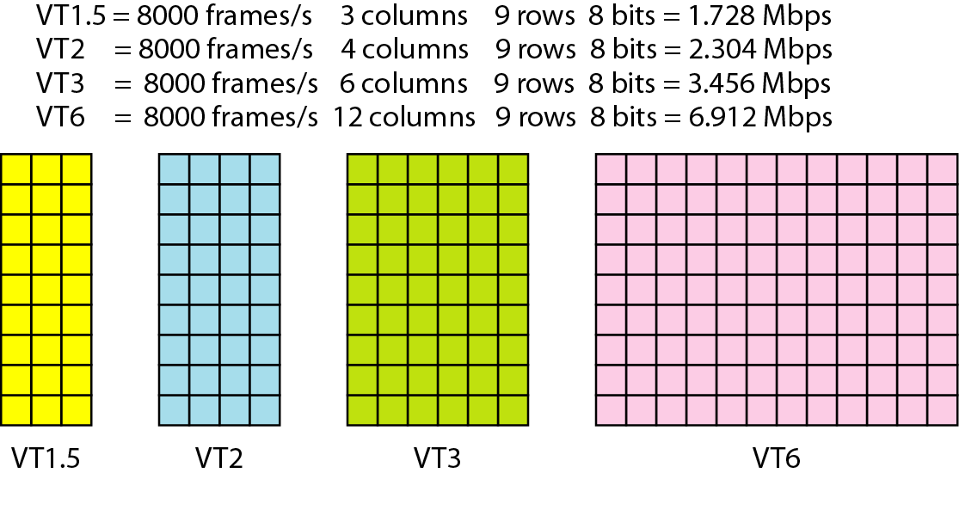
Figure 17.26 Virtual tributary types

