Slide 1

Chapter 18
Virtual-Circuit Networks:
Frame Relay and ATM
Copyright © The McGraw-Hill Companies, Inc. Permission required for reproduction or display.

Slide 2
18-1 FRAME RELAY
Frame Relay is a virtual-circuit wide-area network that was designed in response to demands for a new type of WAN in the late 1980s and early 1990s.
Topics discussed in this section:
Architecture Frame Relay Layers
Extended Address
FRADs
VOFR
LMI

Slide 3
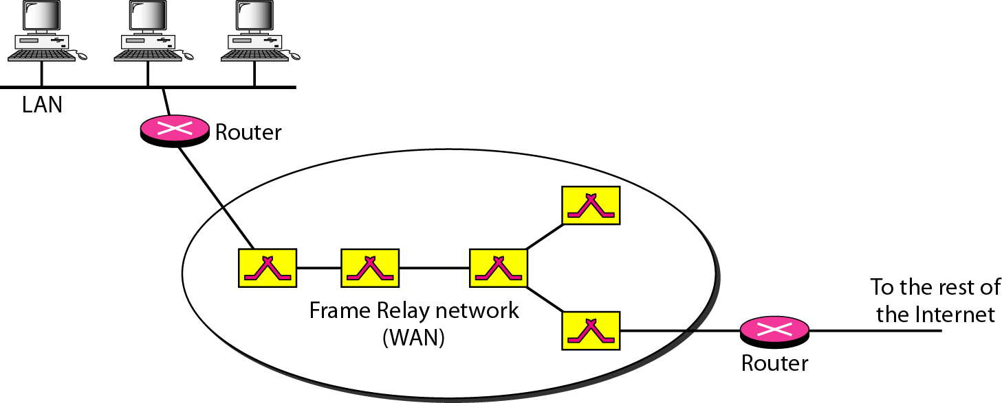
Figure 18.1 Frame Relay network

Slide 4

Note
VCIs in Frame Relay are called DLCIs.

Slide 5
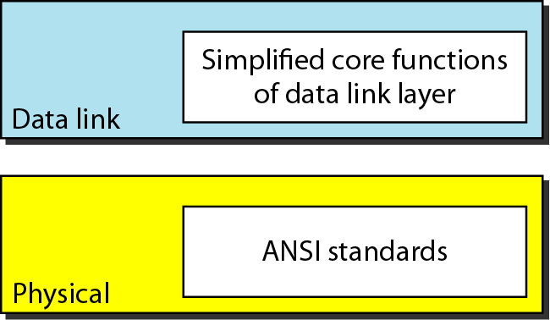
Figure 18.2 Frame Relay layers

Slide 6
Note
Frame Relay operates only at the physical and data link layers.

Slide 7
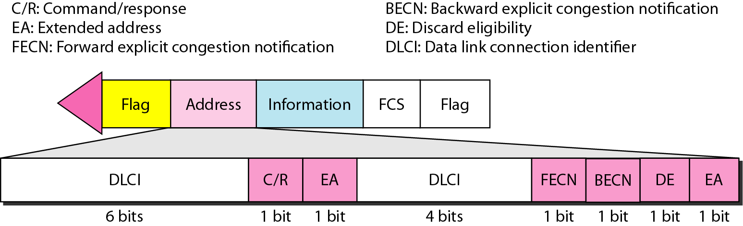
Figure 18.3 Frame Relay frame

Slide 8
Note
Frame Relay does not provide flow or error control; they must be provided
by the upper-layer protocols.

Slide 9
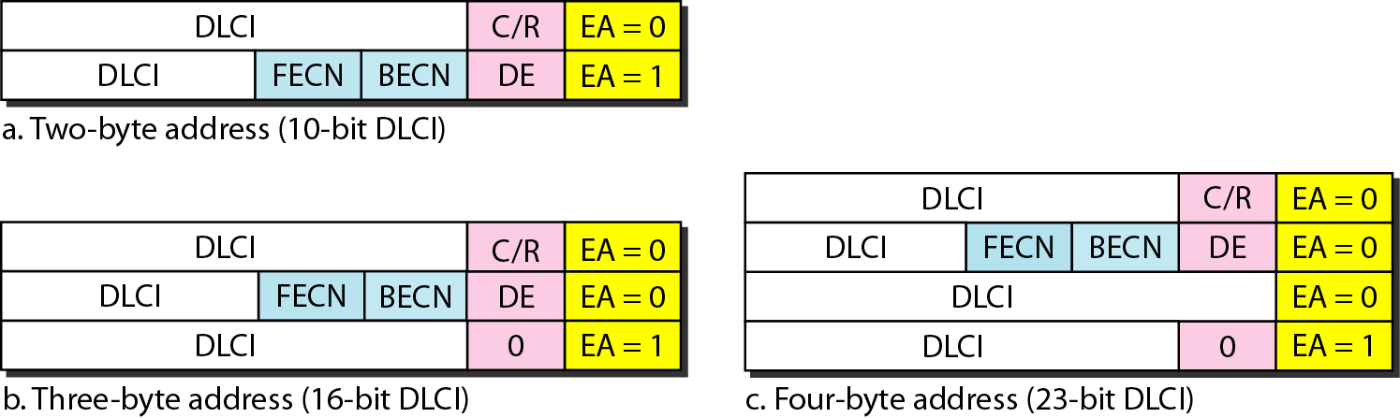
Figure 18.4 Three address formats

Slide 10
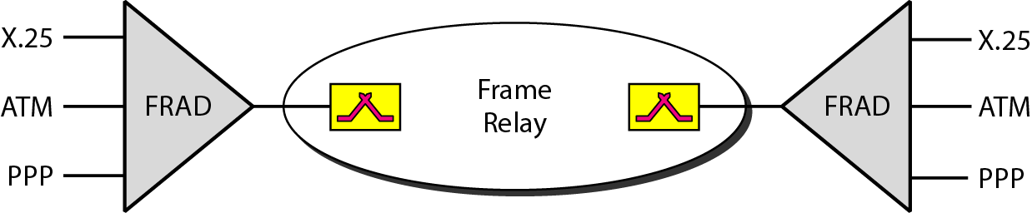
Figure 18.5 FRAD

Slide 11
18-2 ATM
Asynchronous Transfer Mode (ATM) is the cell relay protocol designed by the ATM Forum and adopted by the ITU-T.
Topics discussed in this section:
Design Goals Problems Architecture
Switching
ATM Layers

Slide 12
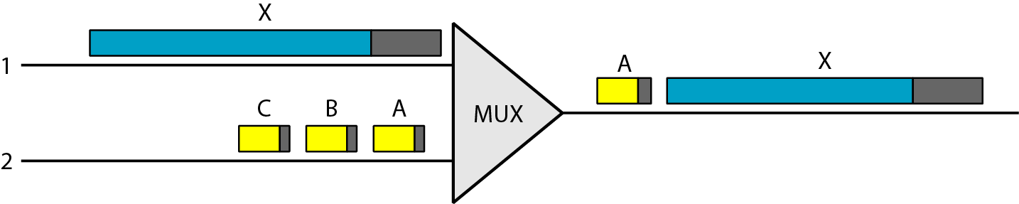
Figure 18.6 Multiplexing using different frame sizes

Slide 13
Note
A cell network uses the cell as the basic unit of data exchange.
A cell is defined as a small, fixed-size block of information.

Slide 14
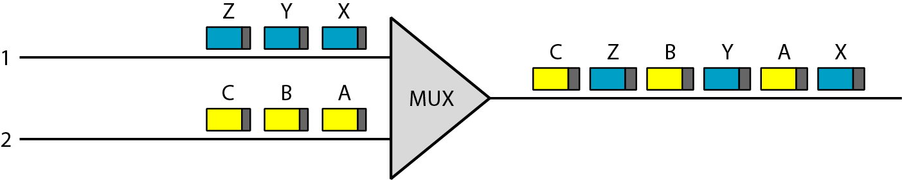
Figure 18.7 Multiplexing using cells

Slide 15
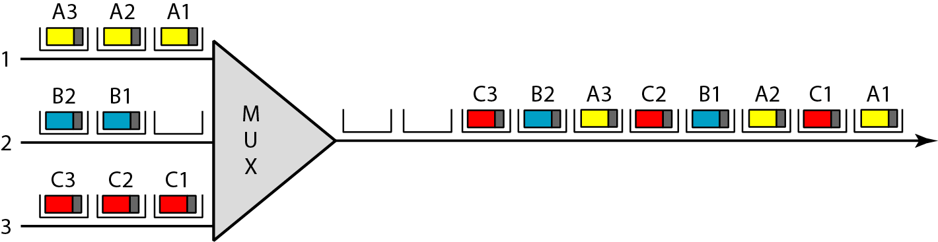
Figure 18.8 ATM multiplexing

Slide 16
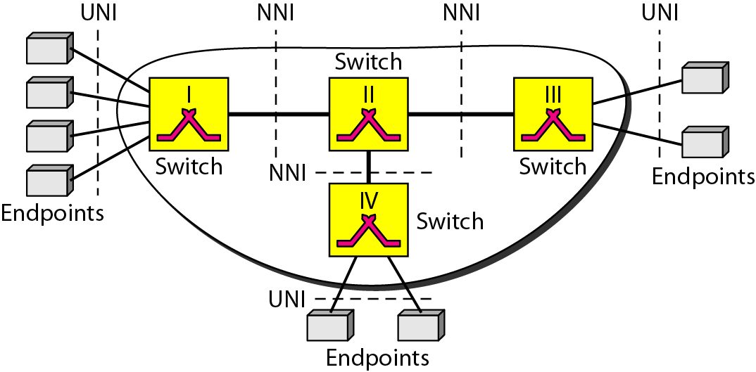
Figure 18.9 Architecture of an ATM network

Slide 17
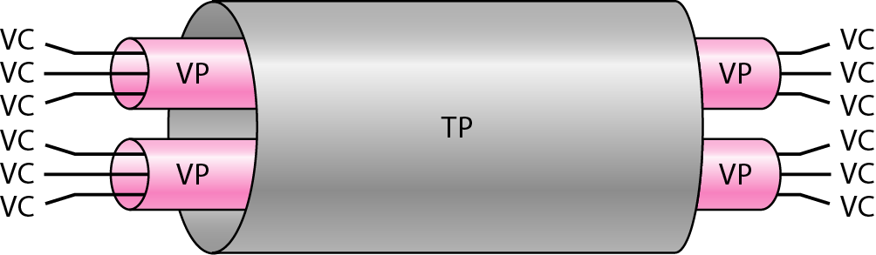
Figure 18.10 TP, VPs, and VCs

Slide 18
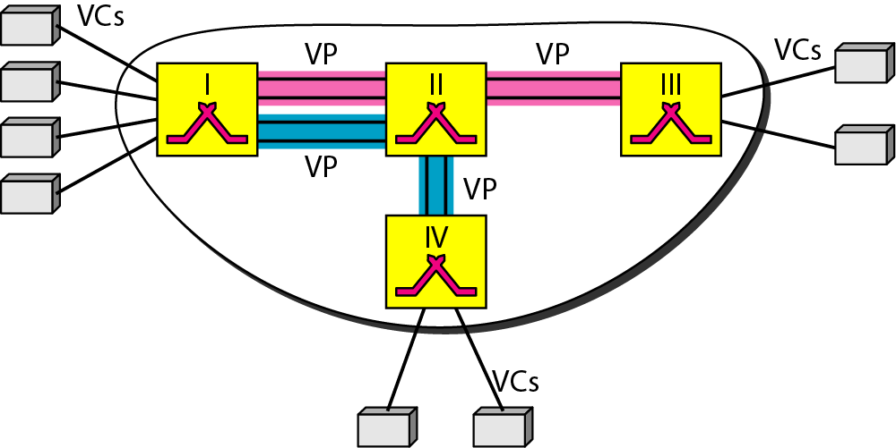
Figure 18.11 Example of VPs and VCs

Slide 19
Note
Note that a virtual connection is defined by a pair of numbers: the VPI and the VCI.

Slide 20
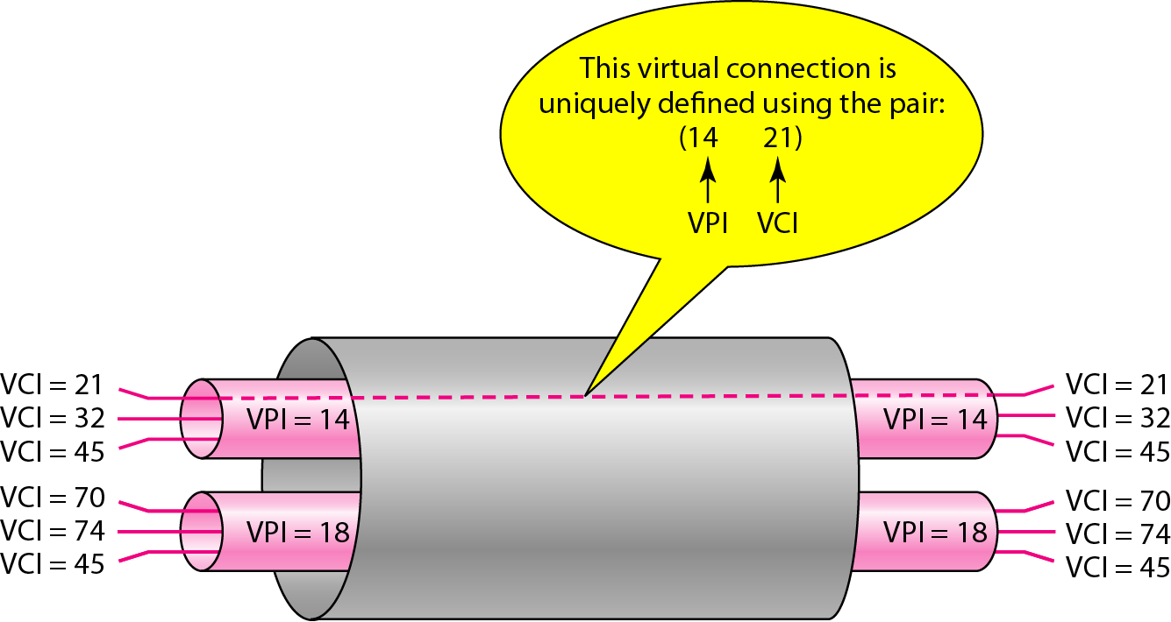
Figure 18.12 Connection identifiers

Slide 21
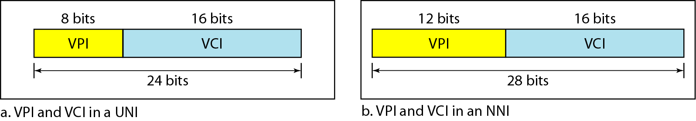
Figure 18.13 Virtual connection identifiers in UNIs and NNIs

Slide 22
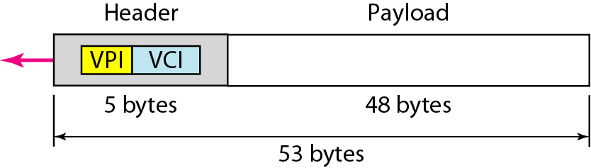
Figure 18.14 An ATM cell

Slide 23
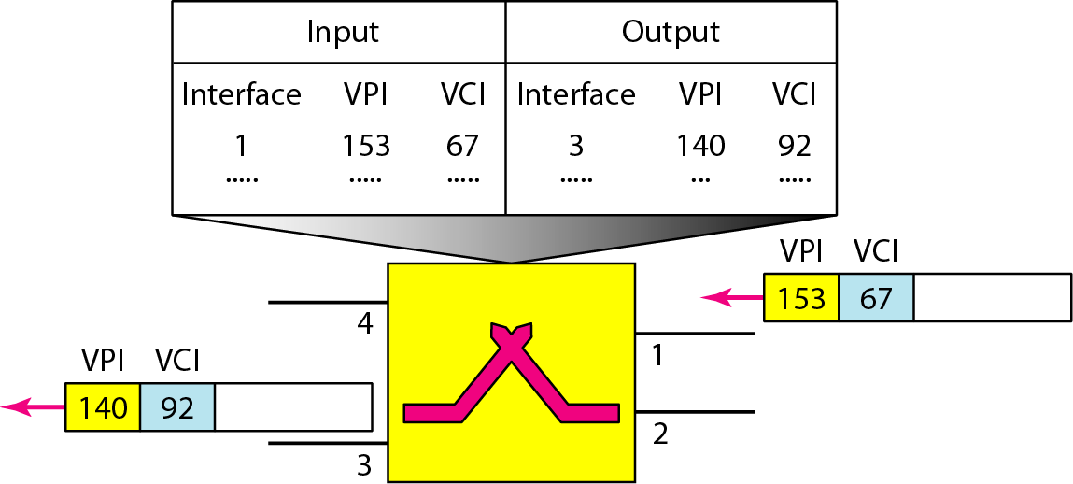
Figure 18.15 Routing with a switch

Slide 24
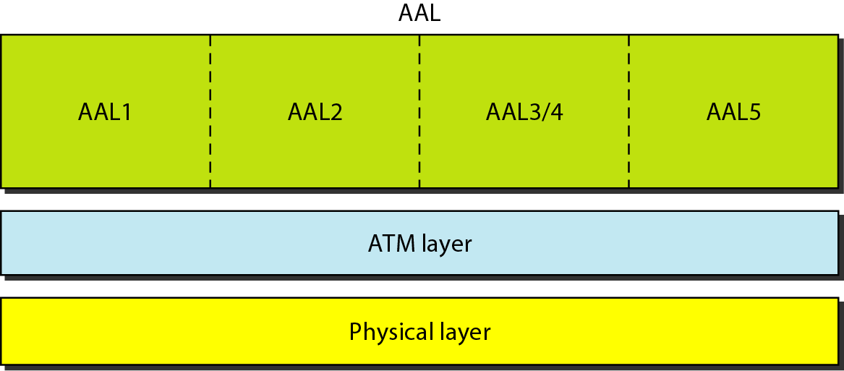
Figure 18.16 ATM layers

Slide 25
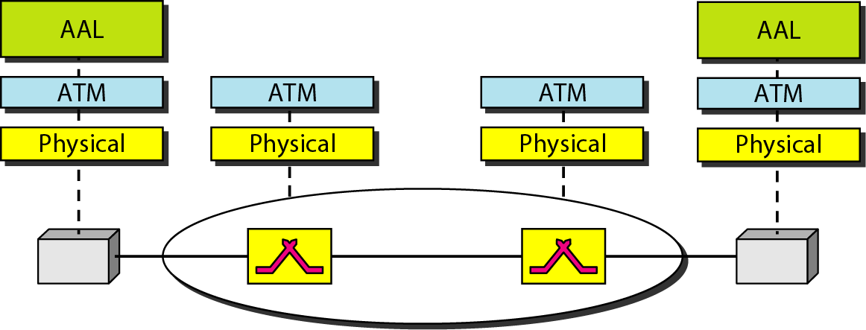
Figure 18.17 ATM layers in endpoint devices and switches

Slide 26
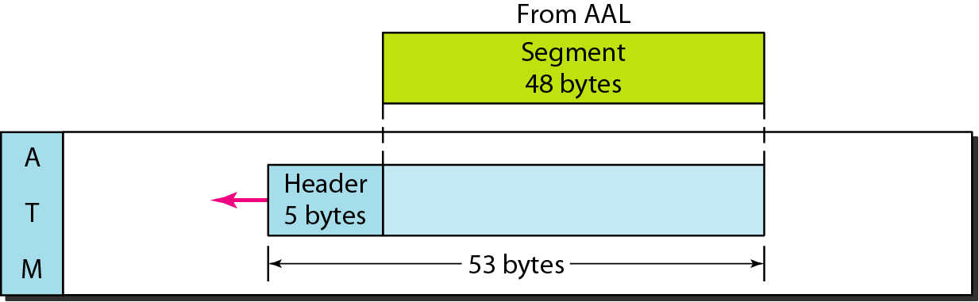
Figure 18.18 ATM layer

Slide 27
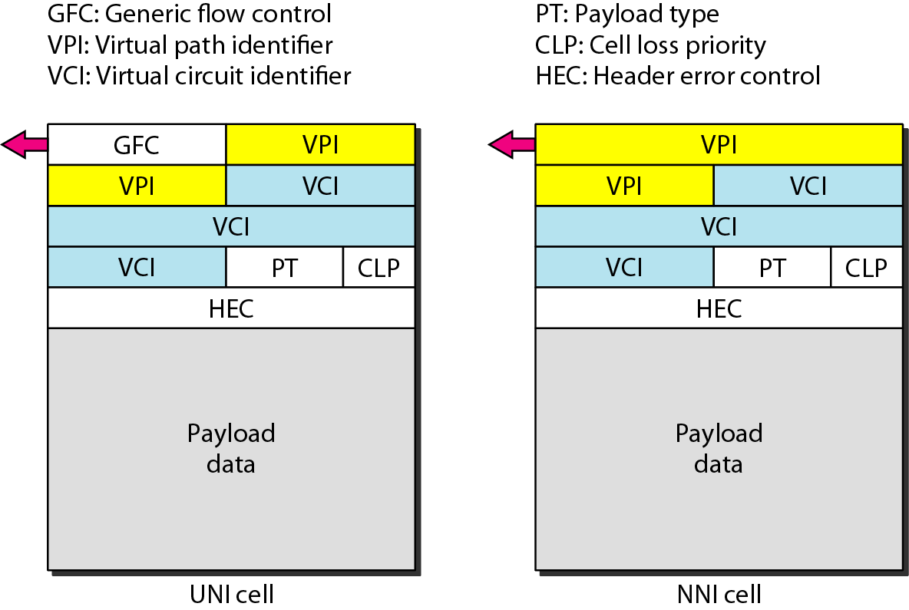
Figure 18.19 ATM headers

Slide 28
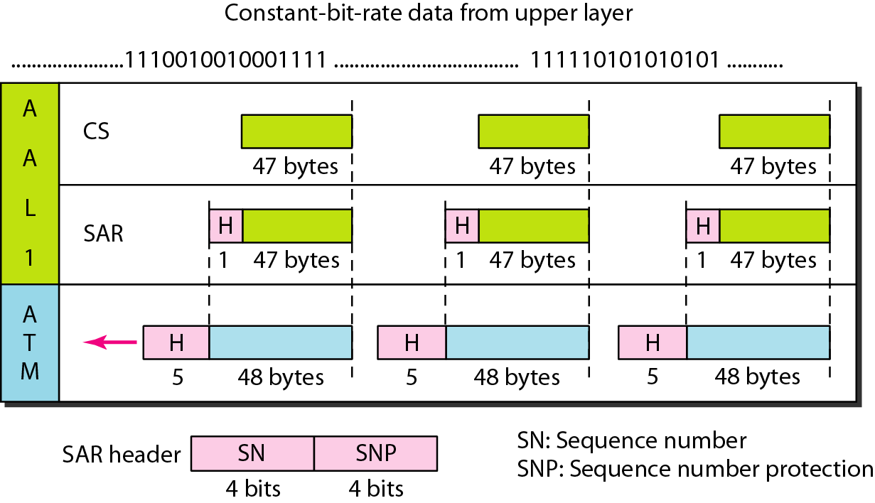
Figure 18.20 AAL1

Slide 29
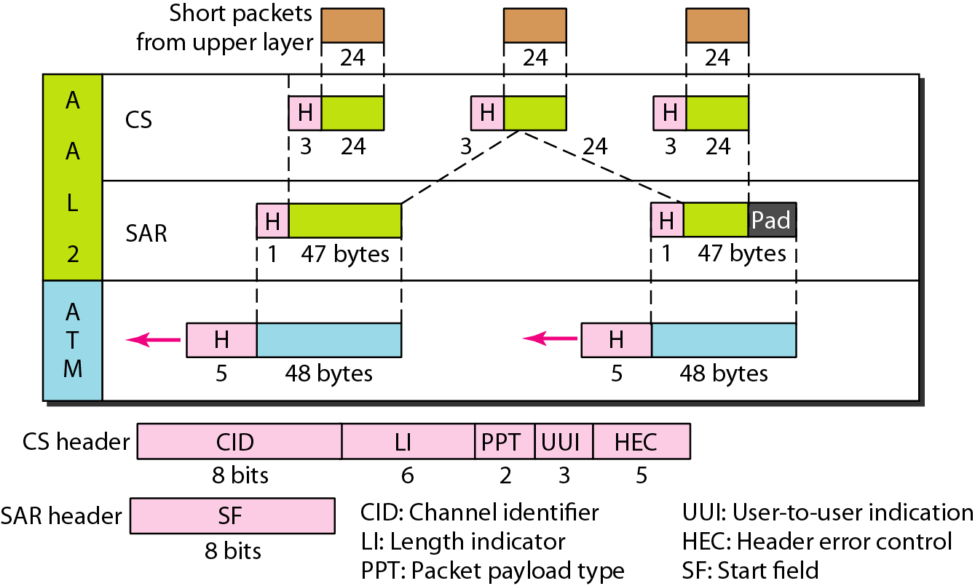
Figure 18.21 AAL2

Slide 30
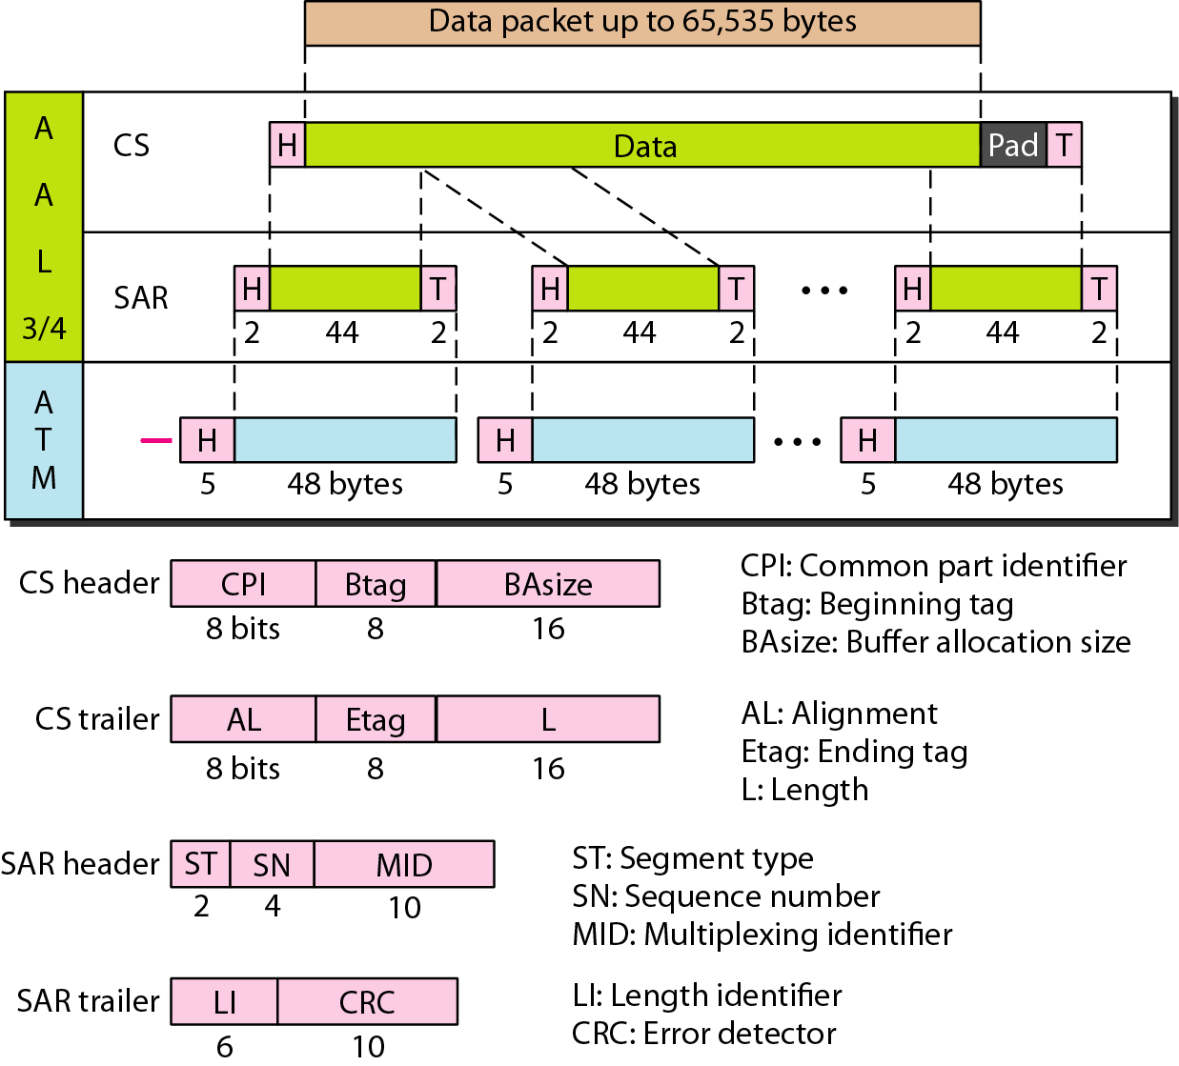
Figure 18.22 AAL3/4

Slide 31
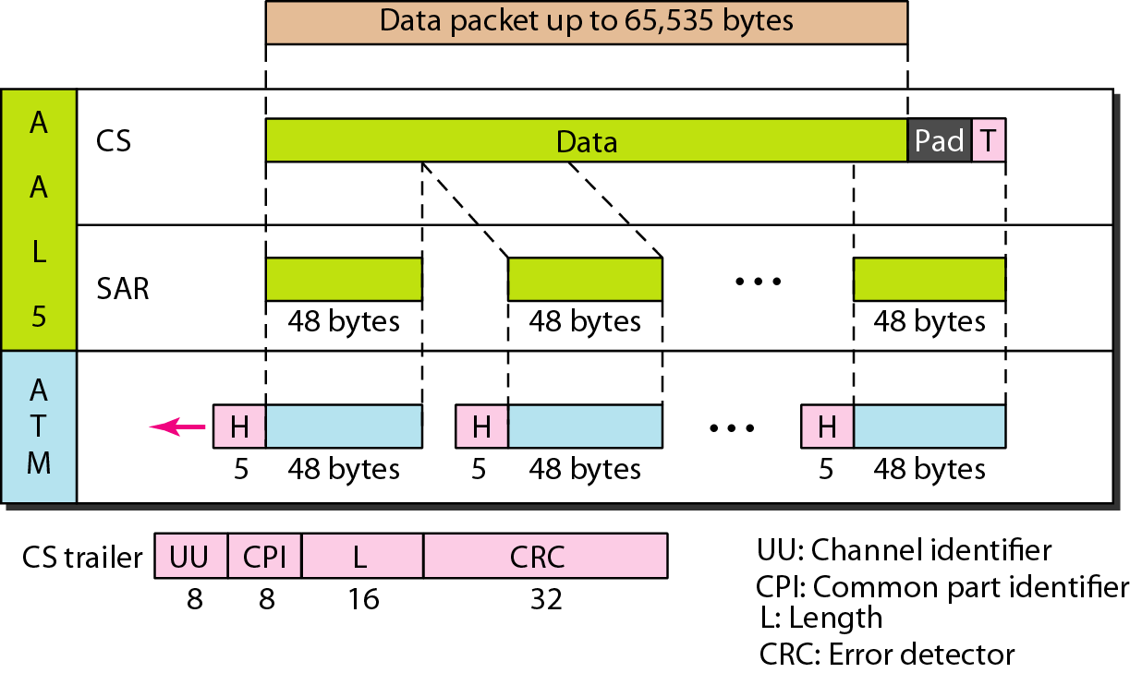
Figure 18.23 AAL5

Slide 32
18-3 ATM LANs
ATM is mainly a wide-area network (WAN ATM); however, the technology can be adapted to local-area networks (ATM LANs). The high data rate of the technology has attracted the attention of designers who are looking for greater and greater speeds in LANs.
Topics discussed in this section:
ATM LAN Architecture LAN Emulation (LANE)
Client/Server Model
Mixed Architecture with Client/Server

Slide 33
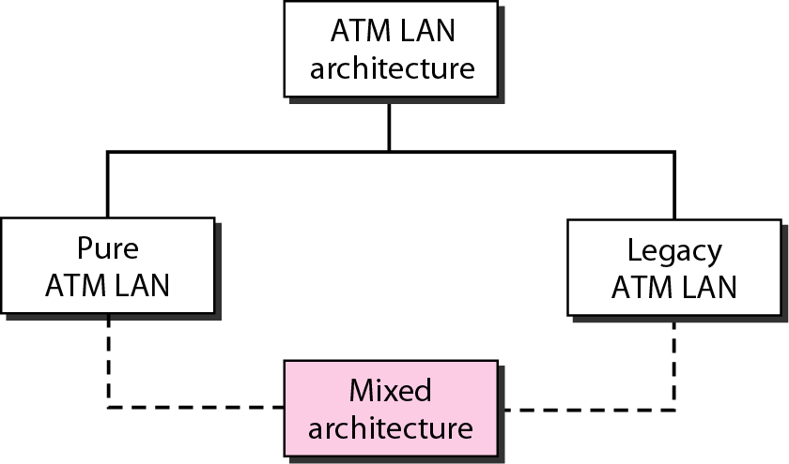
Figure 18.24 ATM LANs

Slide 34
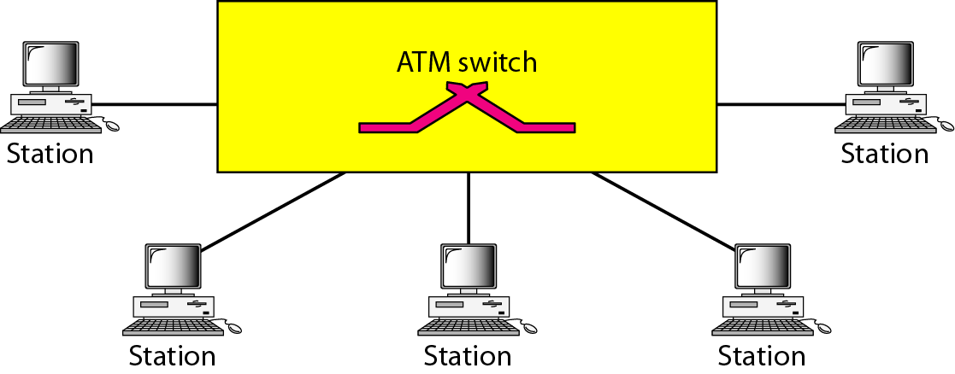
Figure 18.25 Pure ATM LAN

Slide 35
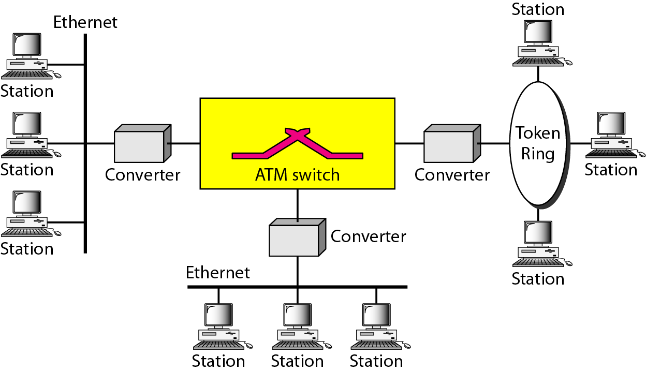
Figure 18.26 Legacy ATM LAN

Slide 36
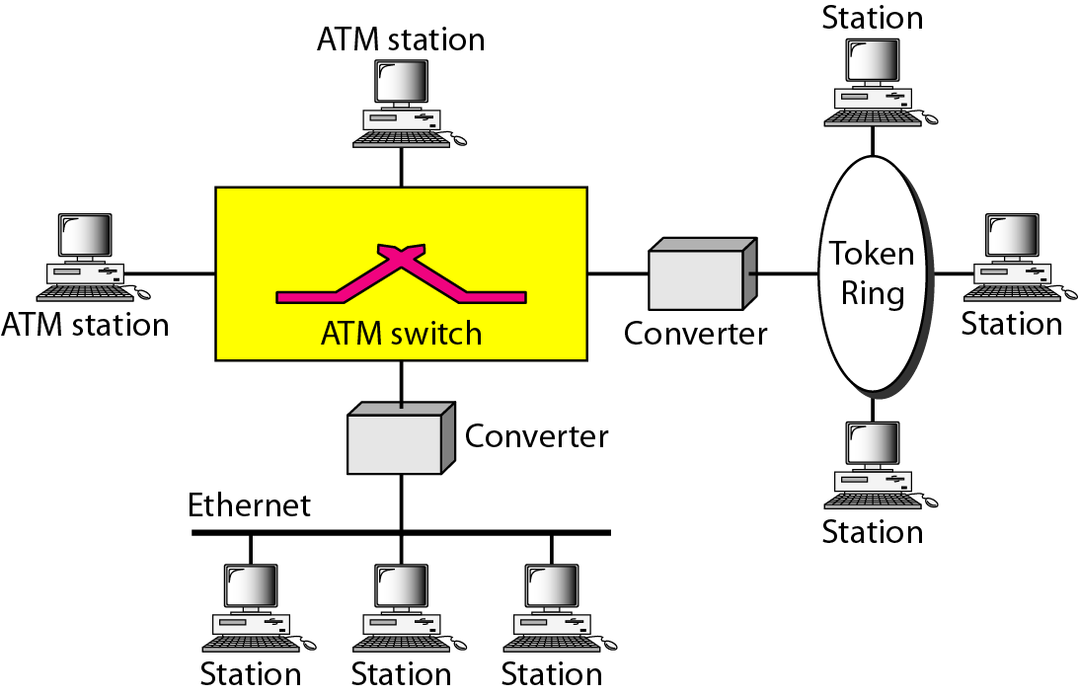
Figure 18.27 Mixed architecture ATM LAN

Slide 37
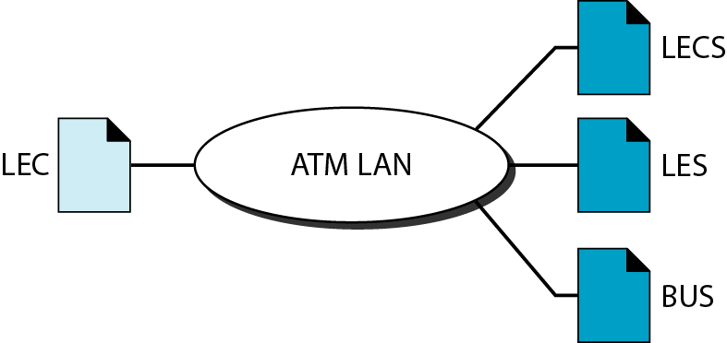
Figure 18.28 Client and servers in a LANE

Slide 38
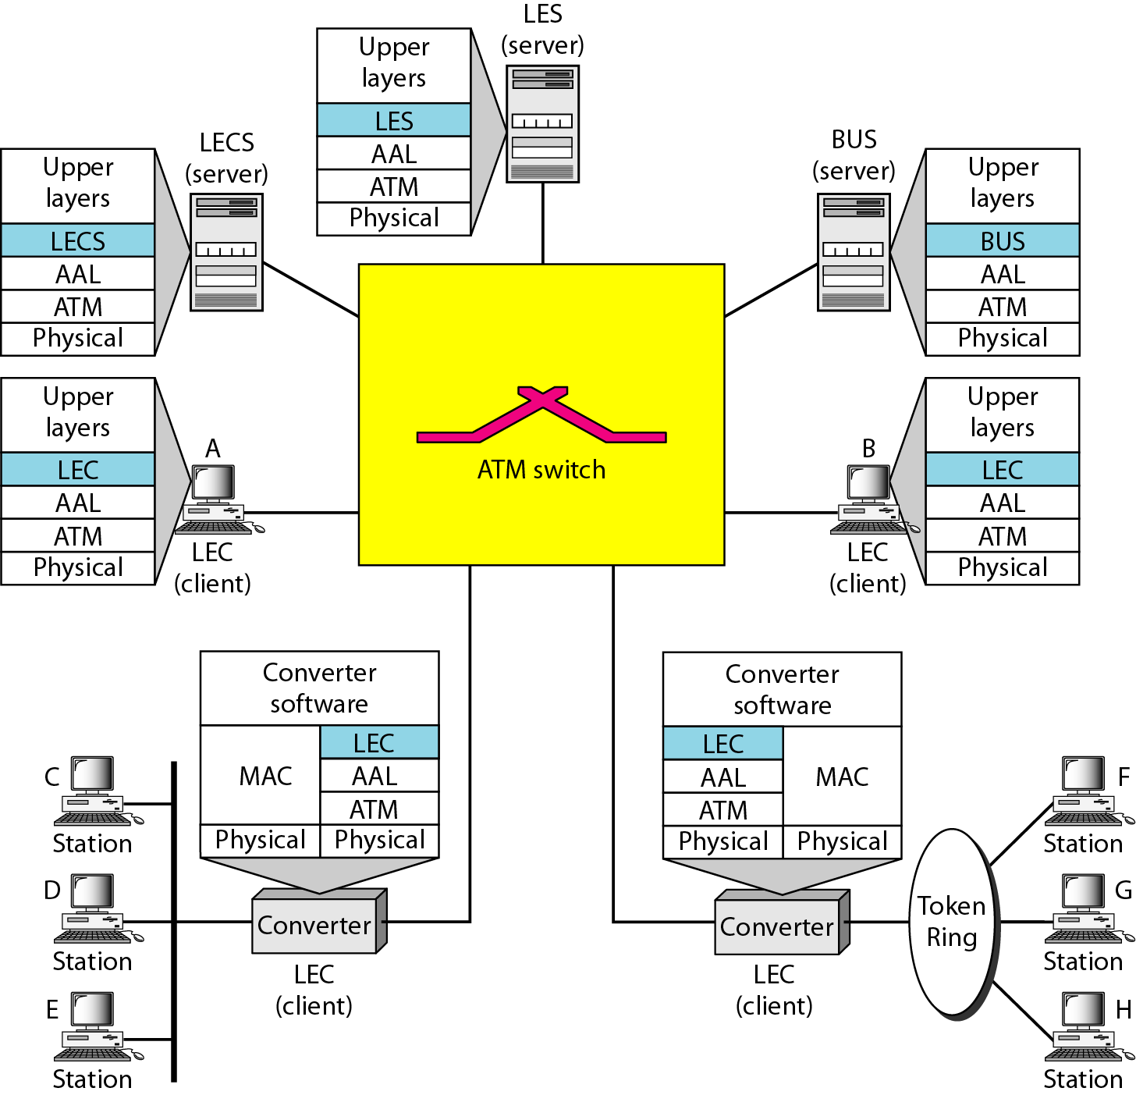
Figure 18.29 Client and servers in a LANE

