Slide 1

Chapter 22
Network Layer:
Delivery, Forwarding, and Routing
Copyright © The McGraw-Hill Companies, Inc. Permission required for reproduction or display.

Slide 2
22-1 DELIVERY
The network layer supervises the handling of the packets by the underlying physical networks. We define this handling as the delivery of a packet.
Topics discussed in this section:
Direct Versus Indirect Delivery

Slide 3
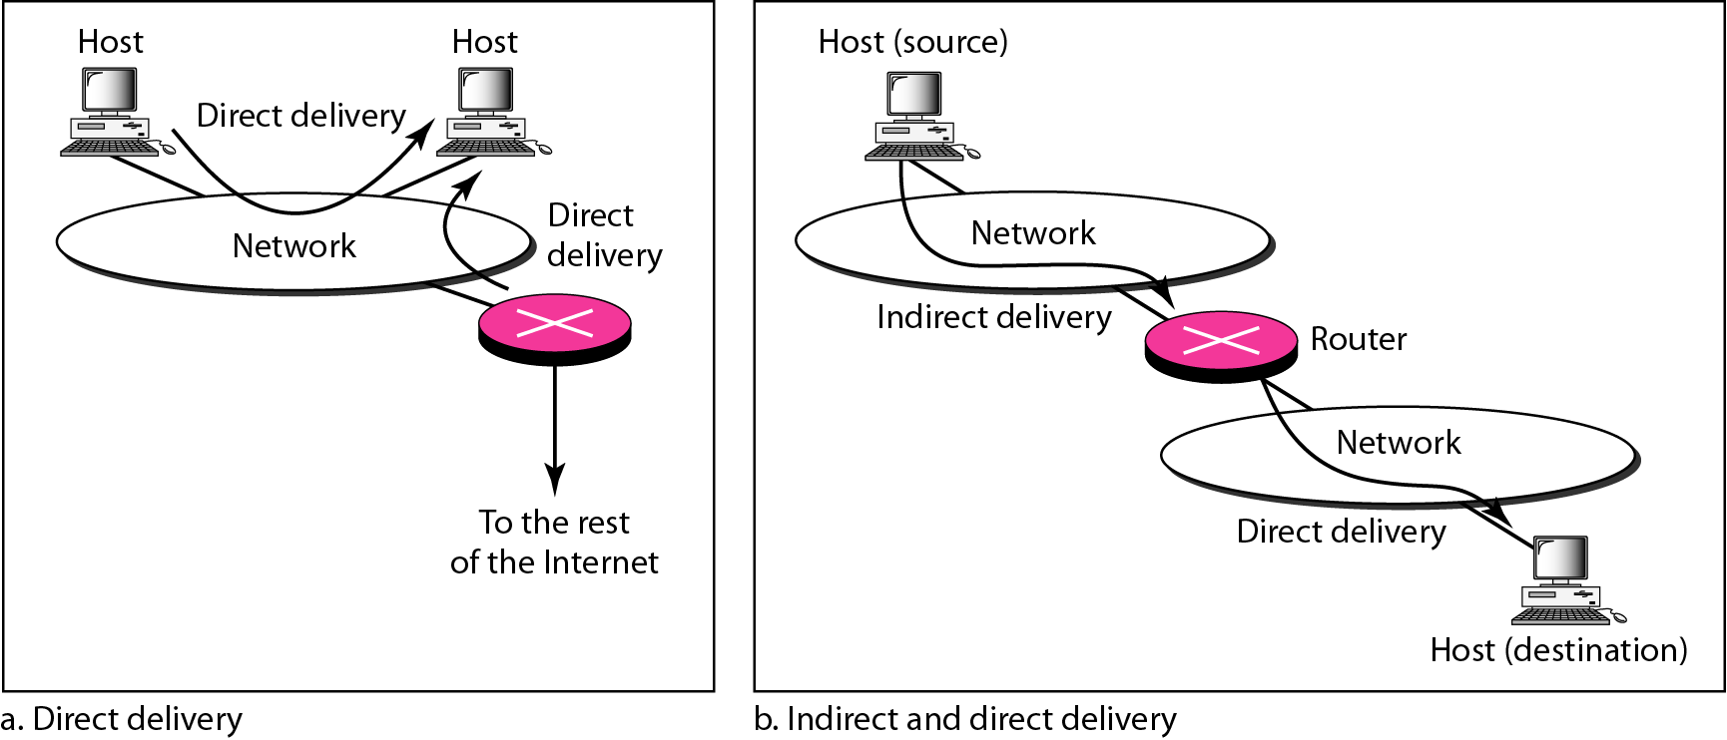
Figure 22.1 Direct and indirect delivery

Slide 4
22-2 FORWARDING
Forwarding means to place the packet in its route to its destination. Forwarding requires a host or a router to have a routing table. When a host has a packet to send or when a router has received a packet to be forwarded, it looks at this table to find the route to the final destination.
Topics discussed in this section:
Forwarding Techniques Forwarding Process
Routing Table

Slide 5
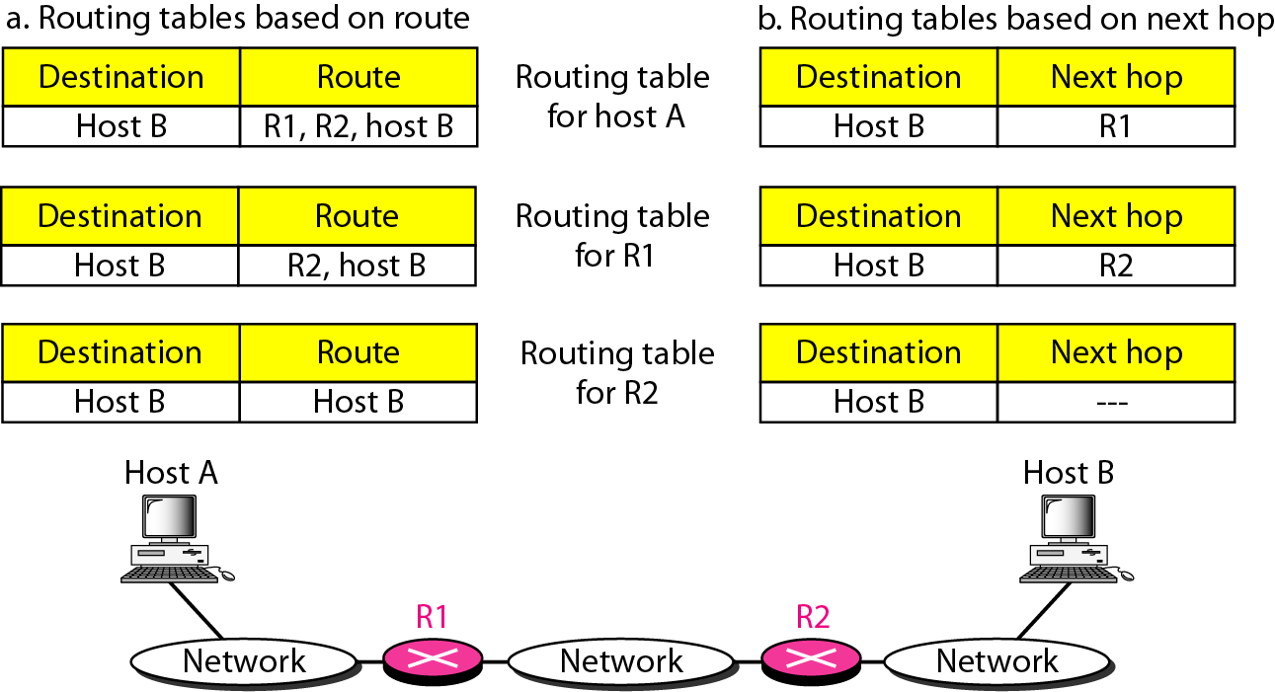
Figure 22.2 Route method versus next-hop method

Slide 6
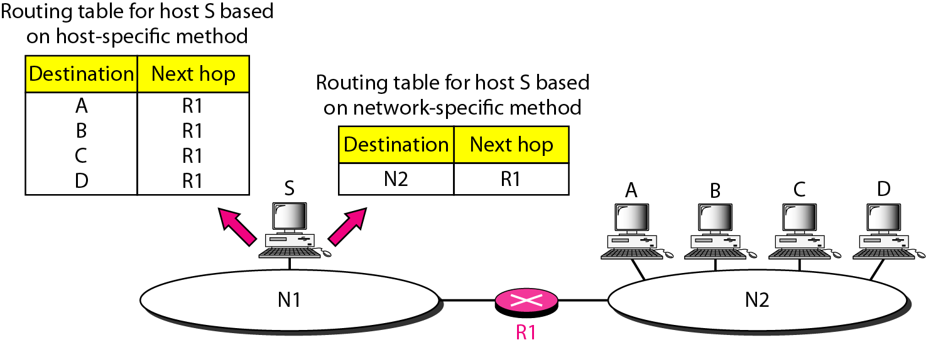
Figure 22.3 Host-specific versus network-specific method

Slide 7
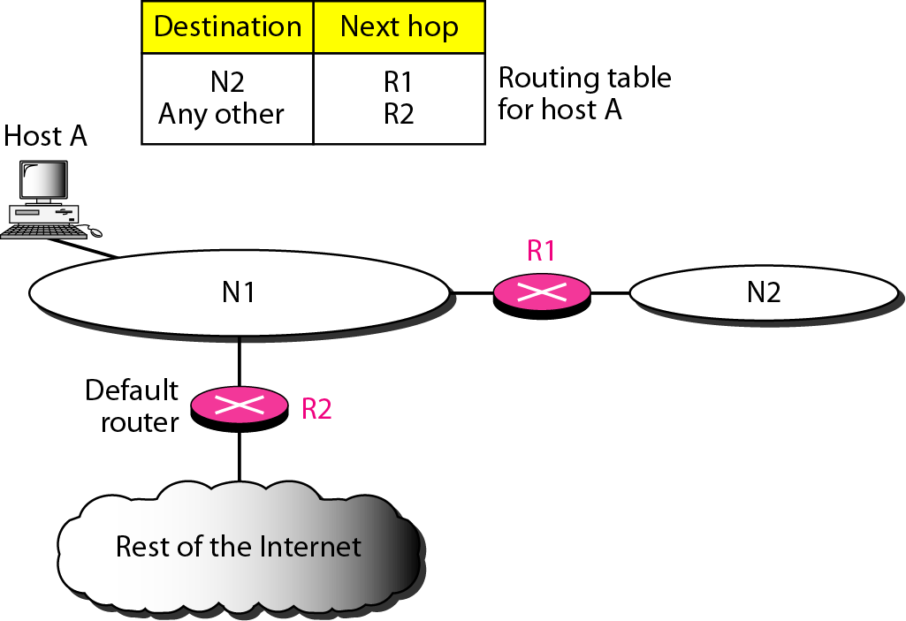
Figure 22.4 Default method

Slide 8
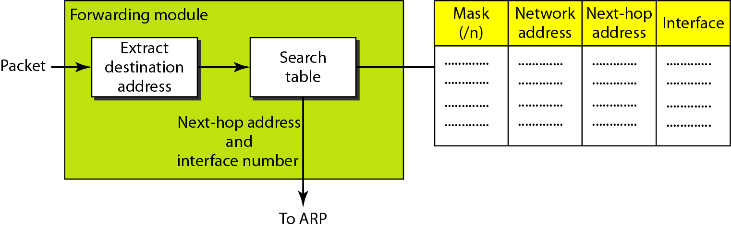
Figure 22.5 Simplified forwarding module in classless address

Slide 9

Note
In classless addressing, we need at least four columns in a routing table.

Slide 10
Example 22.1
Make a routing table for router R1, using the configuration in Figure 22.6.
Solution
Table 22.1 shows the corresponding table.

Slide 11
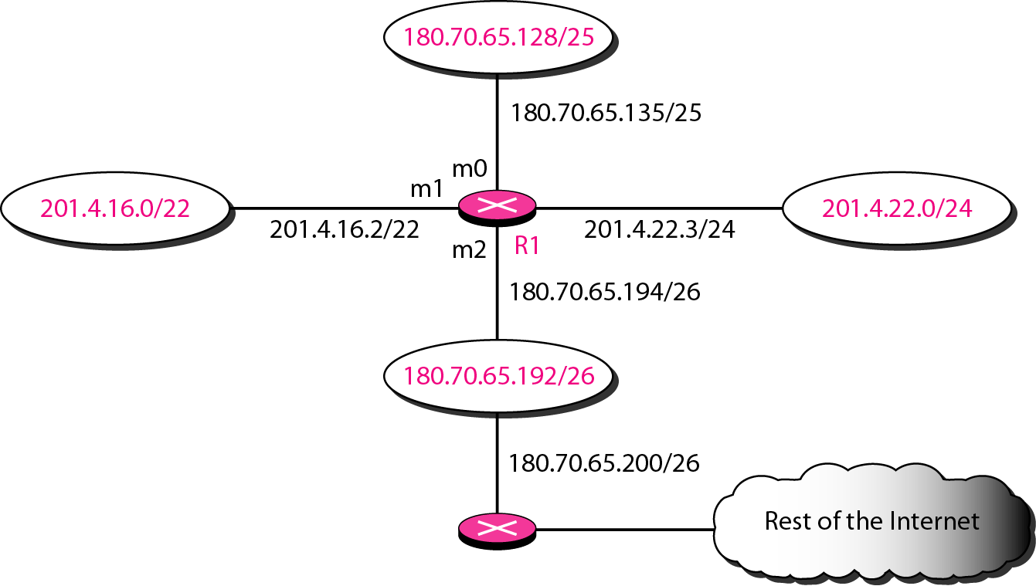
Figure 22.6 Configuration for Example 22.1

Slide 12
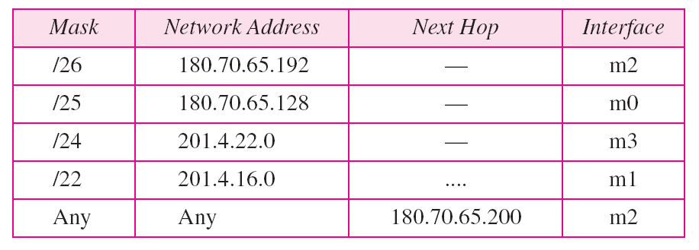
Table 22.1 Routing table for router R1 in Figure 22.6

Slide 13
Example 22.2
Show the forwarding process if a packet arrives at R1 in Figure 22.6 with the destination address 180.70.65.140.
Solution
The router performs the following steps:
1. The first mask (/26) is applied to the destination address. The result is 180.70.65.128, which does not match the corresponding network address.
2. The second mask (/25) is applied to the destination address. The result is 180.70.65.128, which matches the corresponding network address. The next-hop address and the interface number m0 are passed to ARP for further processing.

Slide 14
Example 22.3
Show the forwarding process if a packet arrives at R1 in Figure 22.6 with the destination address 201.4.22.35.
Solution
The router performs the following steps:
1. The first mask (/26) is applied to the destination address. The result is 201.4.22.0, which does not match the corresponding network address.
2. The second mask (/25) is applied to the destination address. The result is 201.4.22.0, which does not match the corresponding network address (row 2).

Slide 15
Example 22.3 (continued)
3. The third mask (/24) is applied to the destination address. The result is 201.4.22.0, which matches the corresponding network address. The destination address of the packet and the interface number m3 are passed to ARP.

Slide 16
Example 22.4
Show the forwarding process if a packet arrives at R1 in Figure 22.6 with the destination address 18.24.32.78.
Solution
This time all masks are applied, one by one, to the destination address, but no matching network address is found. When it reaches the end of the table, the module gives the next-hop address 180.70.65.200 and interface number m2 to ARP. This is probably an outgoing package that needs to be sent, via the default router, to someplace else in the Internet.

Slide 17
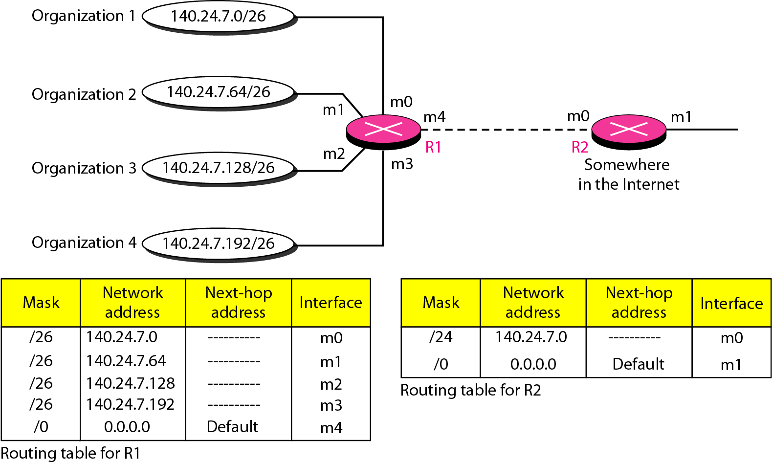
Figure 22.7 Address aggregation

Slide 18
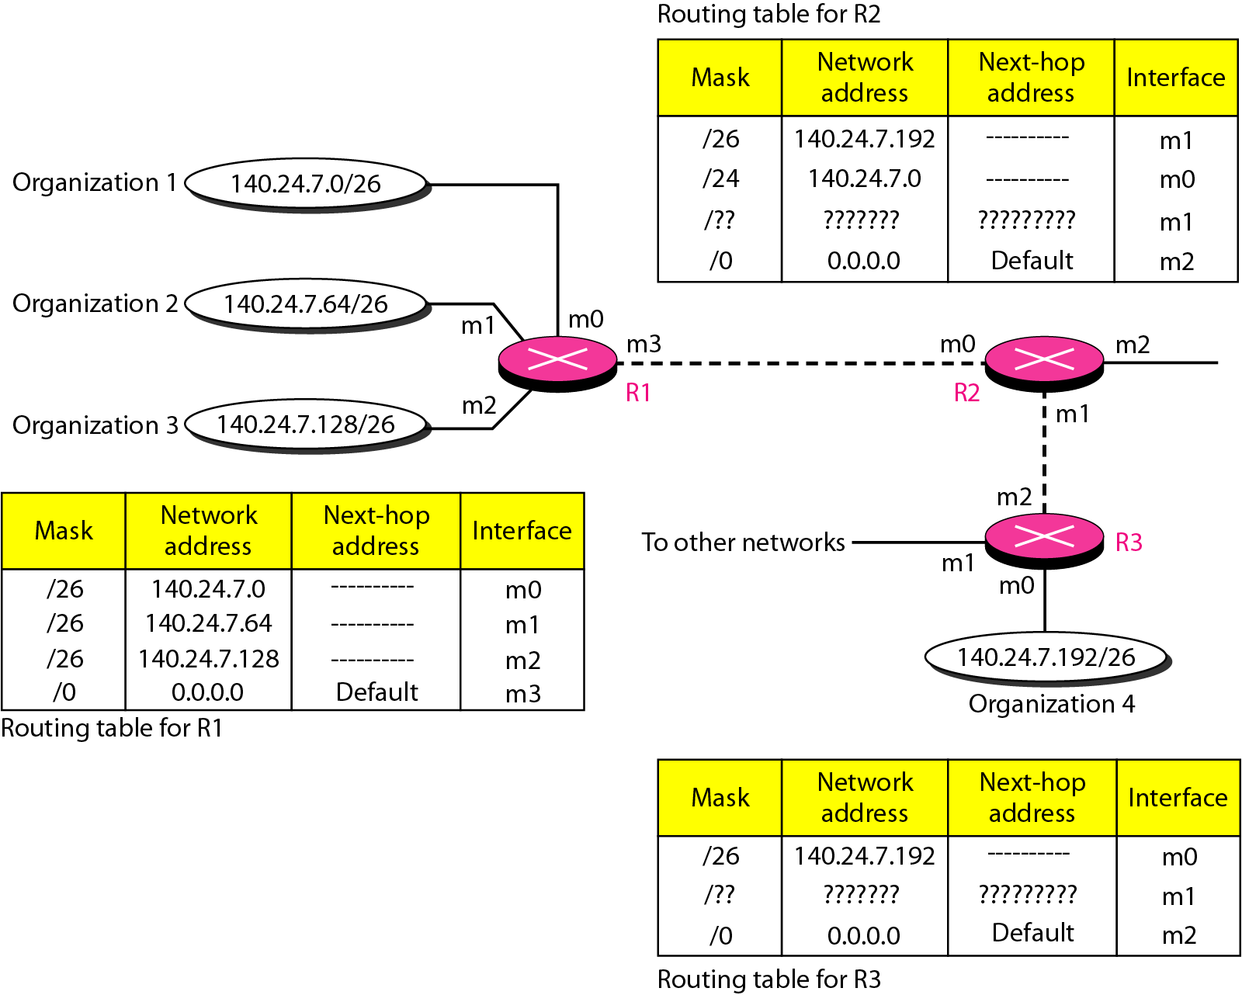
Figure 22.8 Longest mask matching

Slide 19
Example 22.5
As an example of hierarchical routing, let us consider Figure 22.9. A regional ISP is granted 16,384 addresses starting from 120.14.64.0. The regional ISP has decided to divide this block into four subblocks, each with 4096 addresses. Three of these subblocks are assigned to three
local ISPs; the second subblock is reserved for future use. Note that the mask for each block is /20 because the original block with mask /18 is divided into 4 blocks.
The first local ISP has divided its assigned subblock into 8 smaller blocks and assigned each to a small ISP. Each small ISP provides services to 128 households, each using four addresses.

Slide 20
Example 22.5 (continued)
The second local ISP has divided its block into 4 blocks and has assigned the addresses to four large organizations.
The third local ISP has divided its block into 16 blocks and assigned each block to a small organization. Each small organization has 256 addresses, and the mask is /24.
There is a sense of hierarchy in this configuration. All routers in the Internet send a packet with destination address 120.14.64.0 to 120.14.127.255 to the regional ISP.

Slide 21
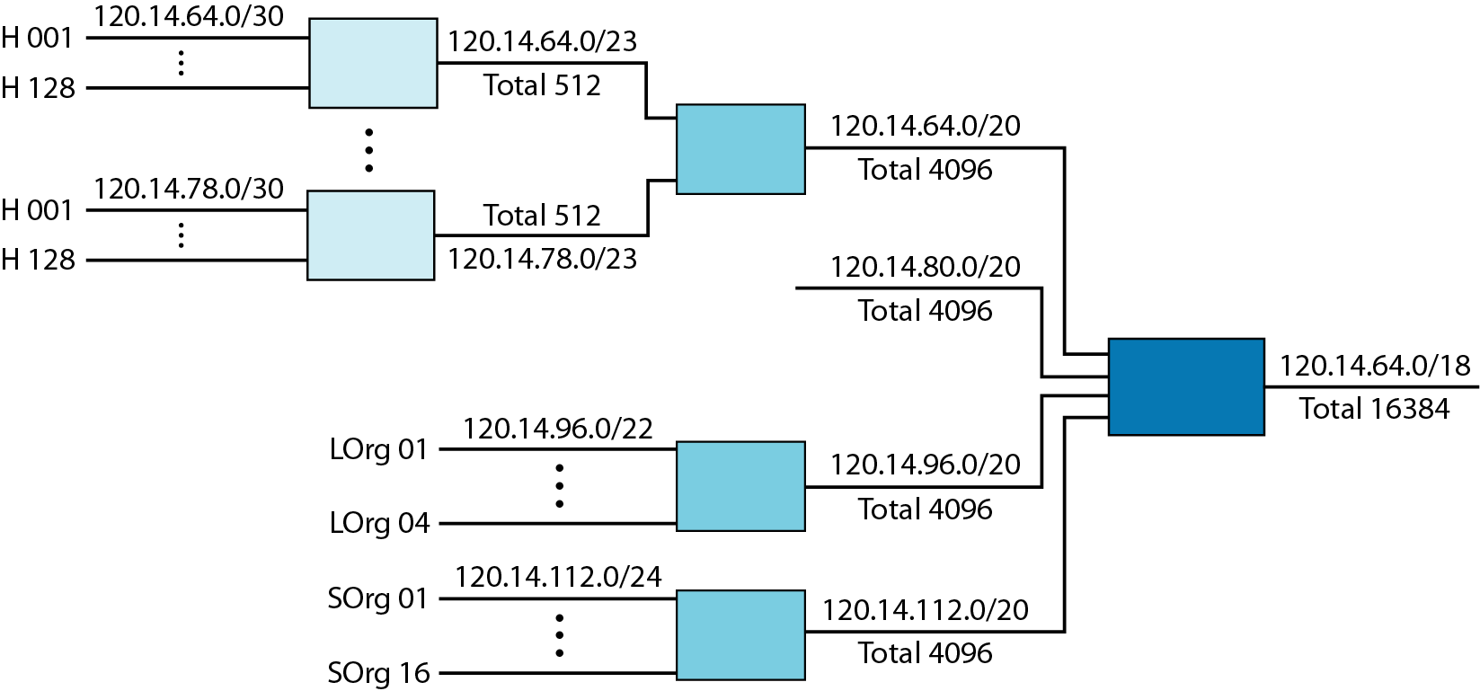
Figure 22.9 Hierarchical routing with ISPs

Slide 22
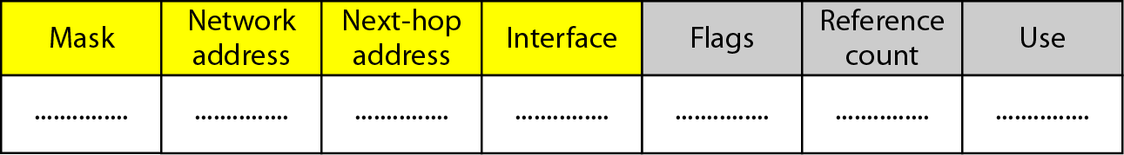
Figure 22.10 Common fields in a routing table

Slide 23
Example 22.6
One utility that can be used to find the contents of a routing table for a host or router is netstat in UNIX or LINUX. The next slide shows the list of the contents of a default server. We have used two options, r and n. The option r indicates that we are interested in the routing table, and the option n indicates that we are looking for numeric addresses. Note that this is a routing table for a host, not a router. Although we discussed the routing table for a router throughout the chapter, a host also needs a routing table.

Slide 24
Example 22.6 (continued)
The destination column here defines the network address. The term gateway used by UNIX is synonymous with router. This column actually defines the address of the next hop. The value 0.0.0.0 shows that the delivery is direct. The last entry has a flag of G, which means that the destination can be reached through a router (default router). The Iface defines the interface.

Slide 25
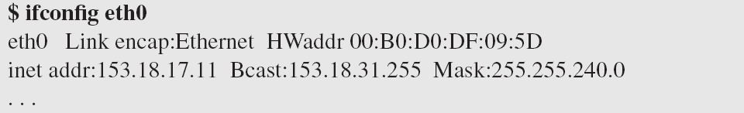
Example 22.6 (continued)
More information about the IP address and physical address of the server can be found by using the ifconfig command on the given interface (eth0).

Slide 26
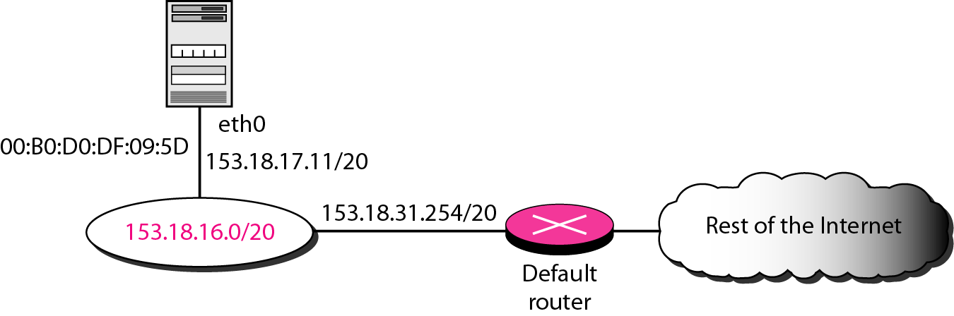
Figure 22.11 Configuration of the server for Example 22.6

Slide 27
22-3 UNICAST ROUTING PROTOCOLS
A routing table can be either static or dynamic. A static table is one with manual entries. A dynamic table is one that is updated automatically when there is a change somewhere in the Internet. A routing protocol is a combination of rules and procedures that lets routers in the Internet inform each other of changes.
Topics discussed in this section:
Optimization Intra- and Interdomain Routing
Distance Vector Routing and RIP
Link State Routing and OSPF
Path Vector Routing and BGP

Slide 28
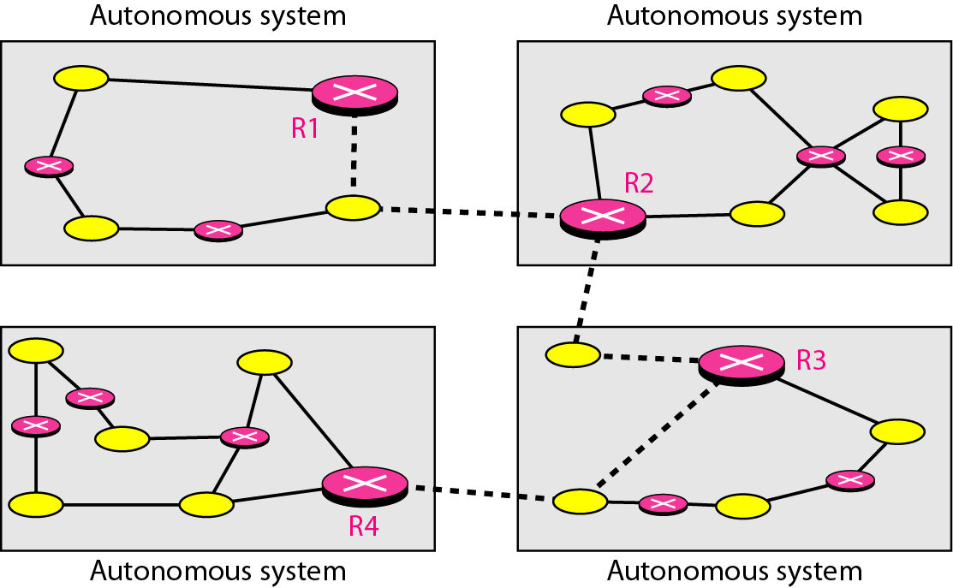
Figure 22.12 Autonomous systems

Slide 29
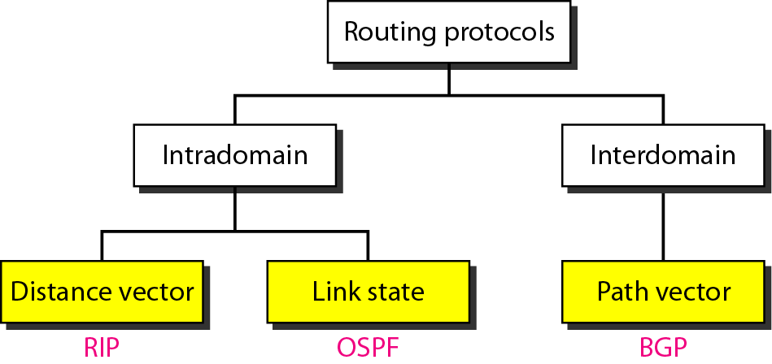
Figure 22.13 Popular routing protocols

Slide 30
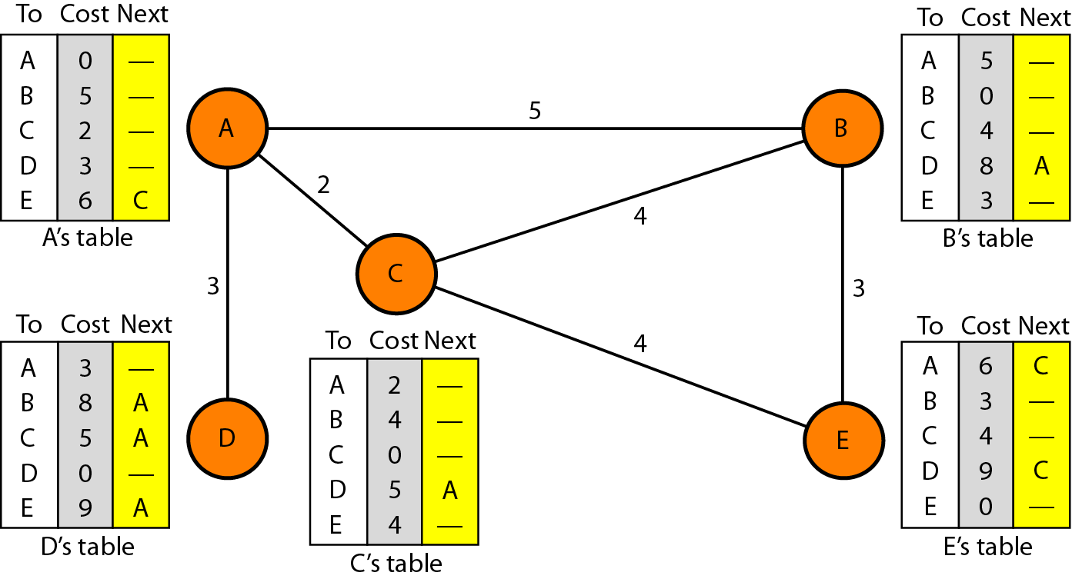
Figure 22.14 Distance vector routing tables

Slide 31
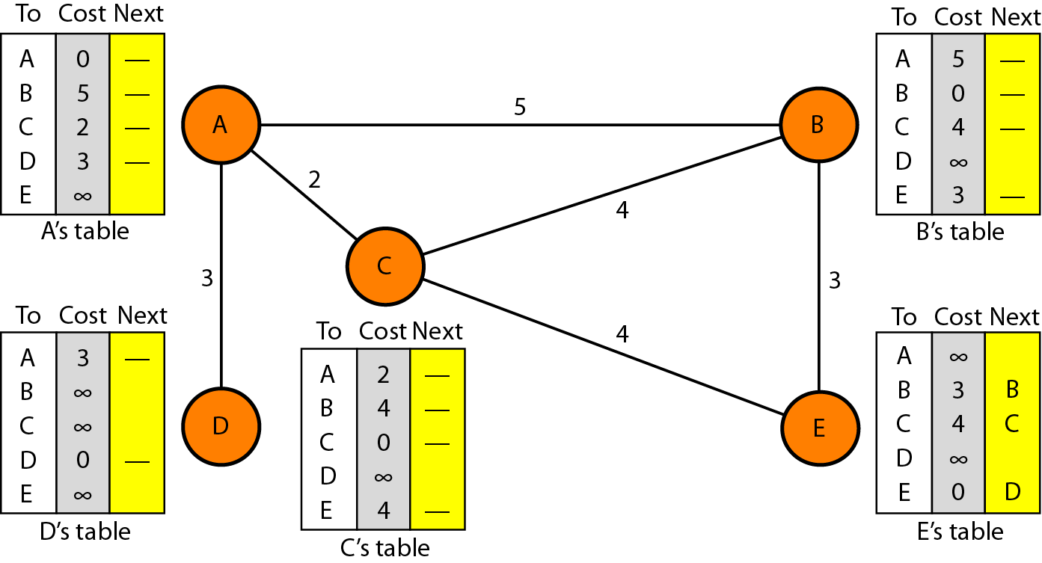
Figure 22.15 Initialization of tables in distance vector routing

Slide 32
Note
In distance vector routing, each node shares its routing table with its
immediate neighbors periodically and when there is a change.

Slide 33
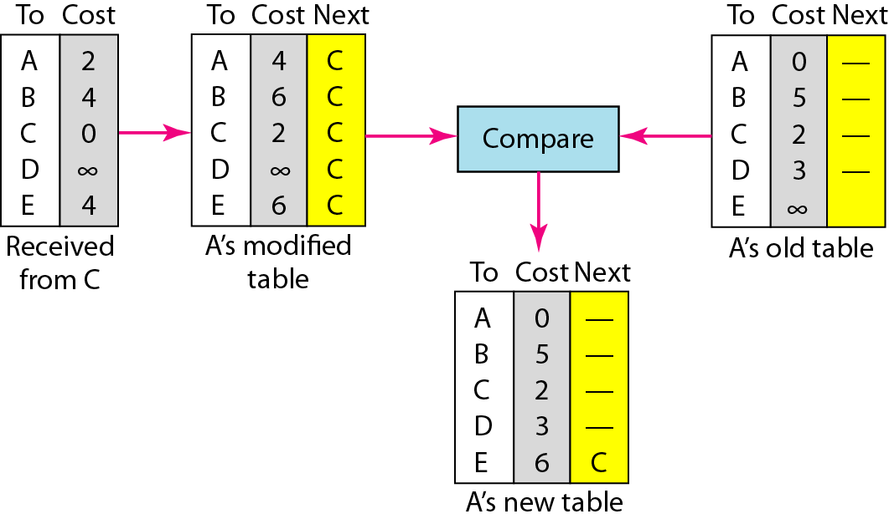
Figure 22.16 Updating in distance vector routing

Slide 34
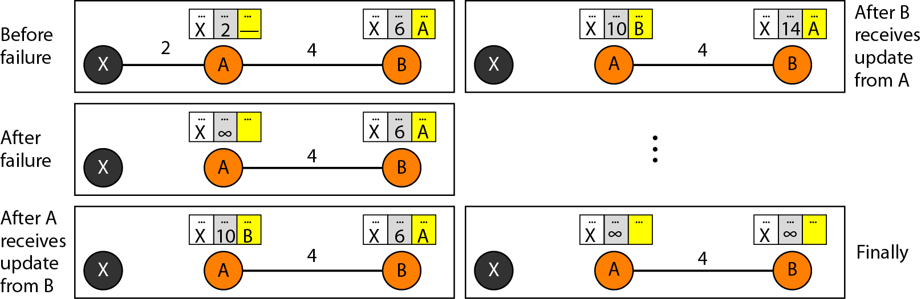
Figure 22.17 Two-node instability

Slide 35
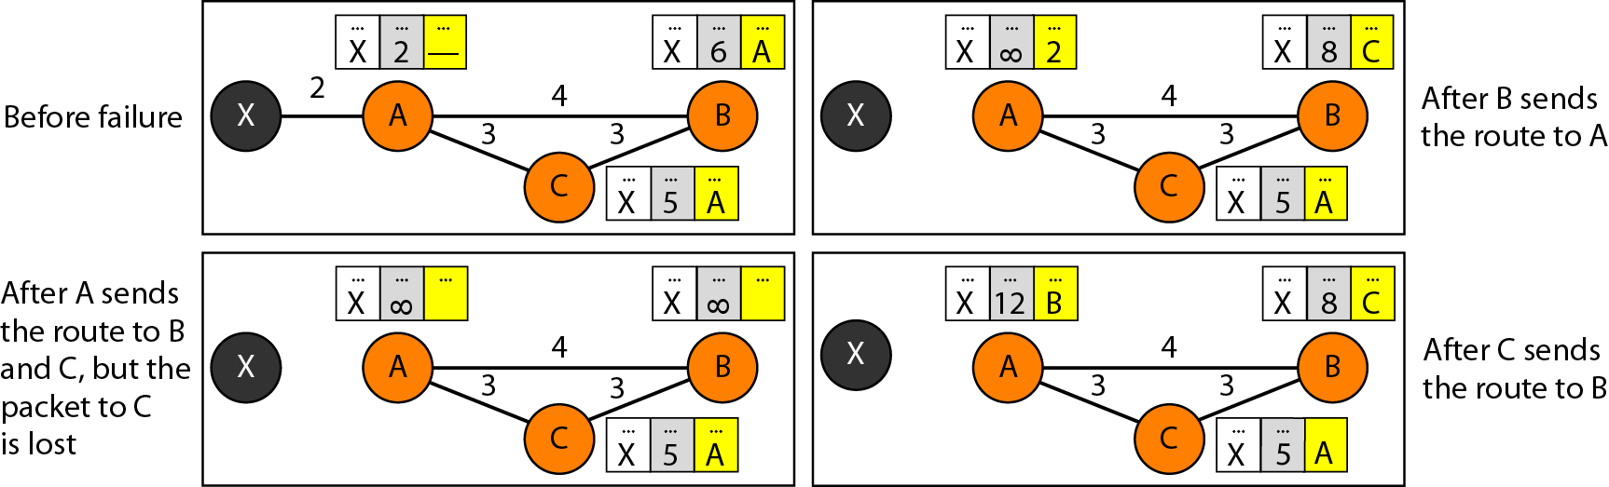
Figure 22.18 Three-node instability

Slide 36
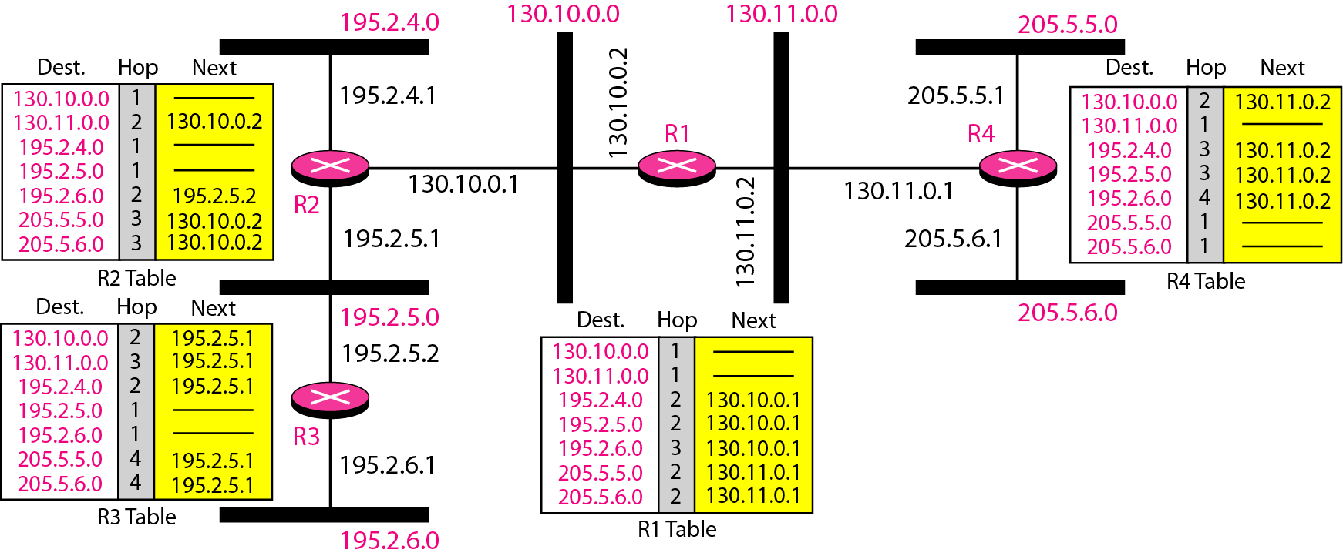
Figure 22.19 Example of a domain using RIP

Slide 37
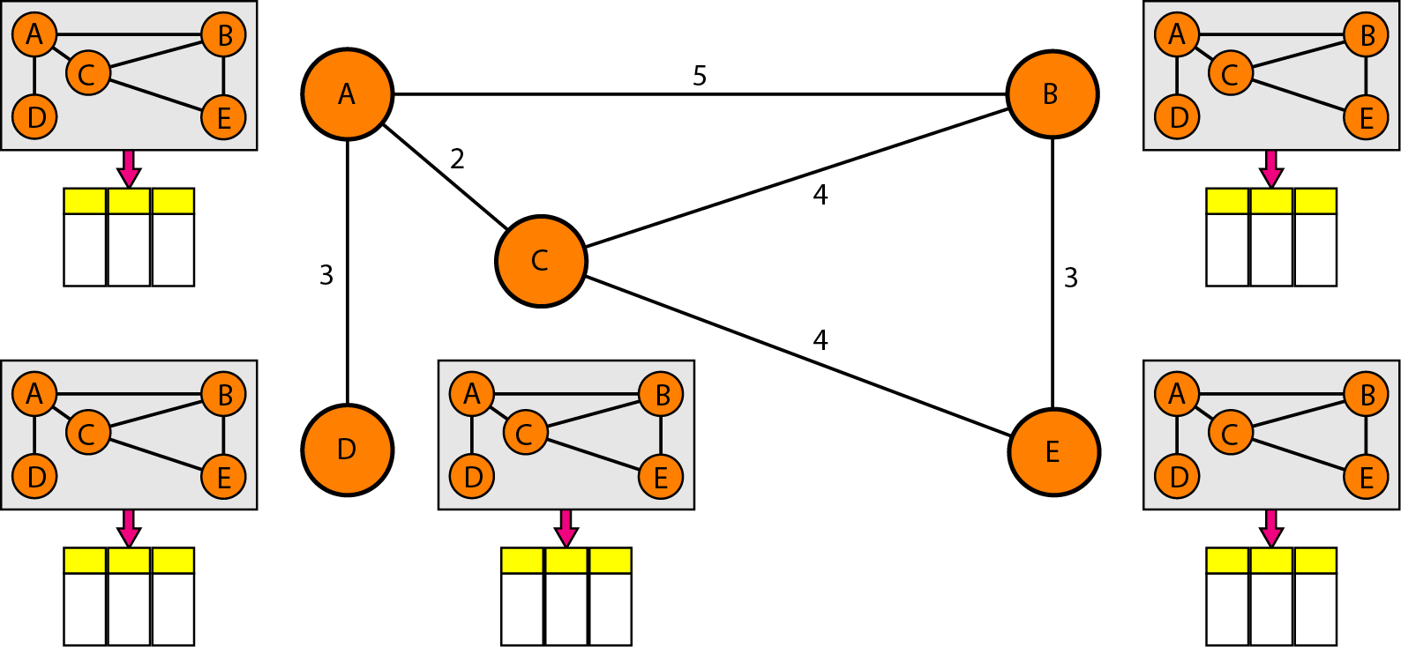
Figure 22.20 Concept of link state routing

Slide 38
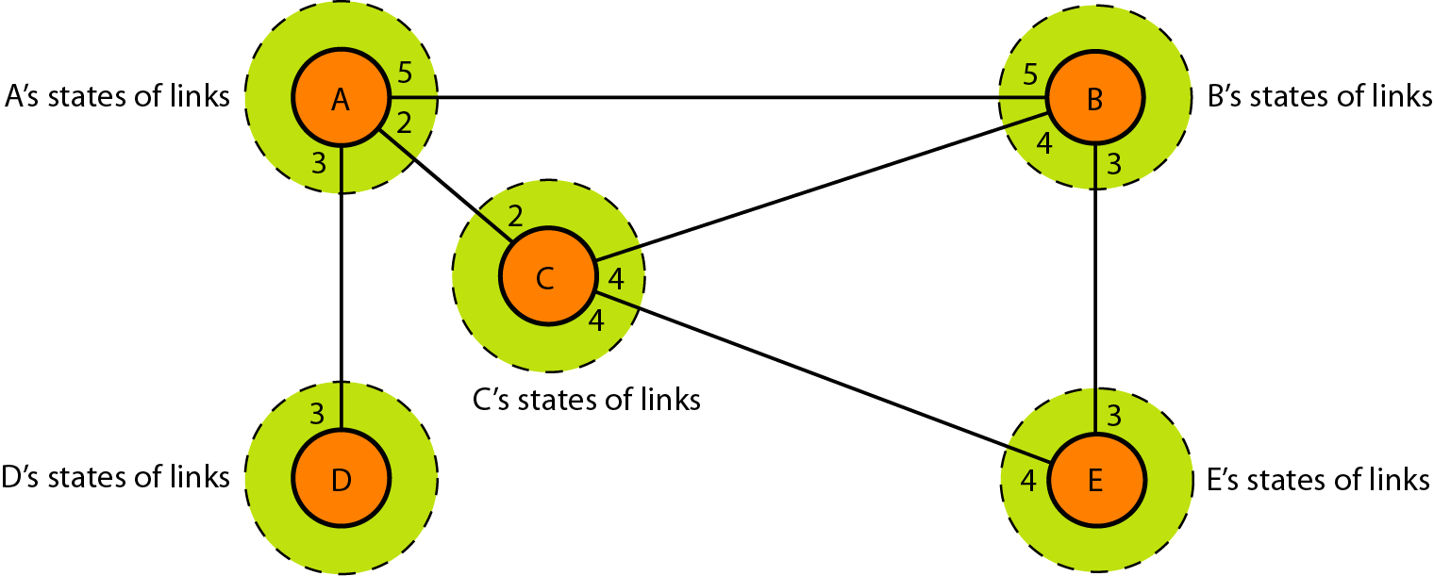
Figure 22.21 Link state knowledge

Slide 39
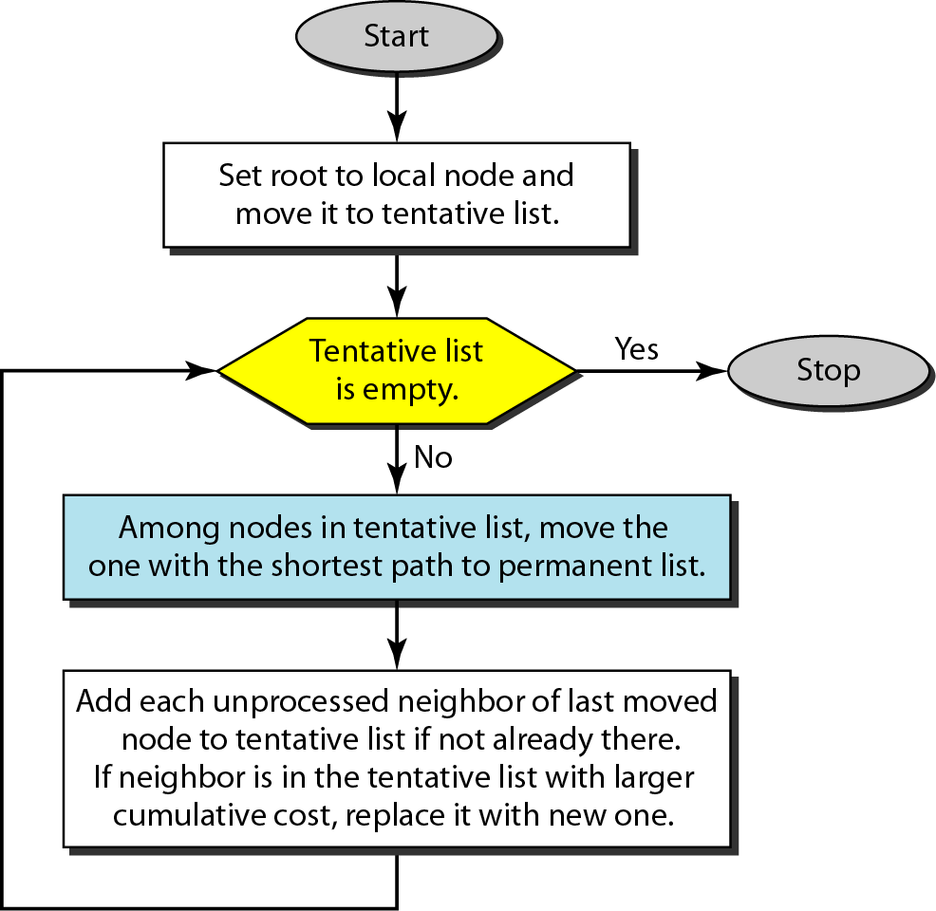
Figure 22.22 Dijkstra algorithm

Slide 40
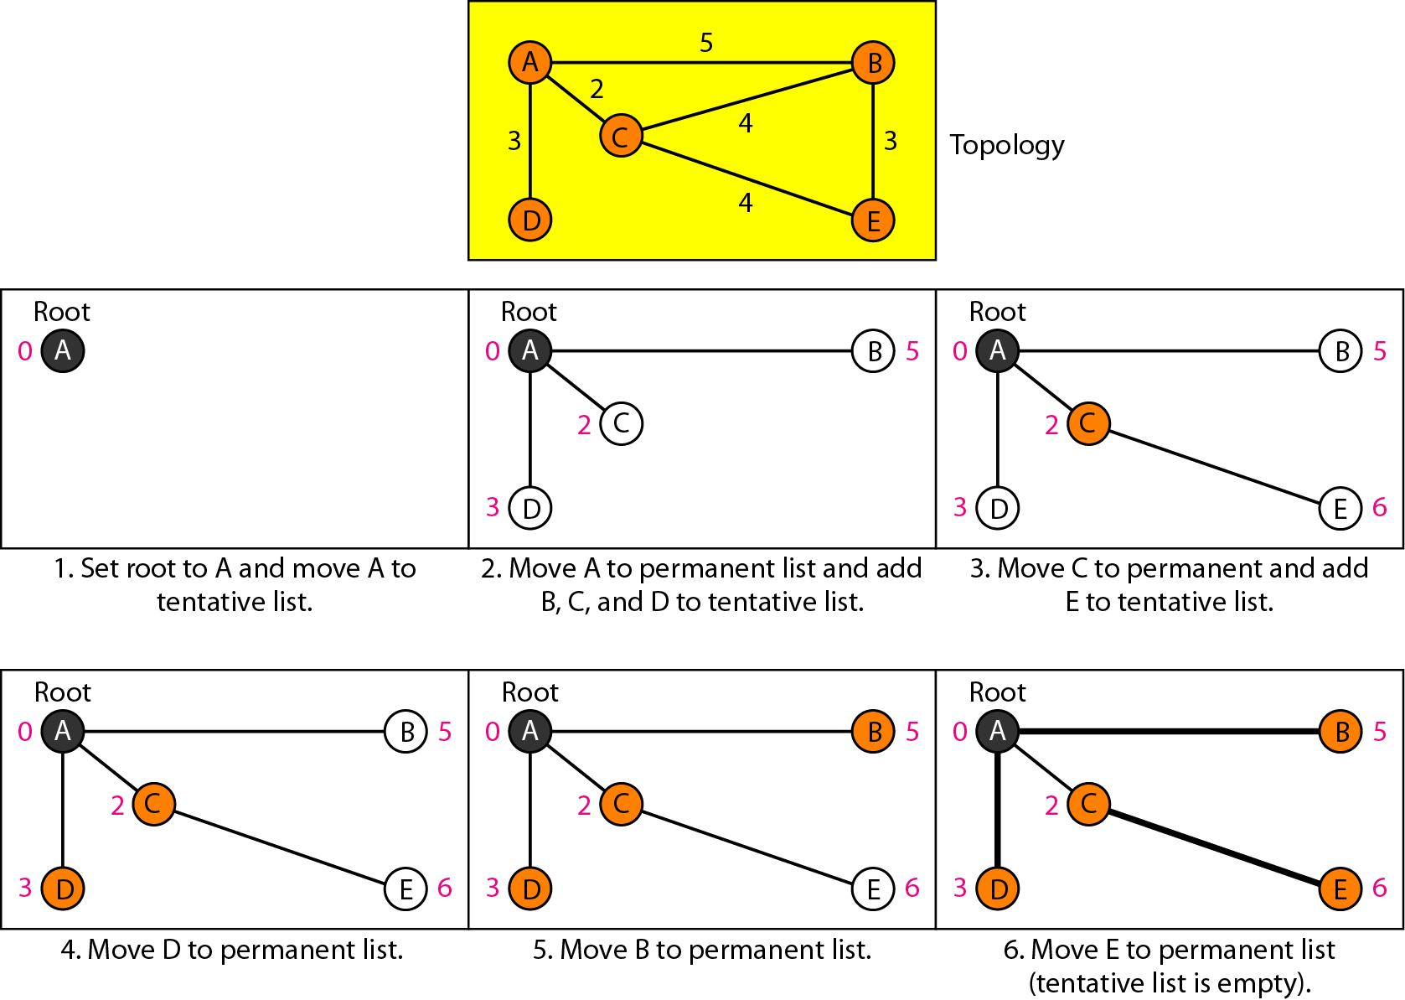
Figure 22.23 Example of formation of shortest path tree

Slide 41
Table 22.2 Routing table for node A

Slide 42
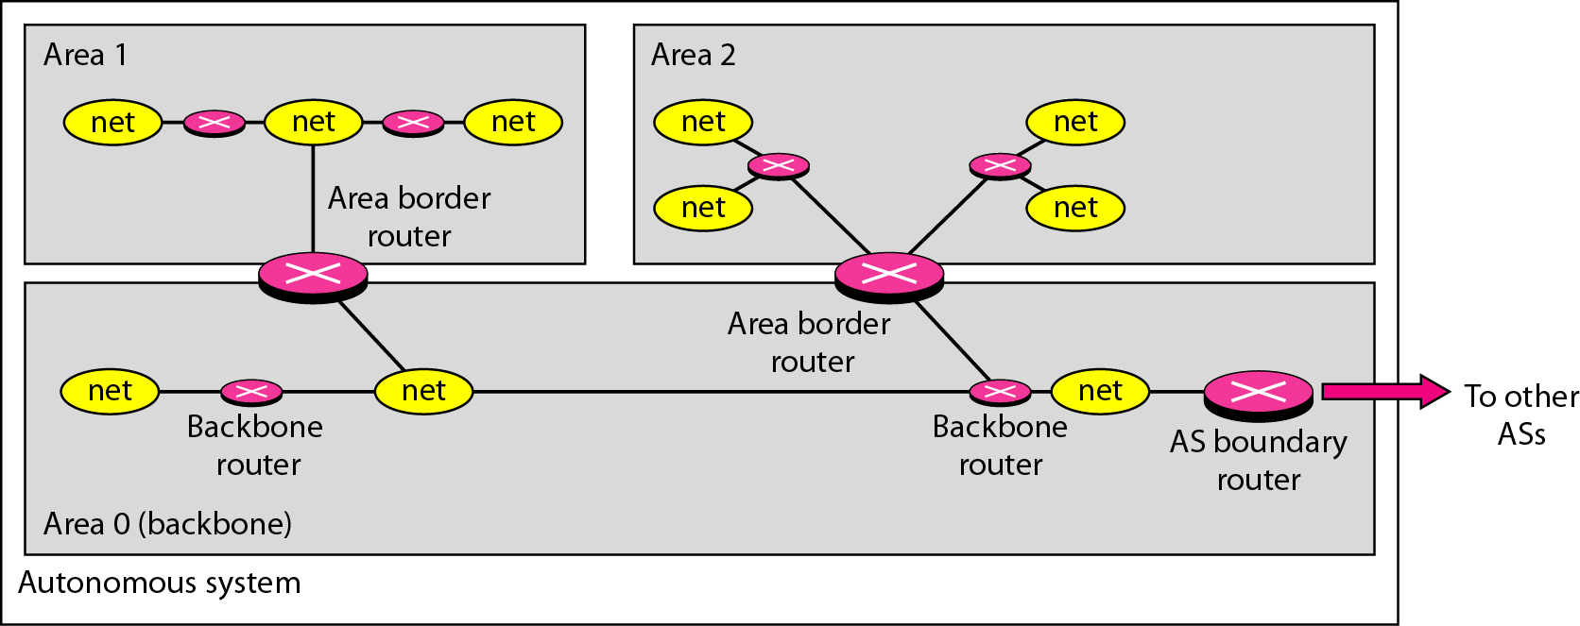
Figure 22.24 Areas in an autonomous system

Slide 43
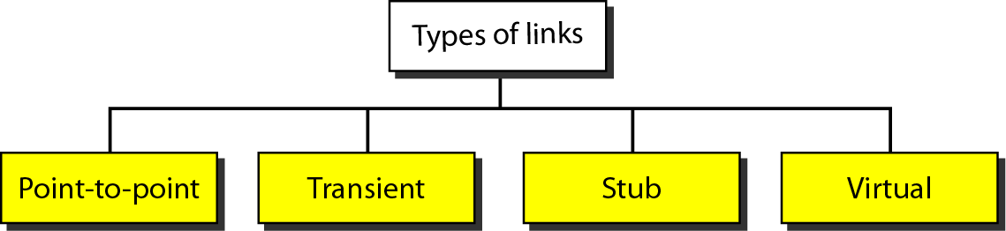
Figure 22.25 Types of links

Slide 44
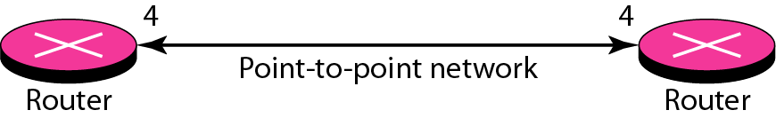
Figure 22.26 Point-to-point link

Slide 45
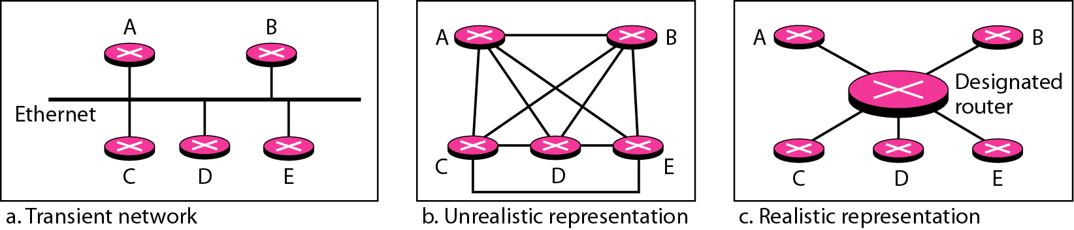
Figure 22.27 Transient link

Slide 46
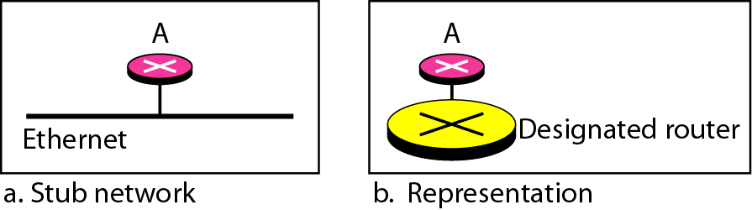
Figure 22.28 Stub link

Slide 47
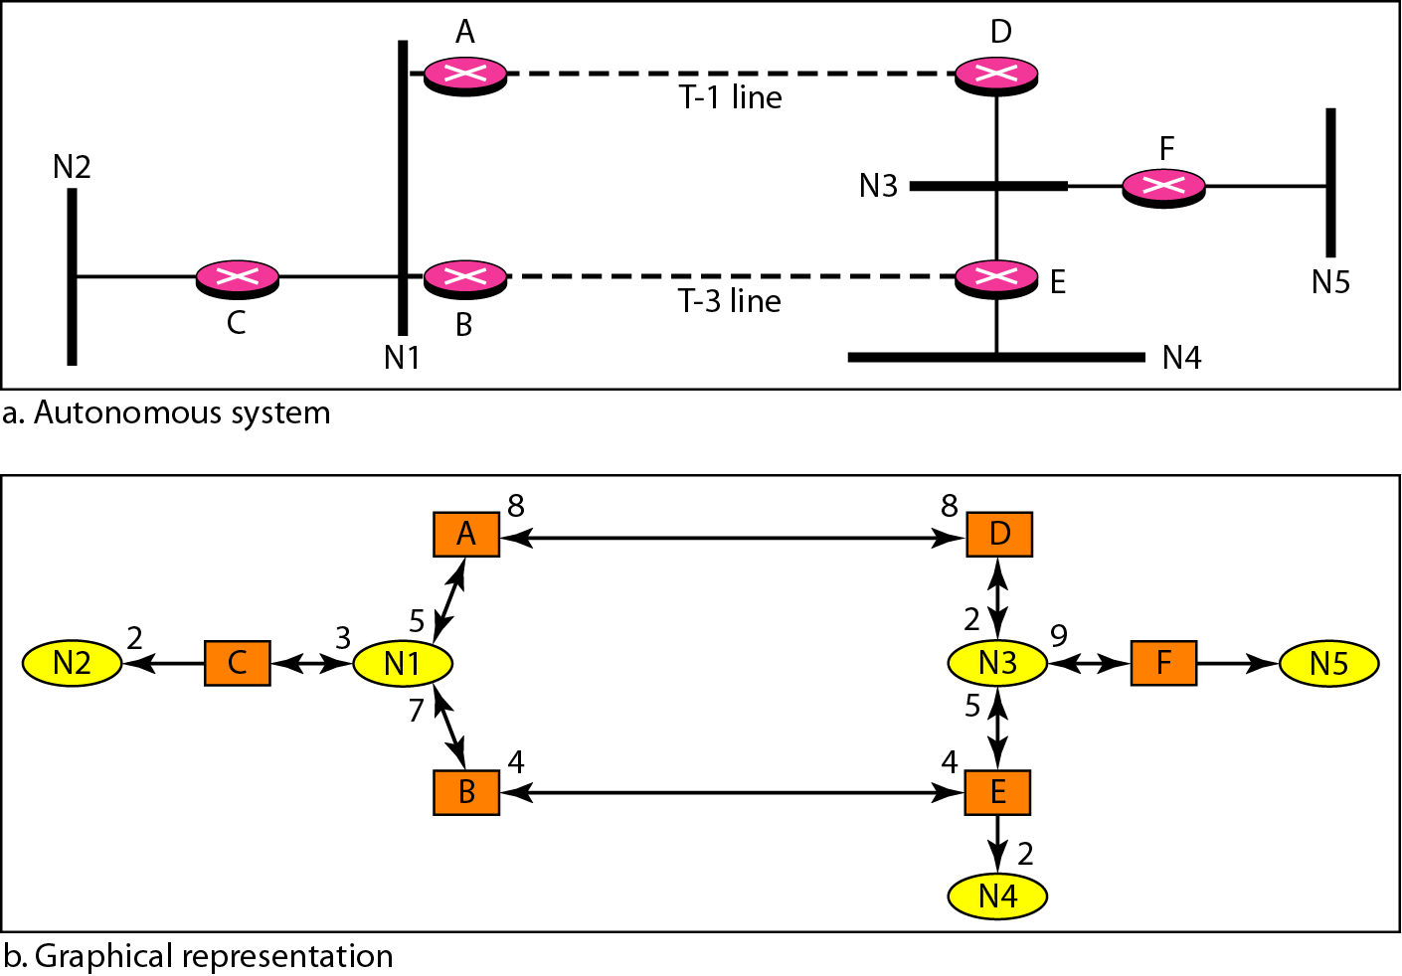
Figure 22.29 Example of an AS and its graphical representation in OSPF

Slide 48
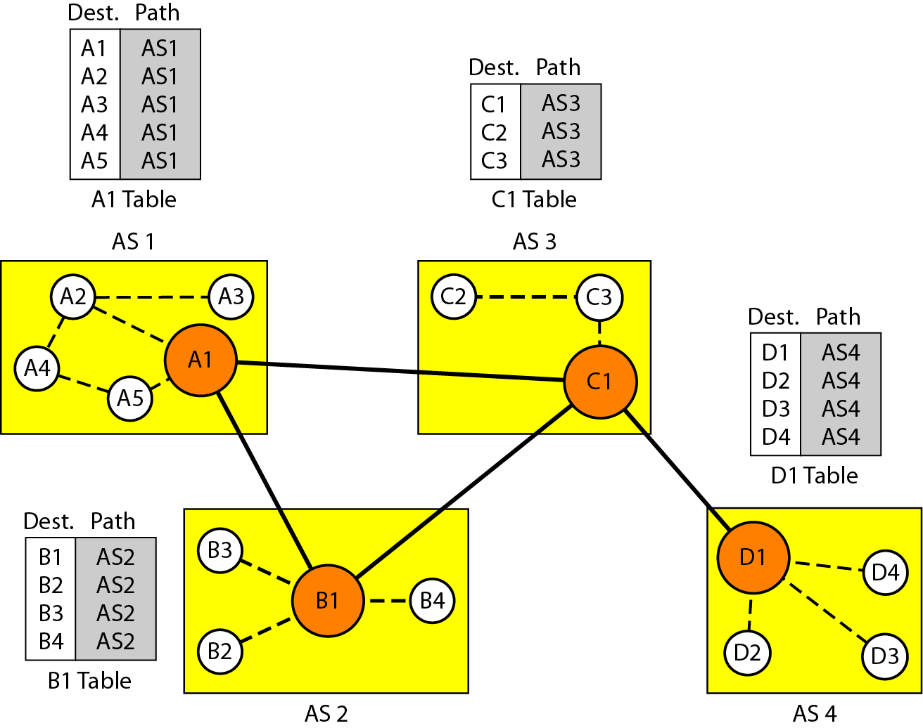
Figure 22.30 Initial routing tables in path vector routing

Slide 49
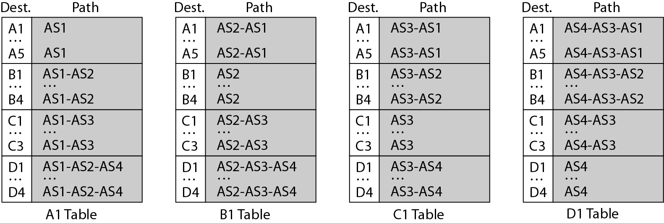
Figure 22.31 Stabilized tables for three autonomous systems

Slide 50
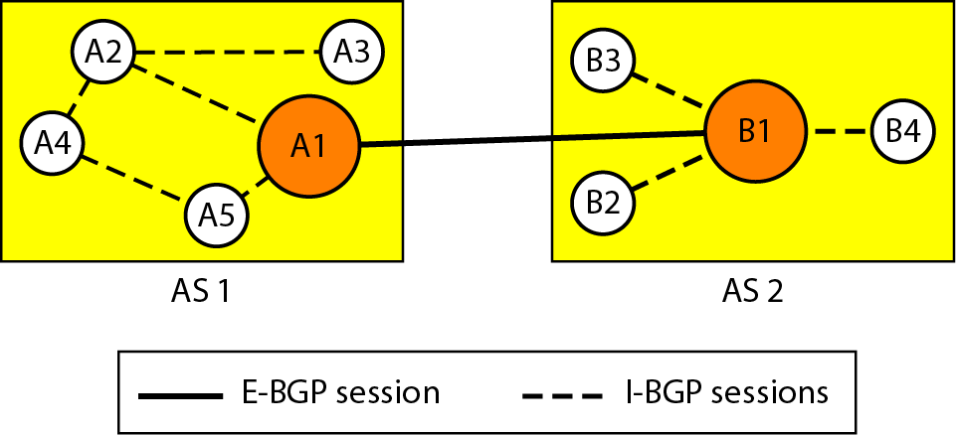
Figure 22.32 Internal and external BGP sessions

Slide 51
22-4 MULTICAST ROUTING PROTOCOLS
In this section, we discuss multicasting and multicast routing protocols.
Topics discussed in this section:
Unicast, Multicast, and Broadcast Applications
Multicast Routing
Routing Protocols

Slide 52
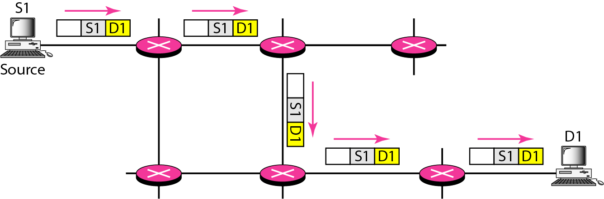
Figure 22.33 Unicasting

Slide 53
Note
In unicasting, the router forwards the received packet through
only one of its interfaces.

Slide 54
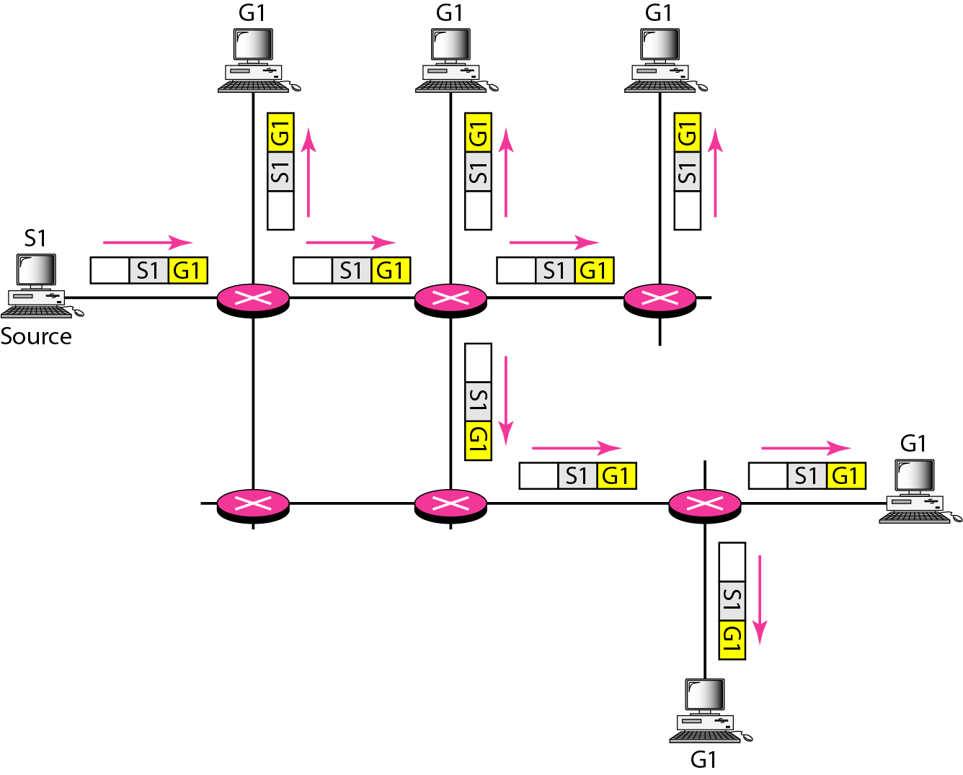
Figure 22.34 Multicasting

Slide 55
Note
In multicasting, the router may forward the received packet
through several of its interfaces.

Slide 56
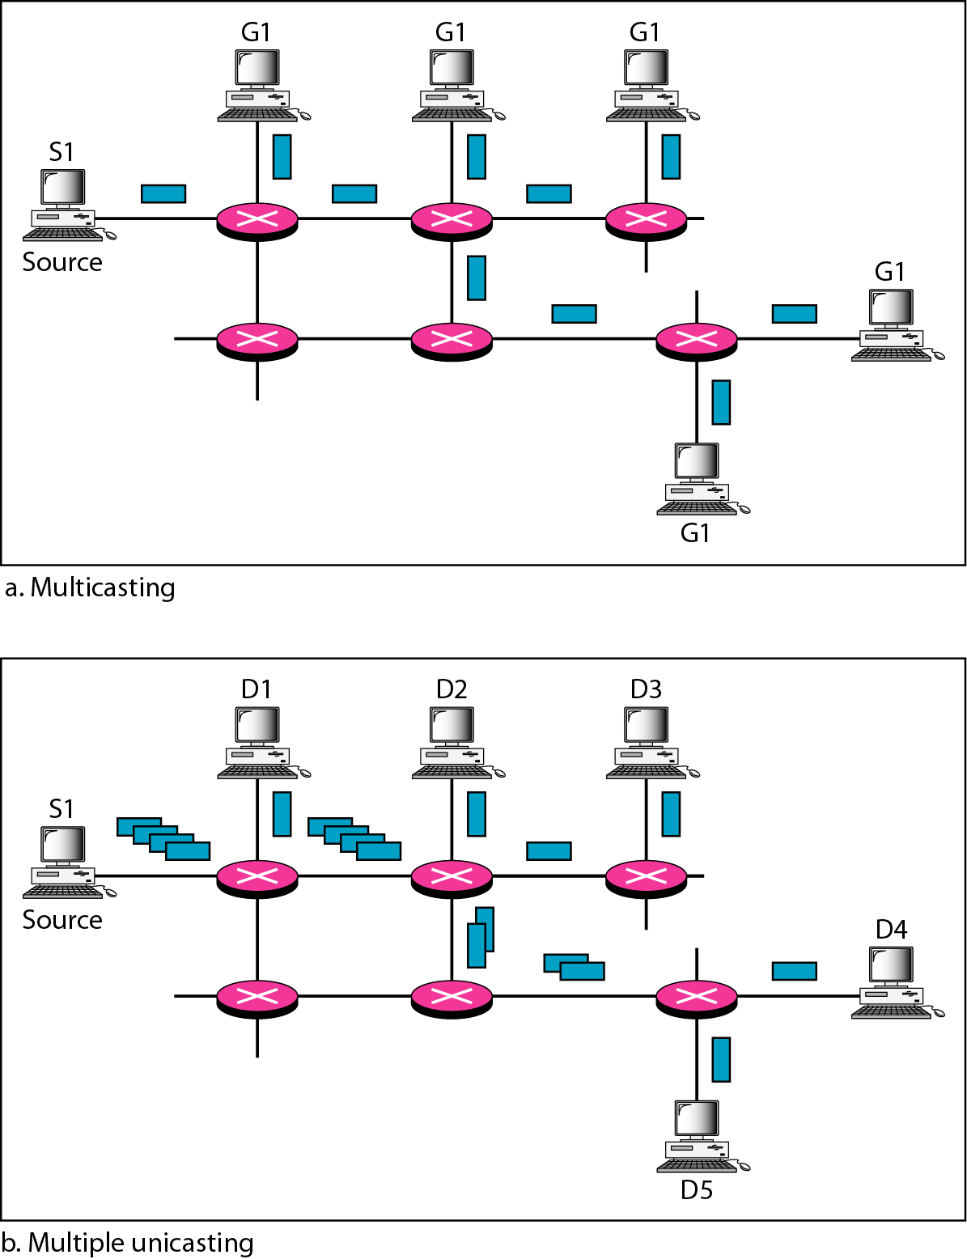
Figure 22.35 Multicasting versus multiple unicasting

Slide 57
Note
Emulation of multicasting through multiple unicasting is not efficient
and may create long delays, particularly with a large group.

Slide 58
Note
In unicast routing, each router in the domain has a table that defines
a shortest path tree to possible destinations.

Slide 59
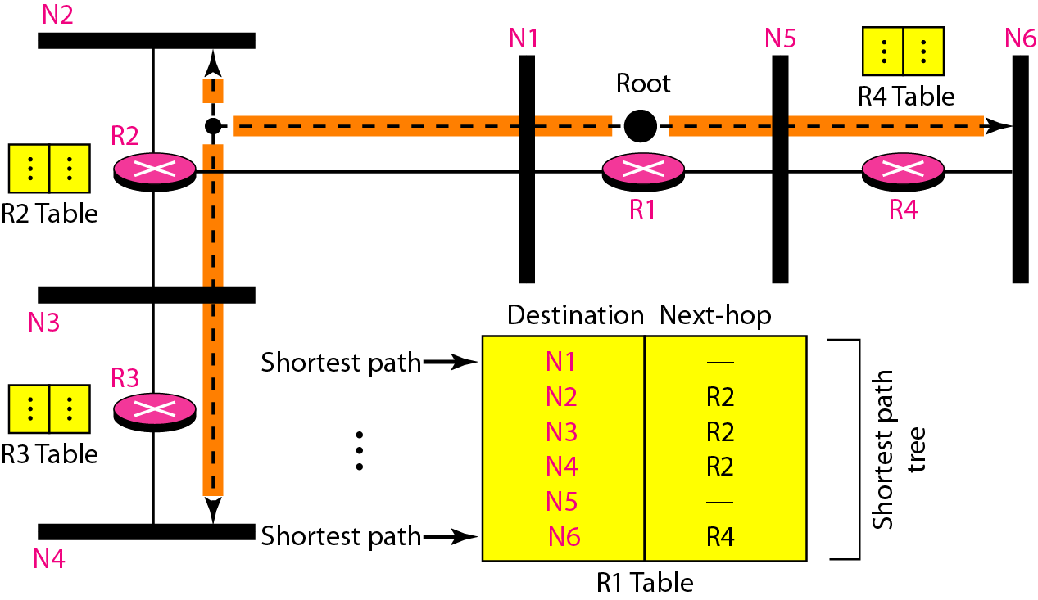
Figure 22.36 Shortest path tree in unicast routing

Slide 60
Note
In multicast routing, each involved router needs to construct
a shortest path tree for each group.

Slide 61
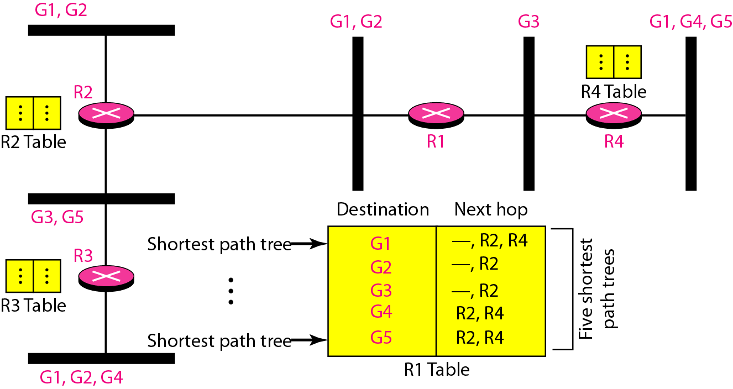
Figure 22.37 Source-based tree approach

Slide 62
Note
In the source-based tree approach, each router needs to have one shortest path tree for each group.

Slide 63
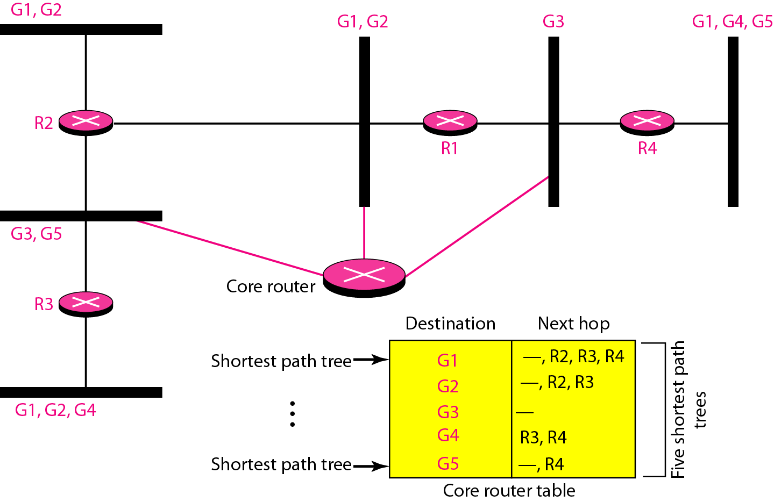
Figure 22.38 Group-shared tree approach

Slide 64
Note
In the group-shared tree approach, only the core router, which has a shortest path tree for each group, is involved in multicasting.

Slide 65
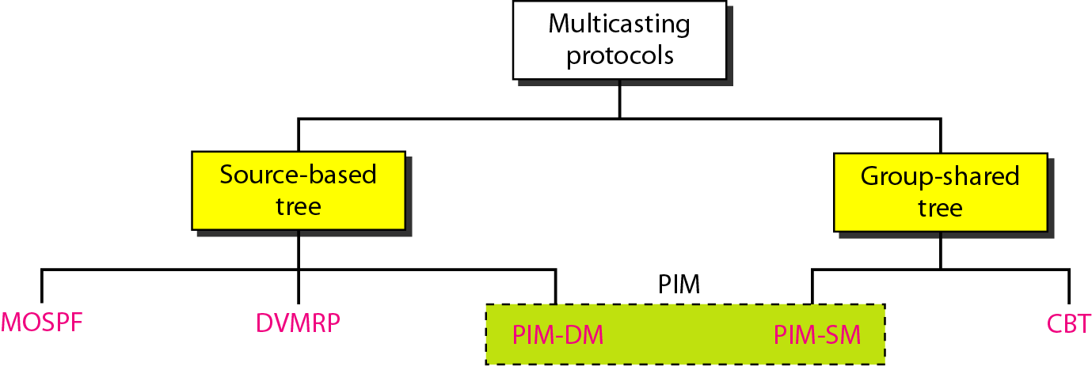
Figure 22.39 Taxonomy of common multicast protocols

Slide 66
Note
Multicast link state routing uses the source-based tree approach.

Slide 67
Note
Flooding broadcasts packets, but creates loops in the systems.

Slide 68
Note
RPF eliminates the loop in the flooding process.

Slide 69
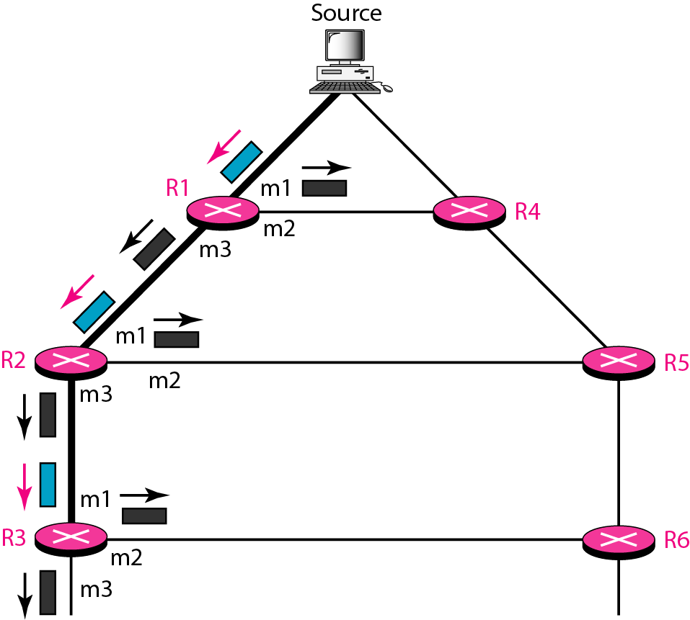
Figure 22.40 Reverse path forwarding (RPF)

Slide 70
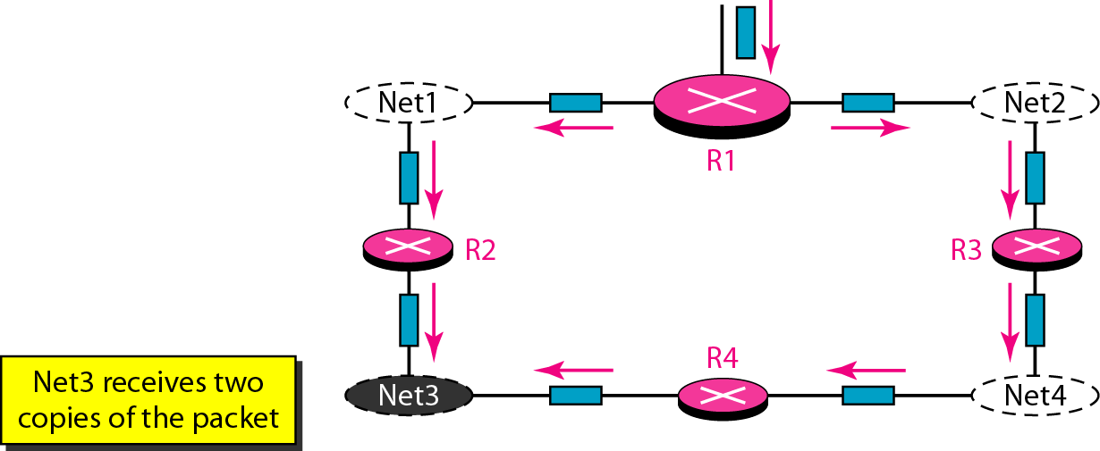
Figure 22.41 Problem with RPF

Slide 71
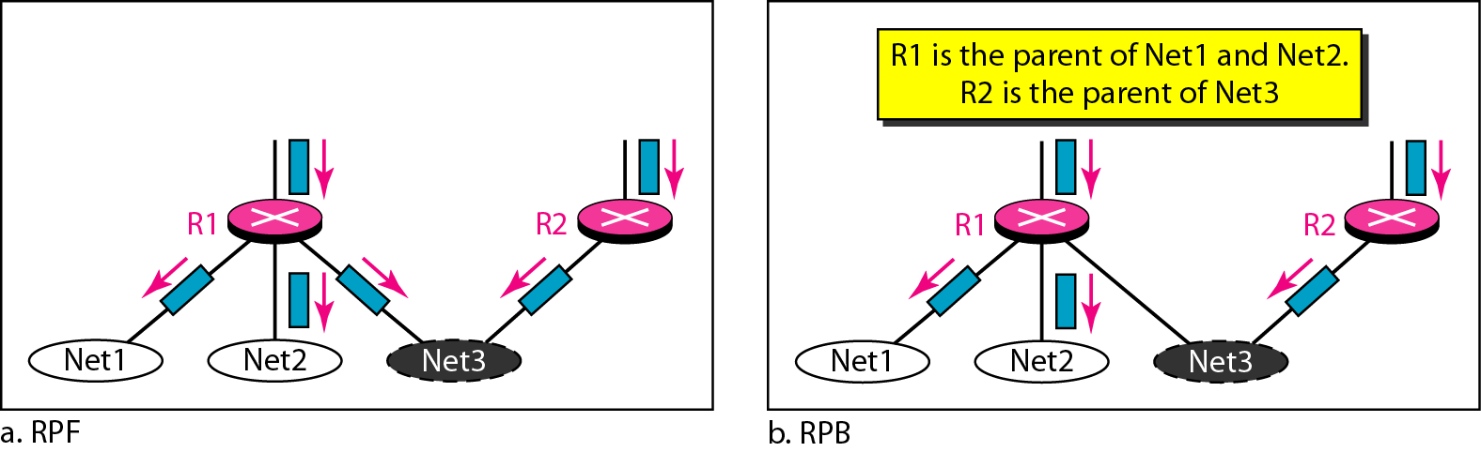
Figure 22.42 RPF Versus RPB

Slide 72
Note
RPB creates a shortest path broadcast tree from the source to each destination.
It guarantees that each destination receives one and only one copy of the packet.

Slide 73
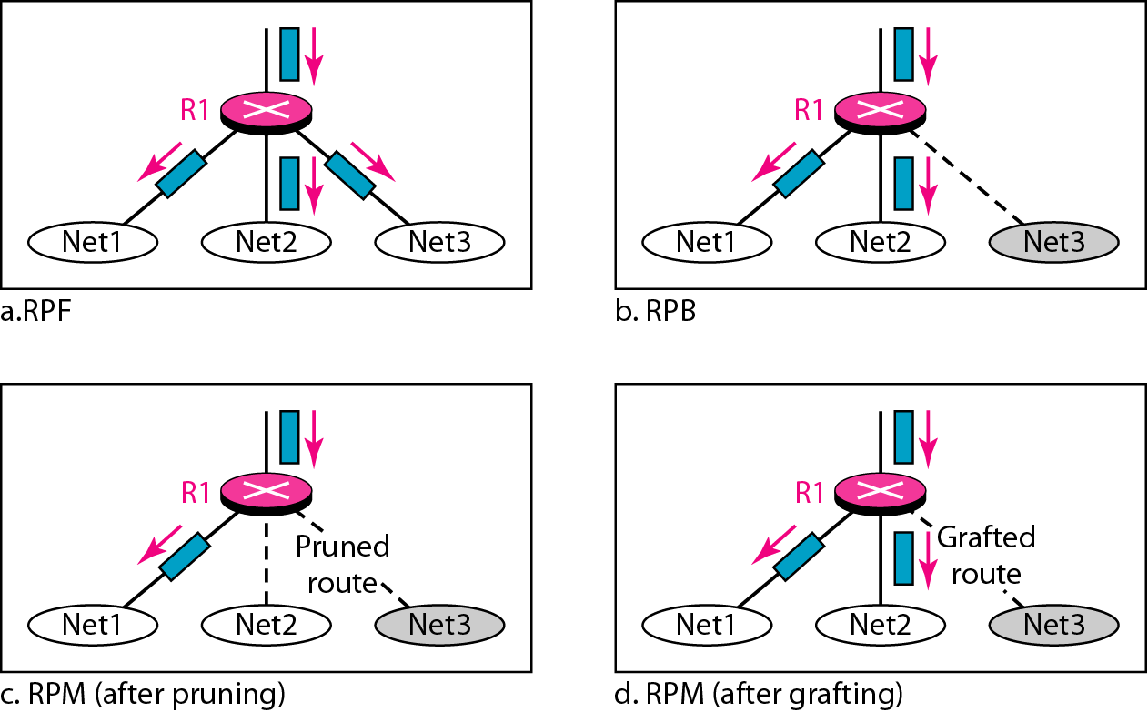
Figure 22.43 RPF, RPB, and RPM

Slide 74
Note
RPM adds pruning and grafting to RPB to create a multicast shortest
path tree that supports dynamic membership changes.

Slide 75
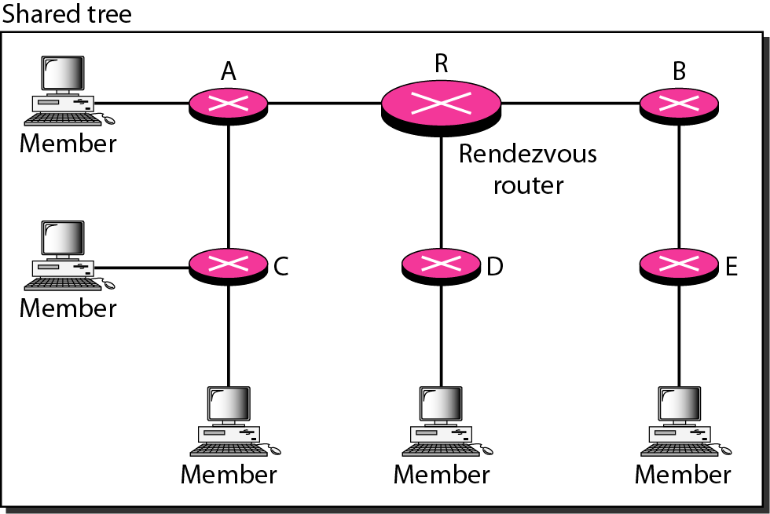
Figure 22.44 Group-shared tree with rendezvous router

Slide 76
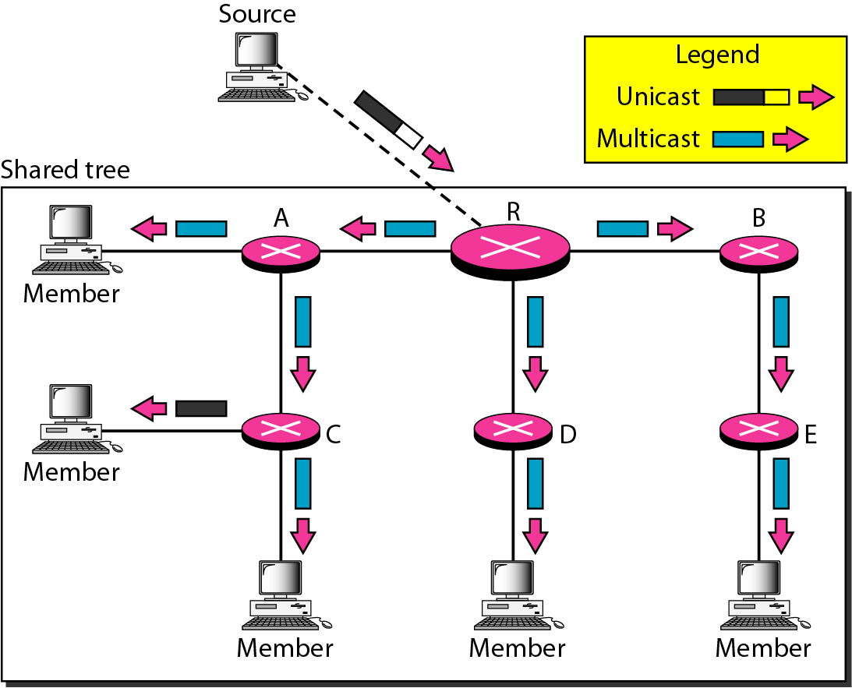
Figure 22.45 Sending a multicast packet to the rendezvous router

Slide 77
Note
In CBT, the source sends the multicast packet (encapsulated in a unicast packet) to the core router. The core router decapsulates the packet and forwards it to all interested interfaces.

Slide 78
Note
PIM-DM is used in a dense multicast environment, such as a LAN.

Slide 79
Note
PIM-DM uses RPF and pruning and grafting strategies to handle multicasting.
However, it is independent of the underlying unicast protocol.

Slide 80
Note
PIM-SM is used in a sparse multicast environment such as a WAN.

Slide 81
Note
PIM-SM is similar to CBT but uses a simpler procedure.

Slide 82
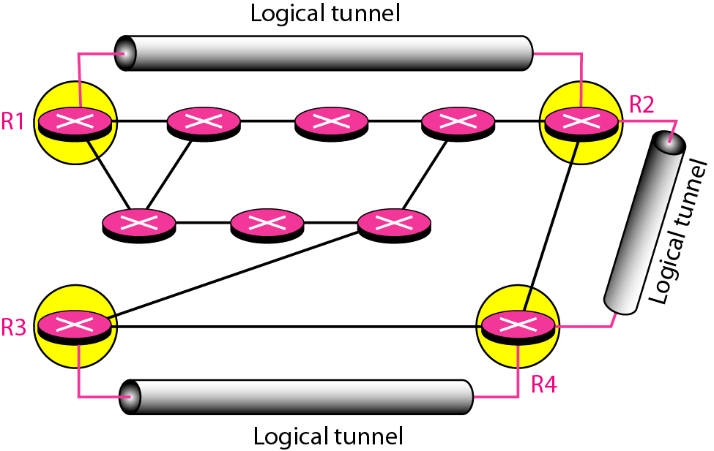
Figure 22.46 Logical tunneling

Slide 83
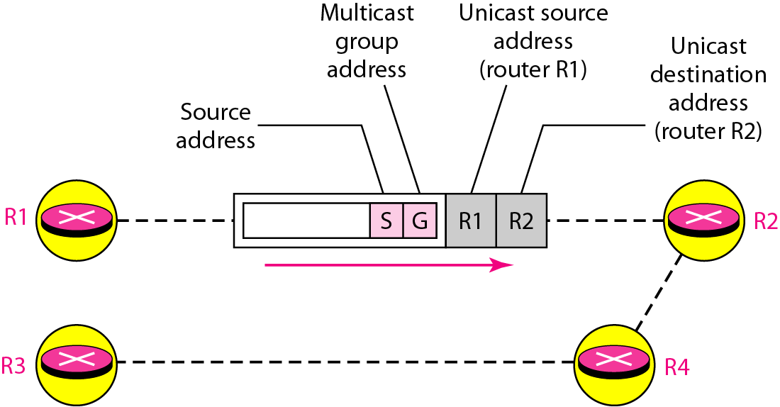
Figure 22.47 MBONE

