Slide 1

Chapter 24
Congestion Control and
Quality of Service
Copyright © The McGraw-Hill Companies, Inc. Permission required for reproduction or display.

Slide 2
24-1 DATA TRAFFIC
The main focus of congestion control and quality of service is data traffic. In congestion control we try to avoid traffic congestion. In quality of service, we try to create an appropriate environment for the traffic. So, before talking about congestion control and quality of service, we discuss the data traffic itself.
Topics discussed in this section:
Traffic Descriptor Traffic Profiles

Slide 3
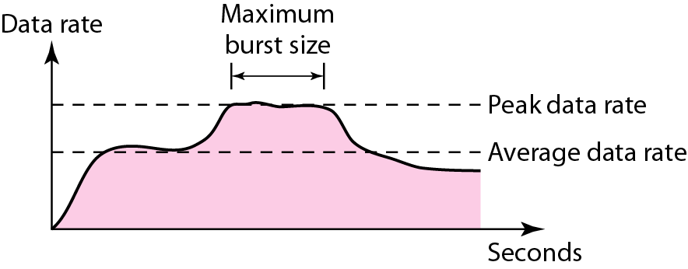
Figure 24.1 Traffic descriptors

Slide 4
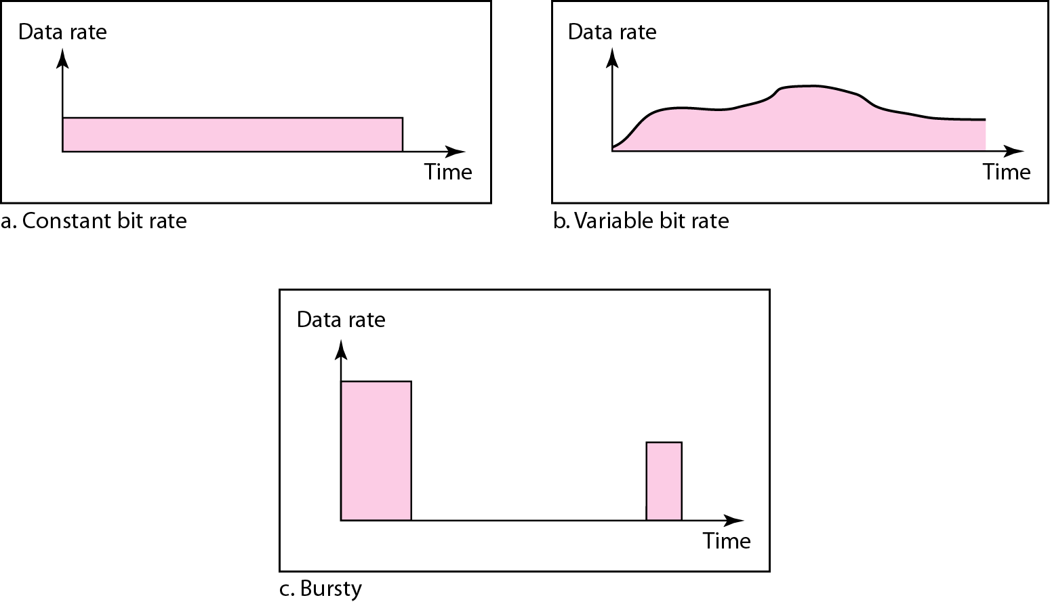
Figure 24.2 Three traffic profiles

Slide 5
24-2 CONGESTION
Congestion in a network may occur if the load on the network—the number of packets sent to the network—is greater than the capacity of the network—the number of packets a network can handle. Congestion control refers to the mechanisms and techniques to control the congestion and keep the load below the capacity.
Topics discussed in this section:
Network Performance

Slide 6
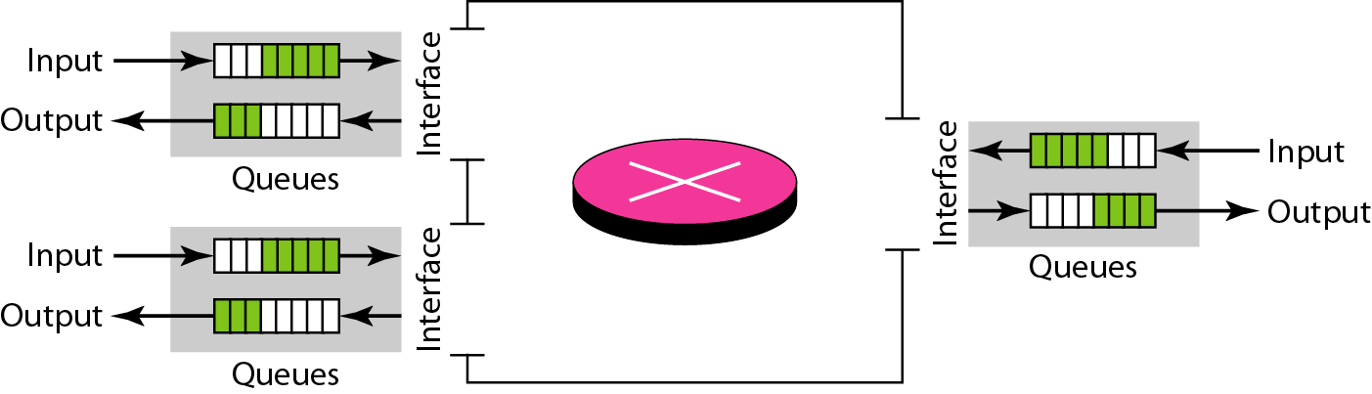
Figure 24.3 Queues in a router

Slide 7
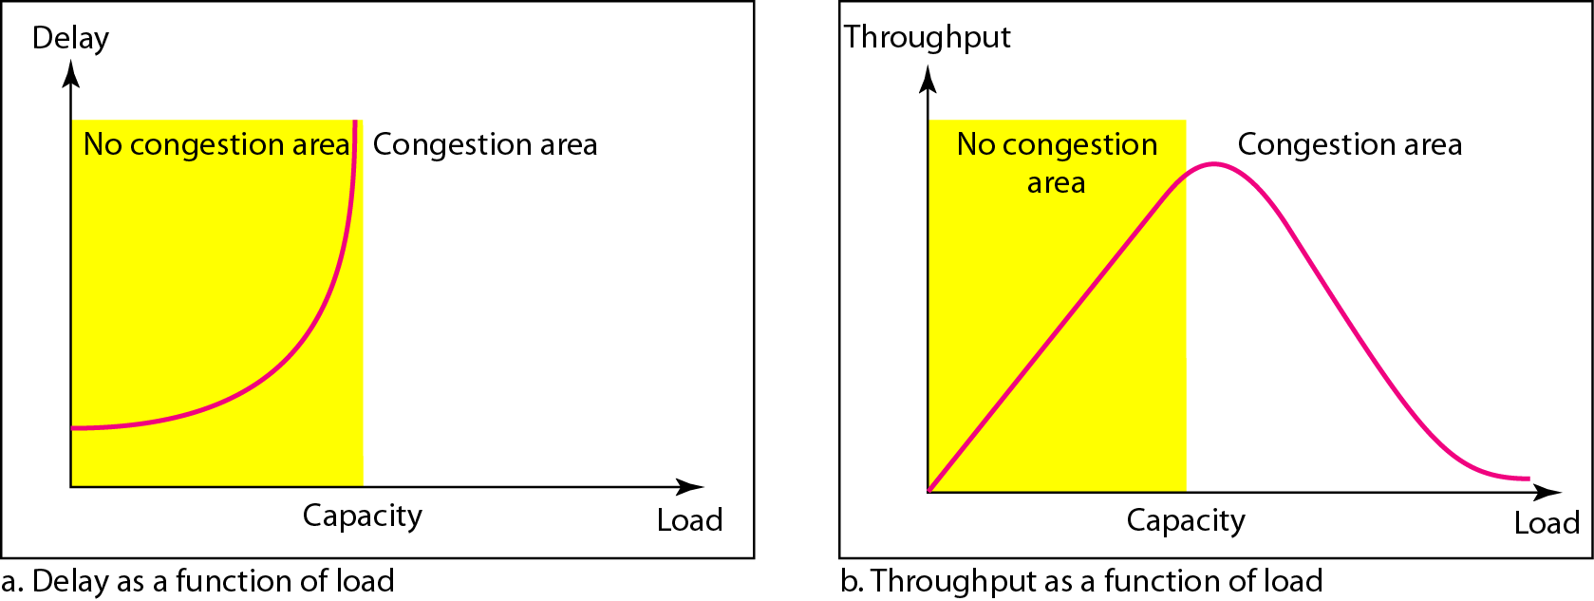
Figure Packet delay and throughput as functions of load

Slide 8
24-3 CONGESTION CONTROL
Congestion control refers to techniques and mechanisms that can either prevent congestion, before it happens, or remove congestion, after it has happened. In general, we can divide congestion control mechanisms into two broad categories: open-loop congestion control (prevention) and closed-loop congestion control (removal).
Topics discussed in this section:
Open-Loop Congestion Control Closed-Loop Congestion Control

Slide 9
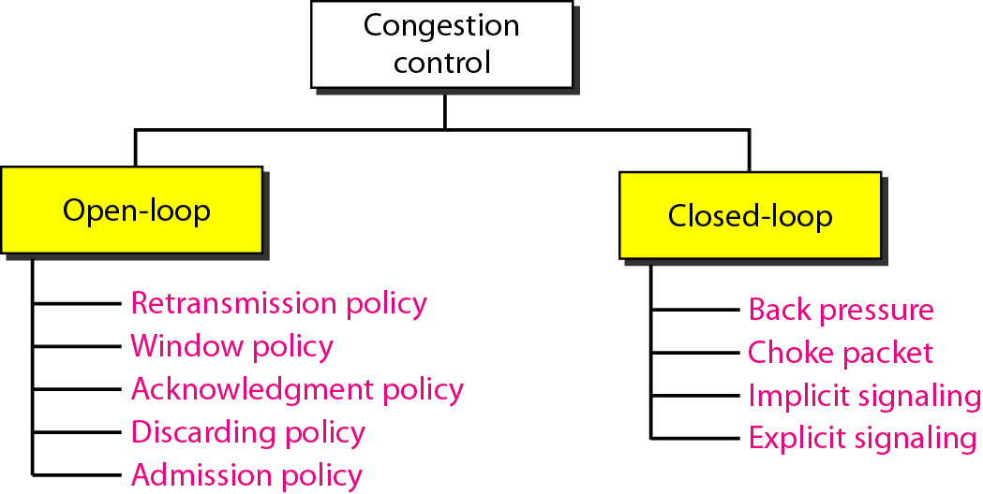
Figure 24.5 Congestion control categories

Slide 10
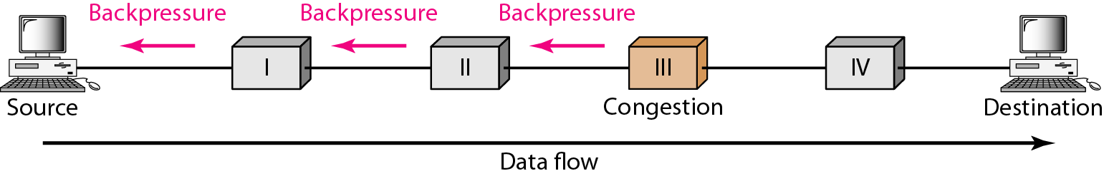
Figure 24.6 Backpressure method for alleviating congestion

Slide 11
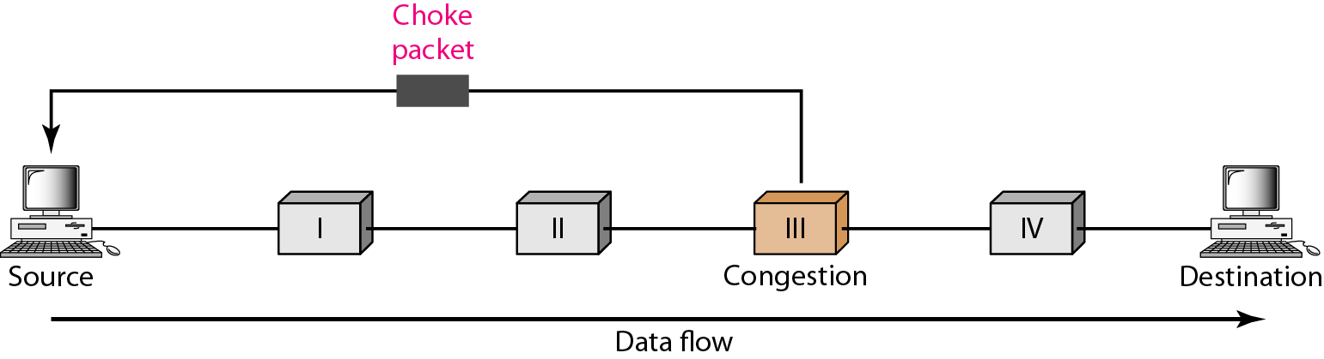
Figure 24.7 Choke packet

Slide 12
24-4 TWO EXAMPLES
To better understand the concept of congestion control, let us give two examples: one in TCP and the other in Frame Relay.
Topics discussed in this section:
Congestion Control in TCP Congestion Control in Frame Relay

Slide 13
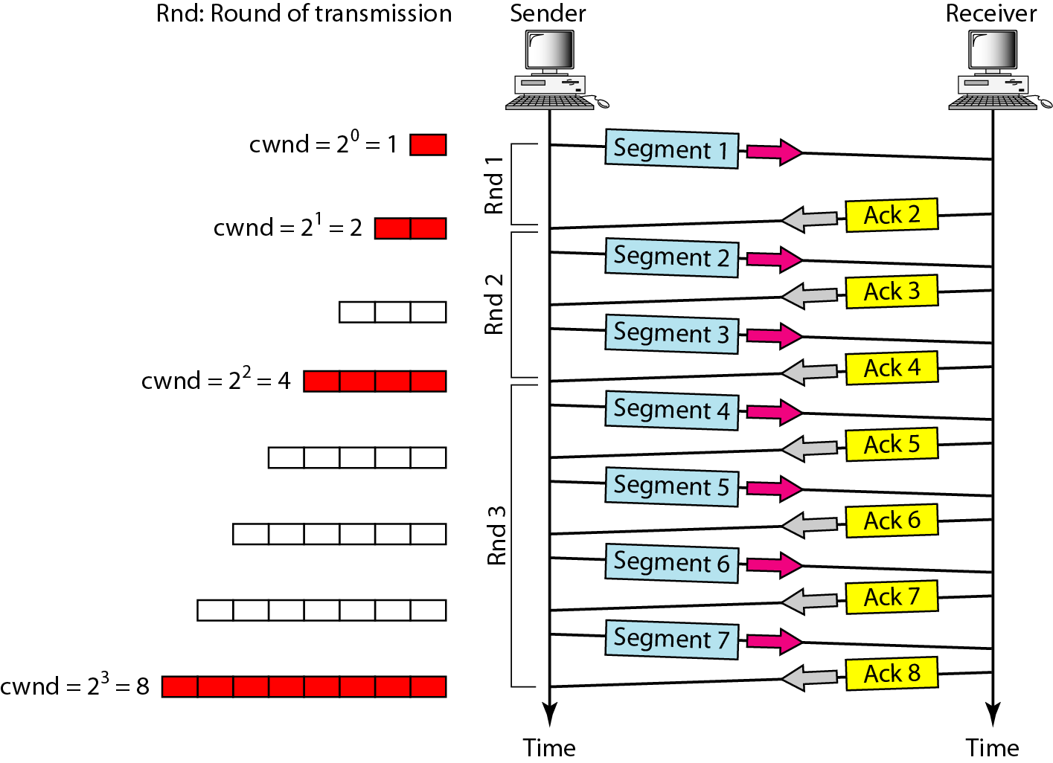
Figure 24.8 Slow start, exponential increase

Slide 14

Note
In the slow-start algorithm, the size of the congestion window increases exponentially until it reaches a threshold.

Slide 15
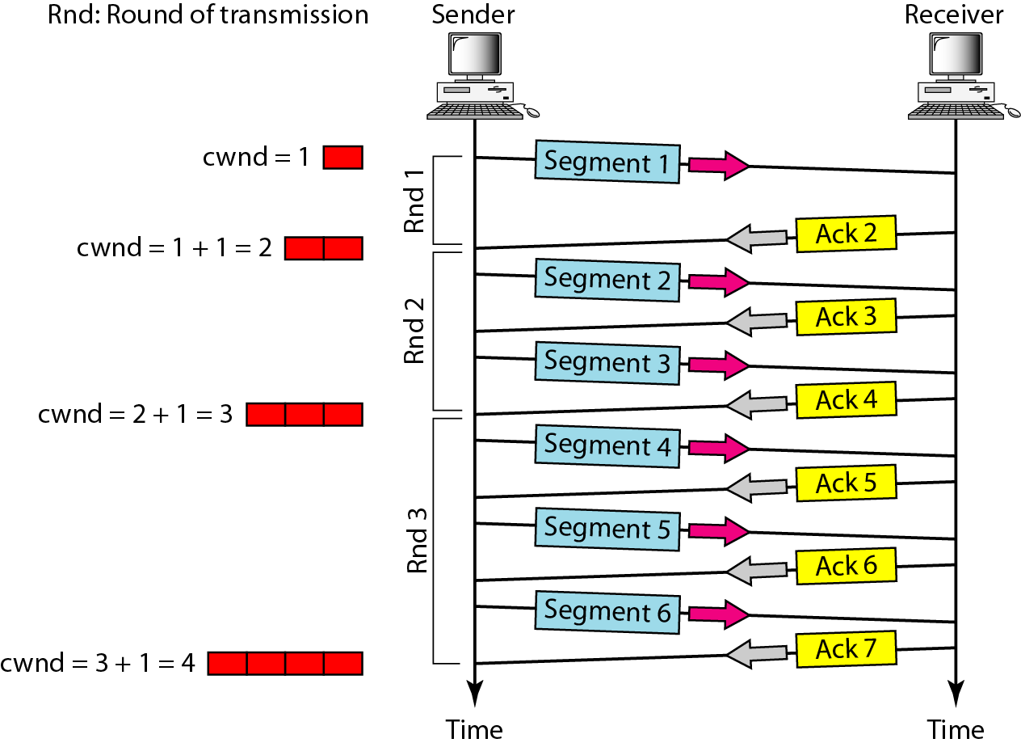
Figure 24.9 Congestion avoidance, additive increase

Slide 16
Note
In the congestion avoidance algorithm, the size of the congestion window increases additively until congestion is detected.

Slide 17
Note
An implementation reacts to congestion detection in one of the following ways:
❏ If detection is by time-out, a new slow start phase starts.
❏ If detection is by three ACKs, a new congestion avoidance phase starts.

Slide 18
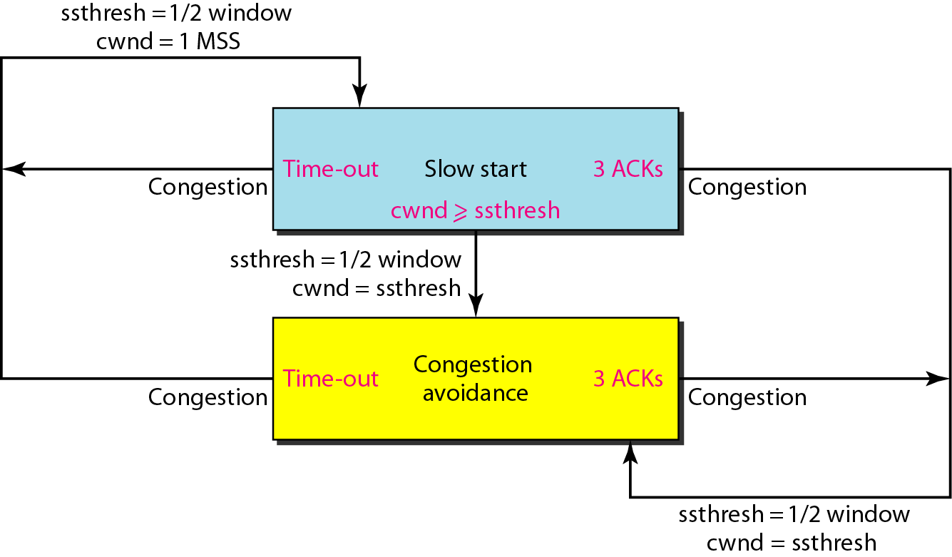
Figure 24.10 TCP congestion policy summary

Slide 19
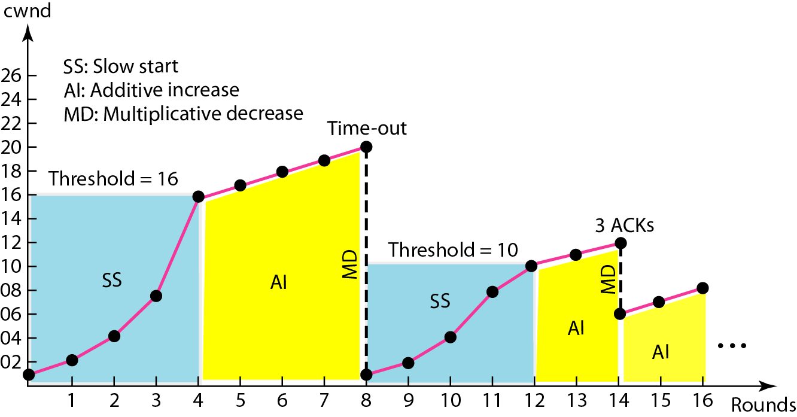
Figure 24.11 Congestion example

Slide 20
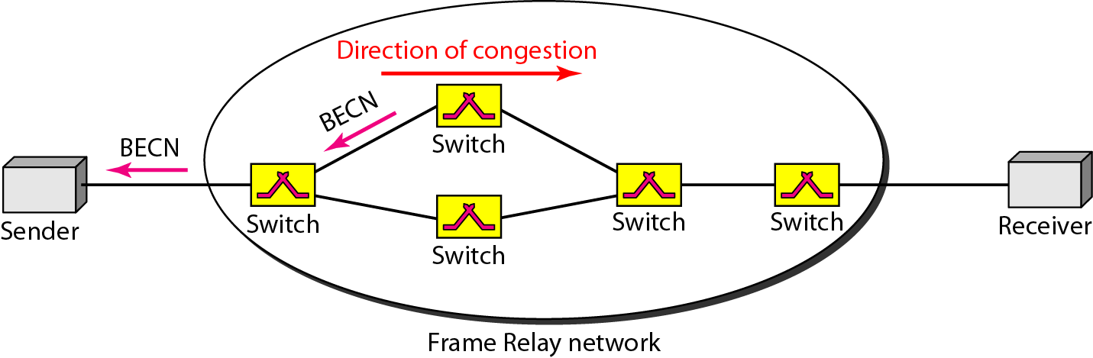
Figure 24.12 BECN

Slide 21
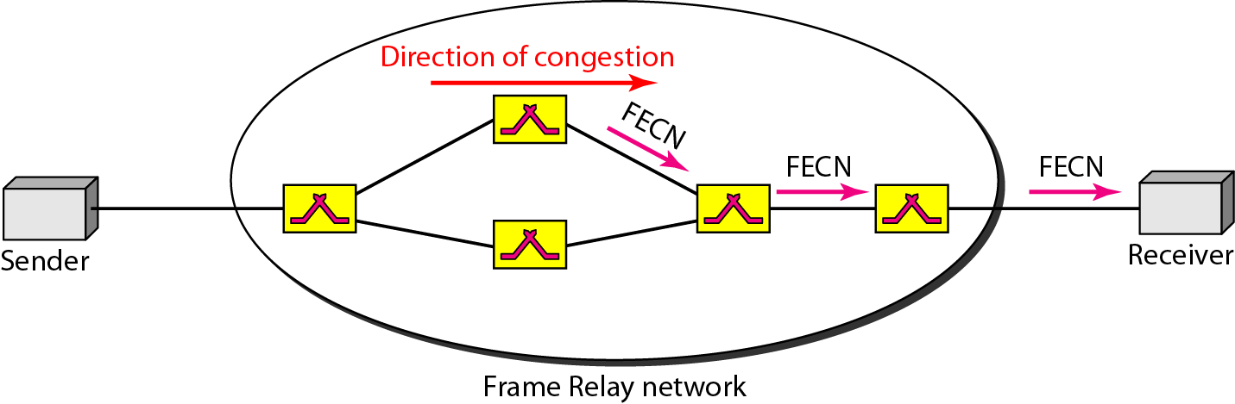
Figure 24.13 FECN

Slide 22
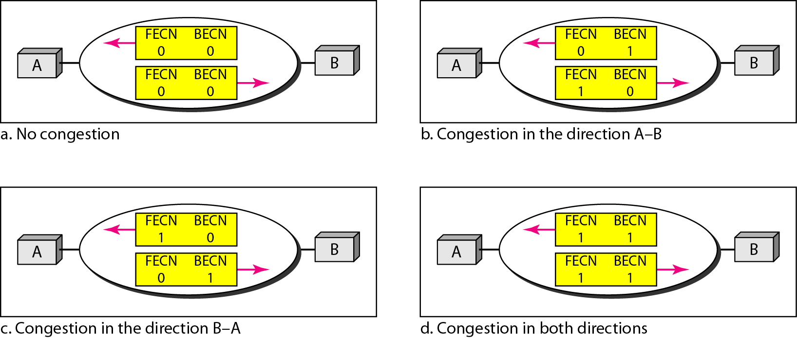
Figure 24.14 Four cases of congestion

Slide 23
24-5 QUALITY OF SERVICE
Quality of service (QoS) is an internetworking issue that has been discussed more than defined. We can informally define quality of service as something a flow seeks to attain.
Topics discussed in this section:
Flow Characteristics Flow Classes

Slide 24
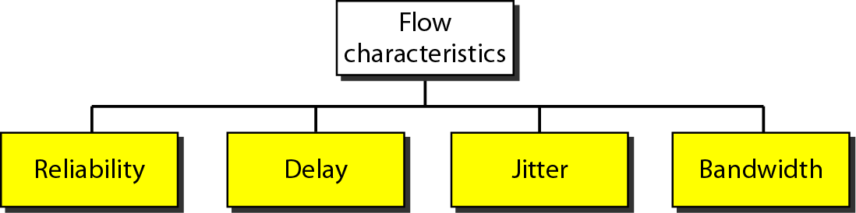
Figure 24.15 Flow characteristics

Slide 25
24-6 TECHNIQUES TO IMPROVE QoS
In Section 24.5 we tried to define QoS in terms of its characteristics. In this section, we discuss some techniques that can be used to improve the quality of service. We briefly discuss four common methods: scheduling, traffic shaping, admission control, and resource reservation.
Topics discussed in this section:
Scheduling Traffic Shaping Resource Reservation
Admission Control

Slide 26
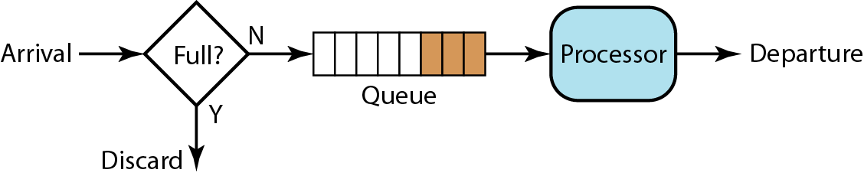
Figure 24.16 FIFO queue

Slide 27
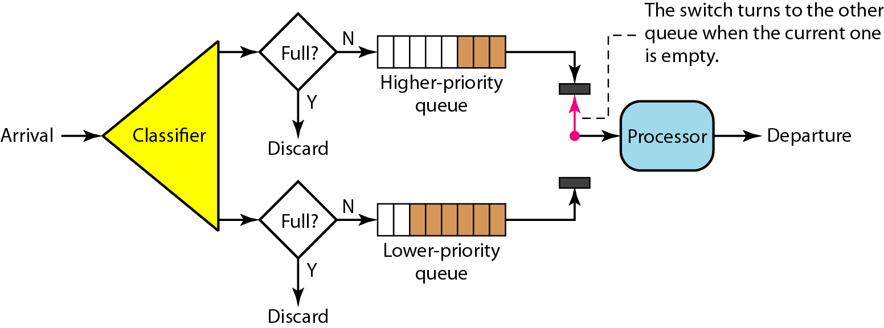
Figure 24.17 Priority queuing

Slide 28
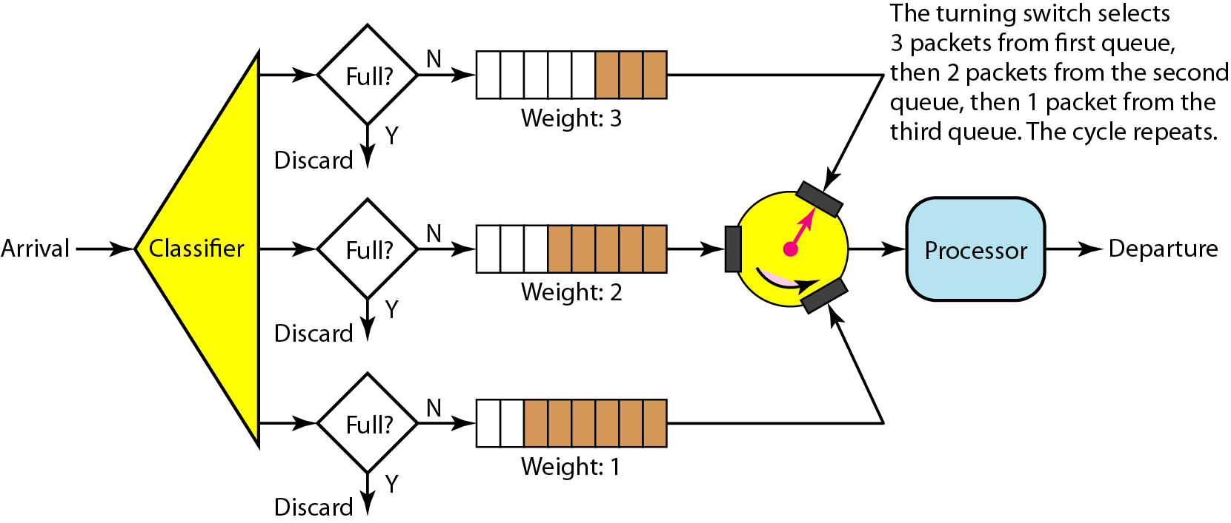
Figure 24.18 Weighted fair queuing

Slide 29
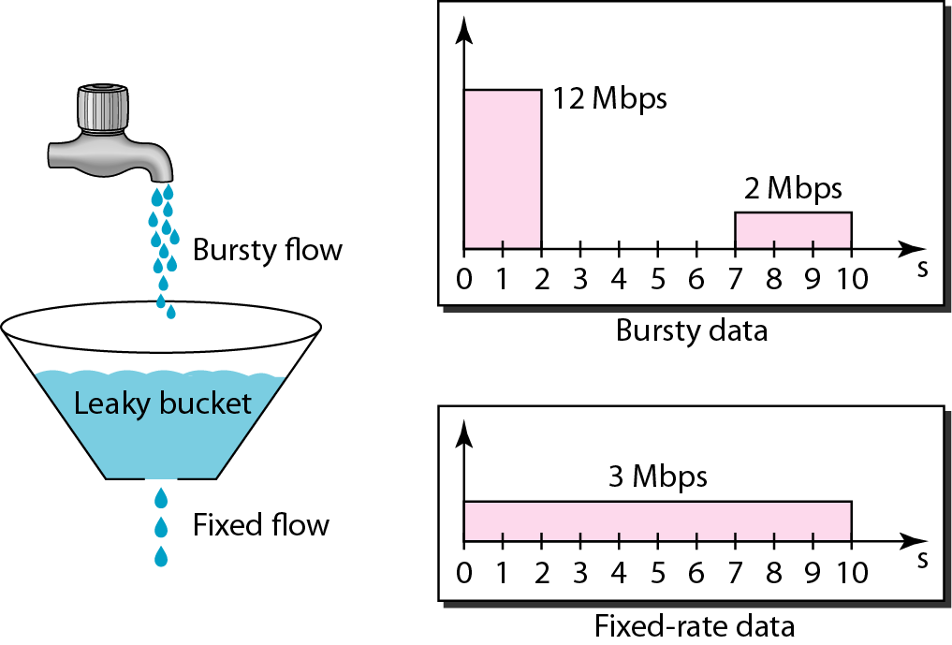
Figure 24.19 Leaky bucket

Slide 30
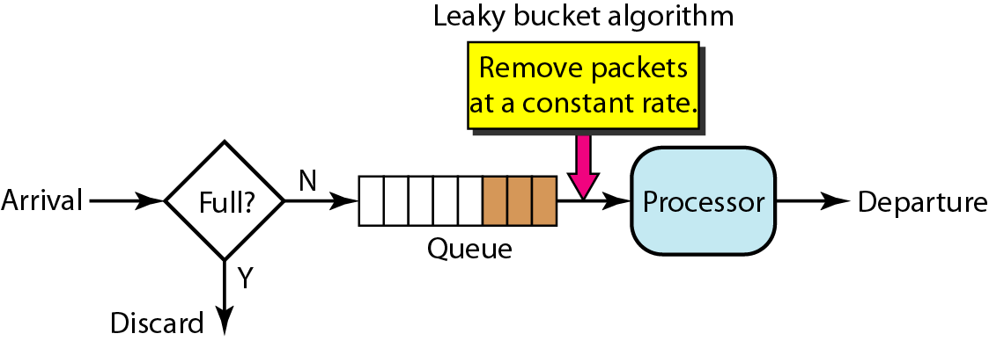
Figure 24.20 Leaky bucket implementation

Slide 31
Note
A leaky bucket algorithm shapes bursty traffic into fixed-rate traffic by averaging the data rate. It may drop the packets if the bucket is full.

Slide 32
Note
The token bucket allows bursty traffic at a regulated maximum rate.

Slide 33
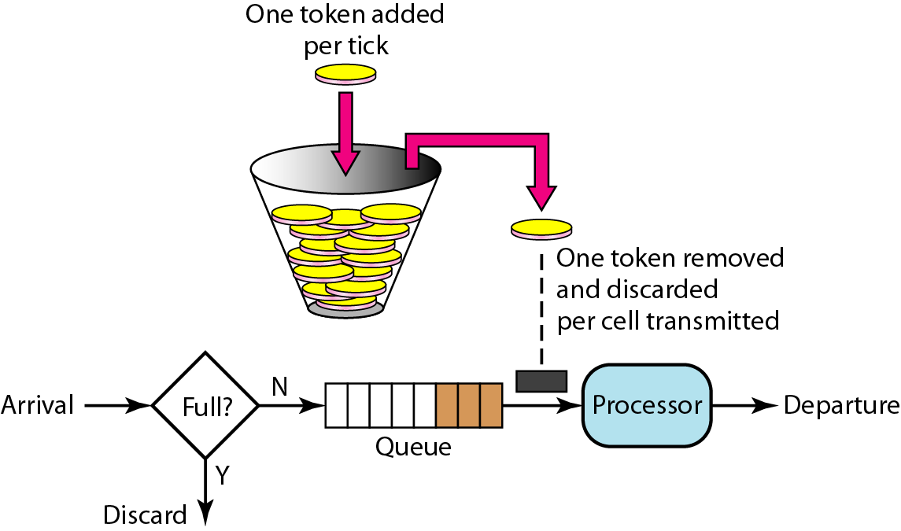
Figure 24.21 Token bucket

Slide 34
24-7 INTEGRATED SERVICES
Two models have been designed to provide quality of service in the Internet: Integrated Services and Differentiated Services. We discuss the first model here.
Topics discussed in this section:
Signaling Flow Specification Admission
Service Classes
RSVP
Problems with Integrated Services

Slide 35
Note
Integrated Services is a flow-based QoS model designed for IP.

Slide 36
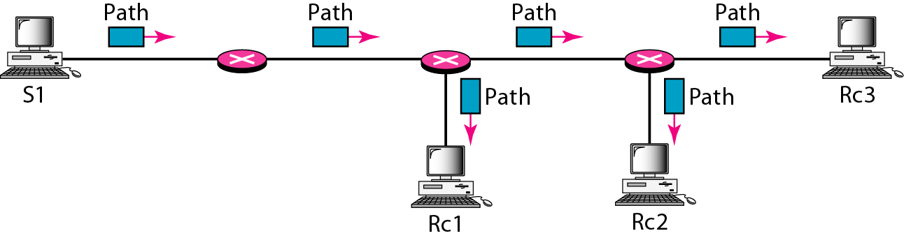
Figure 24.22 Path messages

Slide 37
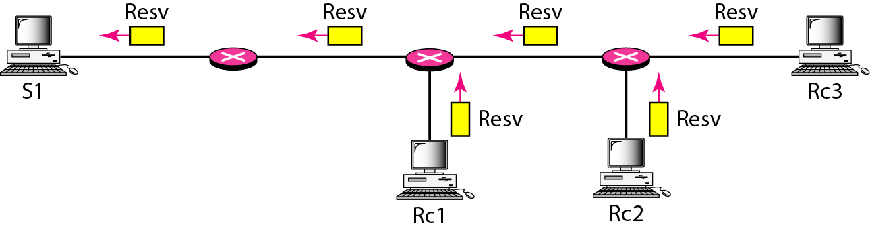
Figure 24.23 Resv messages

Slide 38
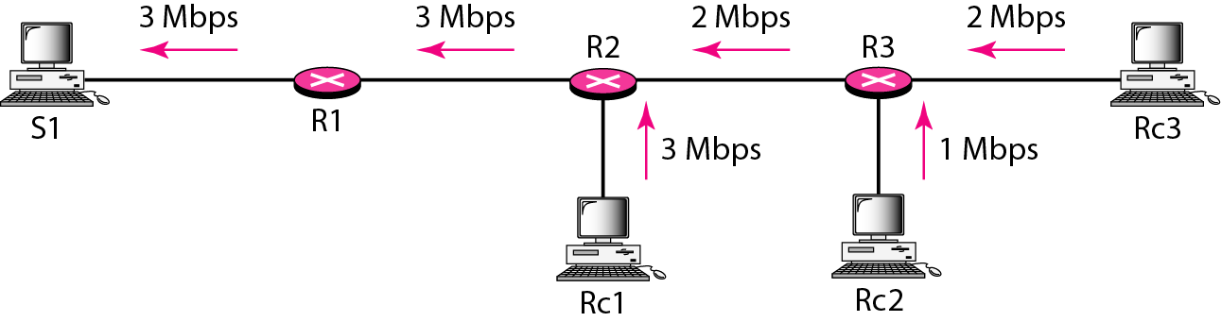
Figure 24.24 Reservation merging

Slide 39
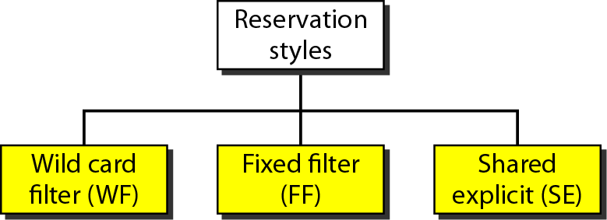
Figure 24.25 Reservation styles

Slide 40
24-8 DIFFERENTIATED SERVICES
Differentiated Services (DS or Diffserv) was introduced by the IETF (Internet Engineering Task Force) to handle the shortcomings of Integrated Services.
Topics discussed in this section:
DS Field

Slide 41
Note
Differentiated Services is a class-based QoS model designed for IP.

Slide 42

Figure 24.26 DS field

Slide 43
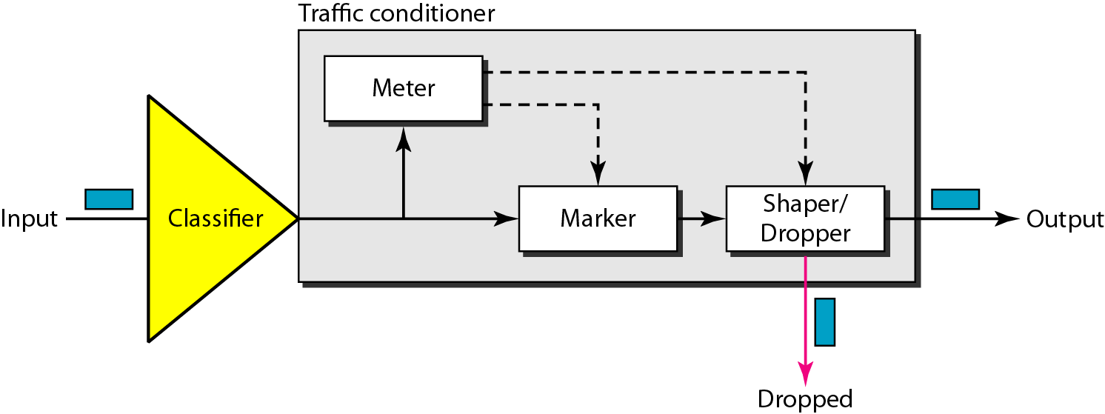
Figure 24.27 Traffic conditioner

Slide 44
24-9 QoS IN SWITCHED NETWORKS
Let us now discuss QoS as used in two switched networks: Frame Relay and ATM. These two networks are virtual-circuit networks that need a signaling protocol such as RSVP.
Topics discussed in this section:
QoS in Frame Relay QoS in ATM

Slide 45
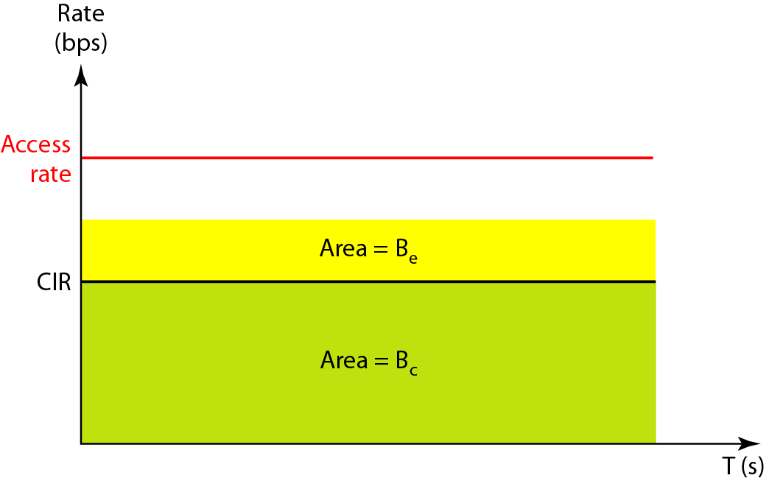
Figure 24.28 Relationship between traffic control attributes

Slide 46
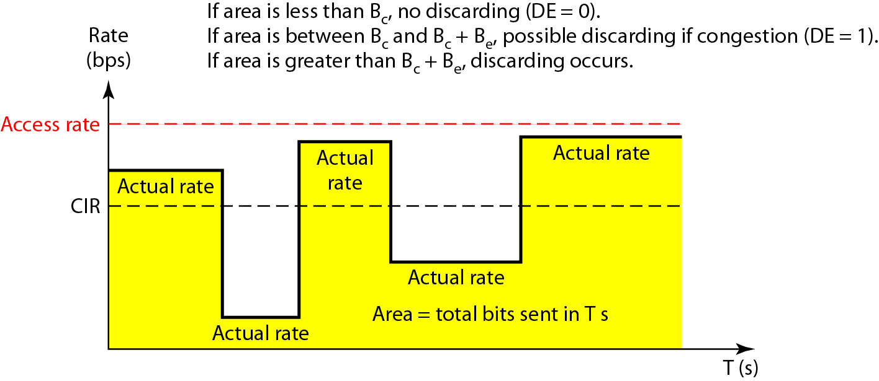
Figure 24.29 User rate in relation to Bc and Bc + Be

Slide 47
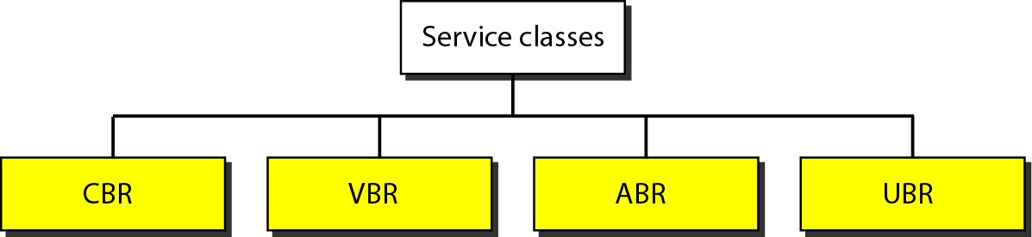
Figure 24.30 Service classes

Slide 48
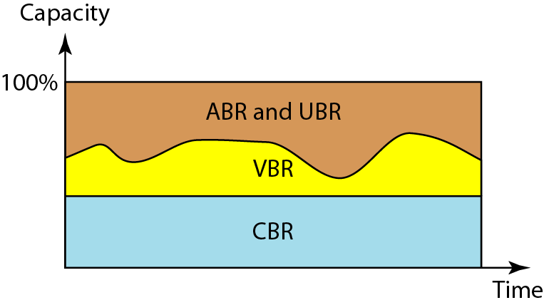
Figure 24.31 Relationship of service classes to the total capacity of the network

