Slide 1

Chapter 27
WWW and HTTP
Copyright © The McGraw-Hill Companies, Inc. Permission required for reproduction or display.

Slide 2
27-1 ARCHITECTURE
The WWW today is a distributed client/server service, in which a client using a browser can access a service using a server. However, the service provided is distributed over many locations called sites.
Topics discussed in this section:
Client (Browser) Server Uniform Resource Locator
Cookies

Slide 3
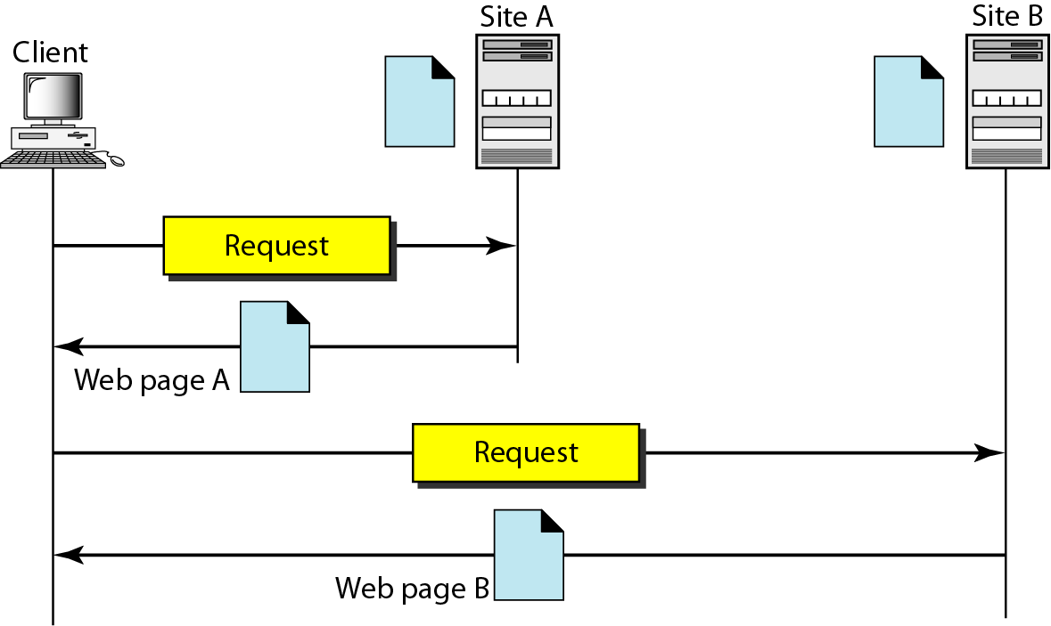
Figure 27.1 Architecture of WWW

Slide 4
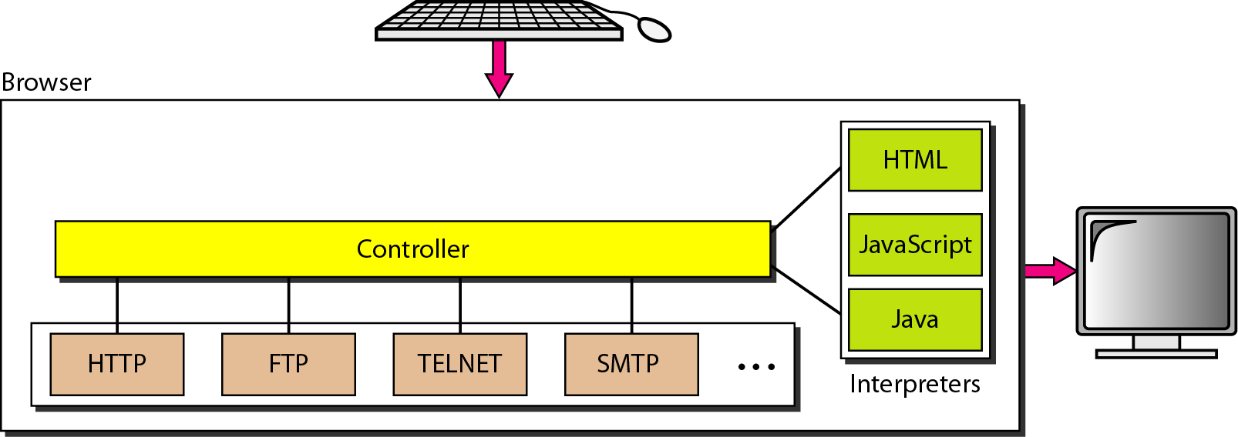
Figure 27.2 Browser

Slide 5
Figure 27.3 URL

Slide 6
27-2 WEB DOCUMENTS
The documents in the WWW can be grouped into three broad categories: static, dynamic, and active. The category is based on the time at which the contents of the document are determined.
Topics discussed in this section:
Static Documents
Dynamic Documents Active Documents

Slide 7
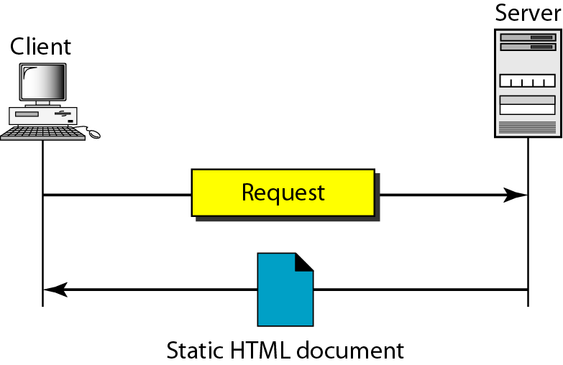
Figure 27.4 Static document

Slide 8
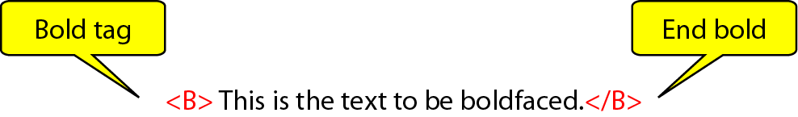
Figure 27.5 Boldface tags

Slide 9
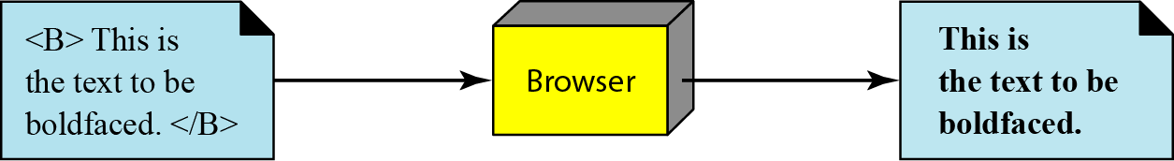
Figure 27.6 Effect of boldface tags

Slide 10
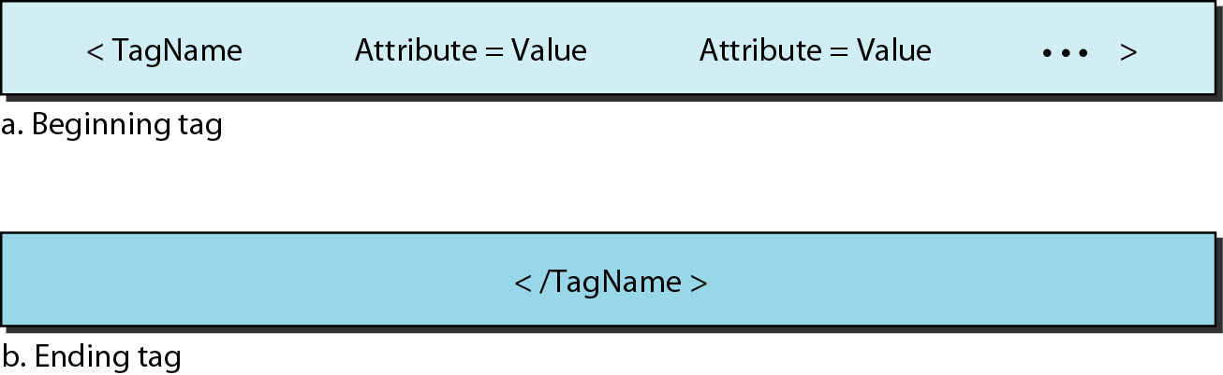
Figure 27.7 Beginning and ending tags

Slide 11
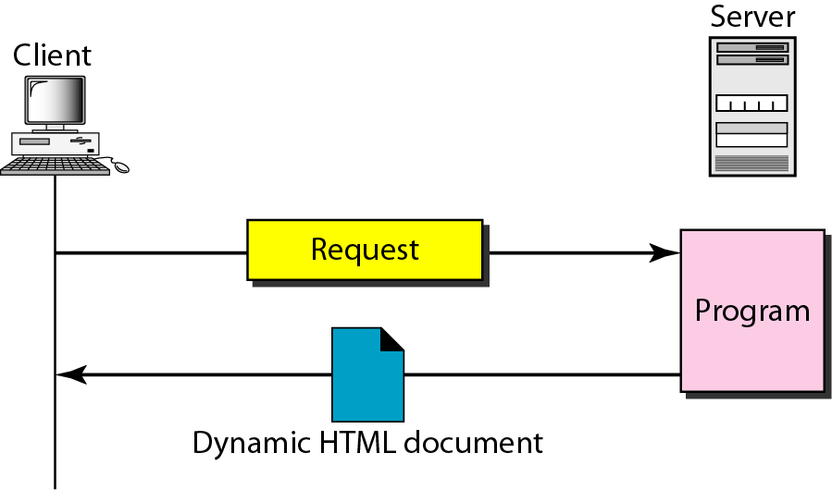
Figure 27.8 Dynamic document using CGI

Slide 12
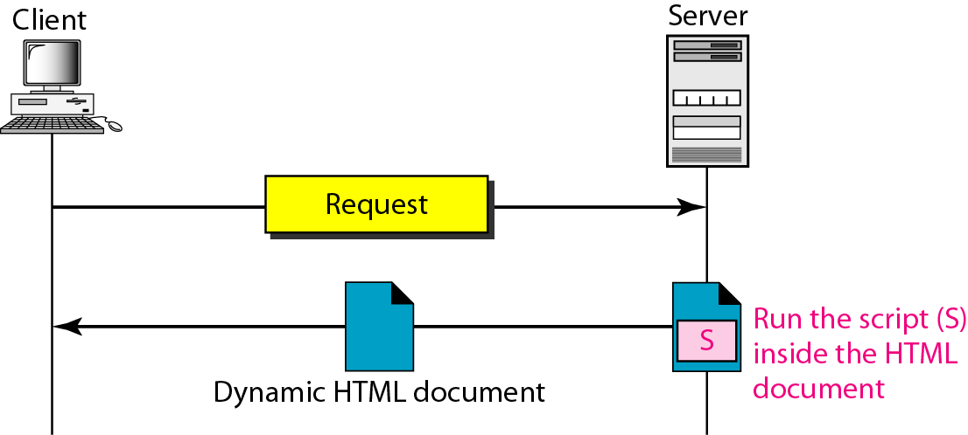
Figure 27.9 Dynamic document using server-site script

Slide 13

Note
Dynamic documents are sometimes referred to as server-site dynamic documents.

Slide 14
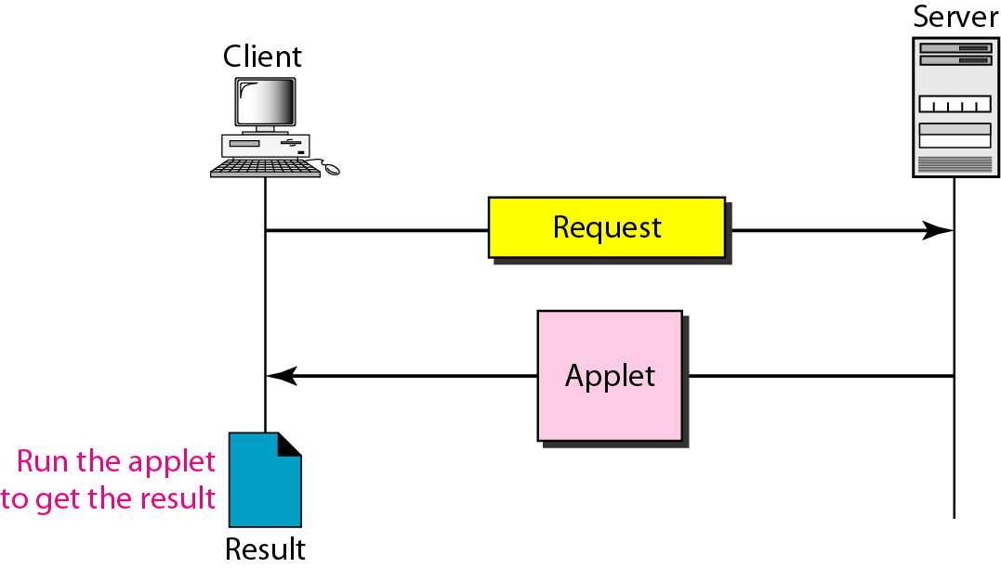
Figure 27.10 Active document using Java applet

Slide 15
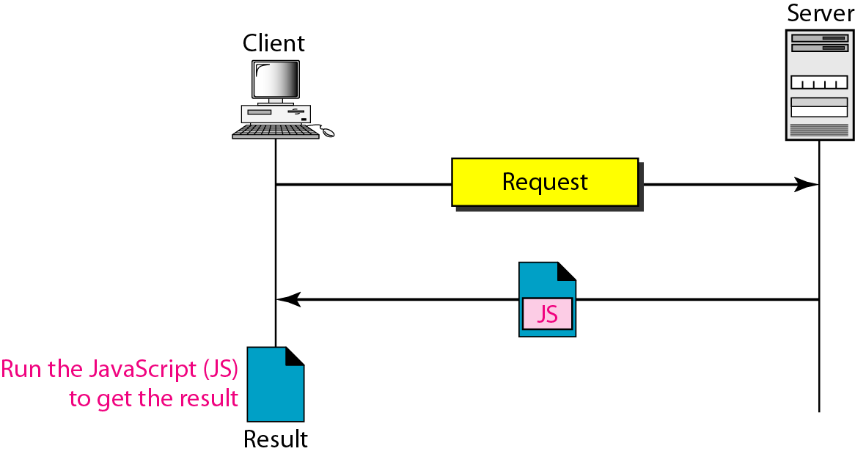
Figure 27.11 Active document using client-site script

Slide 16
Note
Active documents are sometimes referred to as client-site dynamic documents.

Slide 17
27-3 HTTP
The Hypertext Transfer Protocol (HTTP) is a protocol used mainly to access data on the World Wide Web. HTTP functions as a combination of FTP and SMTP.
Topics discussed in this section:
HTTP Transaction Persistent Versus Nonpersistent Connection

Slide 18
Note
HTTP uses the services of TCP on well-known port 80.

Slide 19
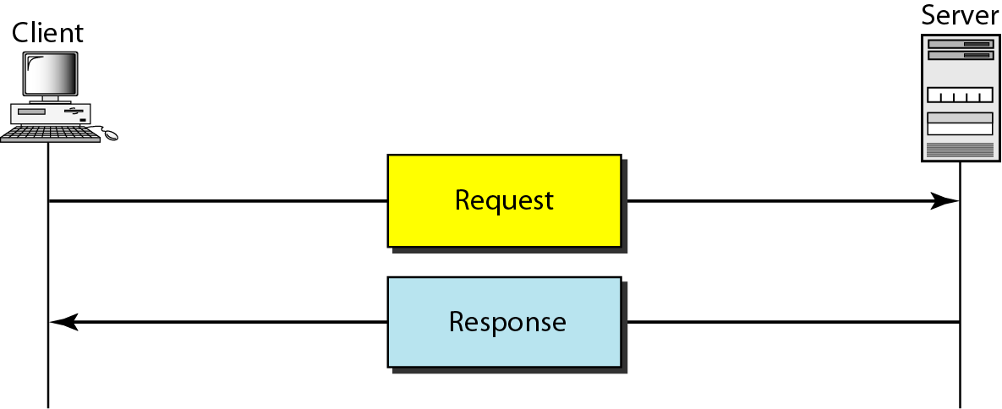
Figure 27.12 HTTP transaction

Slide 20
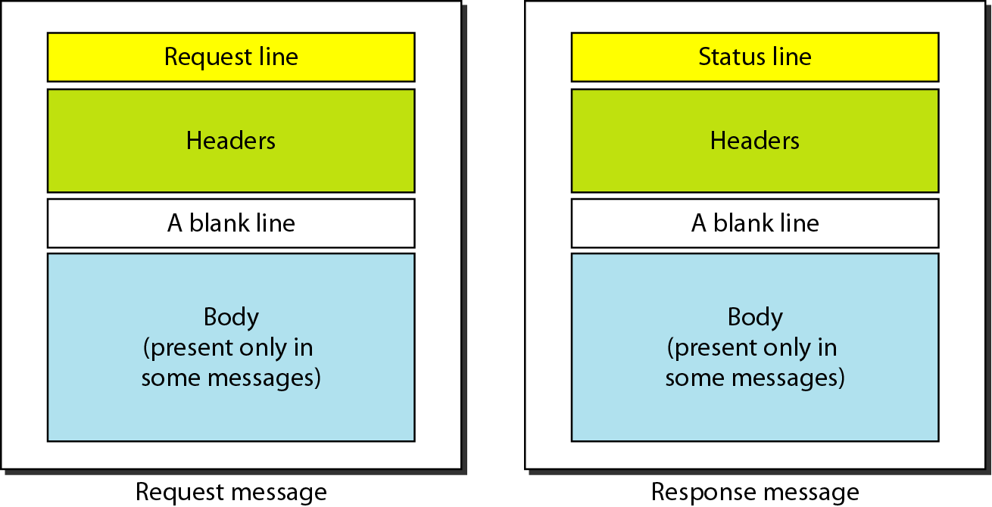
Figure 27.13 Request and response messages

Slide 21
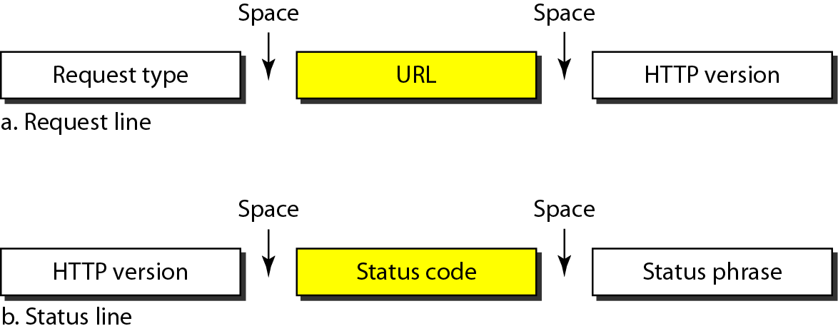
Figure 27.14 Request and status lines

Slide 22
Table 27.1 Methods

Slide 23
Table 27.2 Status codes

Slide 24
Table 27.2 Status codes (continued)

Slide 25
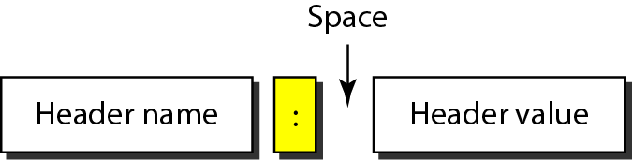
Figure 27.15 Header format

Slide 26
Table 27.3 General headers

Slide 27
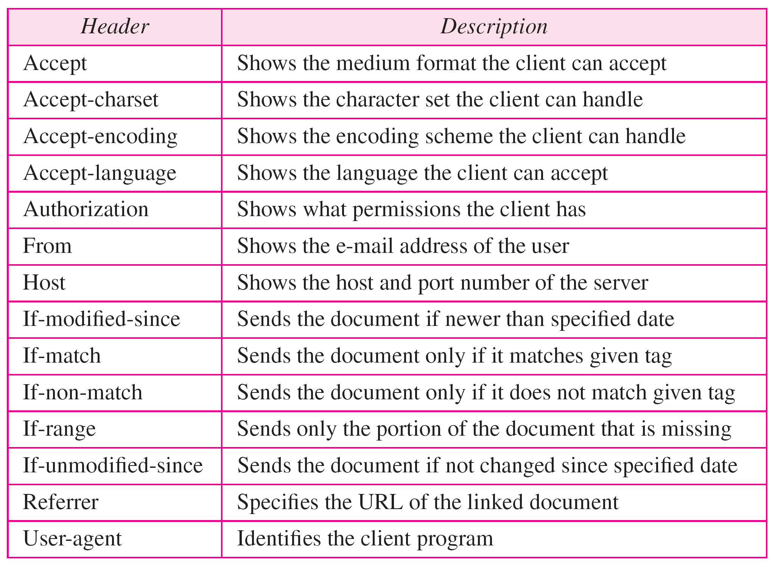
Table 27.4 Request headers

Slide 28
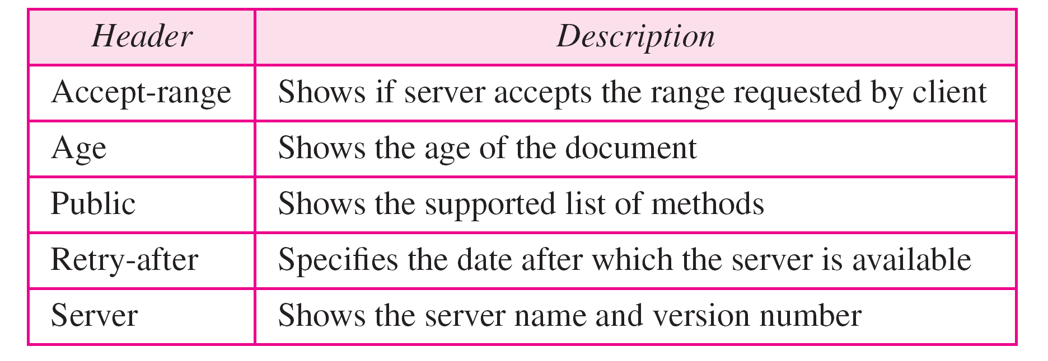
Table 27.5 Response headers

Slide 29
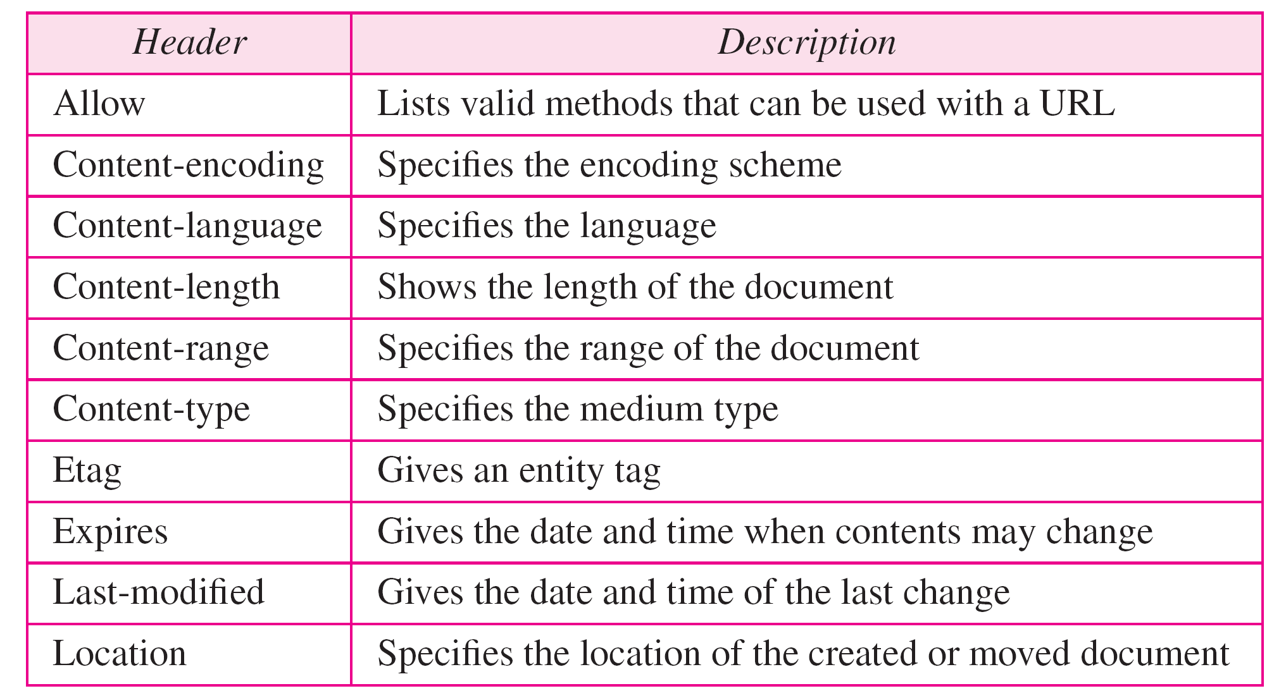
Table 27.6 Entity headers

Slide 30
Example 27.1
This example retrieves a document. We use the GET method to retrieve an image with the path /usr/bin/image1. The request line shows the method (GET), the URL, and the HTTP version (1.1). The header has two lines that show that the client can accept images in the GIF or JPEG format. The request does not have a body. The response message contains the status line and four lines of header. The header lines define the date, server, MIME version, and length of the document. The body of the document follows the header (see Figure 27.16).

Slide 31
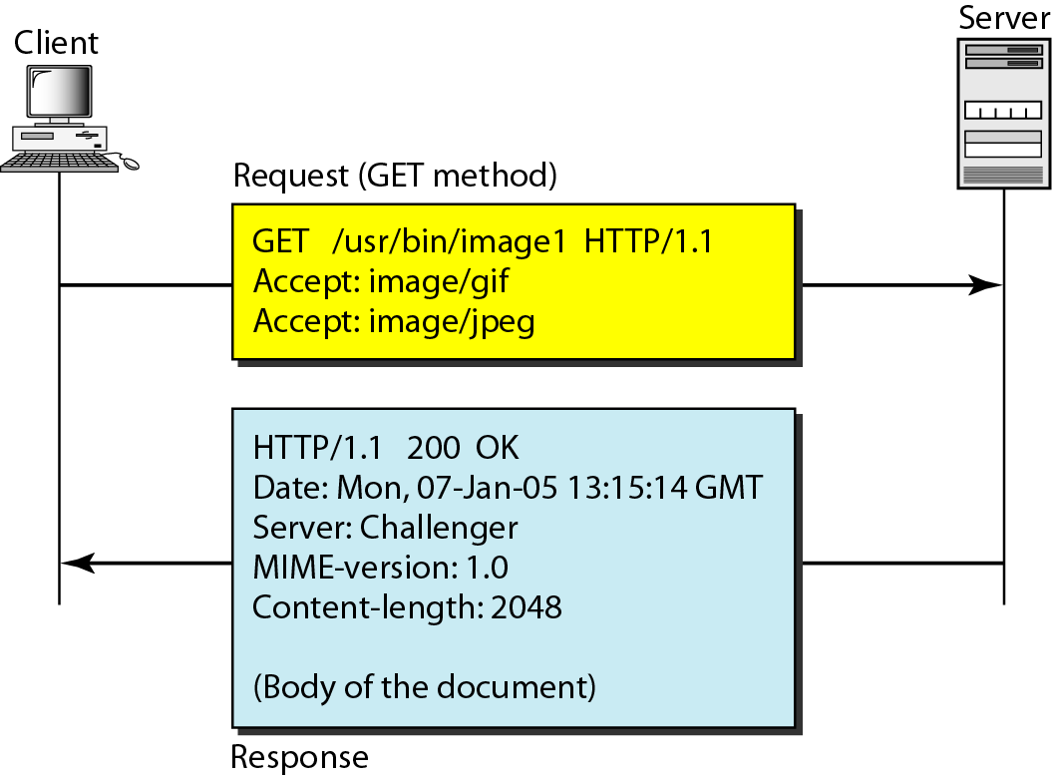
Figure 27.16 Example 27.1

Slide 32
Example 27.2
In this example, the client wants to send data to the server. We use the POST method. The request line shows the method (POST), URL, and HTTP version (1.1). There are four lines of headers. The request body contains the input information. The response message contains the status line and four lines of headers. The created document, which is a CGI document, is included as the body (see Figure 27.17).

Slide 33
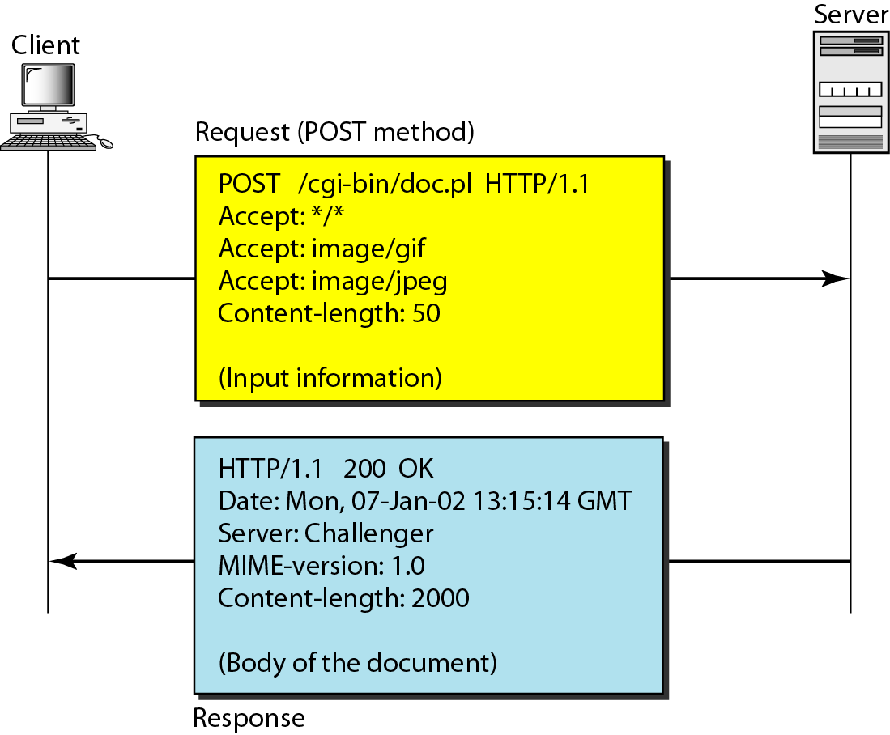
Figure 27.17 Example 27.2

Slide 34
Example 27.3
HTTP uses ASCII characters. A client can directly connect to a server using TELNET, which logs into port 80 (see next slide). The next three lines show that the connection is successful. We then type three lines. The first shows the request line (GET method), the second is the header (defining the host), the third is a blank, terminating the request. The server response is seven lines starting with the status line. The blank line at the end terminates the server response. The file of 14,230 lines is received after the blank line (not shown here). The last line is the output by the client.

Slide 35
Example 27.3 (continued)

Slide 36
Note
HTTP version 1.1 specifies a persistent connection by default.

