Slide 1

Chapter 30
Cryptography
Copyright © The McGraw-Hill Companies, Inc. Permission required for reproduction or display.

Slide 2
30-1 INTRODUCTION
Let us introduce the issues involved in cryptography. First, we need to define some terms; then we give some taxonomies.
Topics discussed in this section:
Definitions Two Categories

Slide 3
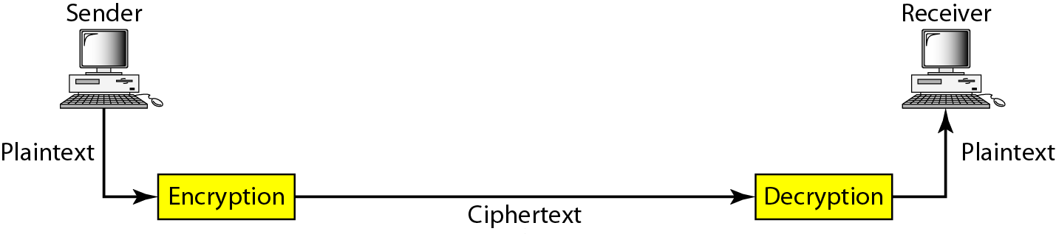
Figure 30.1 Cryptography components

Slide 4
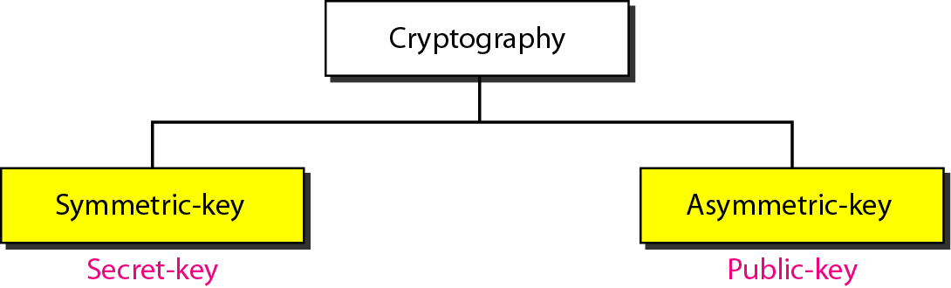
Figure 30.2 Categories of cryptography

Slide 5
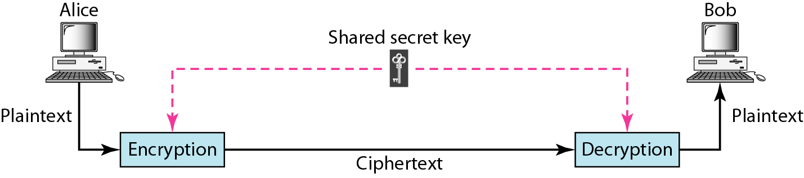
Figure 30.3 Symmetric-key cryptography

Slide 6

Note
In symmetric-key cryptography, the same key is used by the sender
(for encryption) and the receiver (for decryption).
The key is shared.

Slide 7
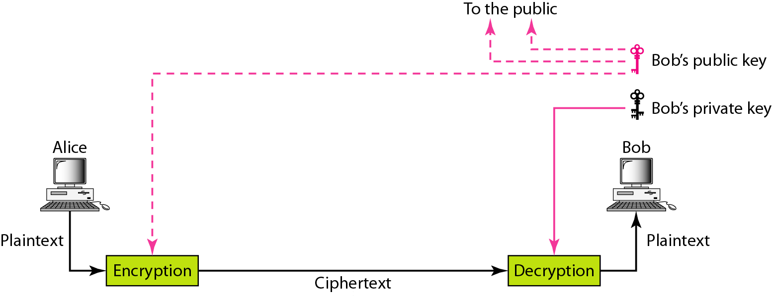
Figure 30.4 Asymmetric-key cryptography

Slide 8
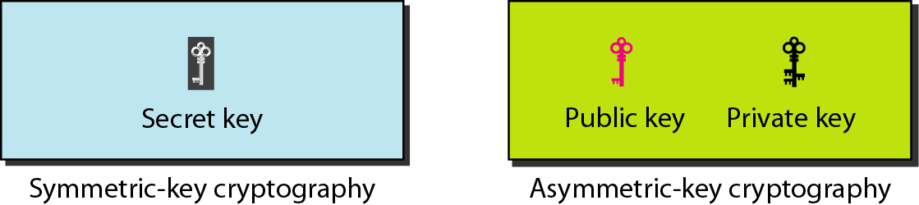
Figure 30.5 Keys used in cryptography

Slide 9
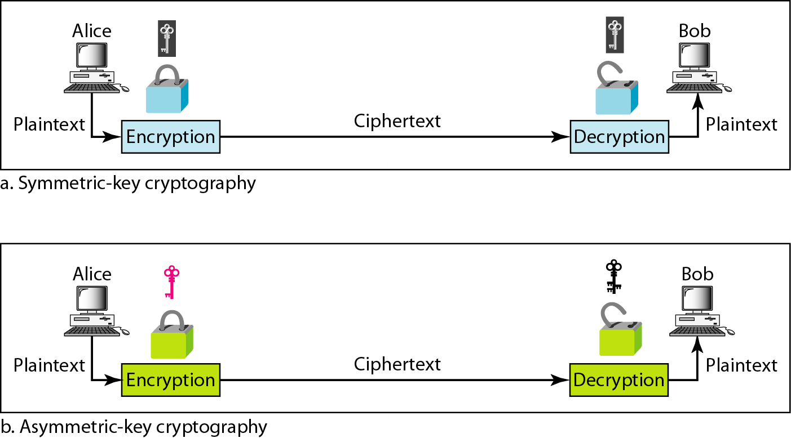
Figure 30.6 Comparison between two categories of cryptography

Slide 10
30-2 SYMMETRIC-KEY CRYPTOGRAPHY
Symmetric-key cryptography started thousands of years ago when people needed to exchange secrets (for example, in a war). We still mainly use symmetric-key cryptography in our network security.
Topics discussed in this section:
Traditional Ciphers Simple Modern Ciphers Modern Round Ciphers Mode of Operation

Slide 11
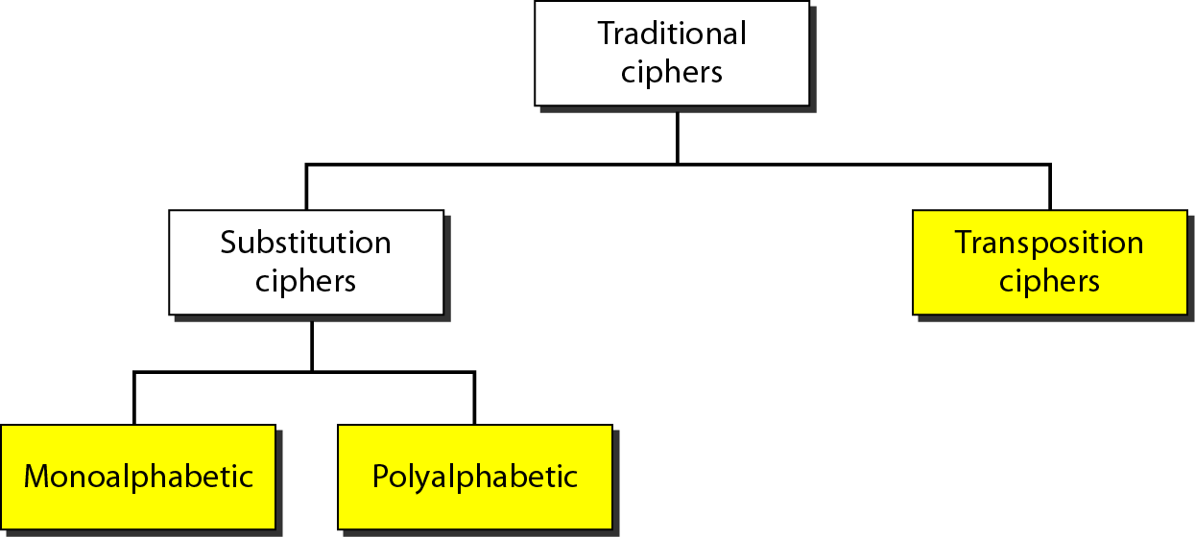
Figure 30.7 Traditional ciphers

Slide 12
Note
A substitution cipher replaces one symbol with another.

Slide 13
Example 30.1
The following shows a plaintext and its corresponding ciphertext. Is the cipher monoalphabetic?
Solution
The cipher is probably monoalphabetic because both occurrences of L’s are encrypted as O’s.

Slide 14
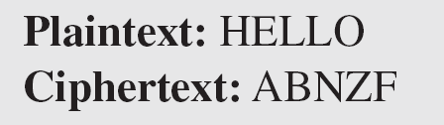
Example 30.2
The following shows a plaintext and its corresponding ciphertext. Is the cipher monoalphabetic?
Solution
The cipher is not monoalphabetic because each occurrence of L is encrypted by a different character. The first L is encrypted as N; the second as Z.

Slide 15
Note
The shift cipher is sometimes referred to as the Caesar cipher.

Slide 16
Example 30.3
Use the shift cipher with key = 15 to encrypt the message “HELLO.”
Solution
We encrypt one character at a time. Each character is shifted 15 characters down. Letter H is encrypted to W. Letter E is encrypted to T. The first L is encrypted to A. The second L is also encrypted to A. And O is encrypted to D. The cipher text is WTAAD.

Slide 17
Example 30.4
Use the shift cipher with key = 15 to decrypt the message “WTAAD.”
Solution
We decrypt one character at a time. Each character is shifted 15 characters up. Letter W is decrypted to H. Letter T is decrypted to E. The first A is decrypted to L. The second A is decrypted to L. And, finally, D is decrypted to O. The plaintext is HELLO.

Slide 18
Note
A transposition cipher reorders (permutes) symbols in a block of symbols.

Slide 19
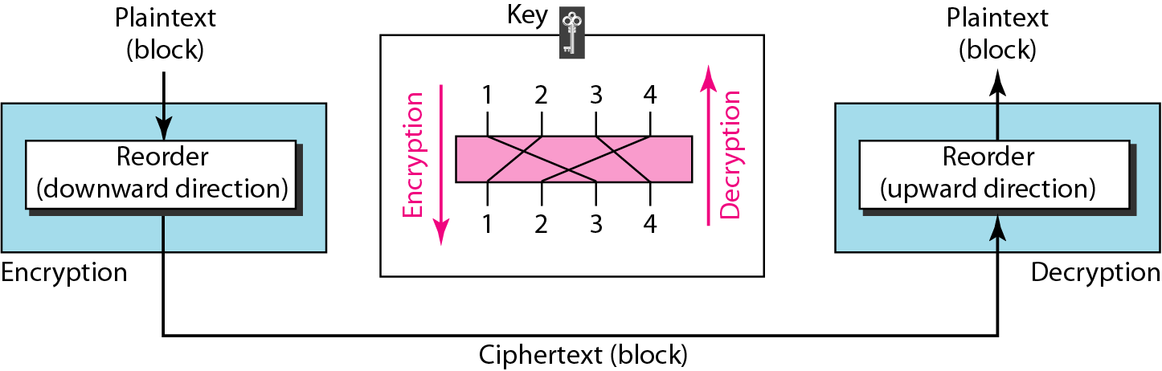
Figure 30.8 Transposition cipher

Slide 20
Example 30.5
Encrypt the message “HELLO MY DEAR,” using the key shown in Figure 30.8.
Solution
We first remove the spaces in the message. We then divide the text into blocks of four characters. We add a bogus character Z at the end of the third block. The result is HELL OMYD EARZ. We create a three-block ciphertext ELHLMDOYAZER.

Slide 21
Example 30.6
Using Example 30.5, decrypt the message “ELHLMDOYAZER”.
Solution
The result is HELL OMYD EARZ. After removing the bogus character and combining the characters, we get the original message “HELLO MY DEAR.”

Slide 22
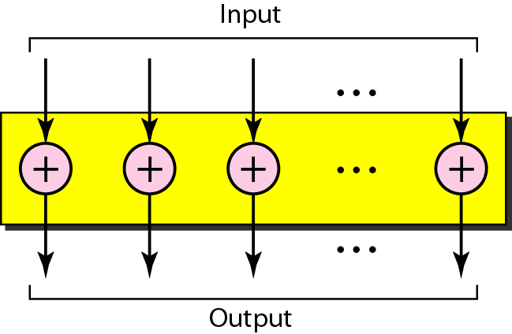
Figure 30.9 XOR cipher

Slide 23
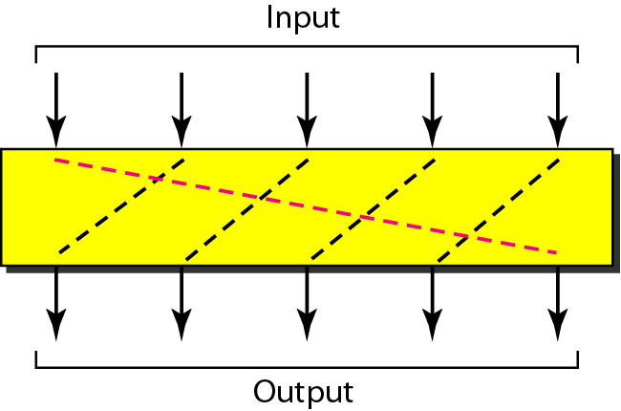
Figure 30.10 Rotation cipher

Slide 24
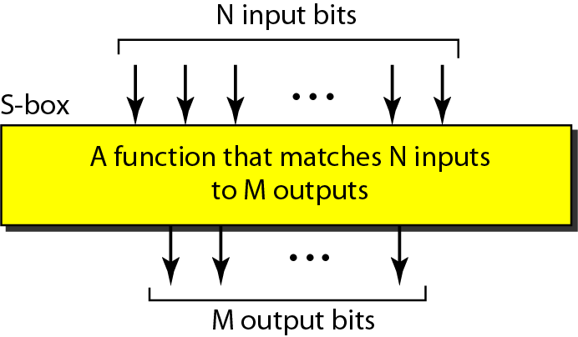
Figure 30.11 S-box

Slide 25
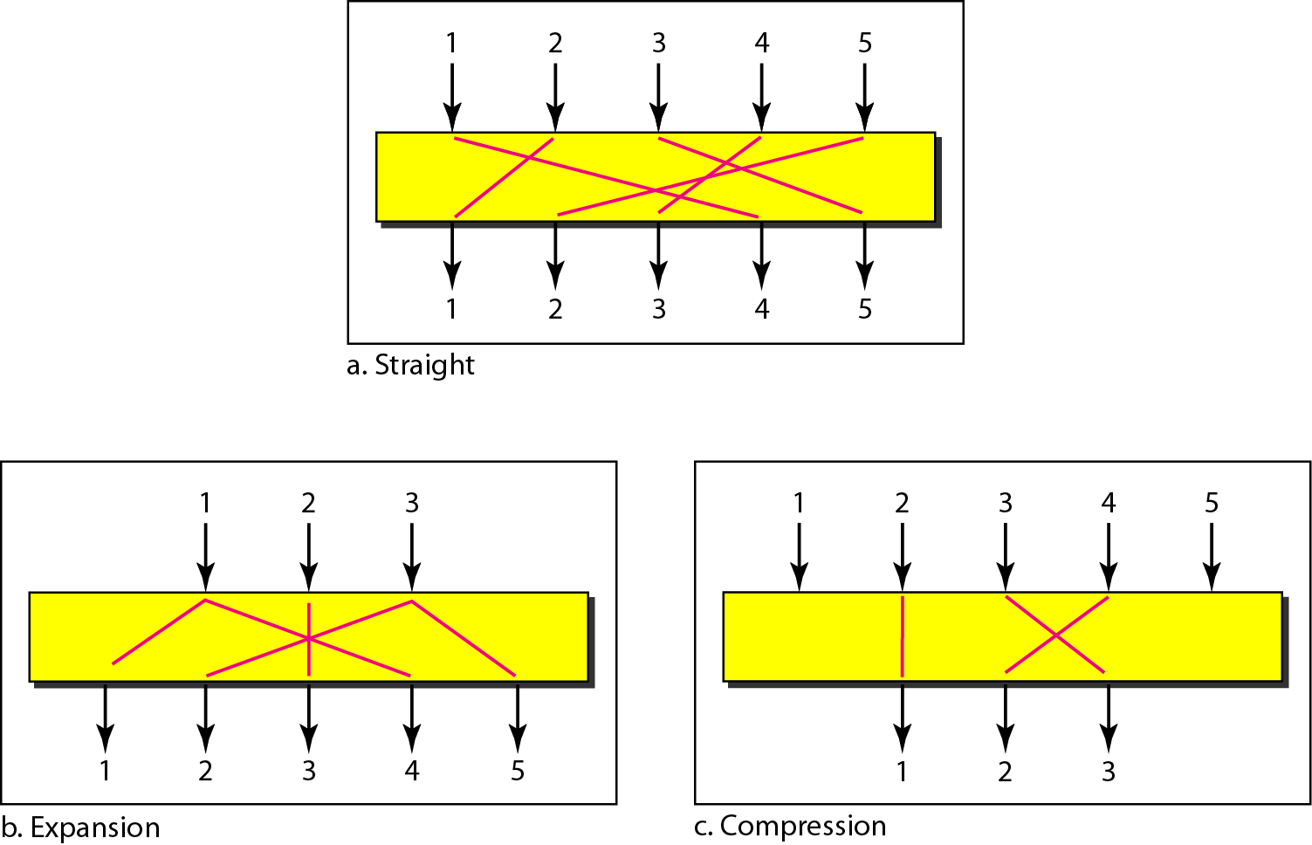
Figure 30.12 P-boxes: straight, expansion, and compression

Slide 26
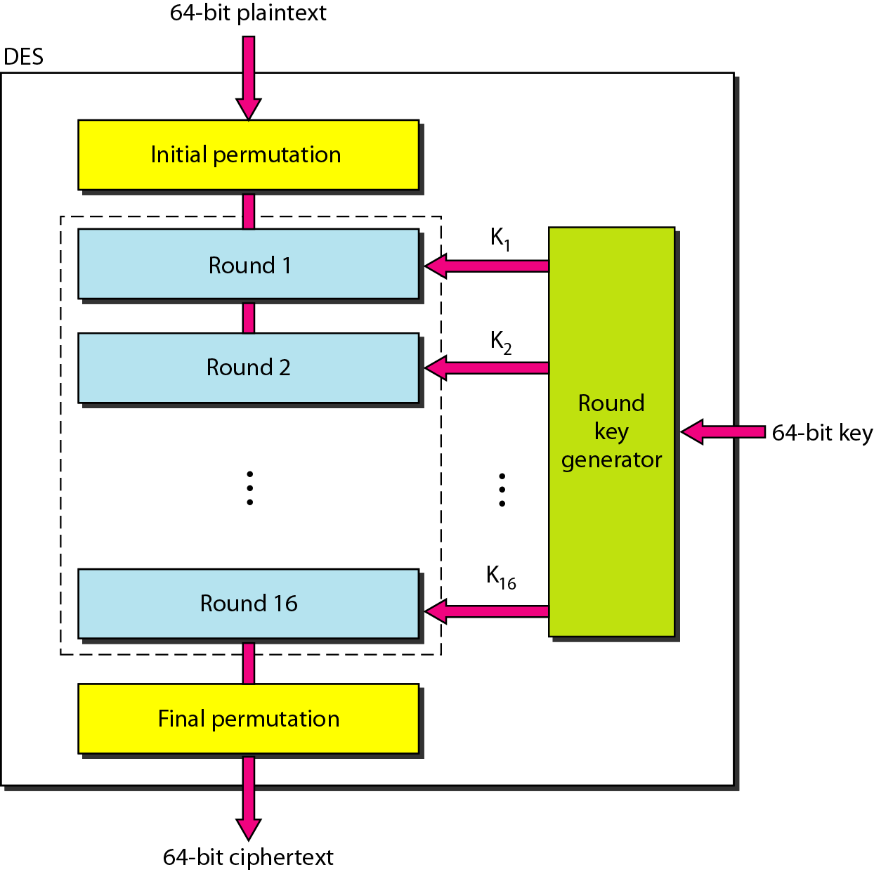
Figure 30.13 DES

Slide 27
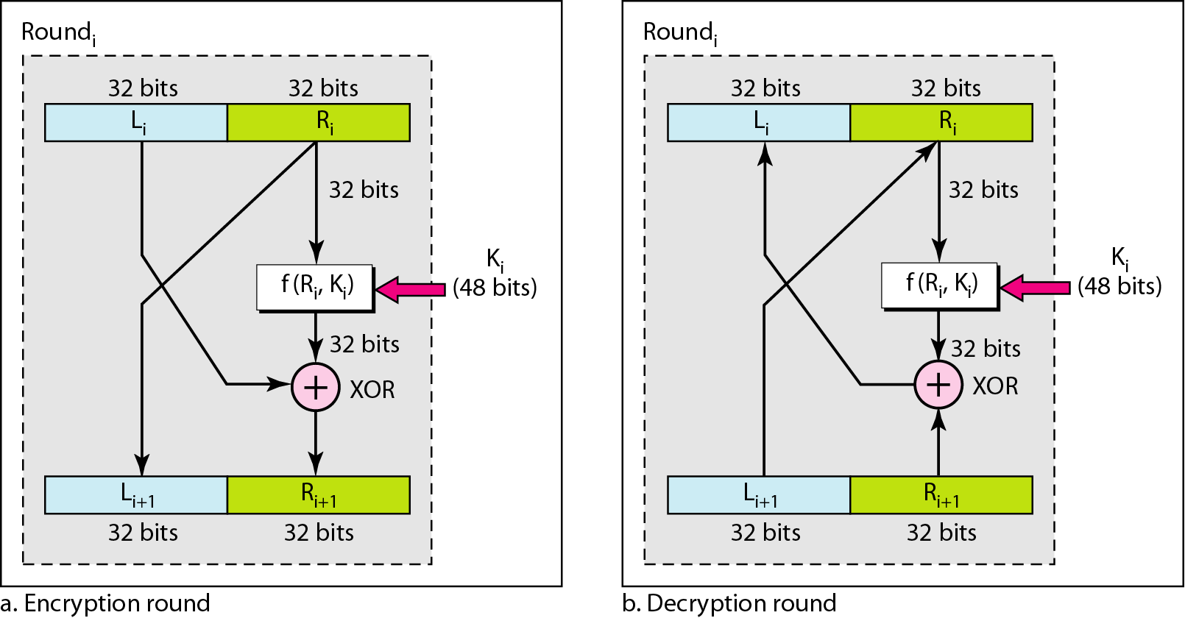
Figure 30.14 One round in DES ciphers

Slide 28
Figure 30.15 DES function

Slide 29
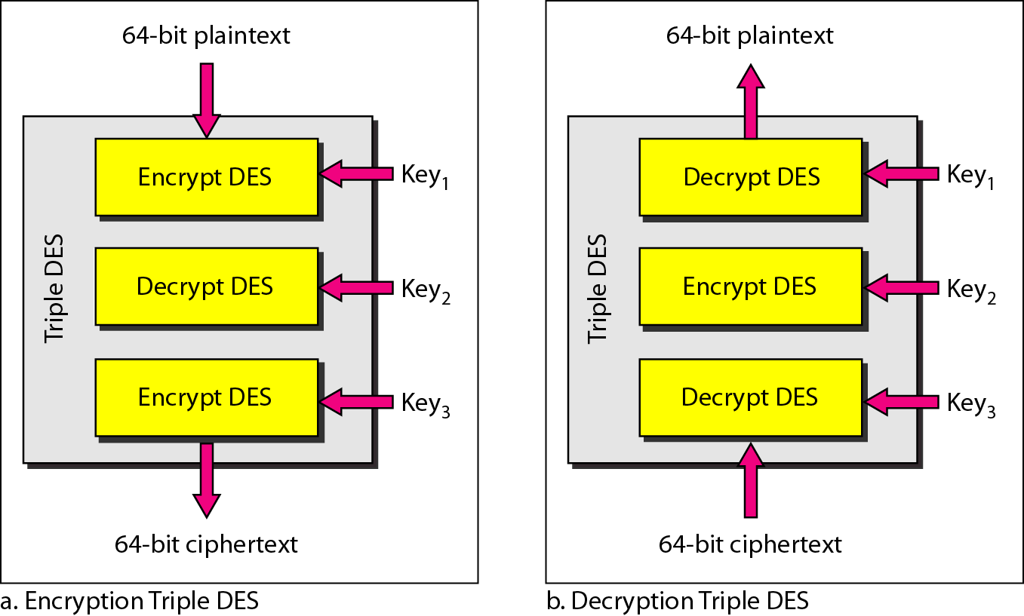
Figure 30.16 Triple DES

Slide 30
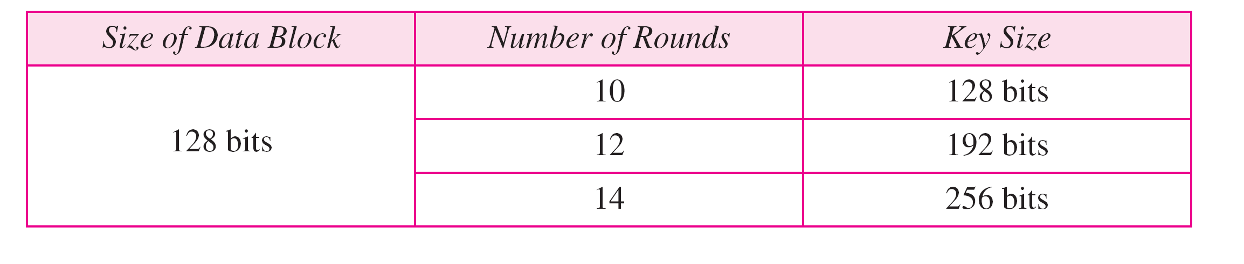
Table 30.1 AES configuration

Slide 31
Note
AES has three different configurations with respect to the number of rounds and key size.

Slide 32
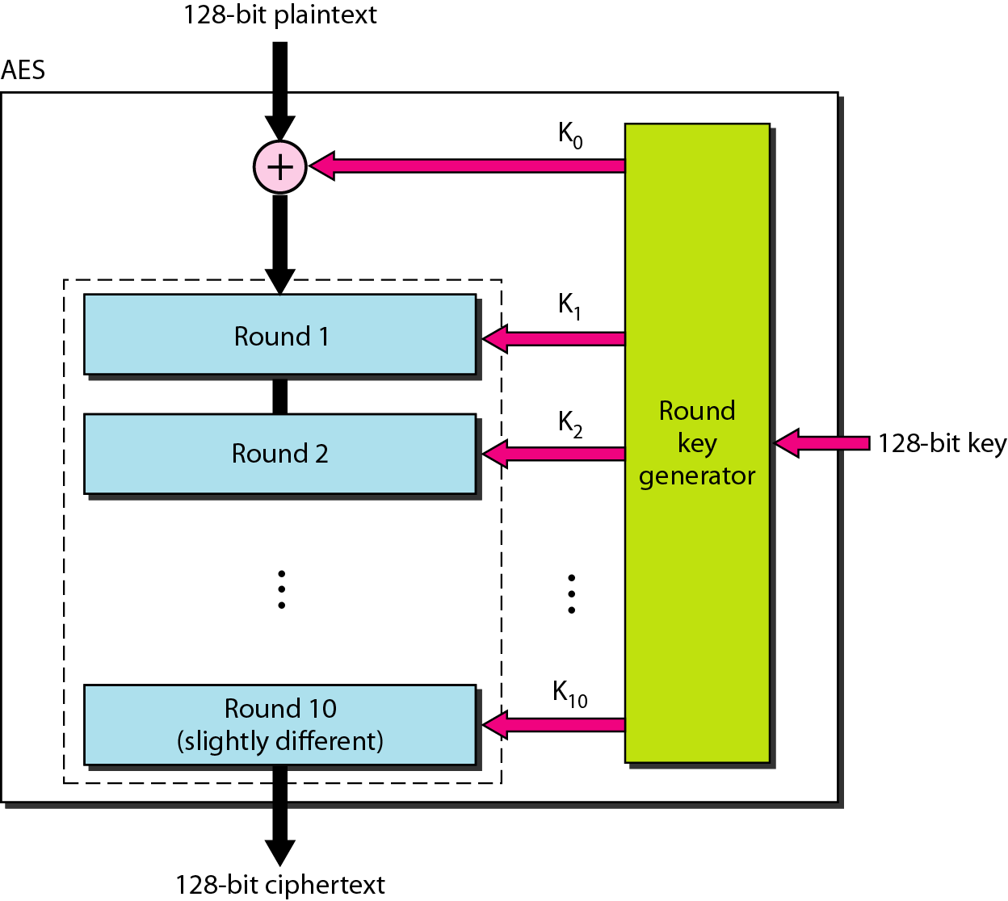
Figure 30.17 AES

Slide 33
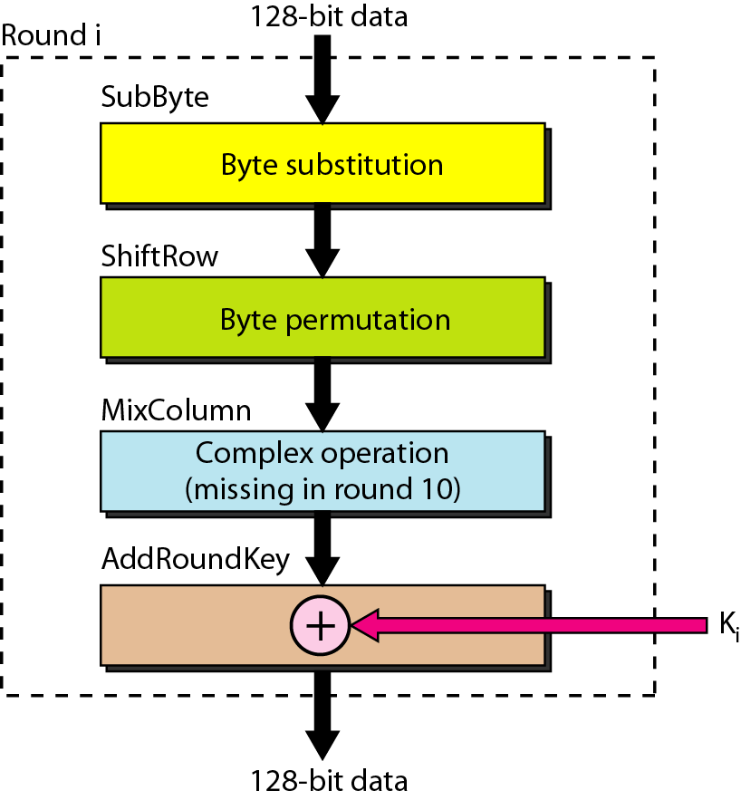
Figure 30.18 Structure of each round

Slide 34
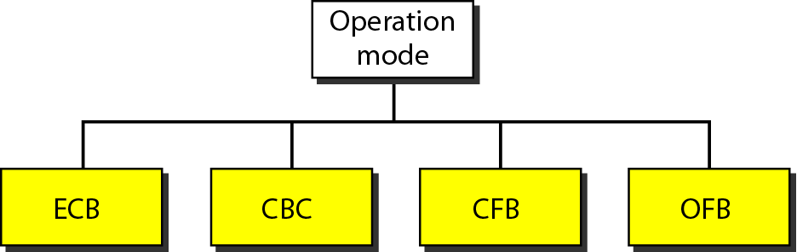
Figure 30.19 Modes of operation for block ciphers

Slide 35
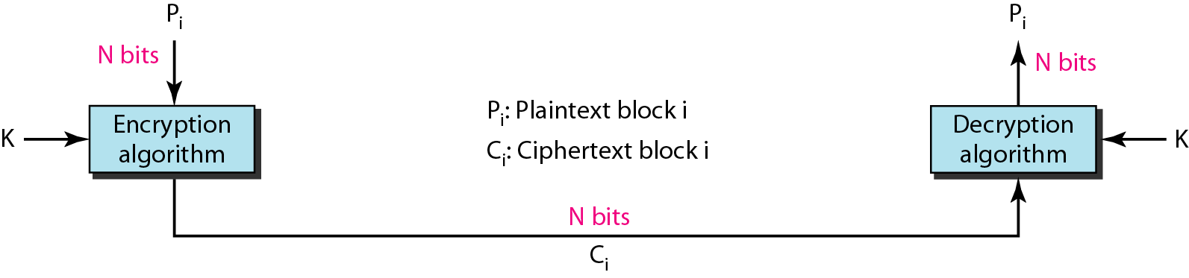
Figure 30.20 ECB mode

Slide 36
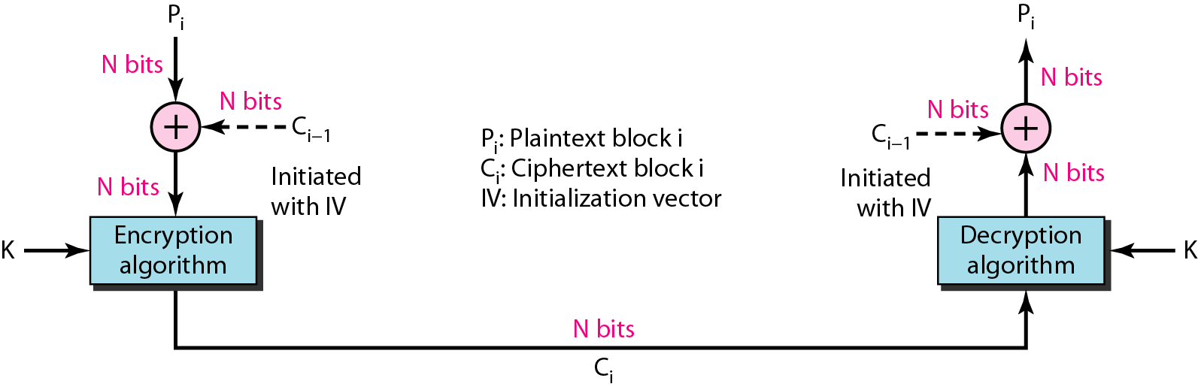
Figure 30.21 CBC mode

Slide 37
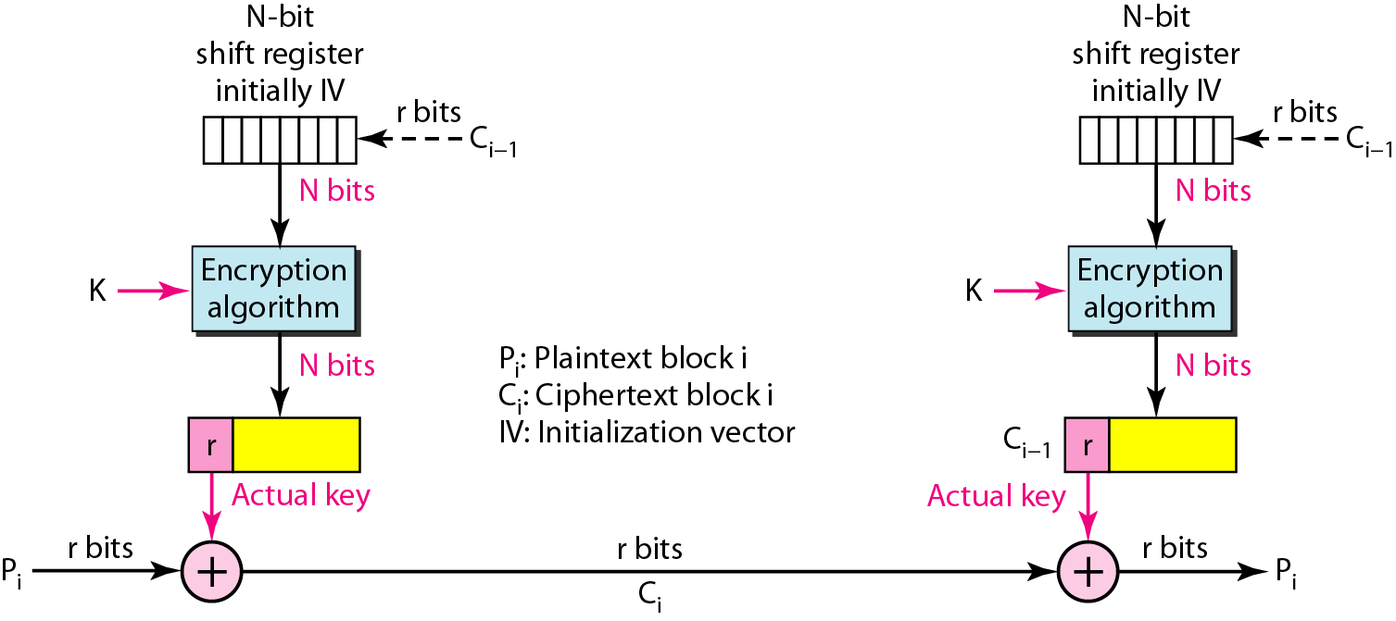
Figure 30.22 CFB mode

Slide 38
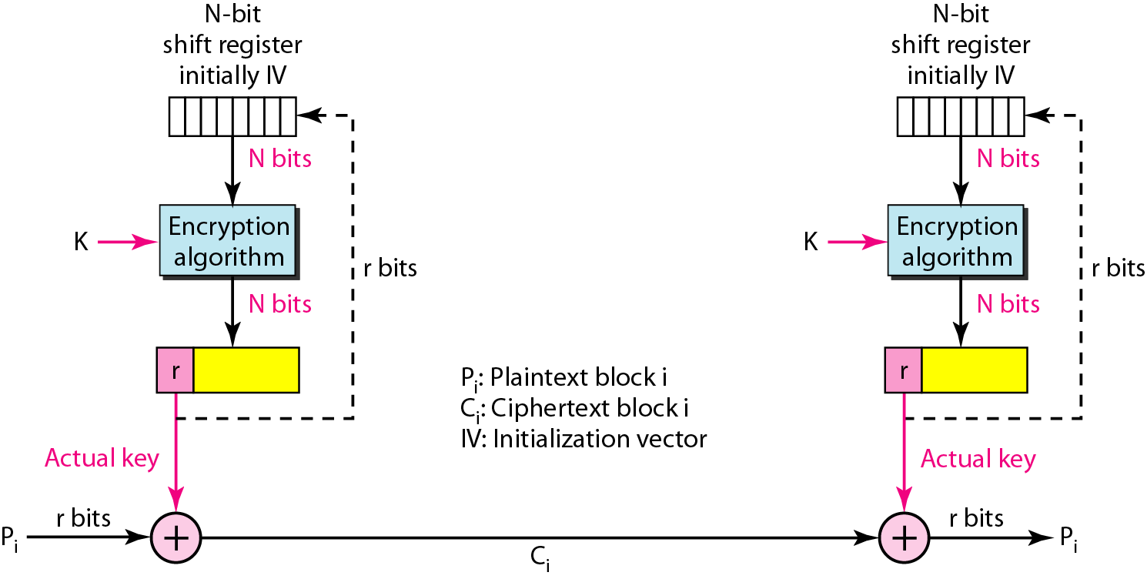
Figure 30.23 OFB mode

Slide 39
30-3 ASYMMETRIC-KEY CRYPTOGRAPHY
An asymmetric-key (or public-key) cipher uses two keys: one private and one public. We discuss two algorithms: RSA and Diffie-Hellman.
Topics discussed in this section:
RSA Diffie-Hellman

Slide 40
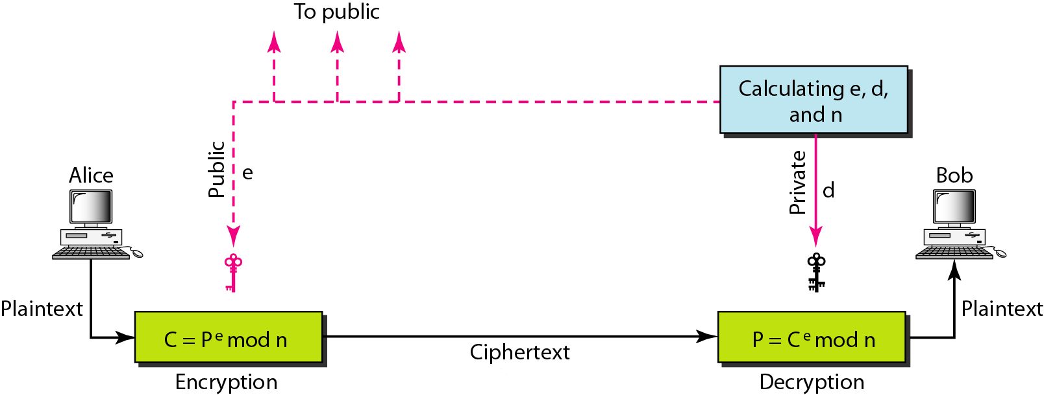
Figure 30.24 RSA

Slide 41
Note
In RSA, e and n are announced to the public; d and Φ are kept secret.

Slide 42
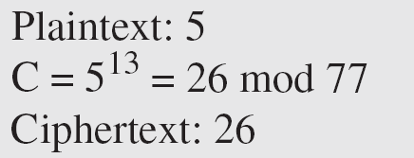
Example 30.7
Bob chooses 7 and 11 as p and q and calculates n = 7 · 11 = 77. The value of Φ = (7 − 1) (11 − 1) or 60. Now he chooses two keys, e and d. If he chooses e to be 13, then d is 37. Now imagine Alice sends the plaintext 5 to Bob. She uses the public key 13 to encrypt 5.

Slide 43
Example 30.7 (continued)
Bob receives the ciphertext 26 and uses the private key 37 to decipher the ciphertext:
The plaintext 5 sent by Alice is received as plaintext 5 by Bob.

Slide 44
Example 30.8
Jennifer creates a pair of keys for herself. She chooses p = 397 and q = 401. She calculates n = 159,197 and Φ = 396 · 400 = 158,400. She then chooses e = 343 and d = 12,007. Show how Ted can send a message to Jennifer if he knows e and n.

Slide 45
Example 30.8 (continuted)
Solution
Suppose Ted wants to send the message “NO” to Jennifer. He changes each character to a number (from 00 to 25) with each character coded as two digits. He then concatenates the two coded characters and gets a four-digit number. The plaintext is 1314. Ted then uses e and n to encrypt the message. The ciphertext is 1314³⁴³ = 33,677 mod 159,197. Jennifer receives the message 33,677 and uses the decryption key d to decipher it as 33,677^{12,007} = 1314 mod 159,197. Jennifer then decodes 1314 as the message “NO”. Figure 30.25 shows the process.

Slide 46
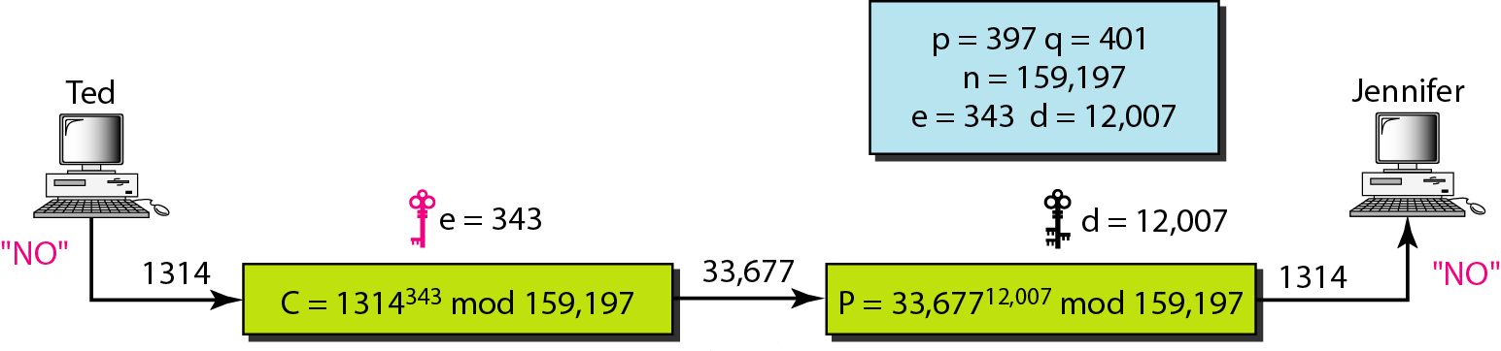
Figure 30.25 Example 30.8

Slide 47
Example 30.9
Let us give a realistic example. We randomly chose an integer of 512 bits. The integer p is a 159-digit number.
The integer q is a 160-digit number.

Slide 48
Example 30.9 (continued)
We calculate n. It has 309 digits:
We calculate Φ. It has 309 digits:

Slide 49
Example 30.9 (continued)
We choose e = 35,535. We then find d.
Alice wants to send the message “THIS IS A TEST” which can be changed to a numeric value by using the 00–26 encoding scheme (26 is the space character).

Slide 50
Example 30.9 (continued)
The ciphertext calculated by Alice is C = P^{e}, which is.
Bob can recover the plaintext from the ciphertext by using P = C^{d}, which is
The recovered plaintext is THIS IS A TEST after decoding.

Slide 51
Note
The symmetric (shared) key in the Diffie-Hellman protocol is
K = g^{xy} mod p.

Slide 52
Example 30.10
Let us give a trivial example to make the procedure clear. Our example uses small numbers, but note that in a real situation, the numbers are very large. Assume g = 7 and p = 23. The steps are as follows:
1. Alice chooses x = 3 and calculates R₁ = 7³ mod 23 = 21.
2. Bob chooses y = 6 and calculates R₂ = 7⁶ mod 23 = 4.
3. Alice sends the number 21 to Bob.
4. Bob sends the number 4 to Alice.
5. Alice calculates the symmetric key K = 4³ mod 23 = 18.
6. Bob calculates the symmetric key K = 21⁶ mod 23 = 18.
The value of K is the same for both Alice and Bob; g^{xy} mod p = 7¹⁸ mod 23 = 18.

Slide 53
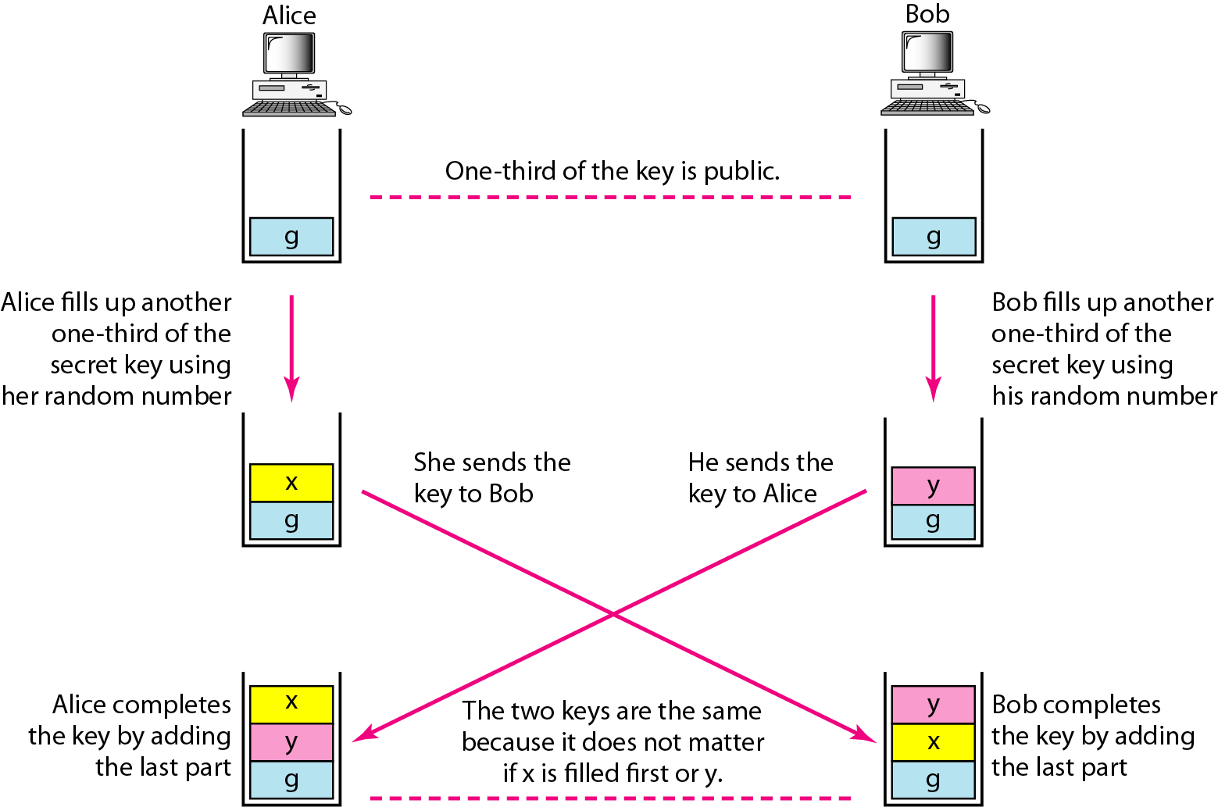
Figure 30.27 Diffie-Hellman idea

Slide 54
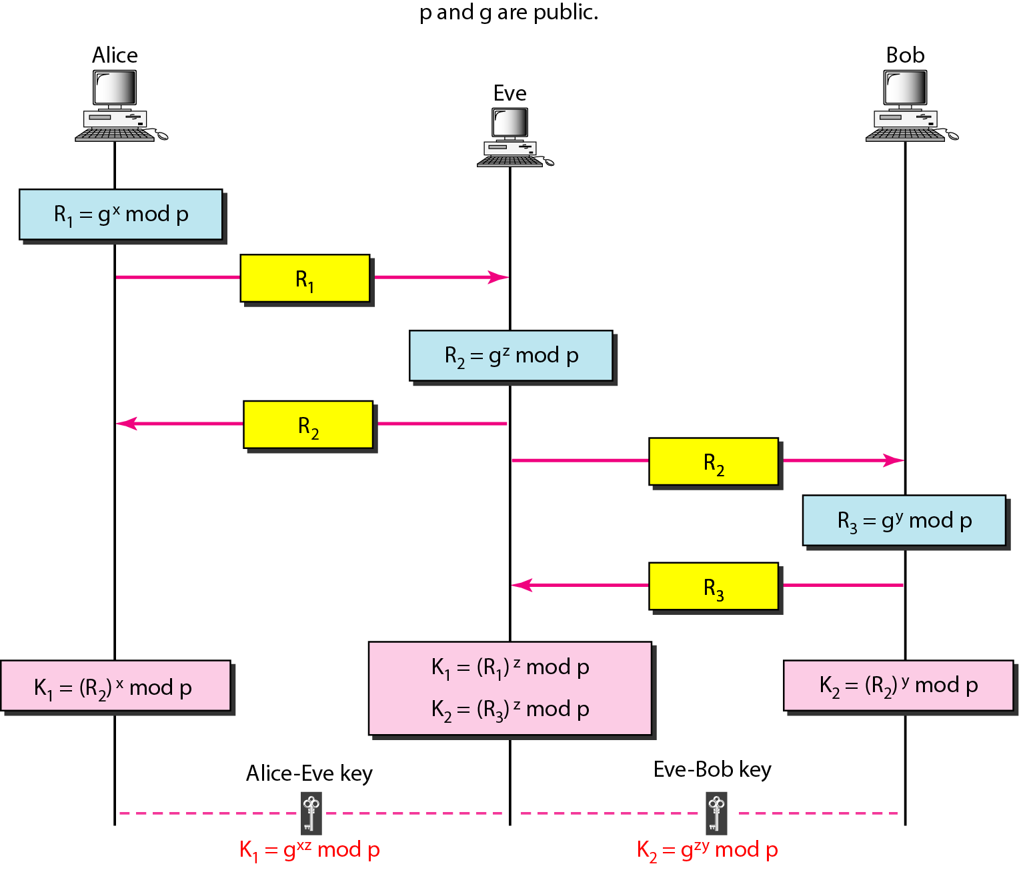
Figure 30.28 Man-in-the-middle attack

