Slide 1

Chapter 31
Network Security
Copyright © The McGraw-Hill Companies, Inc. Permission required for reproduction or display.

Slide 2
31-1 SECURITY SERVICES
Network security can provide five services. Four of these services are related to the message exchanged using the network. The fifth service provides entity authentication or identification.
Topics discussed in this section:
Message Confidentiality Message Integrity Message Authentication Message Nonrepudiation
Entity Authentication

Slide 3
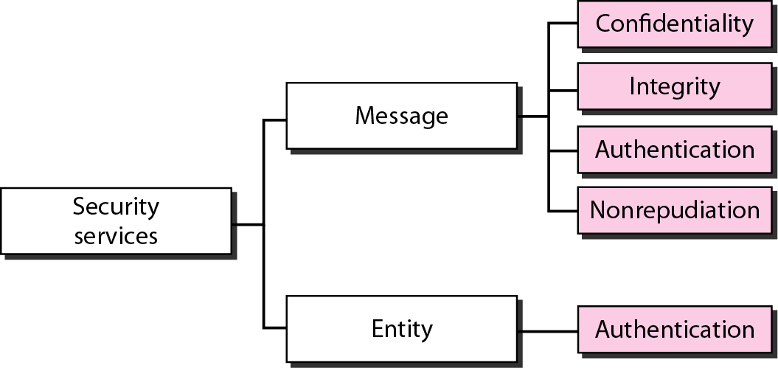
Figure 31.1 Security services related to the message or entity

Slide 4
31-2 MESSAGE CONFIDENTIALITY
The concept of how to achieve message confidentiality or privacy has not changed for thousands of years. The message must be encrypted at the sender site and decrypted at the receiver site. This can be done using either symmetric-key cryptography or asymmetric-key cryptography.
Topics discussed in this section:
Confidentiality with Symmetric-Key Cryptography
Confidentiality with Asymmetric-Key Cryptography

Slide 5
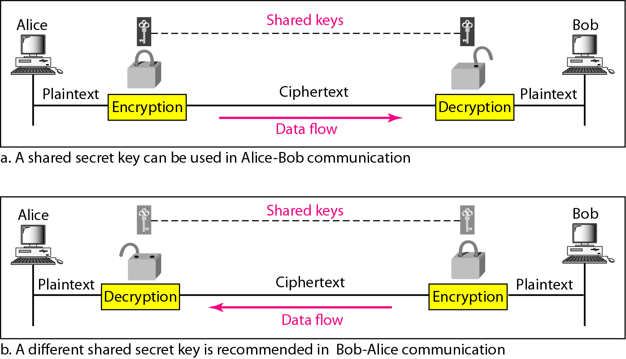
Figure 31.2 Message confidentiality using symmetric keys in two directions

Slide 6
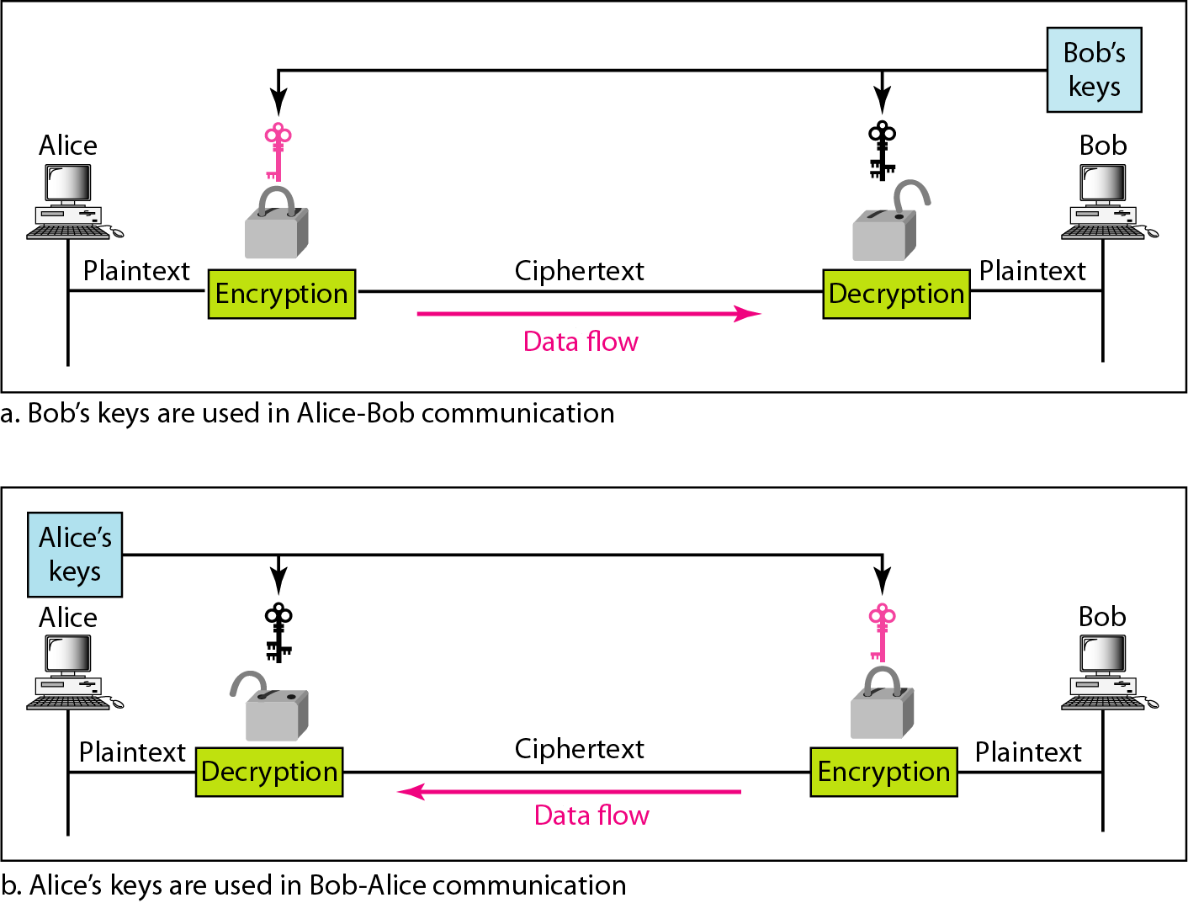
Figure 31.3 Message confidentiality using asymmetric keys

Slide 7
31-3 MESSAGE INTEGRITY
Encryption and decryption provide secrecy, or confidentiality, but not integrity. However, on occasion we may not even need secrecy, but instead must have integrity.
Topics discussed in this section:
Document and Fingerprint Message and Message Digest Creating and Checking the Digest Hash Function Criteria
Hash Algorithms: SHA-1

Slide 8

Note
To preserve the integrity of a document,
both the document and the fingerprint are needed.

Slide 9
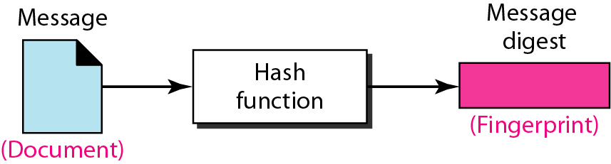
Figure 31.4 Message and message digest

Slide 10
Note
The message digest needs to be kept secret.

Slide 11
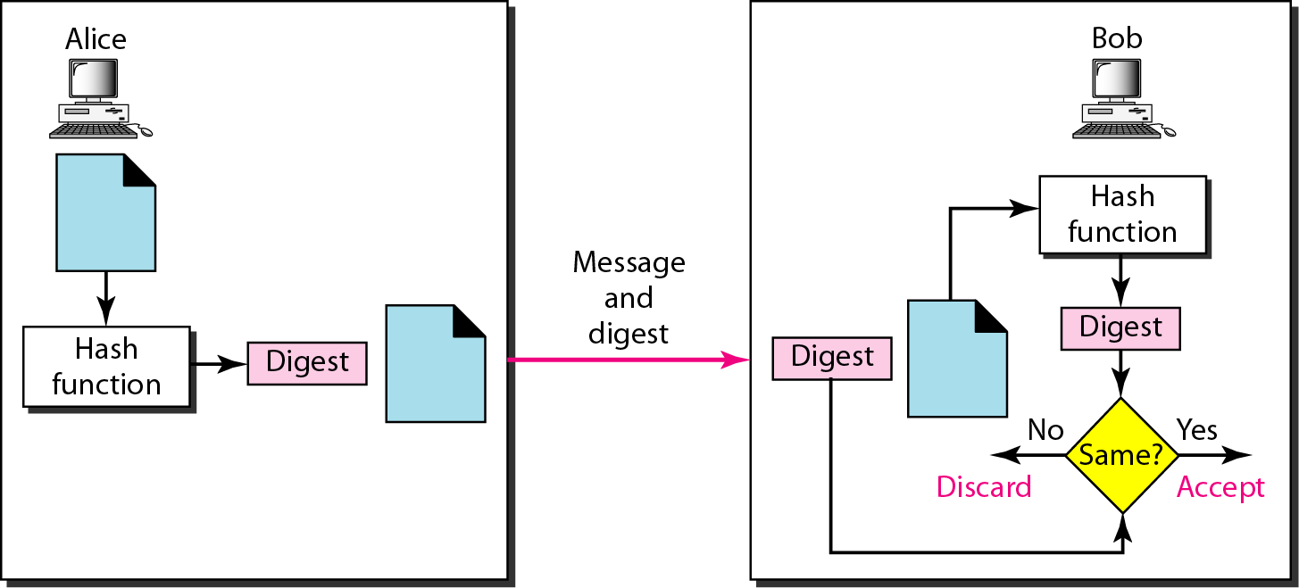
Figure 31.5 Checking integrity

Slide 12
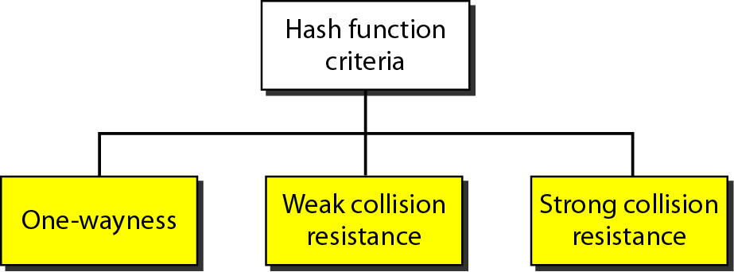
Figure 31.6 Criteria of a hash function

Slide 13
Example 31.1
Can we use a conventional lossless compression method as a hashing function?
Solution
We cannot. A lossless compression method creates a compressed message that is reversible. You can uncompress the compressed message to get the original one.

Slide 14
Example 31.2
Can we use a checksum method as a hashing function?
Solution
We can. A checksum function is not reversible; it meets the first criterion. However, it does not meet the other criteria.

Slide 15
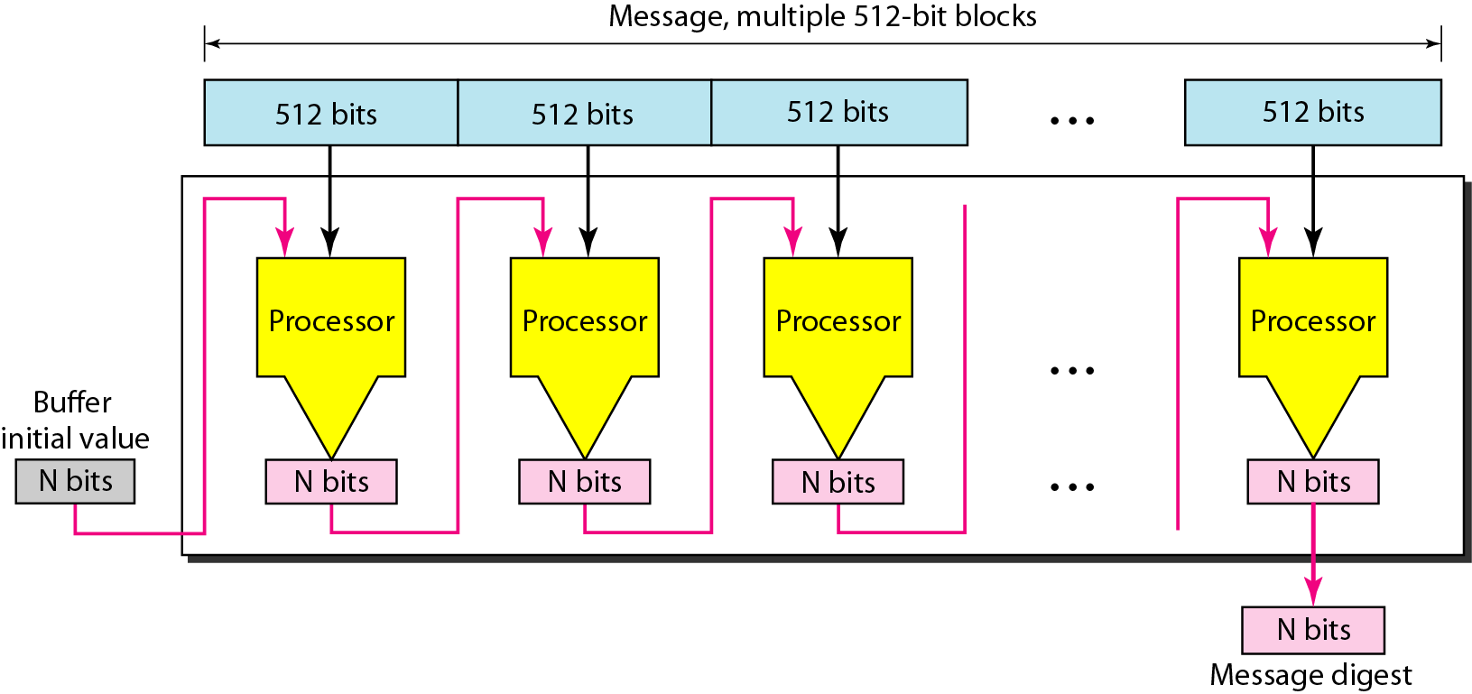
Figure 31.7 Message digest creation

Slide 16
Note
SHA-1 hash algorithms create an N-bit message digest out of a message of
512-bit blocks.
SHA-1 has a message digest of 160 bits (5 words of 32 bits).

Slide 17
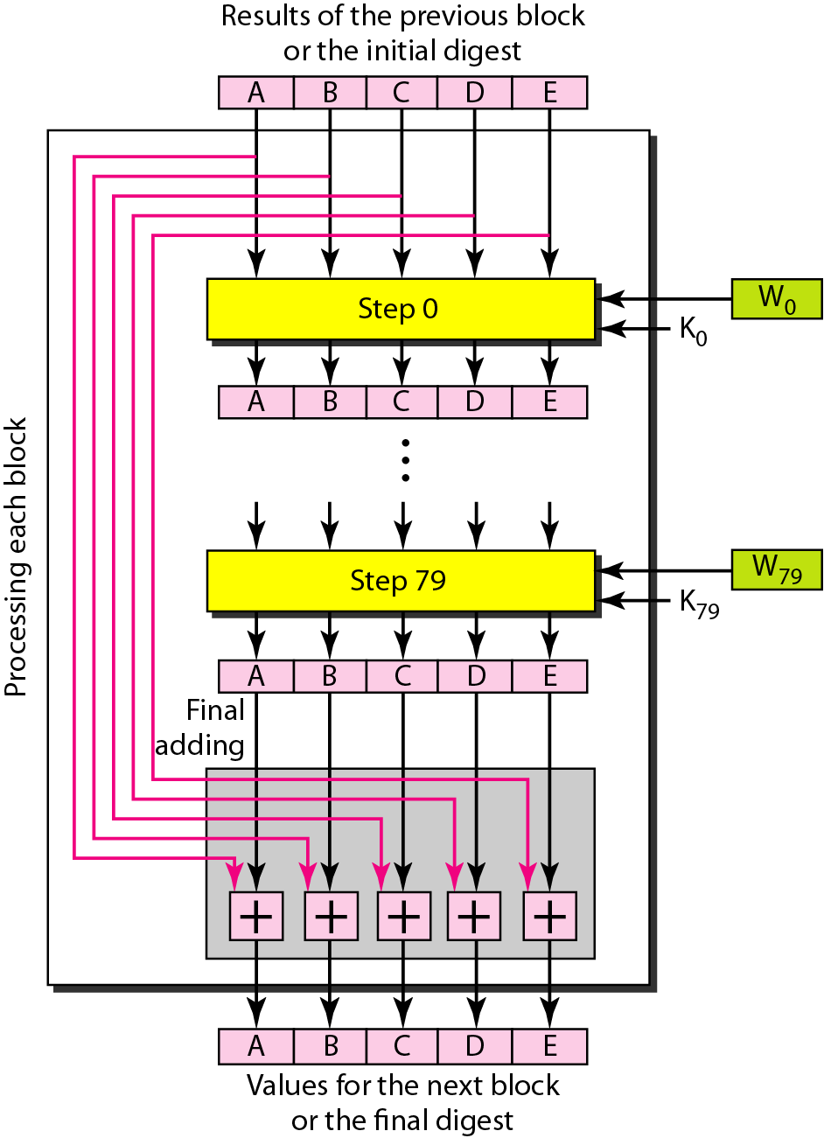
Figure 31.8 Processing of one block in SHA-1

Slide 18
31-4 MESSAGE AUTHENTICATION
A hash function per se cannot provide authentication. The digest created by a hash function can detect any modification in the message, but not authentication.
Topics discussed in this section:
MAC

Slide 19
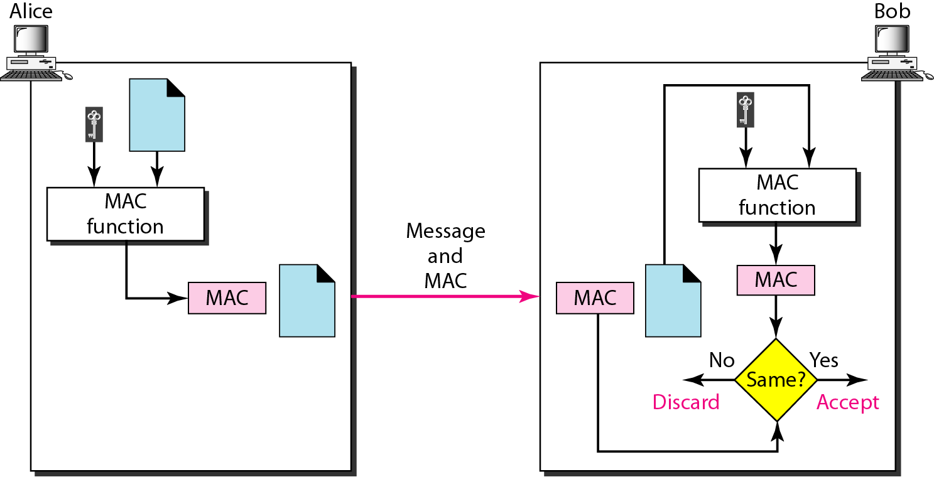
Figure 31.9 MAC, created by Alice and checked by Bob

Slide 20
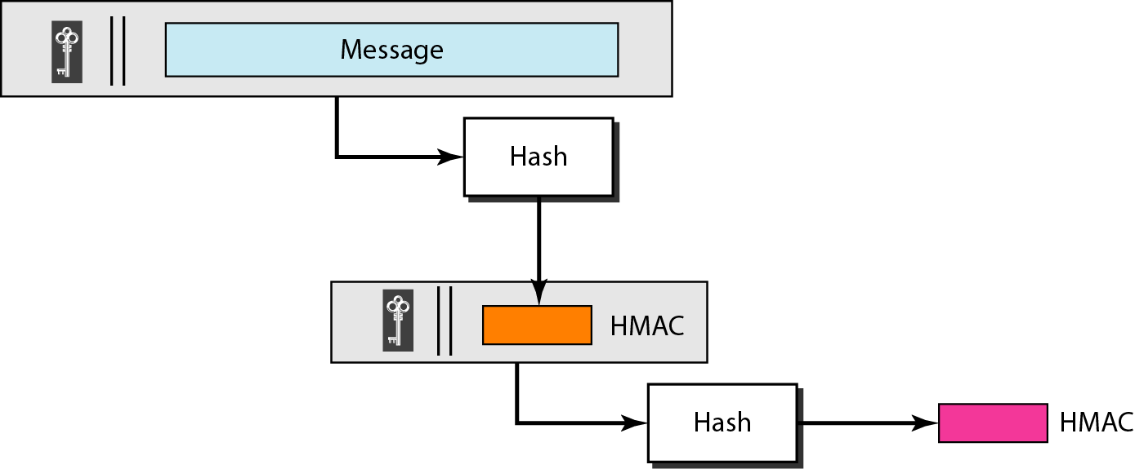
Figure 31.10 HMAC

Slide 21
31-5 DIGITAL SIGNATURE
When Alice sends a message to Bob, Bob needs to check the authenticity of the sender; he needs to be sure that the message comes from Alice and not Eve. Bob can ask Alice to sign the message electronically. In other words, an electronic signature can prove the authenticity of Alice as the sender of the message. We refer to this type of signature as a digital signature.
Topics discussed in this section:
Comparison Need for Keys Process

Slide 22
Note
A digital signature needs a public-key system.

Slide 23
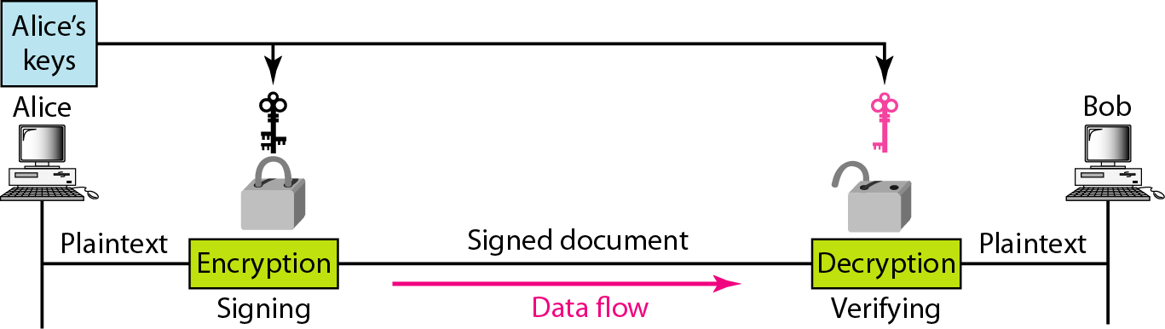
Figure 31.11 Signing the message itself in digital signature

Slide 24
Note
In a cryptosystem, we use the private and public keys of the receiver;
in digital signature, we use the private and public keys of the sender.

Slide 25
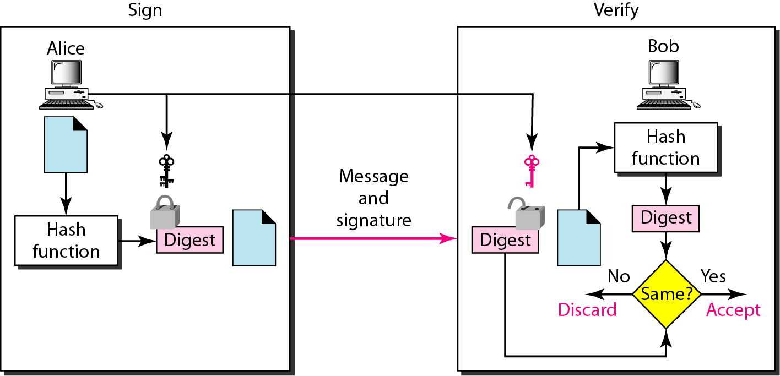
Figure 31.12 Signing the digest in a digital signature

Slide 26
Note
A digital signature today provides message integrity.

Slide 27
Note
Digital signature provides message authentication.

Slide 28
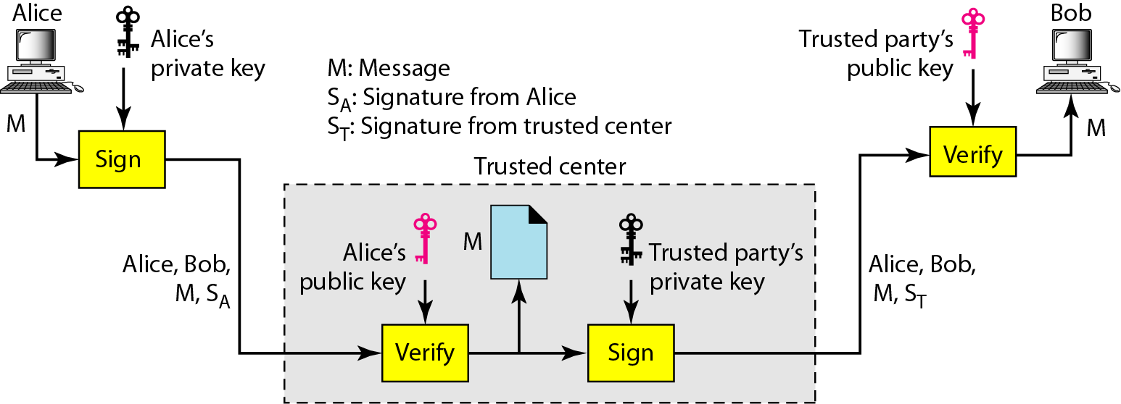
Figure 31.13 Using a trusted center for nonrepudiation

Slide 29
Note
Nonrepudiation can be provided using a trusted party.

Slide 30
31-6 ENTITY AUTHENTICATION
Entity authentication is a technique designed to let one party prove the identity of another party. An entity can be a person, a process, a client, or a server. The entity whose identity needs to be proved is called the claimant; the party that tries to prove the identity of the claimant is called the verifier.
Topics discussed in this section:
Passwords Challenge-Response

Slide 31
Note
In challenge-response authentication,
the claimant proves that she knows a secret without revealing it.

Slide 32
Note
The challenge is a time-varying value sent by the verifier;
the response is the result of a function applied on the challenge.

Slide 33
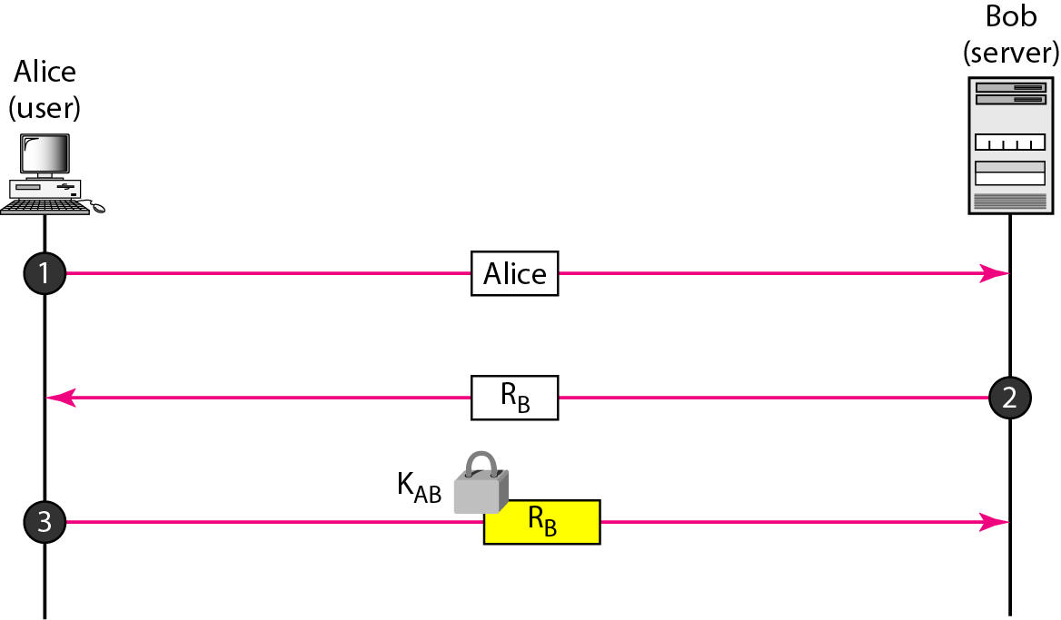
Figure 31.14 Challenge/response authentication using a nonce

Slide 34
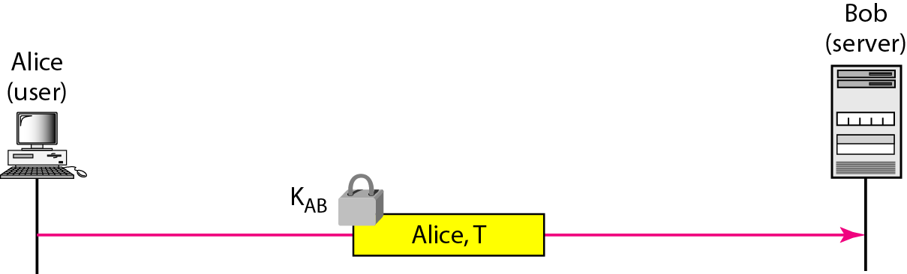
Figure 31.15 Challenge-response authentication using a timestamp

Slide 35
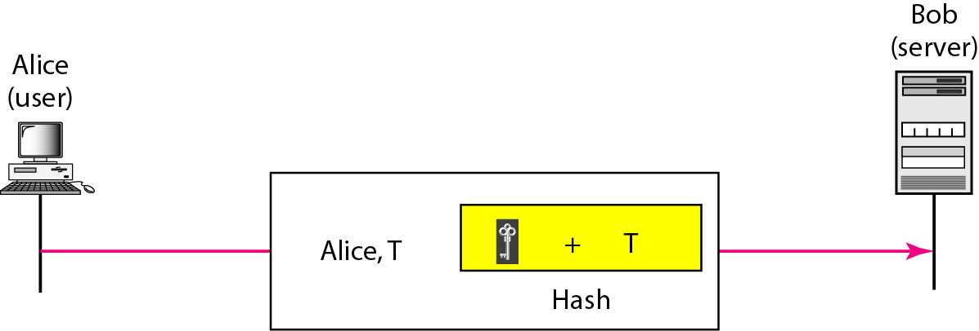
Figure 31.16 Challenge-response authentication using a keyed-hash function

Slide 36
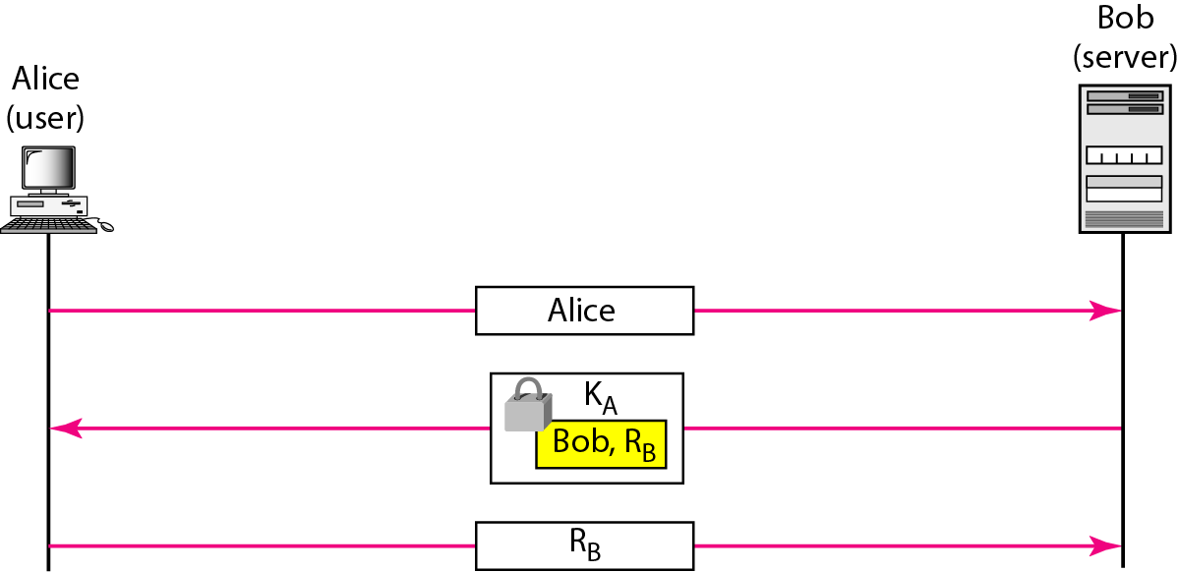
Figure 31.17 Authentication, asymmetric-key

Slide 37
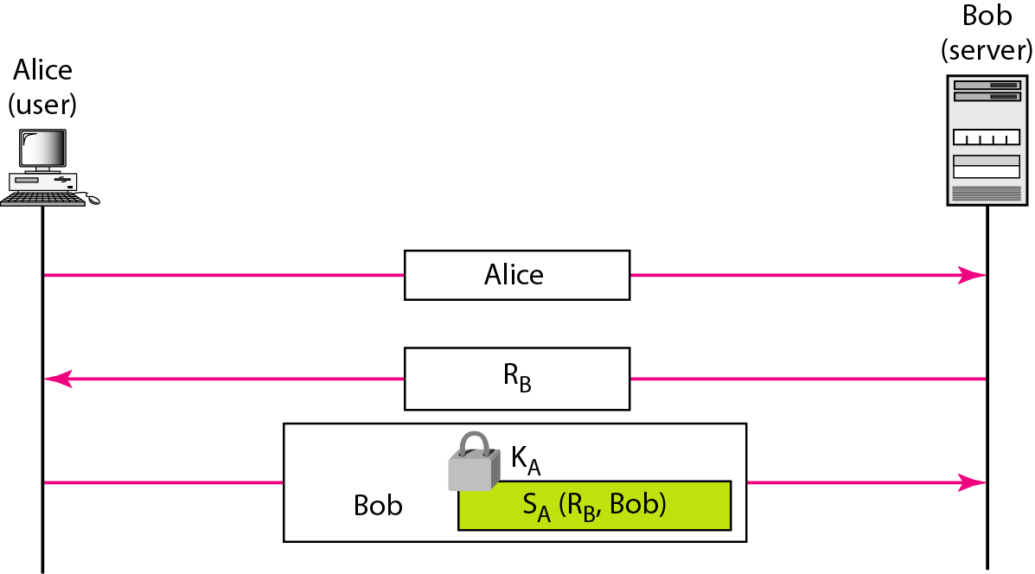
Figure 31.18 Authentication, using digital signature

Slide 38
31-7 KEY MANAGEMENT
We never discussed how secret keys in symmetric-key cryptography and how public keys in asymmetric-key cryptography are distributed and maintained. In this section, we touch on these two issues. We first discuss the distribution of symmetric keys; we then discuss the distribution of asymmetric keys.
Topics discussed in this section:
Symmetric-Key Distribution Public-Key Distribution

Slide 39
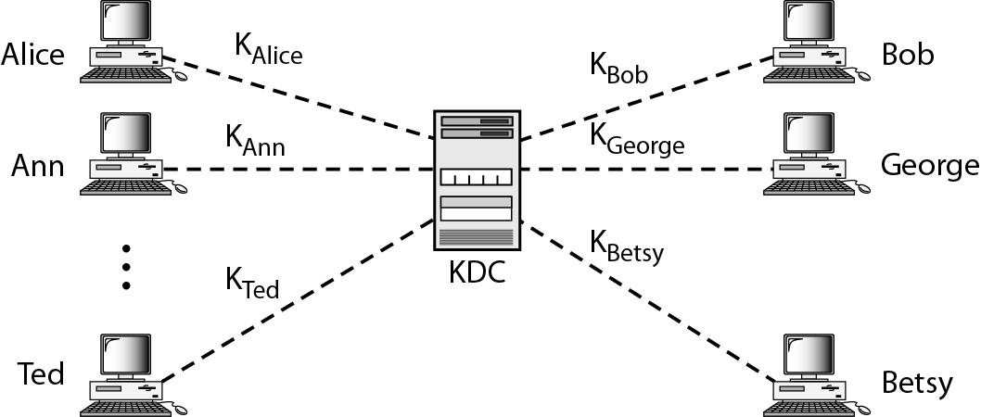
Figure 31.19 KDC

Slide 40
Note
A session symmetric key between two parties is used only once.

Slide 41
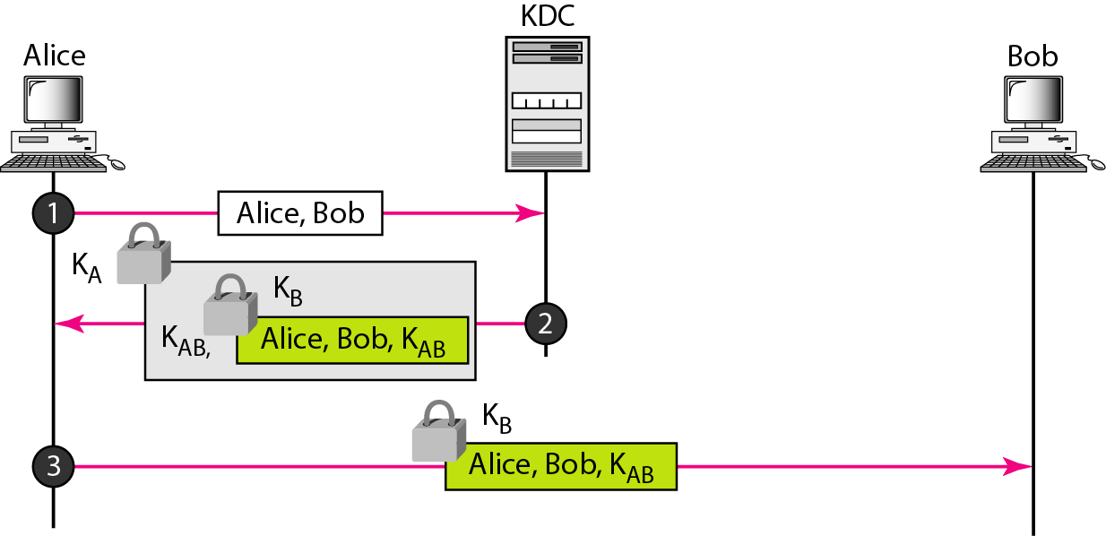
Figure 31.30 Creating a session key between Alice and Bob using KDC

Slide 42
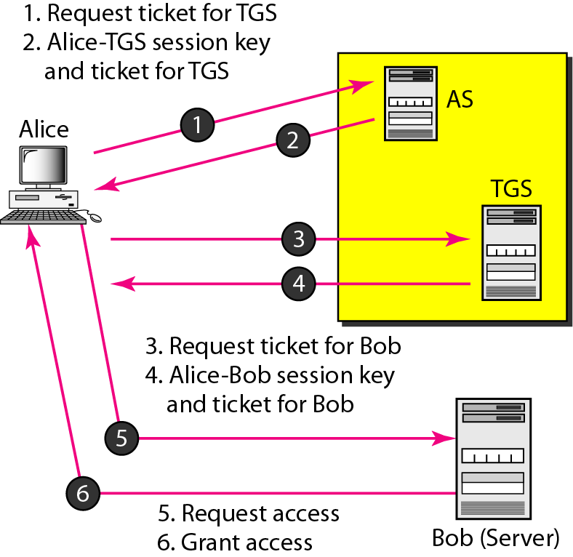
Figure 31.21 Kerberos servers

Slide 43
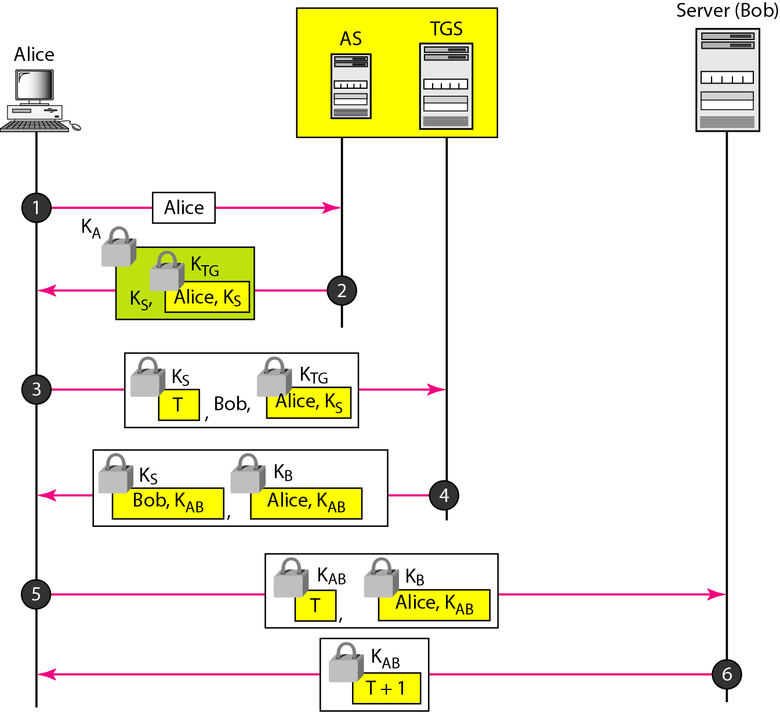
Figure 31.22 Kerberos example

Slide 44
Note
In public-key cryptography, everyone has access to everyone’s public key;
public keys are available to the public.

Slide 45
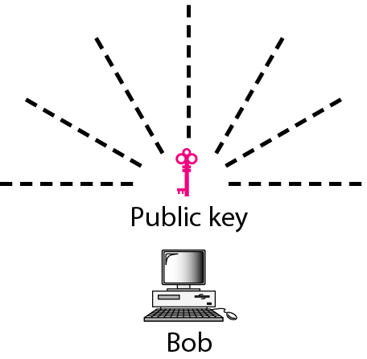
Figure 31.23 Announcing a public key

Slide 46
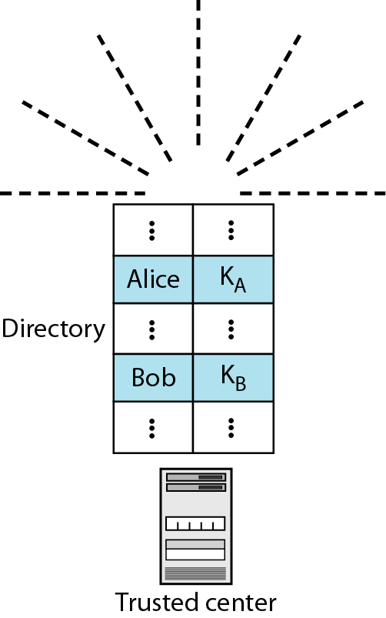
Figure 31.24 Trusted center

Slide 47
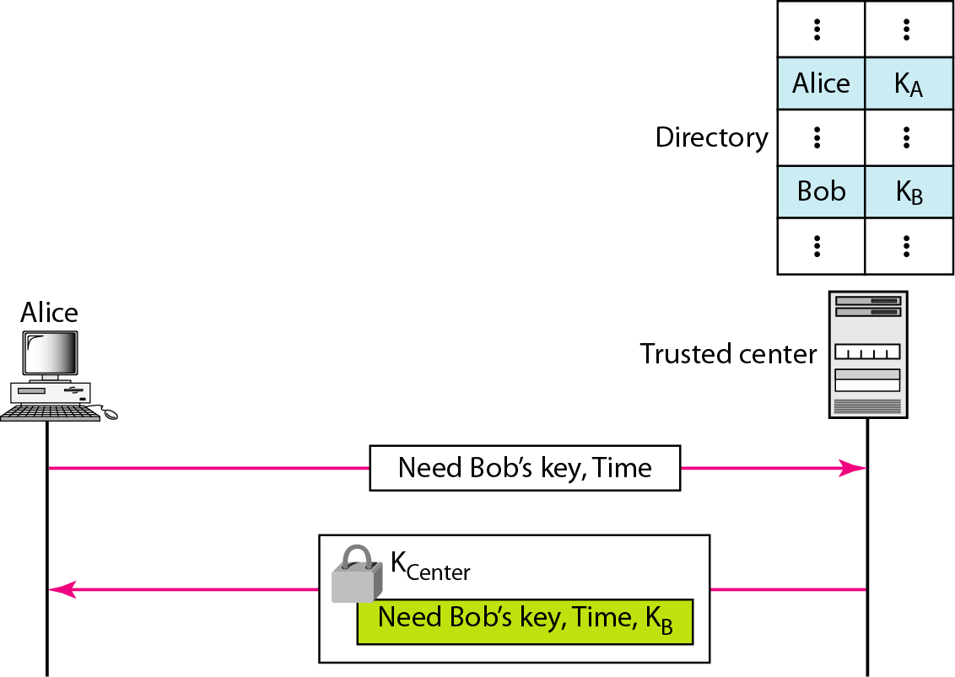
Figure 31.25 Controlled trusted center

Slide 48
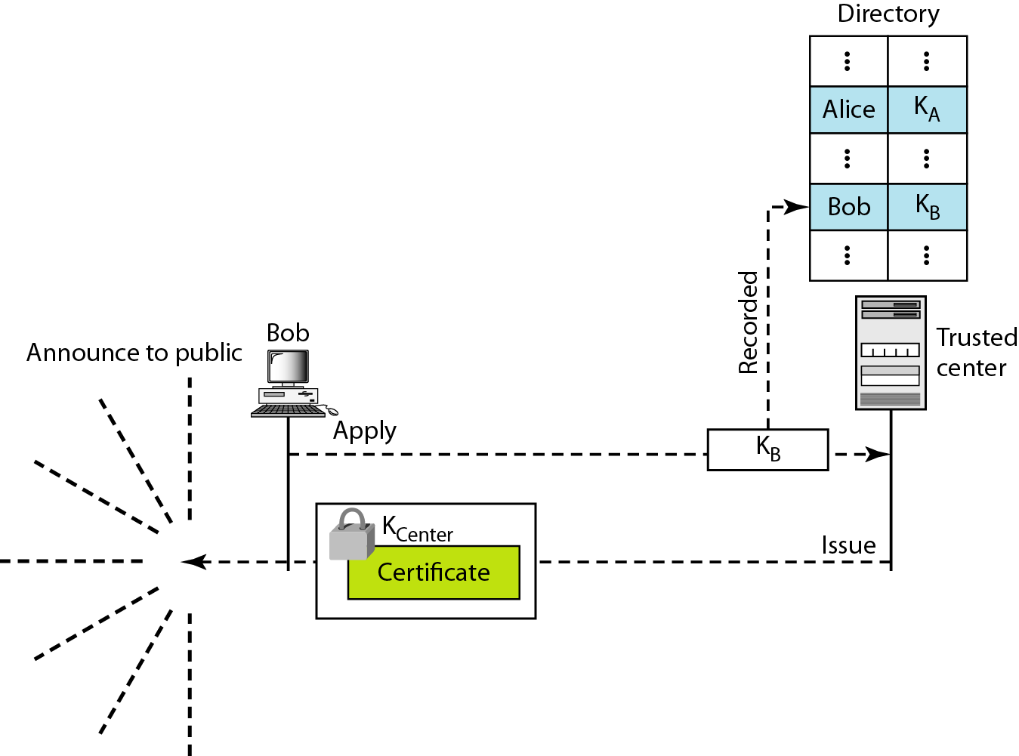
Figure 31.26 Certification authority

Slide 49
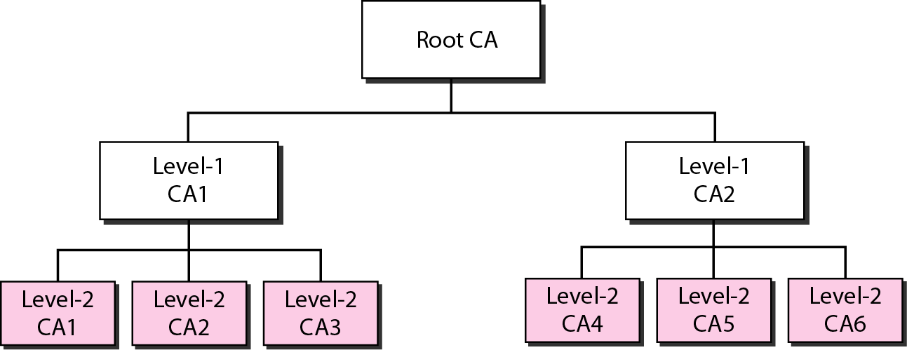
Figure 31.27 PKI hierarchy

