Slide 1

Chapter 4
Digital Transmission
Copyright © The McGraw-Hill Companies, Inc. Permission required for reproduction or display.

Slide 2
4-1 DIGITAL-TO-DIGITAL CONVERSION
In this section, we see how we can represent digital data by using digital signals. The conversion involves three techniques: line coding, block coding, and scrambling. Line coding is always needed; block coding and scrambling may or may not be needed.
Topics discussed in this section:
Line Coding
Line Coding Schemes Block Coding
Scrambling

Slide 3
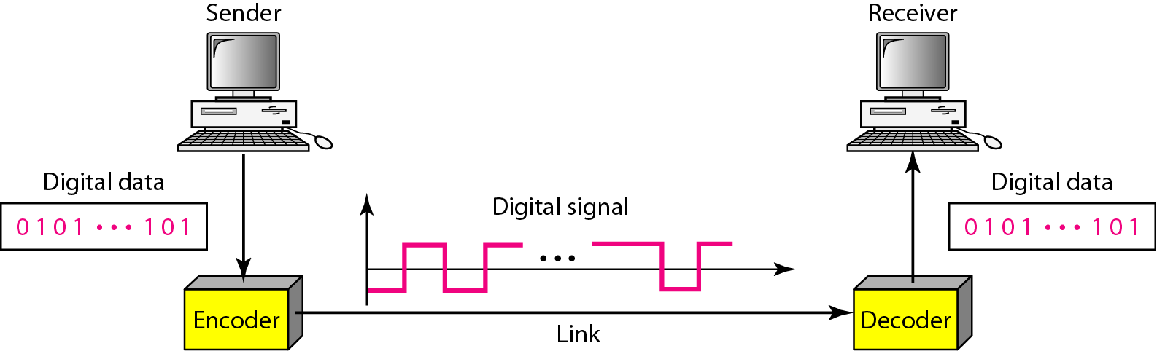
Figure 4.1 Line coding and decoding

Slide 4
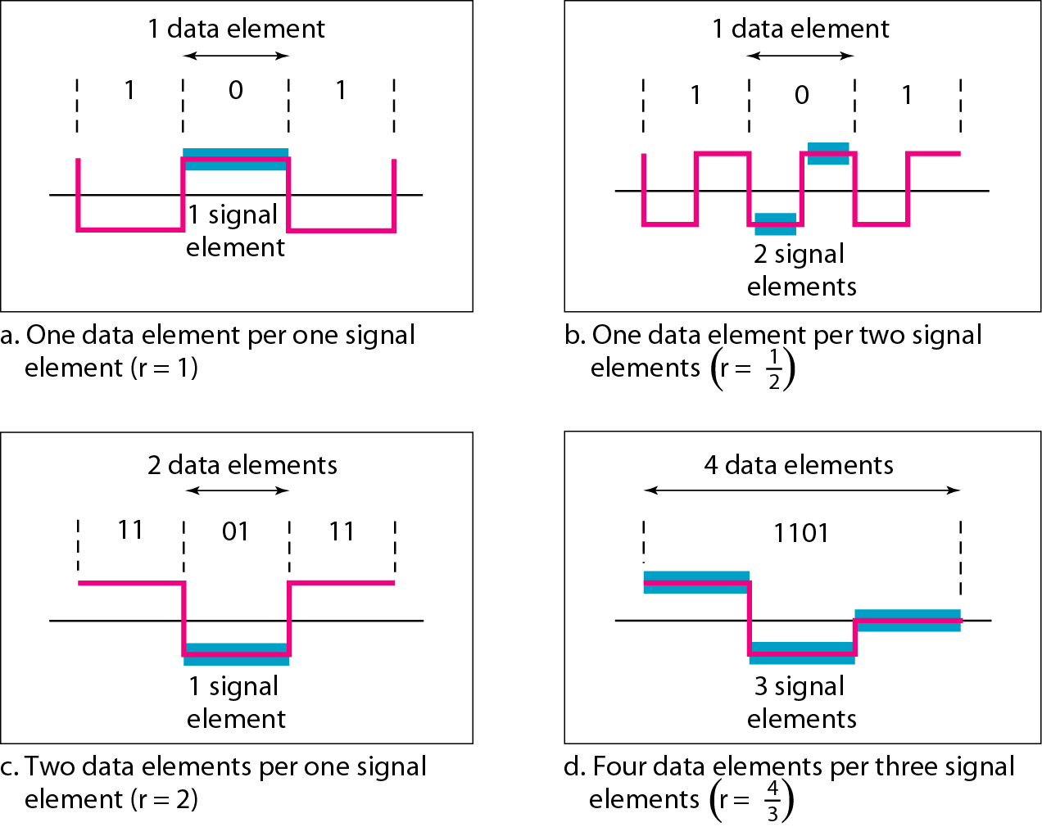
Figure 4.2 Signal element versus data element

Slide 5
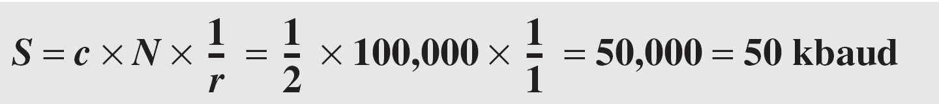
Example 4.1
A signal is carrying data in which one data element is encoded as one signal element ( r = 1). If the bit rate is 100 kbps, what is the average value of the baud rate if c is between 0 and 1?
Solution
We assume that the average value of c is 1/2 . The baud rate is then

Slide 6

Note
Although the actual bandwidth of a digital signal is infinite, the effective bandwidth is finite.

Slide 7
Example 4.2
The maximum data rate of a channel (see Chapter 3) is Nmax = 2 × B × log₂ L (defined by the Nyquist formula). Does this agree with the previous formula for N_{max}?
Solution
A signal with L levels actually can carry log₂L bits per level. If each level corresponds to one signal element and we assume the average case (c = 1/2), then we have

Slide 8
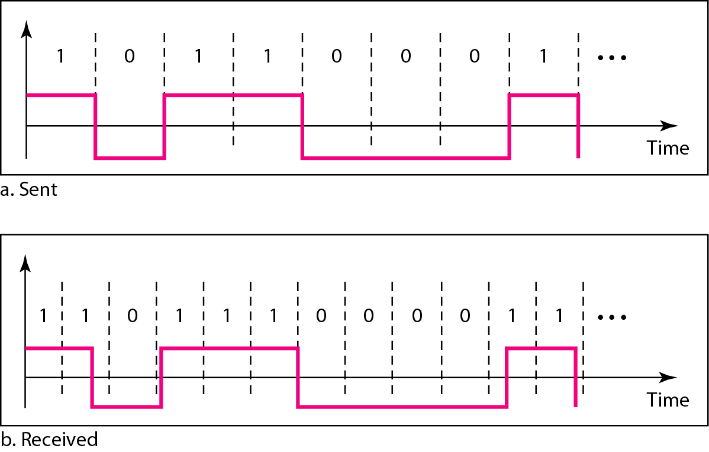
Figure 4.3 Effect of lack of synchronization

Slide 9
Example 4.3
In a digital transmission, the receiver clock is 0.1 percent faster than the sender clock. How many extra bits per second does the receiver receive if the data rate is 1 kbps? How many if the data rate is 1 Mbps?
Solution
At 1 kbps, the receiver receives 1001 bps instead of 1000 bps.
At 1 Mbps, the receiver receives 1,001,000 bps instead of 1,000,000 bps.

Slide 10
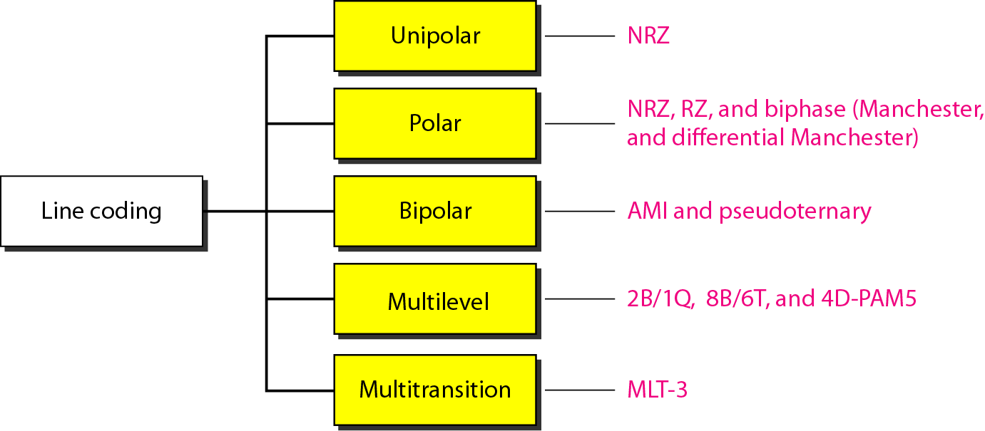
Figure 4.4 Line coding schemes

Slide 11
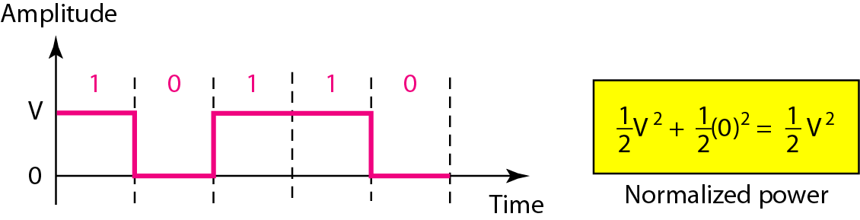
Figure 4.5 Unipolar NRZ scheme

Slide 12
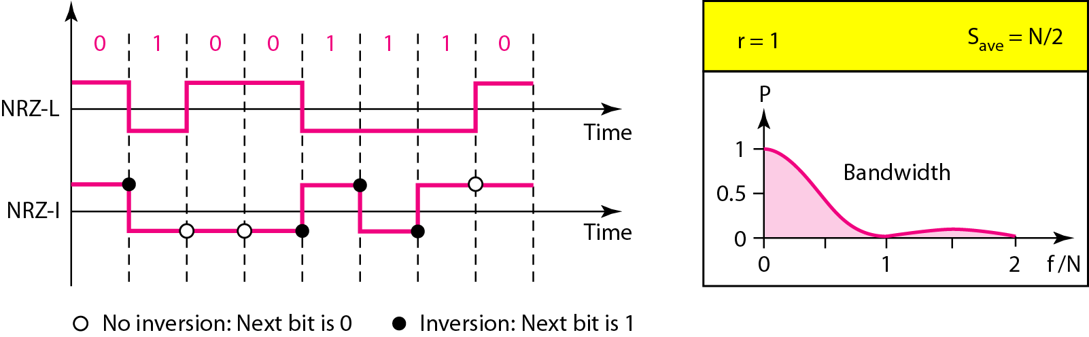
Figure 4.6 Polar NRZ-L and NRZ-I schemes

Slide 13
Note
In NRZ-L the level of the voltage determines the value of the bit. In NRZ-I the inversion or the lack of inversion determines the value of the bit.

Slide 14
Note
NRZ-L and NRZ-I both have an average signal rate of N/2 Bd.

Slide 15
Note
NRZ-L and NRZ-I both have a DC component problem.

Slide 16
Example 4.4
A system is using NRZ-I to transfer 10-Mbps data. What are the average signal rate and minimum bandwidth?
Solution
The average signal rate is S = N/2 = 500 kbaud. The minimum bandwidth for this average baud rate is Bmin = S = 500 kHz.

Slide 17
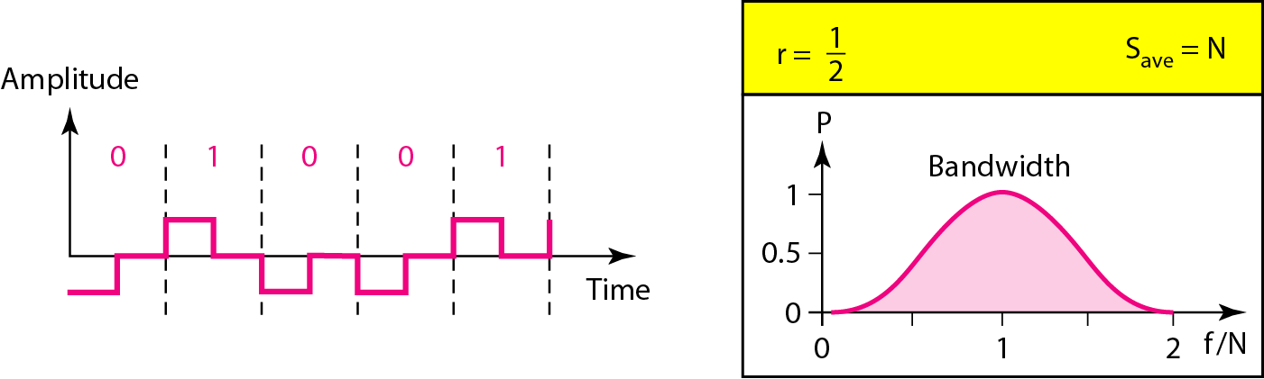
Figure 4.7 Polar RZ scheme

Slide 18
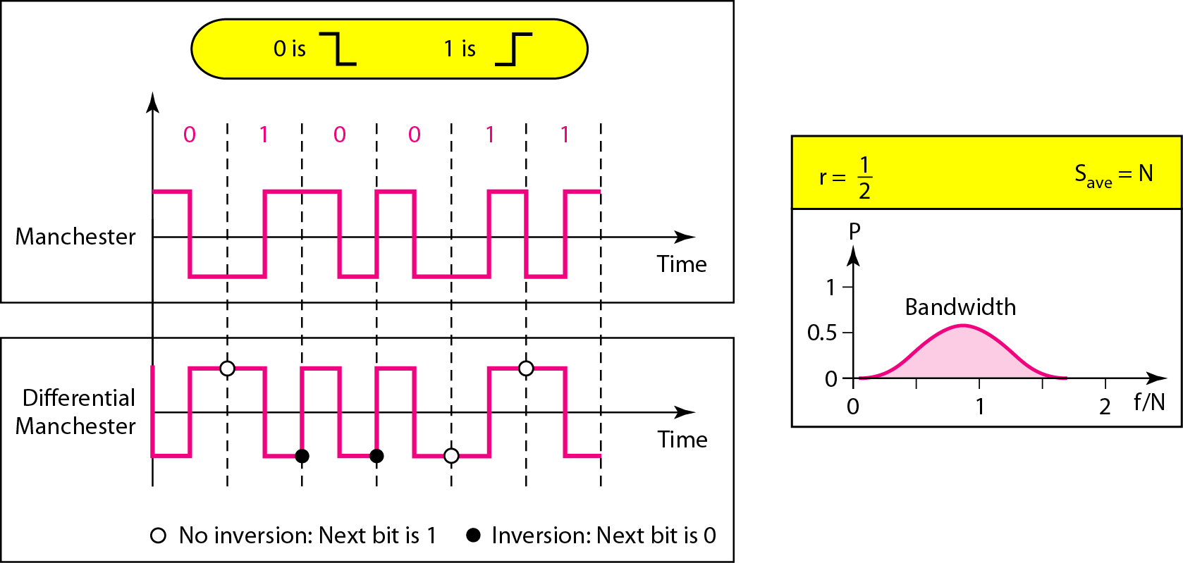
Figure 4.8 Polar biphase: Manchester and differential Manchester schemes

Slide 19
Note
In Manchester and differential Manchester encoding, the transition
at the middle of the bit is used for synchronization.

Slide 20
Note
The minimum bandwidth of Manchester and differential Manchester is 2 times that of NRZ.

Slide 21
Note
In bipolar encoding, we use three levels: positive, zero, and negative.

Slide 22
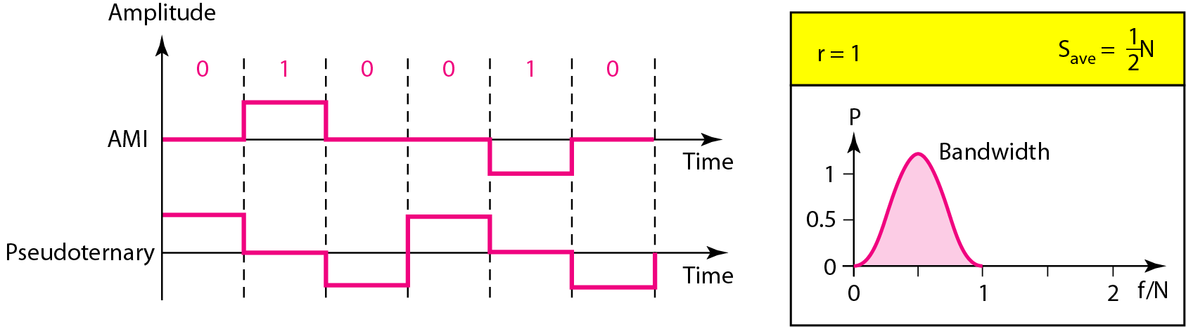
Figure 4.9 Bipolar schemes: AMI and pseudoternary

Slide 23
Note
In mBnL schemes, a pattern of m data elements is encoded as a pattern of n signal elements in which 2^{m} ≤ L^{n}.

Slide 24
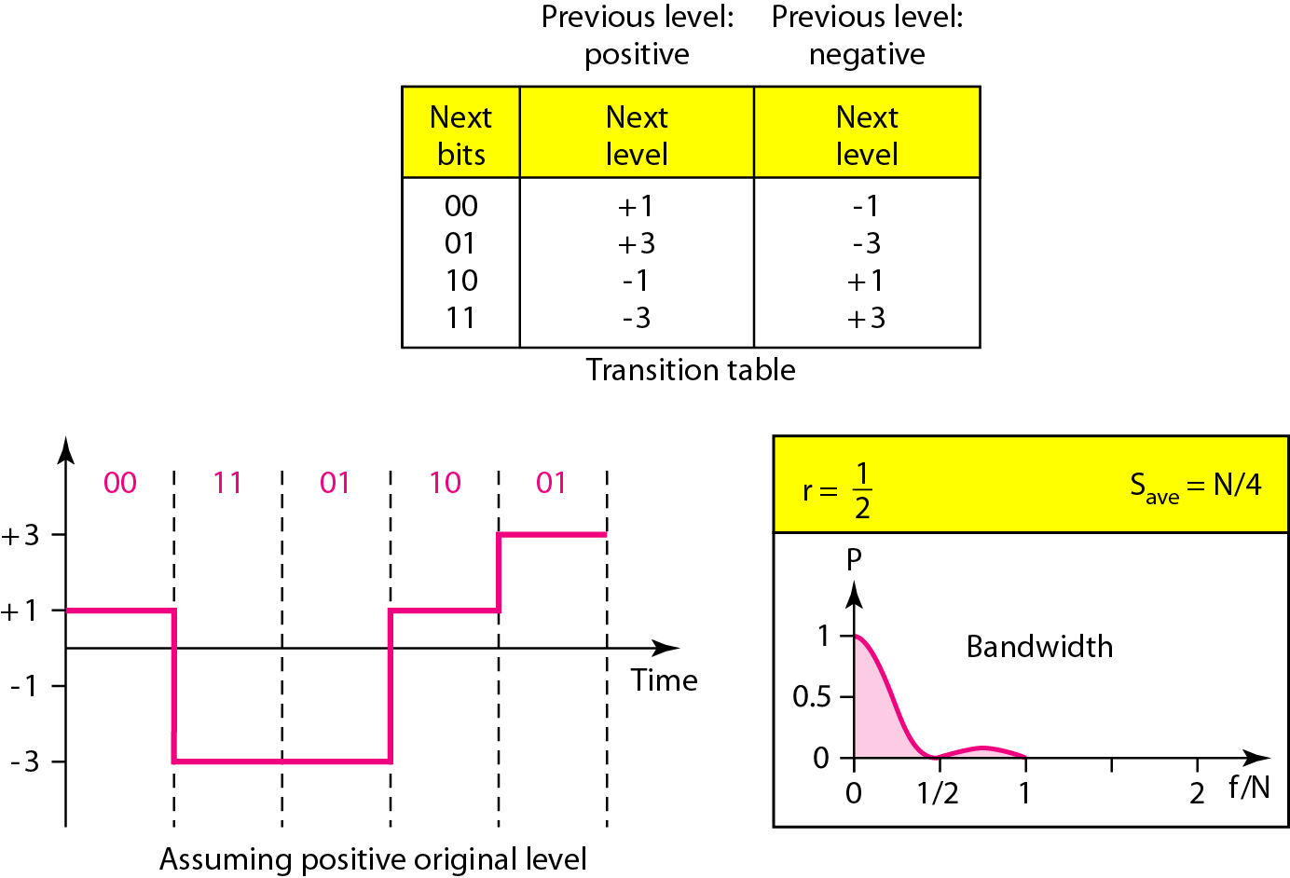
Figure 4.10 Multilevel: 2B1Q scheme

Slide 25
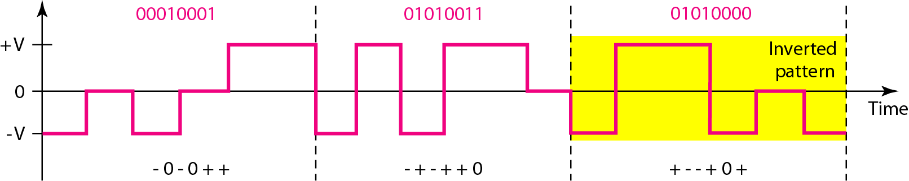
Figure 4.11 Multilevel: 8B6T scheme

Slide 26
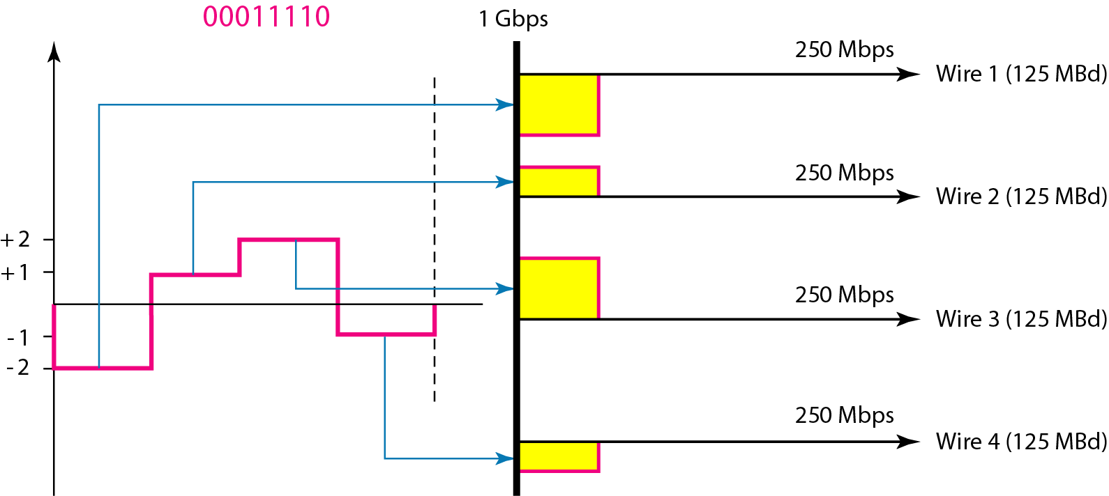
Figure 4.12 Multilevel: 4D-PAM5 scheme

Slide 27
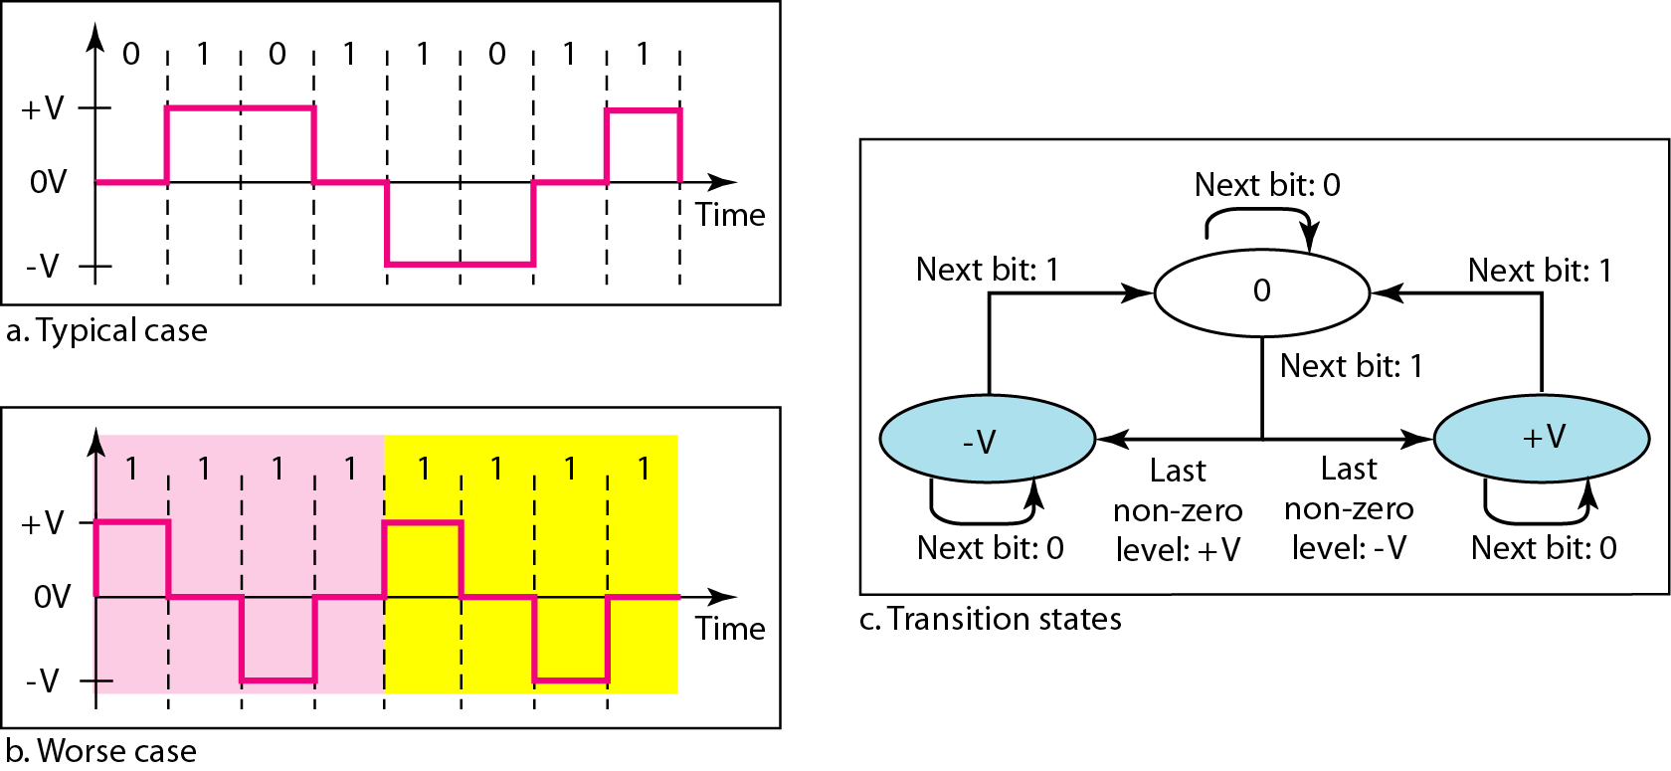
Figure 4.13 Multitransition: MLT-3 scheme

Slide 28
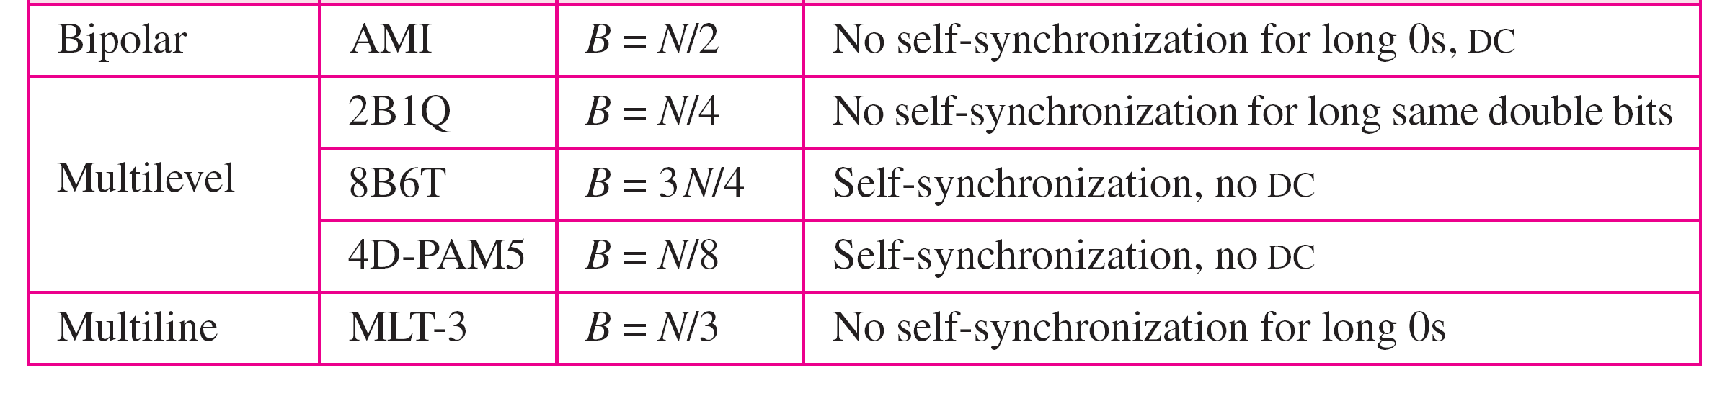
Table 4.1 Summary of line coding schemes

Slide 29
Note
Block coding is normally referred to as mB/nB coding;
it replaces each m-bit group with an n-bit group.

Slide 30
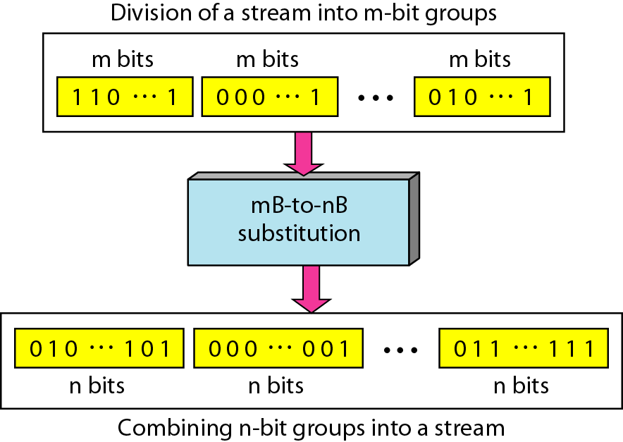
Figure 4.14 Block coding concept

Slide 31
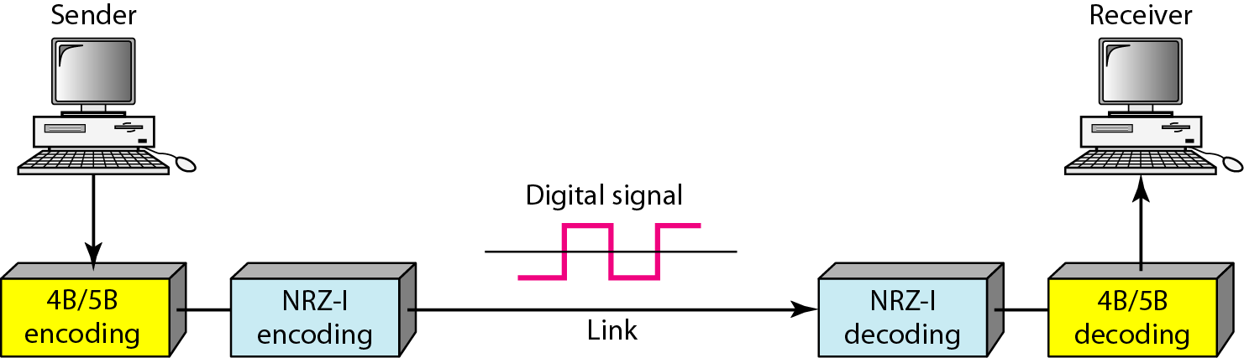
Figure 4.15 Using block coding 4B/5B with NRZ-I line coding scheme

Slide 32
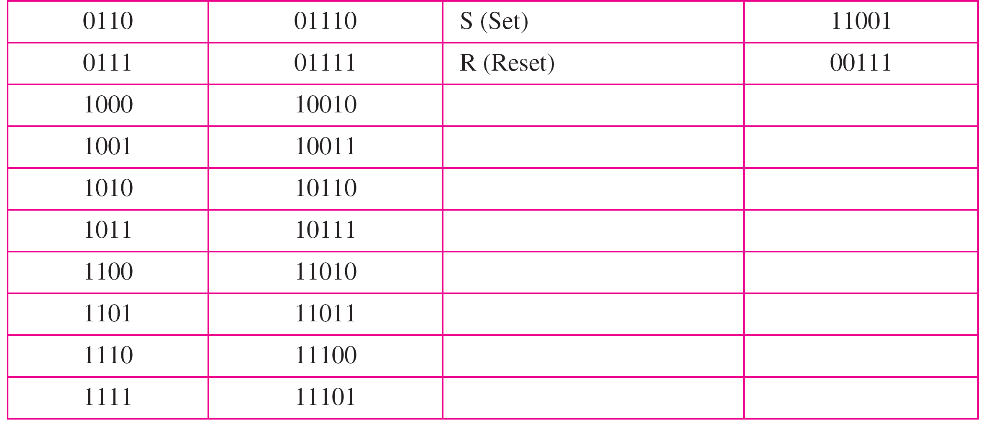
Table 4.2 4B/5B mapping codes

Slide 33
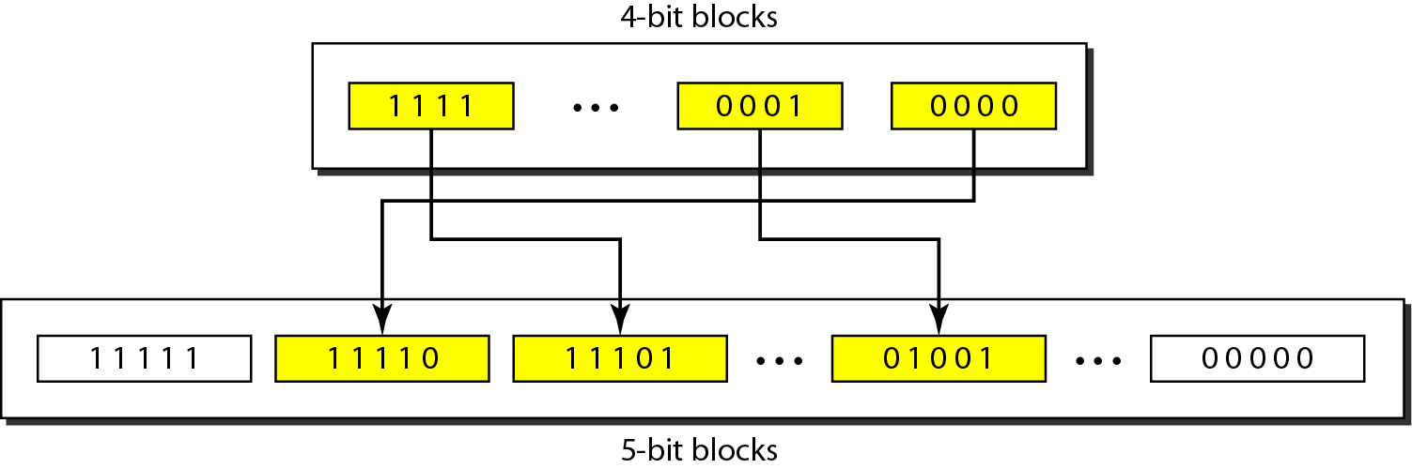
Figure 4.16 Substitution in 4B/5B block coding

Slide 34
Example 4.5
We need to send data at a 1-Mbps rate. What is the minimum required bandwidth, using a combination of 4B/5B and NRZ-I or Manchester coding?
Solution
First 4B/5B block coding increases the bit rate to 1.25 Mbps. The minimum bandwidth using NRZ-I is N/2 or 625 kHz. The Manchester scheme needs a minimum bandwidth of 1 MHz. The first choice needs a lower bandwidth, but has a DC component problem; the second choice needs a higher bandwidth, but does not have a DC component problem.

Slide 35
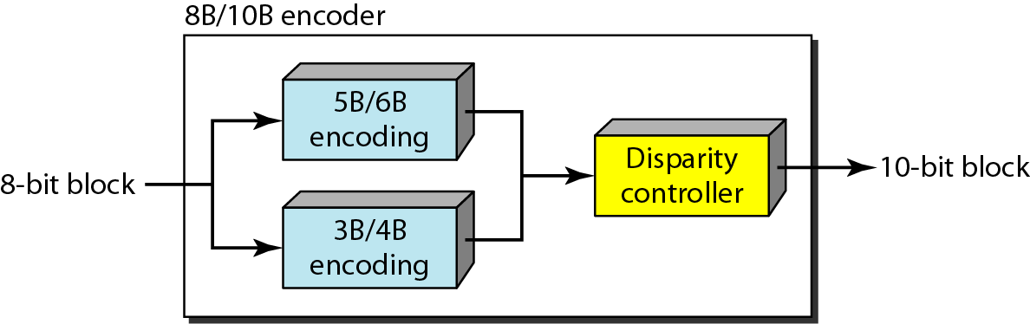
Figure 4.17 8B/10B block encoding

Slide 36
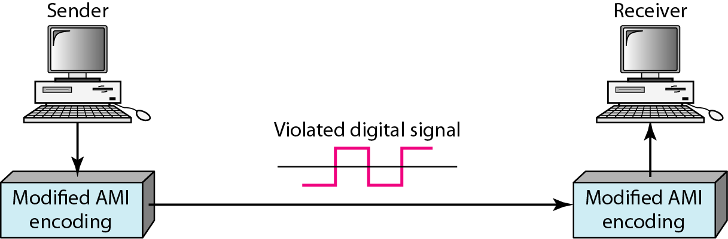
Figure 4.18 AMI used with scrambling

Slide 37
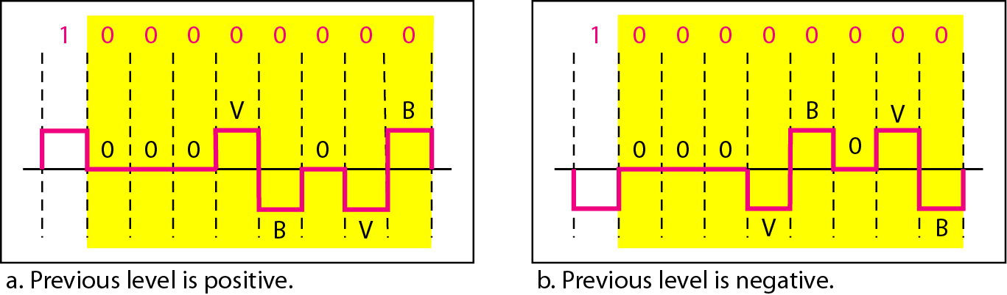
Figure 4.19 Two cases of B8ZS scrambling technique

Slide 38
Note
B8ZS substitutes eight consecutive zeros with 000VB0VB.

Slide 39
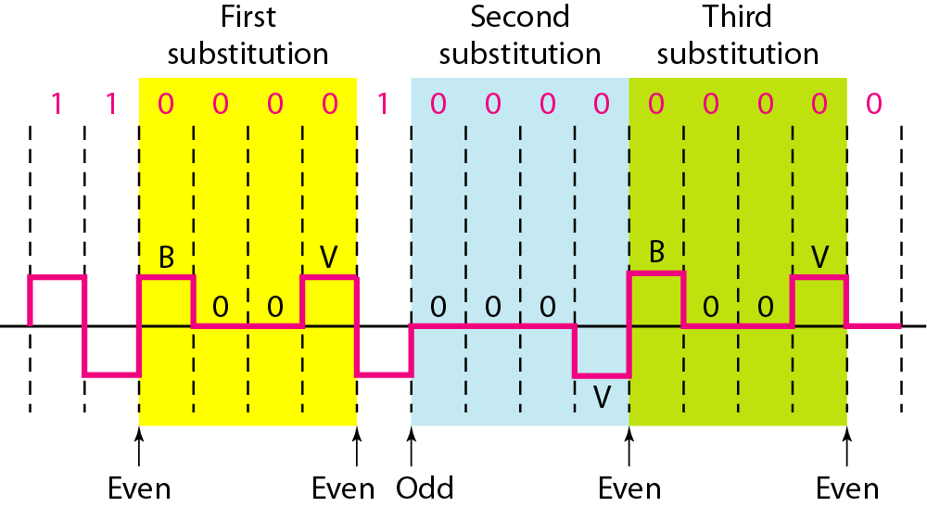
Figure 4.20 Different situations in HDB3 scrambling technique

Slide 40
Note
HDB3 substitutes four consecutive zeros with 000V or B00V depending
on the number of nonzero pulses after the last substitution.

Slide 41
4-2 ANALOG-TO-DIGITAL CONVERSION
We have seen in Chapter 3 that a digital signal is superior to an analog signal. The tendency today is to change an analog signal to digital data. In this section we describe two techniques, pulse code modulation and delta modulation.
Topics discussed in this section:
Pulse Code Modulation (PCM) Delta Modulation (DM)

Slide 42
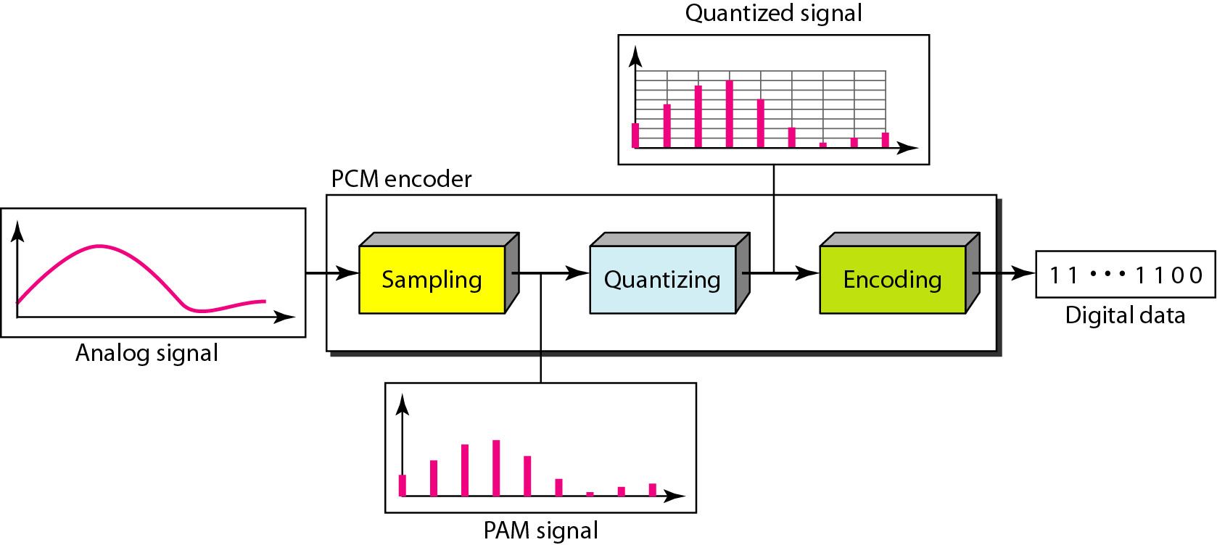
Figure 4.21 Components of PCM encoder

Slide 43
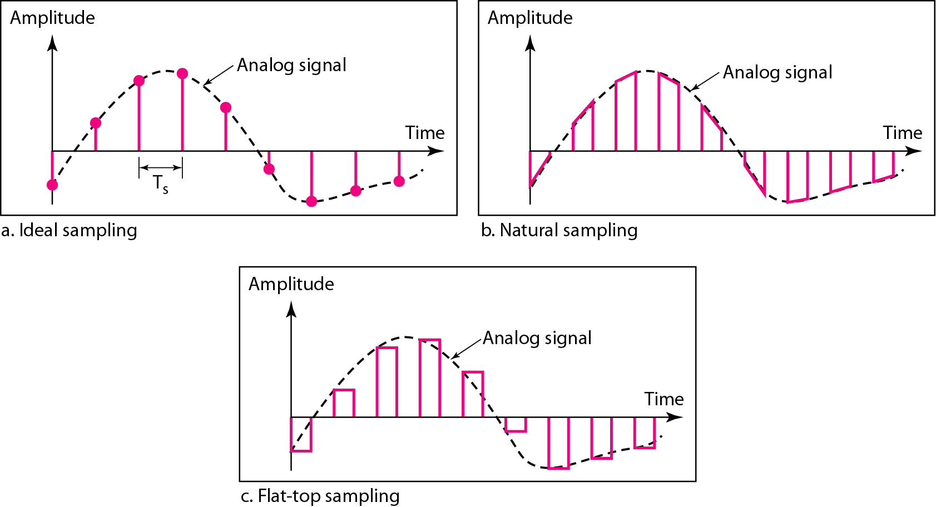
Figure 4.22 Three different sampling methods for PCM

Slide 44
Note
According to the Nyquist theorem, the sampling rate must be
at least 2 times the highest frequency contained in the signal.

Slide 45
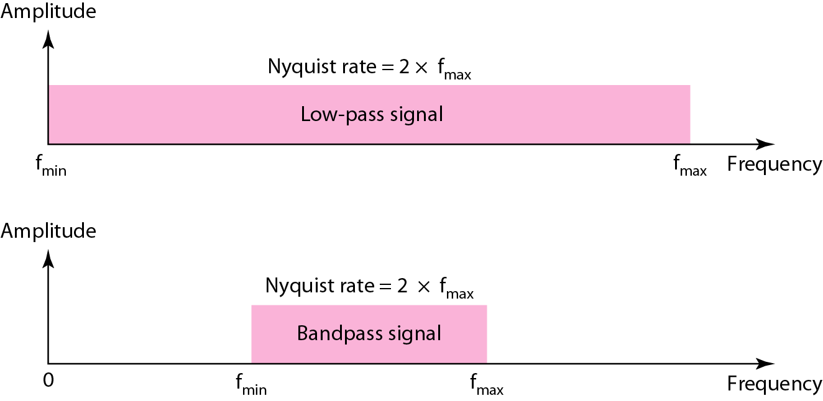
Figure 4.23 Nyquist sampling rate for low-pass and bandpass signals

Slide 46
Example 4.6
For an intuitive example of the Nyquist theorem, let us sample a simple sine wave at three sampling rates: f_{s} = 4f (2 times the Nyquist rate), f_{s} = 2f (Nyquist rate), and f_{s} = f (one-half the Nyquist rate). Figure 4.24 shows the sampling and the subsequent recovery of the signal.
It can be seen that sampling at the Nyquist rate can create a good approximation of the original sine wave (part a). Oversampling in part b can also create the same approximation, but it is redundant and unnecessary. Sampling below the Nyquist rate (part c) does not produce a signal that looks like the original sine wave.

Slide 47
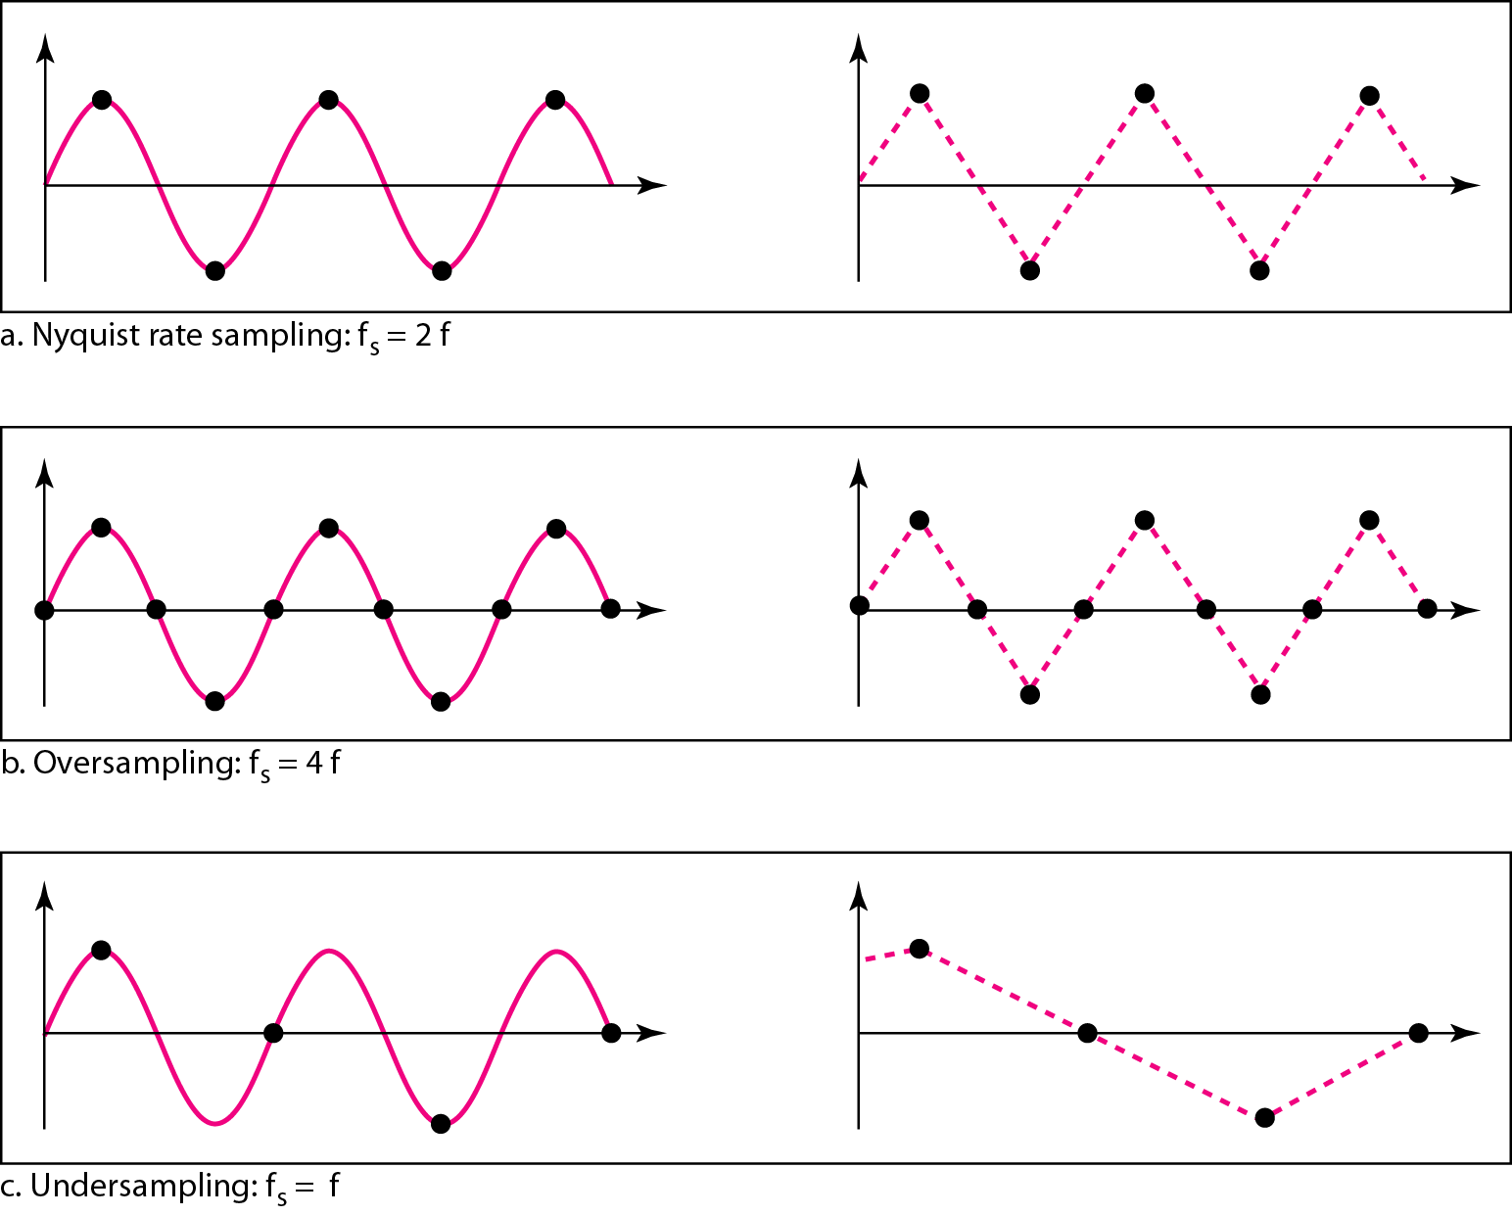
Figure 4.24 Recovery of a sampled sine wave for different sampling rates

Slide 48
Example 4.7
Consider the revolution of a hand of a clock. The second hand of a clock has a period of 60 s. According to the Nyquist theorem, we need to sample the hand every 30 s (T_{s} = T or f_{s} = 2f ). In Figure 4.25a, the sample points, in order, are 12, 6, 12, 6, 12, and 6. The receiver of the samples cannot tell if the clock is moving forward or backward. In part b, we sample at double the Nyquist rate (every 15 s). The sample points are 12, 3, 6, 9, and 12. The clock is moving forward. In part c, we sample below the Nyquist rate (T_{s} = T or f_{s} = f ). The sample points are 12, 9, 6, 3, and 12. Although the clock is moving forward, the receiver thinks that the clock is moving backward.

Slide 49
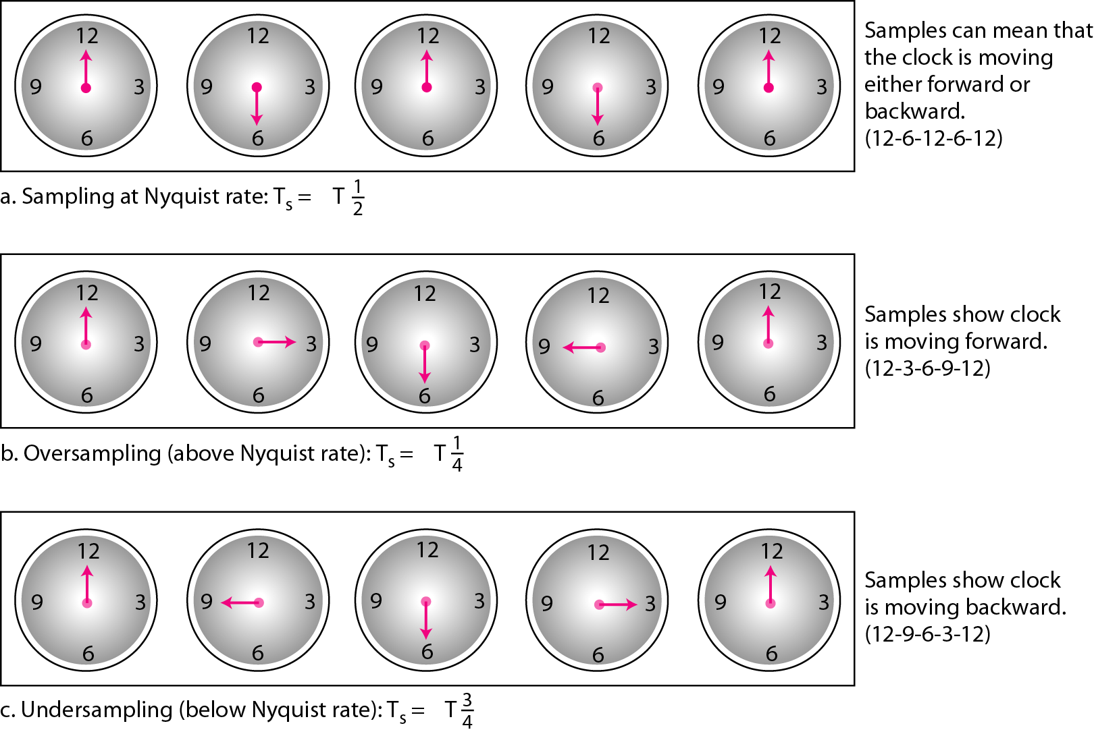
Figure 4.25 Sampling of a clock with only one hand

Slide 50
Example 4.8
An example related to Example 4.7 is the seemingly backward rotation of the wheels of a forward-moving car in a movie. This can be explained by under-sampling. A movie is filmed at 24 frames per second. If a wheel is rotating more than 12 times per second, the under-sampling creates the impression of a backward rotation.

Slide 51
Example 4.9
Telephone companies digitize voice by assuming a maximum frequency of 4000 Hz. The sampling rate therefore is 8000 samples per second.

Slide 52
Example 4.10
A complex low-pass signal has a bandwidth of 200 kHz. What is the minimum sampling rate for this signal?
Solution
The bandwidth of a low-pass signal is between 0 and f, where f is the maximum frequency in the signal. Therefore, we can sample this signal at 2 times the highest frequency (200 kHz). The sampling rate is therefore 400,000 samples per second.

Slide 53
Example 4.11
A complex bandpass signal has a bandwidth of 200 kHz. What is the minimum sampling rate for this signal?
Solution
We cannot find the minimum sampling rate in this case because we do not know where the bandwidth starts or ends. We do not know the maximum frequency in the signal.

Slide 54
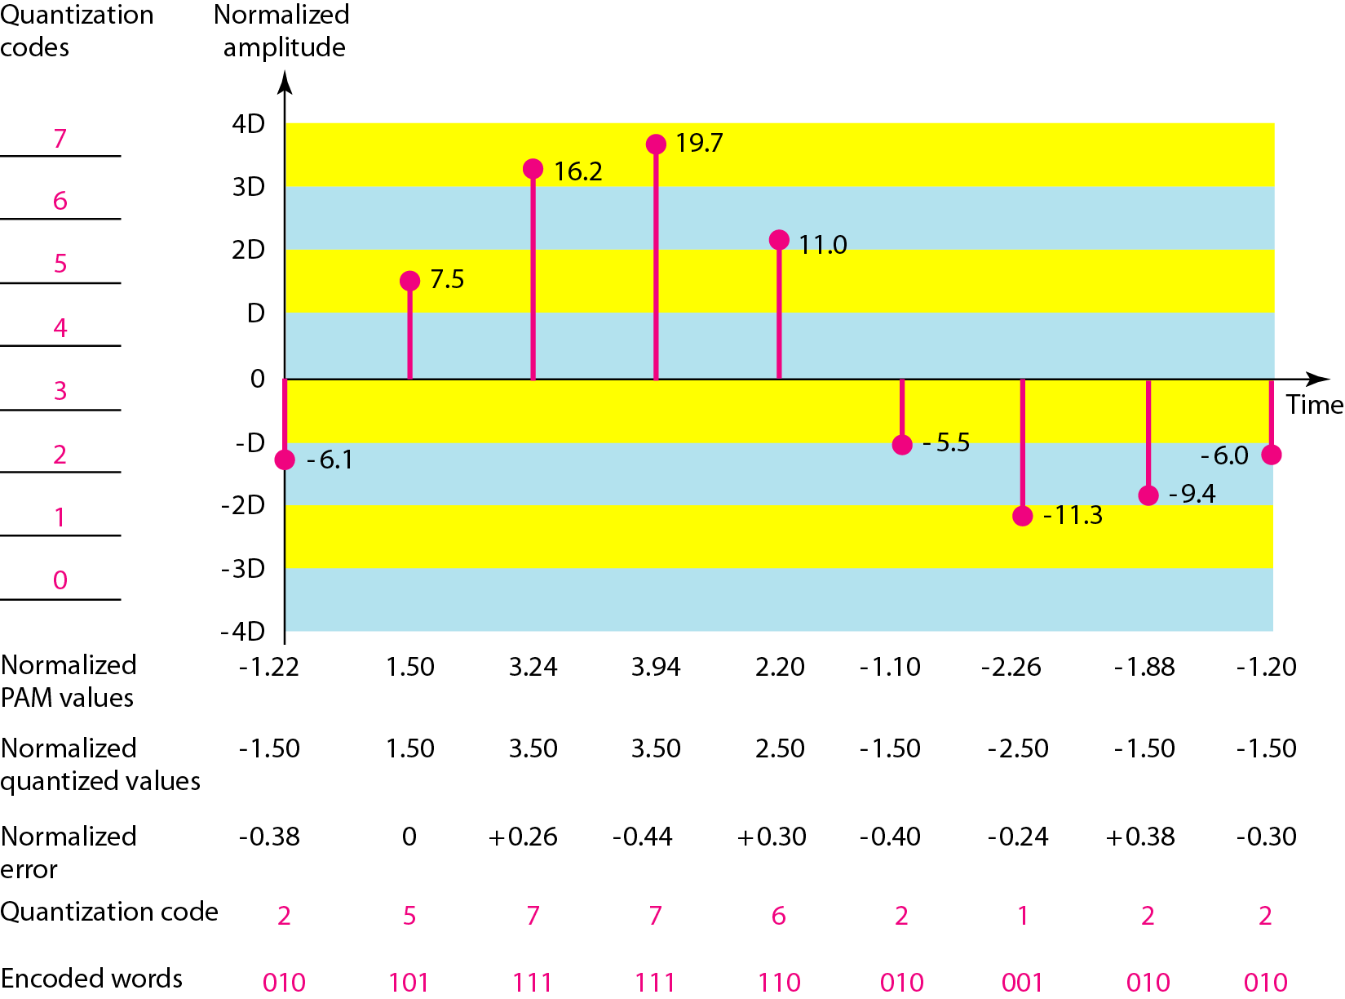
Figure 4.26 Quantization and encoding of a sampled signal

Slide 55
Example 4.12
What is the SNRdB in the example of Figure 4.26?
Solution
We can use the formula to find the quantization. We have eight levels and 3 bits per sample, so
SNRdB = 6.02(3) + 1.76 = 19.82 dB
Increasing the number of levels increases the SNR.

Slide 56
Example 4.13
A telephone subscriber line must have an SNRdB above 40. What is the minimum number of bits per sample?
Solution
We can calculate the number of bits as
Telephone companies usually assign 7 or 8 bits per sample.

Slide 57
Example 4.14
We want to digitize the human voice. What is the bit rate, assuming 8 bits per sample?
Solution
The human voice normally contains frequencies from 0 to 4000 Hz. So the sampling rate and bit rate are calculated as follows:

Slide 58
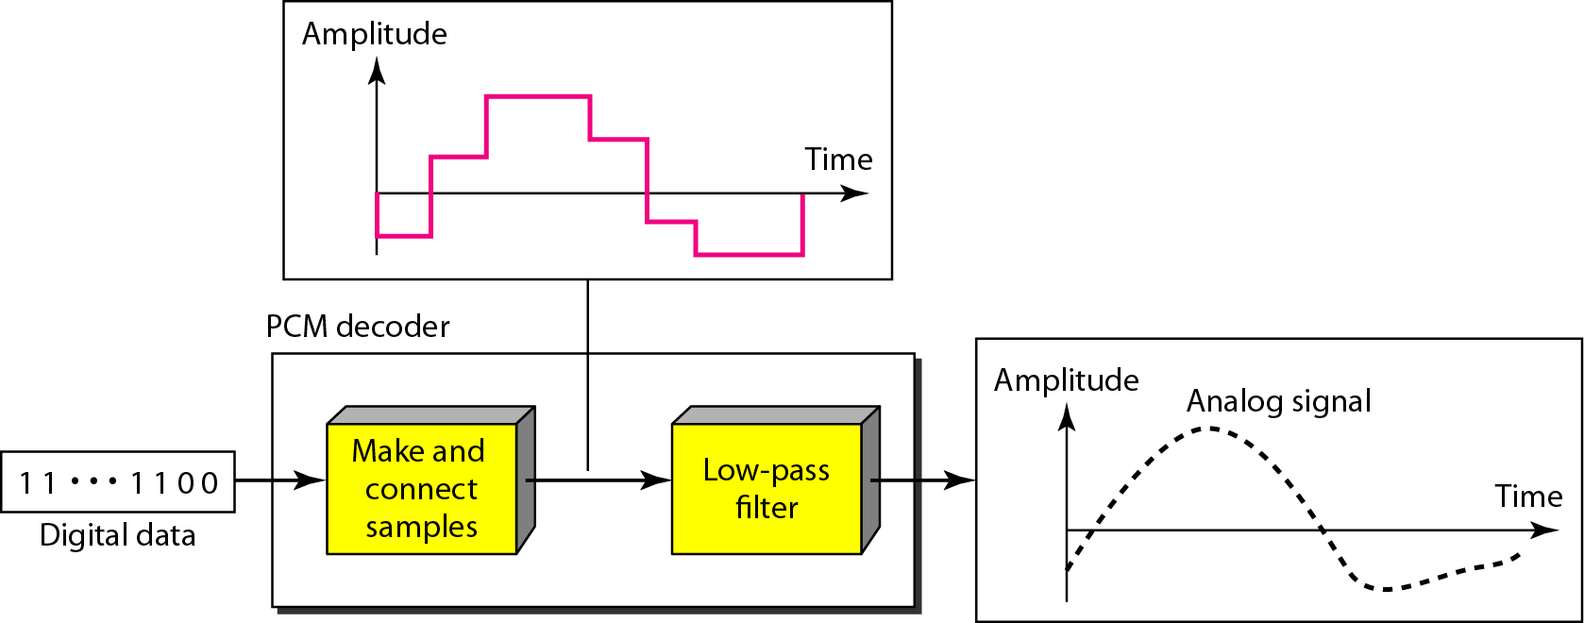
Figure 4.27 Components of a PCM decoder

Slide 59
Example 4.15
We have a low-pass analog signal of 4 kHz. If we send the analog signal, we need a channel with a minimum bandwidth of 4 kHz. If we digitize the signal and send 8 bits per sample, we need a channel with a minimum bandwidth of 8 × 4 kHz = 32 kHz.

Slide 60
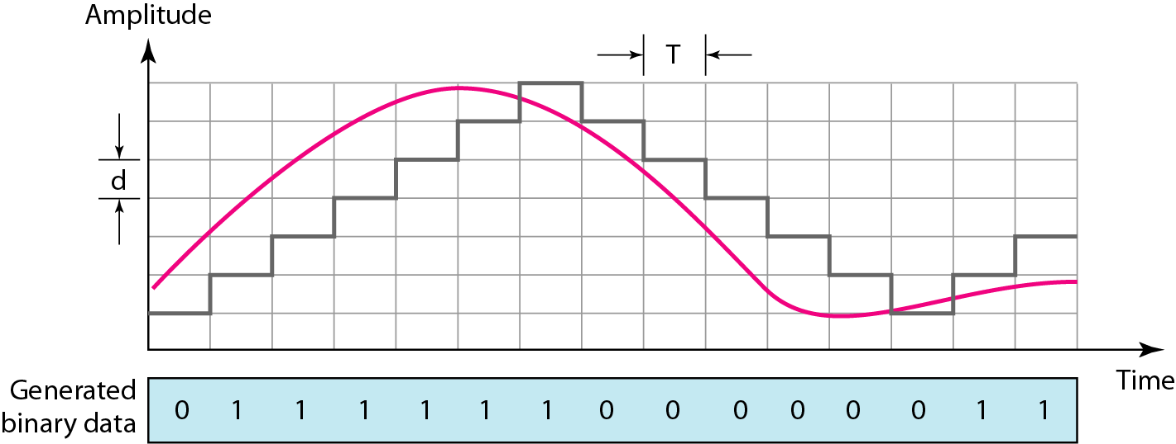
Figure 4.28 The process of delta modulation

Slide 61
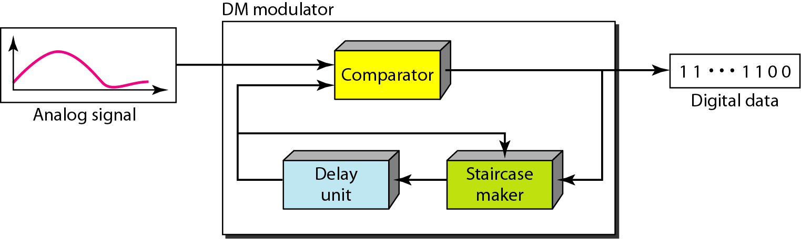
Figure 4.29 Delta modulation components

Slide 62
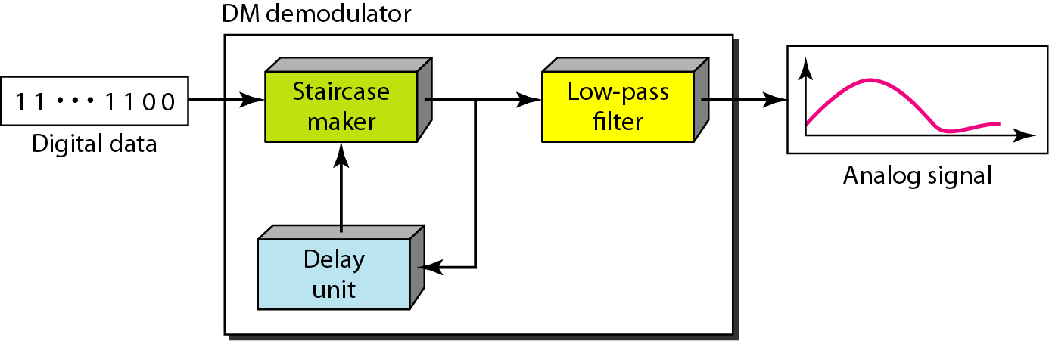
Figure 4.30 Delta demodulation components

Slide 63
4-3 TRANSMISSION MODES
The transmission of binary data across a link can be accomplished in either parallel or serial mode. In parallel mode, multiple bits are sent with each clock tick. In serial mode, 1 bit is sent with each clock tick. While there is only one way to send parallel data, there are three subclasses of serial transmission: asynchronous, synchronous, and isochronous.
Topics discussed in this section:
Parallel Transmission Serial Transmission

Slide 64
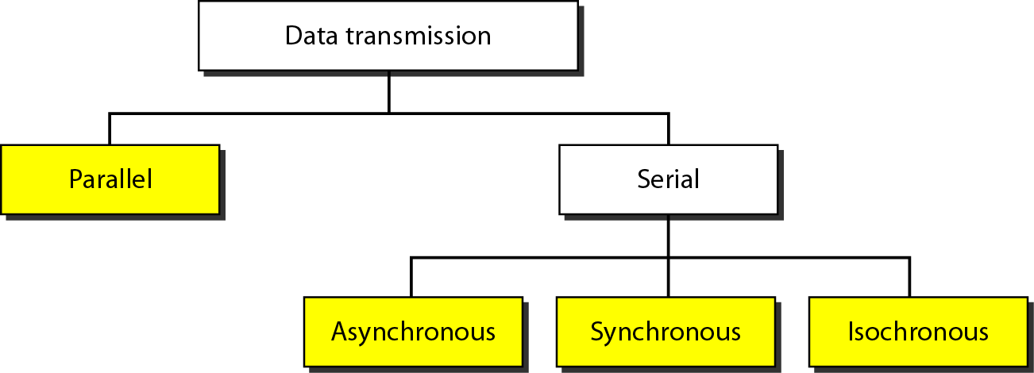
Figure 4.31 Data transmission and modes

Slide 65
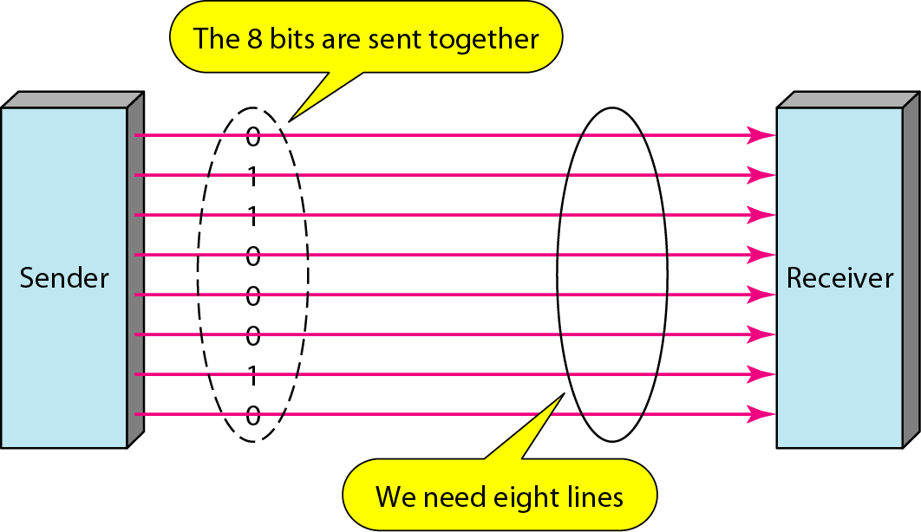
Figure 4.32 Parallel transmission

Slide 66
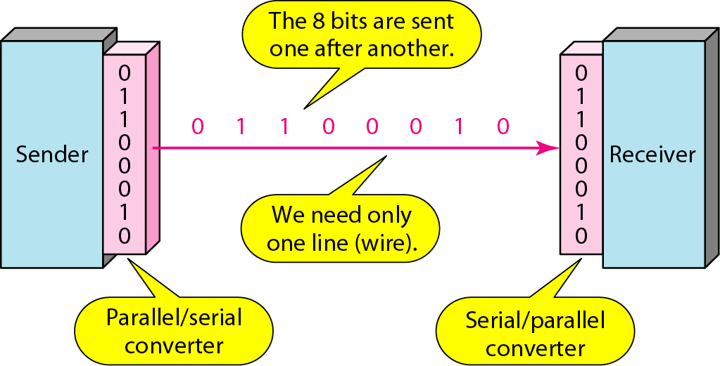
Figure 4.33 Serial transmission

Slide 67
Note
In asynchronous transmission, we send 1 start bit (0) at the beginning and 1 or more stop bits (1s) at the end of each byte. There may be a gap between each byte.

Slide 68
Note
Asynchronous here means “asynchronous at the byte level,”
but the bits are still synchronized; their durations are the same.

Slide 69
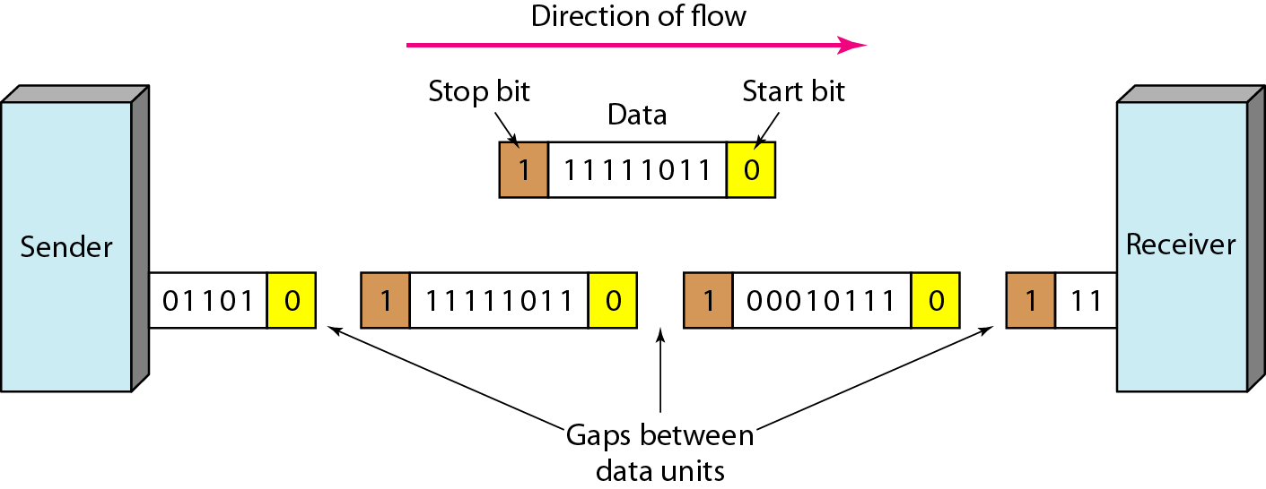
Figure 4.34 Asynchronous transmission

Slide 70
Note
In synchronous transmission, we send bits one after another without start or stop bits or gaps. It is the responsibility of the receiver to group the bits.

Slide 71
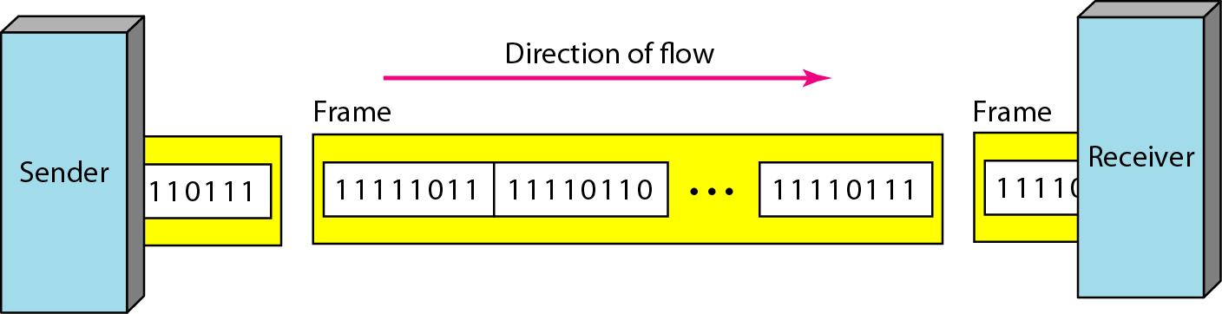
Figure 4.35 Synchronous transmission

