Slide 1

Chapter 9
Using Telephone and Cable Networks
for Data Transmission
Copyright © The McGraw-Hill Companies, Inc. Permission required for reproduction or display.

Slide 2
9-1 TELEPHONE NETWORK
Telephone networks use circuit switching. The telephone network had its beginnings in the late 1800s. The entire network, which is referred to as the plain old telephone system (POTS), was originally an analog system using analog signals to transmit voice.
Topics discussed in this section:
Major Components
LATAs Signaling
Services Provided by Telephone Networks

Slide 3
Figure 9.1 A telephone system

Slide 4

Note
Intra-LATA services are provided by local exchange carriers. Since 1996, there are two
types of LECs: incumbent local exchange carriers and competitive local exchange carriers.

Slide 5
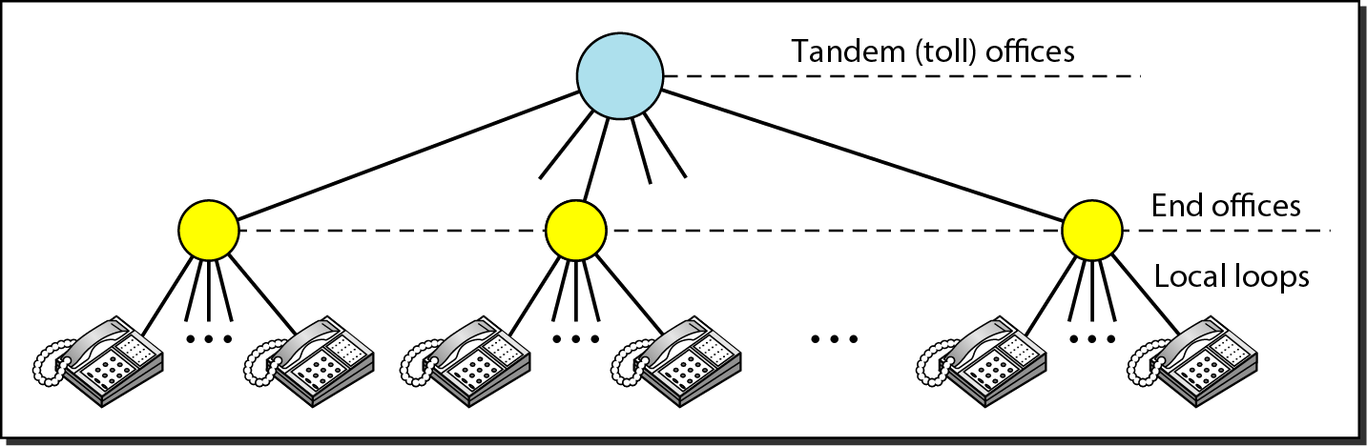
Figure 9.2 Switching offices in a LATA

Slide 6
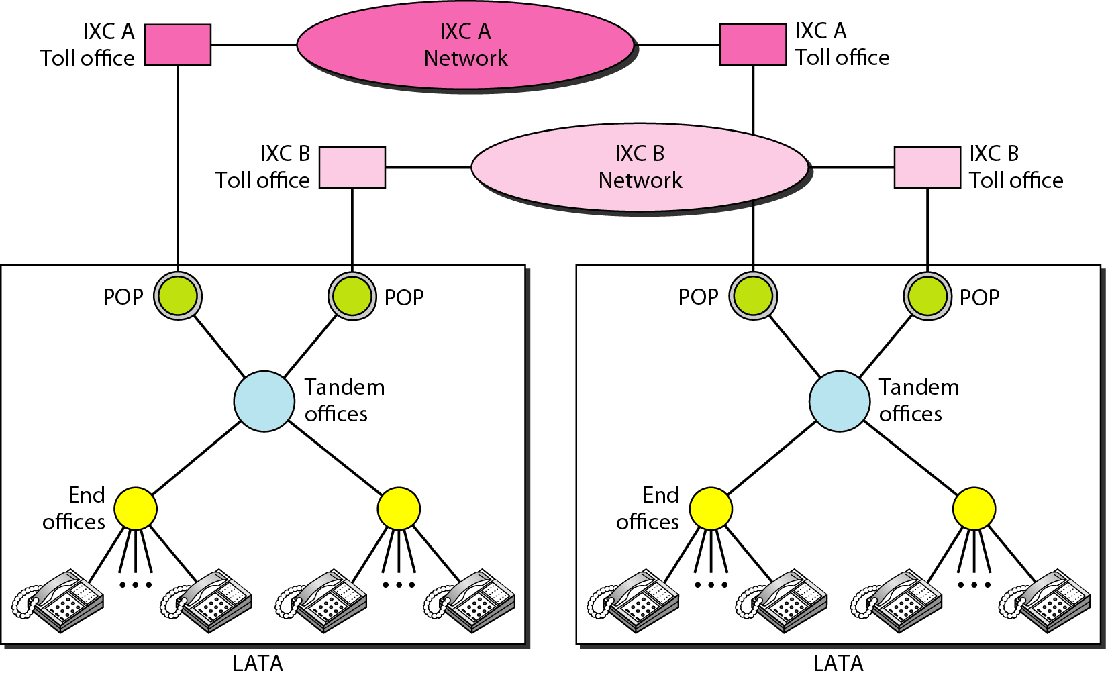
Figure 9.3 Point of presences (POPs)

Slide 7
Note
The tasks of data transfer and signaling are separated in modern telephone networks: data transfer is done by one network, signaling by another.

Slide 8
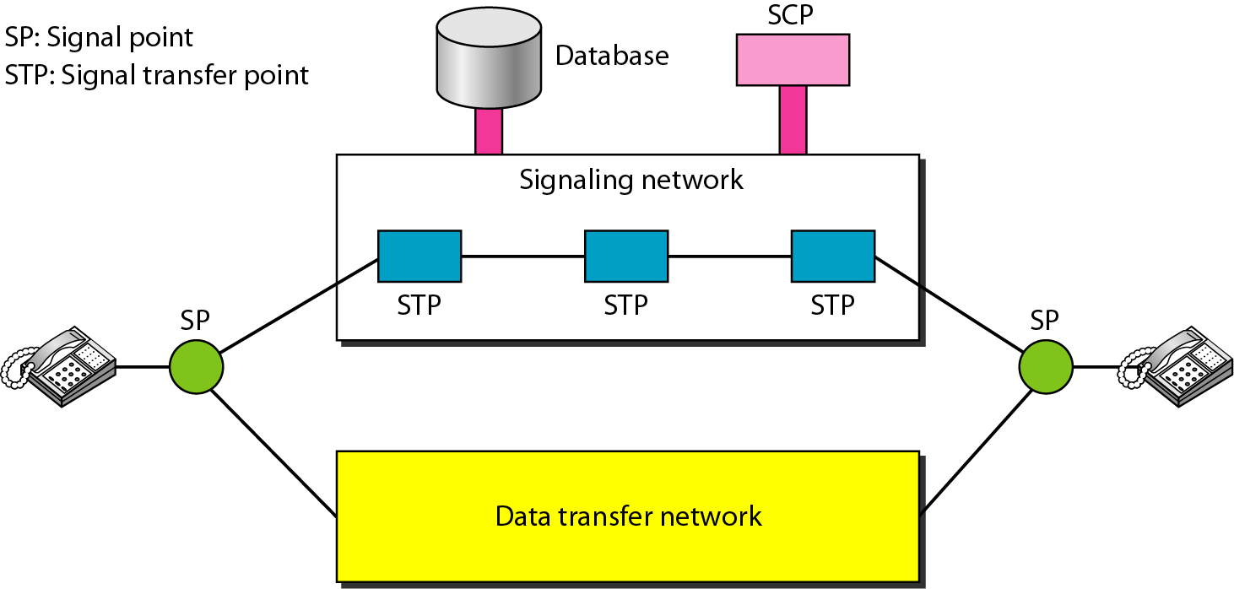
Figure 9.4 Data transfer and signaling networks

Slide 9
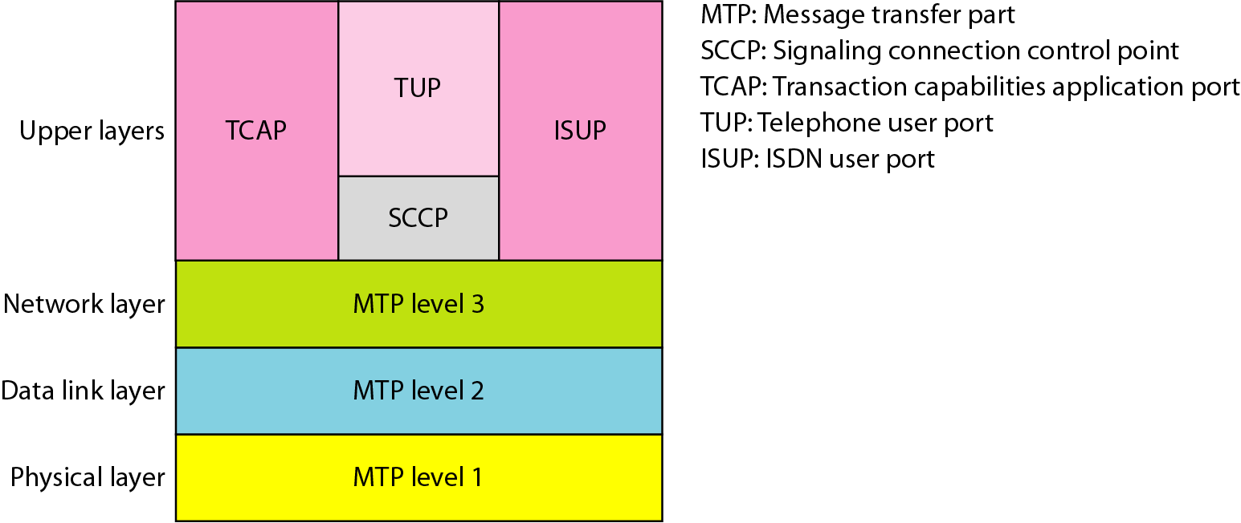
Figure 9.5 Layers in SS7

Slide 10
9-2 DIAL-UP MODEMS
Traditional telephone lines can carry frequencies between 300 and 3300 Hz, giving them a bandwidth of 3000 Hz. All this range is used for transmitting voice, where a great deal of interference and distortion can be accepted without loss of intelligibility.
Topics discussed in this section:
Modem Standards

Slide 11
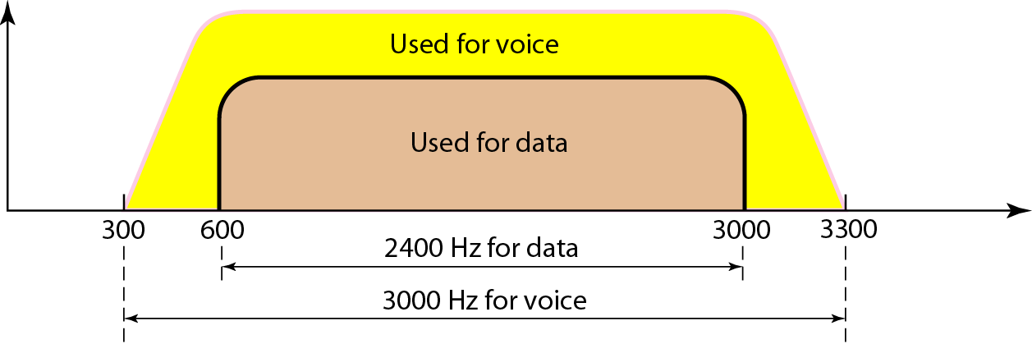
Figure 9.6 Telephone line bandwidth

Slide 12
Note
Modem
stands for modulator/demodulator.

Slide 13
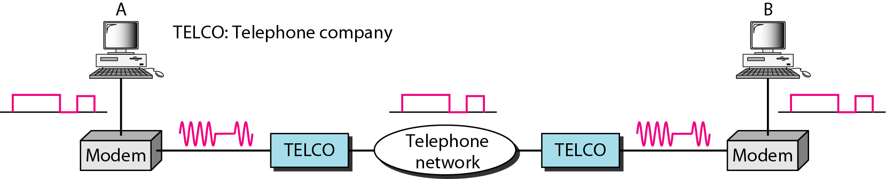
Figure 9.7 Modulation/demodulation

Slide 14
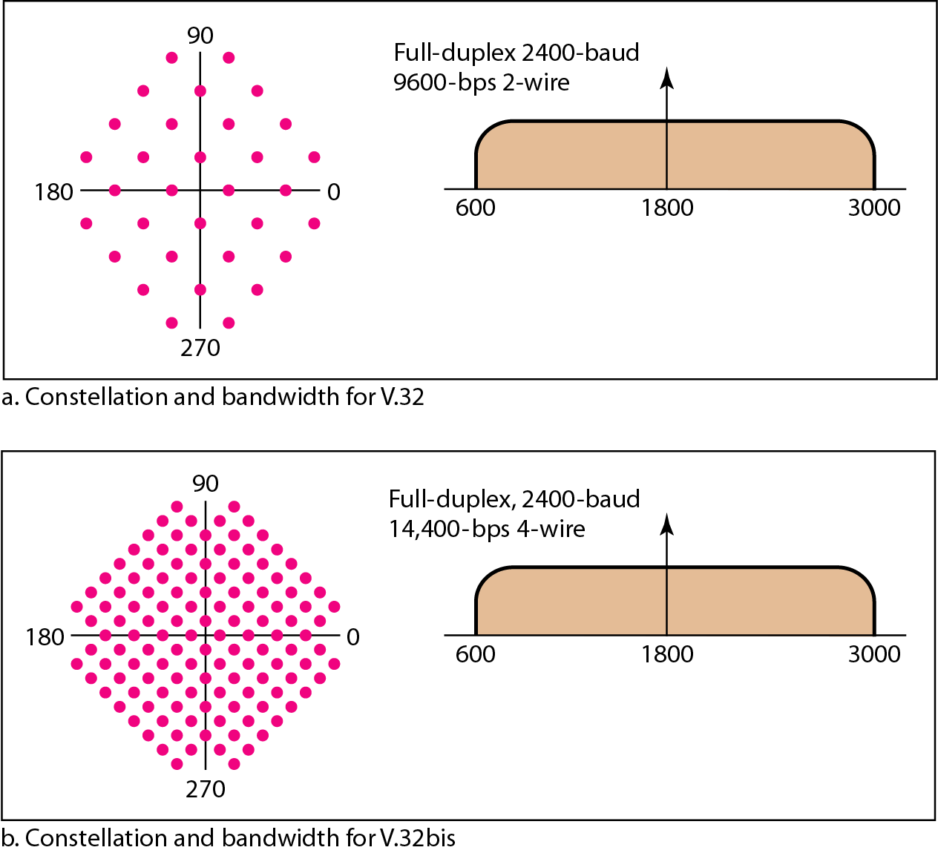
Figure 9.8 The V.32 and V.32bis constellation and bandwidth

Slide 15
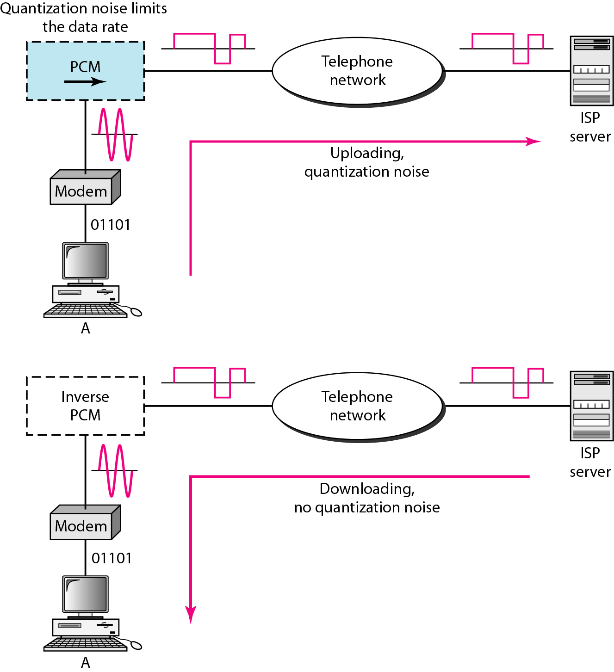
Figure 9.9 Uploading and downloading in 56K modems

Slide 16
9-3 DIGITAL SUBSCRIBER LINE
After traditional modems reached their peak data rate, telephone companies developed another technology, DSL, to provide higher-speed access to the Internet. Digital subscriber line (DSL) technology is one of the most promising for supporting high-speed digital communication over the existing local loops.
Topics discussed in this section:
ADSL
ADSL Lite
HDSL
SDSL VDSL

Slide 17
Note
ADSL is an asymmetric communication technology designed for residential users; it is not suitable for businesses.

Slide 18
Note
The existing local loops can handle bandwidths up to 1.1 MHz.

Slide 19
Note
ADSL is an adaptive technology. The system uses a data rate
based on the condition of the local loop line.

Slide 20
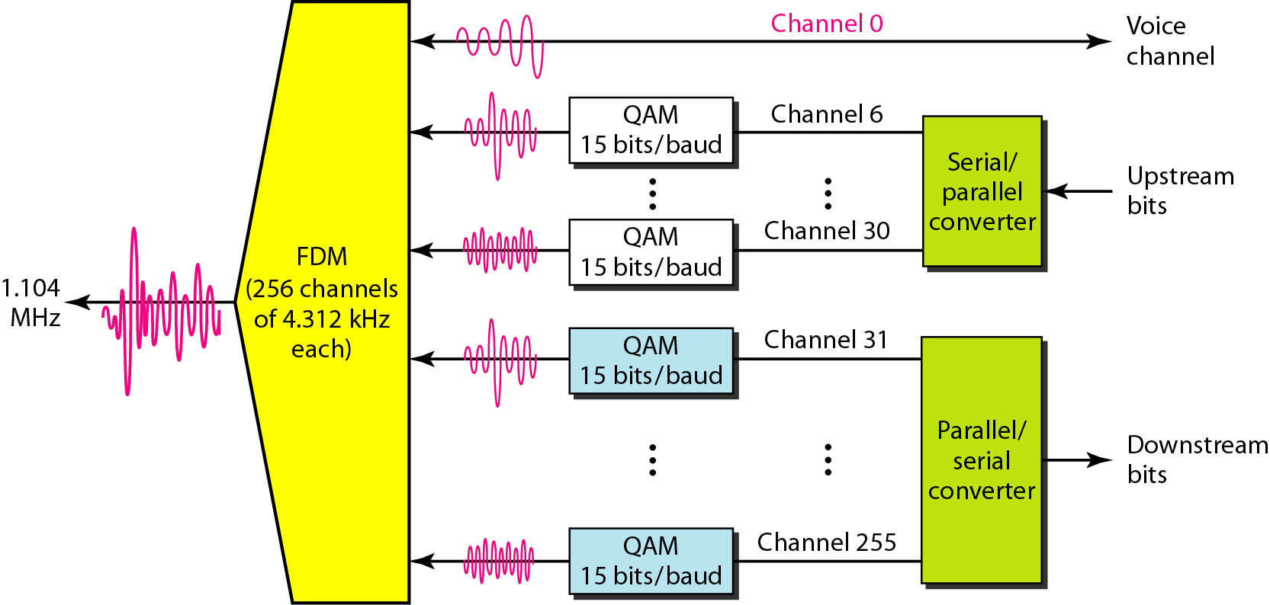
Figure 9.10 Discrete multitone technique

Slide 21
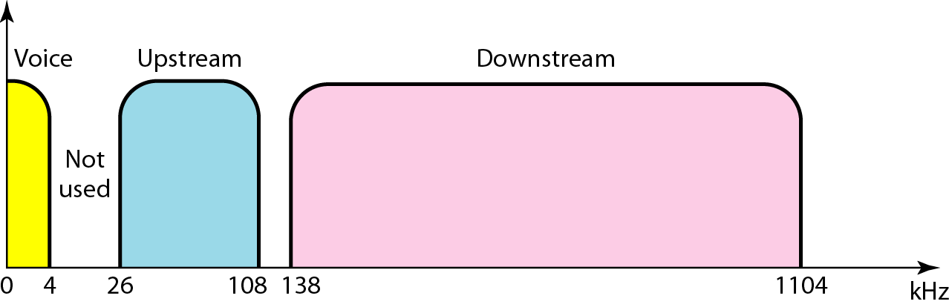
Figure 9.11 Bandwidth division in ADSL

Slide 22
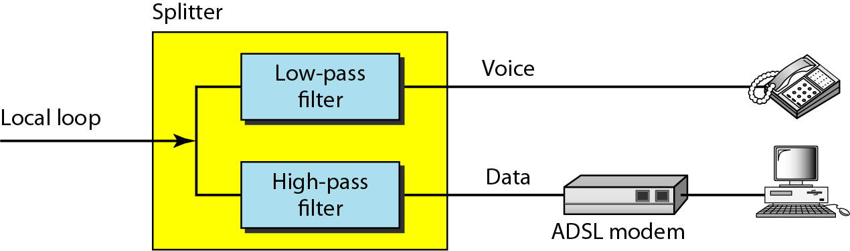
Figure 9.12 ADSL modem

Slide 23
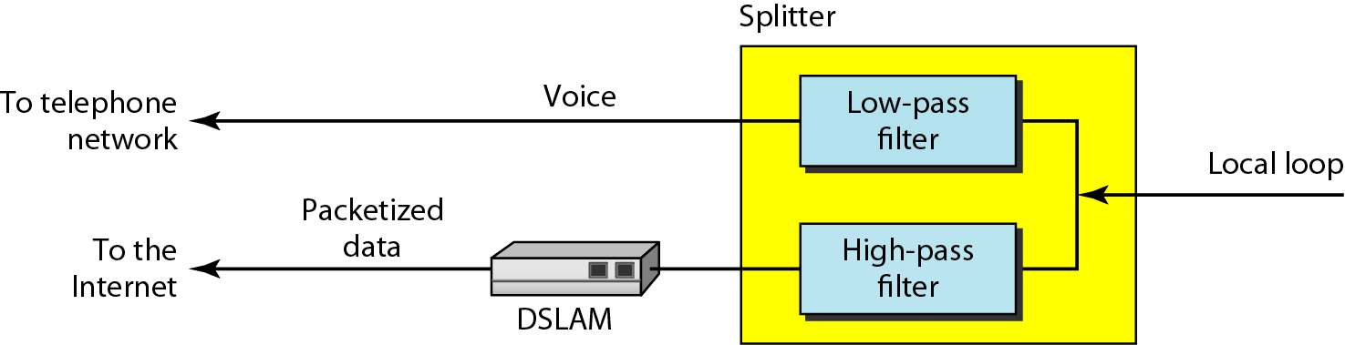
Figure 9.13 DSLAM

Slide 24
Table 9.2 Summary of DSL technologies

Slide 25
9-4 CABLE TV NETWORKS
The cable TV network started as a video service provider, but it has moved to the business of Internet access. In this section, we discuss cable TV networks per se; in Section 9.5 we discuss how this network can be used to provide high-speed access to the Internet.
Topics discussed in this section:
Traditional Cable Networks
Hybrid Fiber-Coaxial (HFC) Network

Slide 26
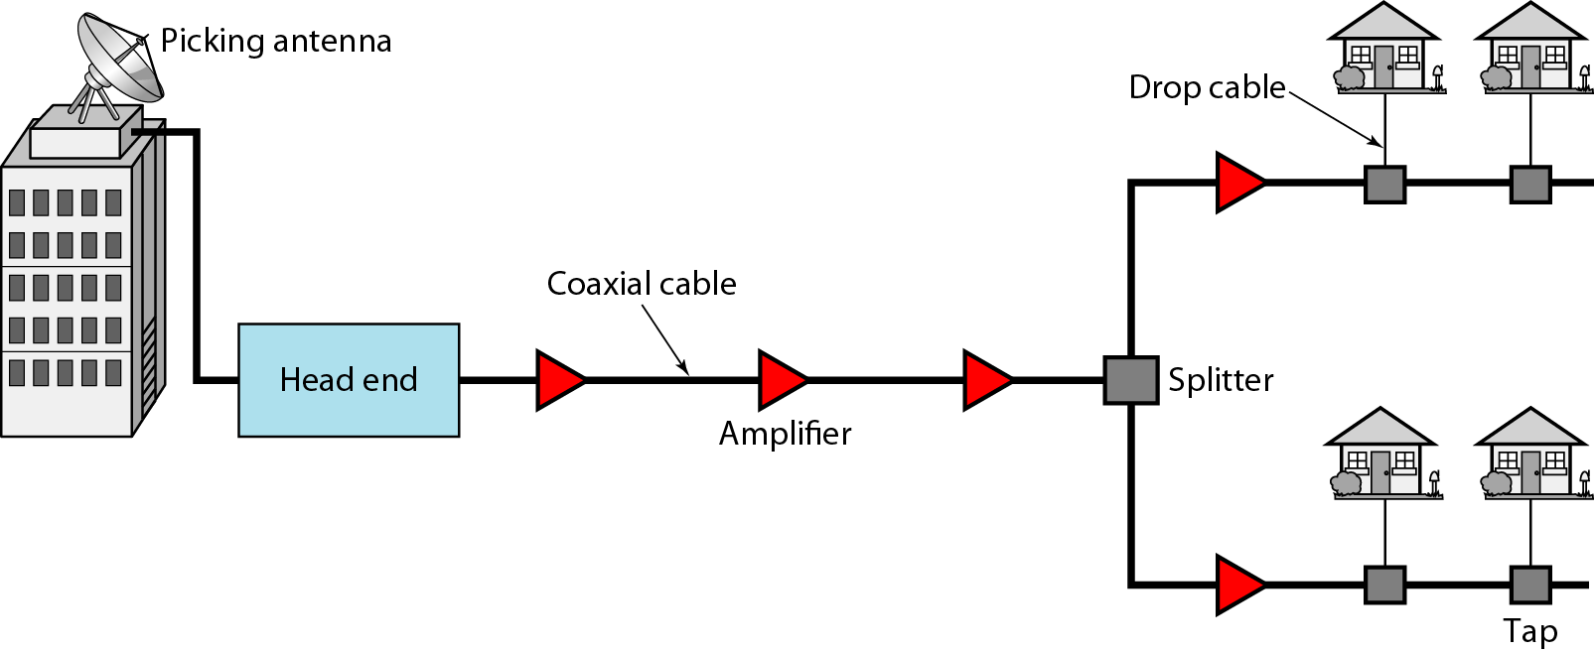
Figure 9.14 Traditional cable TV network

Slide 27
Note
Communication in the traditional cable TV network is unidirectional.

Slide 28
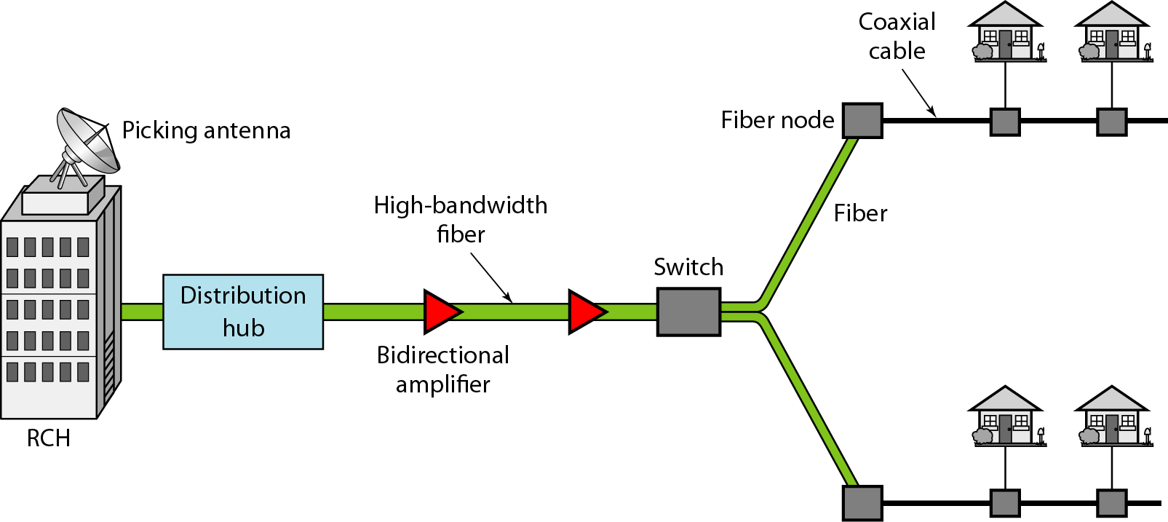
Figure 9.15 Hybrid fiber-coaxial (HFC) network

Slide 29
Note
Communication in an HFC cable TV network can be bidirectional.

Slide 30
9-5 CABLE TV FOR DATA TRANSFER
Cable companies are now competing with telephone companies for the residential customer who wants high-speed data transfer. In this section, we briefly discuss this technology.
Topics discussed in this section:
Bandwidth
Sharing CM and CMTS
Data Transmission Schemes: DOCSIS

Slide 31
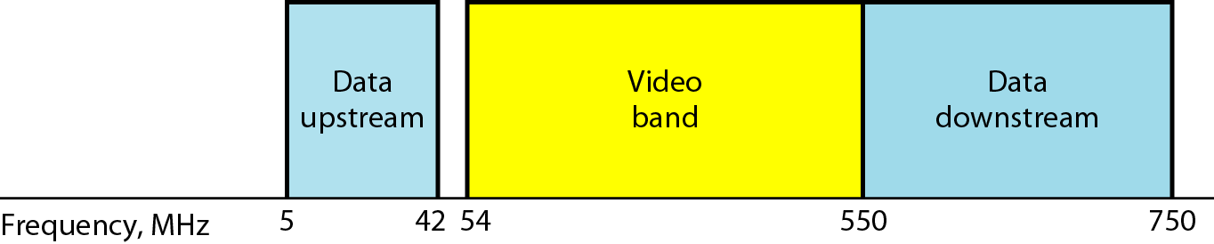
Figure 9.16 Division of coaxial cable band by CATV

Slide 32
Note
Downstream data are modulated using the 64-QAM modulation technique.

Slide 33
Note
The theoretical downstream data rate is 30 Mbps.

Slide 34
Note
Upstream data are modulated using the QPSK modulation technique.

Slide 35
Note
The theoretical upstream data rate is 12 Mbps.

Slide 36
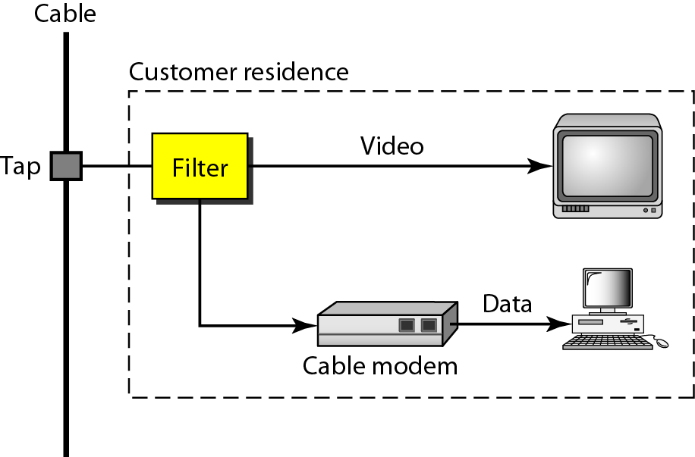
Figure 9.17 Cable modem (CM)

Slide 37
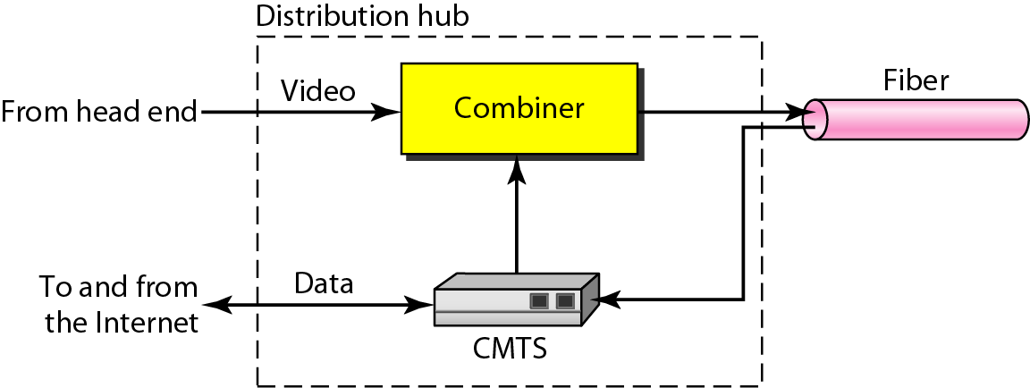
Figure 9.18 Cable modem transmission system (CMTS)

